Slide 1
Radiation Safety Training Beckman® LS 6500 Liquid Scintillation Counter
CSULB Radiation Safety Office
March, 2013

Slide 2
Welcome
This PowerPoint presentation provides an overview of how to use the LSC for qualitative purposes such as for contamination surveys. You will be provided detailed instructions on specific LSC counting methods and materials by experienced personnel in your particular lab. Proper use of the LSC is monitored by supervisor, the IRUA holder for whom you work and by Radiation Safety as a part of their audits of your radiation safety program compliance.

Slide 3
Topics
What is a Liquid Scintillation Counter?
Liquid Scintillation Counter Overview
Step by Step Procedures for LSC
Things to Consider
Post-counting procedures

Slide 4
What is a Scintillation Counter - LSC?
A liquid scintillation counter is a machine that measures ionizing radiation, predominantly beta radiation such as ¹⁴C, ³H, ³⁵S and ³²P. It will measure gamma radiations, but at a reduced efficiency. Only use the LSC to measure gamma emitters for monthly swipes when your lab uses both gamma and beta labeled materials – not for data collection. Gamma emitters in LSC vials are expensive and difficult to dispose of.
A scintillator is a material that generates photons of light in response to incident radiation. In LSC, the scintillator is the cocktail (LSC fluid) added to a counting vial. Radiation emissions from a radiolabled sample “excite” molecules to generate light.
Sensitive photomultiplier tubes (PMT) measures the light from the scintillator. The PMT are attached to electronic amplifiers and other electronic equipment to count the signals produced by the photomultiplier tubes.

Slide 5
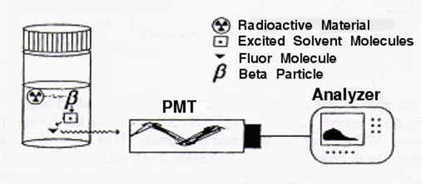
Liquid scintillation counter Details
Samples are dissolved or suspended in the LSC fluid which is an organic solvent containing small amounts of additives known as fluors which increase performance.
Radiation emitted from the sample transfer energy to the solvent molecules, which in turn transfer their energy to the fluors; the excited fluor molecules dissipate the energy by emitting light.
In this way, each beta emission results in a pulse of light

Slide 6
Beckman® LS 6500 Scintillation Counter This is located in MLSC-214

Slide 7
Liquid scintillation counting Overview
Samples and Scintillation Cocktail are mixed. Lids must be screwed on tightly.
Samples are placed in the counting racks.
Counting racks are labeled with a user number card. The number on the card activates a specific counting program entered into the machine’s hard drive.
Racks are then loaded onto conveyor with a rack having the “STOP” card in place.
Sample compartment is closed and counting is begun.

Slide 8
How to perform counting using LSC
Wearing lab coat and gloves, add sample (swipes or experimental) to scintillation vial.

Slide 9
How to perform counting using LSC, 2
Add Scintillation Cocktail
Note: Chemical splash goggles, gloves and lab coat are required when dispensing common brands of scintillation cocktail. Use of a fume hood to eliminate exposure is recommended. Review the MSDS for the cocktail you are using. Do NOT use any of the older formulations that contain toluene. Toluene based flammable cocktails are to be surrendered as hazardous waste.

Slide 10
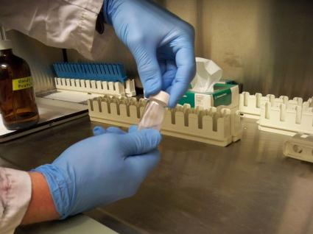
How to perform counting using LSC, 3
Secure lid tightly

Slide 11
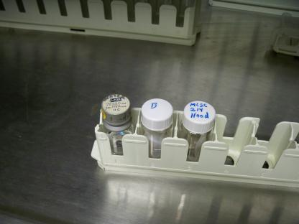
How to perform counting using LSC, 4
Place vial(s) in counting rack
Use secondary containment if transporting glass or open vials
Note: The fiberboard “egg crate” flats vials come in from the factory
are considered acceptable containment for vial transport.

Slide 12
How to perform counting using LSC, 5
Add user number to rack
Note: There are two slots in each rack. Use extreme care when inserting cards to avoid jamming a card in the wrong slot!

Slide 13
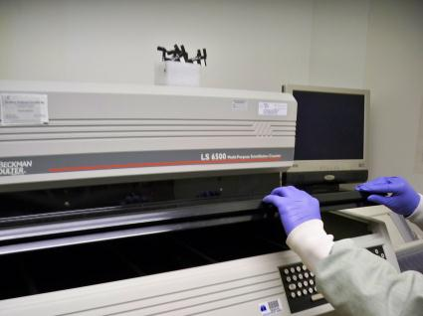
How to perform counting using LSC, 6
Open sample compartment

Slide 14
How to perform counting using LSC, 7
Place samples in LSC
The card must face the inside sensors

Slide 15
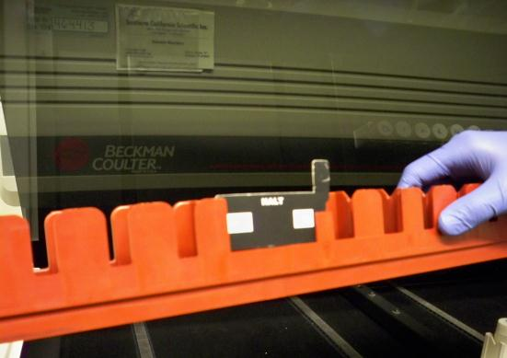
How to perform counting using LSC, 8
Make sure to add “Halt” rack after samples
Without this rack in with card facing in, the machine runs on and on…

Slide 16
How to perform counting using LSC, 9
Make sure the Printer paper is aligned to top of page and the printer is online.
To adjust, press “online” to turn off the online light. Press form feed and check where paper stops. If adjustment needed, use manual feed knob to adjust top of page 2–4 cm from print head.
Press online again. Printer is ready.
Report printer or machine problems to Radiation Safety

Slide 17
How to perform counting using LSC, 10
Initiate counting by pressing “Start” button twice.
Sign the Log Book.

Slide 18
How to perform counting using LSC, 11
Generic instructions for using the RSO qualitative contamination swipe analysis program are posted on the wall next to the LSC.

Slide 19
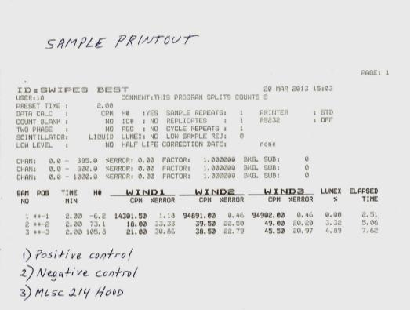
LSC Printout
A Negative Control is a “blank” which contains NO radioactive material. To make
Such a blank, use the same LSC vials, fluid and matrix you use in your sample vials
A Positive Control is a “standard” made up by the LSC manufacturer or in your lab
with a known DPM/CPM value. The LSC value must be within 5% of the standard value.
Radiation Safety can provide a factory-made control if desired. Report any inaccuracy.

Slide 20
Things to consider: User number
Radiation Safety personnel employ user #2 for contamination surveys.
User #2 is set up to count for two minutes in three windows.
These windows delineate a specific energy range and assist in the detection of various nuclides.
l--window1--l

Slide 21
Things to consider: User number, 2
You may want to set up your own user number with parameters specific to your isotope and experiments.
l--window1--l
l---------window2-------l

Slide 22
Things to consider: User number, 3
User number 2 can be used for post-experimental surveys and monthly surveys.
Or use your own user number/program as long as the windows used can “see” the isotope you are working with.
l--window1--l
l---------window2-------l
l---------------window3-------------l

Slide 23
Things to consider: Quench
Quench is any issue that hides or falsely lowers the true number of light flashes
Quench reduces the light output from the sample and thus affects the accuracy of the cpm.
It may result from color in the sample or from chemicals that affect energy transfer in the cocktail or dirty/inked vials.
The H# on the printout indicates the extent of quench in the sample and can be corrected for. Please see pg. 4.12 in the user manual.
A quench curve can be set up as described on pg. 6-8 of the user manual.

Slide 24
Things to consider: Chemiluminescence and Lum-Ex
Light producing events can occur in a sample that are not a result of radioactivity of the sample. This is called Chemiluminescence.
Lum-Ex values, shown on the printout, provide an indication of what percent of the total CPM’s are due to non-radioactive events. If too high, results may be erroneous.
If Lum-Ex values are greater than 5 to 10%, steps should be taken to reduce the problem.

Slide 25
Things to consider: Counting Efficiency
Counting Efficiencies for various nuclides*
³H 47%-60% (wide open window)
¹⁴C 95%
³²P 98%
³⁵S 95%
¹⁰⁹Cd 50%
¹²⁵I 77%
*Maximum efficiencies for unquenched samples, 10ml Beckman Ready-Solv HP LSC cocktail. Approx. 200,000 dpm

Slide 26
Things to consider: Hot Sample Reject
The hot sample reject will not allow the counting of samples that are so radioactive (“hot”) that they will give incorrect CPM.
Samples over 5 x 10⁶ cpm may be rejected depending on window.
It is suggested that samples not exceed 2 x 10⁶ cpm or 1.0 µCi to avoid sample reject.

Slide 27
When Finished Counting:
Remove vials promptly after counting.
Remove the print-out showing your counting results.
If this is a contamination survey make sure to write on the print-out what was swiped for each vial counted.
Transport the vials back to the lab in double containment.

Slide 28
LSC Vial Waste Management
Used LSC vials should be stored in the original ‘egg crate’ flats.
Flats of used vials must be labeled in the standard manner – use a yellow rad label and enter in the PI name, nuclide(s) and date started.
It is understood that some flats contain only vials that are at background levels. The word “trace” may be written on flats of cold vials. Writing <1 microCurie is acceptable as well.
When ready for RS pick-up of the vials, complete an entry on the blue log sheet.

Slide 29
THE END!

