Slide 1
Quantitative compositional characterization of the biosiliceous Miocene Lark Formation, Danish North Sea and Norwegian Margin
MARS Science Symposium
Megan Mortimer-Lamb, M.S. Candidate
July, 2018

Slide 2
Objective & Importance
Introduction
Introduction
Generate a reproducible, biosilica quantification method
  Quantification complicated by amorphous and diagenetic silica
Pure science - paleoceanography/mass accumulation rates
Applied science - mechanical properties/reservoir quality
Opal-A
Opal-CT
Diagenetic quartz
Notes:
Importance
Understudied
Paleoceanography- Miocene Silica switch
Lithified/diagenetic material
Predict reservoir rock characteristics
Complications: Amorphous silica
Monterey Formation one of the most prolific reserviors in the world, diatomaceous,
You’ll see through the course of this week that the amount of silica has massive impacts on reservoir quality
Porosity
Permeability
Mechanical stratigraphy
Mass accumulation rates
Paleoproductivity/ ocean change

Slide 3
Diatomaceous Sediments
Introduction
Sensitive to:
  Nutrient availability
  Climatic changes
DSi (μmol)
Implications for:
Paleoceanography
  Thermohaline circulation
Paleoclimatology
Modified from Cortese et al. (2004)
Notes:
-photosyntehic algae can be found in freshwater, oceans, most are pelagic although some are benthic
-Diatoms play a major role in carbon cycling in the ocean and they can be used as a paleoproductivity proxy (bsi) because they reproduce much more rapidly than calcareous plankton
-accumulation is sensitive to nutrient availability, climactic changes on glacial to interglacial scales
-calcareous microfossils are preserved in the anti-estuarine atlantic, and diatomaceous sediments are preserved in the estuarine pacific
-biogenic silica is used for paleoceanography because perturbations to ocean circulation will change their presence and extent

Slide 4
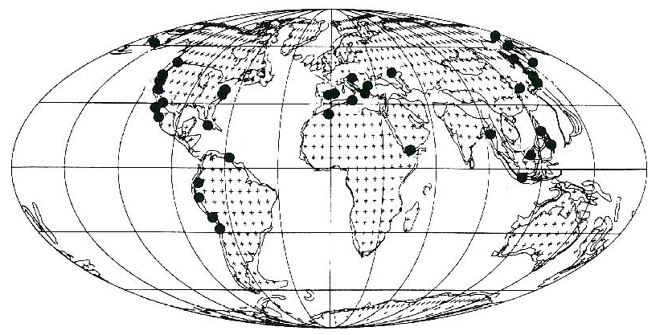
Distribution of Neogene Diatomaceous Deposits
Introduction
Behl (2016); modified from Hein & Parrish (1987) and other authors
4
Notes:
-this is a figure compiled by Dr. Behl which indicates the widespread distribution of marginal diatomaceous sediments
-accumulation of diatomaceous sediments is a marvel in itself, productivity must greatly overwhelm
-relatively discrete locations they are common at different states of preservation, thicknesses, all throughout the world during the miocene pliocene and this is what makes this work applicable for the north sea and elsewhere and how results could be helpful or valuable

Slide 5
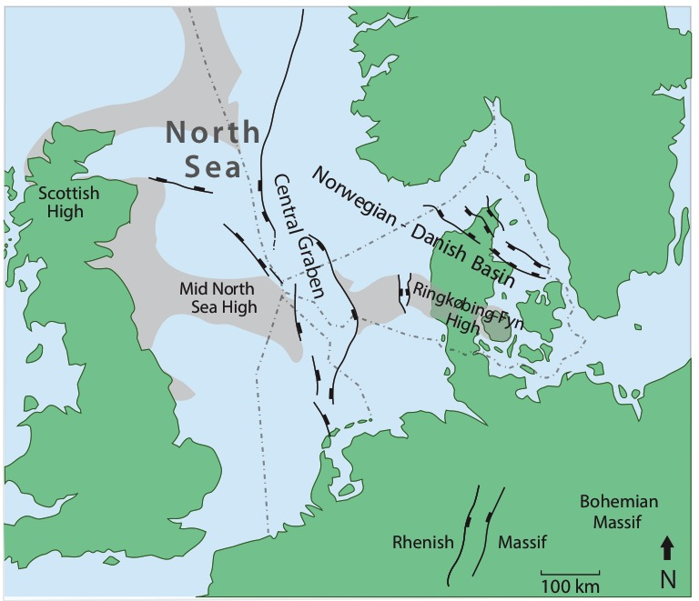
North Sea Overview
Introduction
Modified from Schiøler et al. (2007)
Petroliferous
Cretaceous chalks
Mesozoic sandstones
Cenozoic rocks mostly ignored
Lark Formation biosilceous mudstone

Slide 6
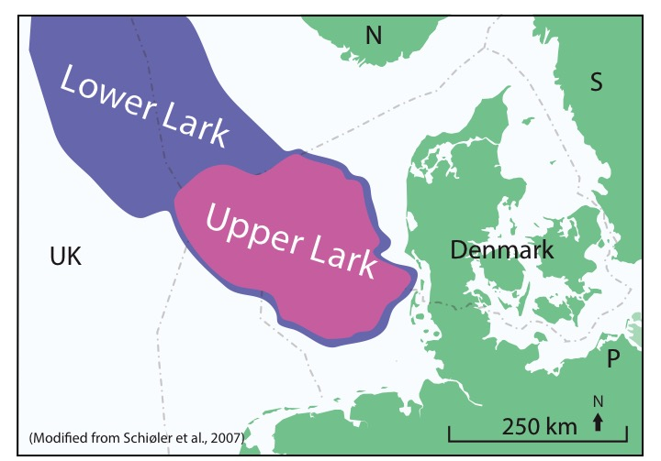
Lark Formation
Introduction
Oligo-Miocene biosiliceous mudstone
  Priabonian to Serravallian age
Margin of southward prograding delta
Differentiated into Upper and Lower members
Modified from Sulsbrück, and Toft, 2011, (unpublished)

Slide 7
Lark Formation Correlation
Introduction
Stratigraphic column modified from Eidvin et al. (2014)
Notes:
Needs more

Slide 8
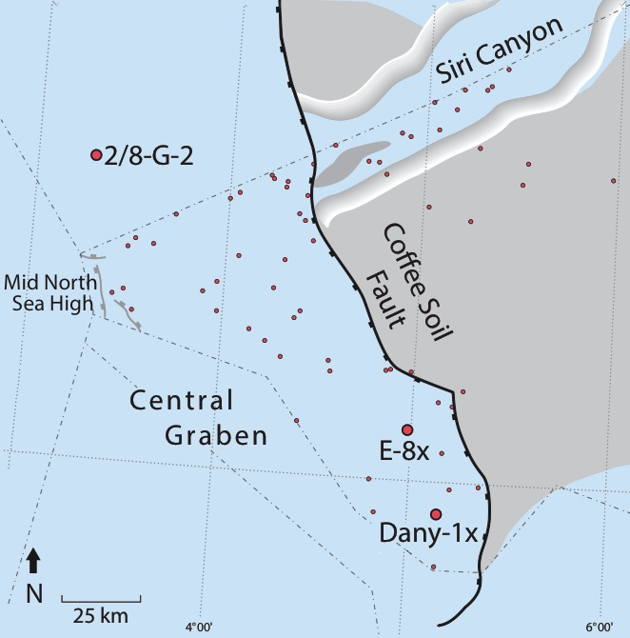
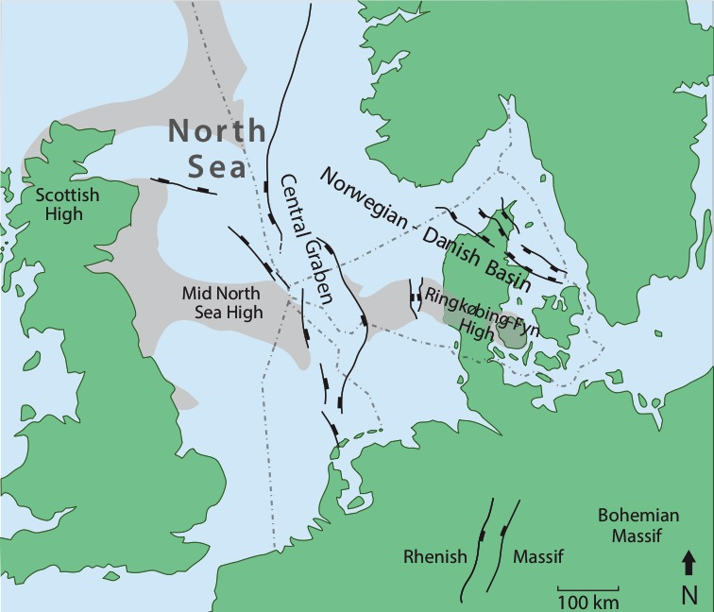
Study Location: Danish North Sea & Norwegian Margin
Introduction
Three wells:
  2/8-G-2 (AkerBP)
  E-8x (Mærsk)
  Dany-1x (Mærsk)
Modified from Schiøler et al. (2007)

Slide 9
Provided Well Data
Introduction
Introduction
2-8/G-2
  30 core samples
  5881-6198’
  Log response, density, fluorescence, gamma ray
E-8x
  50 core samples
  .3 ft, 4100 - 4150’
Dany-1x
  10 core samples
  ~5 feet, 4683.9 - 4678.9’
Courtesy of Mærsk Oil

Slide 10
Scanning Electron Microscope Images
Introduction
E-27
G2-22
E-44
G2-22
G2-11
G2-5

Slide 11
Methodology
Methods
✔
✔
✔
✔
✔
✔

Slide 12
X-Ray Diffraction (XRD)
Methods
Notes:
-non destructive method to analyze matter
-it is used to identify the crystalline phases of various materials which is followed by a quantitative phase subsequent to identification
-three dimentional atomic structure of crystalline soilds based upon characteristic diffraction intensities and the angles at which they are observed and a chemical identification can be performed by comparing this pattern using the full-pat method
-

Slide 13
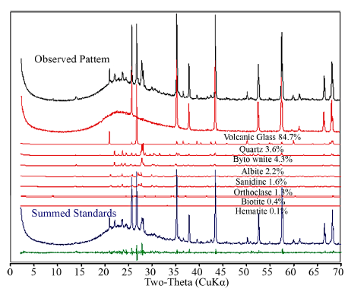
X-Ray Diffraction Techniques
Methods
Reference Intensity Ratio (RIR)
  Suffers from effects of variable chemistry and preferred orientation of crystals, amorphous material
Rietveld method (Rietveld, 1969)
  Crystal phases must be 3-dimentionally ordered, glasses, clay minerals
(Chipera & Bish, 2013)
Full Pattern Matching (FullPat) (Chipera & Bish, 2013)
  -- Observed diffractogram is the sum of individual mineral phases
  -- Amorphous material
13
Notes:
-non destructive method to analyze matter
-it is used to identify the crystalline phases of various materials which is followed by a quantitative phase subsequent to identification
-three dimentional atomic structure of crystalline soilds based upon characteristic diffraction intensities and the angles at which they are observed and a chemical identification can be performed by comparing this pattern using the full-pat method
-

Slide 14
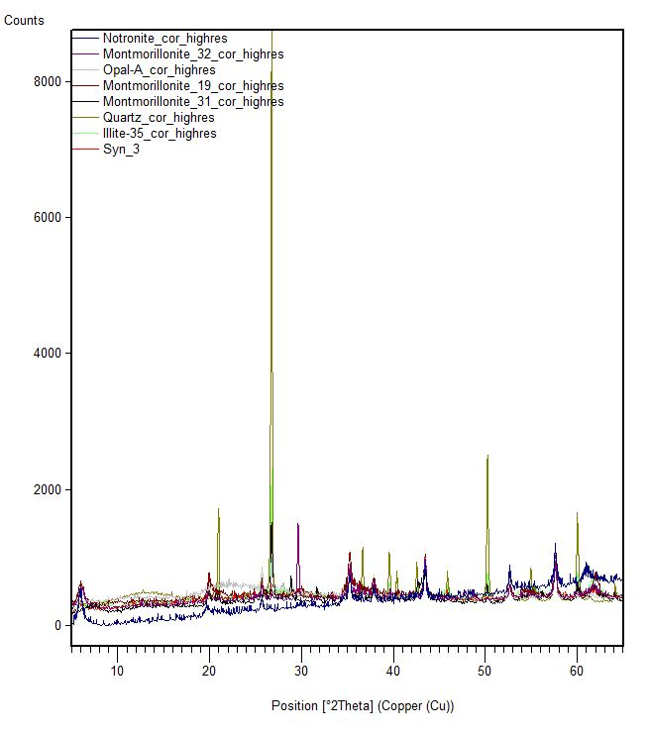
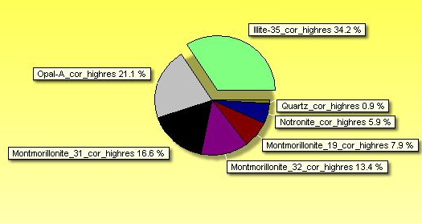
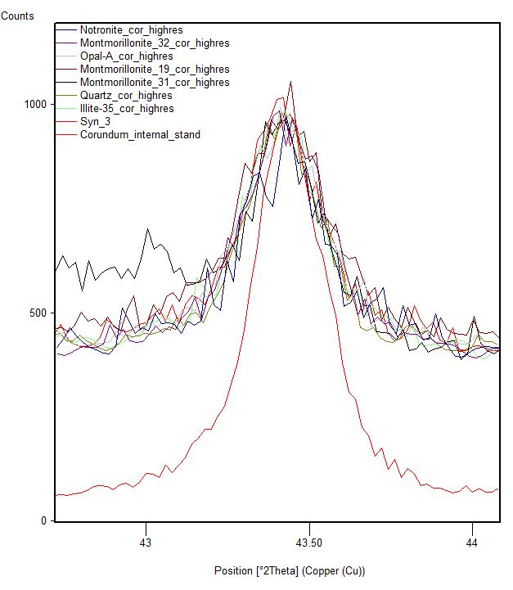
XRD Full Pattern Matching (FullPat)
Preliminary Results
Mineral Constituents:
-Montmorillonite
-Illite
-Opal-A
-Quartz
-Calcite

Slide 15
Inductively Coupled Plasma-Mass Spectroscopy
Preliminary Results
SiO₂, Al₂O_{3,} Fe₂O_{3,} MnO, MgO, CaO, Na₂O, K₂O, TiO_{2,} P₂O₅
Biogenic SiO₂ ?
n = 47 samples
Notes:
Sample ionized with plasma, mass spectrometer separates and quantifies the ions

Slide 16
Geochemical Approach to Excess Silica Equation
Preliminary Results
Assuming a constant provenance:
Total SiO₂ = Biogenic SiO₂ + Detrital SiO₂
Biogenic SiO₂ = Total SiO₂ - Detrital SiO₂
Detrital SiO₂ = (SiO₂/Al₂O₃)_{d} * (Al₂O₃ %) ?
= (SiO₂/K₂O)_{d} * (K₂O %) ?
= (SiO₂/TiO₂)_{d} * (TiO₂ %) ?
(SiO₂/X)_{d} = SiO₂: X in the detritus
Detrital = all aluminosilicates + detrital quartz
Based upon normative techniques of Isaacs (1980); and Medrano & Piper (1992)

Slide 17
Detrital Proxies
Preliminary Results
Detrital SiO₂ = (SiO₂/Al₂O₃)_{d} * (Al₂O₃ %) ?
= (SiO₂/K₂O)_{d} * (K₂O %) ?
= (SiO₂/TiO₂)_{d} * (TiO₂ %) ?
(SiO₂/X)_{d} = SiO₂: X in the detritus

Slide 18
Fundamental Silica to Aluminum Ratio
Preliminary Results
SiO₂/Al₂O₃ “detrital” ratio
Detrital = all aluminosilicates + detrital quartz
Biogenic SiO₂ = Total SiO₂ - 2.85 (Al₂O₃ %)

Slide 19
Excess Silica Estimation
Preliminary Results
Excess Silica
Detrital = all aluminosilicates + detrital quartz

Slide 20
Next Steps
Complete alkaline digestions of ~47 samples @ 5hr
FT-IR sample preparation and analysis
Analyze 2nd batch of carbonate & opal-free ICP-MS data
Perfect Full Pattern Matching
Generate Excess Silica Equation
  calibrated by
    carbonate & opal free ICP-MS data
    Alkaline digestions
    FT-IR

Slide 21
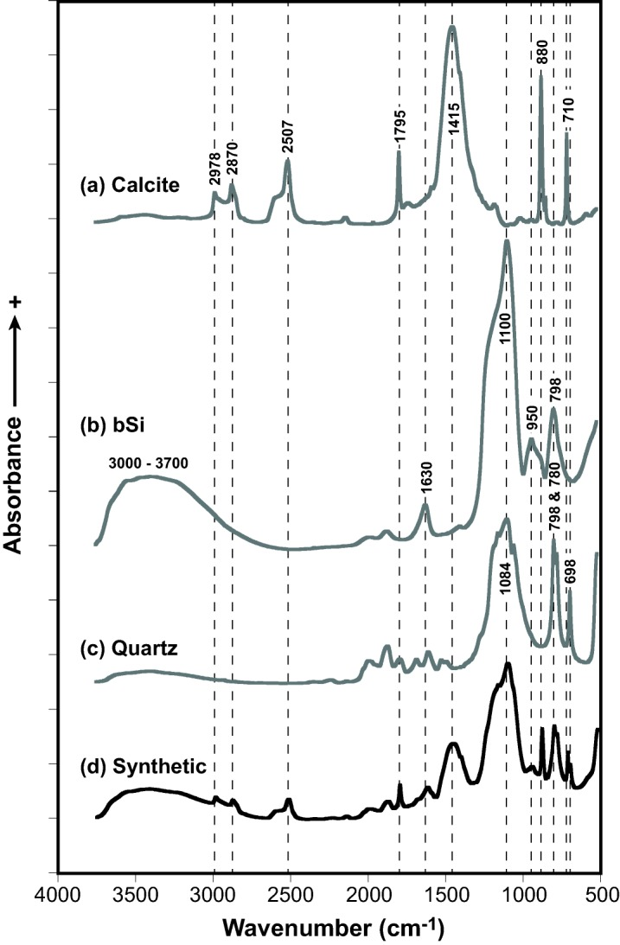
FT-IR & Alkaline Digestions
Methods
Fourier Transform Infrared Spectroscopy
  Calibrated by opal digestions or partial least squares regression
Digestions of opal using Na₂CO₃
  (Mortlock & Froelich, 1992)
Clay mineral dissolution trend
Vogel et al. (2016)

Slide 22
Alkaline Digestion Trial
Preliminary Results
Weight % Biogenic Silica= [concentration (mg/L)]/25/sample weight (mg) * 100

Slide 23
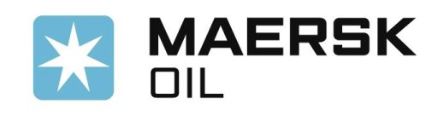





Thank you!

Slide 24
References
Behl, R. J., & Garrison, R. E. (1994, August). The origin of chert in the Monterey Formation of California (USA). In Siliceous, phosphatic and glauconitic sediments of the Tertiary and Mesozoic: Proceedings of the 29th International Geological Congress, Part C (pp. 101-132).
Chipera, S.J., and Bish, D.L., 2013, Fitting Full X-Ray Diffraction Patterns for Quantitative Analysis: A Method for Readily Quantifying Crystalline and Disordered Phases: Advances in Materials Physics and Chemistry, v. 03, p. 47–53, doi: 10.4236/ampc.2013.31A007.
Cortese, G., Gersonde, R., Hillenbrand, C. D., & Kuhn, G. (2004). Opal sedimentation shifts in the World Ocean over the last 15 Myr. Earth and Planetary Science Letters, 224(3–4), 509–527. https://doi.org/10.1016/j.epsl.2004.05.035
DeMaster, D. J. (1979) The marine budgets of silica and 32 Si. PhD thesis, Yale Univ.
Eidvin, T., Riis, F., and Rasmussen, E.S., 2014, Oligocene to Lower Pliocene deposits of the Norwegian continental shelf, Norwegian Sea, Svalbard, Denmark and their relation to the uplift of Fennoscandia: A synthesis: Marine and Petroleum Geology, v. 56, p. 184–221, doi: 10.1016/ j.marpetgeo.2014.04.006.
Guerin, T.F. (1999) The extraction of aged polycyclic aromatic hydrocarbon (PAH) residues from a clay soil using sonication and a Soxhlet procedure: a comparative study.: Journal of environmental monitoring : JEM, v. 1, p. 63–67, doi: 10.1039/a807307d.
Herron, M., Matteson, A., & Gustavson, G. (1997). Dual-Range FT-IR Mineralogy and the Analysis of Sedimentary Formations. Proceedings 1997 Internatinal Symposium of the Society of Core Analysts, 1–12.
Keller, G., & Barron, J. A. (1983). Paleoceanographic implications of Miocene deep-sea hiatuses. Geological Society of America Bulletin, 94(5), 590–613. https://doi.org/10.1130/0016-7606(1983)94<590:PIOMDH>2.0.CO;2
Medrano, M.D., and Piper, D.Z., 1992, A normative-calculation procedure used to determine mineral abundances in rocks from the Montpelier Canyon section of the Phosphoria Formation , Idaho : a tool in deciphering the minor-element geochemistry of sedimentary rocks : US Geological Survey Bulletin, p. A1–A23.
Mortlock, R. A., and P. N. Froelich. (1989). A simple method for the rapid determination of biogenic opal in pelagic marine sediments. Deep-Sea Res. 36: 1415–1426. doi: 10.1016/0198-0149(89)90092-7
Vogel, H., Meyer-Jacob, C., Th??le, L., Lippold, J.A., and Jaccard, S.L., 2016, Quantification of biogenic silica by means of Fourier transform infrared spectroscopy (FTIRS) in marine sediments: Limnology and Oceanography: Methods, v. 14, p. 828–838, doi: 10.1002/lom3.10129.
Schiøler, P., Andsbjerg, J., Clausen, O. R., Dam, G., Dybkjaer, K., Hamberg, L., … Rasmussen, J. a. (2007). Lithostratigraphy of the Palaeogene – Lower Neogene succession of the Danish North Sea. Geological Survey of Denmark and Greenland Bulletin (Vol. 12).

