Slide 1
Spatial and Geochemical Characterization of an Anomalous, Map-Scale Dolomite Breccia in the Monterey Formation, Santa Maria Basin, California
Maia Davis
Department of Geological Sciences,
California State University, Long Beach
Long Beach MARS Project Annual Symposium: 30 July 2018
Long Beach MARS Project: Monterey and Related Sediments
Notes:
Hello everyone! It’s great to have you all here! I’m honored to present my work to the MARS affiliates today.
For my Master’s degree, I got to do a spatial and geochemical characterization of an anomalous, map-scale dolomite breccia in the Monterey Formation, Santa Maria Basin, California.

Slide 2
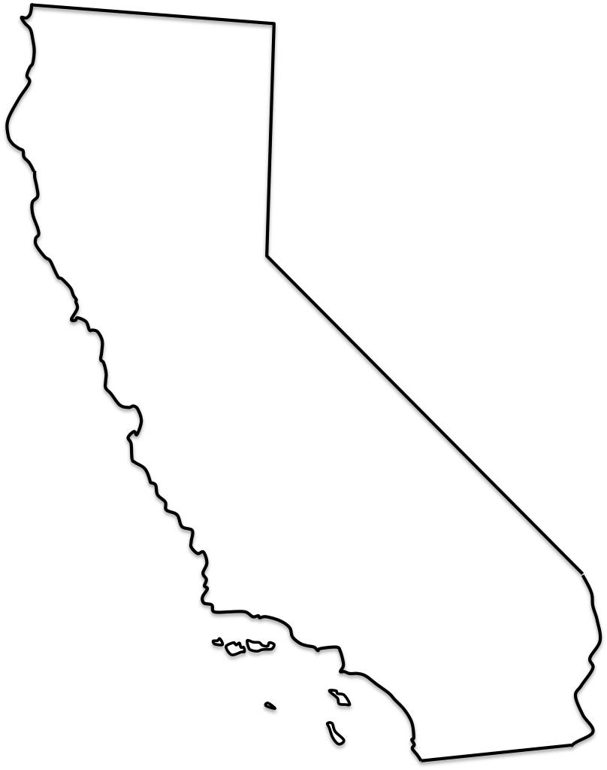
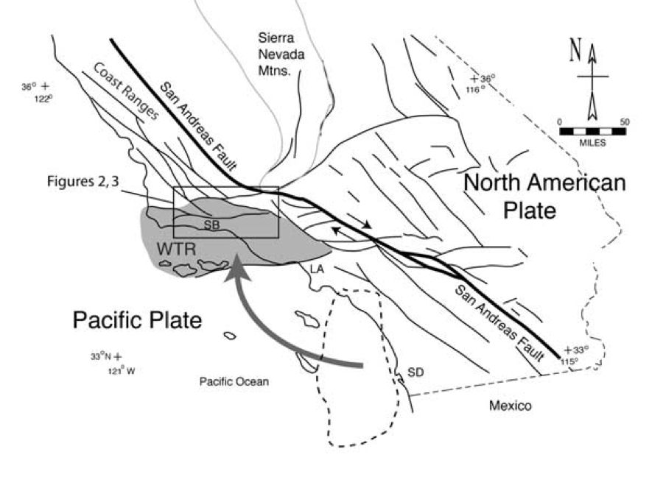
Geologic Setting
SMB
(Onderdonk, 2005)
Long Beach MARS Project: Monterey and Related Sediments
Notes:
My study took place in Central California in the Santa Maria Basin. Central California has a complex tectonic history associated with clockwise rotation of the Western Transverse Ranges. The Santa Maria Basin is a structural and depositional basin that continues offshore.

Slide 3
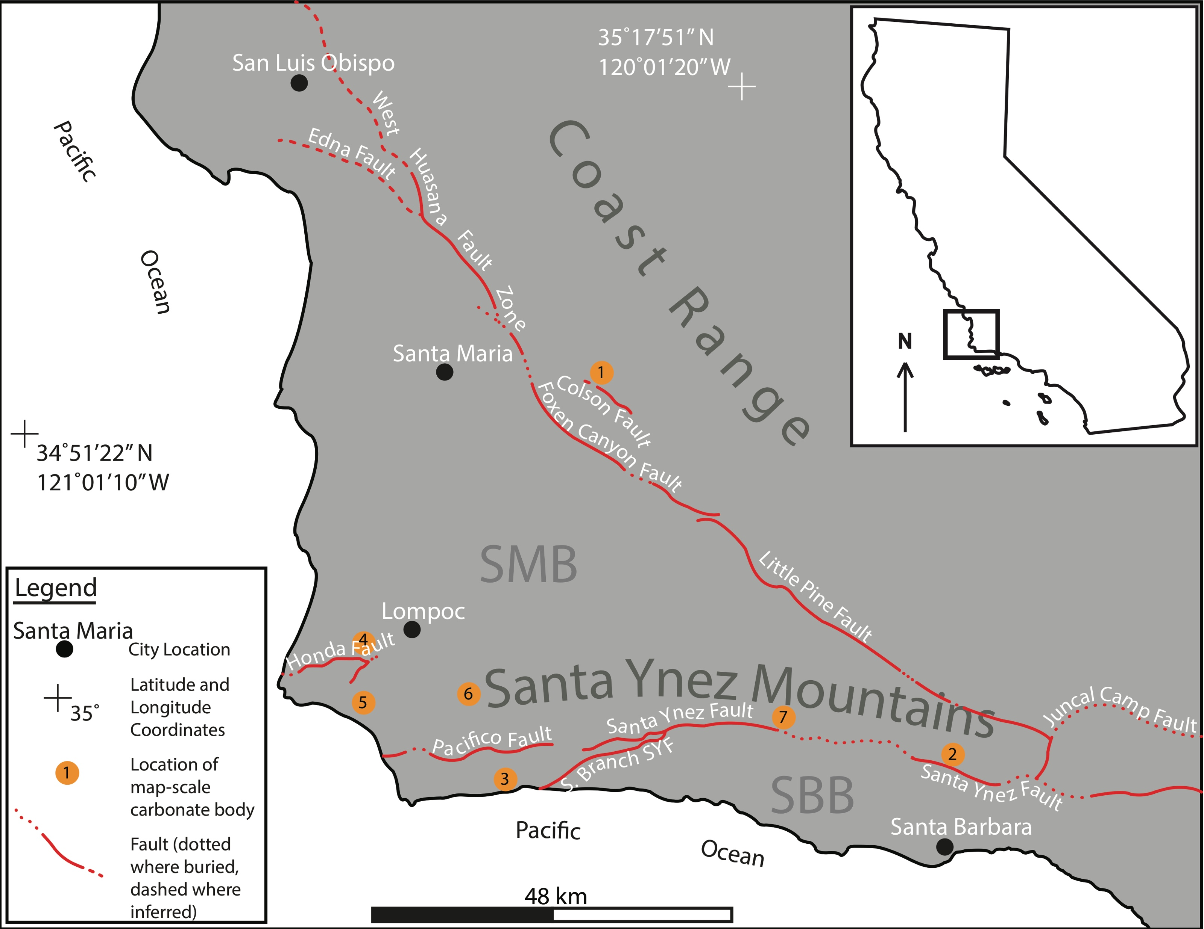
Map-Scale Carbonate Locations
Long Beach MARS Project: Monterey and Related Sediments
Notes:
It is separated from the Santa Barbara Basin to the south by the Santa Ynez Mountains of the Western Transverse Ranges. The Monterey Formation exists in both basins. In the Santa Maria Basin and along the northern margin of the Santa Barbara Basin, Tom Dibblee and Helmut Ehrenspeck mapped seven carbonate bodies within the Monterey Formation, indicated by the orange dots.
Interesting b/c…

Slide 4
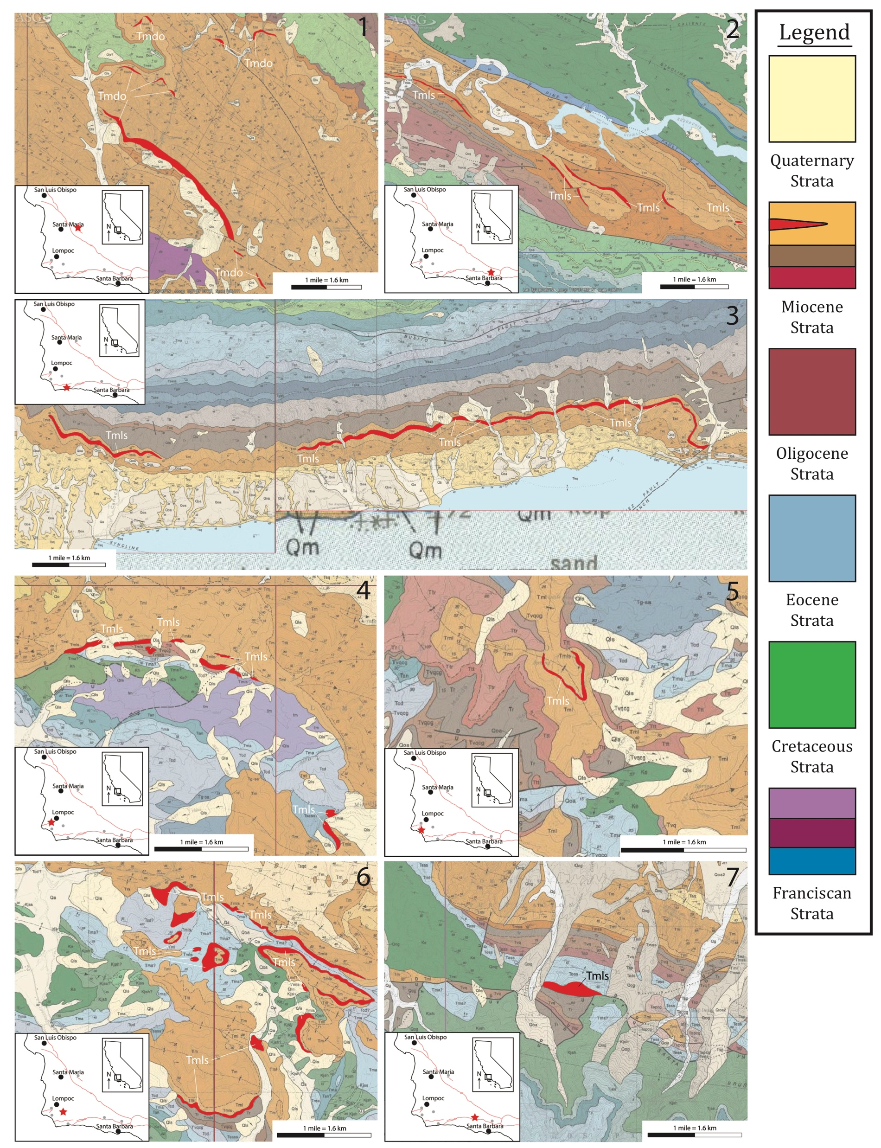
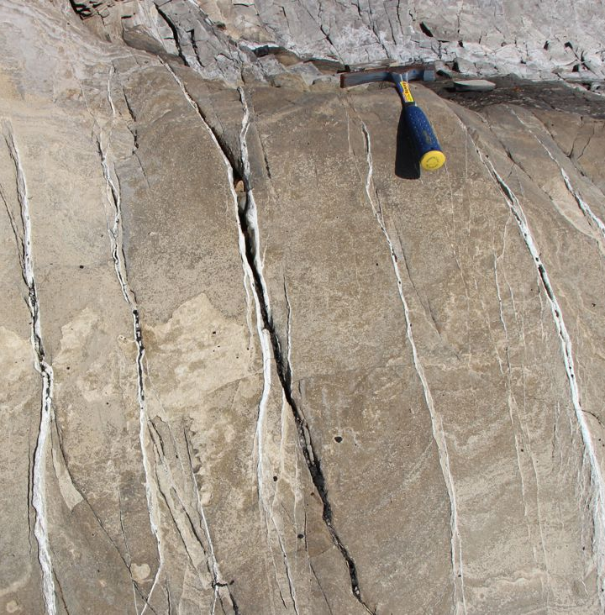
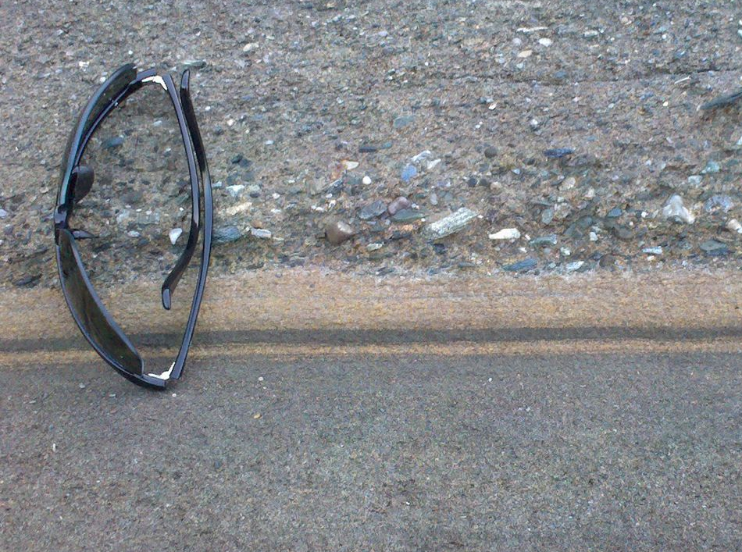
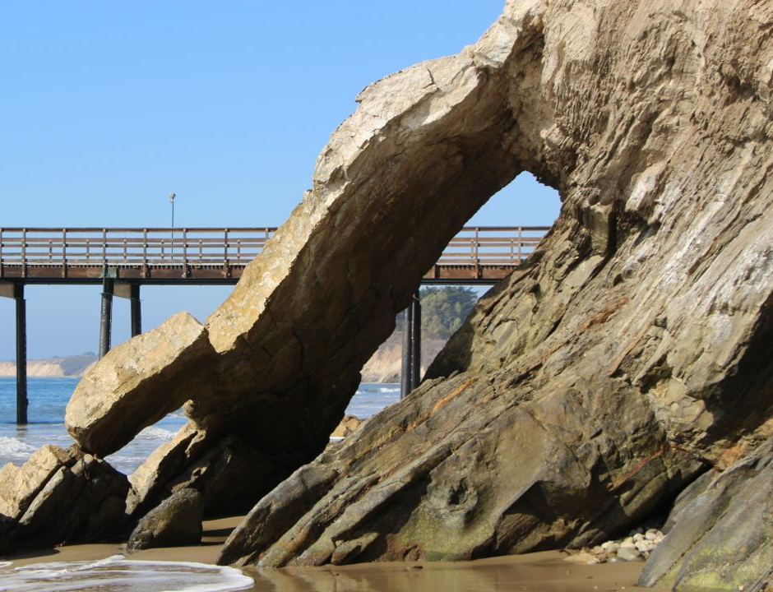
Carbonate Occurrence
Atypical carbonate occurrences (km scale)
Typical carbonate occurrences
(mm-m scale)
(Photos from Behl, 2014)
(After Dibblee and Ehrenspeck, 1987-88b-d; Dibblee et al.,1994)
Notes:
dolomite within the Monterey Formation TYPICALLY occurs on the millimeter to meter scales as veins, laminations, nodules, or beds at the largest, but these mapped features are kilometers long and meters thick, making them ATYPICAL or ANOMALOUS occurrences of dolomite in the Monterey Formation.
These are the geologic maps from Dibblee and Ehrenspeck of each of the seven locations from the previous slide. On the inset location map, this black dot is Santa Barbara, and the red star indicates the location of the occurrence. The carbonate body mapped is highlighted in red on each map, and the scale bar represents one mile in length, which is equivalent to 1.6 kilometers.
I was able to visit all the locations except for this location near Lake Cachuma, but the focus of my thesis was on this location southeast of Lompoc because it is the most extensive occurrence.
The question I wanted to answer was: where did these giant carbonates come from? How did they form? What is their origin?
Understanding the origin of these anomalously large carbonates is important because it provides a better understanding of the Santa Maria Basin’s chemical, structural, and fluid migration history.

Slide 5
So What?
Important petroleum reservoirs in SMB
Important for understanding dewatering history of basin
Important for understanding chemical, structural, and fluid migration history of basin
Long Beach MARS Project: Monterey and Related Sediments

Slide 6
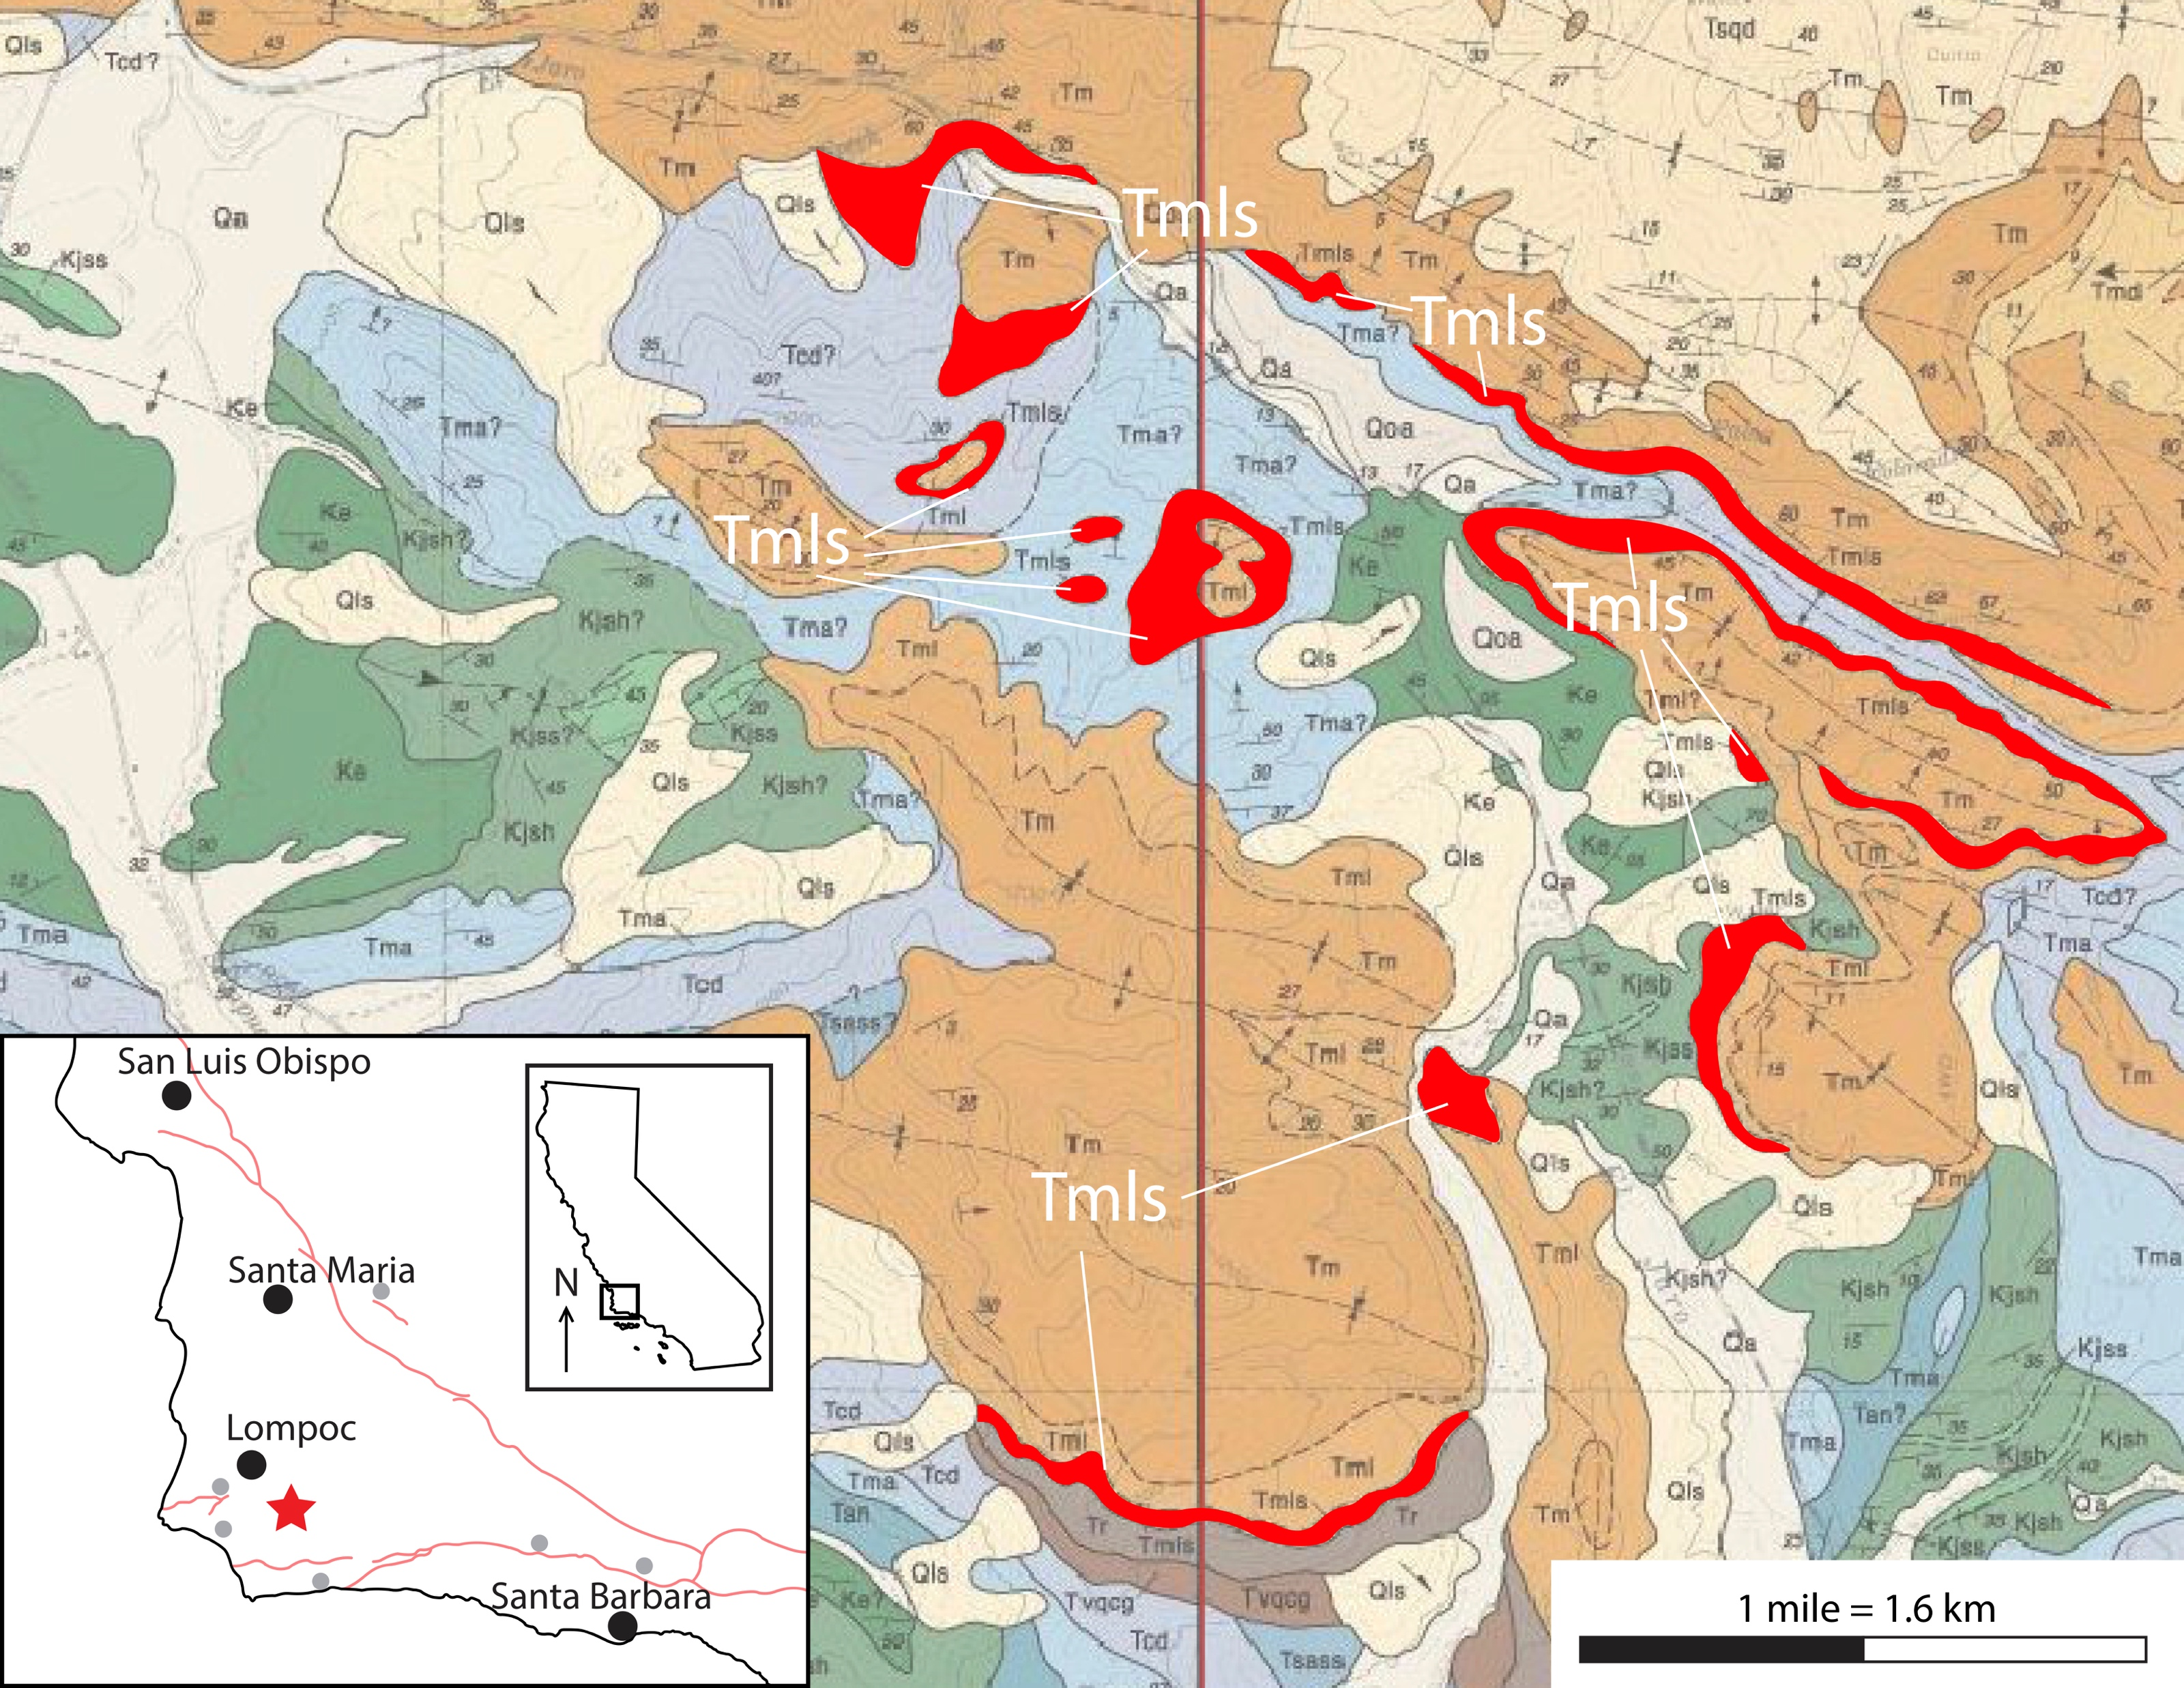
Study Area
(After Dibblee and Ehrenspeck, 1988b, 1988c)
Notes:
In order to determine the origin of at least one of these bodies, I focused on one location southeast of Lompoc. The carbonate in this area was mapped as limestone but described as dolomite. It discontinuously covers approximately 18 square kilometers and was mapped along the unconformable contact between the Monterey Formation in the orange color and older underlying Paleogene and Cretaceous strata in hues of blue and green, respectively.
My study area was here along a private road that goes to the old Grefco diatomite quarry. There is a road cut here than runs roughly north-south then turns east-southeast, basically providing a 3-dimensional exposure of this dolomite, which at this particular location, is a dolomite breccia.

Slide 7
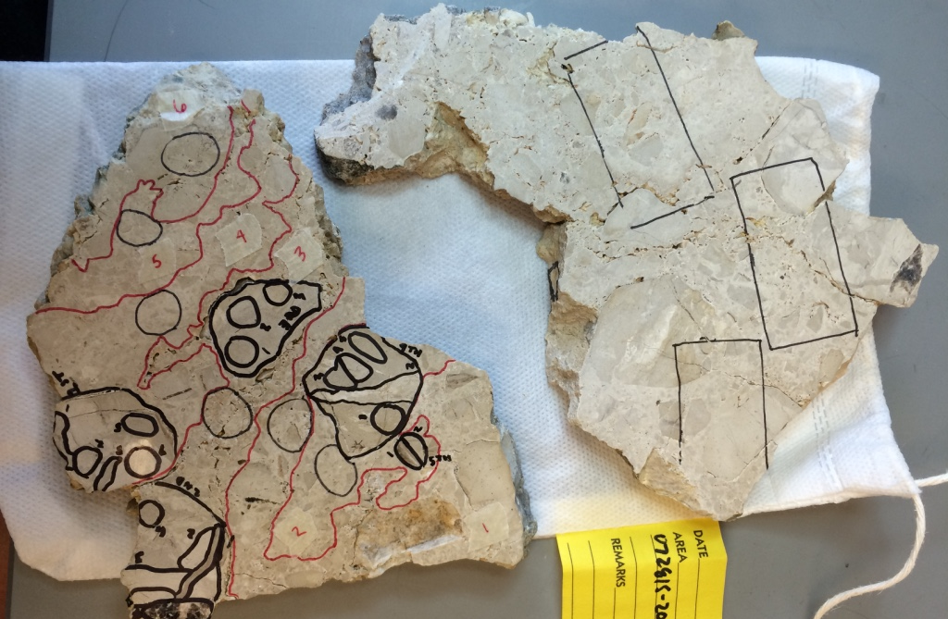
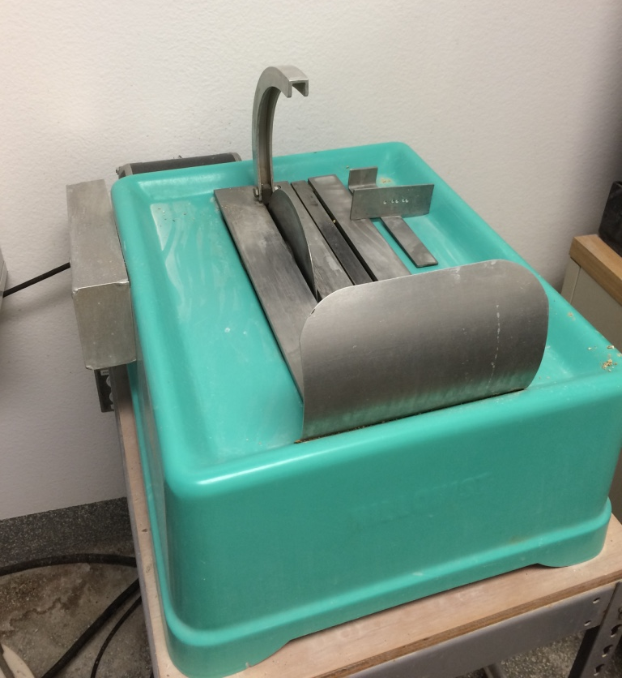
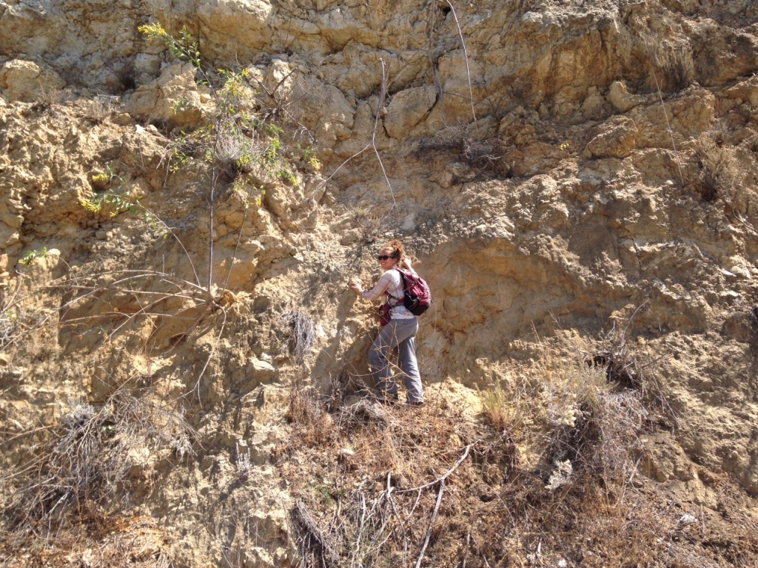
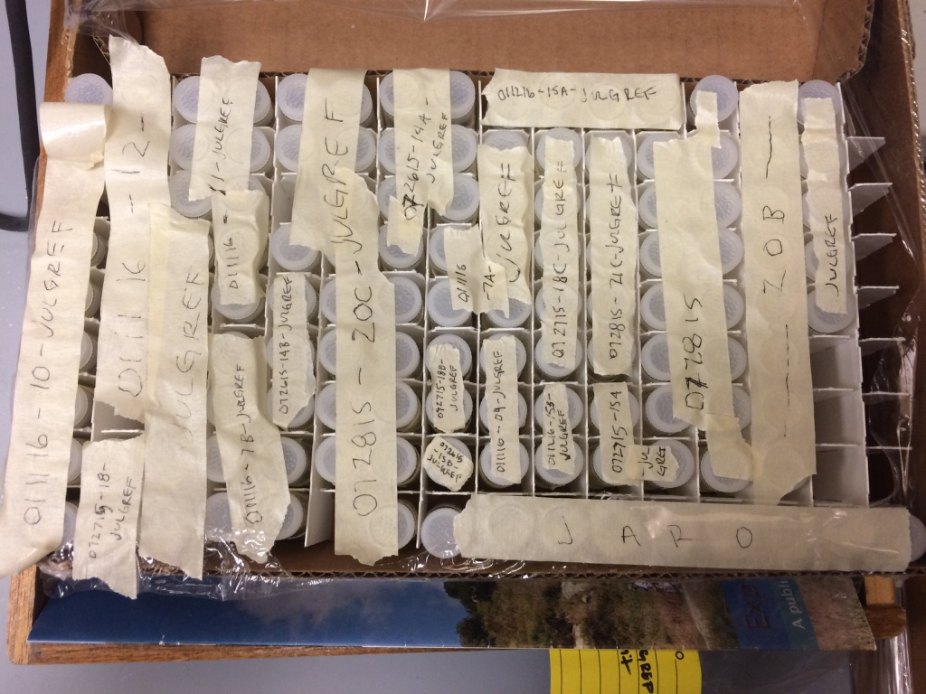
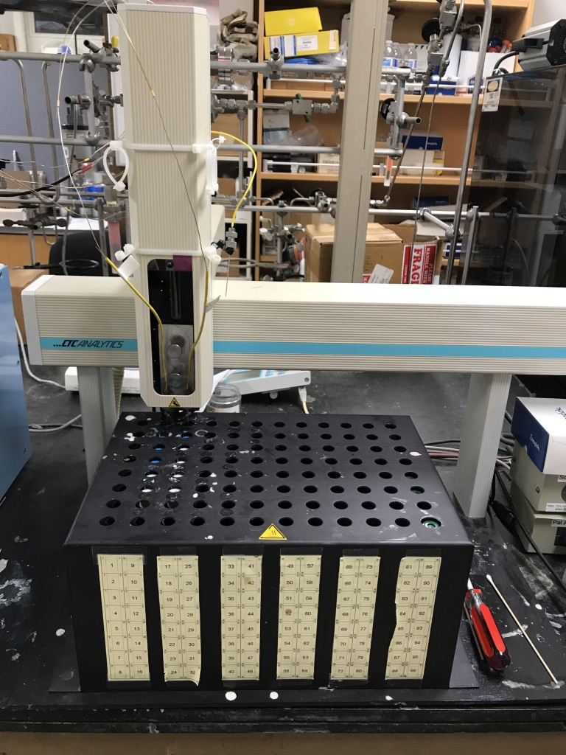
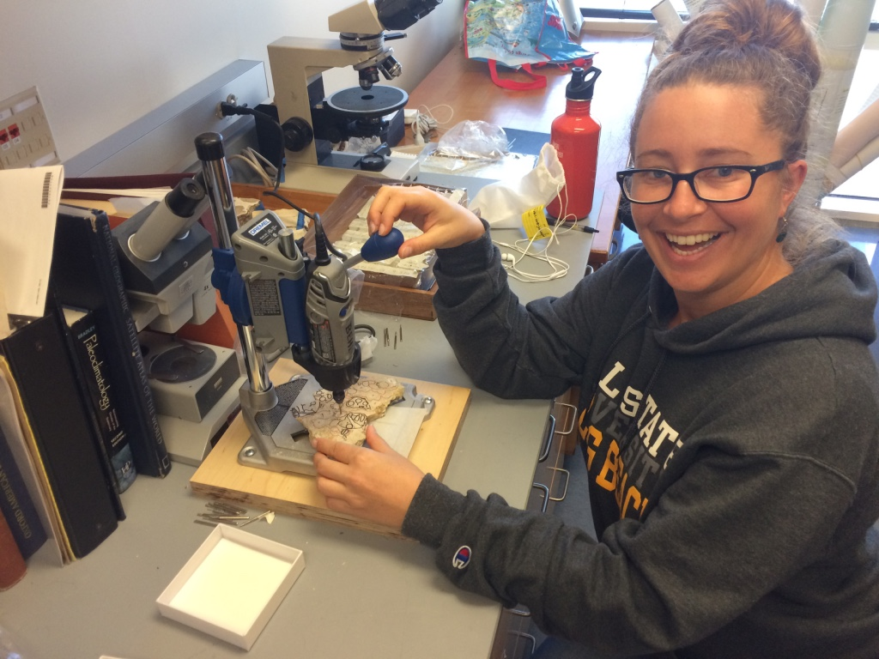
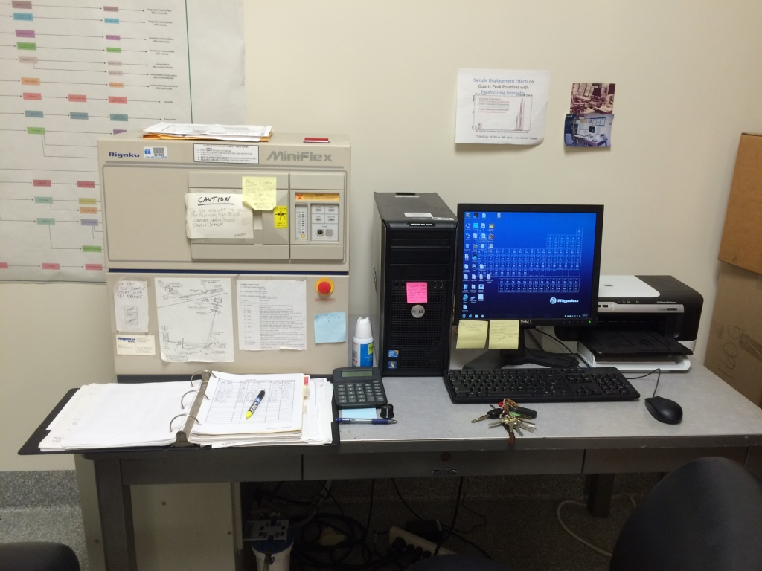
Methods
Long Beach MARS Project: Monterey and Related Sediments
Notes:
Along this road cut, I described outcrop and lithology and collected hand-samples for lab analysis.
Back at the lab, I cut hand-samples into slabs and “mapped out” different breccia zones based on cement color variation, general clast size, and/or different textures in the rock, such as visible porosity.
Then I powdered the samples for XRD analysis, and carbon and oxygen stable isotope analysis.
Trace elements were also analyzed for this study, but the results did not provide any information on the genesis of the dolomite breccia, so I won’t speak any more about them today.

Slide 8
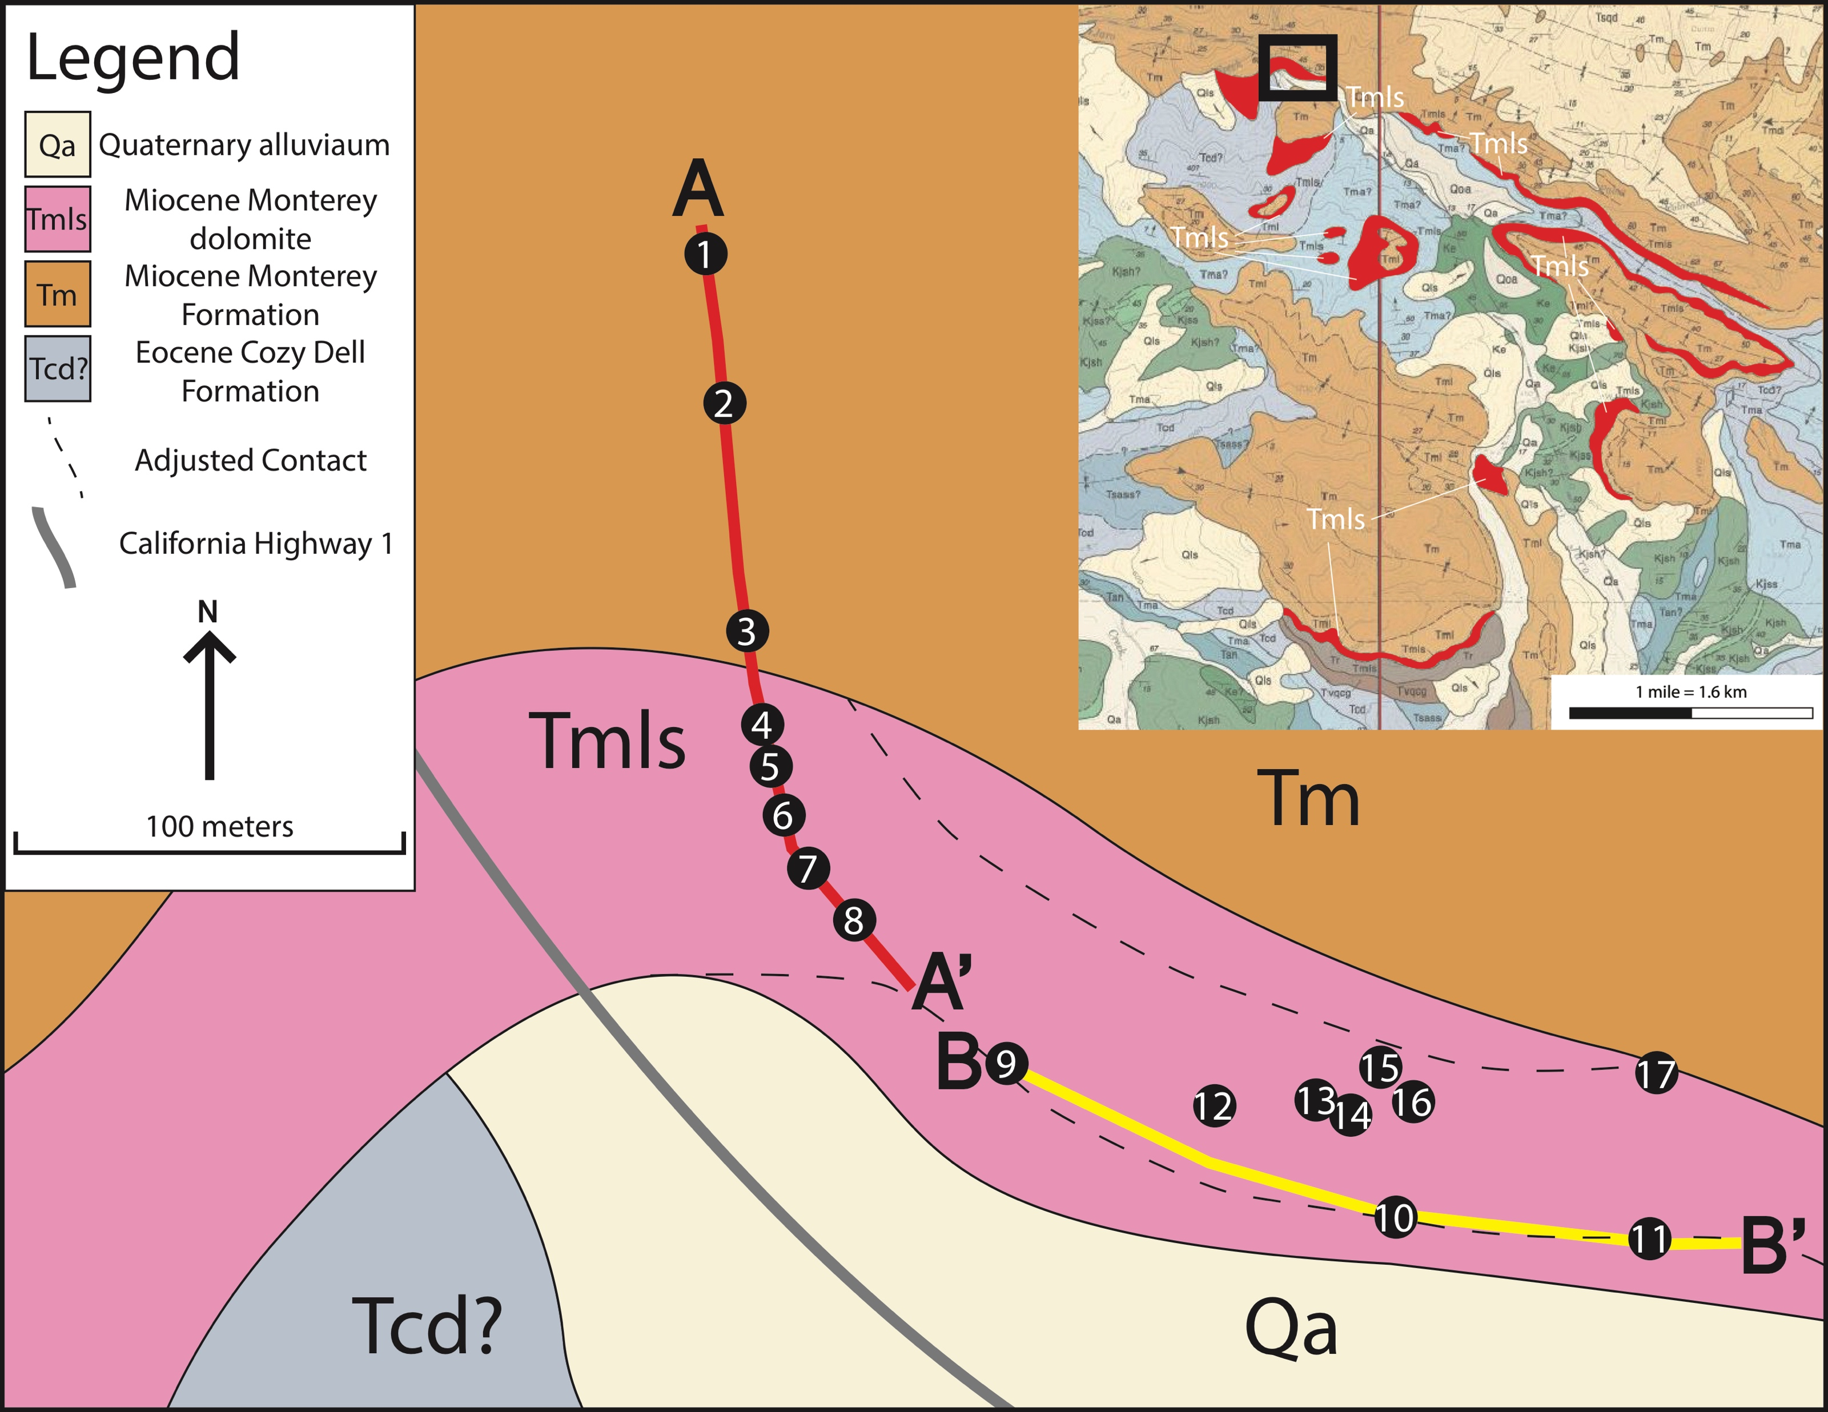
Sample Locations
Long Beach MARS Project: Monterey and Related Sediments
Notes:
The road cut created two transacts that intersect from two directions and give a more-or-less 3-dimensional exposure of the dolomite breccia. Transect A-A’ [point] highlights local structure, and transect B-B’ [point] runs roughly parallel to bedding strike, exposing this massive breccia.
The deformation exposed on Transect A-A’ was described in order to give the dolomite breccia a structural context.

Slide 9
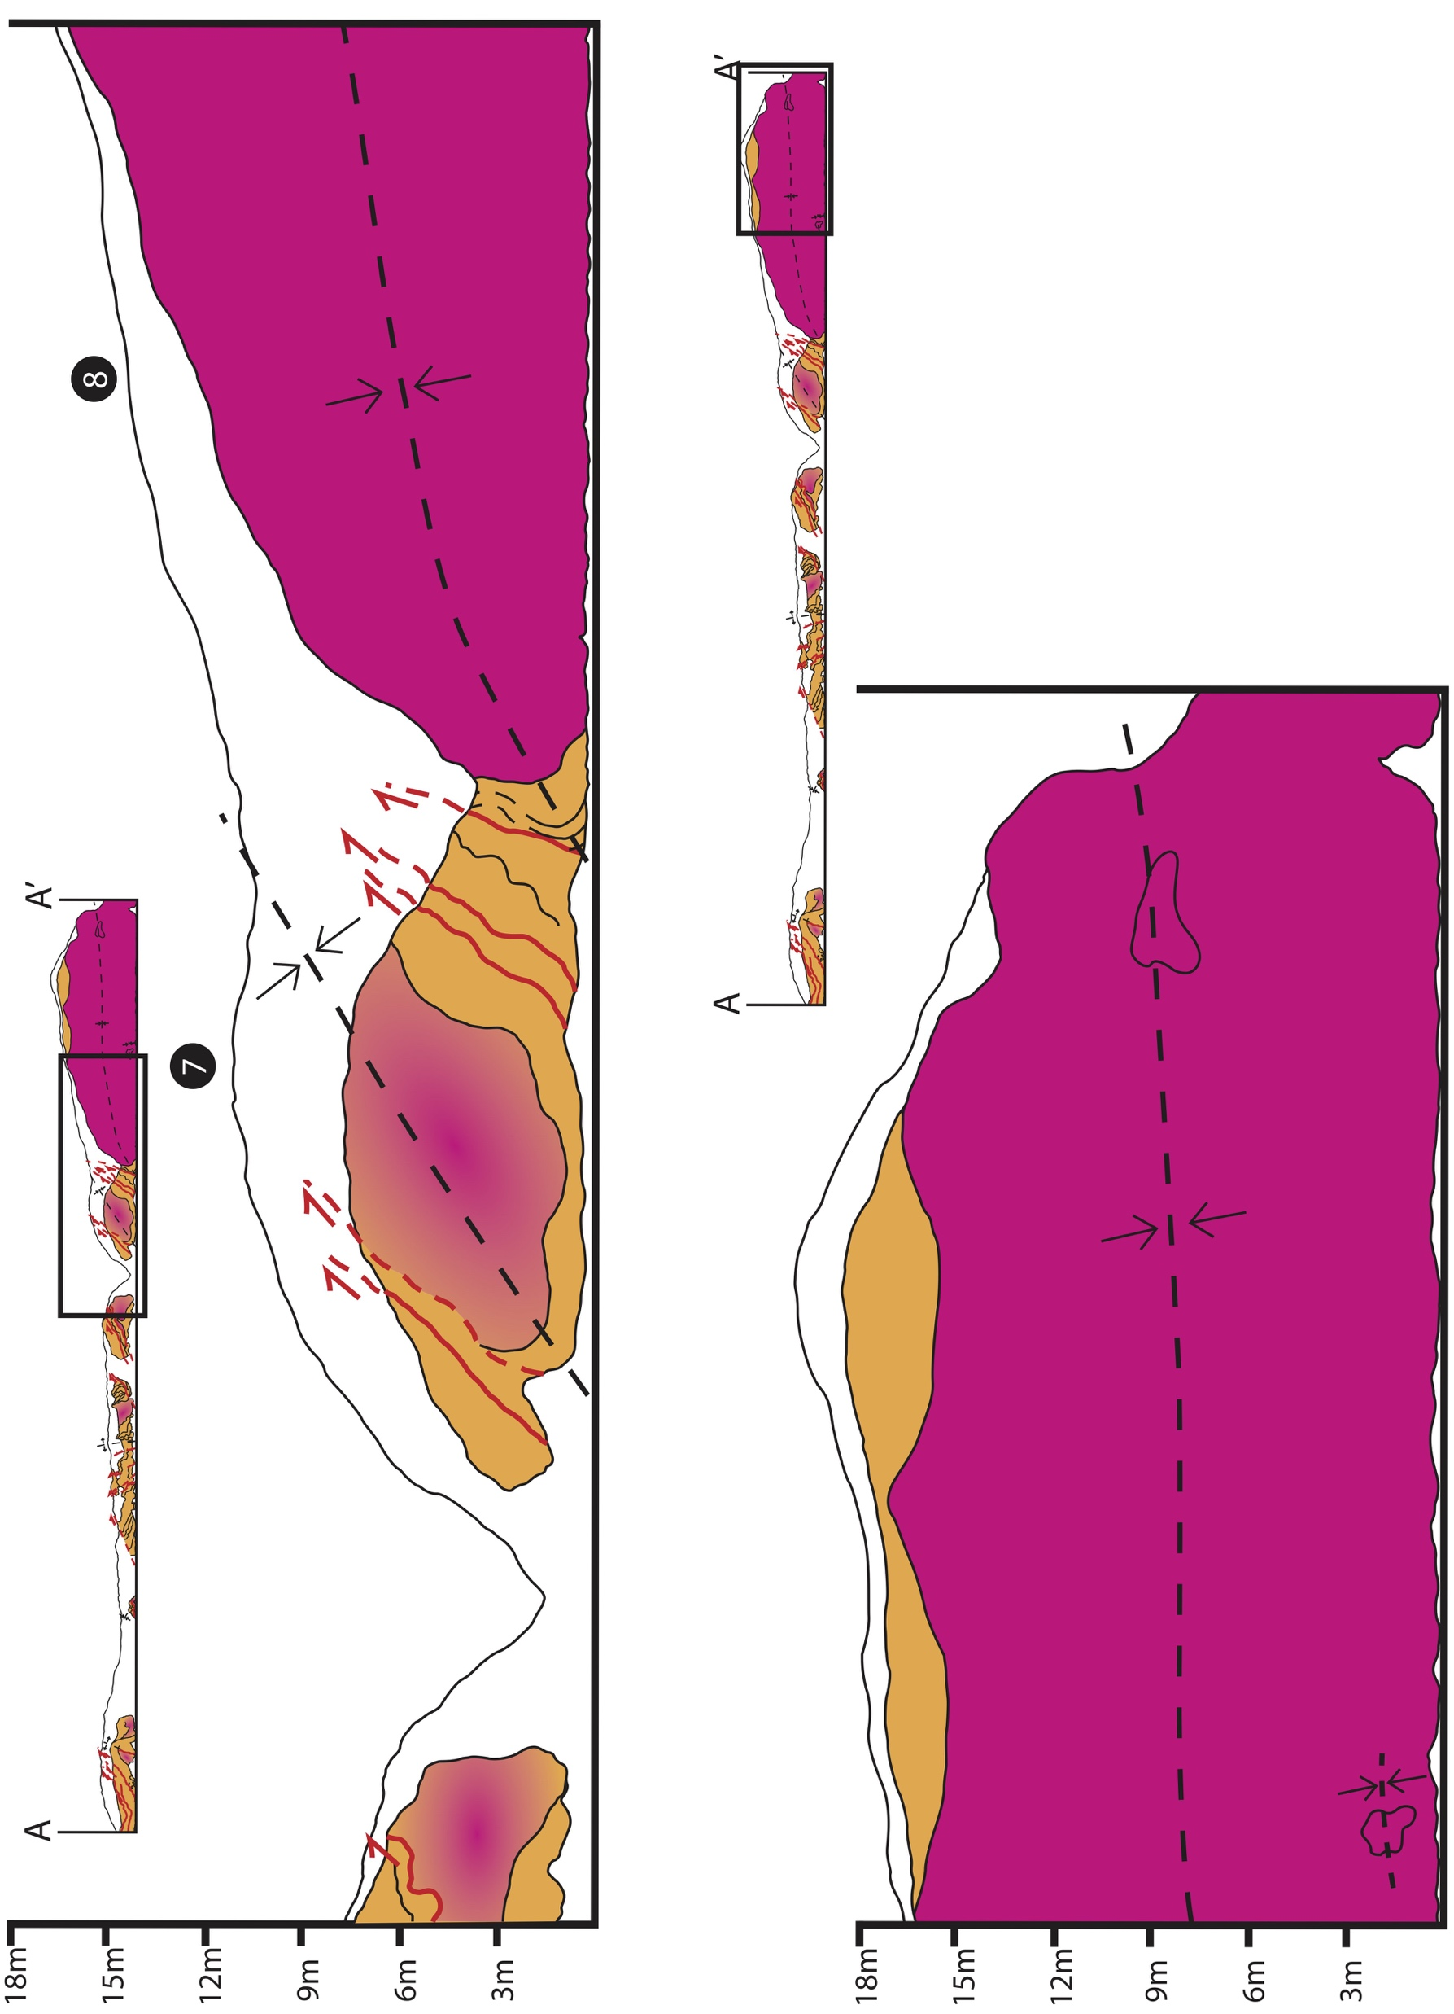
Outcrop-Scale Deformation
Transect A-A’
NNW
SSE
A
Covered Interval
Dolomitized, Brecciated,
Fine-grained Monterey Strata
Dolomite Breccia
Fine-grained Monterey Strata
15 meters
A’
Long Beach MARS Project: Monterey and Related Sediments
Notes:
This is a sketch of the exposure along A-A’. Orange represents fine-grained Monterey strata, which in this area are muddy diatomite, porcelanite, and chert. Magenta represents the dolomite breccia, and the orange/magenta mix represents dolomitized, brecciated, fine-grained Monterey strata. The black circles are field description locations and act as reference points along the transect.
Key items to note on this sketch are dolomitization and brecciation are confined to fold cores and along bedding planes , faults have reverse sense of slip and are predominantly layer-parallel, except at locations 3 and 4 where they crosscut strata, the degree of brecciation increases to the south-southeast, and between points 7 and 8, Monterey rocks become completely unstratified and dolomitized, as indicated by this solid magenta section that continues to the end of the transect.

Slide 10
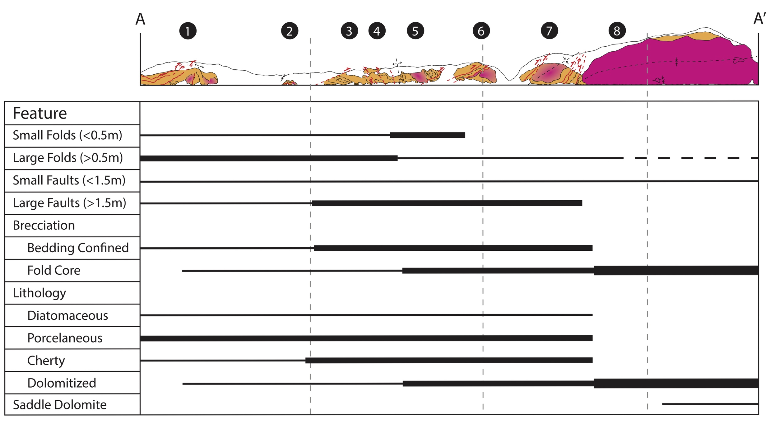
Spatial Distribution of Features
Long Beach MARS Project: Monterey and Related Sediments
Notes:
This figure summarizes the structural and lithologic trends along the A-A’ transect. The horizontal black bars correspond to the presence and abundance of the feature to the left.
Folds and faults are present throughout the transect. Folds less than half a meter increase in abundance between points 4 and 6 but are not present at or beyond point 6. Folds larger than half a meter are present throughout the transect but decrease in abundance along the transect. Faults less that one and a half meters long are present with consistent abundance throughout the transect while faults greater than one and a half meters increase in abundance until they are overprinted by brecciation between points 7 and 8.
Breccias are present along the whole transect. Bedding confined breccias increase in abundance up to just beyond point 7 where they become over-printed by fold core brecciation, which increases in abundance to the end of the transect.
Monterey rock types exist in various abundances up to this point where all the rock types have been dolomitized, and near the end of the transect, there is a little bit of saddle dolomite.

Slide 11
Sample Locations
Long Beach MARS Project: Monterey and Related Sediments
Notes:
Transect B-B’ exposes the lateral extent of the dolomite breccia.

Slide 12
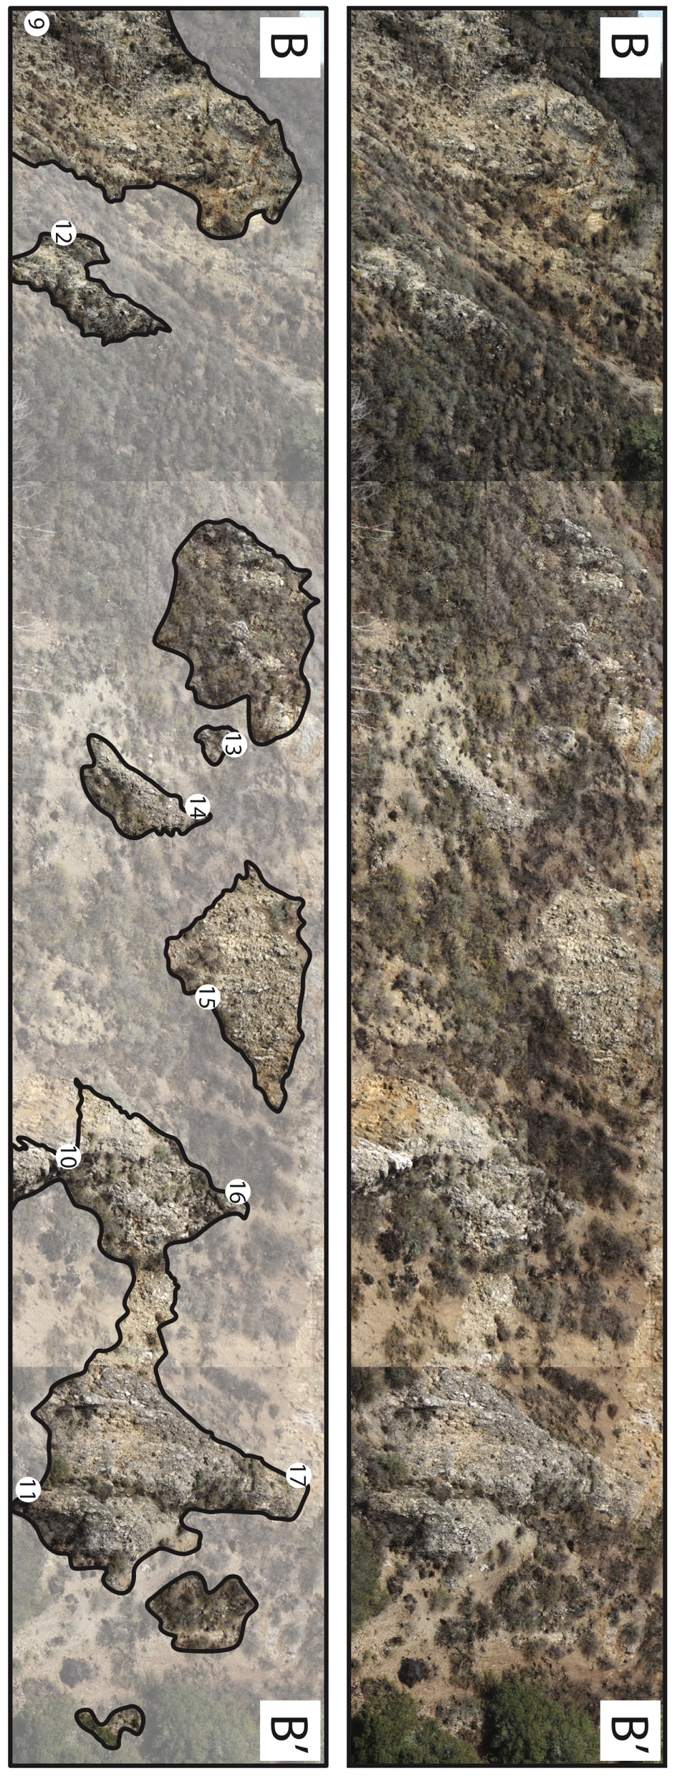
Breccia Outcrops
Transect B-B’
Long Beach MARS Project: Monterey and Related Sediments
Notes:
This is a photo-mosaic of the exposure. The image on the bottom defines where the breccia actually crops out. The circles with numbers in them indicate a location where hand-samples were collected for lab analysis. Locations 9, 10, and 11 are along the basal contact, locations 12 through 16 are within the body of the breccia, and location 17 is on the upper contact of the breccia.

Slide 13
Brecciated Basal Contact
Long Beach MARS Project: Monterey and Related Sediments
Notes:
The basal contact is characterized by a breccia zone about a foot wide. Locations 9 and 10 have good exposures of this zone. In both these images, Paleogene sandstone is on the left [point], dolomite breccia is the right, and the brecciated fault zone is within the dashed red lines.

Slide 14
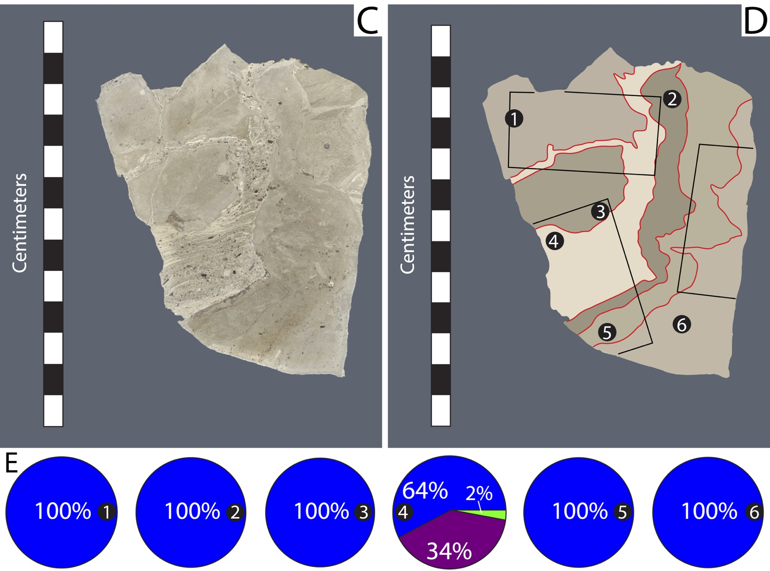
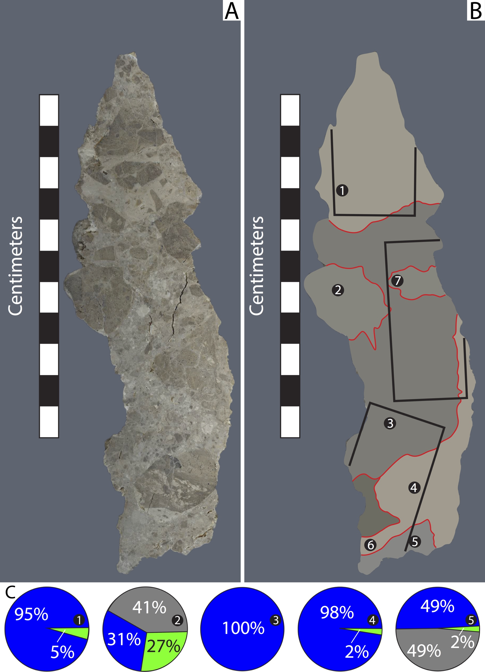
Breccia Slab Fabrics
Dolomite
Quartz
Albite
Main Body
Upper Contact
Fluorapatite
17
13
Basal Contact
9
10
10
Notes:
The predominant fabric in hand sample slabs is multiple distinguishable zones of cement-supported breccias with variable clast size. XRD analysis identified dolomite and quartz almost exclusively in cement and clast mineralogy. Albite and fluorapatite were found in a couple of clasts, but these minerals are believed to represent the primary composition of the clasts prior to dolomitization.
Cements and clasts have a relatively high percentage of quartz near the basal contact, but those percentages are lower in the main body and at the upper contact.

Slide 15
Breccia Mineralogy
Dolomite
Quartz
Upper Contact
Main Body
Basal Contact
B
B’
Long Beach MARS Project: Monterey and Related Sediments
Notes:
In general dolomite content increases and quartz content decreases from B toward B’ and from the basal contact to the upper contact.

Slide 16
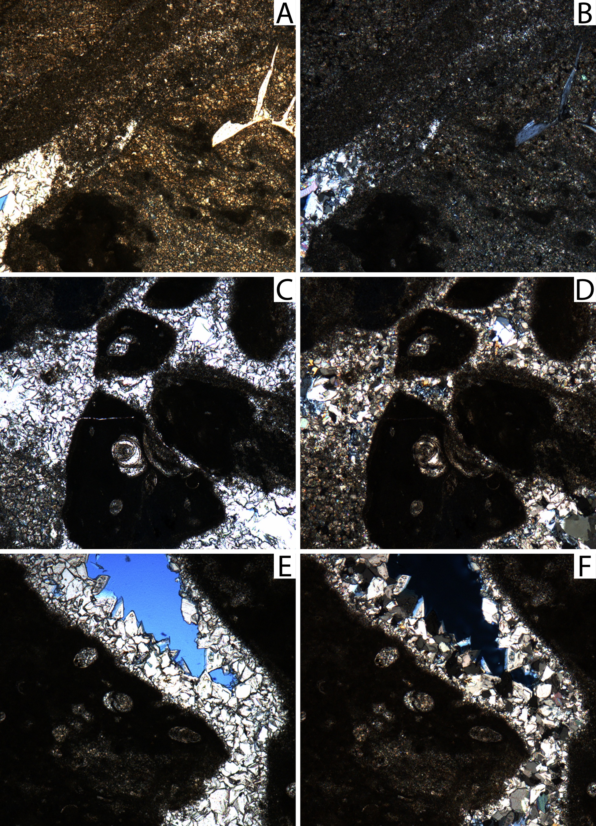
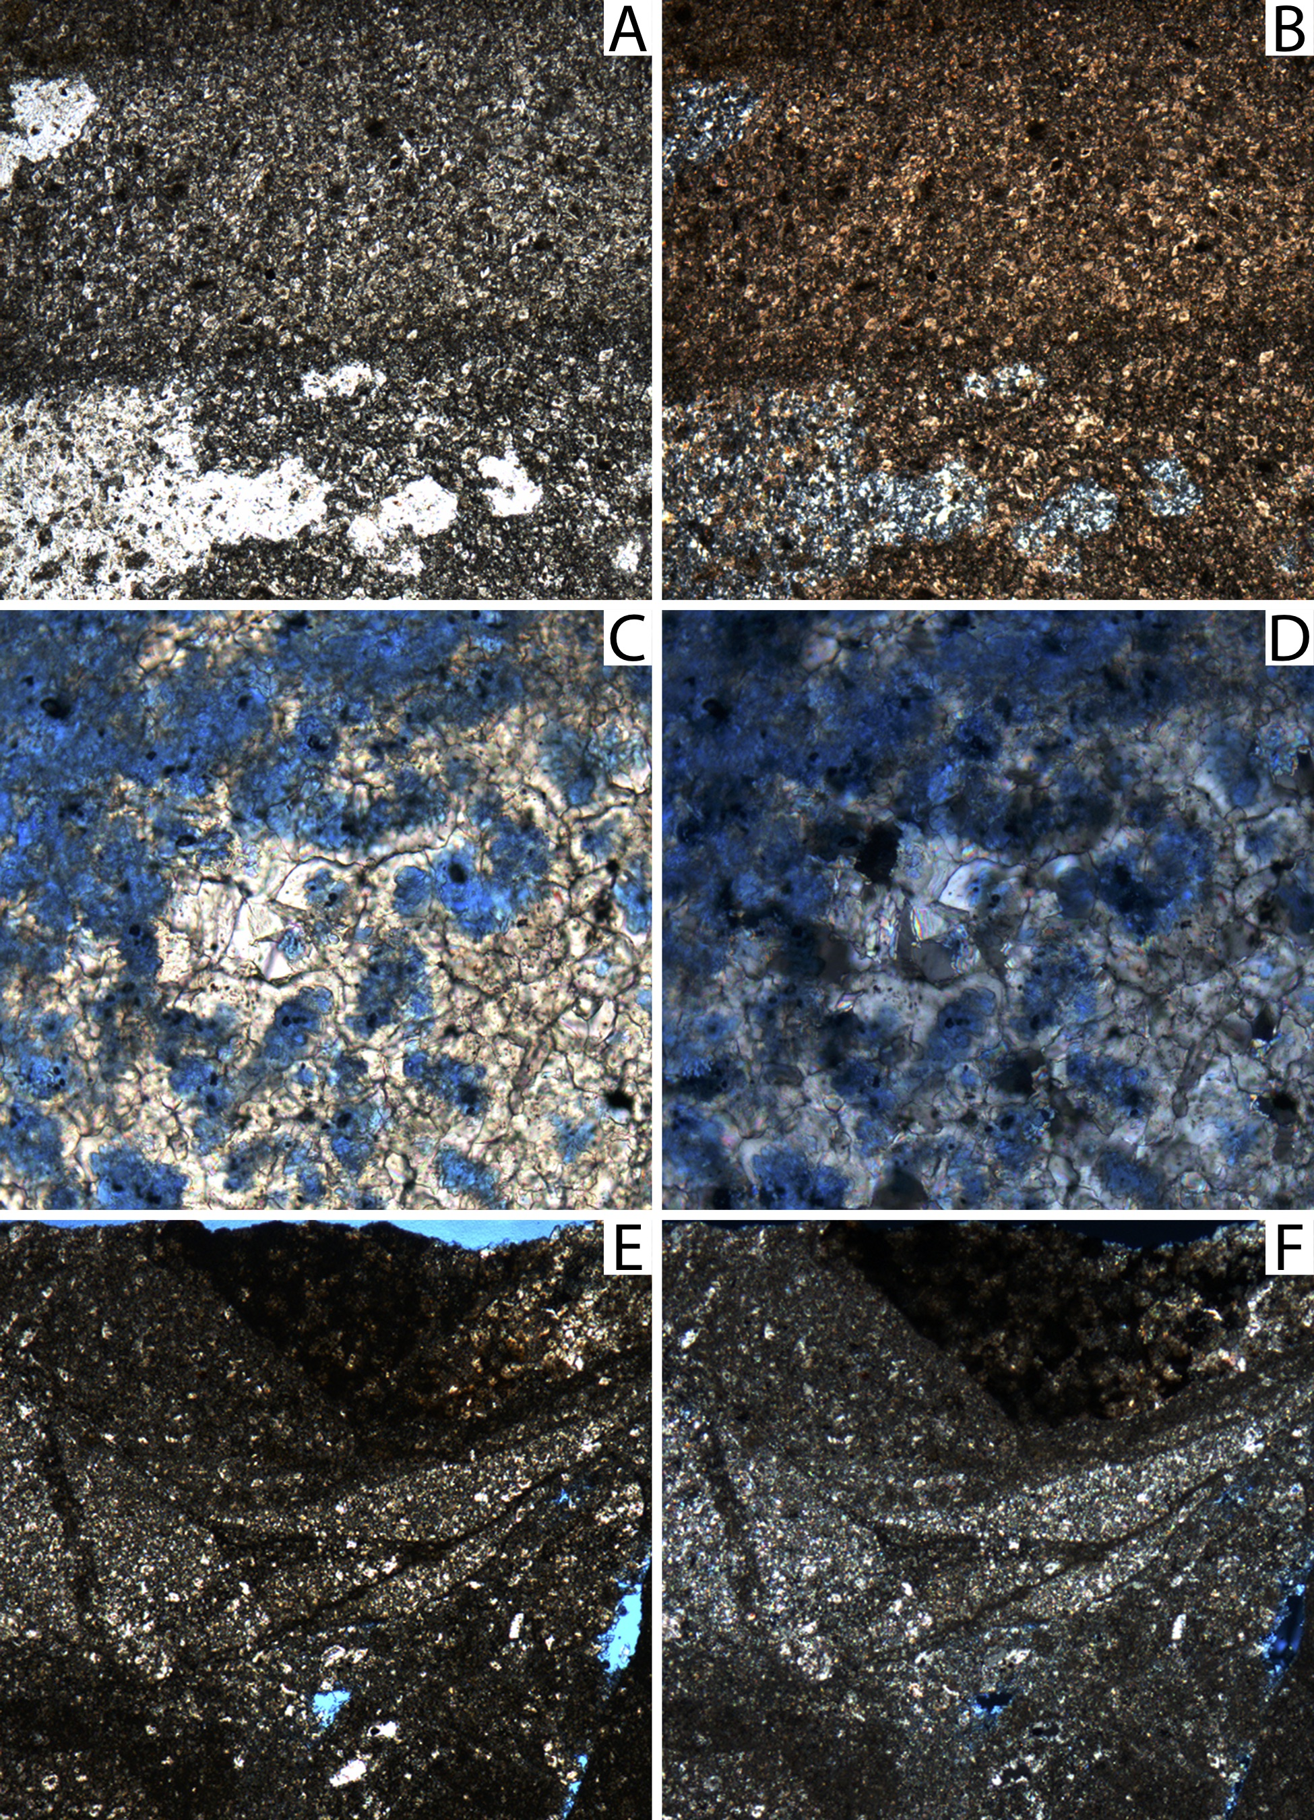
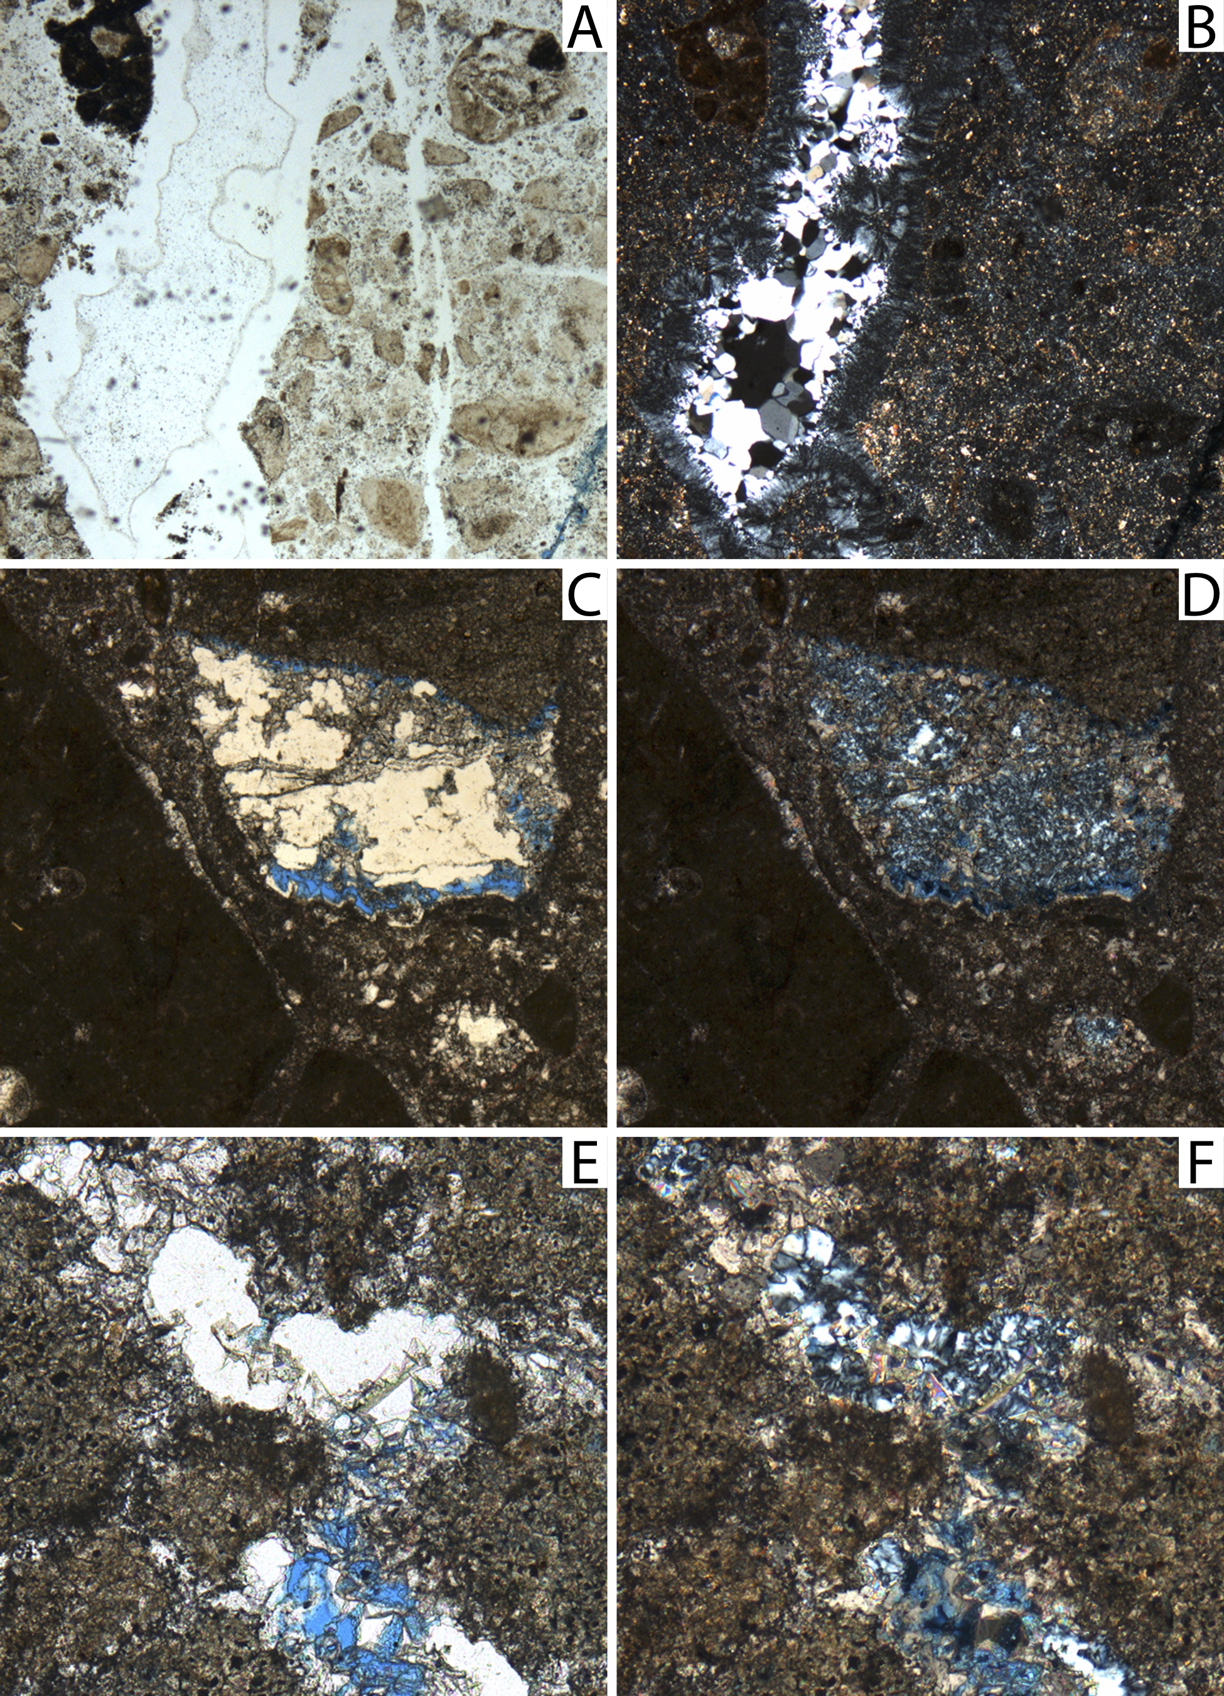
Breccia Microfabrics
Upper Contact
17
Main Body
13
4x
4x
17
Basal Contact
9
4x
4x
15
4x
4x
17
4x
4x
10
20x
20x
16
4x
4x
4x
4x
10
4x
4x
10x
10x
Notes:
Breccia fabrics and minerals identified in thin sections echo what is seen on the hand-sample scale and identified through XRD. In these figures, the images on the left are in plane-polars, the ones on the right in crossed-polars, and pore spaces are highlighted by blue epoxy. There are clasts of Monterey rocks of variable sizes supported by cement.
What becomes apparent in thin section is the relative timing of dolomite and quartz cementation. Chalcedony and polycrystalline quartz veins cut dolomite cement that is sporadically replaced with microcrystalline quartz and microcrystalline [and poly crystalline quartz cement fill voids left by the dissolution of dolomite.
4x fov = 3mm
10x fov = 1mm
20x fov = 0.5mm

Slide 17
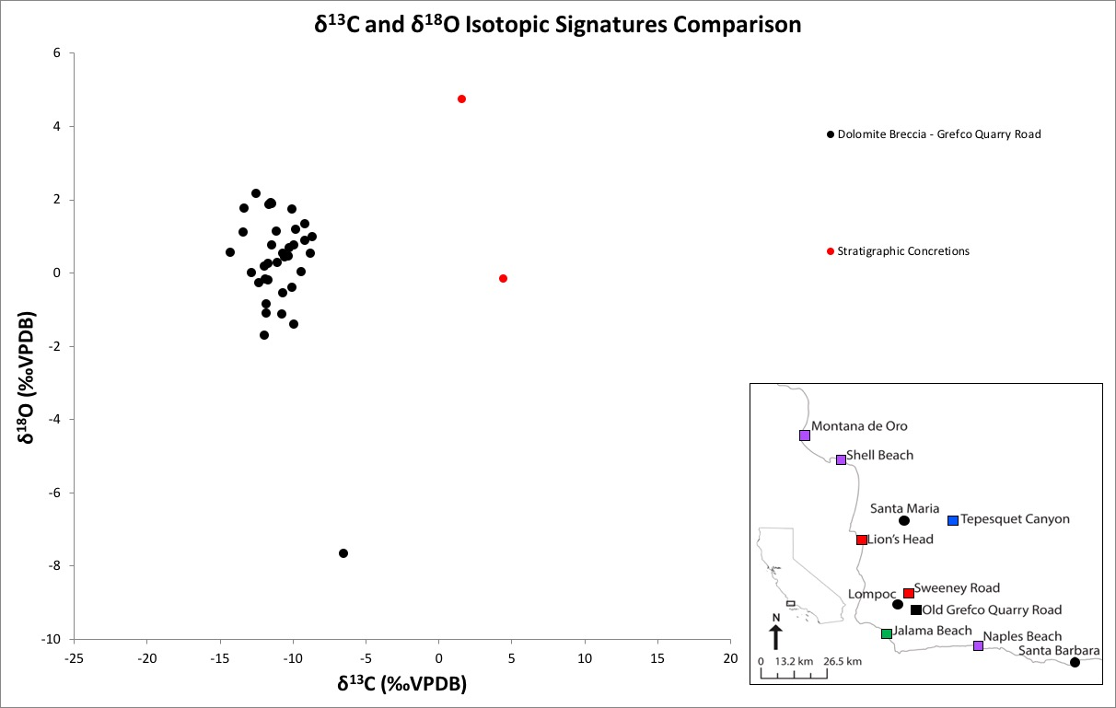
Carbon and Oxygen Isotopes
(δ¹³C and δ¹⁸O )
Davis (2018) – Breccia
Davis (2018) – Concretions
Notes:
Carbon and oxygen stable isotope analysis was done on a subset of the samples used for XRD analysis in order to gain insight to the environment of formation of the dolomite breccia. The data cluster with delta 13 carbon values between -14.3 and -8.7 permil and delta 18 oxygen values between -1.7 and +2.2 permil.
These red data points were measured from dolomite concretions from the greater Lompoc area, and it’s apparent the isotopic signatures are pretty different.

Slide 18
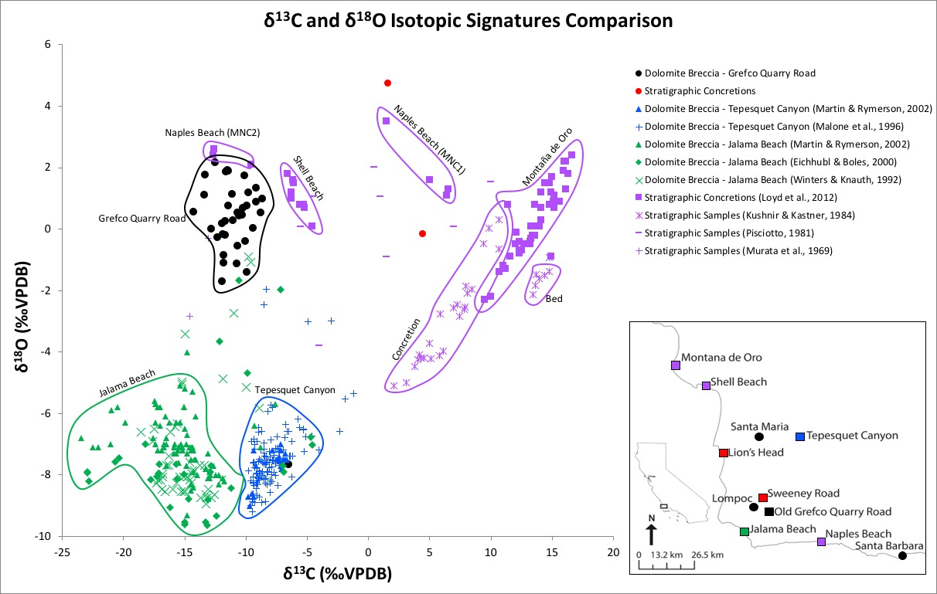
Carbon and Oxygen Isotopes
(δ¹³C and δ¹⁸O ) Comparison
Davis (2018) – Breccia
Davis (2018) – Concretions
Martin & Rymerson (2002)
Malone et al. (1996)
Martin & Rymerson (2002)
Eichhubl & Boles (2000)
Winter & Knauth, 1992)
Loyd et al. (2012)
Kushnir & Kastner (1984)
Pisciotto (1981)
Murata et al. (1969)
Notes:
I compared the isotopic signature from the Grefco Quarry road exposure to isotopic signatures from previous studies. The purple points are from typical, or stratigraphic, dolomite in the Monterey Formation, and the green and blue points are from dolomite breccias at Jalama Beach and Tepusquet Canyon, respectively. Here is the location of the Grefco road exposure.
Since the dolomite at the Grefco road is a dolomite breccia, I expected its isotopic signatures to be similar to the signatures of Tepusquet and Jalama. The delta 13 carbon values of the breccias are similar, but the delta 18 oxygen values from Grefco road are much more positive and more similar to the delta 18 values of the stratigraphic dolomite from lower members of the Monterey. One hypothesis for this result is that dolomite emplacement fluids were derived from oxygen 18 enriched fluids, but that hypothesis would require fluid temperatures to be excessively high in order to get dolomite with this oxygen signature, so that was ruled out.
The favored idea is that the dolomite emplacement fluids were Monterey-sourced fluids. This is because the light carbon signatures are indicative of thermal, abiotic degradation of organic matter, which is basically the initiation of converting organic matter to hydrocarbon, and the oxygen signatures are consistent with evolved pore waters. The Monterey is known for its high organic matter content and as a source for hydrocarbons, and work by Behl shows that pore waters evolve to become more enriched with oxygen 18 with deep burial and silica diagenesis, so this interpretation fits.

Slide 19
Fluid Temperature Derivation
7
0 mbsf
15
$$\left(1000\ln{αdolomite\text{−}water}=3.14 ∗106T\text{–}\text{2} −3.14\right)$$
Opal-A
25
(Horita, 2014)
35
45
500
Temperature (δ¹⁸O_{water} = 3.5‰ SMOW)
37-96 °C
Temperature (°C)
Depth (m)
55
Opal-CT
Miocene seawater: -0.6‰
65
1000
75
85
1500
Hydrothermal Dolomite (HDT): dolomite emplaced at any temp
greater than ambient temp of host
(Davies and Smith, 2006)
95
Quartz
-5
0
5
10
15
20
(Behl, 1992)
δ¹⁸O_{water} (‰SMOW)
Long Beach MARS Project: Monterey and Related Sediments
Notes:
Using the delta 18 oxygen data, I was able to determine the temperature of the dolomitizing fluid with an equation for hydrothermal dolomite fractionation from Horita, 2014. Because there are porcelanites and cherts in the clasts of the dolomite breccia, I know that diagenesis had already occurred by the time dolomitizing fluids came pumping through here. The isotopic signatures of the Grefco road dolomite breccia resembled signatures of concretions from the lower members of the Monterey, so I used a delta 18 oxygen value that represented pore waters from the lower members of the Monterey that evolved from Miocene seawater through quartz-phase silica diagenesis, and the best estimate for this fluid was 3.5 permil SMOW. The resulting fluid temperature range is between 37 and 96ºC.
Because of the mixed phases of silica (diatomite, porcelanite, chert) present at this location, the bulk diagenetic temperature is estimated to be between 45 and 48ºC, and likely does not exceed 50ºC.
Because the fluid temperature exceeds the maximum diagenetic temperature, the dolomite at the Grefco Quarry road location is determined to be of hydrothermal origin, based on the definition from Davies and Smith, 2006.

Slide 20
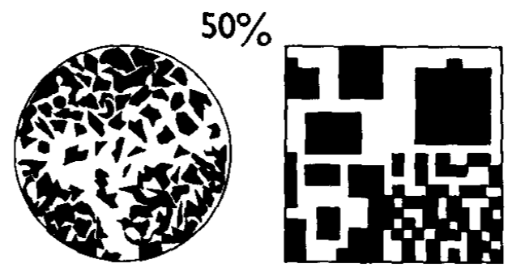
Major Fluid Conduit
Density of dolomite | Temperature of formation | Solubility of dolomite | Percent cement in slab
2.8 g/cm³ | 37-96°C | 4.25-7.65 mg/L | 35%
(Folk et al., 2011)
$$\frac{\left(density ∗percent cement\right)}{solubility}=fluid volume required/rock volume$$
(Behl, 1998)
$$\frac{\left(2.8\frac{g}{cm3}∗\left(\frac{1000mg}{1g}\right) ∗0.35\right)}{\frac{4.25mg}{L}} = \frac{231L}{cm3}∗\left(\frac{1000cm3}{1L}\right)=231,000$$
$$\frac{\left(2.8\frac{g}{cm3}∗\left(\frac{1000mg}{1g}\right) ∗0.35\right)}{\frac{7.65mg}{L}}=\frac{231L}{cm3}∗\left(\frac{1000cm3}{1L}\right)=128,000$$
At LEAST
128,000 to 231,000 volumes of fluid
per 1 volume of breccia!
Notes:
Dr. Behl thought it would be cool to calculate the minimum fluid volume required to deposit the amount of dolomite cement at this location, and of course it was.
The first step was to estimate what percentage of the breccia was cement, which ended up being about 35% averaged over 9 slabs.
Using this formula with the density of dolomite, the percentage of dolomite cement in the breccia, the solubilty of dolomite at the fluid temperatures I calculated earlier, and a little unit conversion, I determined that for every cubic centimeter of breccia, it would require 128,000 to 231,000 cubic centimeters of fluid 35% of dolomite cement.
To give you a better visual: it would require 100% of the dissolved reactant for dolomite in 1.5 to 2.7 Maias of fluid to deposit 35% dolomite cement in this cube. At a minimum. That is a lot of fluid.

Slide 21
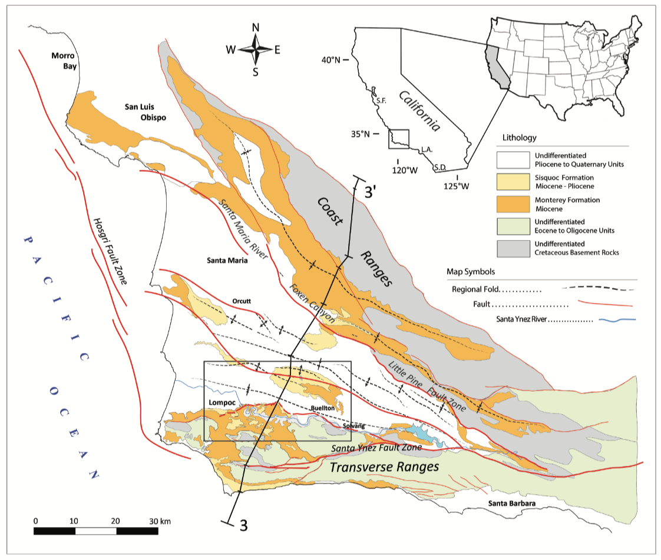
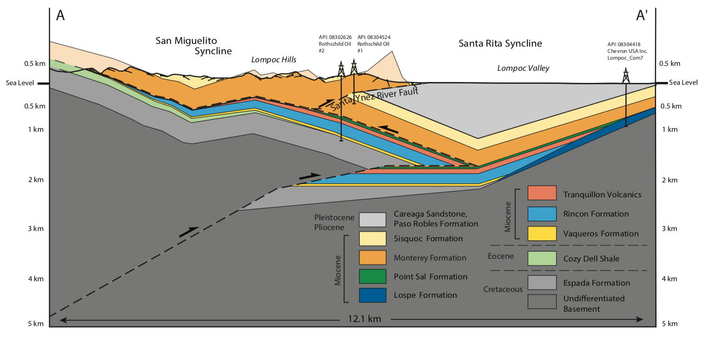
Regional Model (Wirtz, 2017)
S
N
(Wirtz, 2017)
(Wirtz, 2017, after Namson and Davis, 1990)
SW
NE
(Wirtz, 2017)
Notes:
So what does this all mean? Well, based on a structural study of the Monterey and Sisquoc formations done in the Santa Maria Basin, my pal Yannick proposed that a detachment surface at the base of the Monterey is necessary in order to account for higher frequency folding in the Monterey relative to underlying strata in a fold and thrust belt associated with a contractive tectonic regime.

Slide 22
Geologic Interpretation
S
N
Long Beach MARS Project: Monterey and Related Sediments
Notes:
With that in mind, I interpreted the brecciated contact between the base of the dolomite breccia and the underlying sandstone to be a faulted contact between the Monterey Formation and the subjacent formation, not an unconformable contact as previously mapped, and the fault undulates from below to within the Monterey Formation.
The deformation and brecciation in fold cores and along bedding planes described on transect A-A’ are consistent with layer-parallel shortening in fold and thrust belts in a compressive tectonic regime, so this fault is causing the Monterey in this area to buckle and brecciate, and the breccias create fluid conduits along which massive amounts of dolomitizing fluids flow, resulting in this magnificent dolomite breccia.

Slide 23
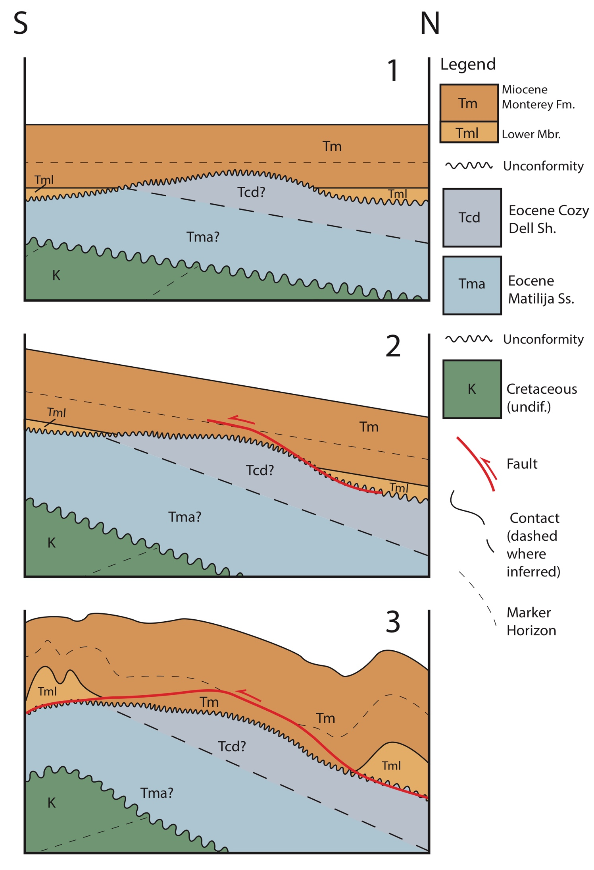
Reconstruction
Notes:
This figure is a reconstruction of how this fault may have developed.
In step 1, the Monterey Formation is unconformably deposited onto unevenly-eroded Eocene strata. A local high of Eocene strata allows for deposition of Tm directly onto Eocene rocks. Lower members of the Monterey are deposited on either side of high.
In step 2 – compression and shortening start, and the detachment surface begins to develop at the base of the Monterey Formation. The detachment surface jumps into higher members of the Monterey Formation along weak bedding surfaces.
In step 3 – compression continues and the detachment surface grows. The detachment surface returns to the unconformable surface at the base of the Monterey Formation, allowing for higher levels of shortening in the Monterey Formation relative to underlying strata.
Continued tectonics create the geology observed today.

Slide 24
Conclusions
Deformation is consistent with fold-thrust compressive regime and layer-parallel shortening
Basal contact between Monterey Formation and underlying strata is faulted, not unconformable as previously mapped
Brecciated basal contact of Monterey Formation is evidence for detachment surface at base of Monterey as proposed by Wirtz, 2017
Brecciation along layer-parallel slip surfaces and detachment surface at base of Monterey Formation creates conduits for focused fluid migration
Dolomite breccia is of hydrothermal origin
δ¹³C and δ¹⁸O isotope data indicate hydrothermal fluids were sourced from the lower members of the Monterey Formation
A minimum of 128,000-231,000 volumes of fluid per 1 volume of breccia migrated through breccia at Grefco Quarry Road
Long Beach MARS Project: Monterey and Related Sediments
Notes:
In conclusion, I determined that
Deformation described at the Grefco Quarry road dolomite exposure is consistent with fold-thrust compressive regime
The basal contact between Monterey Formation and underlying strata is faulted, not unconformable as previously interpreted
Brecciated basal contact of Monterey Formation is evidence for a detachment surface at base of Monterey
Brecciation creates conduits for focused fluid migration
Dolomite breccia is of hydrothermal origin
hydrothermal fluids were sourced from the lower members of the Monterey Formation
A minimum of 128,000-231,000 cm³ fluid volume per cm³ of breccia volume is required to deposit the amount of dolomite cement observed at Grefco Quarry Road

Slide 25
Acknowledgements
MARS affiliates and family for your support!
My most excellent committee – Rick Behl, Lora Stevens, and Sean Loyd – for their superb and kind guidance
Greg Holk for help with isotope data collection
Amber Tucker, Casey Slatten, and Melissa Lizarraga for being great field and lab assistants
San Julian Ranch owners and operators, City of Santa Barbara, Hollister Ranch HOA & Co-op and Phil Hogan, US Air Force, Vandenberg Air Force Base, and Chris Ryan for granting property access and being enthusiastic chaperones and field companions
Long Beach MARS Project: Monterey and Related Sediments
Notes:
I’d like to thank the MARS affiliates for sponsoring this research and for putting the time and energy into the MARS program. It has been a privilege to work in this group.
I’d also like to thank the MARS team, my committee members and Dr. Holk, lab and field assistants, and private land owners for their collaboration and contributions to this research and for making this project possible.

Slide 26
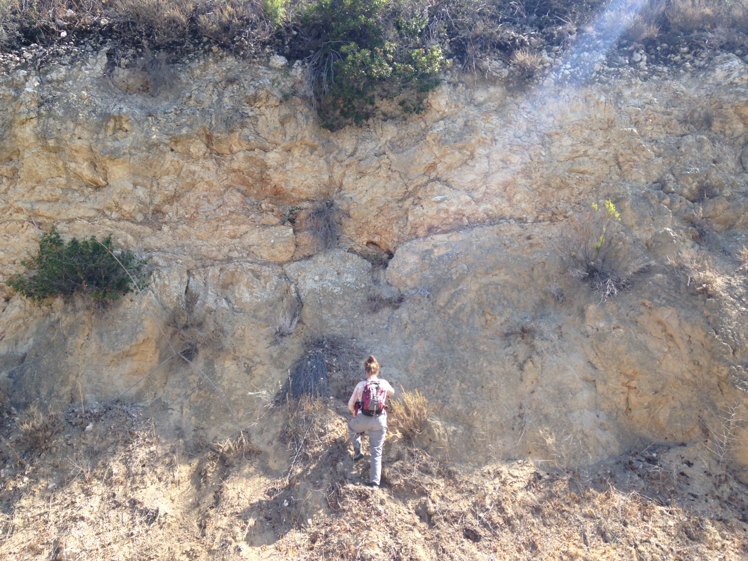
Thank You!
Long Beach MARS Project: Monterey and Related Sediments

Slide 27
References
Behl, R.J., 1992, Chertification in the Monterey Formation of California and deep-sea sediments of the West Pacific [Ph.d thesis]: Santa Cruz, University of California, 302 p.; Behl, R.J., 1998, Relationships between silica diagenesis, deformation, and fluid flow in Monterey Formation cherts, Santa Maria Basin, California, in Eichhubl, P., ed., Diagenesis, Deformation, and Fluid Flow in the Miocene Monterey Formation: Pacific Section SEPM Special Publication, book 83, p. 77-83.; Behl, R.J., 2014, Oil and dolomite in the Monterey Formation of California: Abstract adapted from oral presentation given at Pacific Section AAPG, SEG and SEPM Joint Technical Conference, Bakersfield, California, 27-30 April.; Behl, R.J., and Garrison, R.E., 1994, The origin of chert in the Monterey Formation of Californa (USA), in Iijima, A., Abed, A., and Garrison, R., eds., Siliceous, Phoshpatic and Glauconitic Sediments of the Tertiary and Mesozoic: Proceedings of the 29th International Geological Congress, Part C, VSP, Utrecht.; Billups, K., and Schrag, D.P., 2002, Paleotemperatures and ice volume of the past 27 Myr revisited with paired Mg/Ca and 18O/16O measurements on benthic foraminifera: Paleoceanography, v.17, no.1, 1003, doi: 10.1029/2000PA000567.; Boles, J.R., Eichhubl, P., Garven, G., and Chen, J., 2004, Evolution of a hydrocarbon migration pathway along basin-bounding faults: Evidence from fault cement: AAPG Bulletin, v. 88, no. 7, p. 947-970, doi: 10.1306/02090403040.; Bramlette, M.N., 1946, The Monterey Formation of California and the origin of its siliceous rocks: US Geological Survey Professional Paper 212.; Brown, C.P., 2014, A stable isotope study of fluid-rock interaction in serpentinites of the Franciscan Complex, San Rafael Mountains, California [M.S. thesis]: Long Beach, California State University, 231 p.; Claypool G.E., and Kaplan I.R., 1974, The origin and distribution of methane in marine sediments [abs.]: in Natural Gases in Marine Sediments (ed. I. R. Kaplan). Plenum Press, New York, p. 99-140.; Compton, J. S., and Siever, R., 1984, Stratigraphy and dolostone occurrence in the Miocene Monterey Formation, Santa Maria basin area, California, in Garrison, R.E., Kastner, M. and Zenger, D.H., eds., Dolomites of the Monterey Formation and Other Organic-Rich Units: Pacific Section, Society for Sedimentary Geology, v. 41, p. 141-153.; Curtis C. D., Petrowski C. and Oertel G. (1972) Stable carbon isotope ratios within carbonate concretions: a clue to time and place of origin: Nature v. 235, p. 98–100.; Davies, G.R., and Smith, L.B., Jr., 2006, Structurally controlled hydrothermal dolomite reservoir facies: An overview: AAPG Bulletin, v. 90, p. 1641-1690, doi: 10.1306/05220605164.; Dibblee, T.W., 1950, Geology of Southwestern Santa Barbara County, California: State of California Department of Natural Resources, Bulletin 150.; Dibblee, T.W., 1966, Geology of the central Santa Ynez Mountains, Santa Barbara County, California: Bulletin, California Division of Mines and Geology, v. 186, p. 1-99.; Dibblee, T.W., and Ehrenspeck, H.E., eds., 1986, Geologic map of the Little Pine Mountain quadrangle, Santa Barbara County, California: Dibblee Geological Foundation, Dibblee Foundation Map DF-05, scale 1:24,000.; Dibblee, T.W., and Ehrenspeck, H.E., eds., 1987, Geologic map of the Lake Cachuma quadrangle, Santa Barbara County, California: Dibblee Geological Foundation, Dibblee Foundation Map DF-10, scale 1:24,000.; Dibblee, T.W., and Ehrenspeck, H.E., eds., 1988a, Geologic map of the Solvang and Gaviota quadrangles, Santa Barbara County, California: Dibblee Geological Foundation, Dibblee Foundation Map DF-16, scale 1:24,000.; Dibblee, T.W., and Ehrenspeck, H.E., eds., 1988b, Geologic map of the Santa Rosa Hills and Sacate quadrangles, Santa Barbara County, California: Dibblee Geological Foundation, Dibblee Foundation Map DF-17, scale 1:24,000.; Dibblee, T.W., and Ehrenspeck, H.E., eds., 1988c, Geologic map of the Lompoc Hills and Point Conception quadrangles, Santa Barbara County, California: Dibblee Geological Foundation, Dibblee Foundation Map DF-18, scale 1:24,000.; Dibblee, T.W., and Ehrenspeck, H.E., eds., 1988d, Geologic map of the Point Arguello and Tranquillon Mountain quadrangles, Santa Barbara County, California: Dibblee Geological Foundation, Dibblee Foundation Map DF-19, scale 1:24,000.; Dibblee, T.W., 1989a, Geologic map of the Casmalia and Orcutt Quadrangles, Santa Barbara County, California: Dibble Geological Foundation Map DF-24, scale 1:24,000.; Dibblee, T.W., 1989b, Geologic map of the Point Sal and Guadalupe Quadrangles, Santa Barbara County, California: Dibble Geological Foundation Map DF-25, scale 1:24,000.; Dibblee, T.W., Ehrenspeck, H.E., and Bartlett, W.L., 1994, Geologic map of the Tepusquet Canyon quadrangle, Santa Barbara County, California: Dibblee Geological Foundation, Dibblee Foundation Map DF-52, scale 1:24,000.; Eichhubl, P., and Behl, R.J., 1998, Diagenesis, deformation, and fluid flow in the Miocene Monterey Formation, in Eichhubl, P., ed., Diagenesis, Deformation, and Fluid Flow in the Miocene Monterey Formation: Pacific Section, Society of Sedimentary Geologists Special Publication, Book 83, p. 5-13.; Eichhubl, P., and Boles, J.R., 1998, Vein formation in relation to burial diagenesis in the Miocene Monterey Formation, Arroyo Burro Beach, Santa Barbara, California, in Eichhubl, P., ed., Diagenesis, Deformation, and Fluid Flow in the Miocene Monterey Formation: Pacific Section, Society of Sedimentary Geologists Special Publication, Book 83, p. 15-36.; Eichhubl, P., and Boles, J.R., 2000a, Focused fluid flow along faults in the Monterey Formation, coastal California: GSA Bulletin, v. 112, no. 11, p. 1667-1679.; Eichhubl, P., and Boles, J.R., 2000b, Rates of fluid flow in fault systems; evidence for episodic rapid fluid flow in the Miocene Monterey Formation, coastal California: American Journal of Science, v. 300.7, p. 571-600, doi: 10.2475/ajs.300.7.57.; Fife, D.L., 1979, The “Basal Member of the Monterey Formation,” Lower Aliso Creek Area, Orange County, California: in Geologic Guide to the San Onofre Nuclear Generating Station and Adjacent Regions of So. California: American Association of Petroleum Geologists publication, p. A17-A24.; Finger, K.L., 1988, Depositional Paleoecology of Miocene Ostracods in the Monterey Formation, Laguna Hills, Southern California, USA: Developments in Palaeontology and Stratigraphy, v. 11, p. 1101-1111.; Früh-Green, G., 2005, The Lost City Expedition: http://oceanexplorer.noaa.gov/explorations/05lostcity/background/serp/serpentinization.h tml (accessed December 2017).; Horita, J., 2014, Oxygen and carbon isotope fractionation in the system dolomite-water-CO2 to elevated temperatures: Geochemica et Cosmochimica Acta, v. 129, p. 111-124.; Hornafius, J.S., Luyendyk, B.P., Terres, R.R., and Kamerling, M.J., 1986, Timing and extent of Neogene tectonic rotation in the western Transverse Ranges, California [abs.]: Geological Society of America Bulletin, v. 97.12, p. 1476-1487.; Ijeoma, I.O., 2014, A Test of diagenetic ordering in siliceous lithofacies, Monterey Formation, southwest Casmalia Hills, Santa Maria Basin, California [M.S. thesis]: Long Beach, California State University, p. 25.; International Centre for Diffraction Data, 2008, Quantitative analysis: Reference intensity ratio (RIR): http://www.icdd.com/resources/tutorials/pdf/Quantitative%20Analysis%20 RIR.pdf (accessed May 2017).; Isaacs, C.M., 1981, Outline of diagenesis in the Monterey Formation examined laterally along the Santa Barbara coast, California, in Isaacs, C.M., ed., Guide to the Monterey Formation in the California Coastal Areas, Ventura to San Luis Obispo: Pacific Section AAPG, v. 52, p. 25-38.; Kushnir, J. and Kastner, M., 1984, Two forms of dolomite in the Monterey Formation, California: Concretions and layers – a comparative mineralogical, geochemical, and isotopic study, in Garrison, R.E., Kastner, M., and Zenger, D.H., eds., Dolomites of The Monterey Formation and Other Organic-Rich Units: Pasivic Sections SEPM, v. 41, p. 171-183.; Loyd, S.J., Berelson, W.M., Lyons, T.W., Hammond, D.E., and Corsetti, F.A., 2012a, Constraining pathways of microbial mediation for carbonate concretions of the Miocene Monterey Formation using carbonate-associated sulfate: Geochemica et Cosmochimica Acta, v. 78, p. 77-98.; Loyd, S.J., Corsetti, F.A., Eiler, J.M., Tripati, A.K., 2012b, Determining the diagenetic conditions of concretion formation: Assessing temperatures and pore waters using clumped isotopes: Journal of Sedimentary Research, v. 82, p. 1006-1016.; MacKinnon, T.C., 1989, Petroleum geology of the Monterey Formation in the Santa Maria in: MacKinnon, T.C., ed., Oil in the California Monterey Formation, Field Trip Guidebook, v. T311, p. 11-27.; Magaritz, M. and Taylor, H.P., 1976 Oxygen, hydrogen, and carbon isotope studies of the Franciscan Formation, Coast Ranges, California: Geochimica et Cosmochimica Acta, v. 40, p. 215-234.; Malone, M.J., Baker, P.A., and Burns, S.J., 1994, Recrystallization of dolomite: Evidence from the Monterey Formation (Miocene), California: Sedimentology, v. 41, p. 1223-1239.; Malone, M.J., Baker, P.A., and Burns, S.J, 1996, Hydrothermal dolomitization and recrystallization of dolomite breccias from the Miocene Monterey Formation, Tepusquet area, California: Journal of Sedimentary Research, v. 66, no. 5, p. 976-990.; Martin, J.B., and Rymerson, R.A., 1998, Fluid mixing and heterogeneous isotopic compositions of the diagenetic minerals from the Monterey Formation at Jalama Beach, California, in Eichhubl, P., ed., Diagenesis, Deformation, and Fluid Flow in the Miocene Monterey Formation: Pacific Section, Society of Sedimentary Geologists Special Publication, Book 83, p.67-76.; Martin, J.B., and Rymerson, R.A., 2002, A coupled fluid-inclusion and stable isotope record of paleofluids in the Monterey Formation, California: GSA Bulletin, v. 114, no. 3, p. 269- 280.; McLean, H., 1995, Distribution and juxtaposition of Mesozoic lithotectonic elements in the basement of Santa Maria Basin, California: U.S. Geological Survey Bulletin 1995-B: Evolution of Sedimentary Basins – Santa Maria Province, p. B1-B12.; Morey, G.W., 1962, The action of water on calcite, magnesite, and dolomite: The American Mineralogist, v. 47, p. 1456-1460; Murata, K.J., Friedman, I., and Madsen, B.M., 1969, Isotopic Composition of Diagenetic Carbonates in Marine Miocene Formations of California and Oregon: US Geological Survey Professional Paper 614-B, 24 p.; Murata, K.J., Friedman, I., and Cremer, M., 1972, Geochemistry of Diagenetic Dolomites in Miocene Marine Formations of California and Oregon: US Geological Survey Professional Paper 274-C, 12 p.; Namson, J., and Davis, T.L., 1990, Late Cenozoic fold and thrust belt of the southern Coast Ranges and Santa Maria Basin, California: AAPG Bulletin, v. 74, no. 4, p. 467-492.; Nicholson, C., Sorlien, C., Atwater, T., Crowell, J.C., and Luyendyk, B.P., 1994, Microplate capture, rotation of the western Transverse Ranges, and initiation of the San Andreas transform as a low-angle fault system: Geology, v. 22, p. 491- 495.; Onderdonk, N.W., 2005, Structures that accommodated differential vertical axis rotation of the western Transverse Ranges, California: Tectonics, v. 24, TC4018, doi: 10.1029/2004T C001769.; Pisciotto, K.A., 1981, Review of secondary carbonates in the Monterey Formation, California, in The Monterey Formation and Related Siliceous Rocks of California: Pacific Section, Society for Sedimentary Geology, p. 273-283.; Pisciotto, K.A., and Garrison, R.E., 1981, Lithofacies and depositional environments of the Monterey Formation, California, in The Monterey Formation and Related Siliceous Rocks of California: Pacific Section, Society for Sedimentary Geology, p. 97-122.; Pisciotto, K.A., and Mahoney, J.J, 1981, Isotopic survey of diagenetic carbonates, Deep Sea Drilling Project leg 63: Initial Reports of the Deep Sea Drilling Project, v. 63, p. 595-609.; Roehl, P.O., 1981, Dilation brecciation – A proposed mechanism of fracturing, petroleum expulsion and dolomitization in the Monterey Formation, California in The Monterey Formation and Related Siliceous Rocks of California: Pacific Section, Society for Sedimentary Geology, p. 285-315.; Redwine, L., 1981, Hypothesis combining dilation, natural hydraulic fracturing, and dolomitization to explain petroleum reservoirs in Monterey Shale, Santa Maria area, California, in The Monterey Formation and Related Siliceous Rocks of California: Pacific Section, Society for Sedimentary Geology, p. 221-248.; Strickland, H., 2013, Fracture networks and mechanical stratigraphy in the Monterey-equivalent Pismo Formation and its relationship to primary sedimentology and stratigraphy at Montaña De Oro State Park, California [M.S. thesis]: Long Beach, California State University, 154 p.; Tennyson, M. and Isaacs, C.M., 2001, Geologic setting and petroleum geology of Santa Maria and Santa Barbara basins, coastal California, in The Monterey Formation: From Rocks to Molecules: New York, Columbia University Press, p. 206-229.; University of Cambridge Department of Earth Sciences, 2015, Carbonate staining: http://www.esc.cam.ac.uk/resources/facilities/laboratories/carbonate-staining (accessed May 2017).; Vasconcelos, C., McKenzie, J.A., Warthmann, R., and Bernasconi, S.M., 2005, Calibration of the δ18O paleothermometer of dolomite precipitated in microbial cultures and natural environments: Geological Society of America Bulletin, v. 33, no. 4, p. 317-320, DOI: 10.1130/G20992.1.; White, D. E., 1957, Thermal waters of volcanic origin: Geological Society of America Bulletin, v. 68, p. 1637–1658.; Winter, B.L., and Knauth, L.P., 1992, Stable isotope geochemistry of carbonate fracture fills in the Monterey Formation, California: Journal of Sedimentary Petrology, v. 62, no. 2, p. 208-219.; Wirtz, Y., 2017, Strain variation between the Monterey and Sisquoc formations, southern Santa Maria Basin, California, USA: Implications for structural assessment of fold and thrust belts [M.S. thesis]: Long Beach, California State University, 78 p.; Woodring, W.P., and Bramlette, M.N., 1950, Geology and Paleontology of the Santa Maria District, California: US Geological Survey Professional Paper 222, 136 p.

