Slide 1
Geochemistry of the Monterey Formation in the San Joaquin Basin, California
By Alex Sedlak and Richard Behl
MARS Project: Monterey and Related Sediments
California State University, Long Beach

Slide 2
Objective
Determine the geochemical characteristics of the Monterey Formation in the San Joaquin Basin using trace metal abundances, carbon isotopes, and well-logs
Develop a method of correlation for the San Joaquin Basin utilizing geochemistry

Slide 3
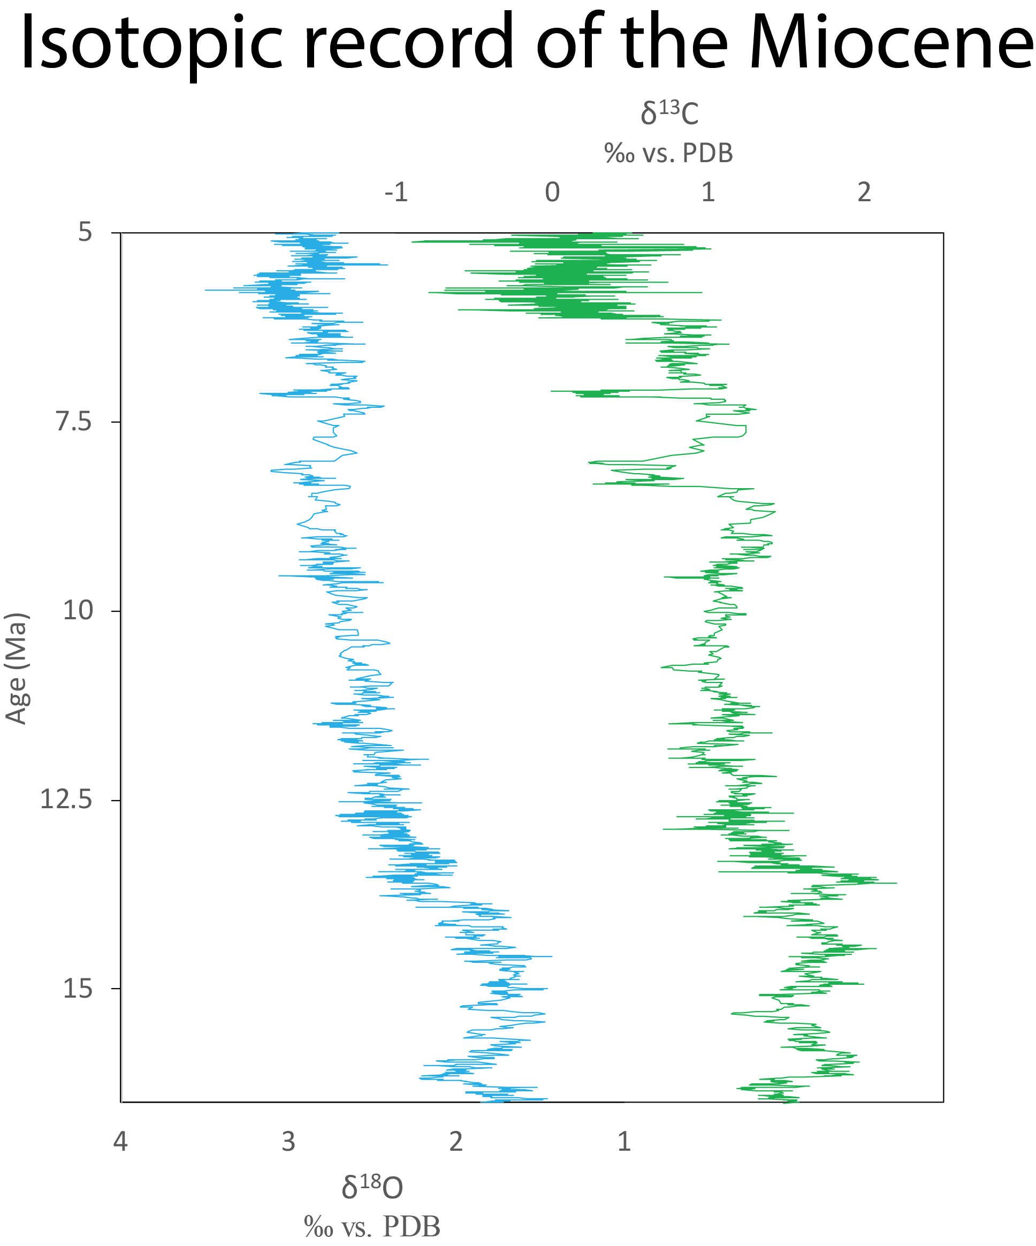
Introduction: Miocene climate and the Monterey Formation
Mid-late Miocene: development of permanent polar ice sheets
Thermohaline circulation
Strong upwelling currents
Diatom productivity
Monterey Hypothesis?
Monterey Formation (16.5-5 Ma)
Organic-rich
Oxic-anoxic cycles
Lithologic heterogeneity
Data from Zachos et al. (2001)

Slide 4
Monterey stratigraphy
Figure from Mosher (2013)

Slide 5
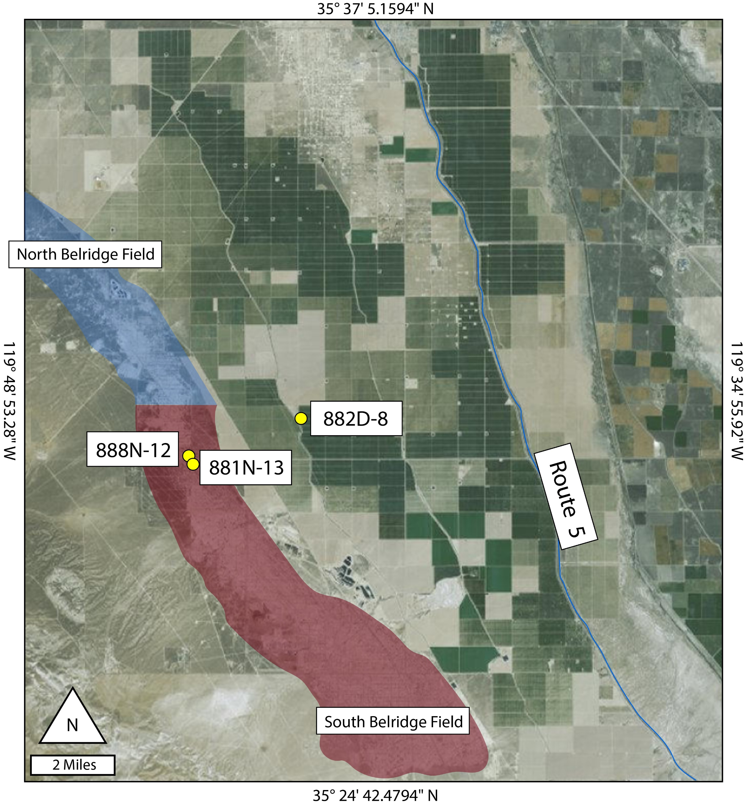
Materials
Cuttings from 3 wells
Courtesy of Aera Energy
888N-12 and 881N-13:
Belridge anticline
Thorndyke (882D-8):
Off of anticline
Comprehensive well log suite
Core
XRF
Source rock eval
Photos
Parallel studies

Slide 6
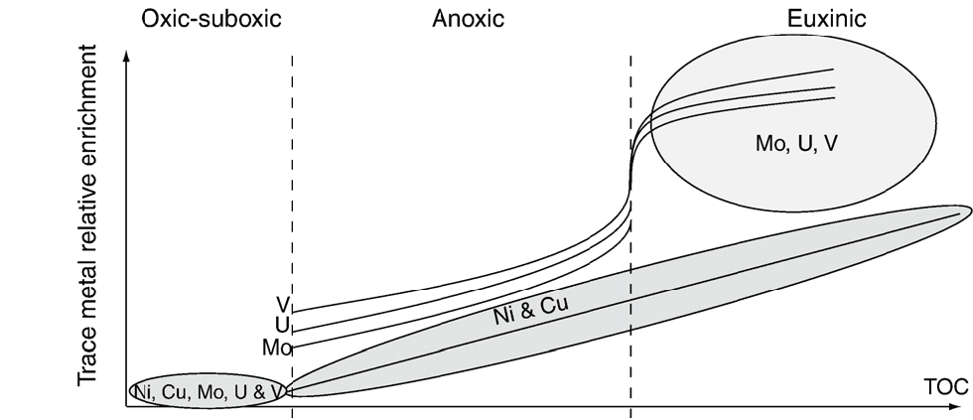
Methods
Trace elemental analysis
Proxies for paleoenvironmental conditions
Redox: Mo, V, U
Productivity: Ni, Cu, Cd, Ba
Detrital content: Ti, Th
Analyzed at UCR
Total rock digest
Samples run on ICP-MS
TOC/TIC
Measure TC via combustion, then TIC via acidification
Figure from Tribovillard et al. (2006)

Slide 7
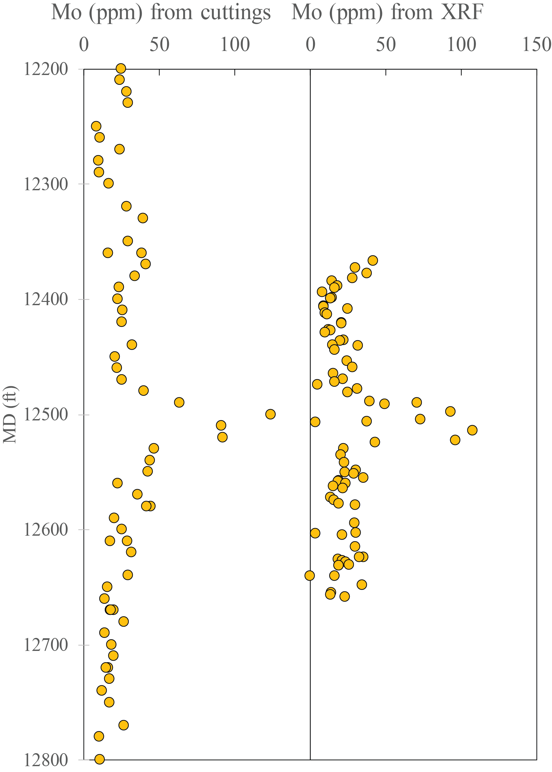
Methods
Comparison:
Cuttings can capture same events as cores
XRF and trace metal analysis are qualitatively similar
Cuttings can be thought of as roughly averaging over an interval

Slide 8
Thorndyke

Slide 9
Thorndyke
Molybdenum can be normalized to Al to account for sedimentation rate
TOC can help determine productivity/redox interplay

Slide 10
Thorndyke

Slide 11
Thorndyke

Slide 12
Thorndyke

Slide 13
Thorndyke

Slide 14
Thorndyke

Slide 15
881N-13

Slide 16
888N-12

Slide 17
Correlation
Anoxia, more reactive iron, moderate productivity
No major enrichment
Minor enrichment in some proxies, esp. Ni
Anoxia, high productivity + U
Euxinia, high productivity
Moderate productivity, dolomitic
Moderate productivity, phosphatic

Slide 18
Discussion
McDonald is moderately productive, suboxic
Dolomitic member in Thorndyke absent in shallower wells
Antelope contains several potential anoxic events that are correlative
Enrichment in trace metals in upper Antelope
May help resolve Antelope/Reef Ridge transition

Slide 19
Discussion
XRF of cores compares favorably to TMD analysis of cuttings
Organic-rich sediments are enriched in trace metals, have discrete intervals indicative of anoxia
Anoxic events may be correlative across basin
Subtle differences in trace elemental profiles may be due to depositional environment
Need to establish age controls, sedimentation rates to confirm
Discrepancy between proxies could be used to infer which anoxic events are driven by productivity vs. basin restriction
Pyrite ECS/Litho Scanner log interpretation may be enhanced with trace element analysis

Slide 20
Acknowledgments
MARS team
MARS Affiliates’ support
Tim Lyons’ lab at UCR
Aera Energy LLC

Slide 21
References
Mosher, A., 2013, Detailed lithostratigraphic characterization of Chico Martinez Creek, California, M.S.: United States -- California, California State University, Long Beach, 130 p.
Graham, S. A., and L. A. Williams, 1985, Tectonic, Depositional, and Diagenetic History of Monterey Formation (Miocene), Central San Joaquin Basin, California: AAPG Bulletin, v. 69, no. 3, p. 385–411.
Isaacs, C. M., 1983, Compositional Variation and Sequence in the Miocene Monterey Formation, Santa Barbara Coastal Area, California: Cenozoic marine sedimentation, Pacific margin: Pacific Section, Society of Economic Paleontologists and Mineralogists Special Publication 28, p. 117–132
Mosher, A., 2013, Detailed lithostratigraphic characterization of Chico Martinez Creek, California, M.S.: United States -- California, California State University, Long Beach, 130 p.
Pisciotto, K. A., and R. E. Garrison, 1981, Lithofacies and Depositional Environments of the Monterey Formation, California: The Monterey Formation and related siliceous rocks of California: Los Angeles, Pacific Section, Society of Economic Paleontologists and Mineralogists, p. 97–122
Tribovillard, N., T. J. Algeo, T. Lyons, and A. Riboulleau, 2006, Trace metals as paleoredox and paleoproductivity proxies: An update: Chemical Geology, v. 232, no. 1–2, p. 12–32,
Zachos, J., M. Pagani, L. Sloan, E. Thomas, and K. Billups, 2001, Trends, Rhythms, and Aberrations in Global Climate 65 Ma to Present: Science, v. 292, no. 5517, p. 686–693

