Slide 1
Monterey Formation Overview, California, USA
Richard Behl
Professor of Geology & Director: Monterey and Related Sediments California State Univ. Long Beach

Slide 2
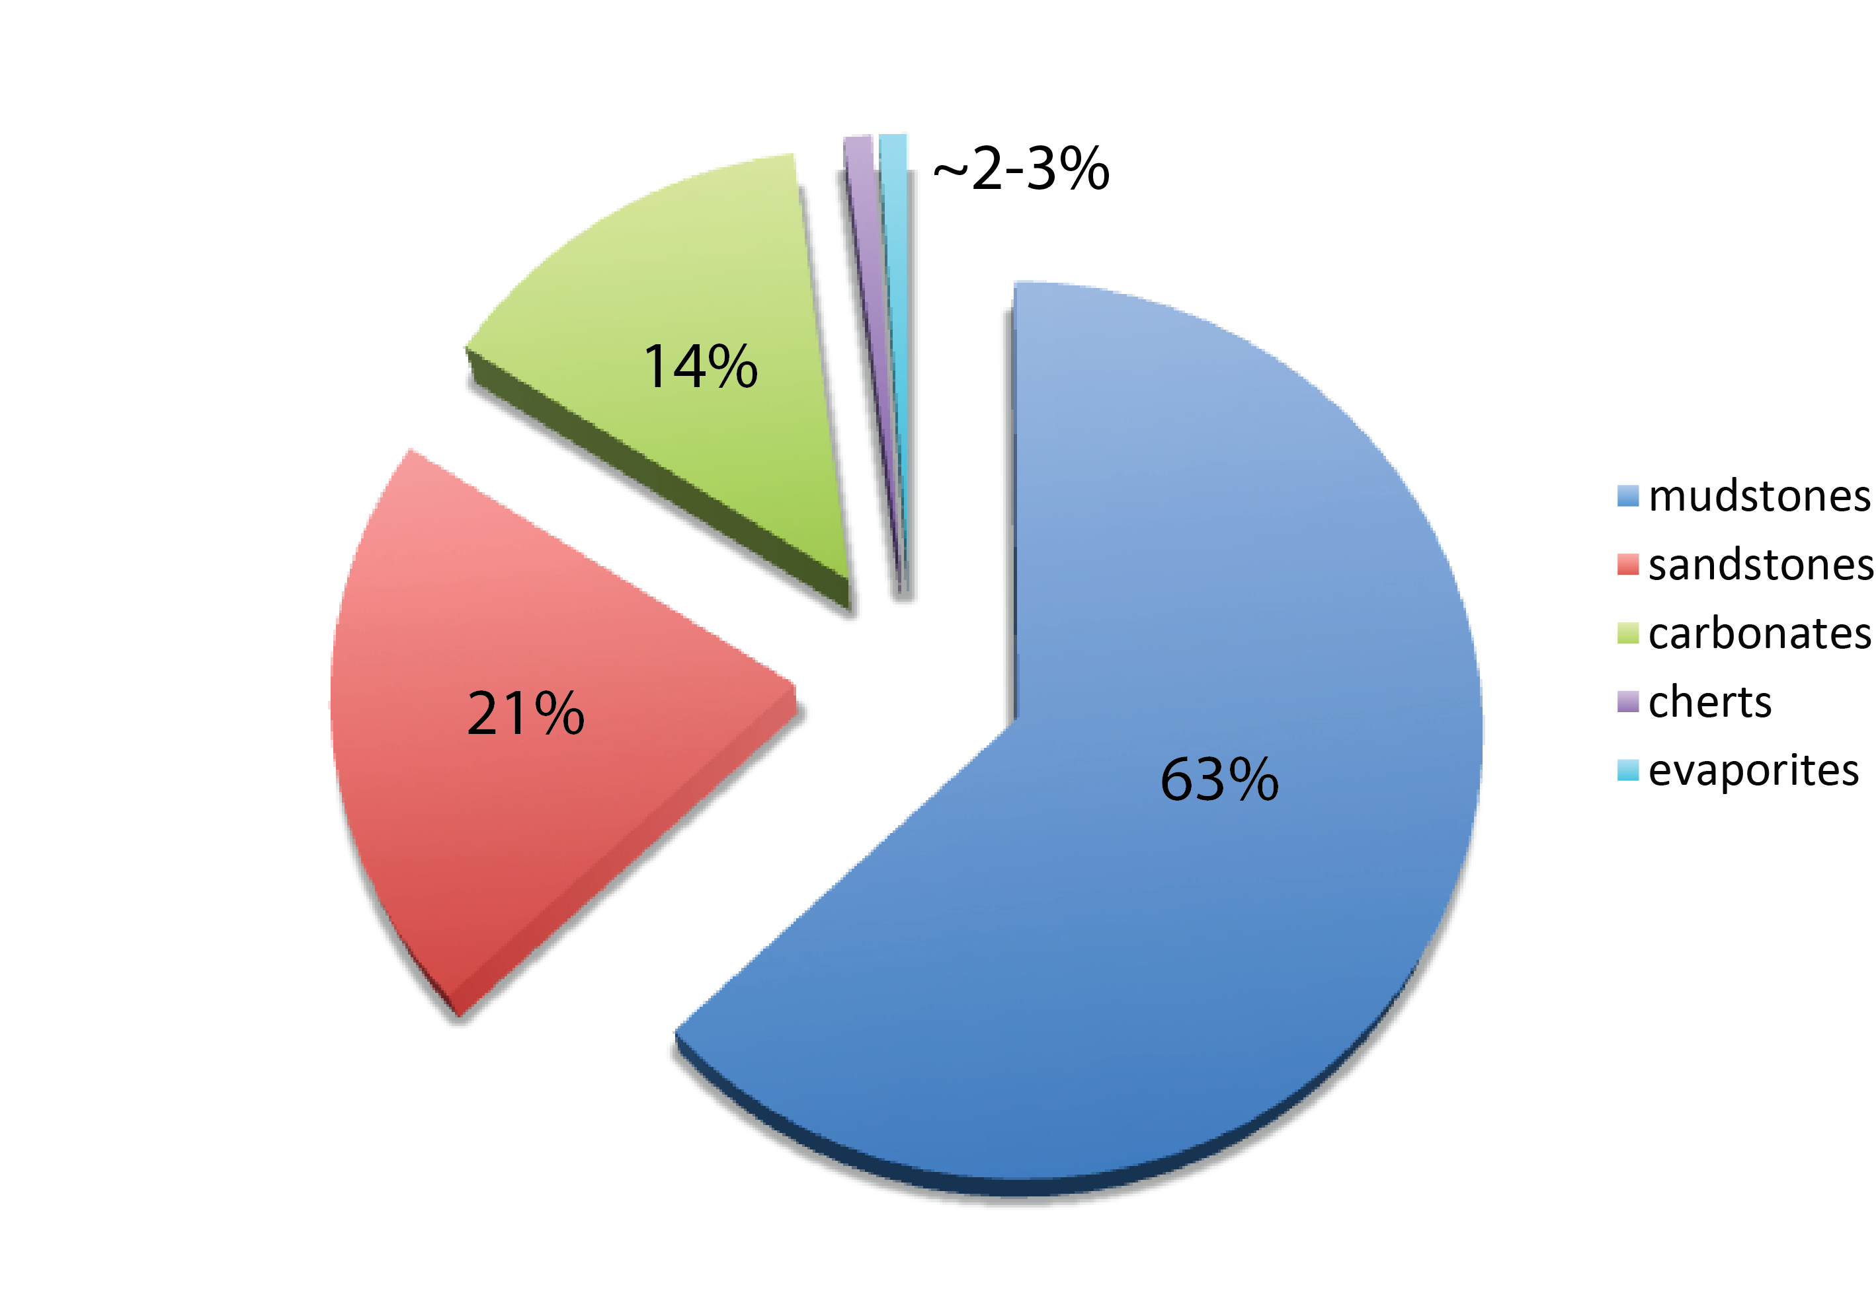
Sedimentary Rocks on Earth
siliceous rocks
Data from Railsback (1993)

Slide 3
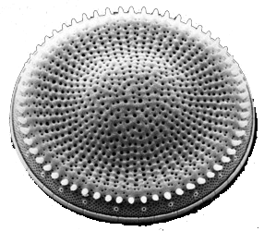
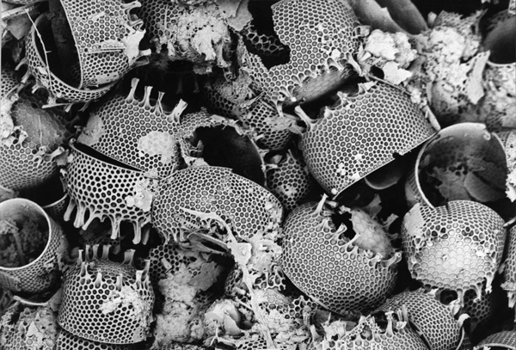
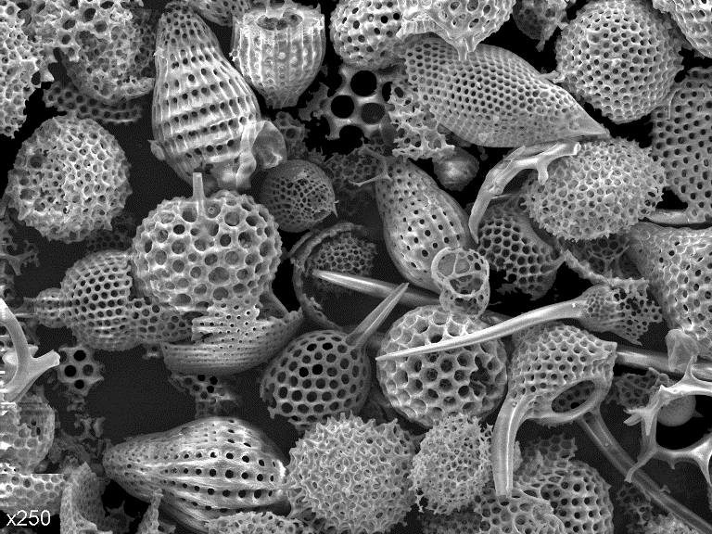
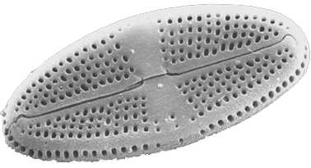
Siliceous Plankton:
Diatoms & Radiolarians

Slide 4
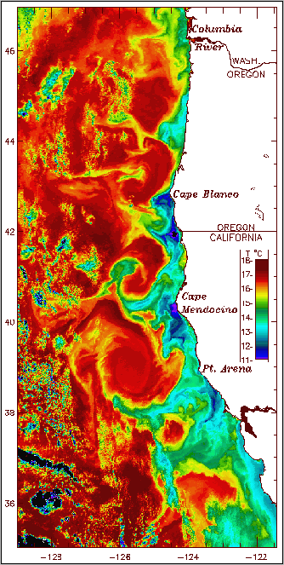
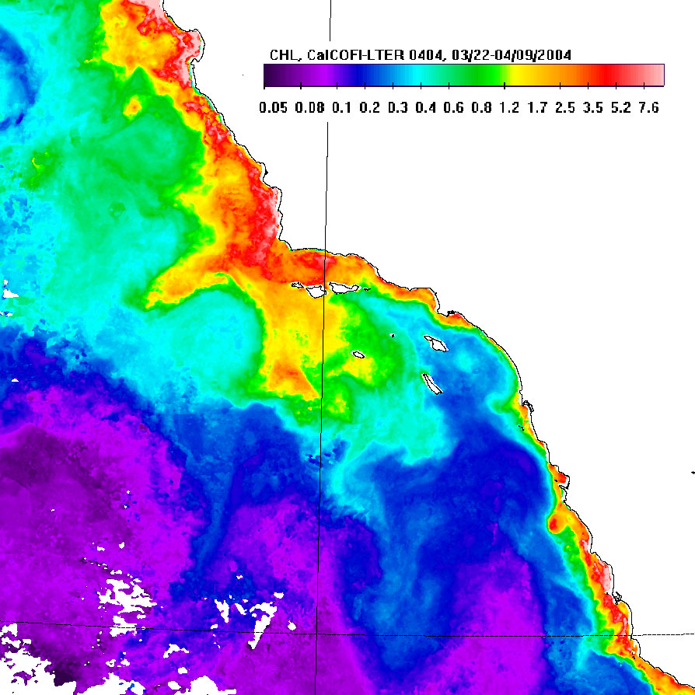
Coastline control of distribution of upwelling cold & nutrient-rich water
after Roesler & Chelton, 1987
Red = chlorophyl-rich
Blue = cold water

Slide 5
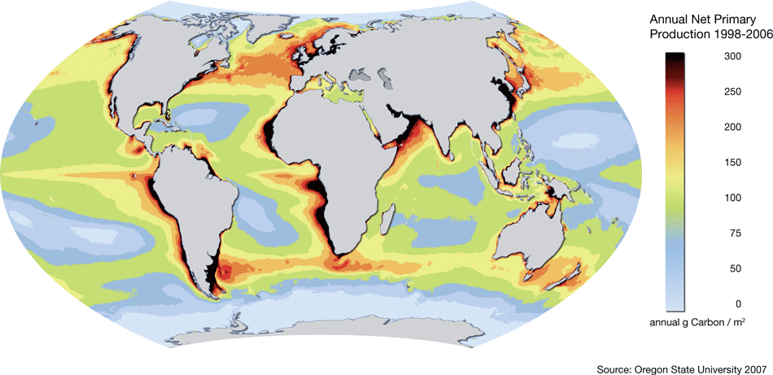
Oceanic Production of Biomass by Photosynthesis (mostly diatoms)

Slide 6
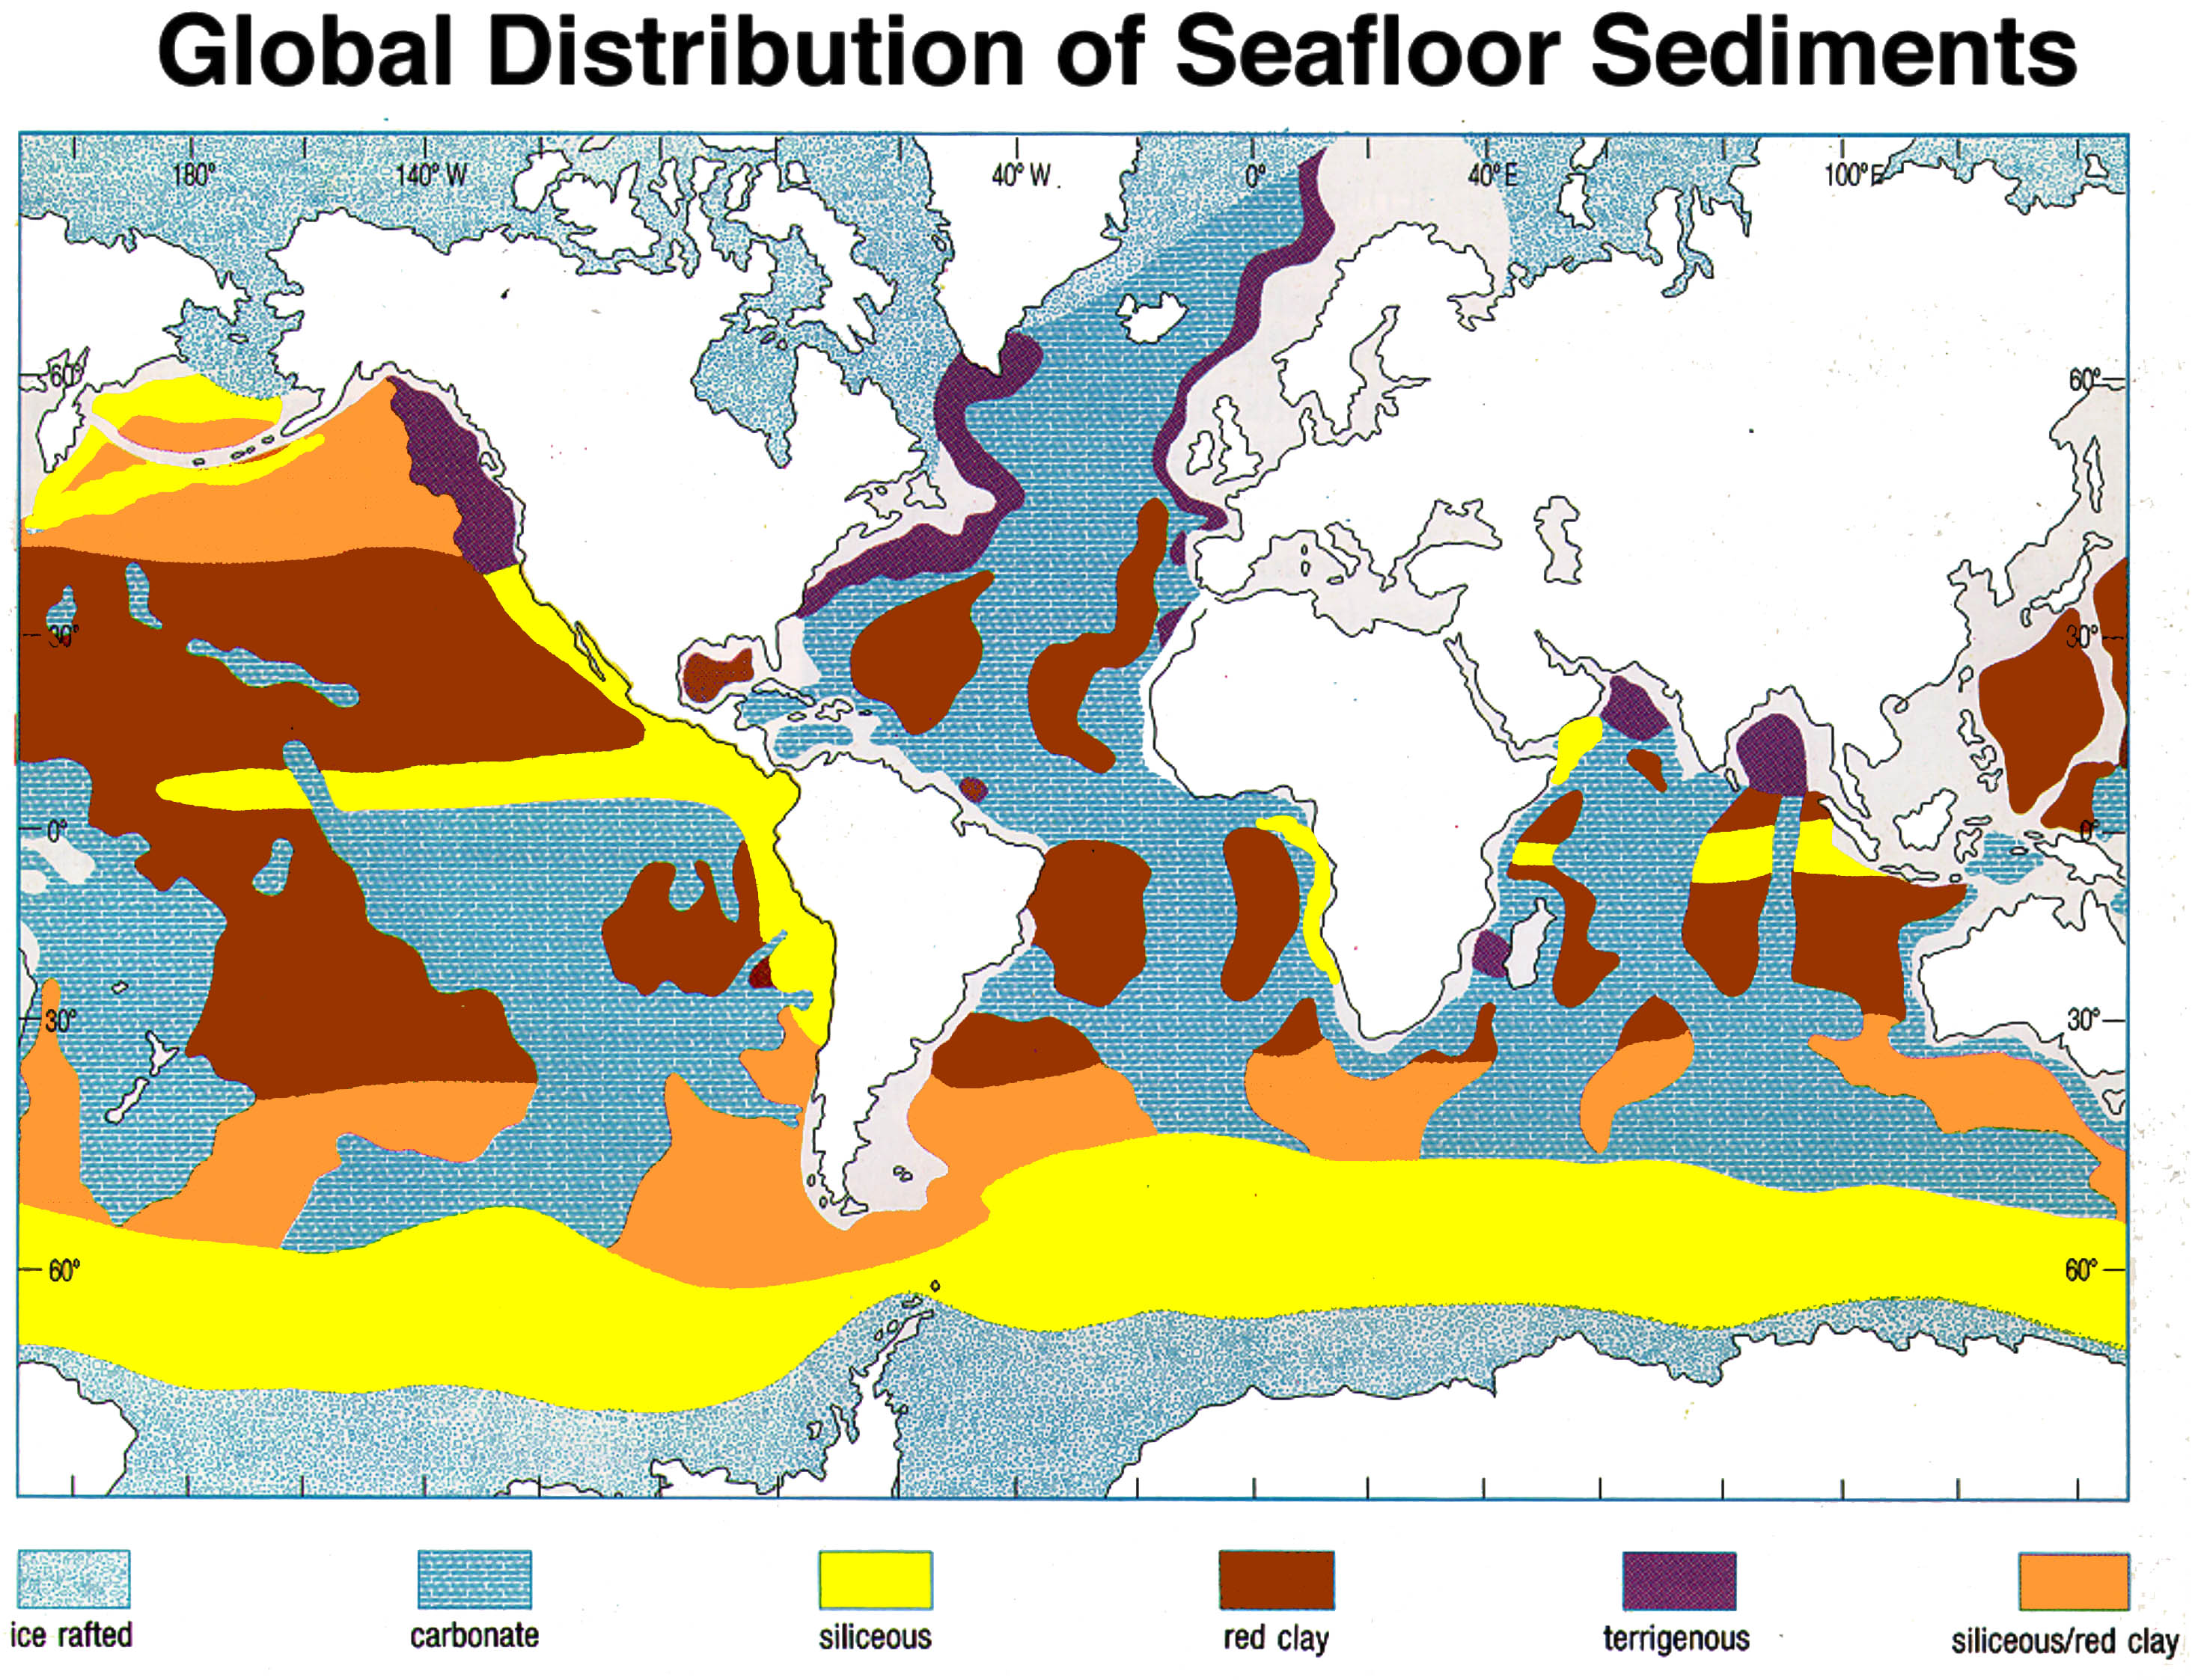

Slide 7
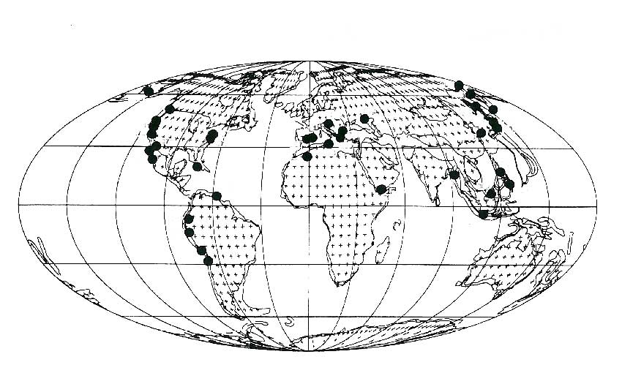
Global Distribution of Neogene Marginal Diatomaceous Sediments:
Behl (2016); modified from Hein & Parrish (1987) and other authors

Slide 8
Monterey Formation
Unconventional reservoir rock
Chiefly conventional production
Naturally Fractured Reservoirs
Tremendous lithologic heterogeneity
Laminations – beds – members
Great outcrop exposures
Range of stress/strain conditions
A natural laboratory for “shales”

Slide 9
Miocene Monterey Formation
Important source & reservoir of oil
Important link to Tertiary climate change
Characteristic sedimentology
Hemipelagic, thin-bedded, laminated
Siliceous
Organic-rich
Age: approximately 17-5 Ma
Related facies span the Pacific Rim

Slide 10
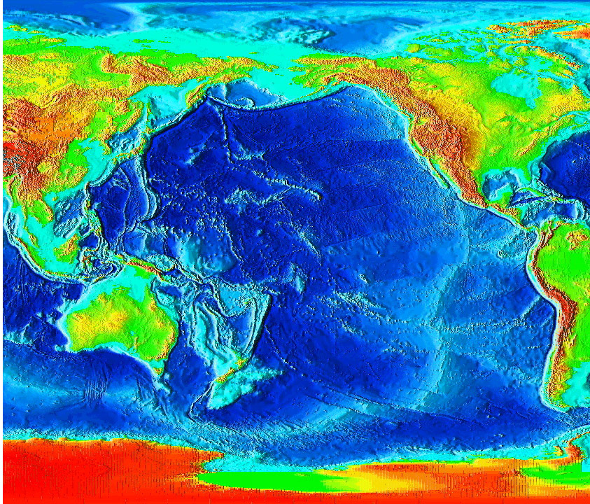
Circum-Pacific “Monterey” facies

Slide 11
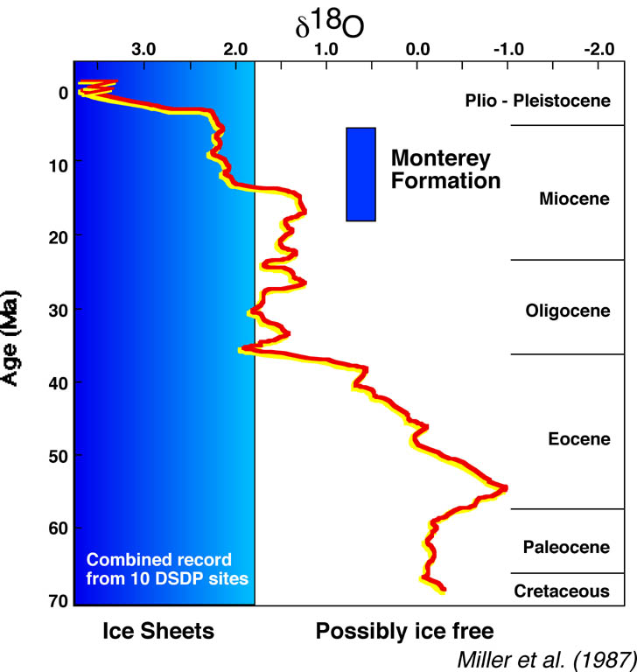
Cenozoic Climate Transition

Slide 12
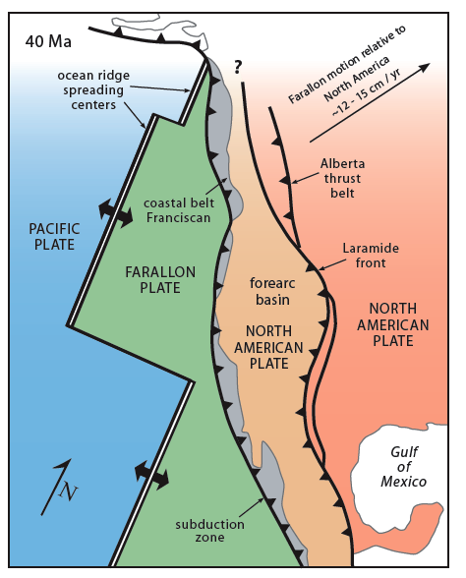
Mid-Miocene tectonic shift from convergent to transform margin formed numerous restricted and silled basins
Dickinson (1979)

Slide 13
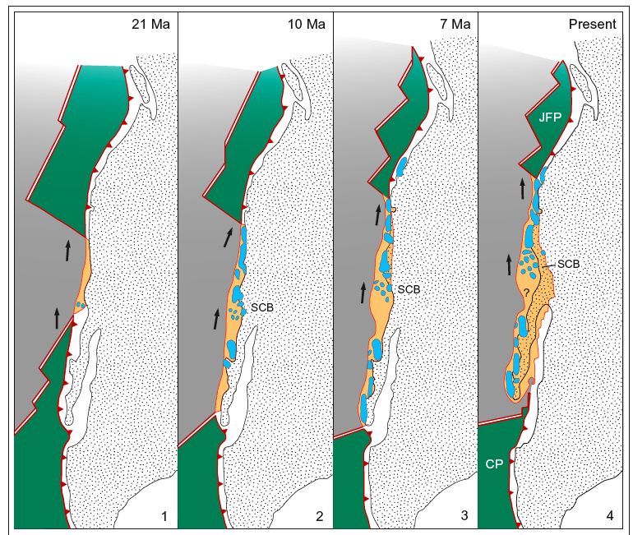
Blake et al. (1978)

Slide 14
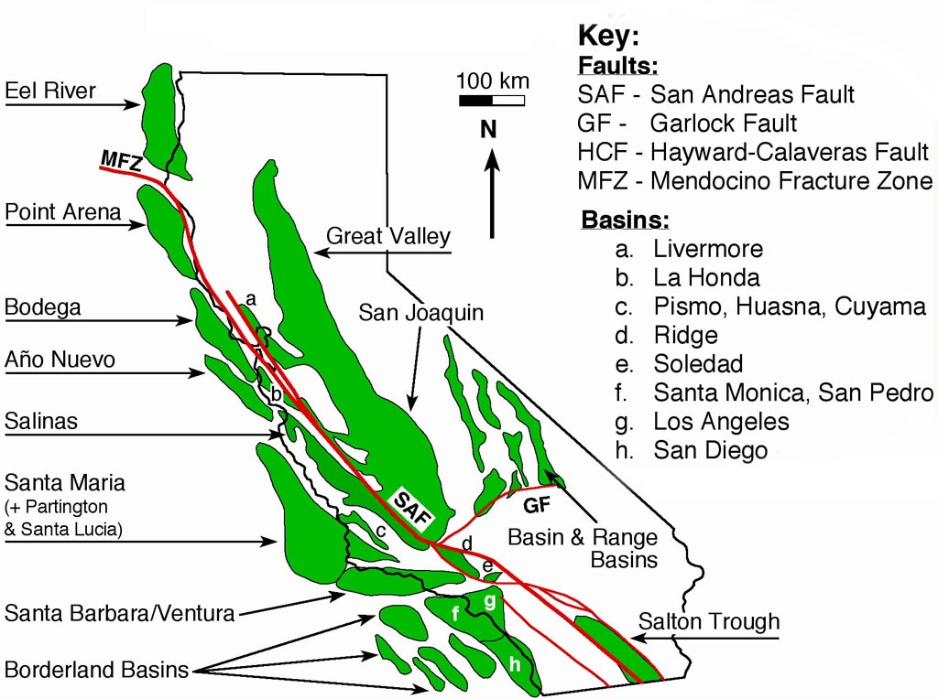

Slide 15
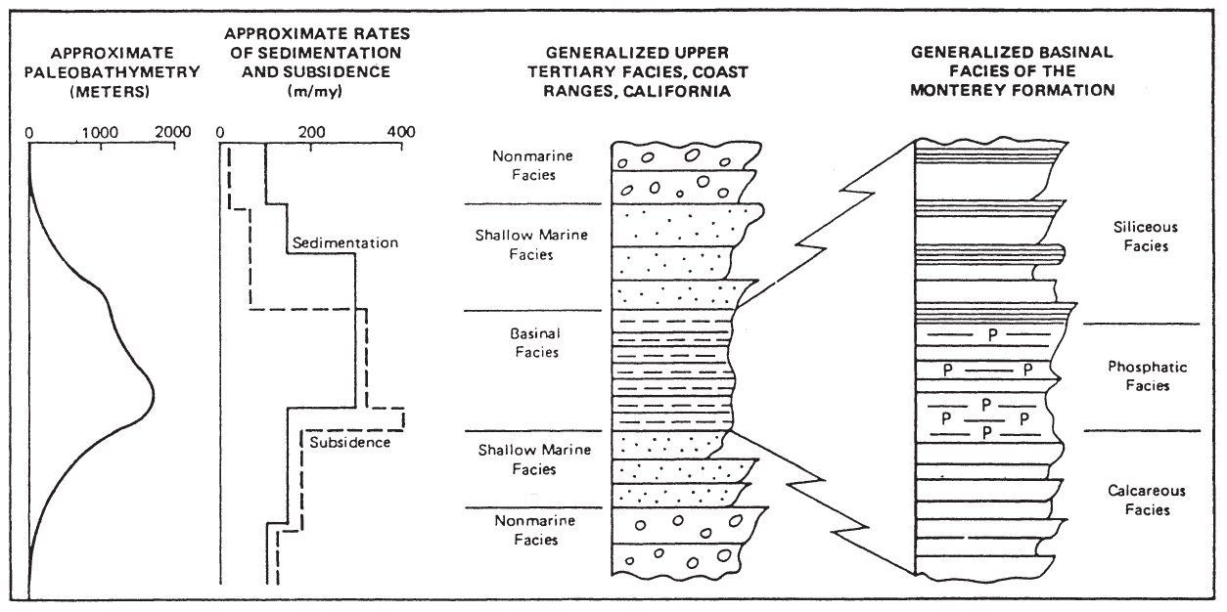
Tectonics and Stratigraphy
Generalized Basinal Facies of the Monterey Formation
Pisciotto & Garrison, 1981

Slide 16
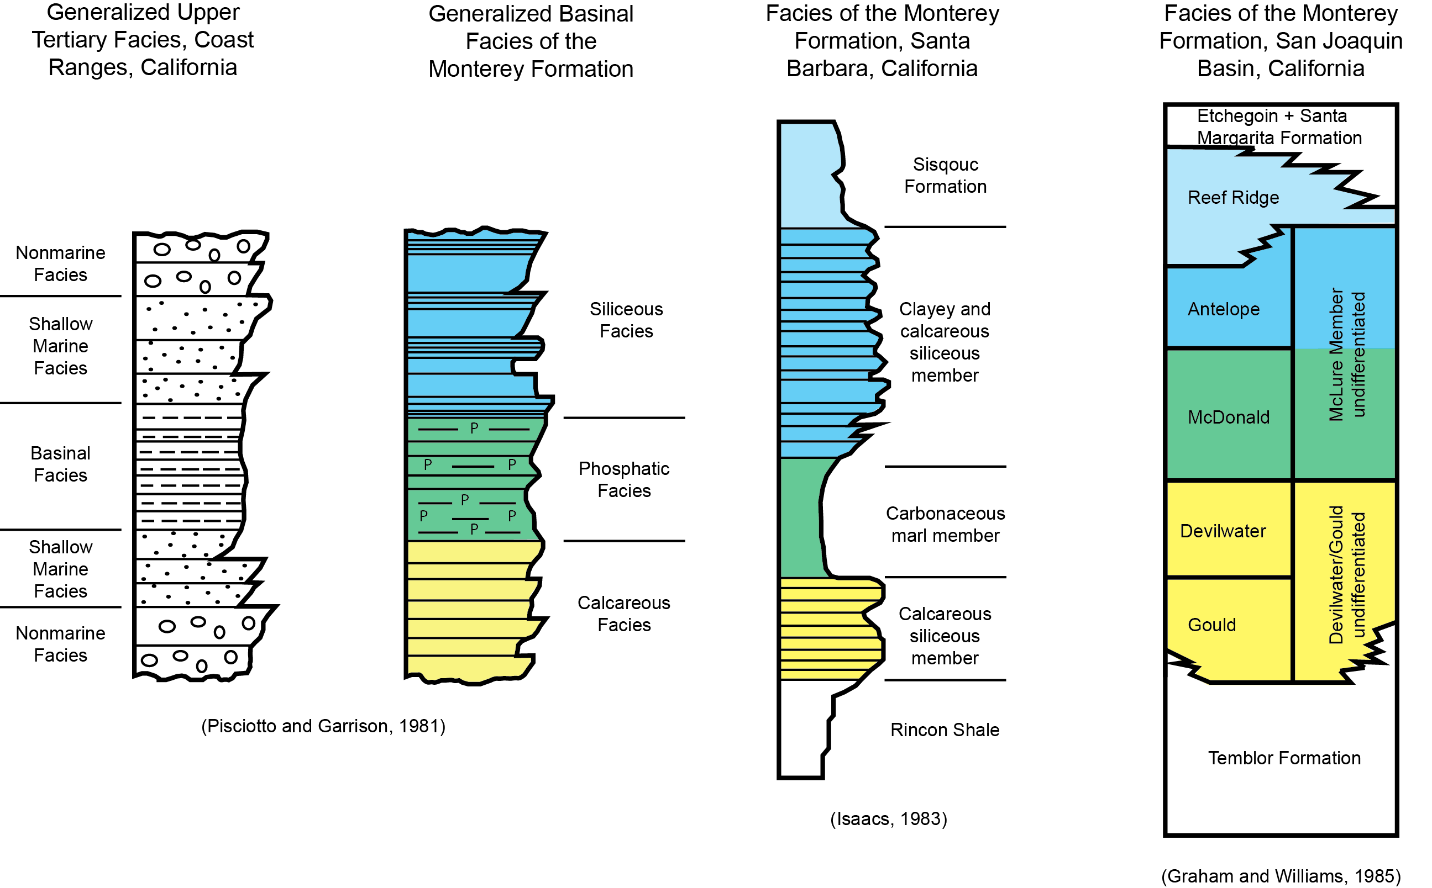
Neogene Basinal Stratigraphy
Generalized Basinal Facies of the Monterey Formation

Slide 17
Main Sedimentary Components
Silica
Carbonate
Organic matter
Phosphate
Detritus (clay, silt & sand)
High diagenetic potential of silica, carbonate, phosphate & organic matter

Slide 18
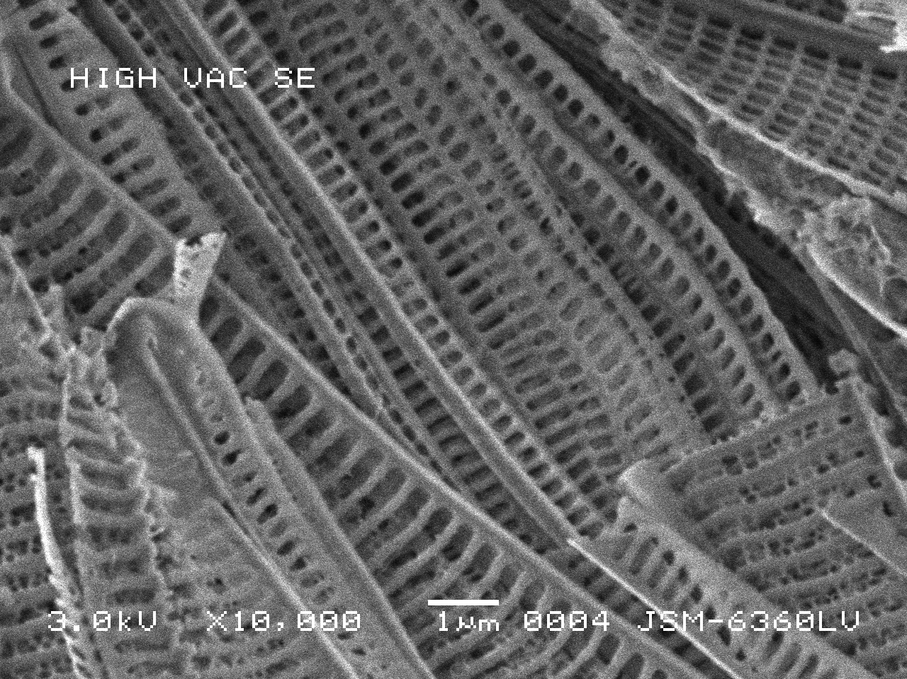
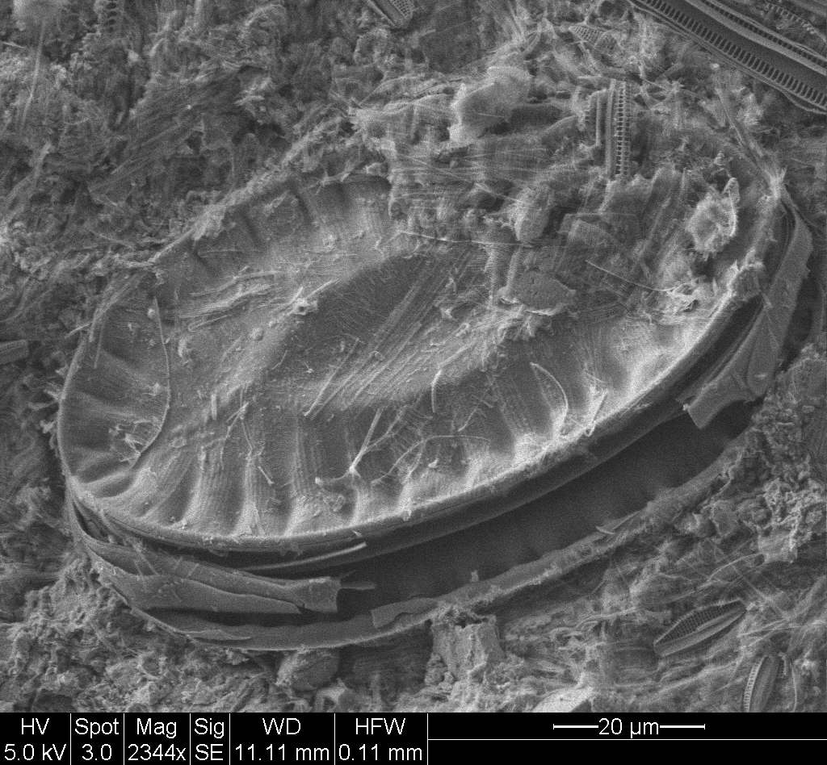
Diatoms

Slide 19
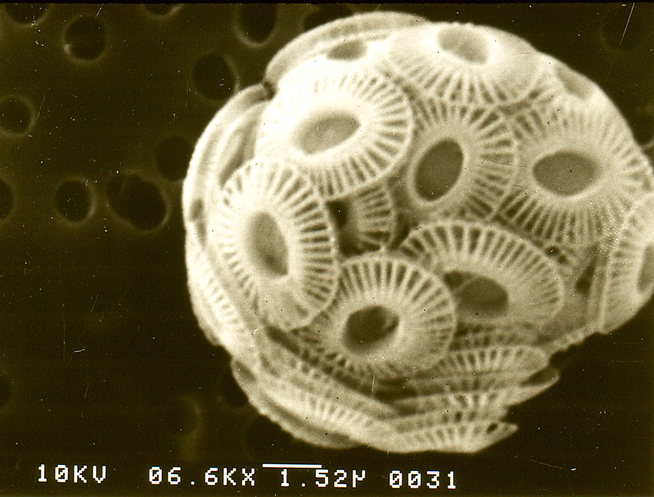
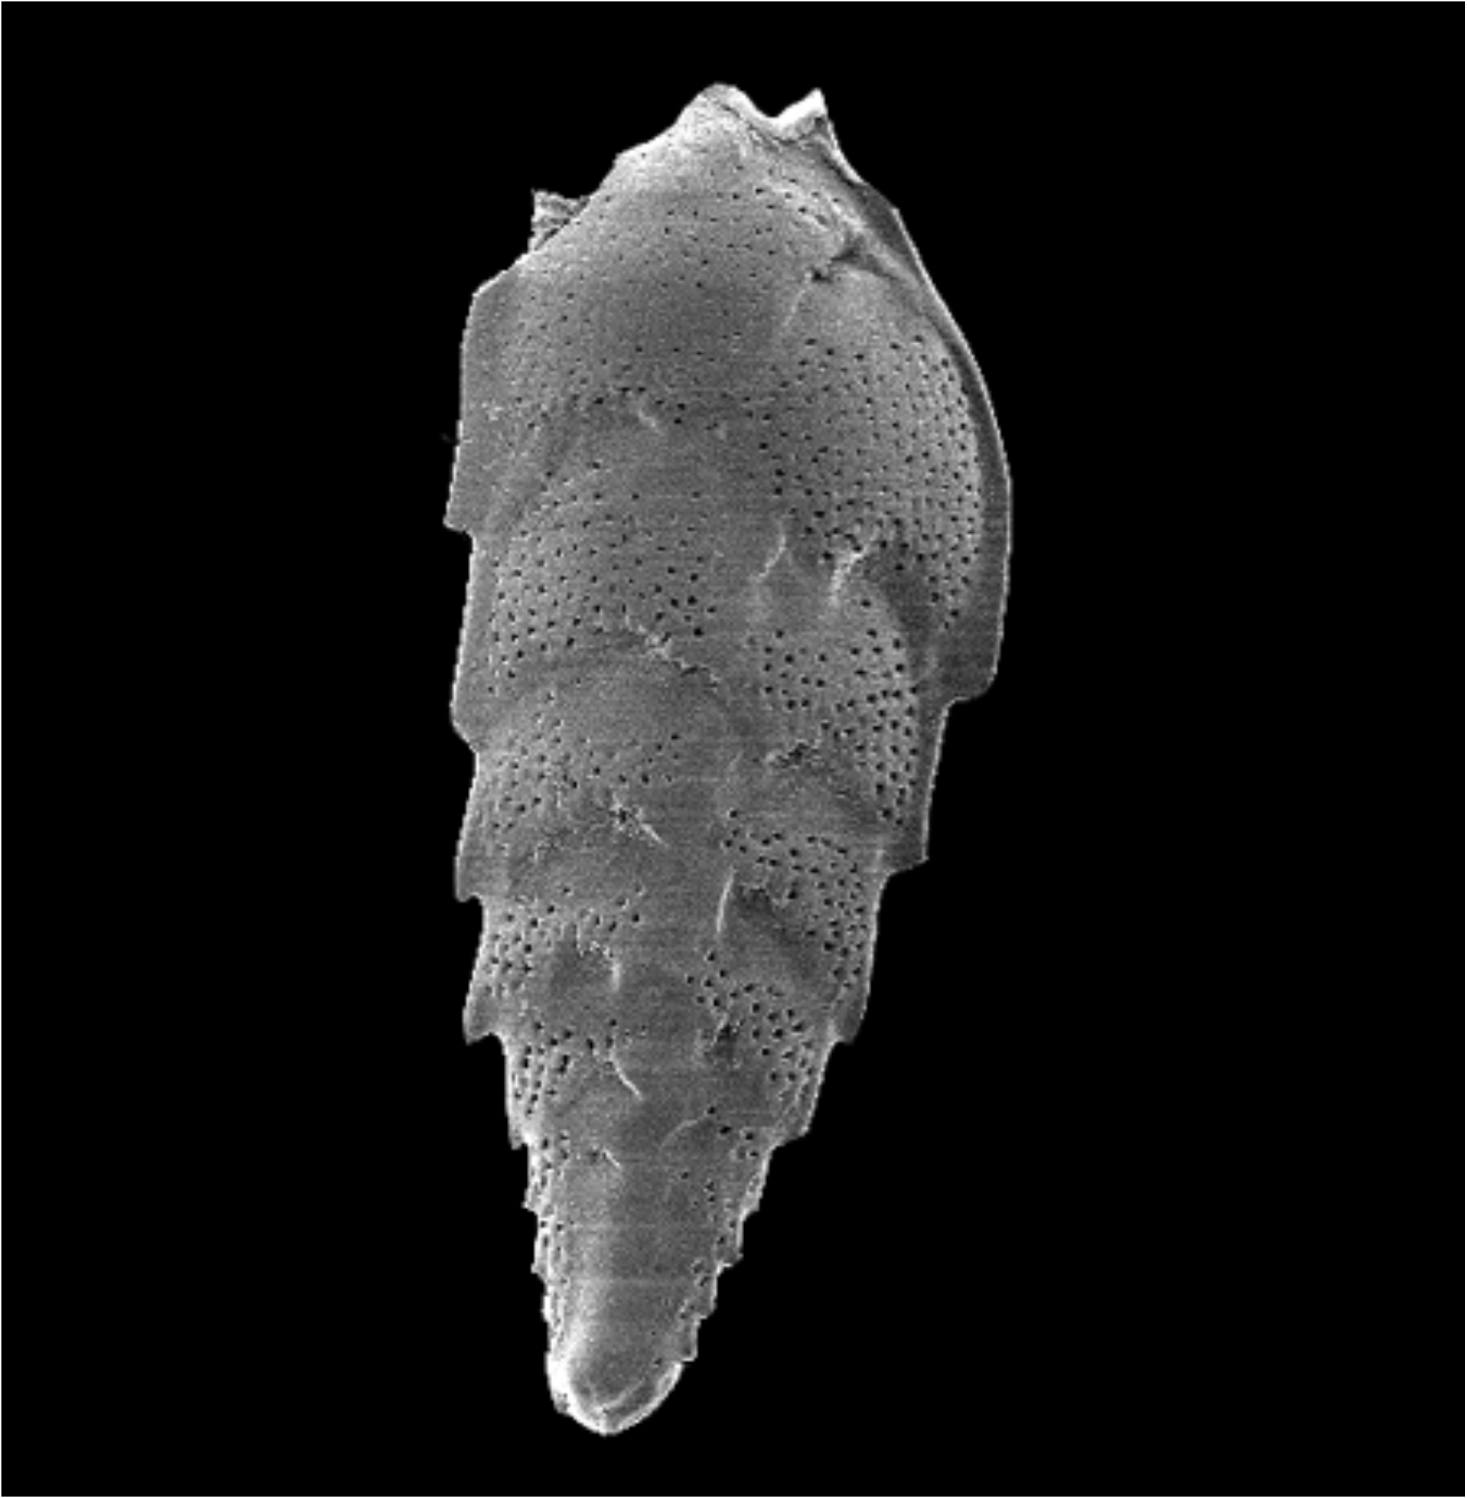
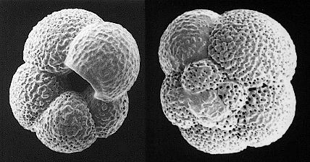
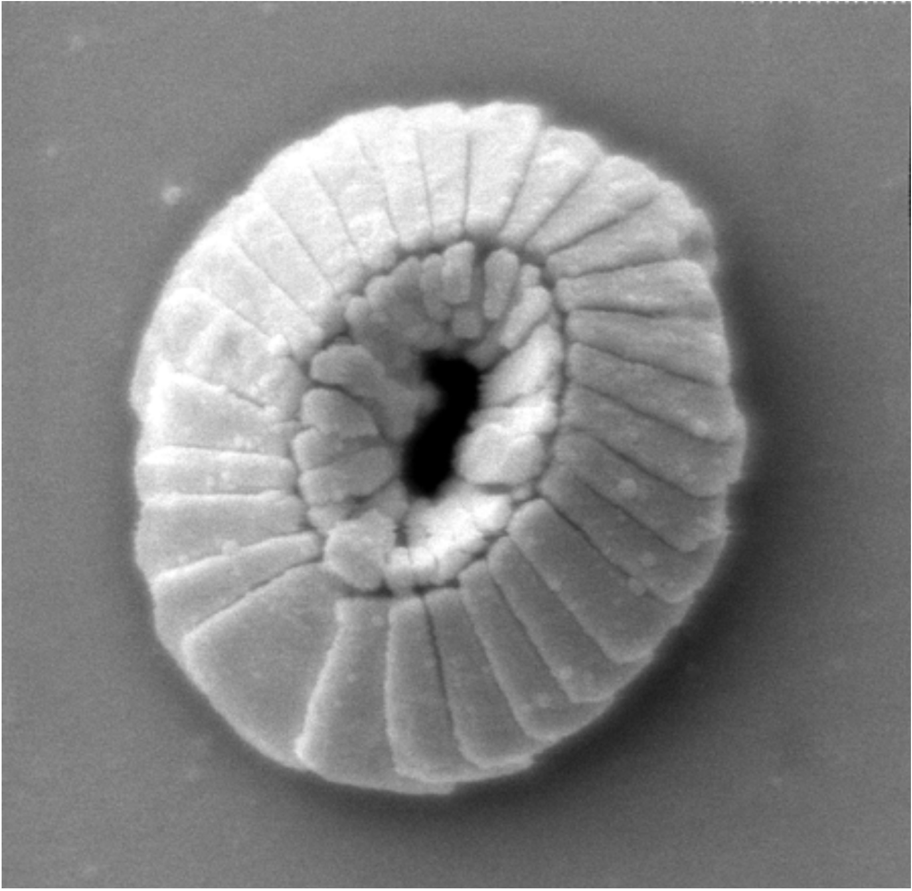
Calcareous Microfossils

Slide 20
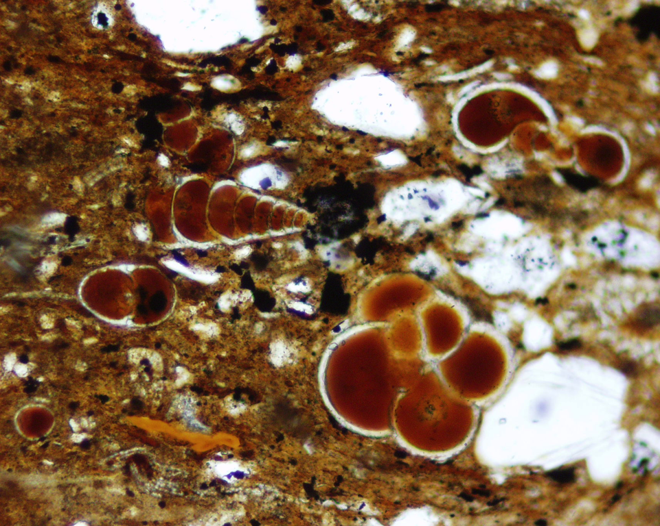
Organic Matter &
Phosphate

Slide 21
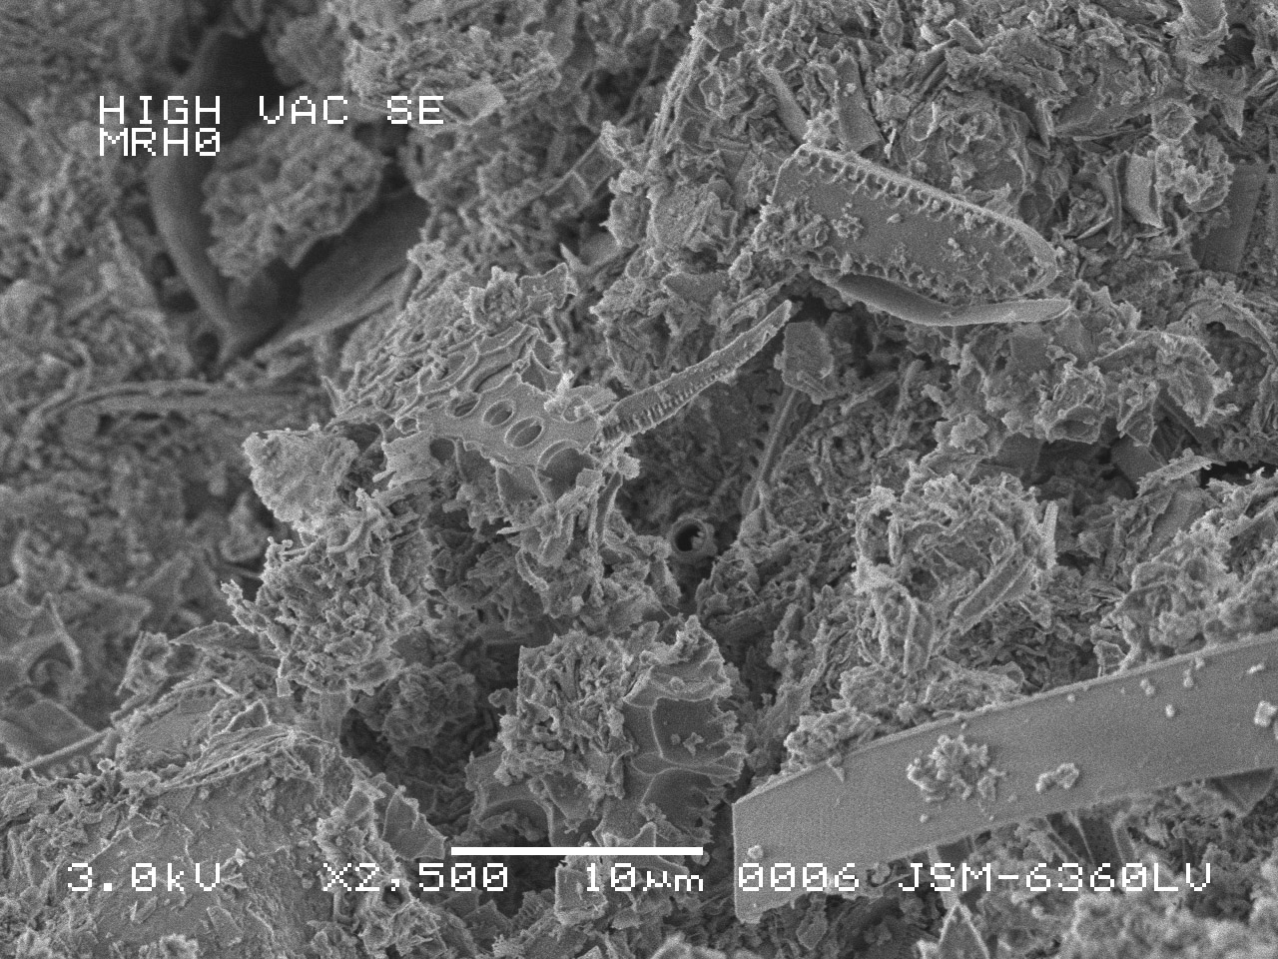
Detritus &
Diatom fragments

Slide 22
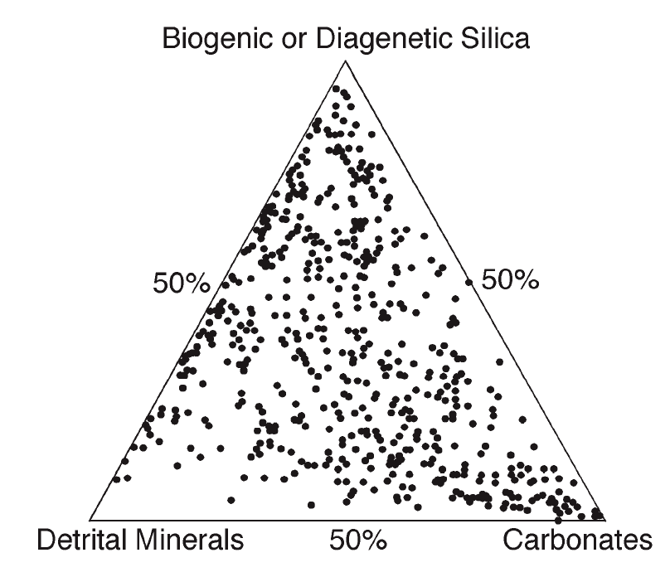
Chert
Diatomite
Monterey Formation Compositional variability
Porcelanite
Siliceous Mudstone
Mudstone/ Shale
Marl / Marlstone
Dolomite/ Limestone
Compositional data of Isaacs (1985)

Slide 23
Rock Types
Chert
Diatomite
Porcelanite
Siliceous/Diatomaceous Shale/Mudstone
Shale/Mudstone (generally sparsely siliceous)
(Also: Calcareous, Dolomitic)
Phosphatic Shale
Dolostone/Limestone/Marlstone
Siltstone/Sandstone
Silica

Slide 24
Silica Diagenesis
2-step dissolution/reprecipitation:
Opal-A
Opal-CT
Quartz
Time +/or Temperature
Siever (1983)

Slide 25
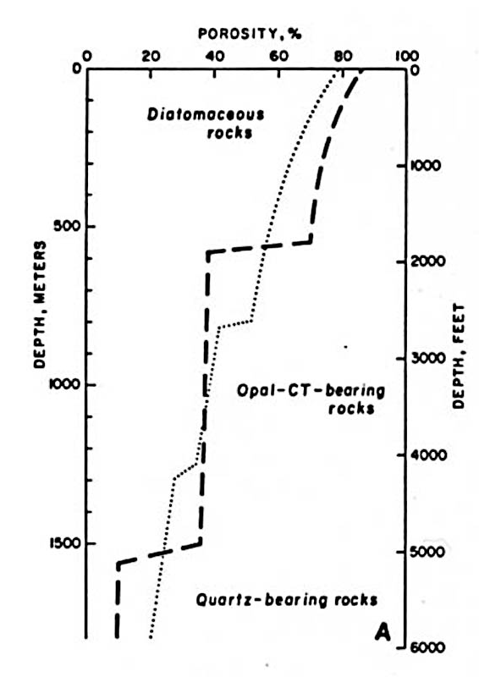
Stepped decreases in porosity at transition zones with progressive burial
Isaacs, 1981; after Hamilton, 1976

Slide 26
Typical reservoir parameters of opal-A, opal-CT and quartz phase rocks (low-detritus siliceous rocks)
 | Typical Porosity (%) | Grain Density (g/cc) | Permeability (air, md) | Pore-throat Diameter (microns) | Oil Saturation (%)
Opal-A | 35-70 | 1.7 - 1.9 | 1.0 - 8.0 | 0.1 - 6.0 | 40 - 65
Opal-CT | 25-40 | 2.25 - 2.35 | 0.01 - 0.1’s | 0.01 - 0.1 | 0 - 30
Quartz | 15-30 | 2.55 - 2.65 | 0.1 - 1.0’s | 0.1 - 1.0 | 30 - 60
Compiled from many workers

Slide 27
Typical reservoir parameters of opal-A, opal-CT and quartz phase rocks (low-detritus siliceous rocks)
 | Typical Porosity (%) | Grain Density (g/cc) | Permeability (air, md) | Pore-throat Diameter (microns) | Oil Saturation (%)
Opal-A | 35-70 | 1.7 - 1.9 | 1.0 - 8.0 | 0.1 - 6.0 | 40 - 65
Opal-CT | 25-40 | 2.25 - 2.35 | 0.01 - 0.1’s | 0.01 - 0.1 | 0 - 30
Quartz | 15-30 | 2.55 - 2.65 | 0.1 - 1.0’s | 0.1 - 1.0 | 30 - 60
Compiled from many workers

Slide 28
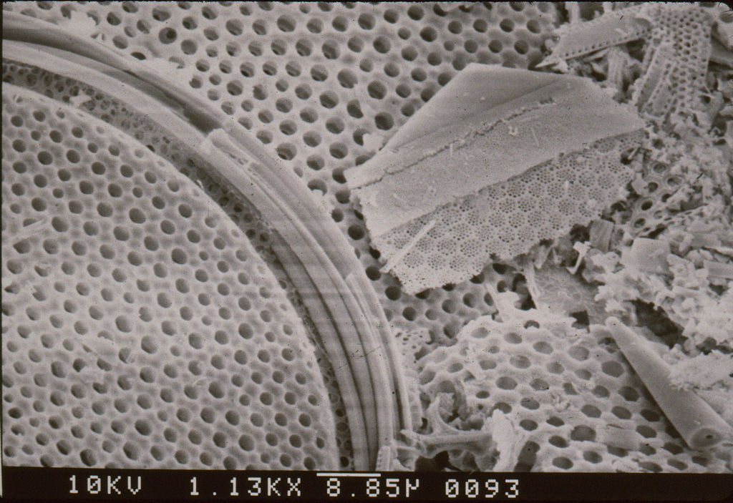
Opal-A diatomite
10 μm

Slide 29
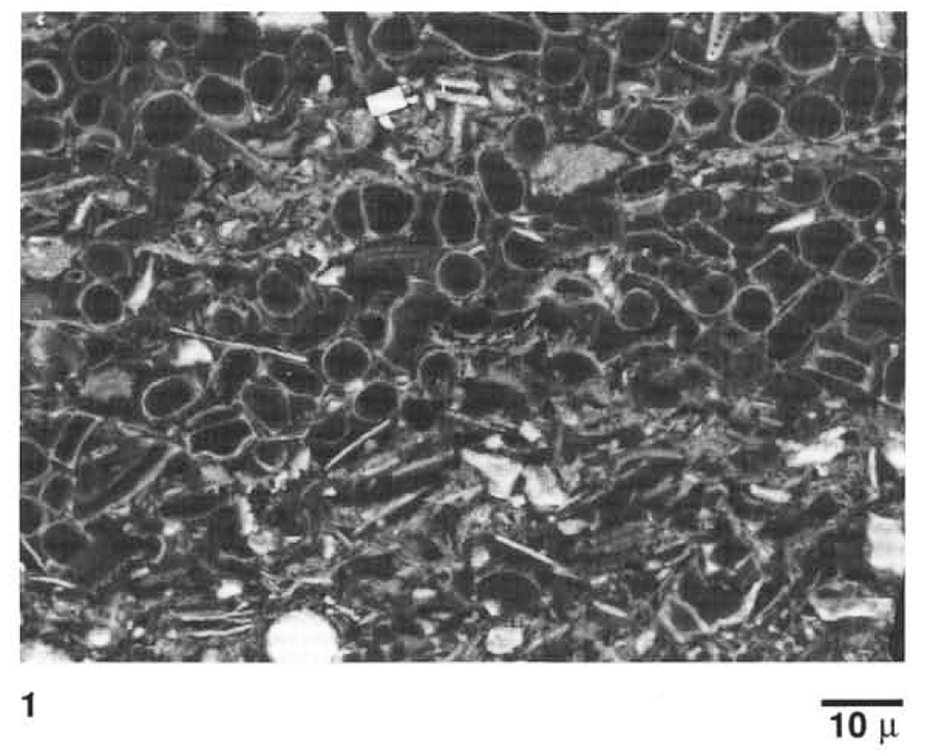
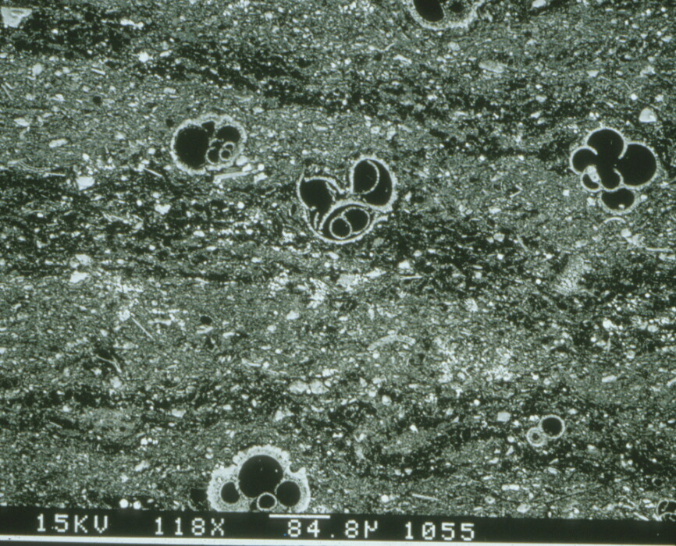
Highly porous diatomite imparts primary massive, patchy or laminated fabric
100 μm
Grimm, 1992

Slide 30
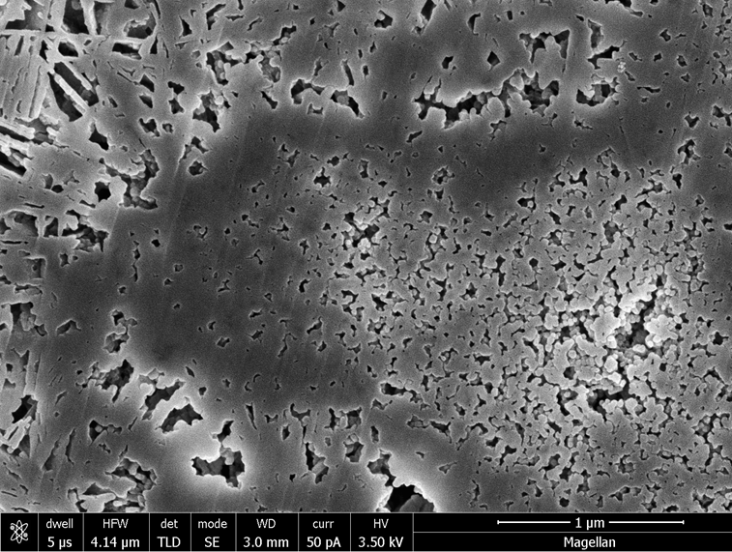
Opal-CT Porcelanite: Detrital-poor (> .75 silica:detritus)
Lepispheres with three isolated to semi-isolated porosity zones
Inter-lepisphere
Mantle
1 μm
Core
Kassa, 2016

Slide 31
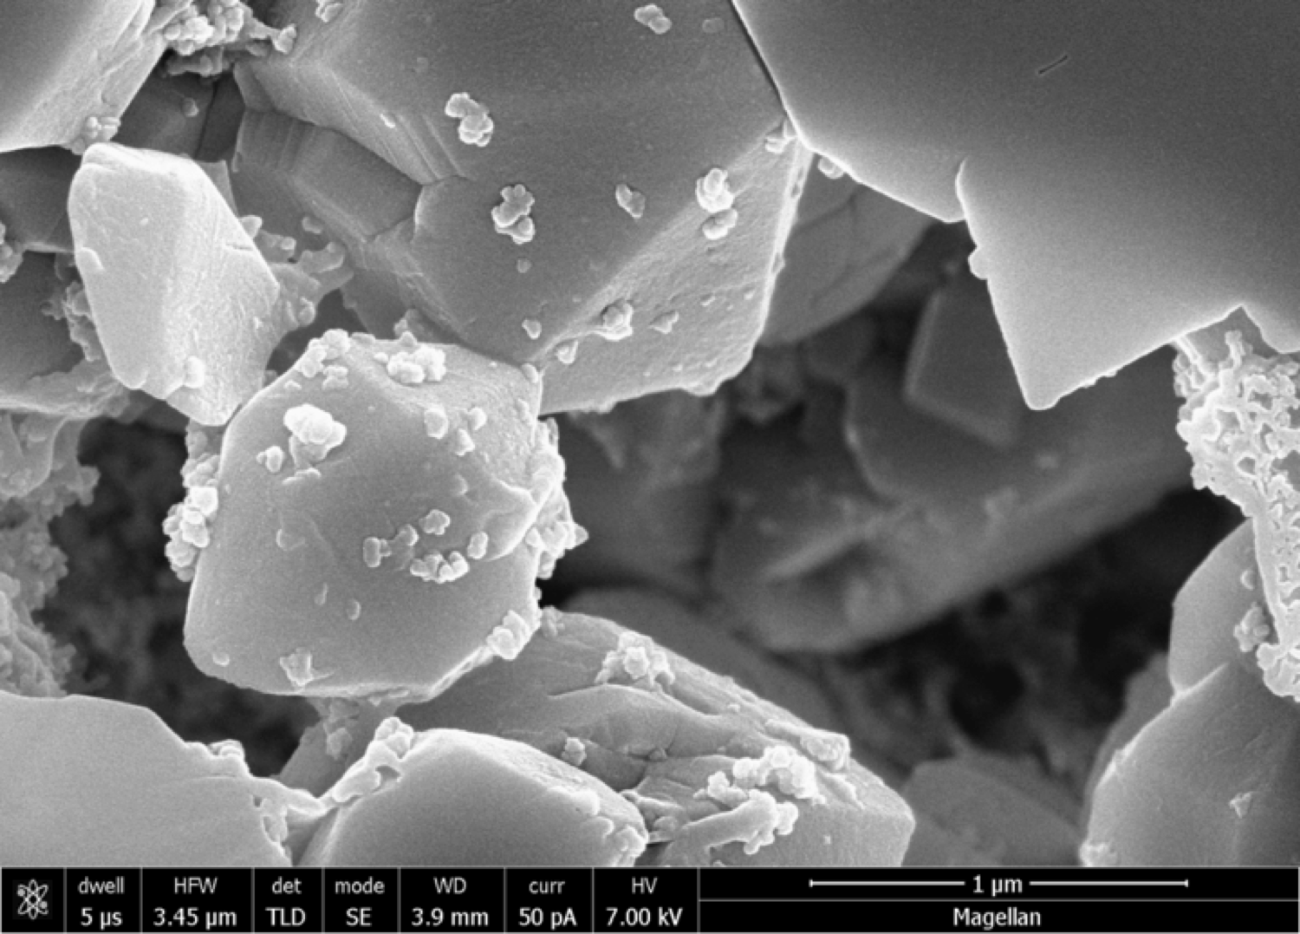
Quartz Porcelanite – equidimensional crystallites and pores

Slide 32
Total Organic Carbon (TOC)
Mostly type II kerogen - marine algae
Mostly between 2% - 6%
Highest in phosphatic shale / carbonaceous marlstone
Up to 23% TOC (34% organic matter by weight)

Slide 33
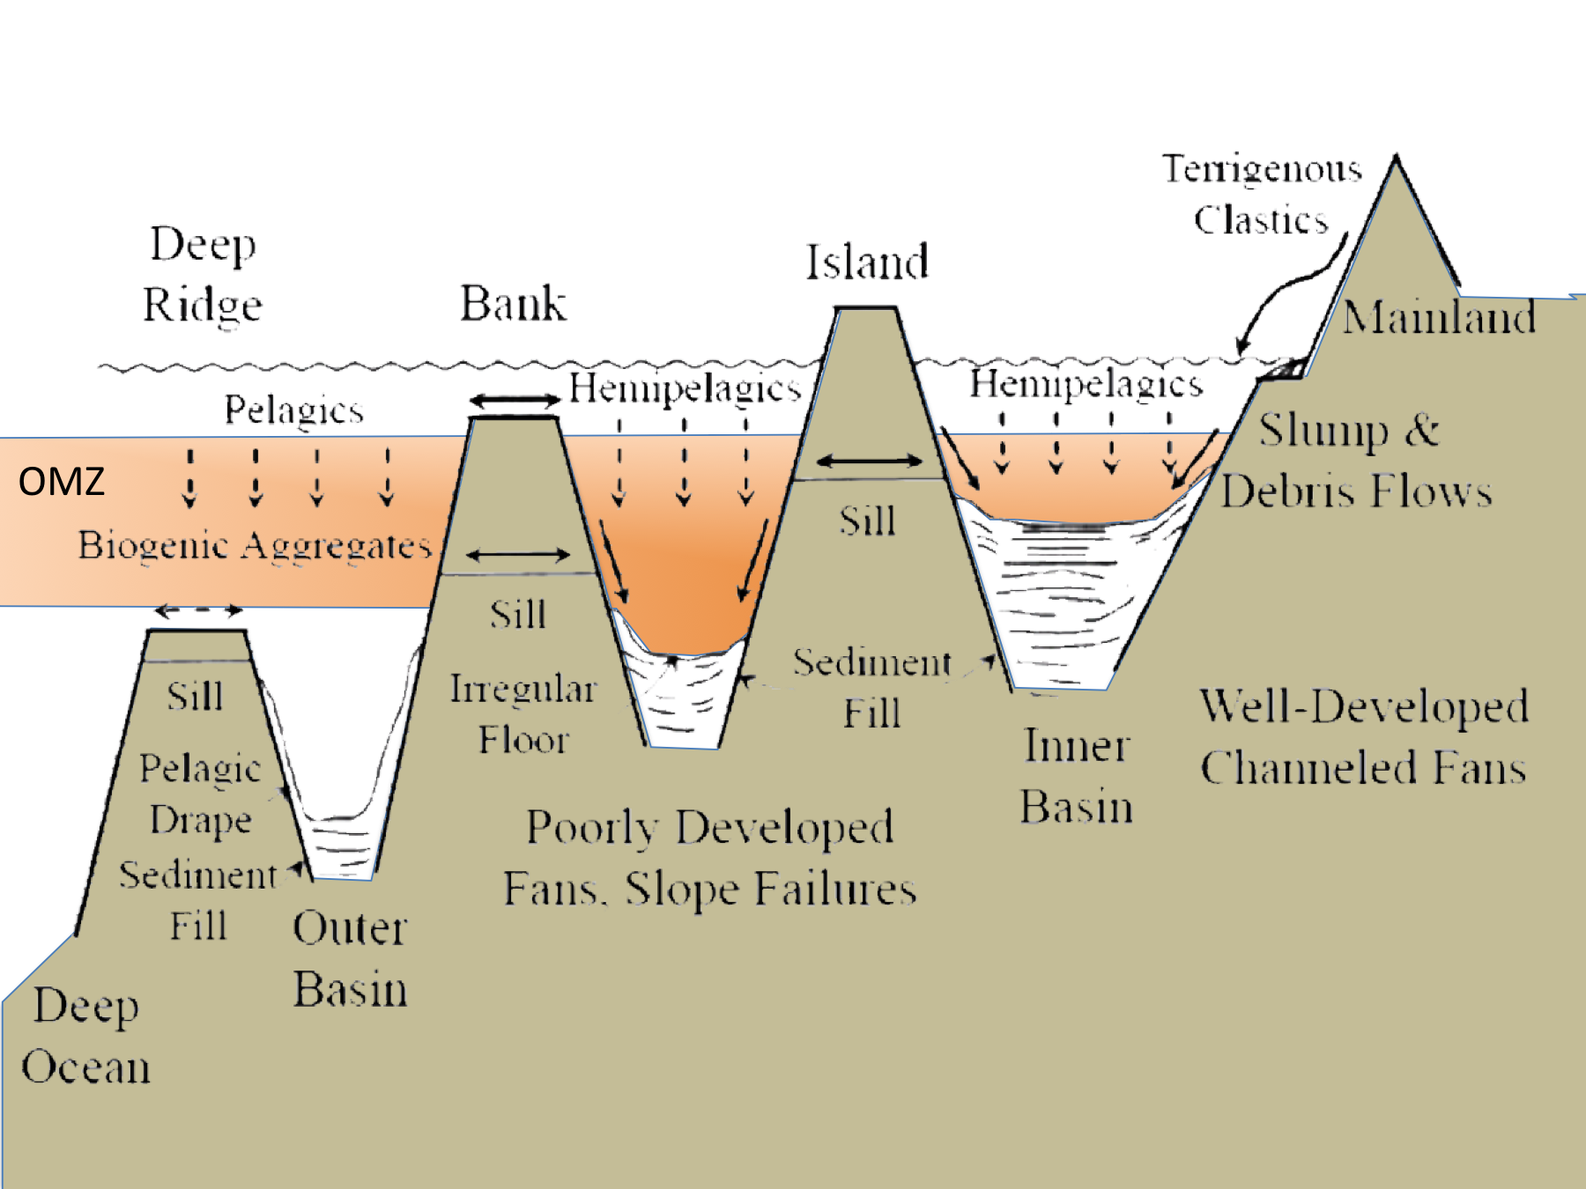
OMZ on an active margin

Slide 34
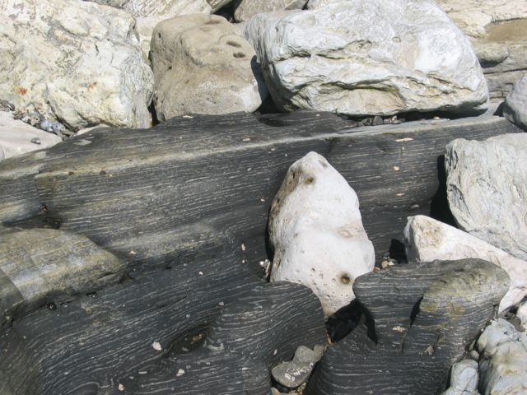
Phosphatic shales or marlstone

Slide 35
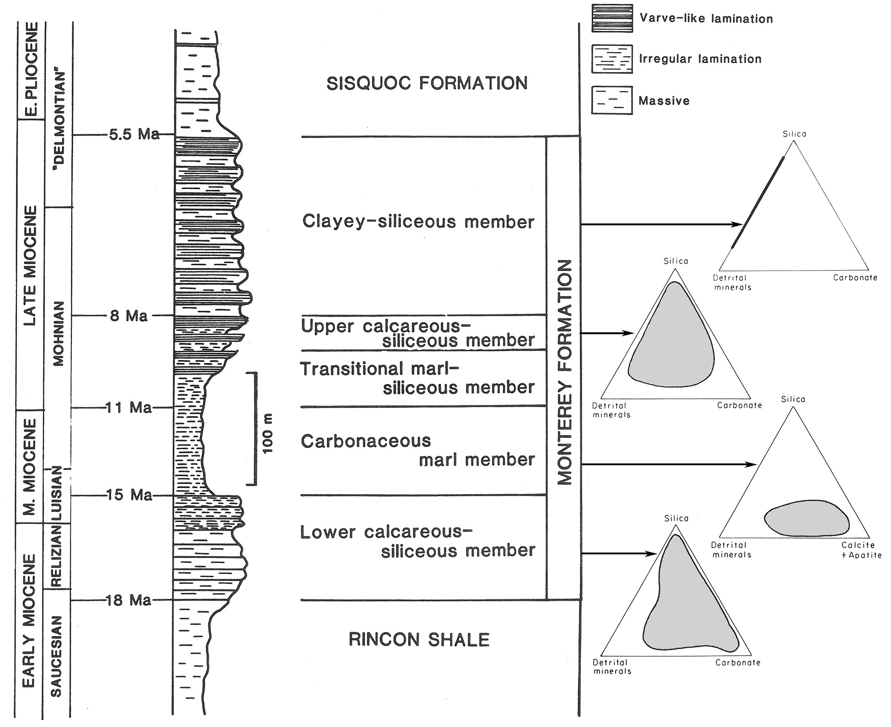
Isaacs (1980, 1983)

Slide 36
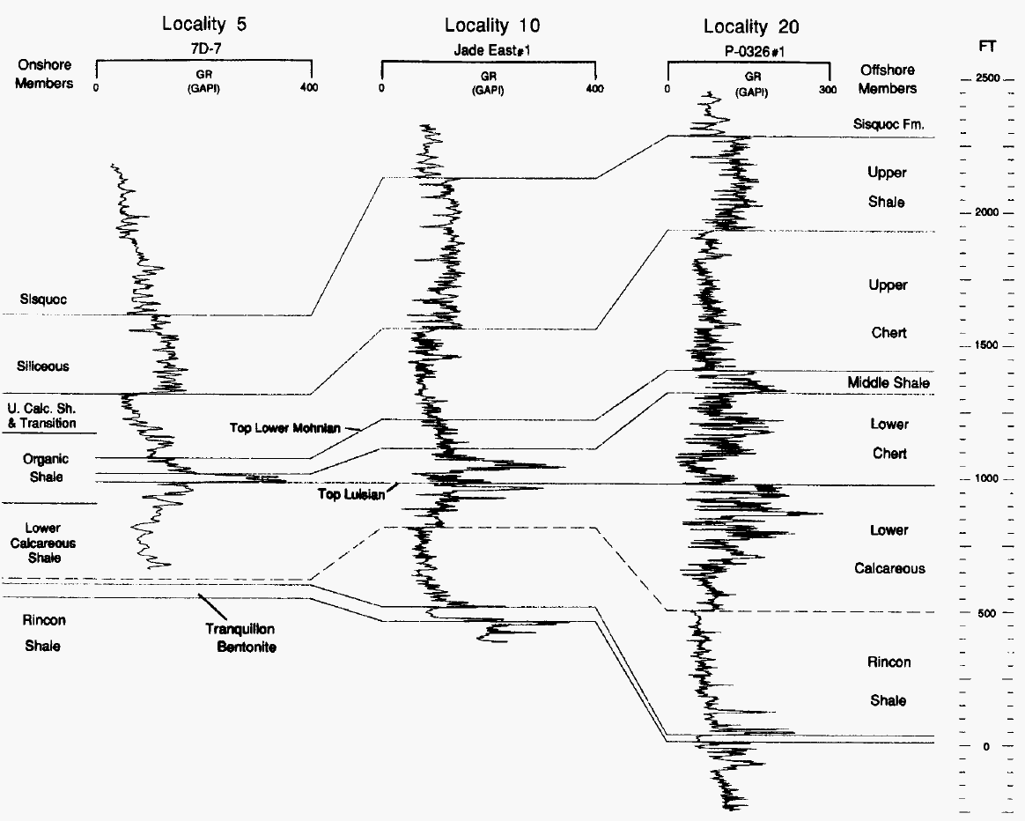
NW
SE
10 miles
Shale
Chert
Lateral Facies Change in SB Basin
Hornafius (1991)

Slide 37
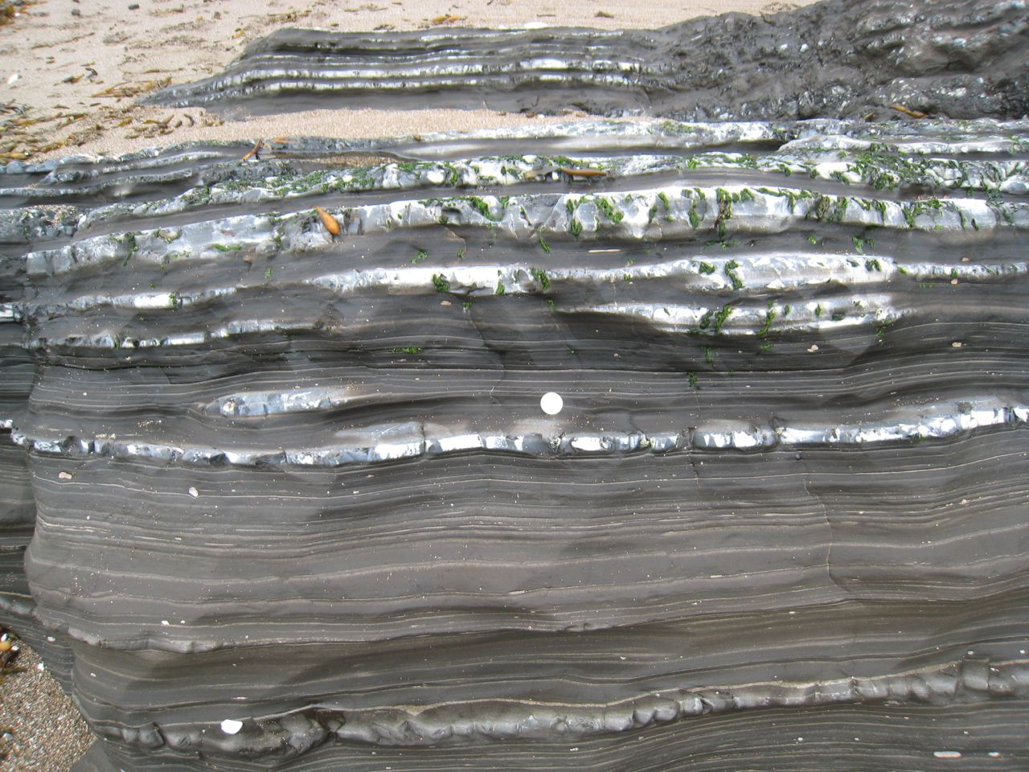

Slide 38
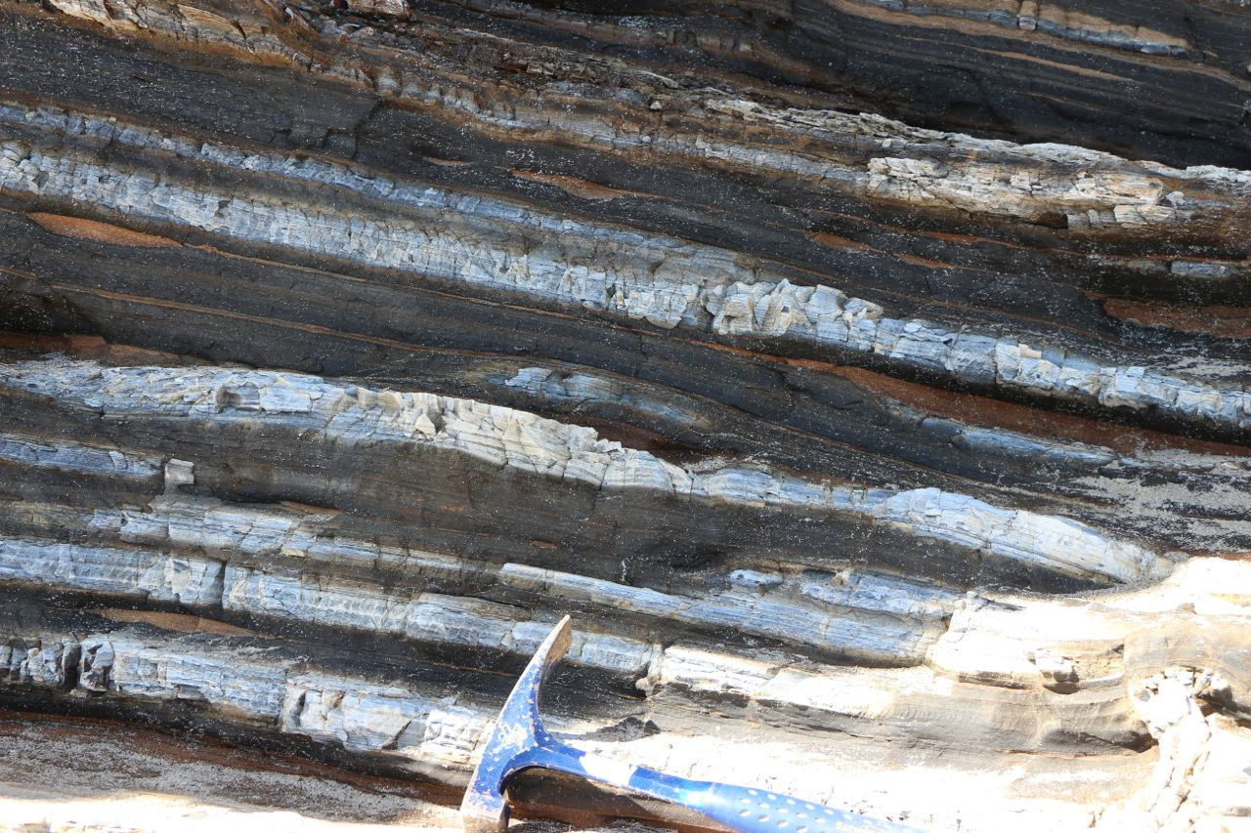

Slide 39
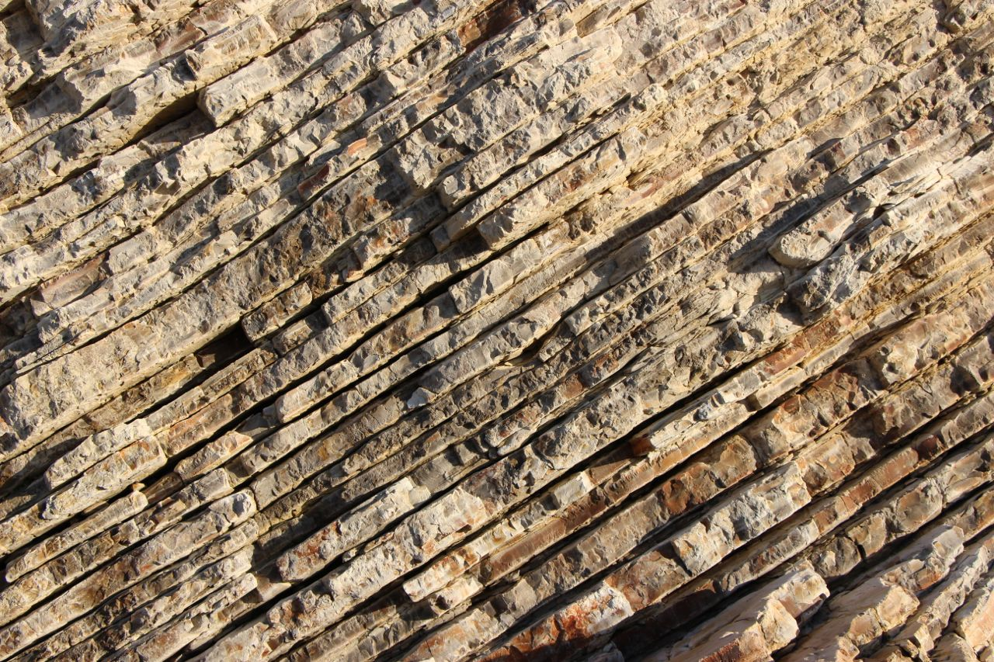

Slide 40
Physical Characteristics of Monterey Lithologies
Factors that control physical rock properties
Silica Phase
Detrital Content
Carbonate Content
Organic Matter
Porosity

Slide 41
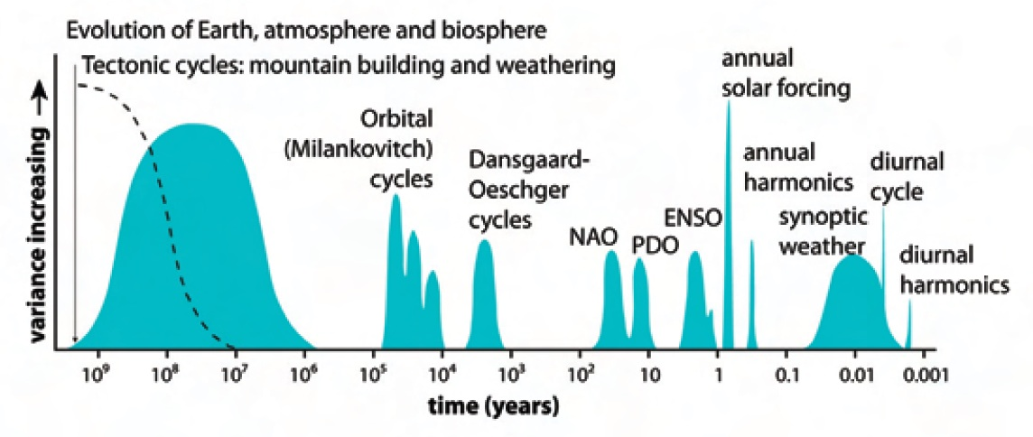
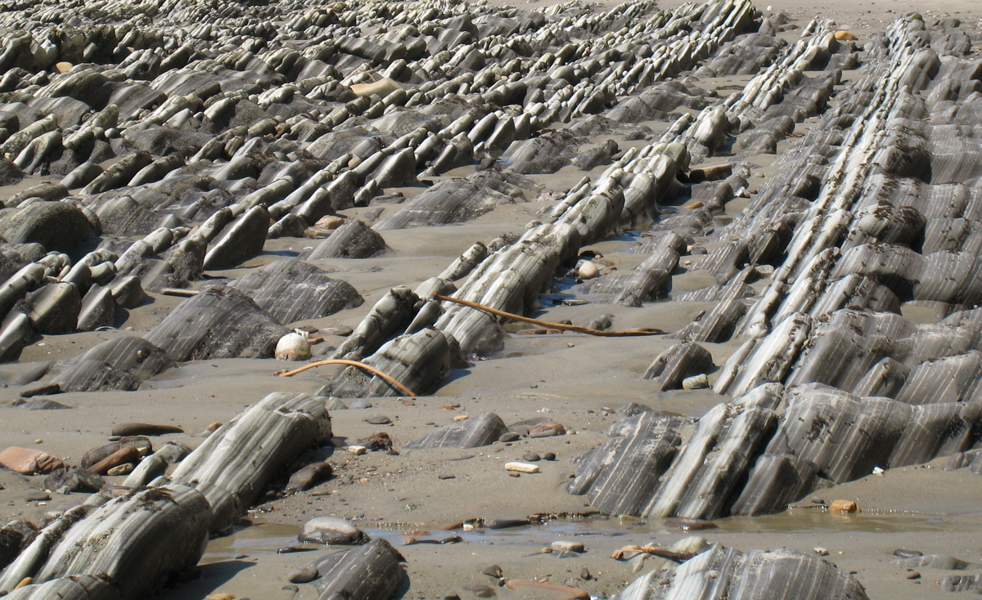
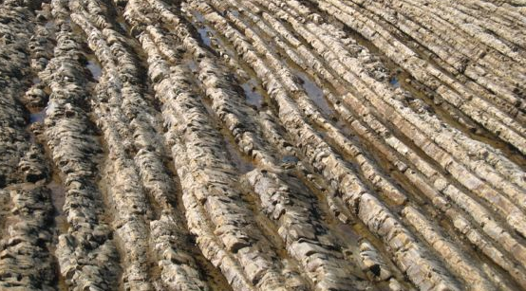
Climate Cycles & Litho-cyclicity
Thurow et al. (2009)

Slide 42
Stacking Patterns for Silica-Clay cycle
Gamma-ray log
Gamma-ray
cycle
Varied bed composition
Varied shale thickness
Varied porcel. thickness
5300
5350
5400
5450
5500
20
30
40
50
60
70
80
90
100

Slide 43
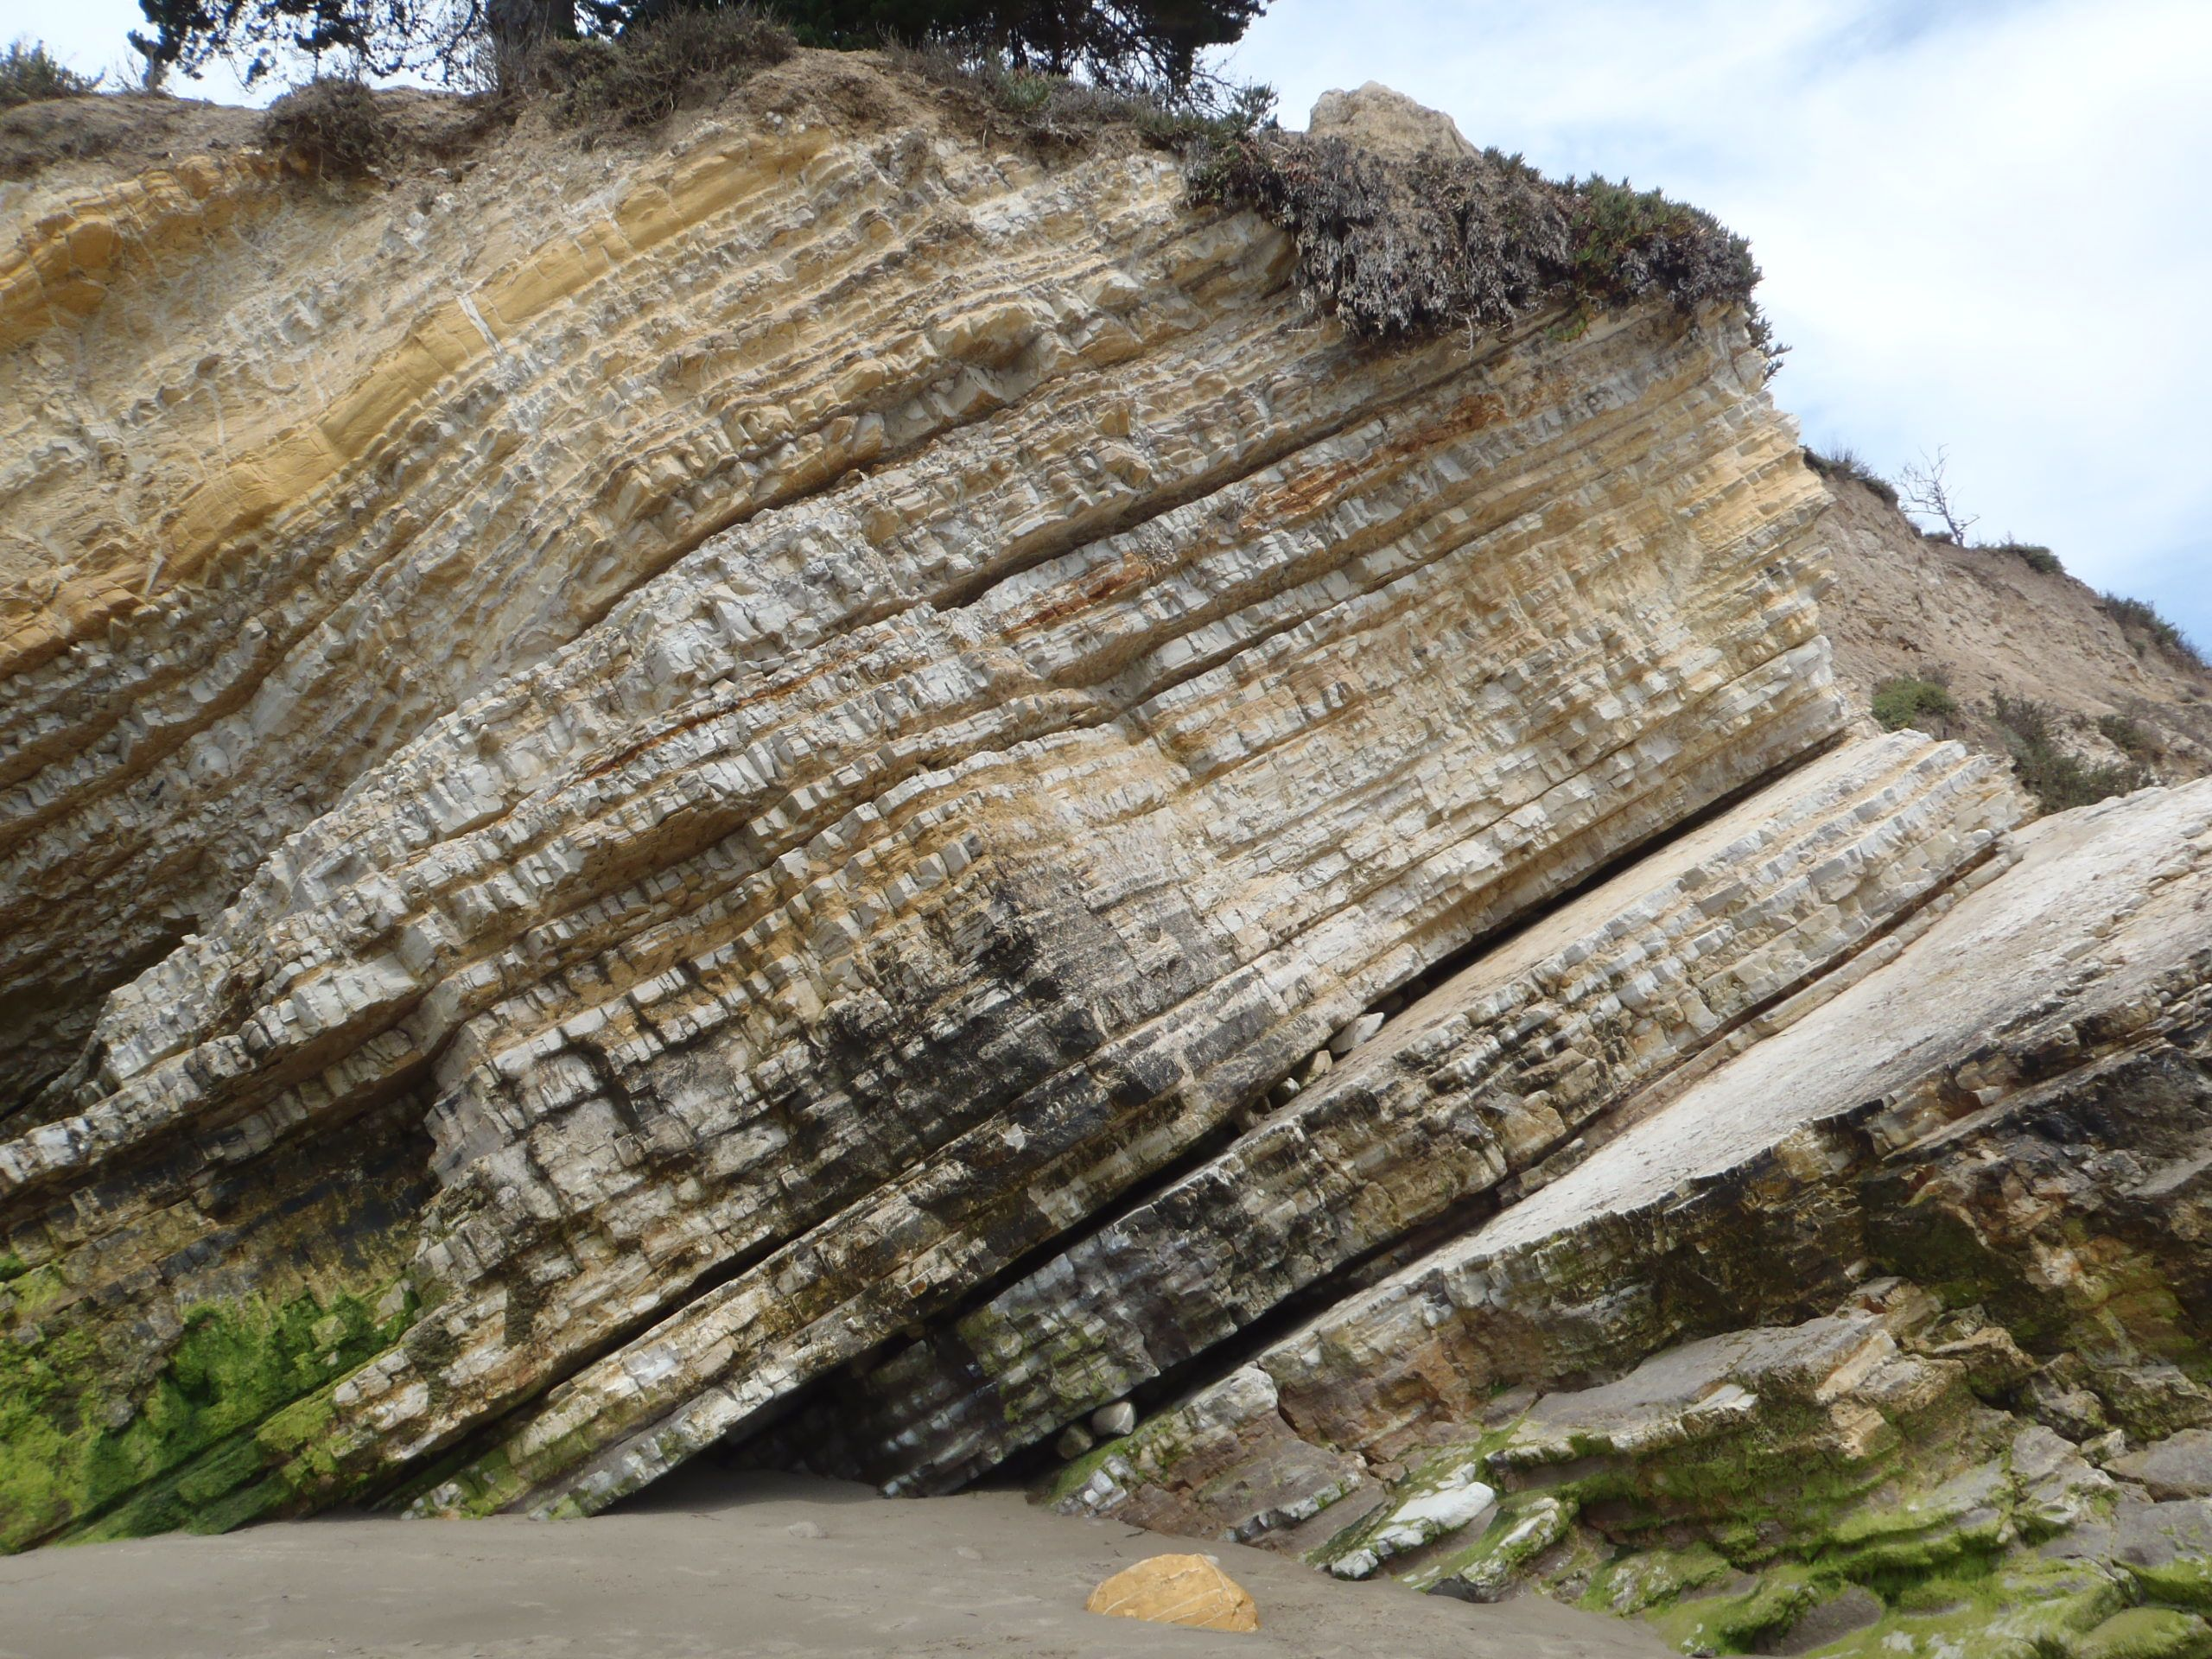

Slide 44
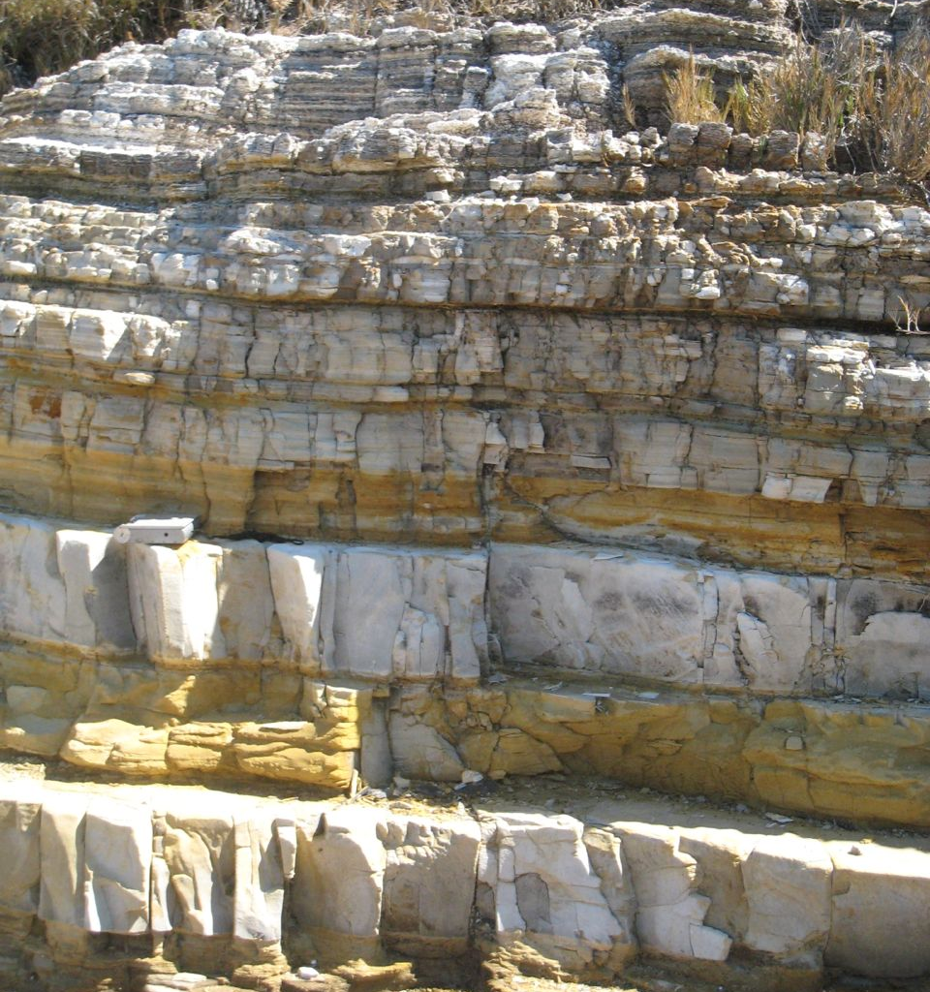

Slide 45
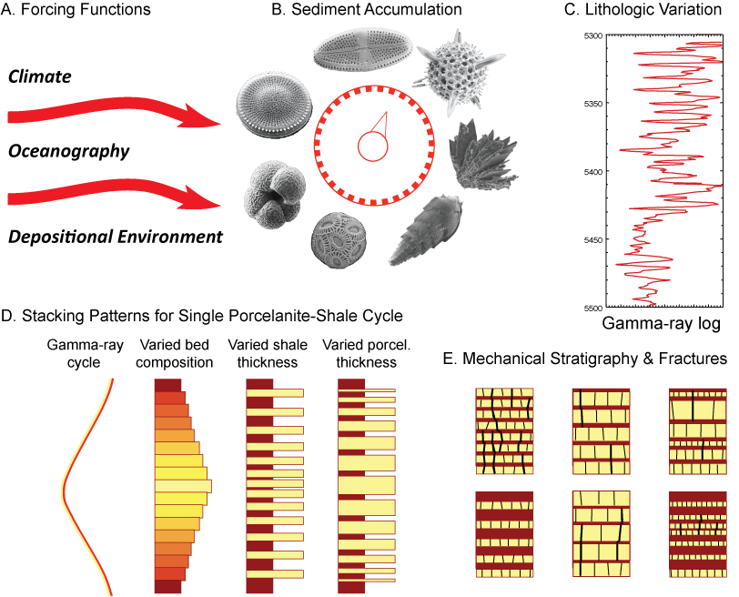

Slide 46
Monterey Summary
Important link to global change & tectonics
Spans the Pacific Rim
Organic-rich, highly siliceous, fine-grained
Vertical and lateral lithofacies variations
Global and local controls
Thin-bedded and cyclic bedding
High diagenetic potential of silica, carbonate, phosphate & organic matter
Composition and diagenesis controls physical properties of sediments and mechanical stratigraphy
A natural laboratory for “shales”

Slide 47
Field Stops

