Slide 1
Welcome! to
California State University Long Beach
aka
Long Beach State University
From the MARS Project Team

Slide 2
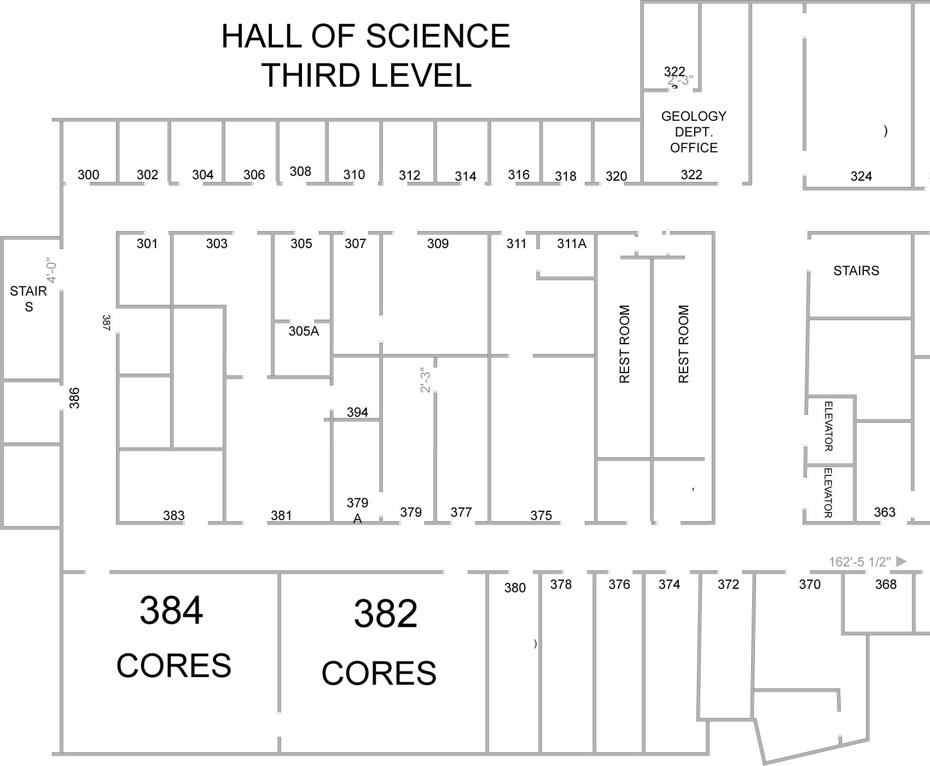
Exit
Exit
Exit
Exit &
other rest rooms
Young Scientists
Camp
MARS Seminar

Slide 3
Status Report on the Long Beach Monterey and Related Sediments Project (MARS): July 2018
Richard Behl
California State University Long Beach

Slide 4
MARS Project Objectives
Development of a focused center of excellence for research into Monterey Formation and related siliceous sediments
Provide sustainable support for ongoing research for graduate student & post-doctoral scholars
Develop well-trained graduate students, ready for entry into industry or PhD programs
Encourage fruitful intellectual interaction between industry and academia on real problems

Slide 5
MARS Project Structure: Affiliates
2011-2014 Founding Members
Aera Energy LLC
Bayswater Exploration and Production Co.
BreitBurn Energy Partners
ExxonMobil Production
Freeport McMoRan
Occidental Petroleum
Signal Hill Petroleum
Venoco, Inc.

Slide 6
MARS Project Structure: Affiliates
2017-2018 Current Members
AkerBP ASA
Berry Petroleum
California Resources Corporation
Signal Hill Petroleum
Total / Maersk Oil & Gas
Introductions?

Slide 7
Seven-Year Report
MARS Project Annual Events
7 science meetings/research symposia
7 MARS Project field trips
1 Lithology/diagenesis short course
MARS Personnel Recruited and Supported
19 MARS MSc graduate students + 7 graduate assistants
16 undergraduate students
1 part-time post-doc
3 occasional consultant colleagues: seismic interpreter/structural geology, diatom/nannofossil paleontology, graphics/cartography specialist

Slide 8
Seven-Year Report
MARS-Related Professional Activities
AAPG ACE Core Workshop, CSULB, 2012
AAPG ACE Monterey Field Trip, 2012
PS-AAPG Core Workshop, April 2013
2 PS-AAPG Monterey Field Trips, April 2013
PS-AAPG Monterey Session, April 2014
PS-AAPG Monterey Session, May 2015
PS-AAPG Monterey Field Trip, 2015
More than 40 professional presentations

Slide 9
Seven-Year Report
MARS Project Students
13 completed MSc theses
5 with thesis research in progress or beginning
2 took alternate paths
9 working in energy industry
2 working in government (DOGGR, BLM)
4 working in environmental/engineering geology, etc.

Slide 10
MARS Project Research Areas
Stratigraphy
Sedimentology
Petrography
Diagenesis
Structural Geology
Paleoceanography
Geochemistry

Slide 11
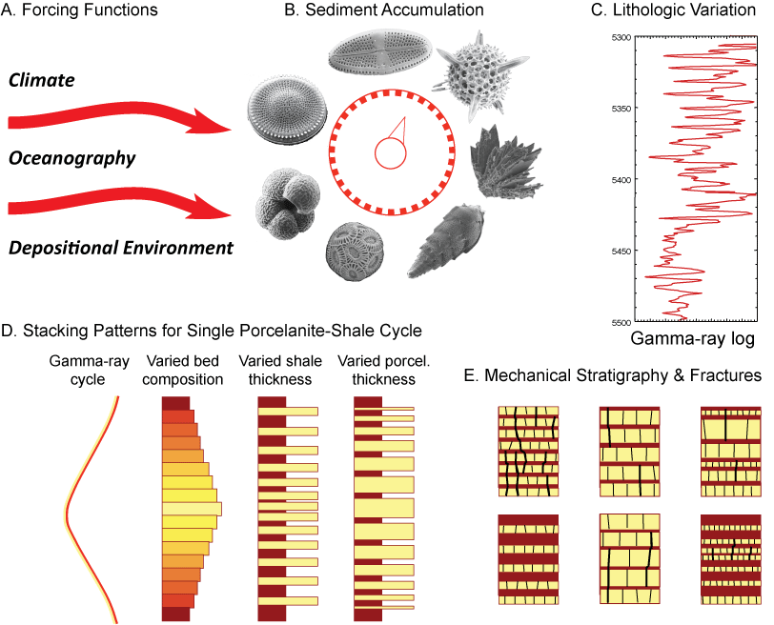
Environment➔Sediment➔Diagenesis➔Rock Properties➔P&P & Def’m Style
Behl, 2013

Slide 12
MARS Project MSc Thesis Research
Outcrop Stratigraphy
Subsurface Stratigraphy
Chemostratigraphy
Mineralogy
Diagenesis (silica & dolomite)
Rock properties
Structural deformation

Slide 13
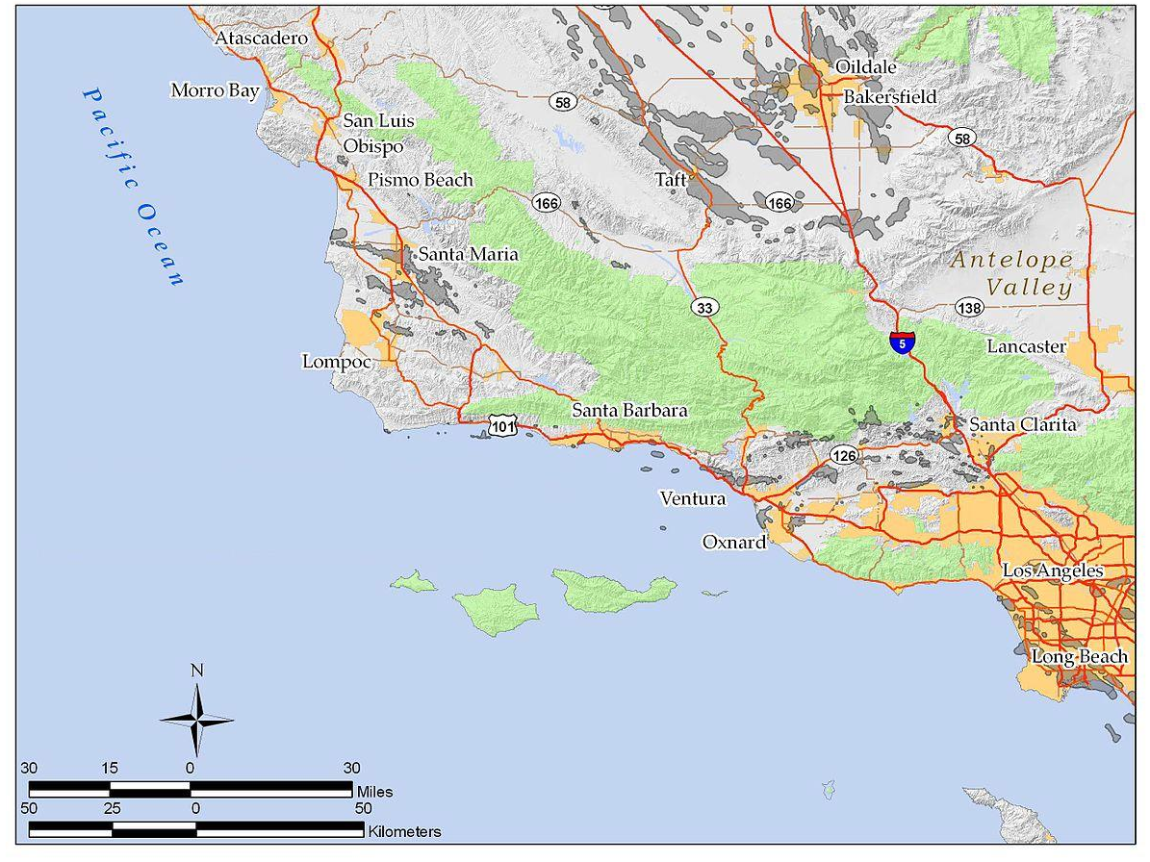
MARS Research Projects
+ North Sea Lark Fm.

