Slide 1
Lateral variation of Monterey Formation, south belridge field Jack Farrell
Notes:
- Name is Jack Farrell student of Rick Behls
I’ve put together a series of slides containing data I hope you all will find helpful in your exploration efforts in the lower antelope upper mcdonald
Please feel free to stop me at anytime if you want to discuss something, want me to slow down, or speed up.

Slide 2
Intro
Important concepts
Study area
Interval composition (XRD & XRF)
Rock Eval (maturity and kerogen type)
Heterogeneity
Well log interpretation
Lateral variation and attribute maps

Slide 3
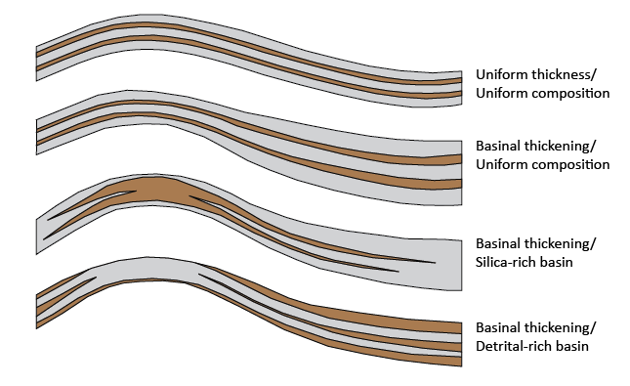
Lateral Variation
Notes:
Displayed are conceptual models of lateral variation in a number of forms from a bathymetric high into a low
The Brown color here is representative of more clay rich strata and the gray diatomaceous intervals
The first illustration depicts uniform thickness of beds, which would be indicative of pure hemipelagic deposition on a stable banktop slope and basin.
The next depicts uniform thickening of both diatomaceous and clay rich beds into the lows
2nd to last shows clay rich beds thinning into a silica rich basin, this model applies to the Santa Barbara basin, where there is a preferential winnowing of diatomaceous material into the lows and enrichment of detritus on the highs
And lastly we see a basinal thickening of detritus, as you know this model can be applied to some of the stevens sand interval

Slide 4
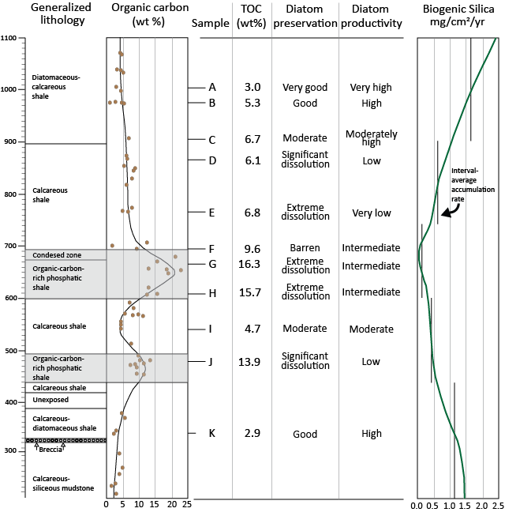
Silica Dissolution
Diatom production and sediment accumulation rate are shown to be inversely related to TOC.
Slow sedimentation rate strengthens the dissolution of silica and enhances the concentration of TOC
Isaacs. 2001
Notes:
Next id like to introduce a few concepts that I think are important to the lateral variation we see within the Monterey formation at the South Belridge Oil Field

Slide 5
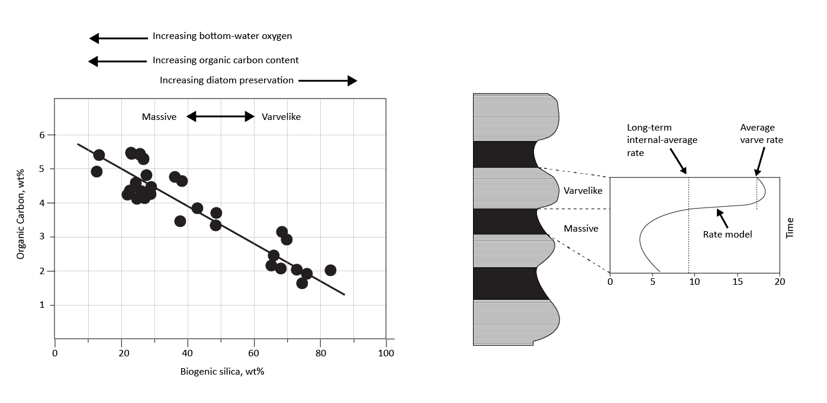
Silica Dissolution
Isaacs, 2001
Notes:
This figure, also by issacs in 2001 supports the last and compares bedding character to TOC
Massive beds are indicative of slow sediment accumulations rates, are relatively rich in OC and poor in SiO2, diatoms are less preserved.

Slide 6
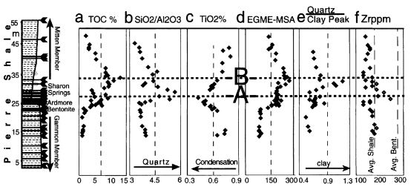
TOC + Clay
Clays may help to preserve organic carbon.
The adsorption of TOC onto the structure of clay minerals may be dependent on mineral surface area (MSA)
Kennedy et al., 2002
Notes:
This figure is by kennedy 2002.
Kennedy suggests that clays play a role in TOC preservation by adsorbing the amorphous OC into their framework.
As TOC increases

Slide 7
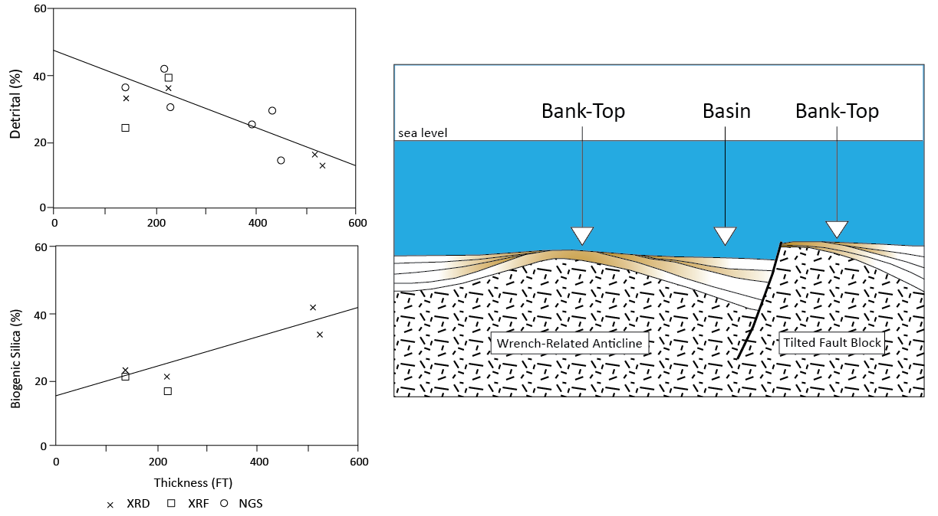
Santa Barbara channel
Hornafius, 1991
Notes:
Lastly we have a figure from Hornafiuses work on the SB channel.
Hornafious showed a trend of thickening and increased silica into the basins.
He interpreted this trend as a result of winnowing where the diatomaceous particles which have a lower grain density then detrital particles would be winnowed into the lows.
He supported this showing higher detritus in thinner intervals and higher biogenic silica in thicker intervals.

Slide 8
San Joaquin Basin
Late Miocene (7 ma)
Schwartz, 1988
Notes:
Schwartz's simplified model of the San Joaquin basin
Diatom blooms to varying degrees throughout the basin
Salinian block shedding sands into the basin
Muds being supplied through the ancient kern river draining the sierra Nevada to the west as well as from fluvial systems to the north and south

Slide 9
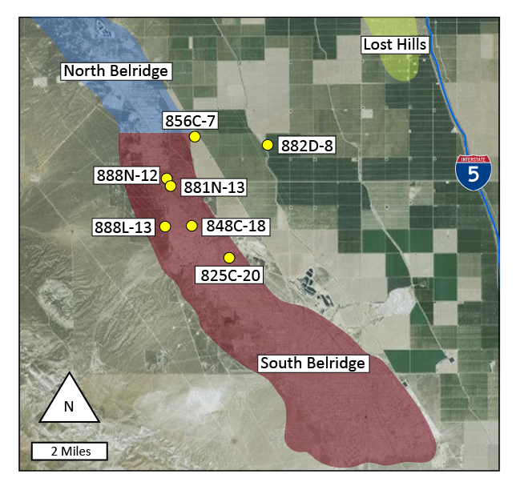
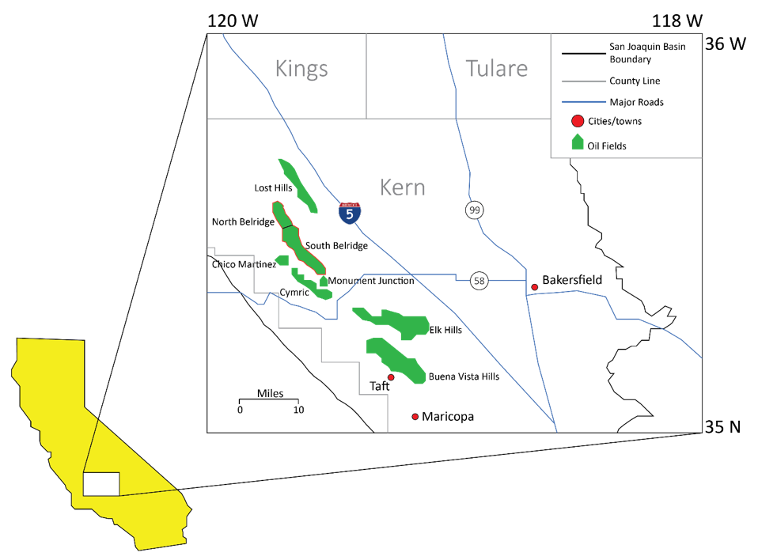
Location
Data set
7 wells
Core (XRD, XRF, Rock eval, conventional analysis)
Spectral gamma ray log suite
Elemental capture spectroscopy log suite
Triple combo log suite
Mosher, 2013
Notes:
Data set consists of 7 wells, for which we have spectral gamma ray, ecs, triple combo, as well as XRD, XRF, rock eval and conventional core analysis data.

Slide 10
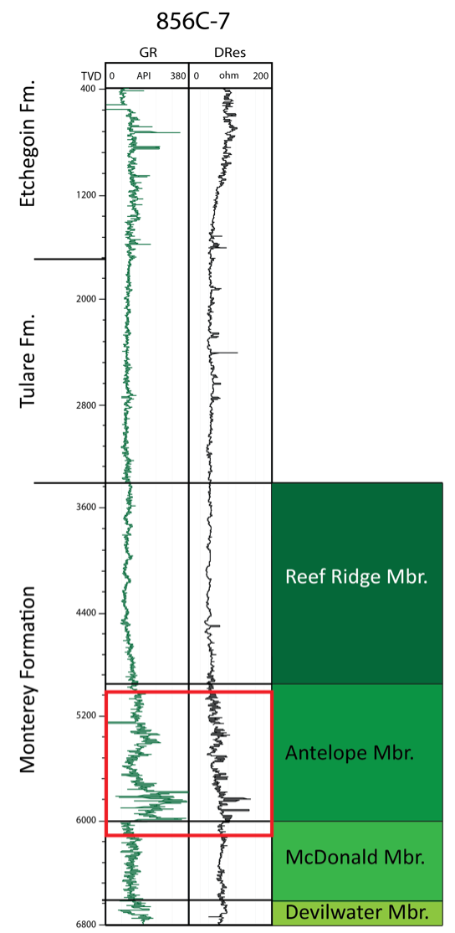
Stratigraphy
Si/Detritus = Si/(Ti +Al)
Strong biogenic trend between Silica and Zircon
No sand has been identified in the study interval
Scheirer and Magoon, 2007
Notes:
My zone of interest is highlighted by the red box in the upper mcdonald and ends in the upper antelope.
Aera refers the this high TOC zone as the 43Z interval
I may be wrong by its my understanding that you guys pick the Top McDonald above this GR spike, right around here.
I have not identified any sand in my interval
This plot shows the relationship between Zr Y axis and Si/Al+Ti, what this suggests is that the source of silica is controlled biogenically through the production of diatoms not from siliciclastics.

Slide 11
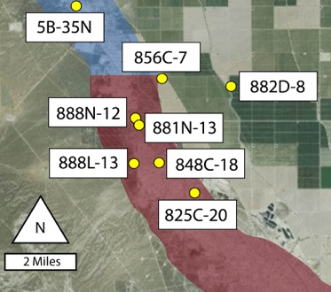
XRD Data
Core +
XRD + XRF analysis
Core +
XRF analysis
Notes:
The well panel on the right here is highlighting the cored intervals with the shaded boxes, the red color is where we have XRD data + XRF, and the peach shade represents intervals where we have XRF
The plot here has TOC on the x axis and quartz on the Y axis
For 856 and 848 we see a good negative relationship between quartz and TOC, suggesting that the more silicious intervals, have less TOC.

Slide 12
XRD Data
Core +
XRD analysis
Core +
XRF analysis
Notes:
This next plot of TOC and Clay shows us a positive relationship between TOC and Clay, so this may be suggesting that these clay rich intervals accumulated at a much slower late allowing silica dissolution and the concentration of detritus and TOC.

Slide 13
XRD Data
Core +
XRD analysis
Core +
XRF analysis
Notes:
Our last figure here is showing TOC vs Feldspar, this relationship is parallel to that of TOC and clay, our clay rich, high TOC intervals are also enriched in feldspars.
Again we have an extremely poor trend in the 882D well. This is because

Slide 14
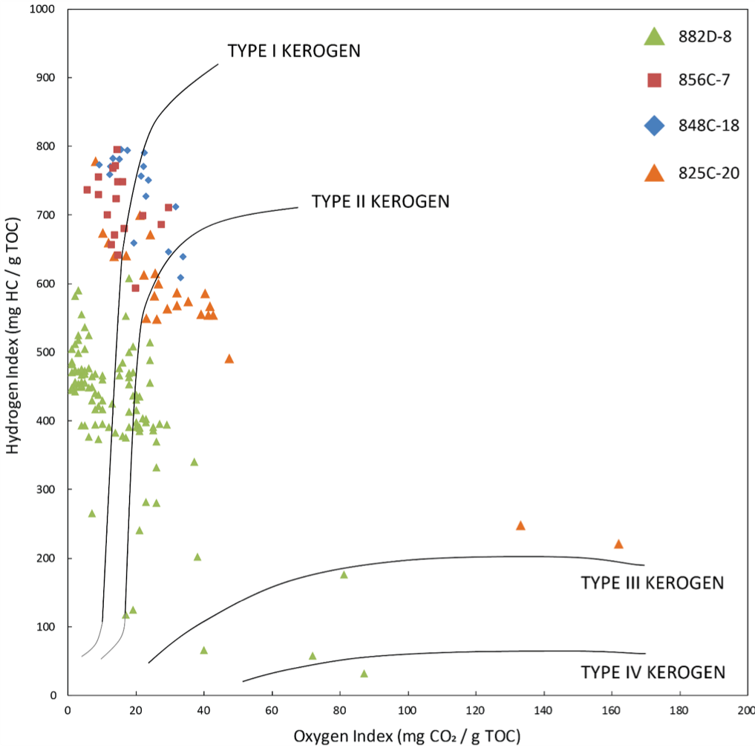
Rock Eval Analysis
Notes:
The 882D-8 well is in the oil generation window so a portion of the original TOC is being converted to hydrocarbon. Tmax lines are drawn at 435 and 455 degrees celcius
Psuedo van krevlin is showing that the interval of interest has mostly Type 1 and type 2 kerogen.

Slide 15
Heterogeneity
Si/Detritus may be used as a proxy for clay
Higher Si/Detritus ratios have a positive relationship with porosity
Darker beds tend to be more clay-rich and organic-rich
Tephra beds are exclusively observed in clay-rich intervals
Weller, 2017
Notes:
As ryan demonstrated, these rocks are highly heterogenous in composition.
On the right is a plot of silica/detritus and a gray scale color
The top plot is SI/Detritus vs clay, show us that the ratio is a good reflection of clay
The bottom plot is of the silica/detritus ratio tied to porosity, more clay less porosity
The plot on the right

Slide 16
Heterogeneity
Significant fluctuation in TOC
Tephras lie exclusively in darker more clay rich beds
Weller, 2017
Notes:
Here we have a more extensive view of the grey scale, si/detritus ratio figure.
I think its pretty amazing that you can move form 9% TOC to 49% in 5 feet.
Another interesting thing to not here is that the ash beds only lie within the dark clay rich intervals, we have two hypothesis for this
A the clay rich intervals took much longer to be deposited
B the more silicious intervals were

Slide 17
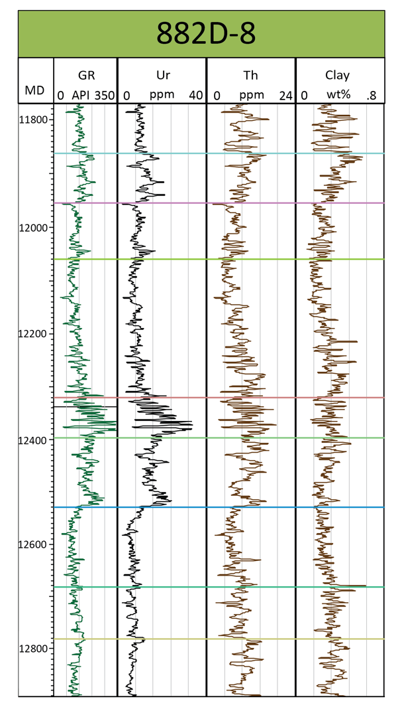
Well Logs
Horizon 8
G
Horizon 7
F
Horizon 6
E
Horizon 5
D
Horizon 4
C
Horizon 3
B
Horizon 2
A
Horizon 1
Notes:
To correlate I used mainly uranium and thorium. Uranium is strong indicator of TOC and phosphate, while thorium is a strong indicator of clay.
I was also supplied with ECS (element capture spectroscopy) logs
I divided my study interval into a number of horizons from 1 to 8 and zones A-G.
Now lets look at the data

Slide 18
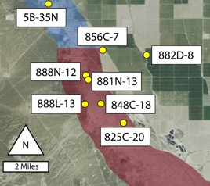
Lateral Variation
North
South
zone
Horizon 8
G
Horizon 7
F
Horizon 6
E
Horizon 5
D
Horizon 4
C
Horizon 3
B
Horizon 2
A
Horizon 1
Notes:
Zone A- relatively clean gamma signature and constant from North South
Zone B- Decrease in thorium and increase to uranium, this increase begins much lower in the interval toward the south
Horizon 3 zone C, maybe a flooding surface, abundance peak of forams
Thickening of seds to the south
Zone D significant thickening and cleaning to the south

Slide 19
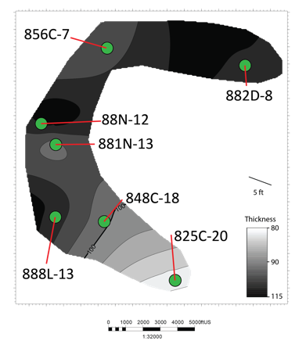
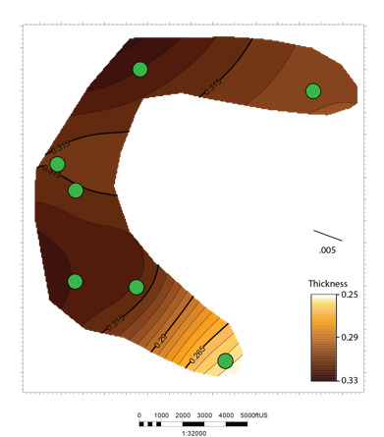
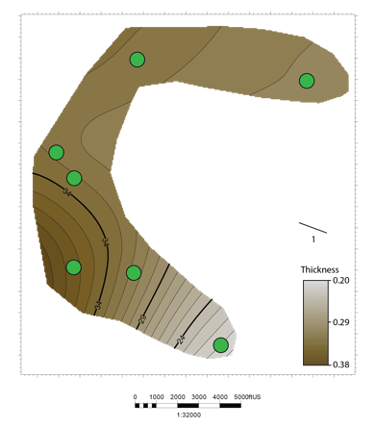
Zone A
Zone A
Thickness
%Clay
Clay Volume Proxy
Thickness
Clay
Clay x Thick
Horizon 8
G
Horizon 7
F
Horizon 6
Thickness: measured off of TVD well log picks. Maps are not a reflection of true stratigraphic thickness.
%Clay = Zonal average of elemental capture spectroscopy (ECS) measurement in weight %.
Clay volume proxy= %Clay x thickness. Reflects a qualitative total clay volume measurement of interval.
E
Horizon 5
D
Horizon 4
C
Horizon 3
B
Horizon 2
A
Horizon 1
Notes:
Zone A, pretty consistent thickness slight thinning to the south.
Average clay % of interval A based off ECS logs is relatively consistent but decreases to as the interval thins to the south
Clay volume is constant and higher in the north vs the south.

Slide 20
Zone C & D
North
South
Horizon 5
Zone D
Horizon 4
Zone C
Horizon 3
Notes:
Zone C 125 ft – 180 ft
Zone D 100 ft – 220 ft

Slide 21
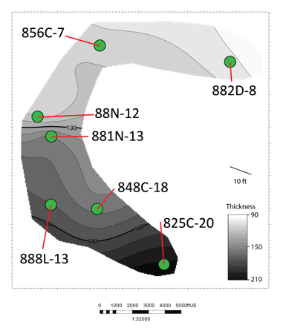
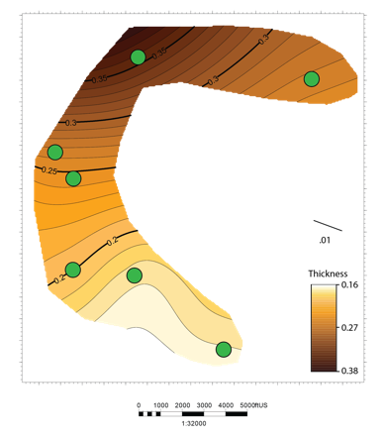
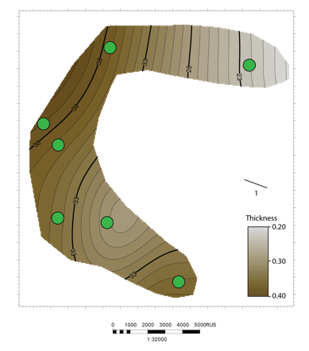
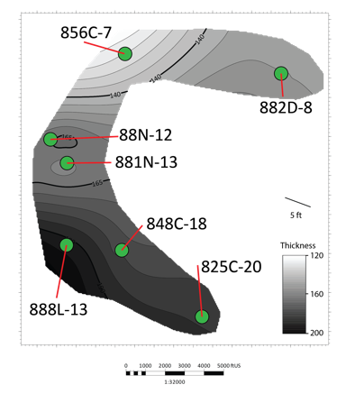
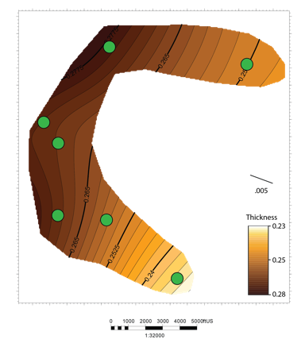
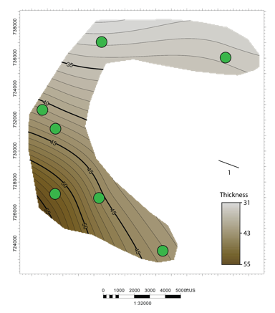
Zone C & D
Zone D
Thickness
%Clay/ft
Clay Volume Proxy
Horizon 5
Thickness
Clay
Clay x Thick
D
Zone C
Horizon 4
Thickness
%Clay/ft
Clay Volume Proxy
C
Horizon 3
Thickness
Clay
Clay x Thick
Notes:
Main points
Zone C we see thickening to the south with a slight decrease in clay % and clay volume
Zone D also shows a thickening to the south with a major decrease in clay % and relatively consistent clay volume
We are seeing different relationships in lateral variation between zones, clay is associated with TOC.
Zone C 125 ft – 170 ft .24 -.28 4% flux over a thickness change of 50 ft
Zone D 100 ft – 230 ft .20 - .35 15% flux over a thickness change of 120 ft
The transition from zone C to Zone D is representative of an increase in diatom productivity, more diatomaceous sediments are being added to the system and contributing to the differences and thickness as well as composition.

Slide 22
Ur & Th
- Lateral variation of Ur and Th relationships in Zone C suggests varying redox conditions.
Zone C
Zone D

Slide 23
Conclusions
There is significant lateral variation in the thickness and composition of studied intervals.
As zones thicken they become more siliceous and vice versa.
Clay concentration tends to coincide with organic richness.
The Monterey Formation contains highly organic and mature intervals that may act as a source, seal or reservoir.

Slide 25
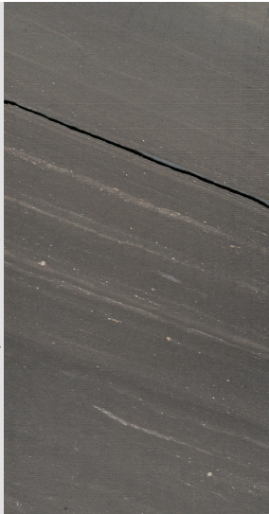
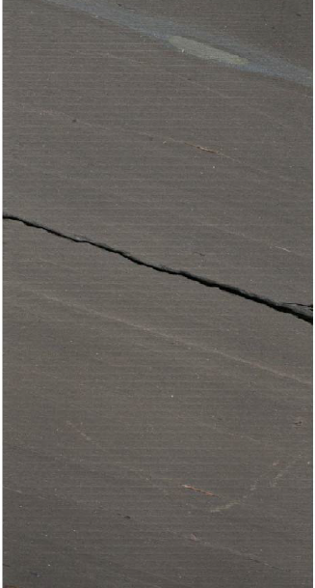
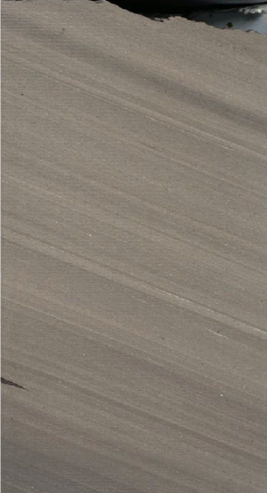
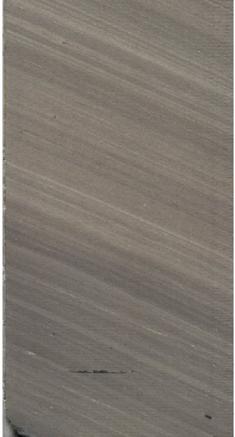
Facies
A
B
.0
.0
.0
.0
.05 ft
.05 ft
.05 ft
.05 ft
Faintly laminated to massive
Common phosphate lamina
Common ash beds
Dark color
Laminated
Individual lams are less than .025 ft (chiefly < .01 ft), bedding planes are weakly defined
Color ranges from dark to light
Phosphate common

Slide 26
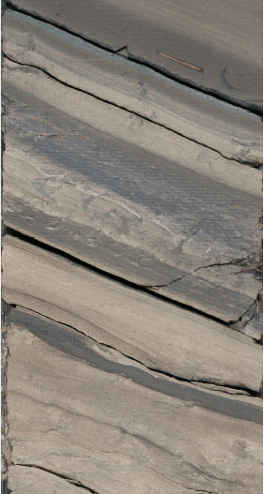
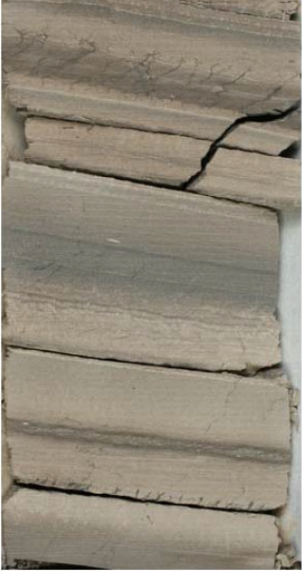
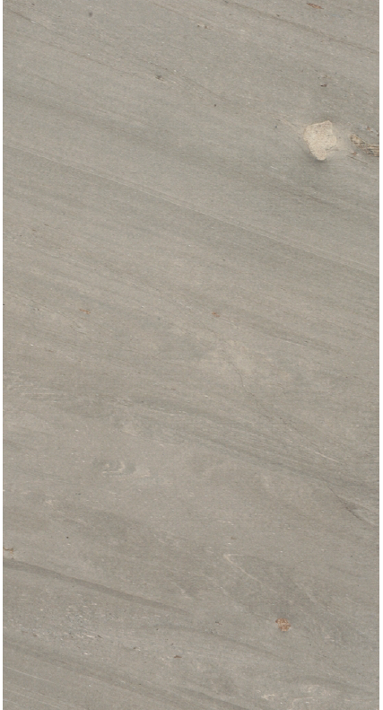
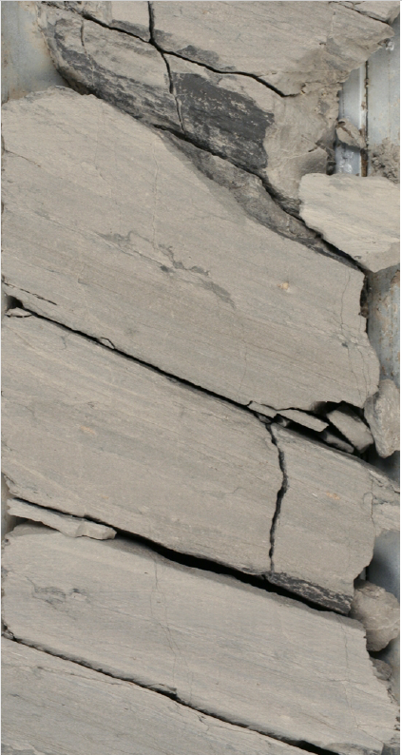
Facies
C
D
.0
.0
.0
.0
.05 ft
.05 ft
.05 ft
.05 ft
Banded facies consists of thin beds ranging from .025 ft to .1 ft
Bands are massive to diffusely laminated
Many individual beds have sharp contacts (scouring ?)
Clay-filled fractures and IMZ common
Soft sediment deformation
Indications of gravity flow (slump beds)
Intermittent continuous diffuse lamina and beds
Light in color
Nodules common

Slide 27
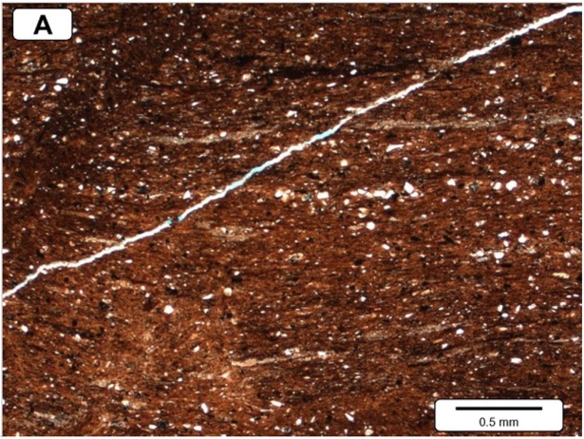
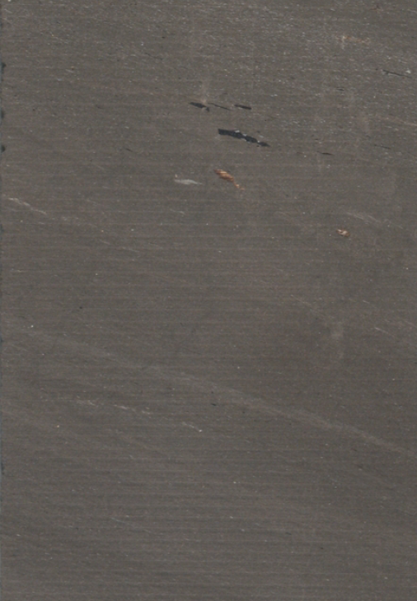
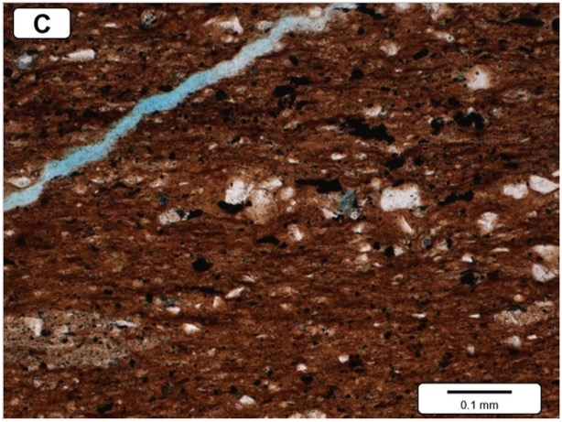
Thin Section 1
6110.5 MD (856C-7)
Facies A
6110.3
Parameter | Value
TOC (wt %) | 9.7
Vclay (XRD) | 31
Quartz (XRD) | 51.7
K-Feldspar (XRD) | 5.4
Plagioclase (XRD) | 6.3
6110.4
Core Lab Description:
Faintly laminated, argillaceous mudrock. This sample has the highest clay volume in the sample suite (see XRD data). A low-angle artificial fracture extends across images A and C. View C Reveals the scattered quartz and pyrite silt.
6110.5
6110.6

Slide 28
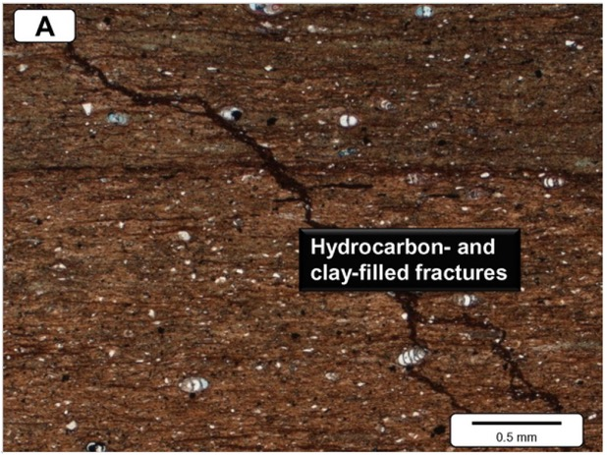
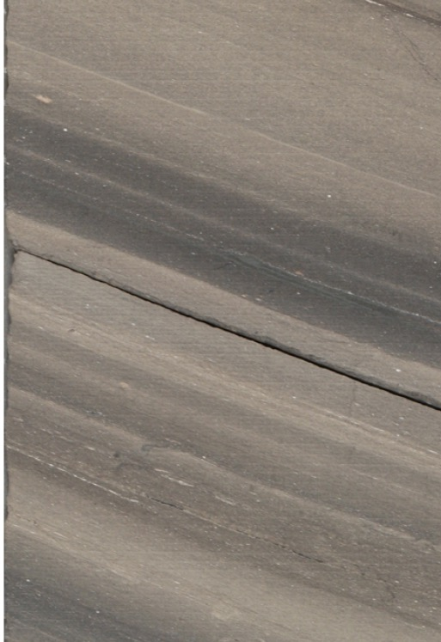
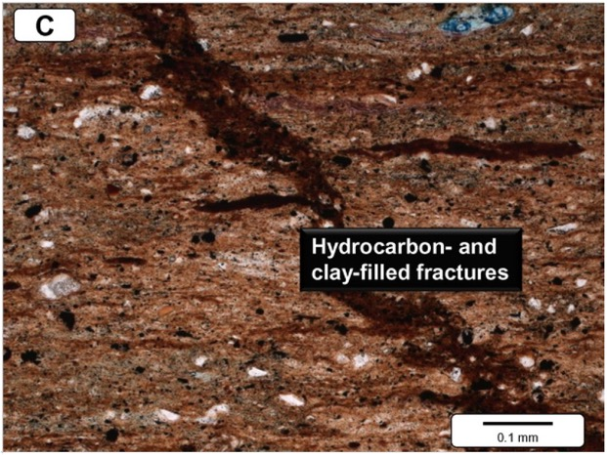
Thin Section 4
6085.0 MD (856C-7)
Facies C
6084.9
Parameter | Value
TOC (wt %) | 6.02
Vclay (XRD) | 12.3
Quartz (XRD) | 72
K-Feldspar (XRD) | 3
Plagioclase (XRD) | 2.7
6085.0
Core Lab Description:
Faintly laminated, fractured mudrock. Oblique, opaque, hydrocarbon- and clay filled fractures are visible. Scattered quartz and feldspar silt grains are visible in view C, and brown translucent lenses may be organic matter. Matrix includes brown clay or organic lenses and scattered opaque pyrite.
6085.1
6085.2

Slide 29
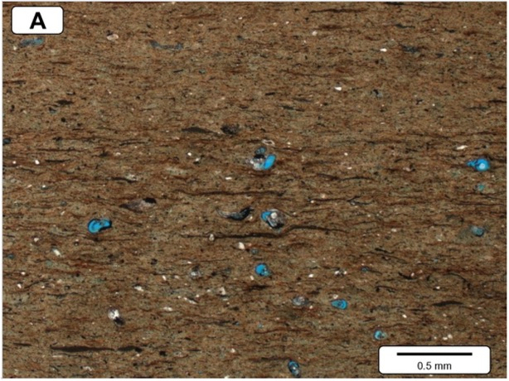
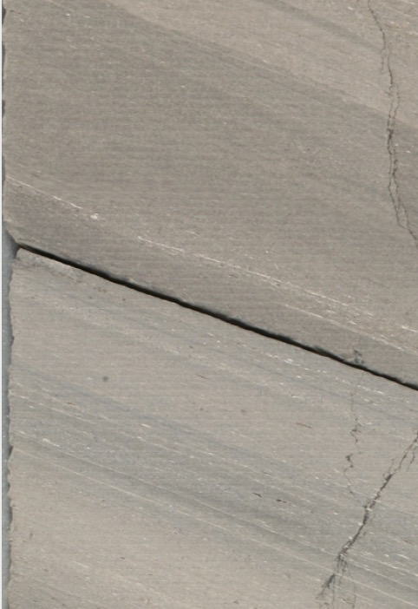
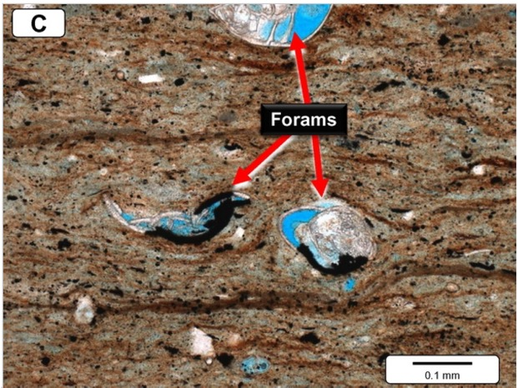
Thin Section 4
6129.5 MD (856C-7)
Facies D
6129.4
Parameter | Value
TOC (wt %) | 3.1
Vclay (XRD) | 10.3
Quartz (XRD) | 78.3
K-Feldspar (XRD) | 2.4
Plagioclase (XRD) | 1.5
6129.5
Core Lab Description:
Massive-appearing to faintly laminated mudrock. Hollow foram tests in the sample are highlighted by blue epoxy in View A and C. View C reveals that the tests tend to be partially filled by calcite and pyrite. The pyrite is assumed to be a geopetal feature.
6129.6
6129.7

Slide 30
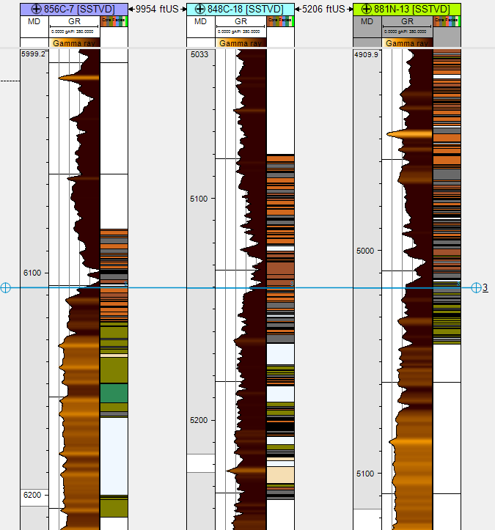
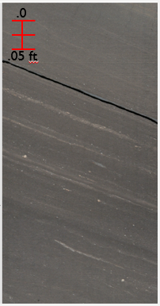
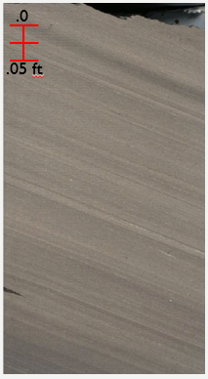
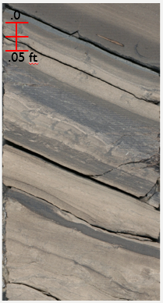
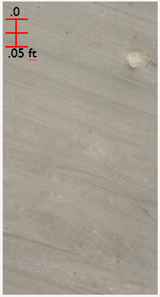
Facies Correlation
A
B
C
D

Slide 31
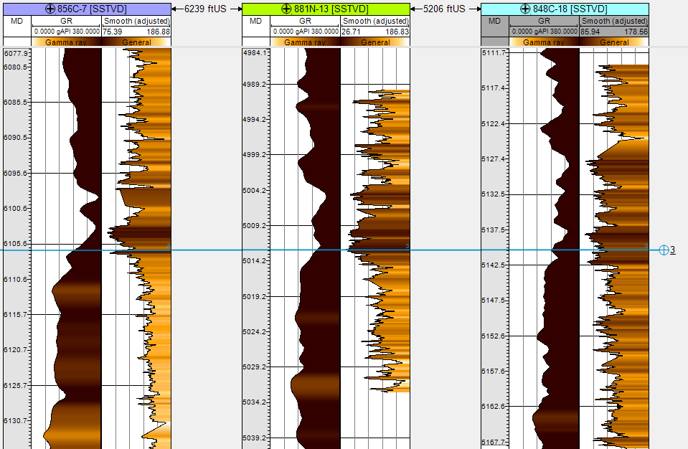
Color Data
Core Color
Core Color
Core Color

Slide 32
Tephra Occurrence
Observation:
Tephra laminae are consistently encased in dark-clay-rich intervals and not in lighter-silica-rich intervals.
Hypotheses
Dark-clay-rich intervals accumulated at a much slower rate than silica-rich intervals and were therefore more likely to accumulate tephra laminae.
Light-silica-rich beds were largely deposited through gravity flow processes that destroyed tephra laminae.

