Slide 1
CSULB MARS Project Monterey & Siliceous Sediments Short-Course & Symposium Bakersfield, 28 July, 2017
Richard J. Behl
California State University
Long Beach, CA
MARS Project: Monterey and Related Sediments

Slide 2
Monterey Short-Course Outline
Part 2. Diatomites
Diatoms
Evolution
Types
Environmental requirements
Depositional environments
Sedimentary processes
Settling
Lateral transport
Downslope transport
MARS Project: Monterey and Related Sediments

Slide 3
Controls of Character and Composition
Part 2 (cont.). Sedimentary structures
Laminations
Mats
Speckled beds
IMZ / vein structure
Slumps
Sedimentary facies and environments
Lateral variation
Sand-rich and sand-starved settings
MARS Project: Monterey and Related Sediments

Slide 4
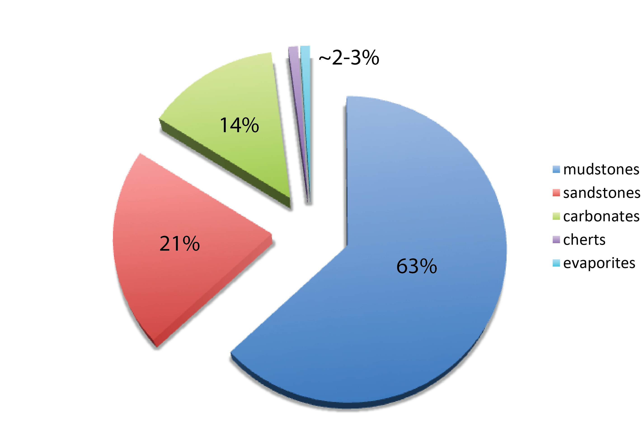
Sedimentary Rocks on Earth
siliceous rocks
Data from Railsback (1993)

Slide 5
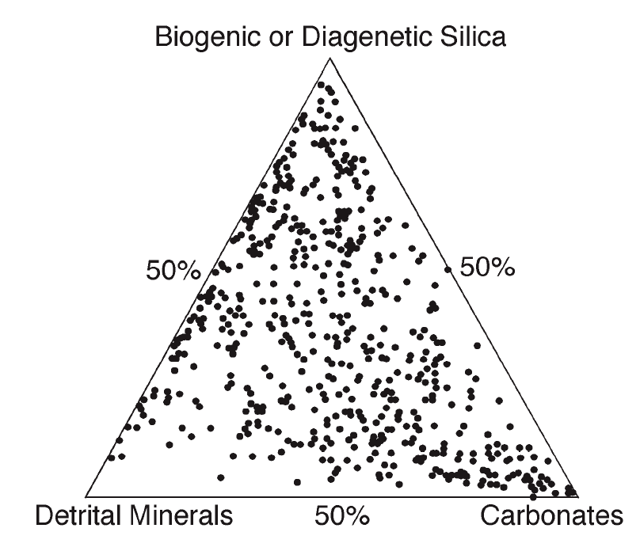
Mudrock Sedimentary Components
Detrital
Clay
Silt
Sand
Biogenous
Silica (opal-A)
Calcite/Aragonite
Kerogen
Diagenetic / Authigenic
Opal-CT / Quartz
Calcite/Siderite/Dolomite
Phosphate
Chert
Diatomite
Porcelanite
Muddy Diatomite
Mudstone/ Shale
Limestone/ Dolostone

Slide 6
Diatoms
First appeared 190-250 Ma (Jurassic)
Evolved from symbiosis of heterotroph and red and green algae
Golden algae
Originally entirely marine organisms
1st nonmarine benthic diatom mats
70 Ma (Late Cretaceous)
Oldest planktonic freshwater diatoms
56-60 Ma (Late Paleocene)

Slide 7
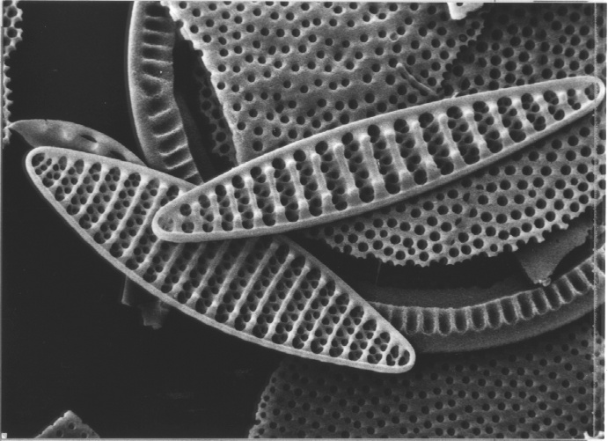

Slide 8
Diatom Environmental Requirements
Sunlight
Clear water
Major nutrients
Phosphate
Nitrate
Carbon dioxide
Silicic acid
Trace nutrients
Iron
MARS Project: Monterey and Related Sediments

Slide 9
Diatom Environments
Oceans, lakes, estuaries, rivers
Wind-driven upwelling zones
Marine
Large lakes
River mouths/estuaries
If not too muddy and turbid
Lake-basin wide overturning
Seasonal temperature changes
MARS Project: Monterey and Related Sediments

Slide 10
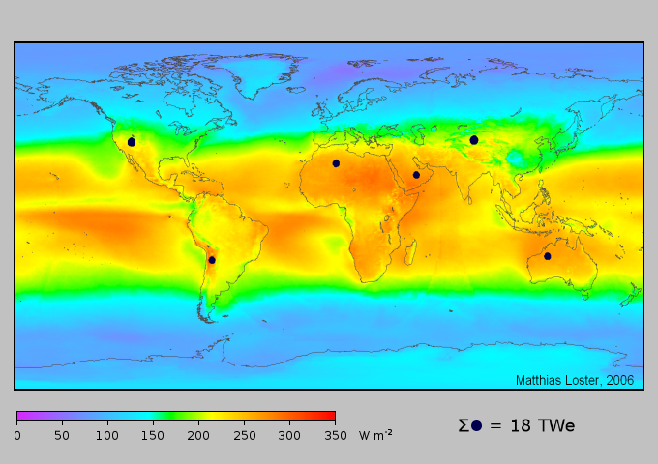
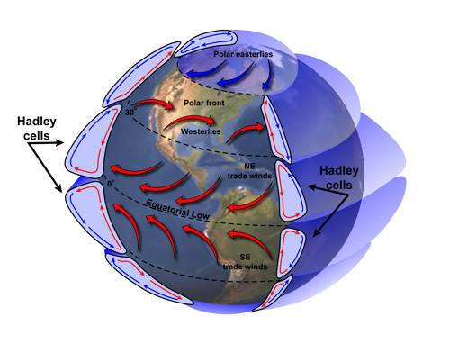
Atmospheric circulation is fundamentally driven by the imbalance of solar radiation and heat

Slide 11
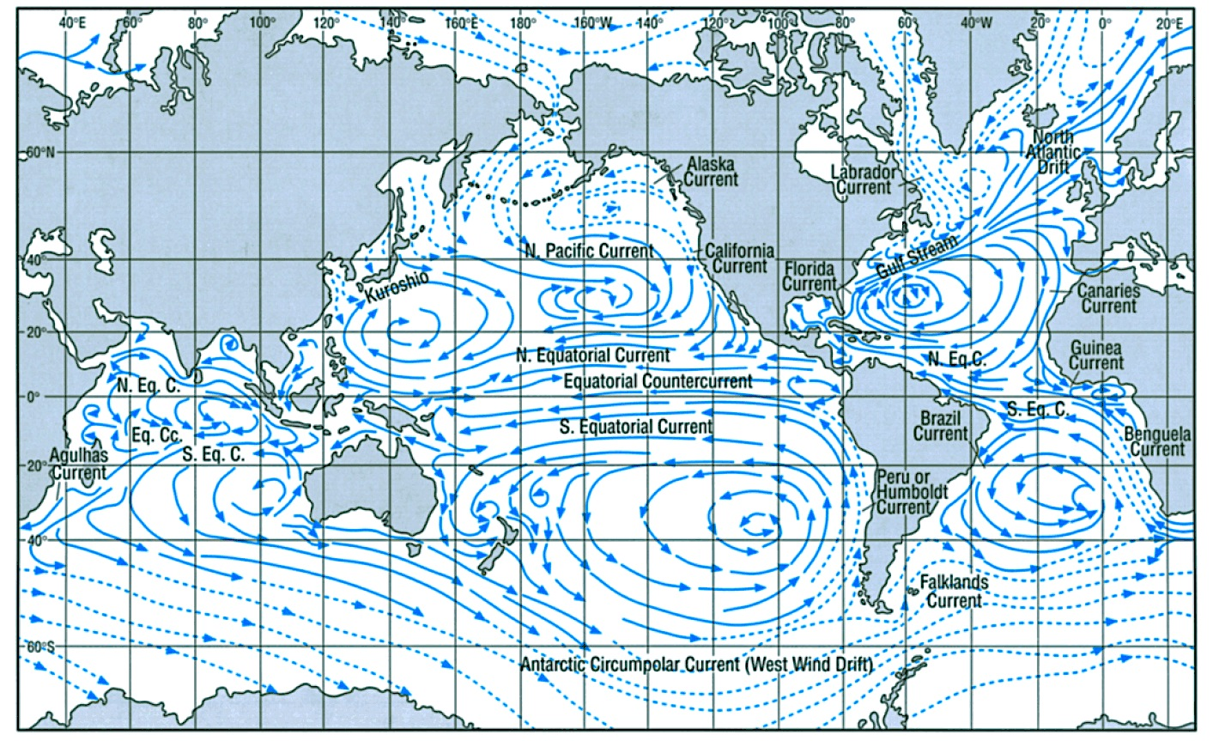
Average oceanic surface currents

Slide 12
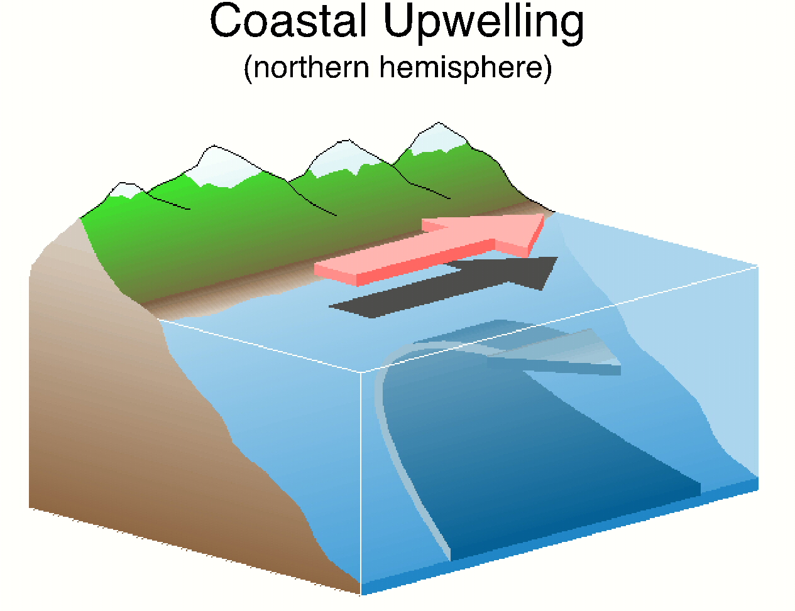
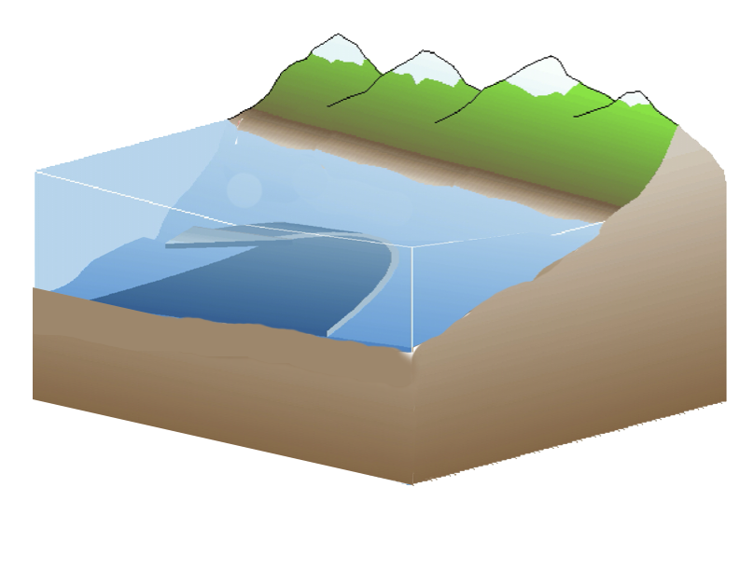
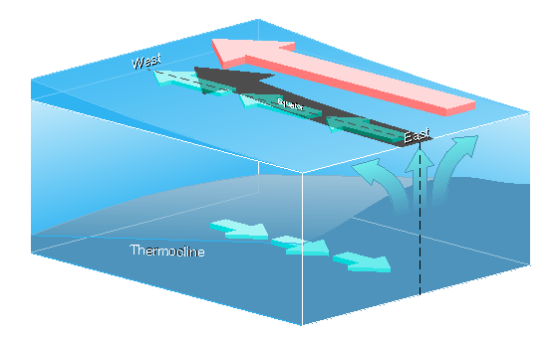
Shallow Shelf Upwelling
Equatorial Upwelling

Slide 13
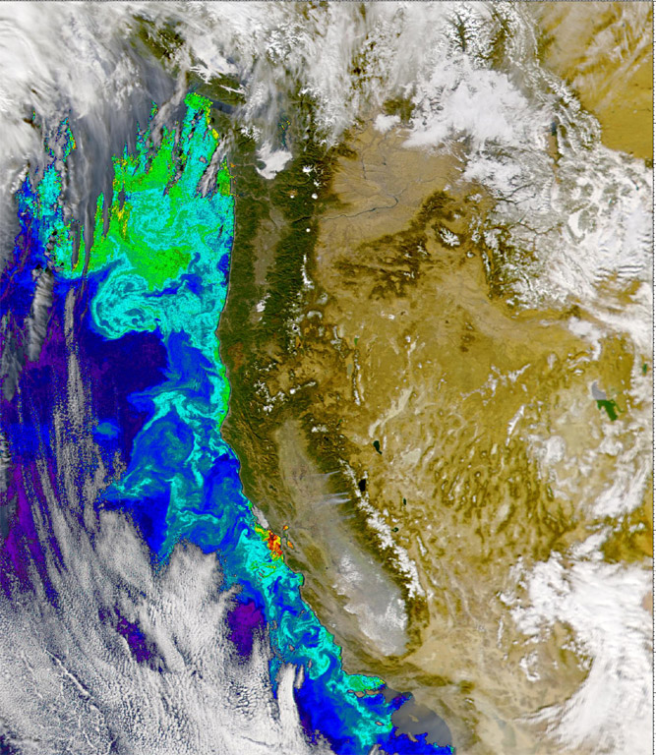
Intense Upwelling along Eastern Boundary Currents

Slide 14
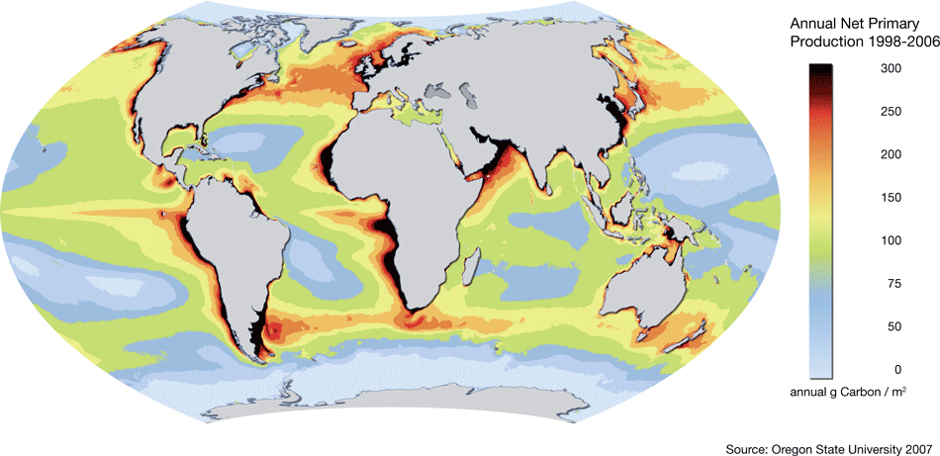
Oceanic Production of Biomass by Photosynthesis (mostly diatoms)

Slide 15
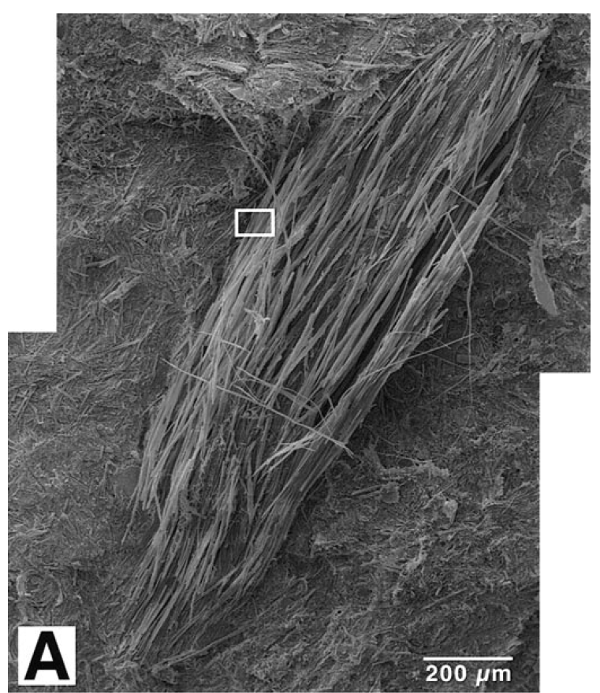
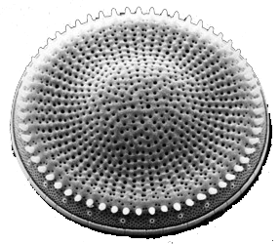
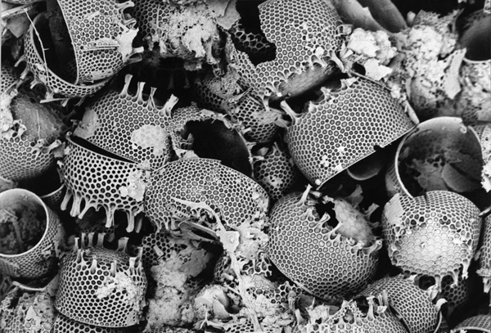
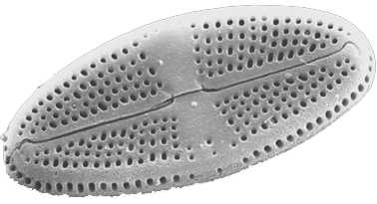
Diatoms

Slide 16
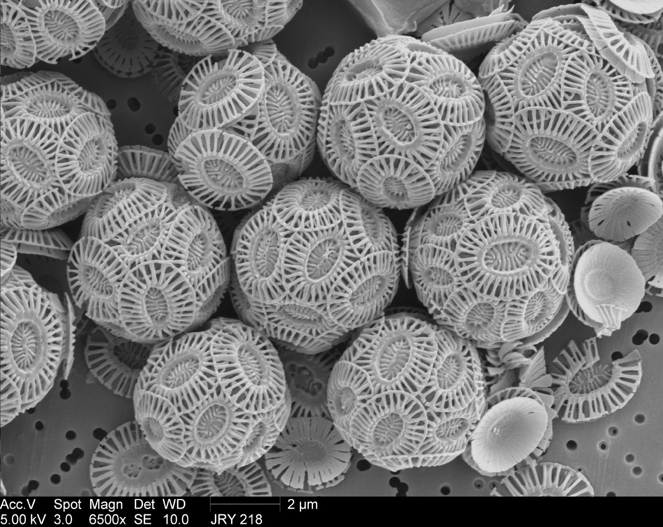
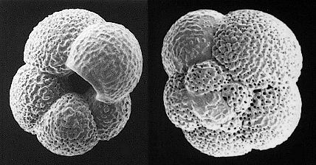
Calcareous Plankton:
Coccolithophorids & Foraminifers

Slide 17
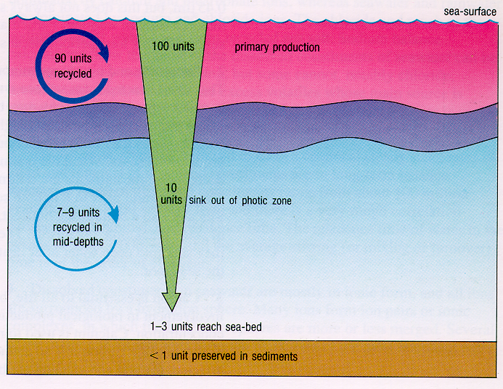

Slide 18
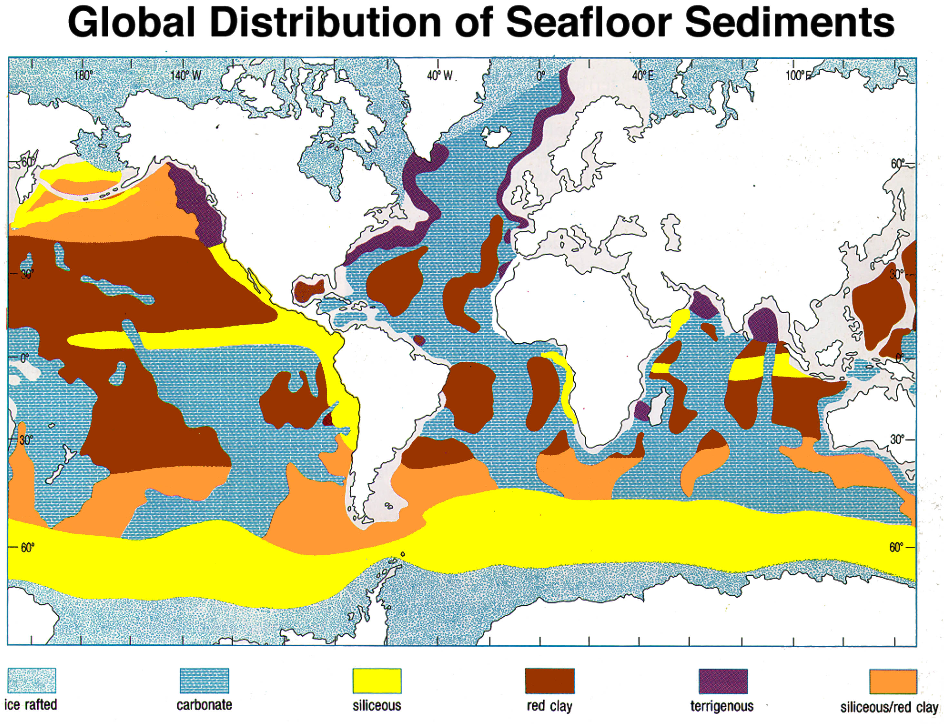

Slide 19
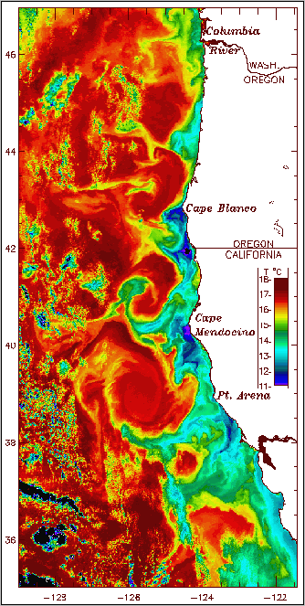
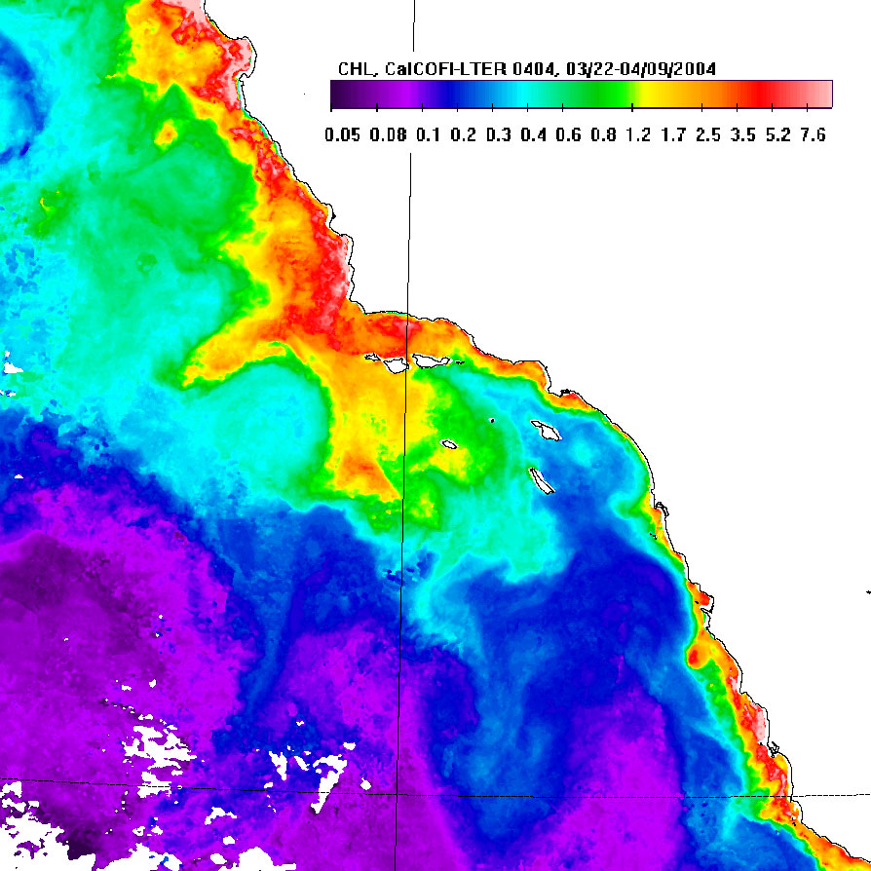
Coastline control of distribution of upwelling & nutrient-rich water
after Roesler & Chelton, 1987

Slide 20
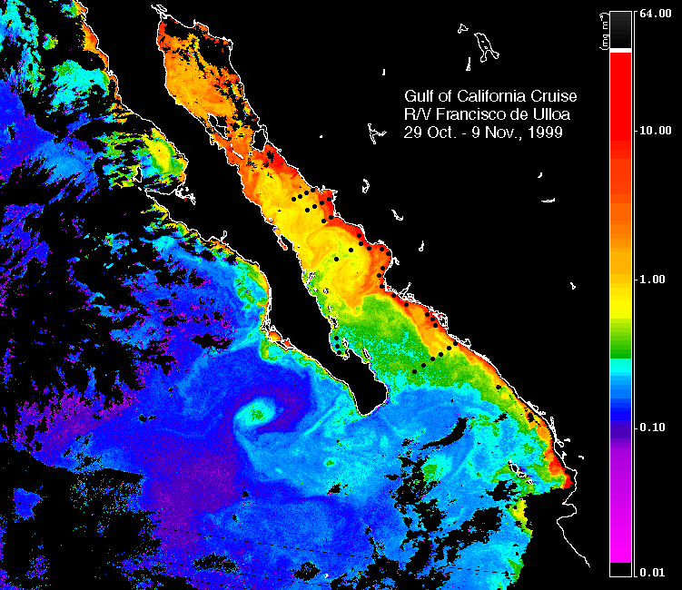
Semi-enclosed basins can have spatially & temporally complex upwelling patterns

Slide 21
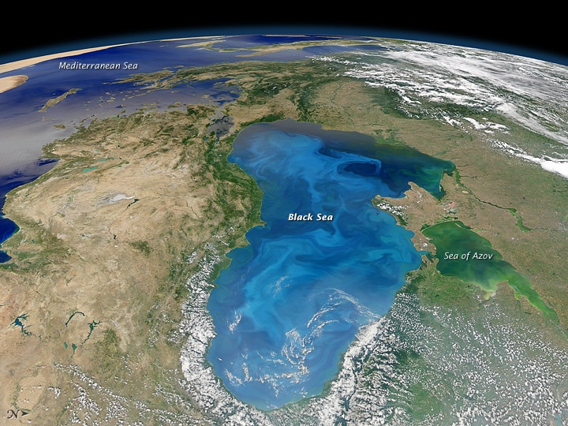
Black Sea algal bloom

Slide 22
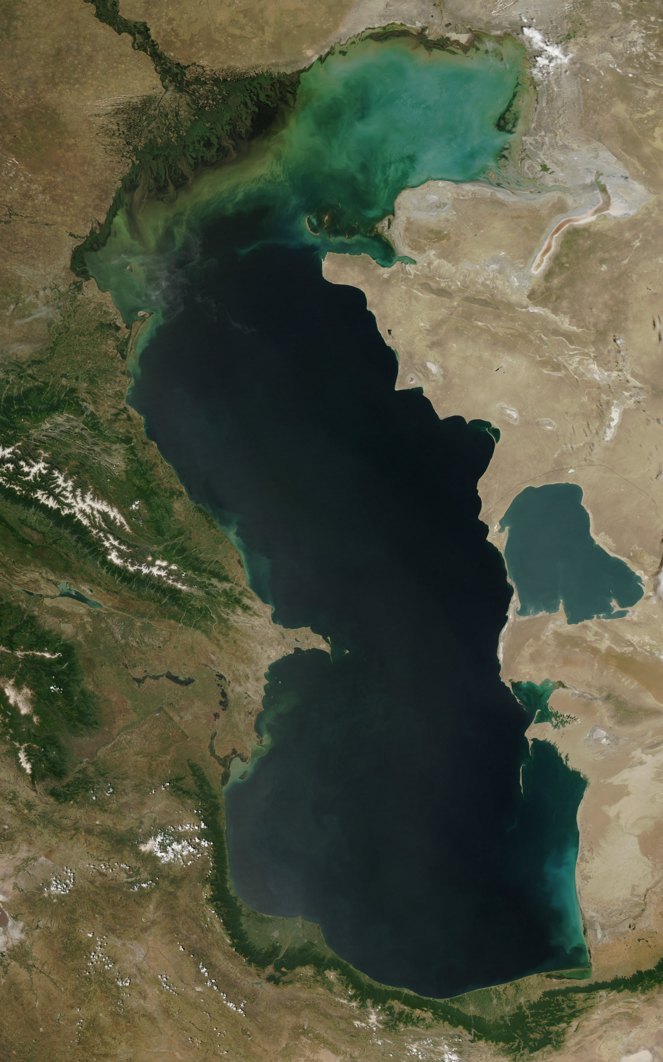
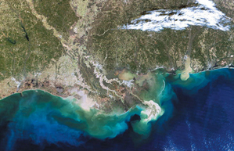
Planktonic algal blooms at river mouths and deltas
Rhone Delta
Caspian Sea

Slide 23
Sedimentation of Diatomaceous Sediments
Vertical Settling
Flocculation
Fecal pellets
Marine snow / excreted polymers
Diatom mats
Lateral & downslope transport
Surface suspension (hypopynal flow)
Bottom/midwater plumes (hyperpynal flow)
Turbidity currents
Slumps
Resuspension or reworking by currents
MARS Project: Monterey and Related Sediments

Slide 24
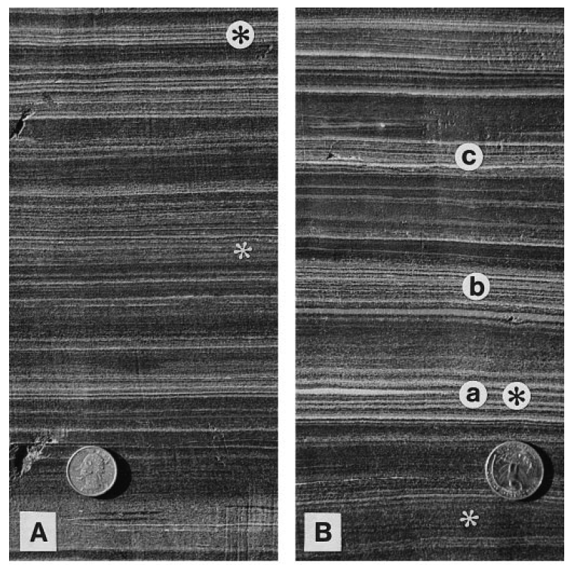
PaleoceneBarmer Hill Formation
Monterey Formation
Chang et al. (1999)
Behl

Slide 25
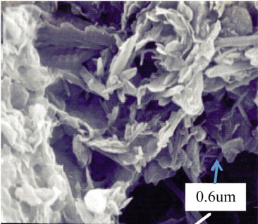
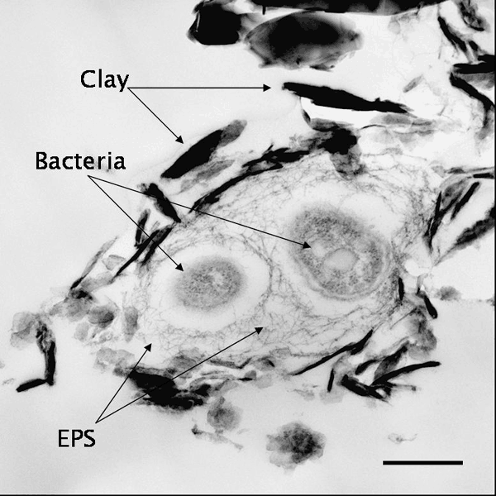
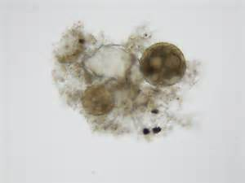
Floccules

Slide 26
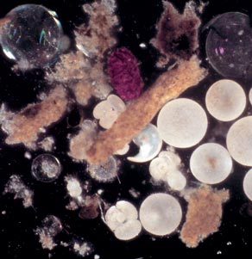
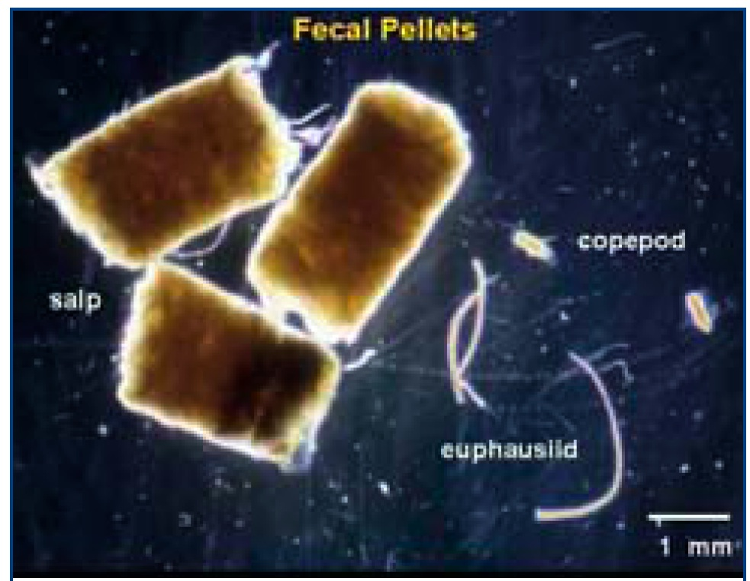
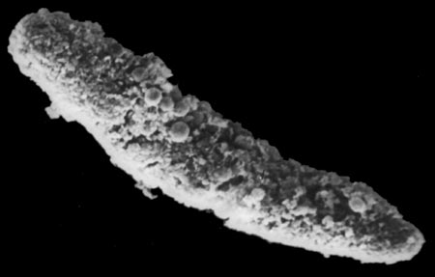
Fecal pellets

Slide 27
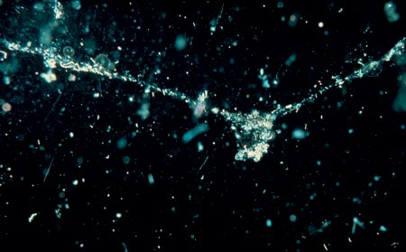
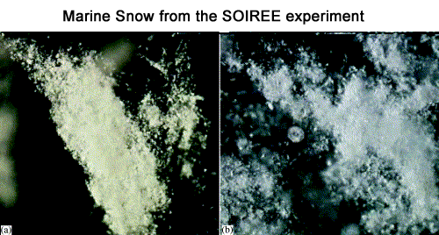
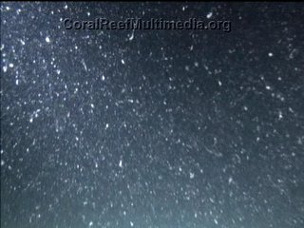
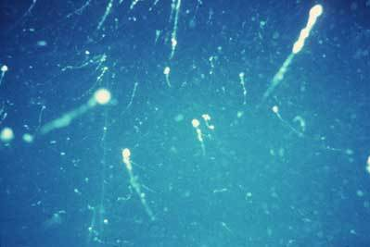
Marine Snow

Slide 28
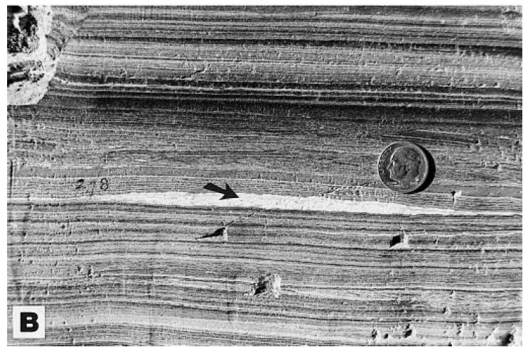
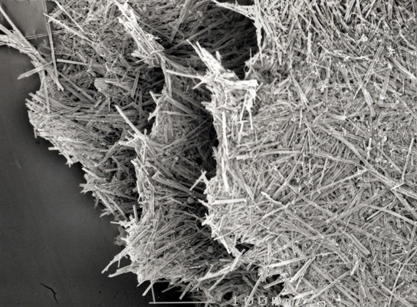
Chang et al. (1999)
Diatom mats
Pike, Kemp

Slide 29
Sedimentation of Hemipelagic Sediments
Vertical Settling
Flocculation
Fecal pellets
Marine snow
Diatom mats
Lateral & downslope transport
Surface suspension (hypopynal flow)
Bottom/midwater plumes (hyperpynal flow)
Turbidity currents and gravity flows
Slumps
Resuspension or reworking by currents
MARS Project: Monterey and Related Sediments

Slide 30
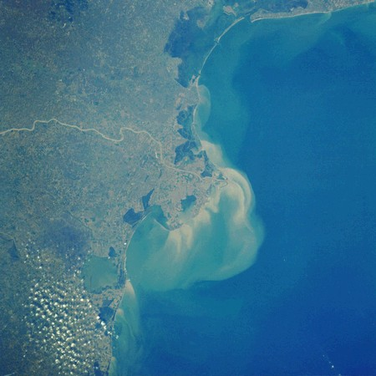
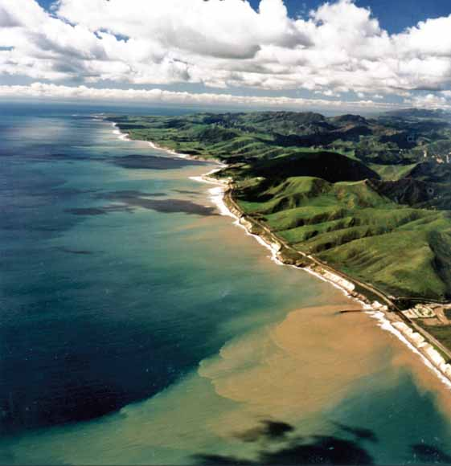
Transport by turbid plumes, both hypo- and hyperpycnal

Slide 31
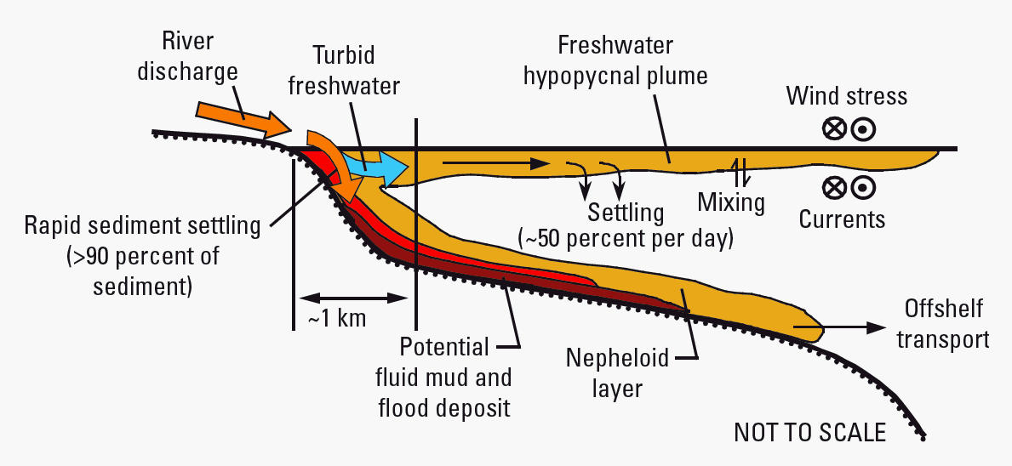
Warrick et al. (2004)

Slide 32
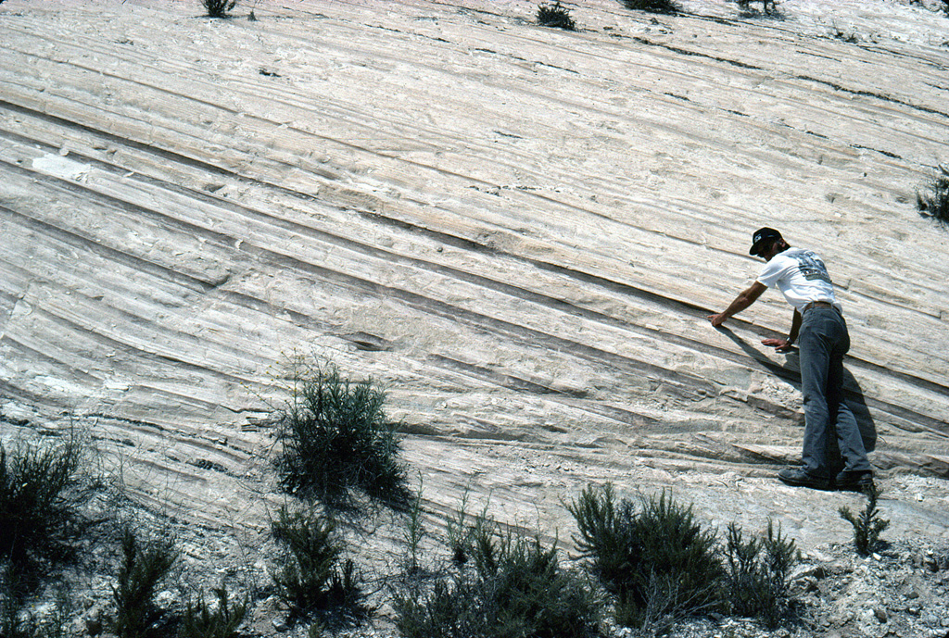
Muddy event deposits in diatomite (Lompoc)

Slide 33
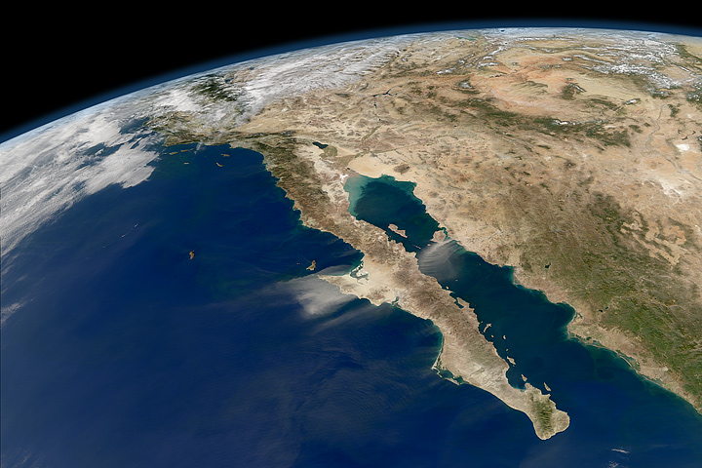
Eolian dust (silt and clay…and iron)

Slide 34
Controls of Sediment Distribution
Seafloor morphology
Basin, slope, banktop/shelf
Proximal or Distal setting
Inner or outer basins
Arid or Humid climate
Riverine or eolian supply, or starved for detritus
Currents
Marginal location and water depth
MARS Project: Monterey and Related Sediments

Slide 35
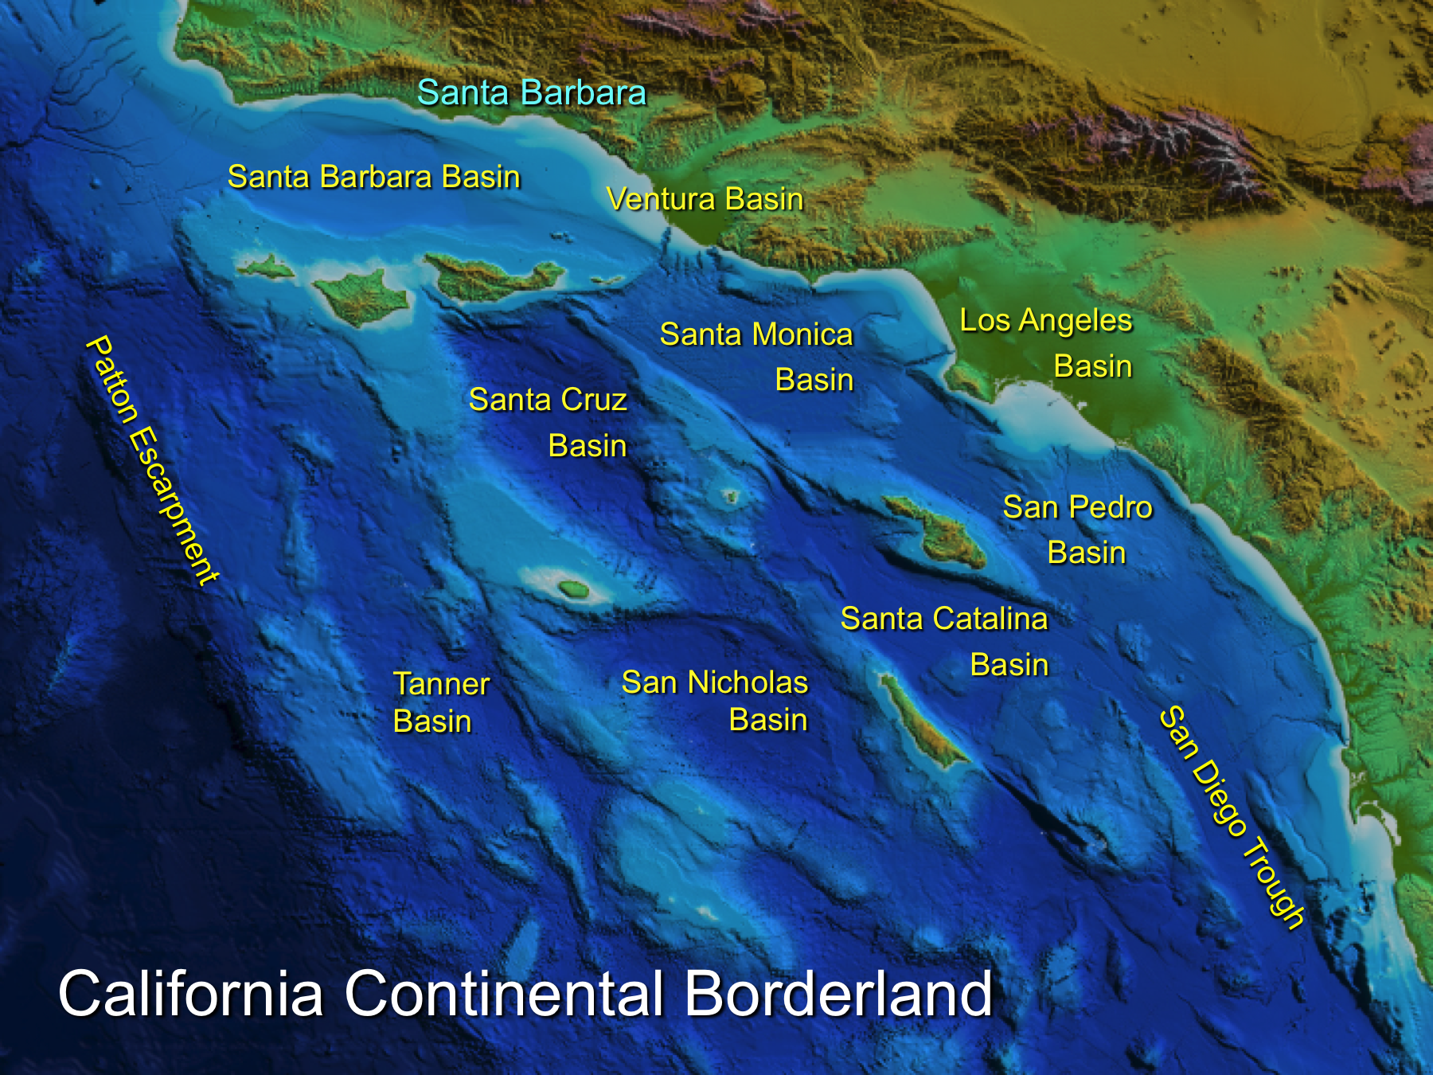

Slide 36
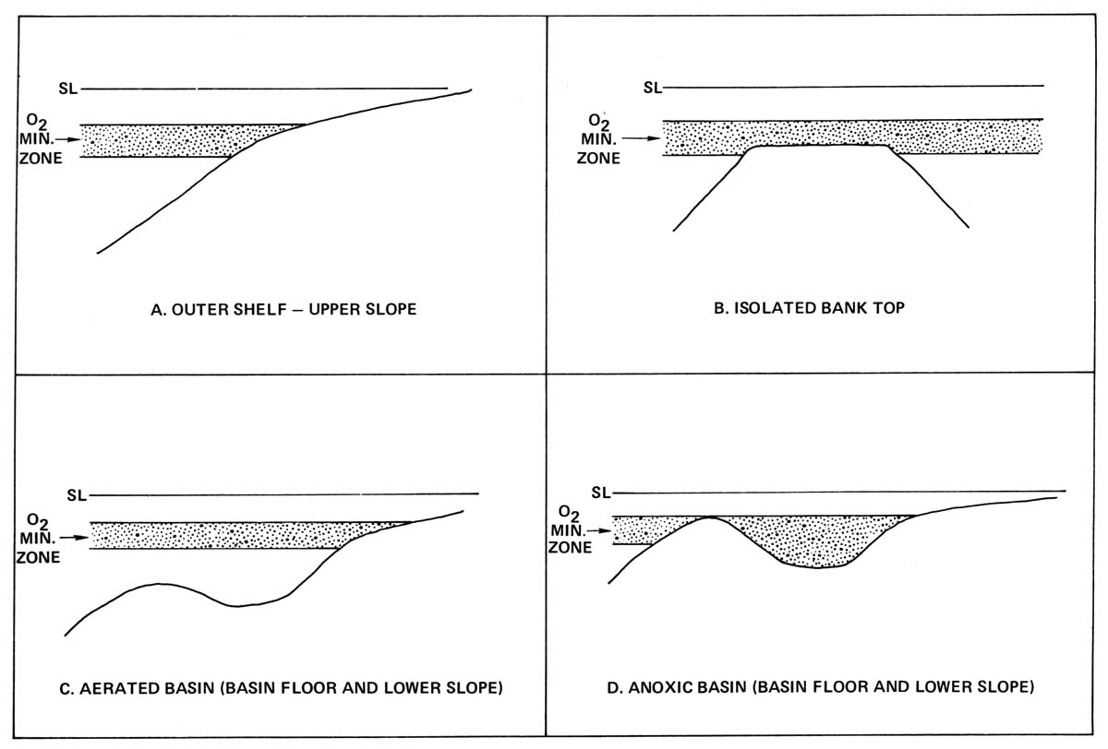
Varied sedimentary environments & facies
Pisciotto & Garrison (1981)

Slide 37
Santa Barbara Model
Distal locations
Primary sediment is hemipelagic
Redistributed off highs
Concentrated in depocenters
(Hornafius, 1991)
Notes:
SB Model- all detrital sedimentation trapped by near shore basins
Banktops: Isolated bathymetric highs
Subjected to current souring and phosphatic hardgrounds
Basinal Setting: axis of Santa Barbara Channel
Receiver of continuous deposition

Slide 38
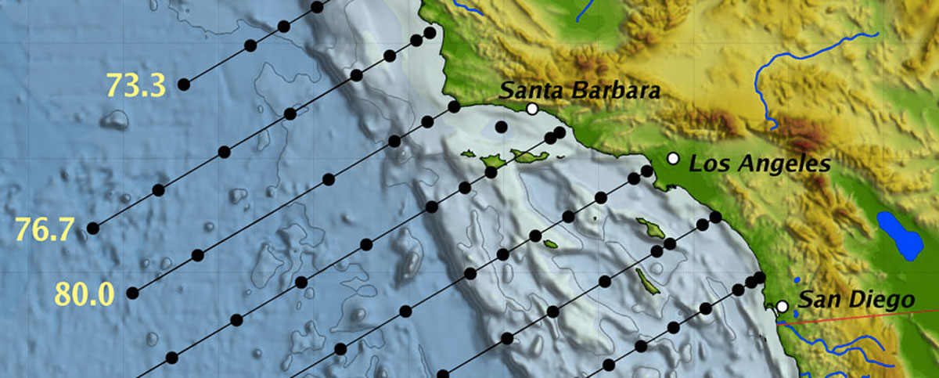
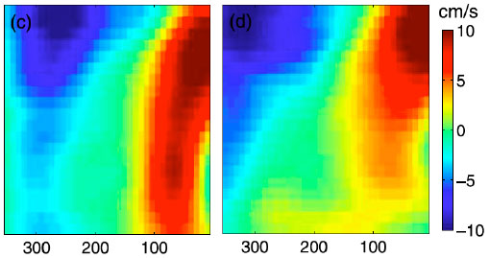
Velocity section off Pt. Conception
(m)
Max velocity >40 cm/s
Gay & Chereskin (2009)
km offshore

Slide 39
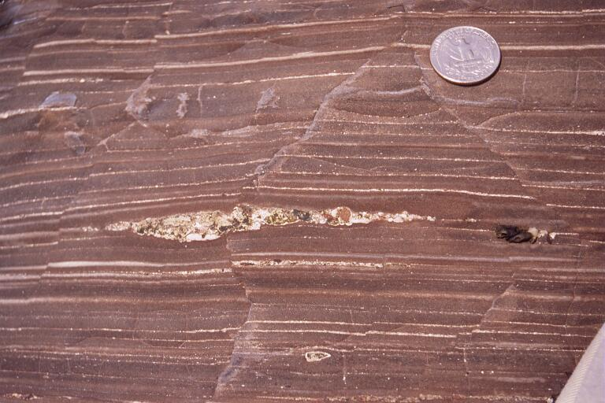
Key sedimentary structures and fabrics
Bottom scour by episodic currents

Slide 40
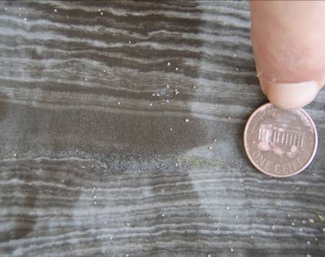
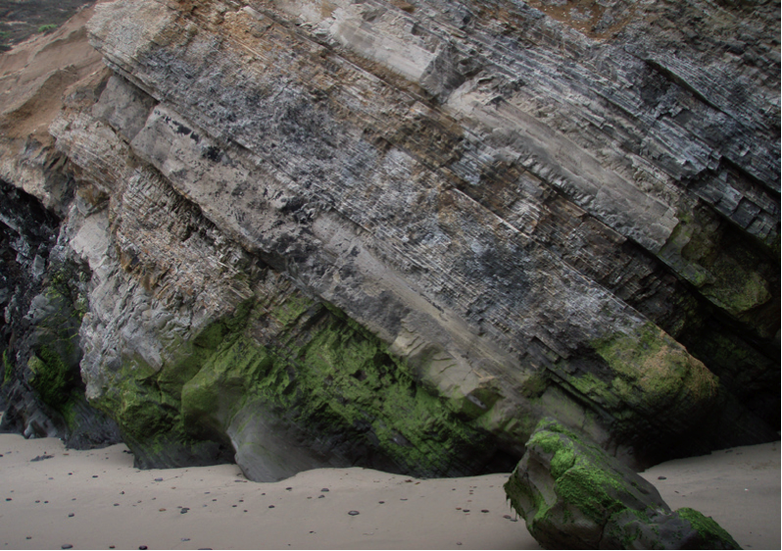
Scour and graded beds

Slide 41
Scoured Surfaces, Onlap, and Mud Drapes

Slide 42
Chang & Grimm (1999)
Slope instability and mobility

Slide 43
IMZ: Intrastratal Microfaulted Zones

Slide 44
IMZ: Intrastratal Microfaulted Zones

Slide 46
Incipient sedimentary breccia

Slide 48
Slumps in more detrital-rich sediments

Slide 49
Slumps

Slide 50
Slumps to muddy turbidites to fluidized flows
“Speckled Beds”
Chang & Grimm (1999)

Slide 51
Gravity flow deposits: speckled beds

Slide 52
“Speckled Beds”:
diatomaceous gravity flows

Slide 53
Interbedded laminated & speckled diatomite and SS

Slide 54
Interbedded SS & laminated & muddy speckled diatomites

Slide 56
Intraformational diatomite & sand conglomerate

Slide 57
Diatomite interbedded
with sandstone &
Intraformational sandy conglomerate

Slide 58
“Doomed Pioneers”
Föllmi & Grimm (1990) Grimm & Föllmi (1994)

Slide 59
“Doomed Pioneers”

Slide 60
Winnowed Highs: Mixed Diatomite and Clastics Facies Model
Scoured surfaces lag deposits D- and stromatolitic phosphates or bioturbated pelagic drape
Truncation surfaces
IMZ
Sedimentary breccias Slumps Speckled beds
Intraformational conglomerates
Sand, silt or diatom turbidites
Doomed Pioneers
Laminated hemipelagites
Rick Behl (2014)
Expanded from Garrison (1992) and Grimm and Orange (1997)

Slide 61
Sand-rich: Mixed Diatomite and Clastics Facies Model
Scoured surfaces or bioturbated pelagic drape
Clean Speckled beds
Intraformational conglomerates
Muddy Speckled beds
Muddy Speckled beds
Sand, silt turbidites
Rick Behl (2014)
Expanded from Garrison (1992) and Grimm and Orange (1997)

Slide 62
Deposition Patterns
Uniform thickness/ Uniform composition
Basinal thickening/ Uniform composition
Basinal thickening/ Silica-rich basin
Basinal thickening/ Detrital-rich basin
Eberle and Behl (2015)

Slide 63
Two End-Member Examples
Santa Barbara Basin (clastic-starved)
Bathymetric highs were subjected to currents that resulted in attenuated sedimentary sections, whereas continuous sedimentation occurred in the surrounding basins. (Hornafius, 1991)
Lost Hills Fractured Shale Pool (clastic-supplied)
Site of anticlinal folding where uplift produced a raised bank protected from bottom-seeking sediment gravity flows. (McGuire et al., 1983)
MARS Project: Monterey and Related Sediments

Slide 64
Santa Barbara Channel
(Hornafius, 1991)
MARS Project: Monterey and Related Sediments

Slide 65
Banktop
Slope
Basin
Shale
Chert
Hornafius (1991)

Slide 66
20 miles
Bohacs & Ferrin (in review)

Slide 67
Case Studies
Santa Barbara Channel
Bathymetric highs were subjected to currents that resulted in attenuated sedimentary sections, whereas continuous sedimentation occurred in the surrounding basins. (Hornafius, 1991)
West Side San Joaquin
Site of anticlinal folding where uplift produced a raised bank protected from bottom-seeking sediment gravity flows. (McGuire et al., 1983)

Slide 68
Lost Hills
Proximal Basin
Hemipelagic & detrital sedimentation
Tubidites
(McGuire et al., 1983)
MARS Project: Monterey and Related Sediments
Notes:
50 miles nw bakersfield
Narrow anticlinal structure
Image in slide above: buena vista

Slide 69
Buena Vista Field Model
(Modified from MacPherson, 1978)
MARS Project: Monterey and Related Sediments
Notes:
Buena Vista Hills Model

Slide 70
Midway-Sunset/Elk Hills Model
(Lamb et al., 2003)
MARS Project: Monterey and Related Sediments
Notes:
Lost Hills

Slide 71
Updip Facies Variation
Porcelanite
Diatomaceous
Mudstone
(Modified from McGuire et al., 1983)
MARS Project: Monterey and Related Sediments

Slide 72
Summary
Both Settings
Sediments thicken towards the basin or troughs and thin towards banktop or structural high.
Distal Basins
Reworking and redeposition results in purer and thicker diatomaceous sediments accumulating in basin lows.
Proximal Basins
Bottom-seeking clastic-rich gravity flow sediments fill the basin lows, diluting the biogenic content.
MARS Project: Monterey and Related Sediments

