Slide 1
Geochemistry of the Monterey Formation in the San Joaquin Basin, California
By Alex Sedlak
California State University, Long Beach
Advisor: Richard Behl
MARS Project: Monterey and Related Sediments

Slide 2
Objective
Determine the geochemical characteristics of the Monterey Formation in the San Joaquin Basin using trace metal abundances, carbon isotopes, and well-logs
Develop a method of correlation for the San Joaquin Basin utilizing geochemistry

Slide 3
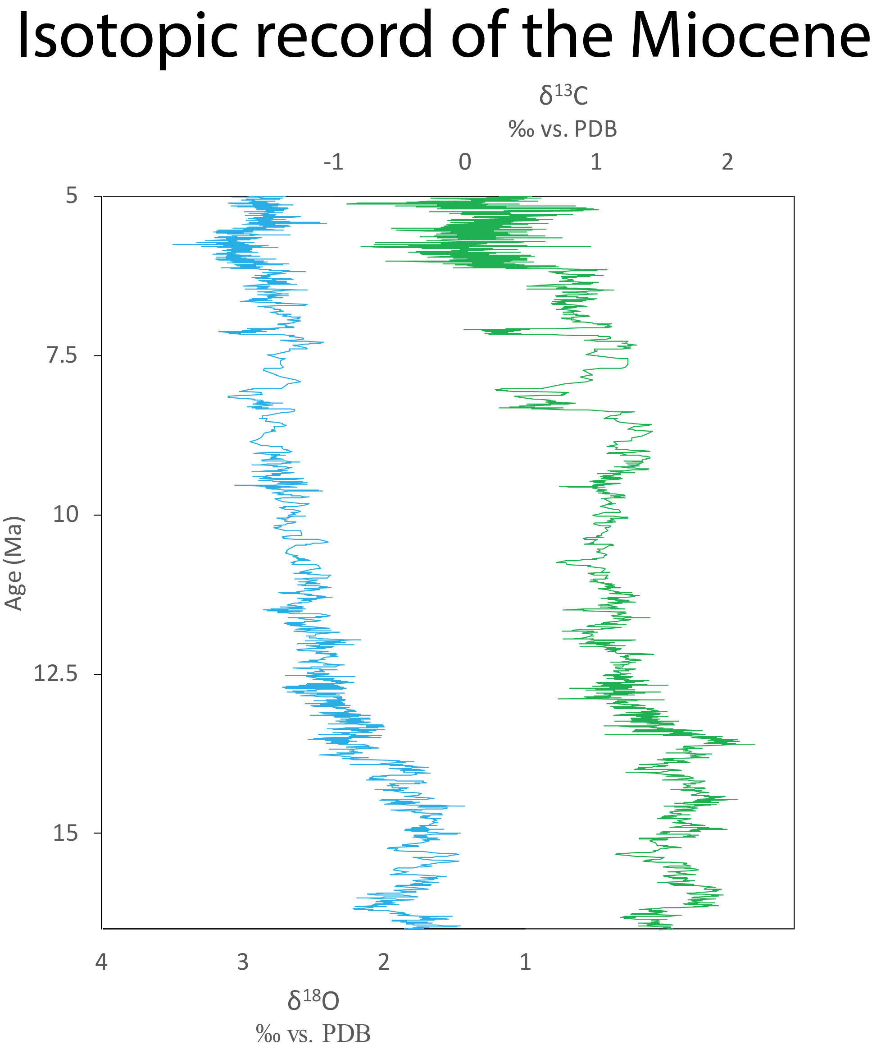
Introduction: Miocene climate and the Monterey
Mid-late Miocene: development of polar ice sheets
Thermohaline circulation
Strong upwelling currents
Diatom productivity
Monterey Formation (16.5-5 Ma)
Organic-rich
Oxic-anoxic cycles
Lithologic heterogeneity
Global record obtained from benthic foraminifera. From Zachos et al. (2001)

Slide 4
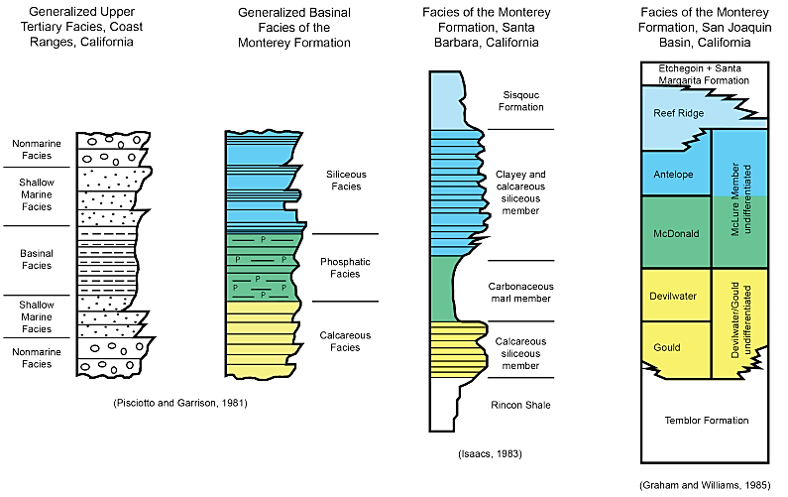
Introduction: Monterey Stratigraphy
Figure from Mosher (2013)

Slide 5
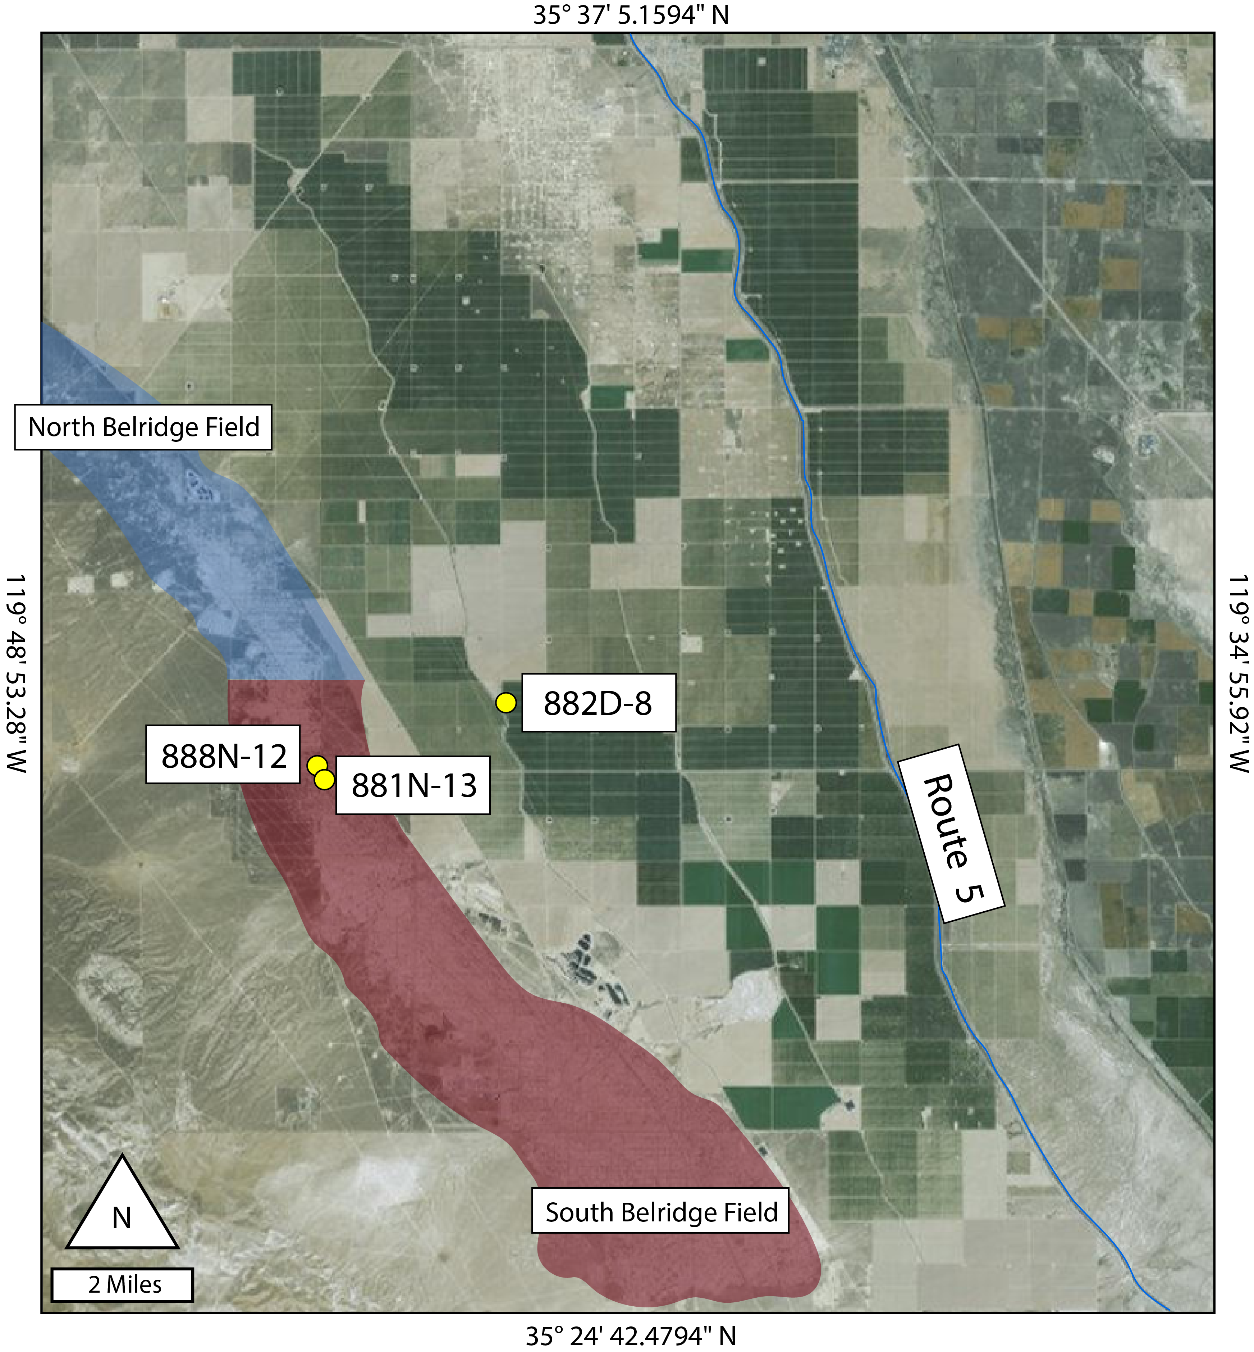
Materials
Cuttings from 3 wells within the San Joaquin Basin (courtesy of Aera Energy LLC)
888N-12 and 881N-13:
Belridge anticline
Thorndyke (882D-8):
Off of anticline
Comprehensive well log suite
Core
XRF
Source rock eval
Photos

Slide 6
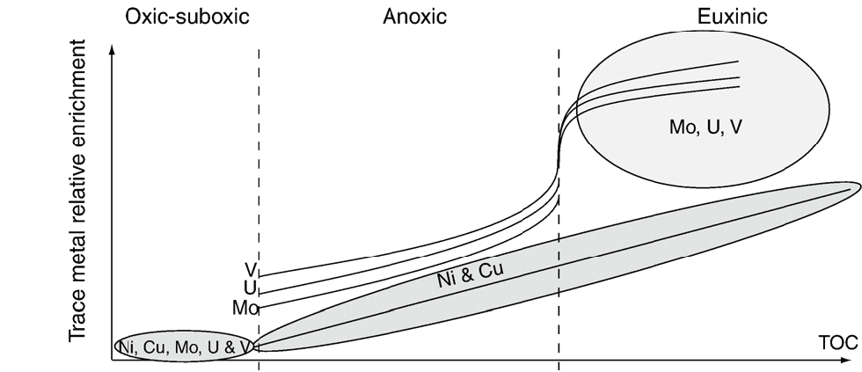
Methods
Trace elemental analysis
Proxies for paleoenvironmental conditions
Redox: Mo, V, U
Productivity: Ni, Cu, Cd, Ba
Detrital content: Ti, Th
Analyzed at UC Riverside
Total rock digest
Samples run on ICP-MS
Figure from Tribovillard et al. (2006)

Slide 7
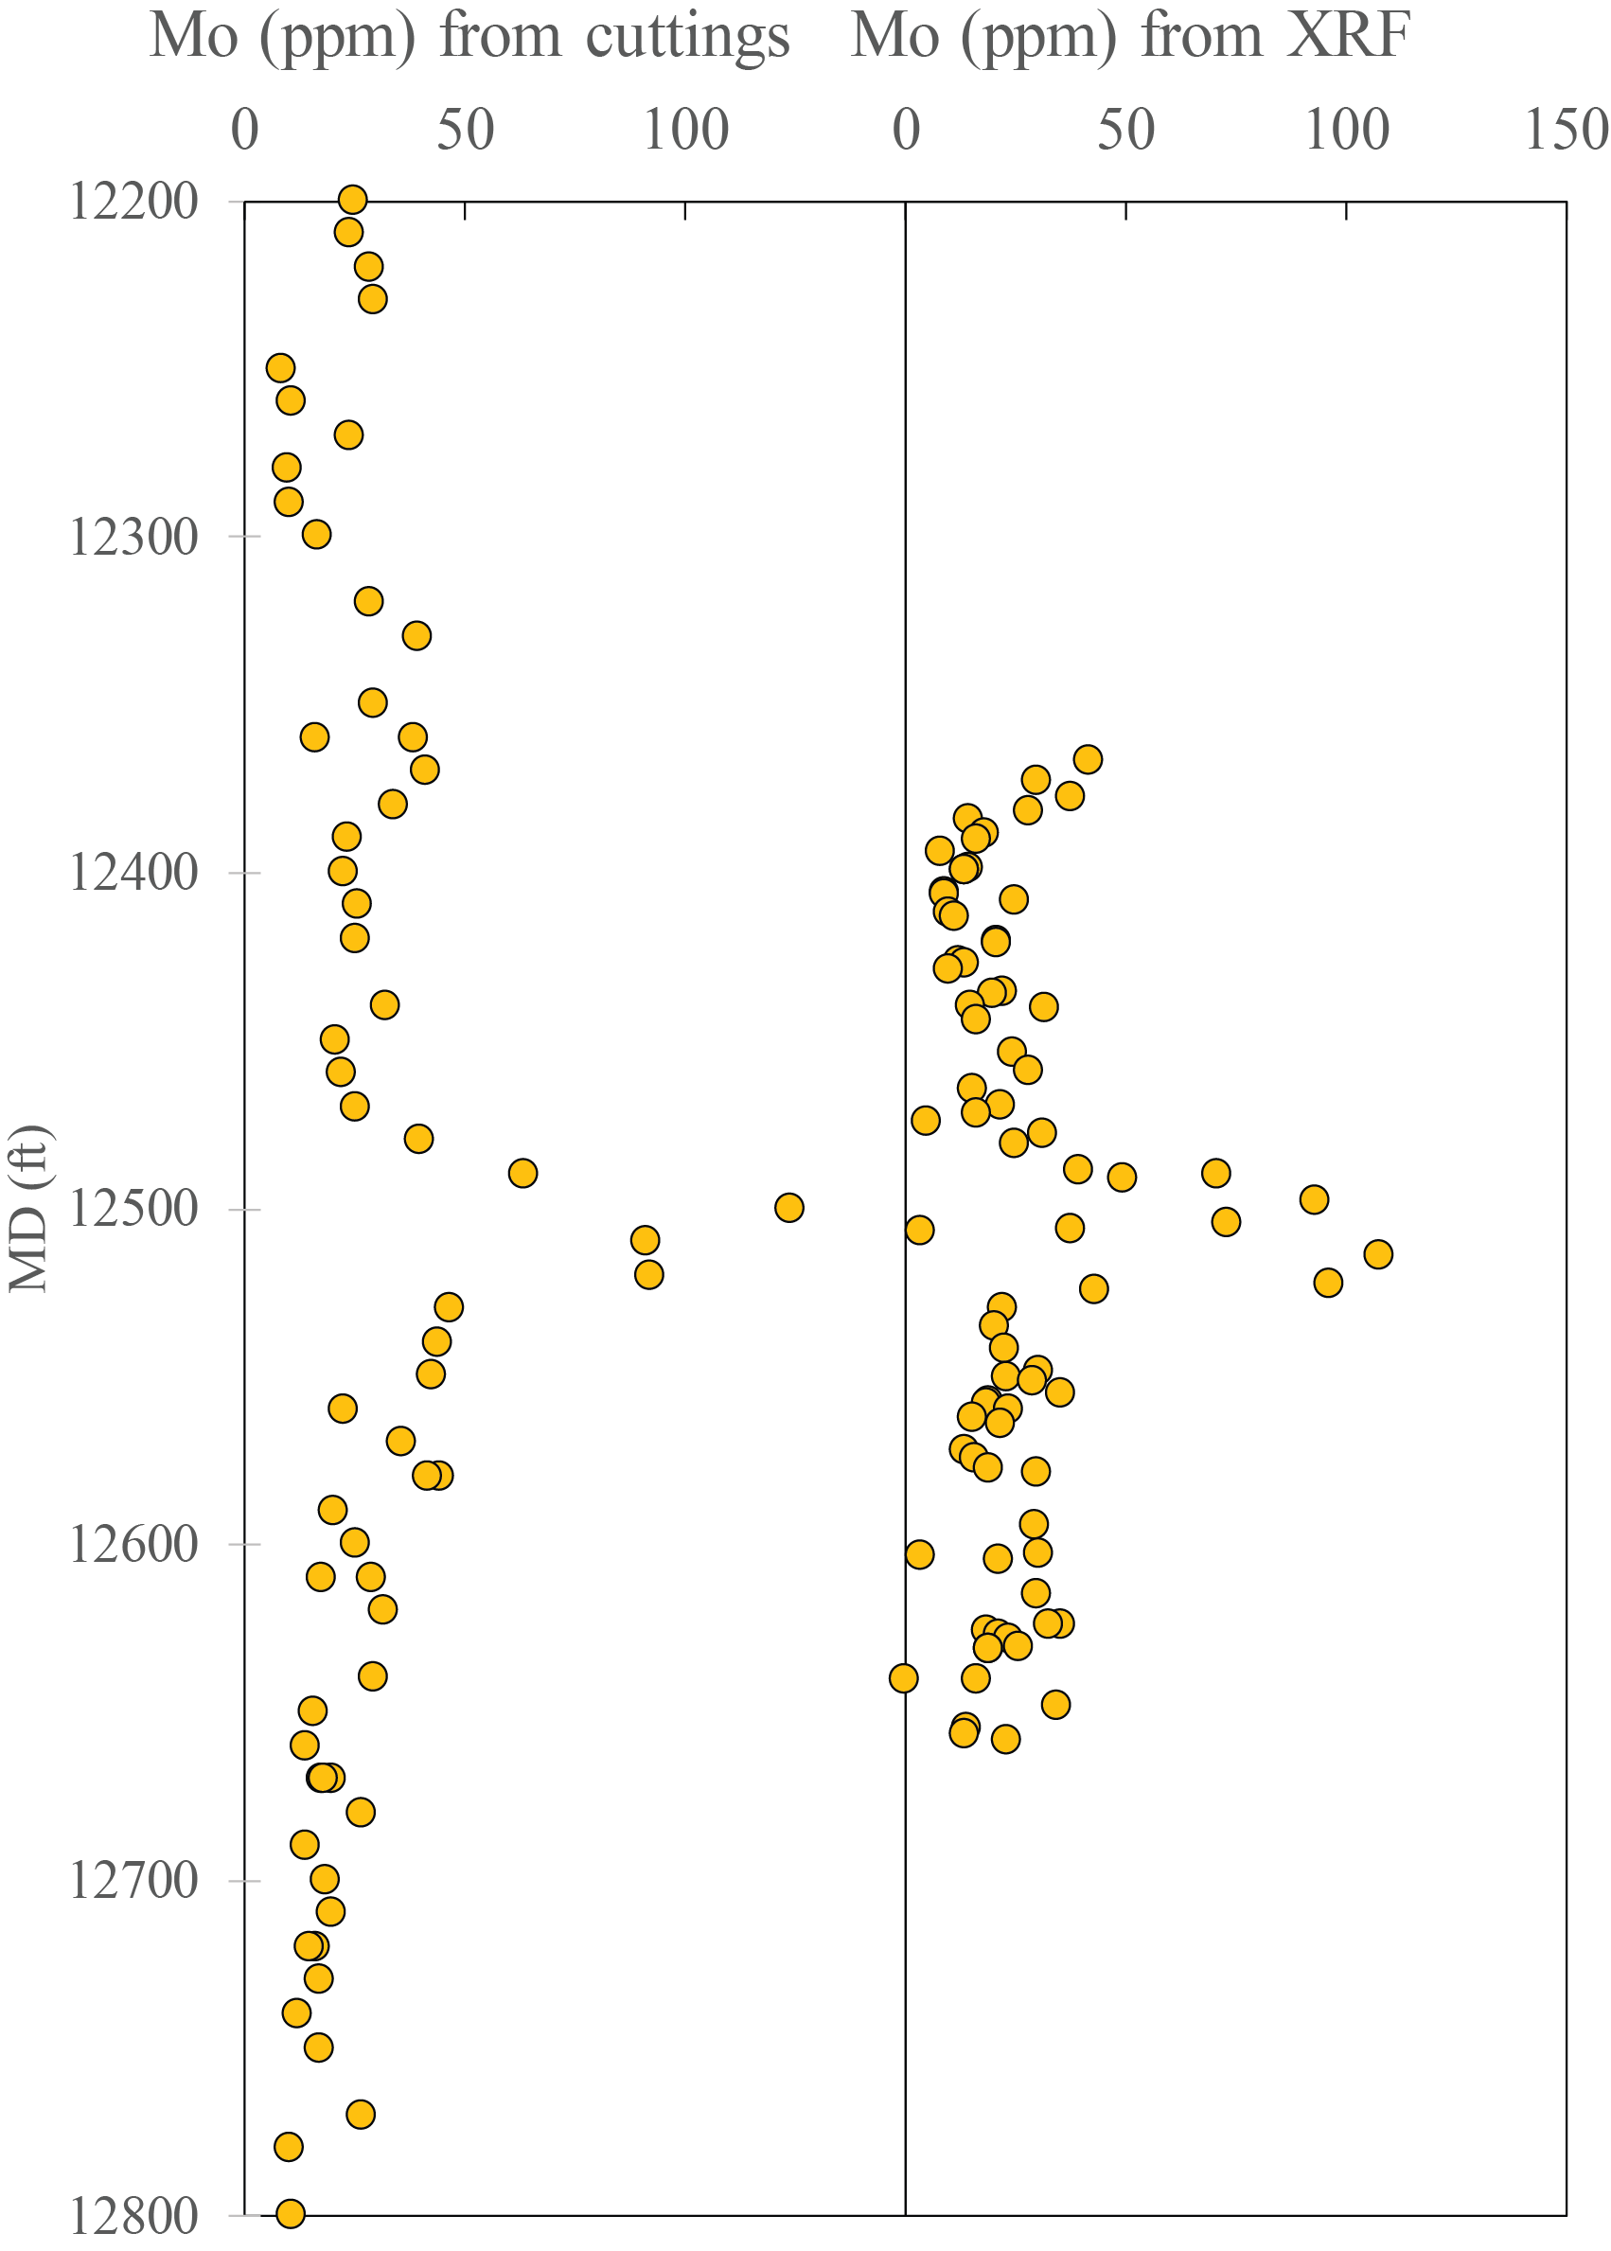
Methods
Cuttings vs. core, XRF vs. trace metal analysis
cuttings can capture same events as cores
XRF and trace metal analysis are comparable

Slide 8
Thorndyke well

Slide 9
Thorndyke well
Low phosphate, low carbonate
Moderate phosphate, low carbonate
Dolomitic
Phosphatic

Slide 10
Thorndyke well
Low phosphate, low carbonate
Moderate phosphate, low carbonate
Dolomitic
Phosphatic, detrital rich

Slide 11
Thorndyke well
Low phosphate, low carbonate
Moderate phosphate, low carbonate
Dolomitic
Phosphatic, detrital rich

Slide 12
Thorndyke well
Low phosphate, low carbonate
Moderate phosphate, low carbonate
Dolomitic
Phosphatic, detrital rich

Slide 13
Thorndyke well
Low phosphate, low carbonate
Moderate phosphate, low carbonate
Dolomitic
Phosphatic, detrital rich

Slide 14
Thorndyke well
Low phosphate, low carbonate
Moderate phosphate, low carbonate
Dolomitic
Phosphatic, detrital rich

Slide 15
Thorndyke well
Low phosphate, low carbonate
Moderate phosphate, low carbonate
Dolomitic
Phosphatic, detrital rich
*Hydrogen indices provided by Aera Energy, LLC

Slide 16
Thorndyke well
Low phosphate, low carbonate
Moderate phosphate, low carbonate
Dolomitic
Phosphatic, detrital rich

Slide 17
Thorndyke well
Low phosphate, low carbonate
Moderate phosphate, low carbonate
Dolomitic
Phosphatic, detrital rich
Anoxic event, moderate productivity
Anoxic and high productivity, no major event
Anoxic event, high productivity
Anoxic event, high productivity
Euxinic event, high productivity
Oxic, moderate productivity
Oxic, low productivity

Slide 18
Thorndyke well
Member boundaries correspond to changes in both bulk and trace chemistry
Major lithostratigraphic members of the Monterey may be further subdivided by major and trace elemental abundances
Strongest euxinic events:
Correlative with wells of similar basinal position?
Correlative with wells of different basinal position?
Tested in 888N-12 and 881N-13

Slide 19
888N-12
Possible anoxic event

Slide 20
881N-13
Possible anoxic event

Slide 21
Discussion
Geochemical data from cuttings compares favorably to data from cores
Lithostratigraphic boundaries display significant, potentially correlative changes in bulk and trace chemistry
Trace elements allow further subdivision of lithostratigraphic units
Euxinic intervals have strong correlative potential
Future work:
Further sampling of McDonald/Antelope transition
Carbon isotope data
TOC
Ash beds
ECS/Litho Scanner comparison
Cyclicity

Slide 22
Acknowledgments
Richard Behl
MARS team
Aera Energy LLC
Tim Lyons’ lab at UCR

Slide 23
References
Mosher, A., 2013, Detailed lithostratigraphic characterization of Chico Martinez Creek, California, M.S.: United States -- California, California State University, Long Beach, 130 p.
Graham, S. A., and L. A. Williams, 1985, Tectonic, Depositional, and Diagenetic History of Monterey Formation (Miocene), Central San Joaquin Basin, California: AAPG Bulletin, v. 69, no. 3, p. 385–411.
Isaacs, C. M., 1983, Compositional Variation and Sequence in the Miocene Monterey Formation, Santa Barbara Coastal Area, California: Cenozoic marine sedimentation, Pacific margin: Pacific Section, Society of Economic Paleontologists and Mineralogists Special Publication 28, p. 117–132
Mosher, A., 2013, Detailed lithostratigraphic characterization of Chico Martinez Creek, California, M.S.: United States -- California, California State University, Long Beach, 130 p.
Pisciotto, K. A., and R. E. Garrison, 1981, Lithofacies and Depositional Environments of the Monterey Formation, California: The Monterey Formation and related siliceous rocks of California: Los Angeles, Pacific Section, Society of Economic Paleontologists and Mineralogists, p. 97–122
Tribovillard, N., T. J. Algeo, T. Lyons, and A. Riboulleau, 2006, Trace metals as paleoredox and paleoproductivity proxies: An update: Chemical Geology, v. 232, no. 1–2, p. 12–32,
Zachos, J., M. Pagani, L. Sloan, E. Thomas, and K. Billups, 2001, Trends, Rhythms, and Aberrations in Global Climate 65 Ma to Present: Science, v. 292, no. 5517, p. 686–693

