Slide 1
CSULB MARS Project Monterey & Siliceous Sediments Short-Course & Symposium Bakersfield, 5 December, 2016
Richard J. Behl
California State University
Long Beach, CA
MARS Project: Monterey and Related Sediments

Slide 2
Petroleum Geology
Mechanical Stratigraphy & Fractures
Strain partitioning
Deformational style
Fracture networks
Scales of deformation
MARS Project: Monterey and Related Sediments

Slide 3
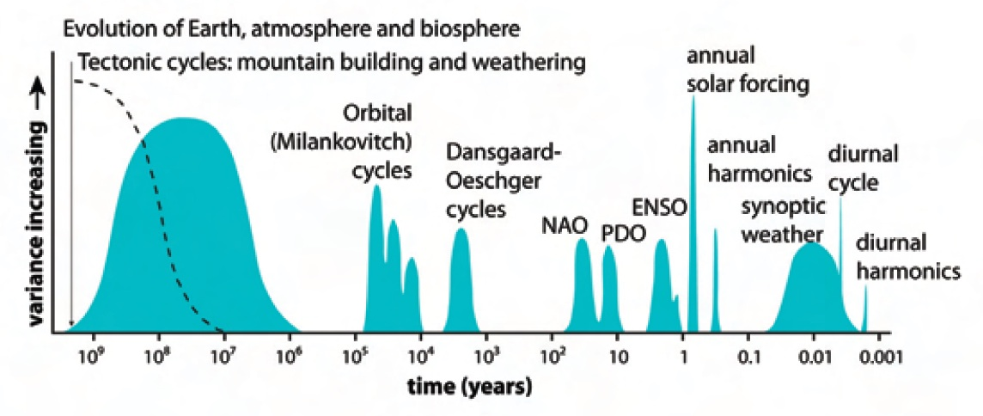
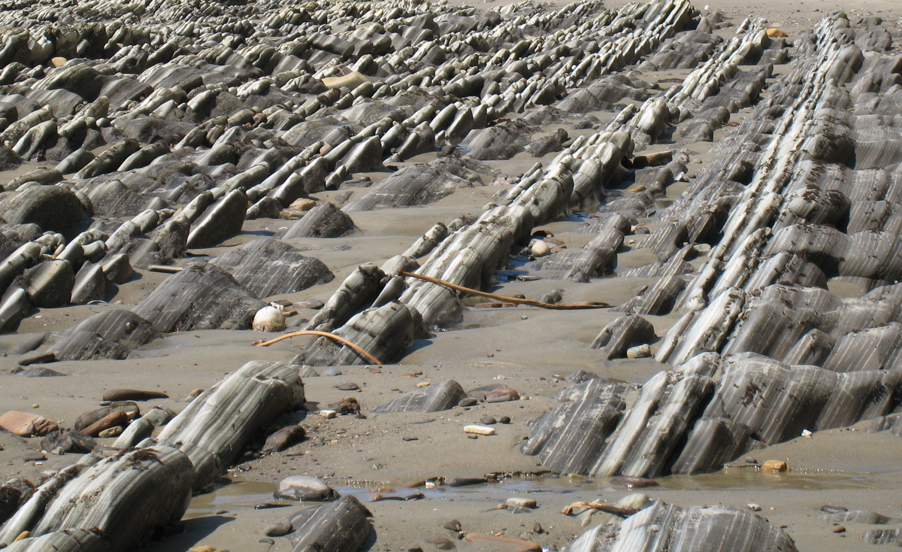
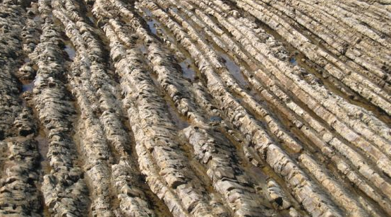
Climate Cycles & Litho-cyclicity
Thurow et al. (2009)

Slide 4
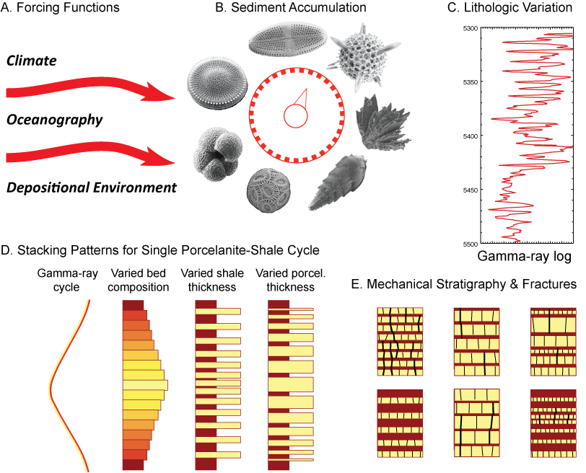

Slide 5
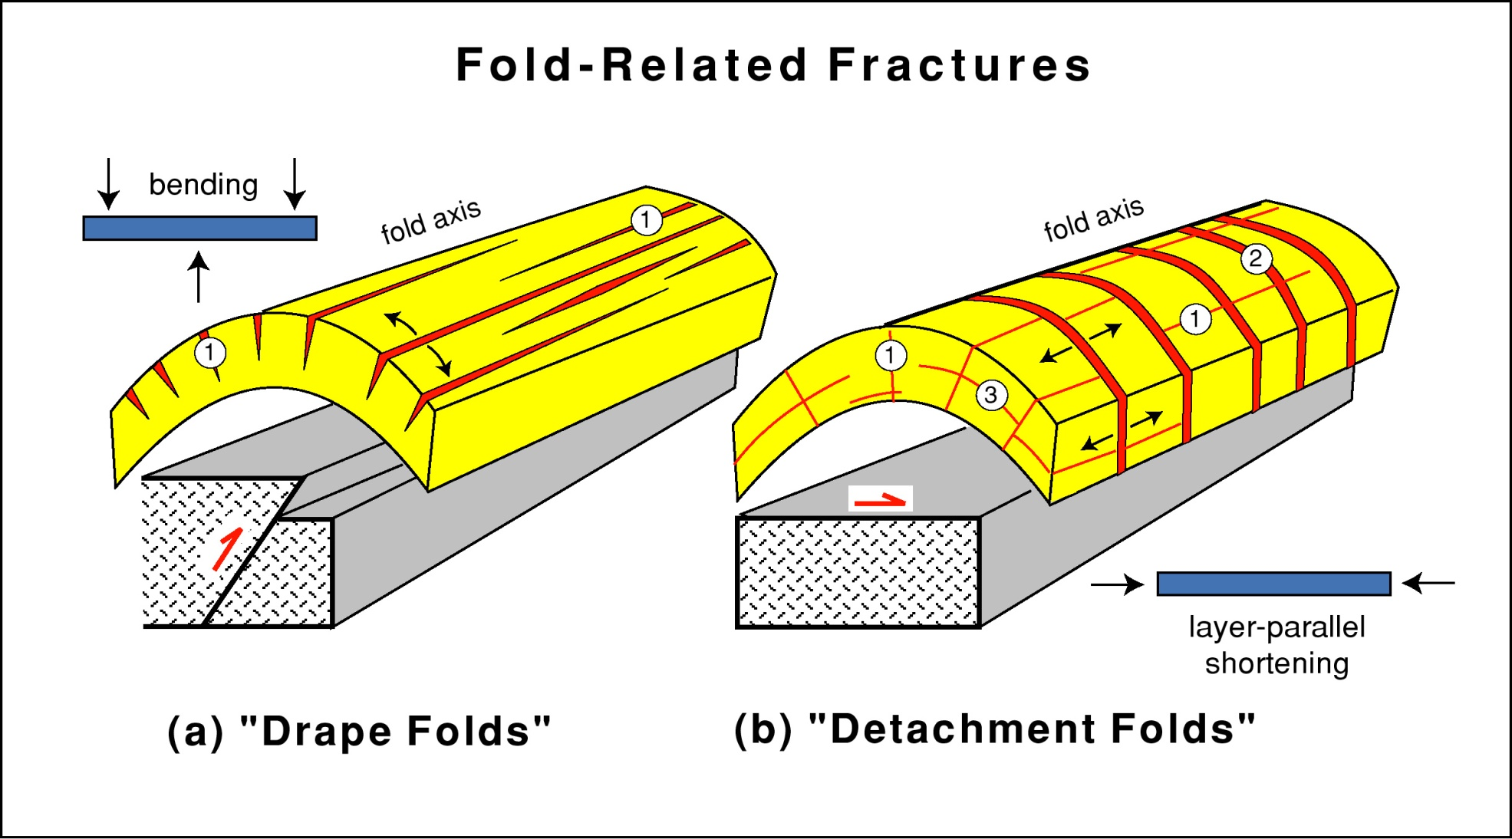
Tectonic / Structural Controls
Hinge-parallel fractures
Hinge-normal fractures
Michael Gross, 2011

Slide 6
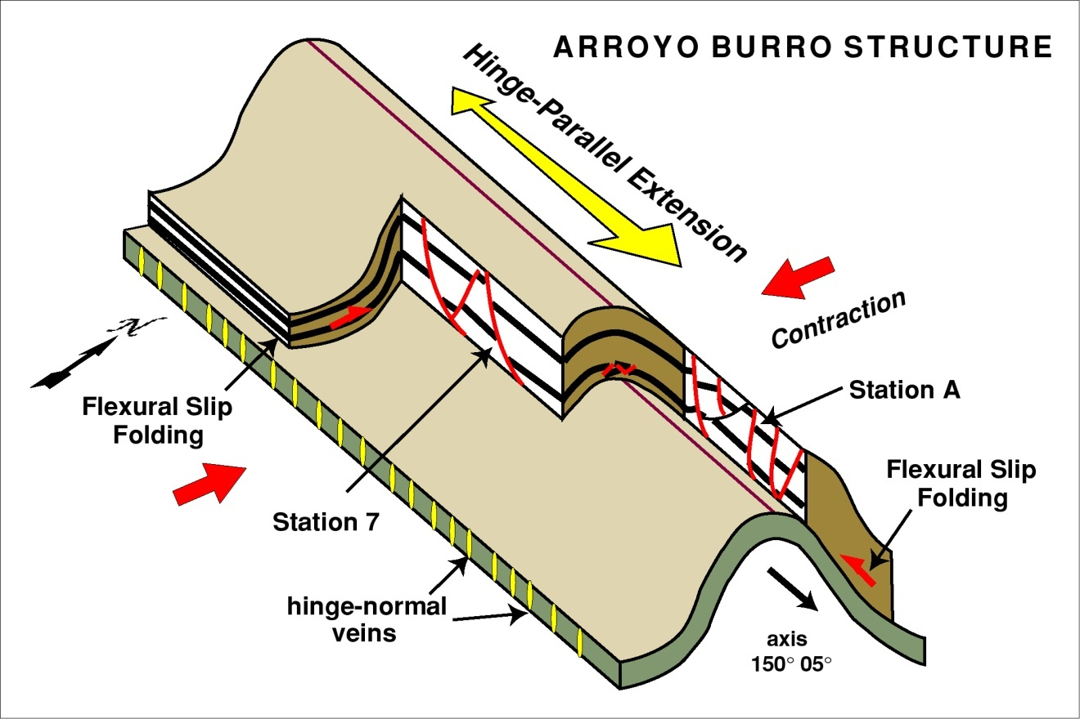
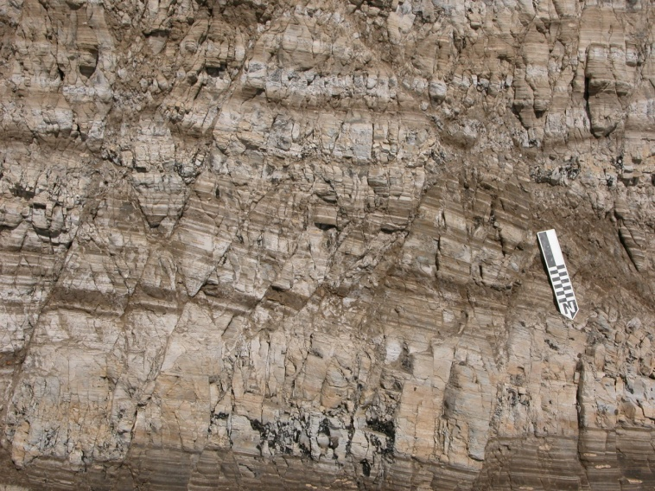
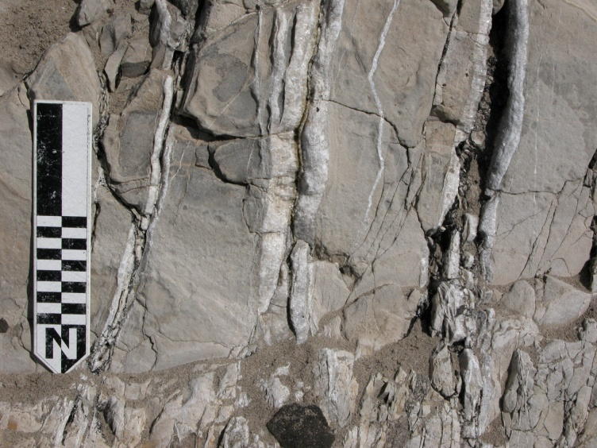
Along-Strike Extension in W. Transverse Ranges Accommodated by Brittle Deformation
Faults in shales (shear)
Veins in dolostones (opening)
Gross et al., 1997

Slide 7
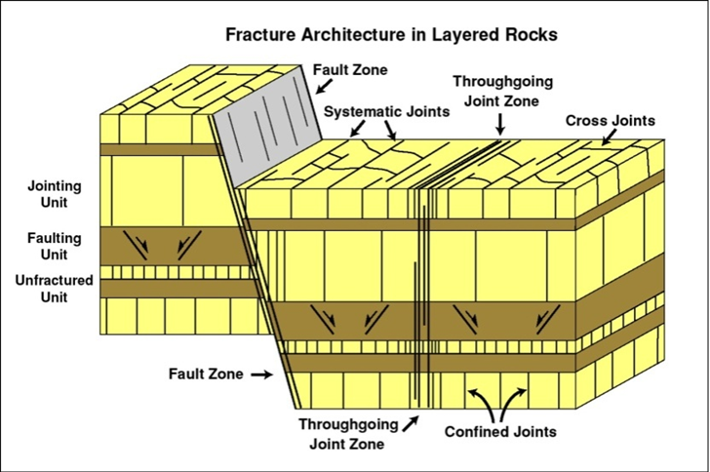
Deformation style and intensity depends on lithology and layer thickness
Gross (1993)

Slide 8
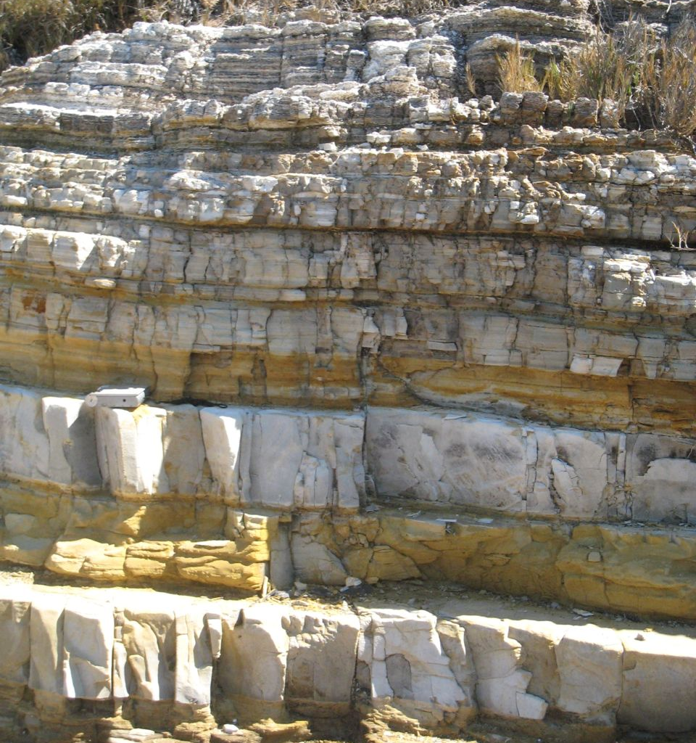
Fracture spacing & layer thickness

Slide 9
Lithology Control on Fracture Density
Monterey Formation
5
4
3
Fracture Density (#/cm)
2
1
0
Chert
Porcelanite
Dolomite
Siliceous
Clay Shale
Shale
Schwalbach et al., 2007

Slide 10
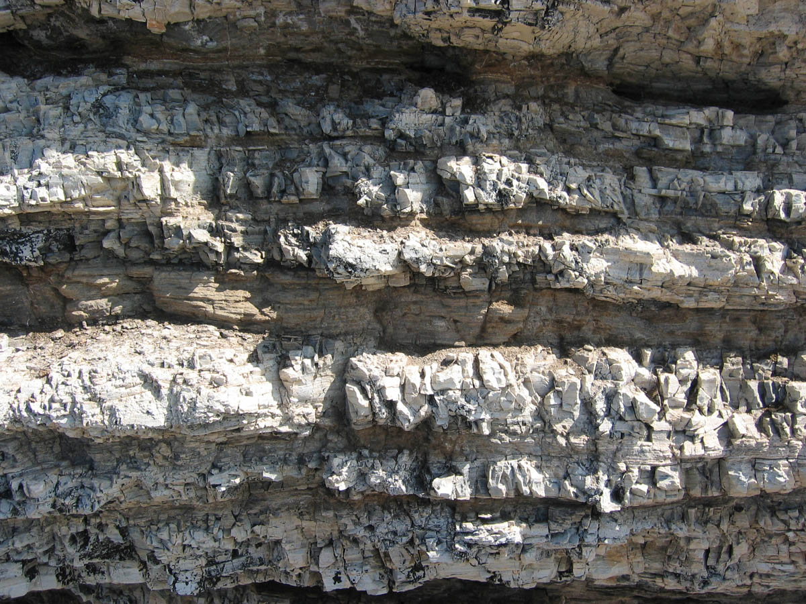
Chert & Mudstone in Outcrop

Slide 11
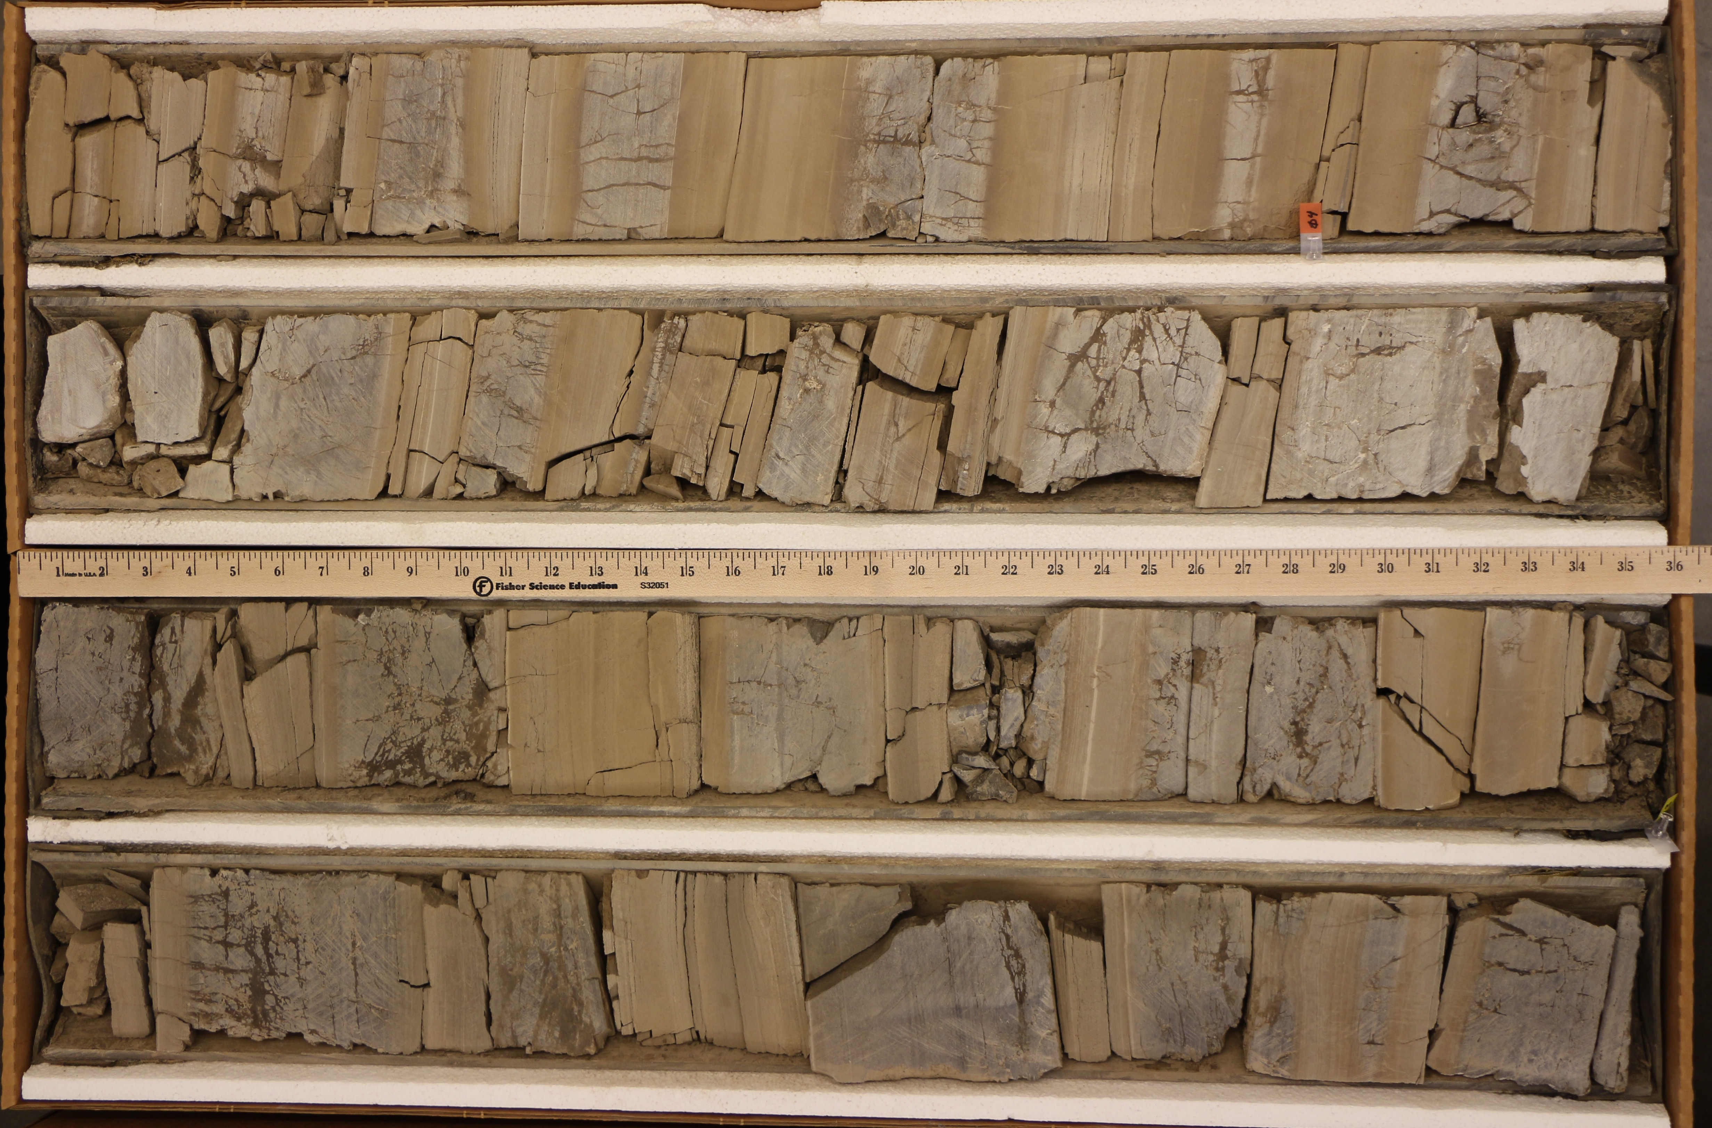
Fracture intensity & lithology in opal-CT chert and mudstone in core

Slide 12
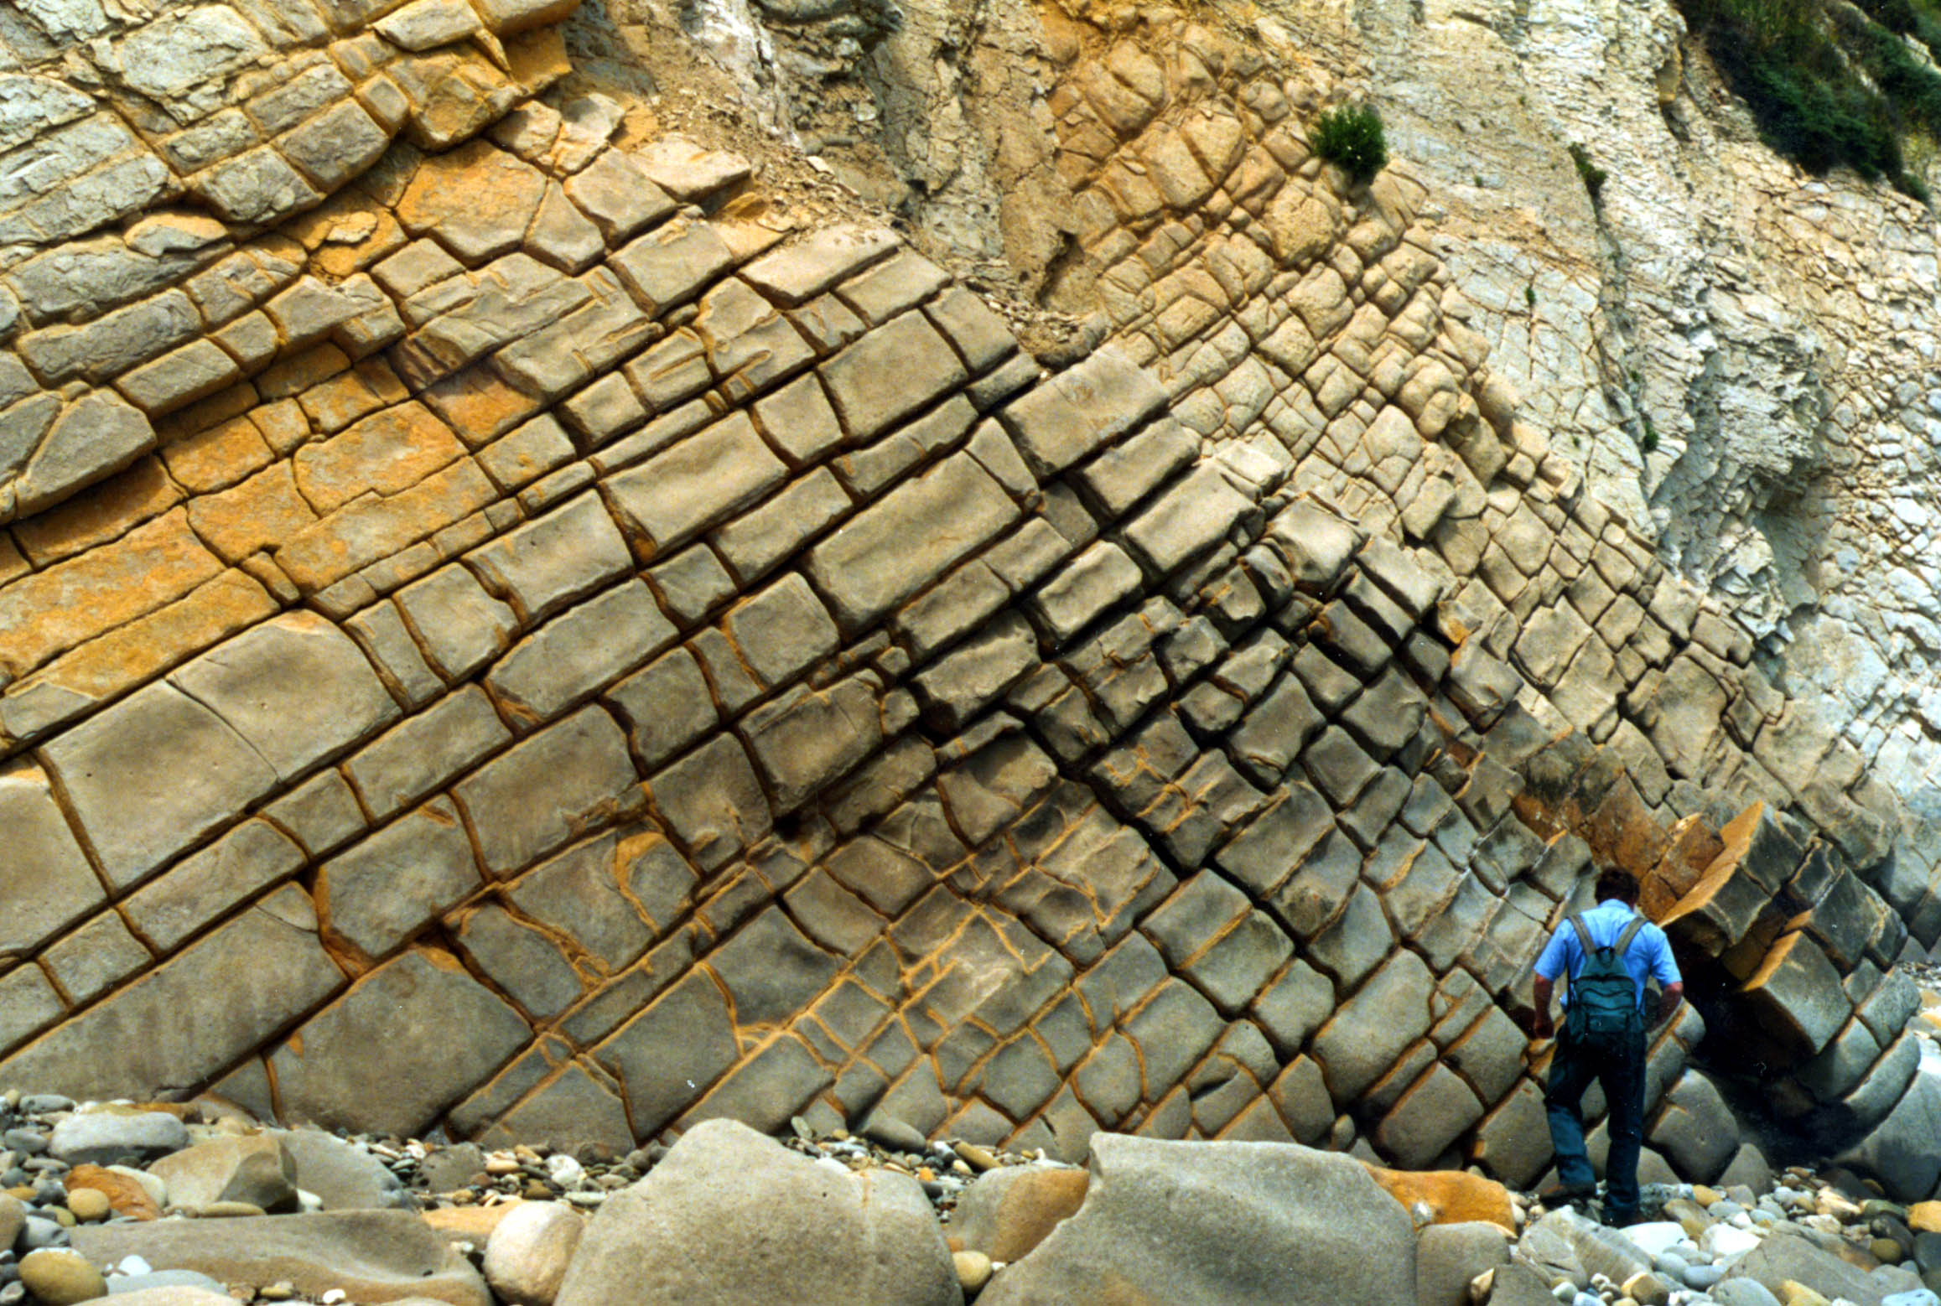
Systematic & cross joint sets in dolomite bed
Photo courtesy of Wendy Bartlett

Slide 13
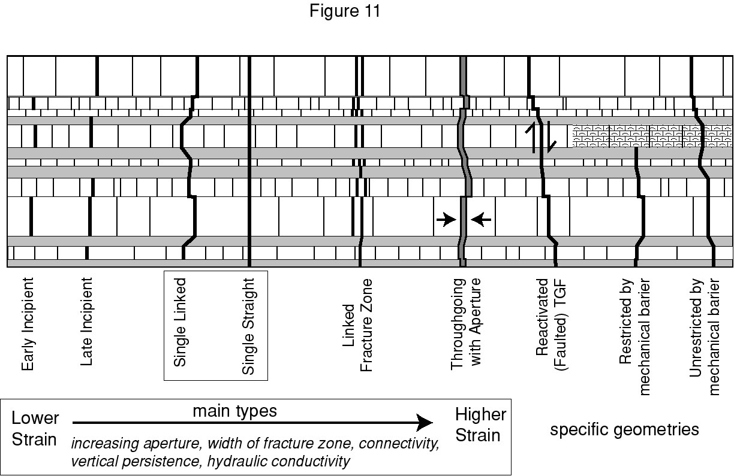
Classification of Through-going Fractures in Layered Rocks
Michael Gross, 2011
Notes:
13

Slide 14
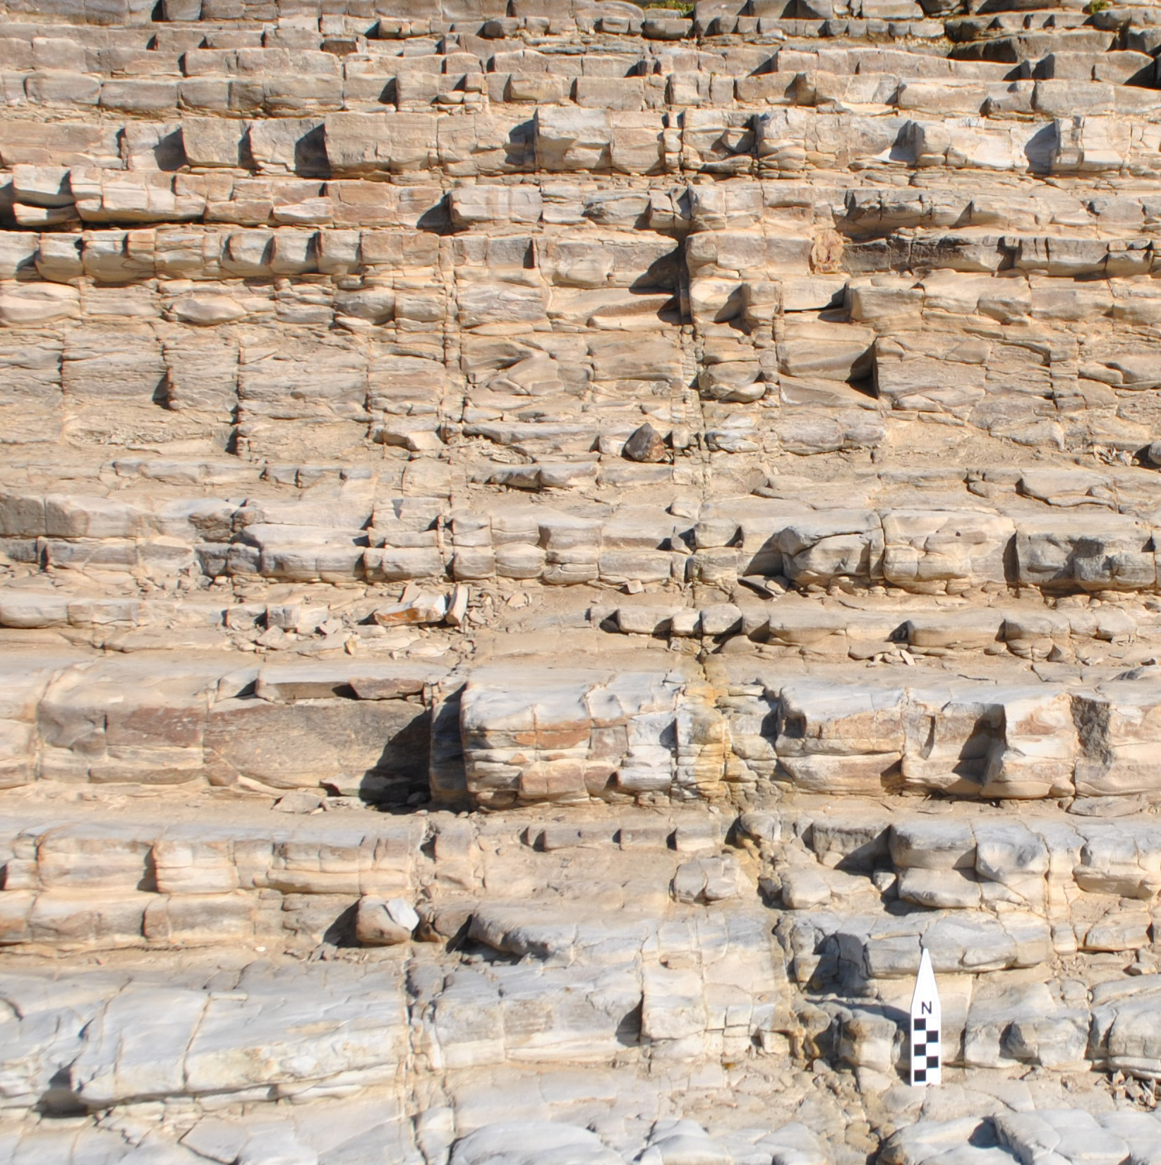
Multi-layer
Bed-confined
Strickland (2013)

Slide 15
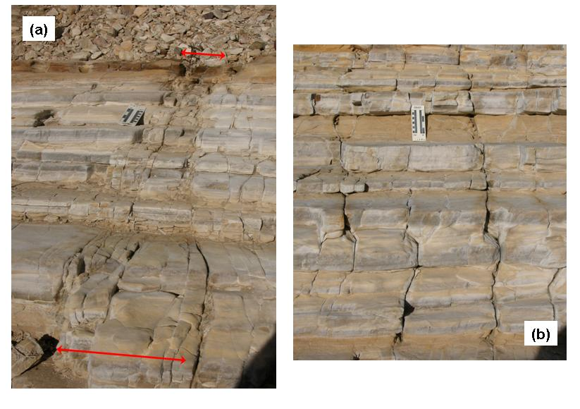
Multi-Layer Fractures, separate and fracture zones
Strickland, 2013

Slide 16
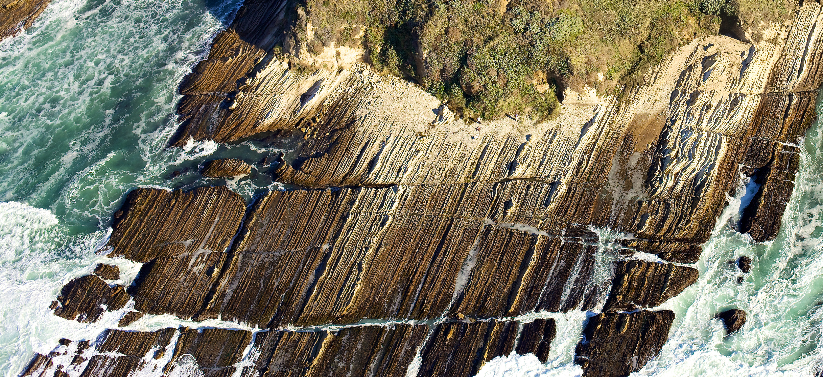
Fracture Scales: single bed to 10’s m
Large through-going
Heather Strickland (2013)

Slide 17
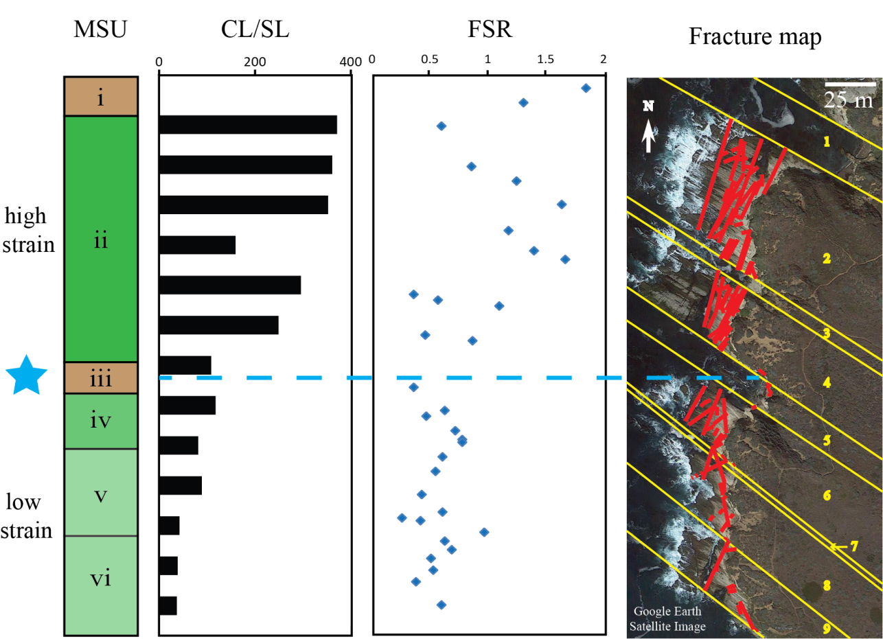
Stratigraphic Variation in Fracture Intensity and Scale
Strickland (2013)

Slide 18
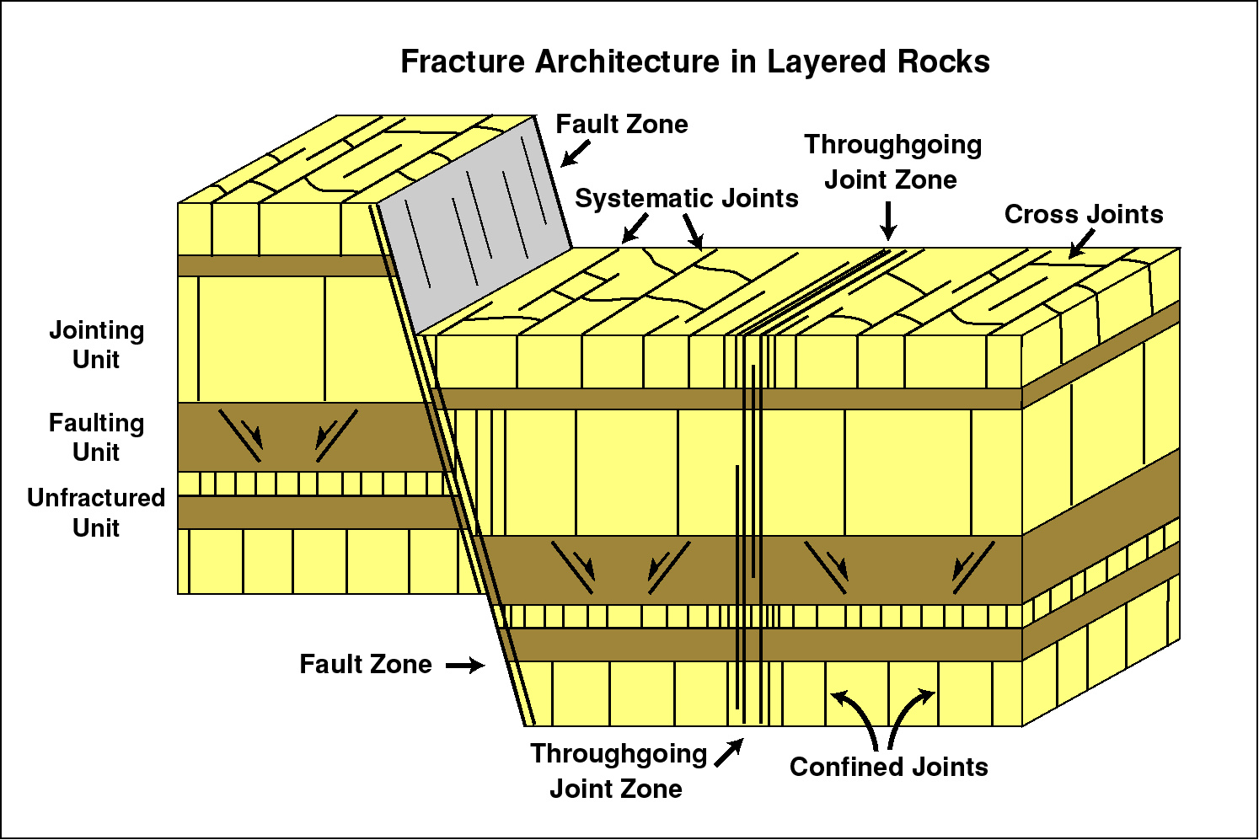
6. Multi-Layer - Throughgoing Fractures
Origin, Geometry, Classification & Distribution
Michael Gross, 2011

Slide 19
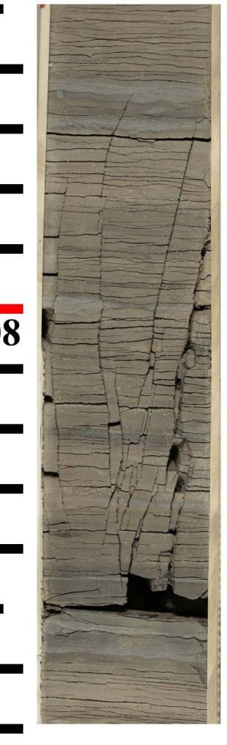
Subsurface Identification
Examples from Monterey Core – vertical wells
Fracture zone (swarm)
Linked throughgoing
fracture
Michael Gross, 2011

Slide 20
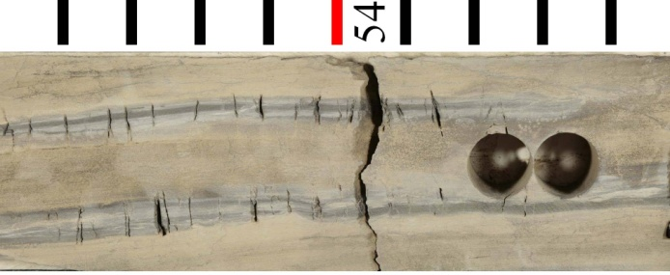
Examples from Monterey core
Many components of the fracture architecture are observed
Horizontal Well
Small bed-confined and single-layer fractures
Regular spacing of single-layer fractures
Fracture
zone
Michael Gross, 2011

Slide 21
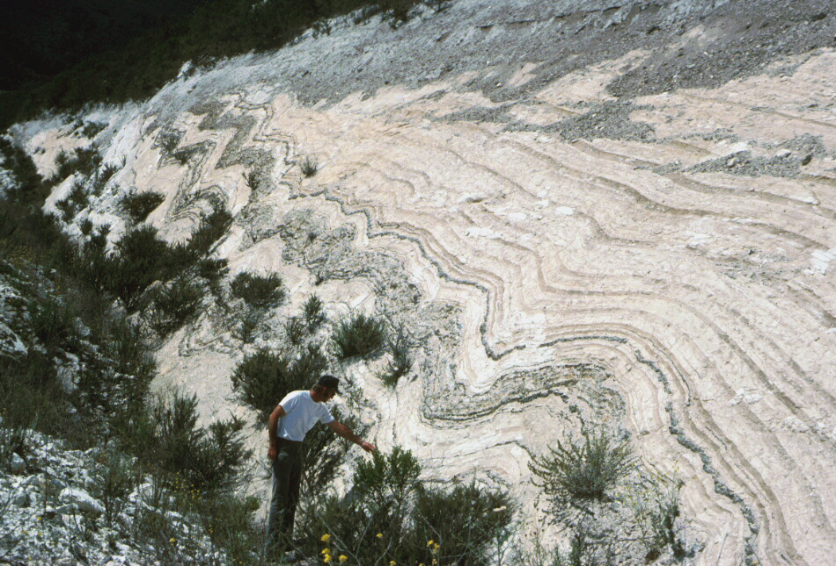
Folded (buckled) opal-CT chert between “unfolded” diatomite.
Diatomite has been equally shortened by horizontal compaction.

Slide 22
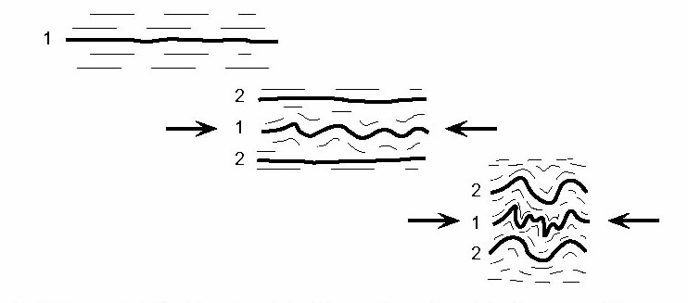
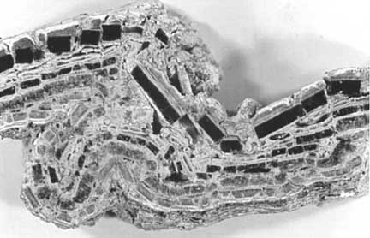
Behl & Garrison, 1994; Eichhubl & Behl, 1998

Slide 23
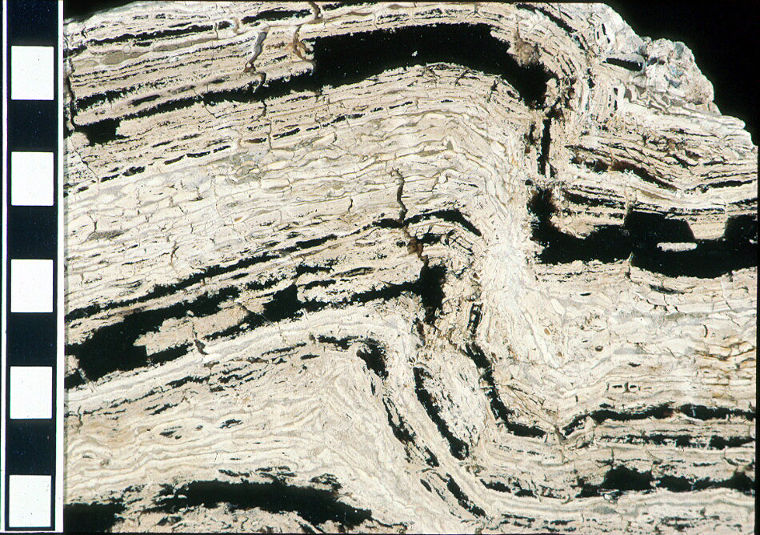
Brittle nature of buckled + brecciated opal-CT chert (white) becoming obscured by lamination-parallel transition to quartz (black). Eventually, “continuous” laminations give the appearance of ductile folding

Slide 24
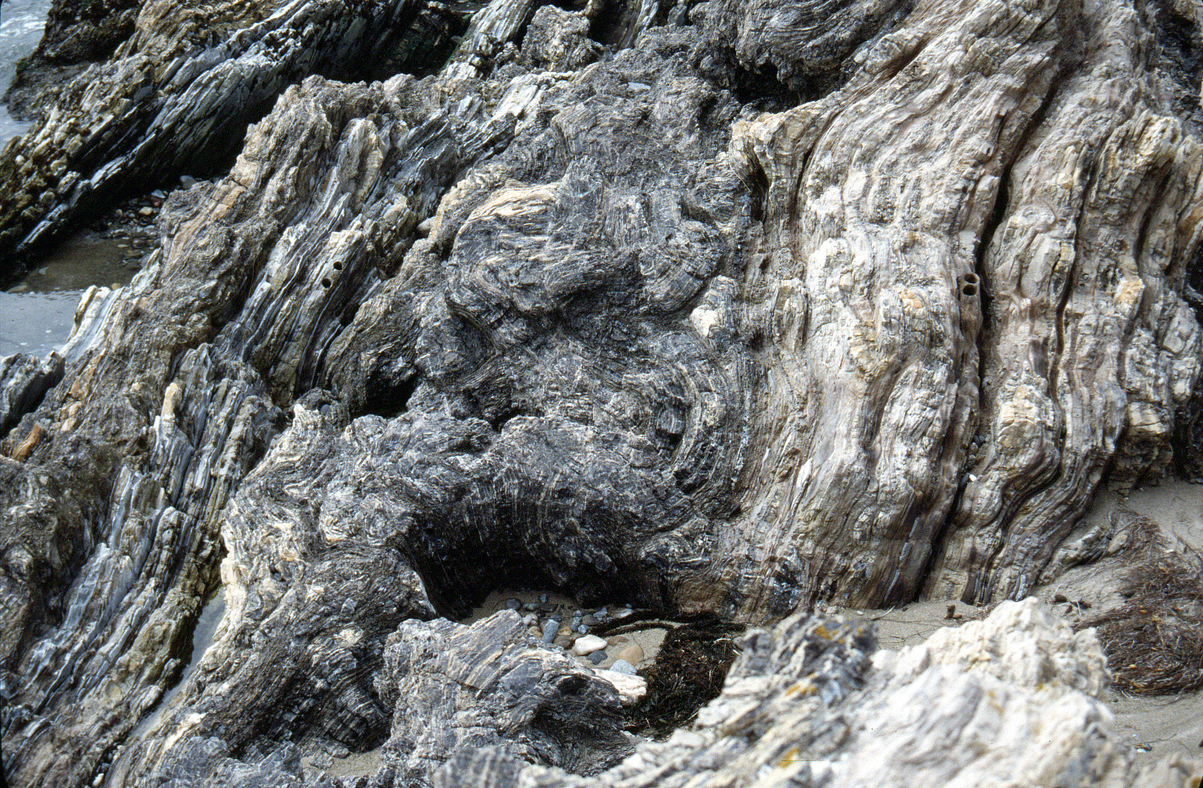
Buckled + brecciated quartz chert between “unfolded” shale.
Shale has actually been shortened just as much by horizontal compaction.

Slide 25
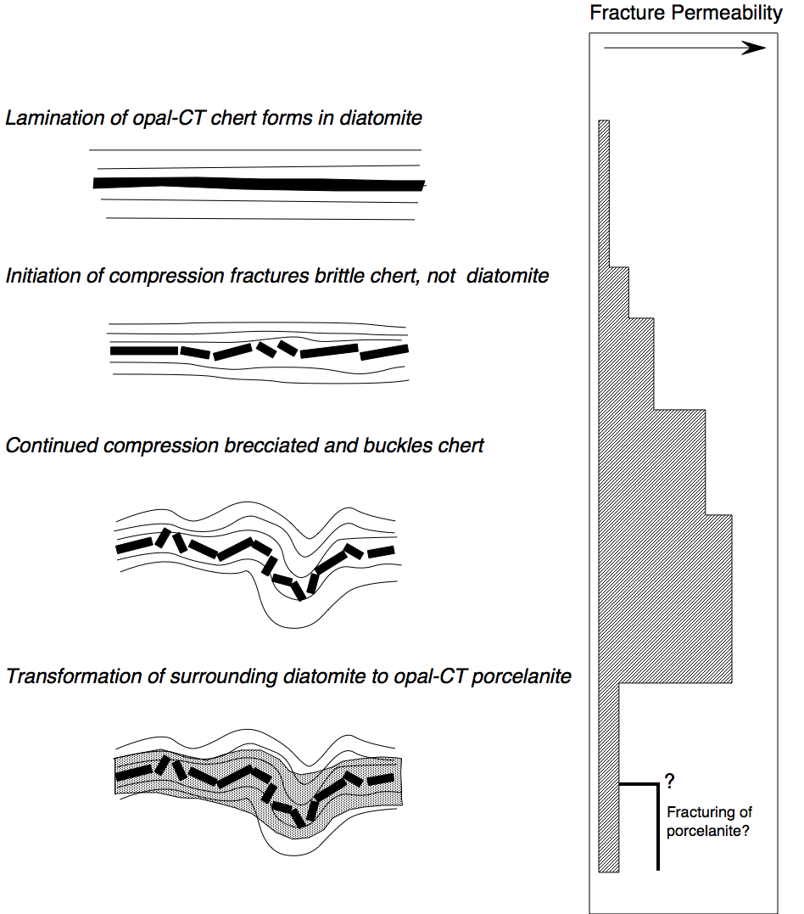
Pores in high permeability breccias are ultimately cemented by silica unless saturated with petroleum

Slide 26
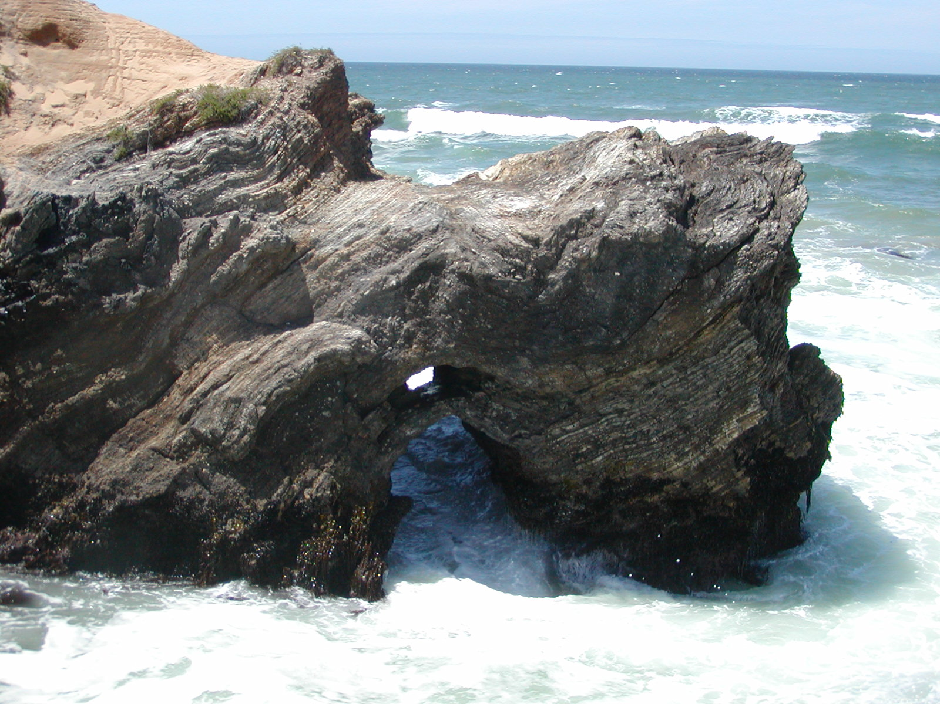
Thick tar-saturated chert breccia
Note folded chert between “unfolded” siliceous shale, dolomite, and porcelanite.

Slide 27
Diagenesis
Cementation
Embrittlement
Increased Fluid Pressure
Change in stress state
Dehydration reactions
Organic matter maturation
Chemical compaction
Sealing of microfractures
Preferred cementation
Advective mass transfer
Advective heat transfer
Chemical transport
Change in pore pressure
Change in rock strength
Deformation
Fluid Flow
Fracture networks
Fracture Permeability
Strain partitioning
Pore fluid expulsion
After Eichhubl & Behl (1998)

