Slide 1
Cairns Energy India
Porcelanite Short Course-4
Gurgaon, 15-16 January, 2015
Richard J. Behl
California State University
Long Beach, CA
MARS Project: Monterey and Related Sediments

Slide 2
Petroleum Geology
Porosity and Permeability
Controlling Variables
  Diatomite
  Porcelanite
  Chert
  Relationships
MARS Project: Monterey and Related Sediments

Slide 3
Petroleum Geology
Primary Porosity
Diatomite
  Diatom assemblages
  Silica: detritus ratios
  Settling environment and rate
  Depositional emvironment
MARS Project: Monterey and Related Sediments

Slide 4
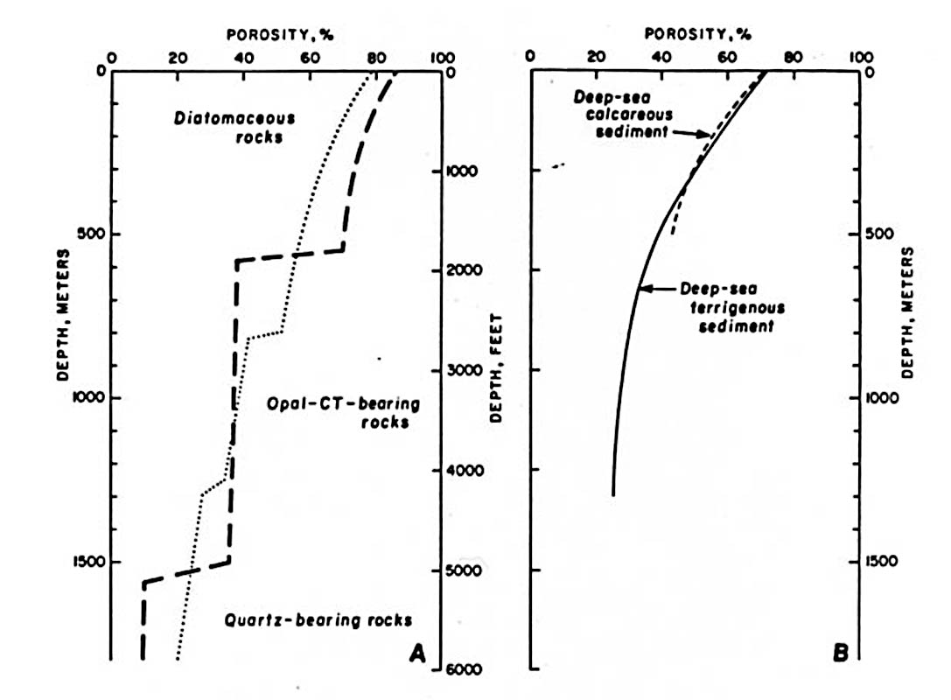
Stepped changes in porosity
Isaacs, 1981; after Hamilton, 1976

Slide 5
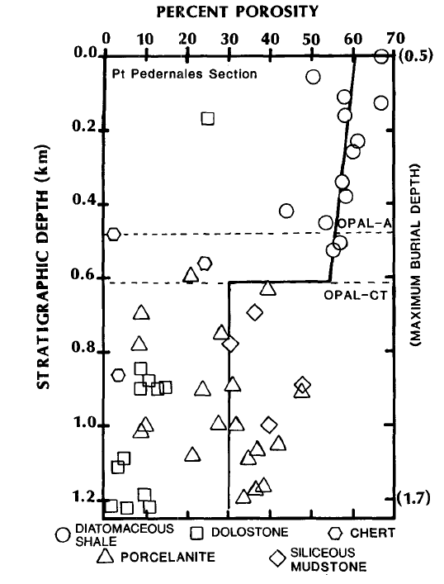
Point Pedernales, Calif.
Compton, 1991

Slide 6
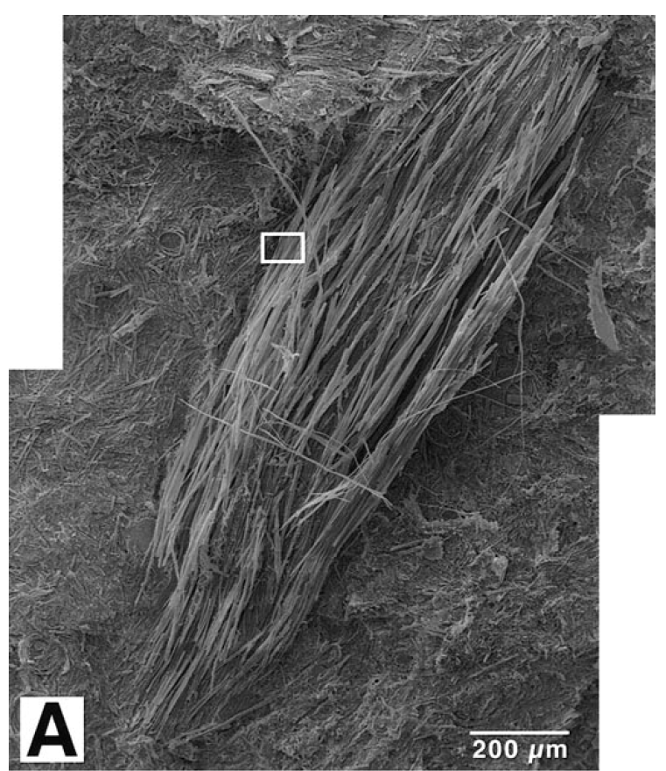
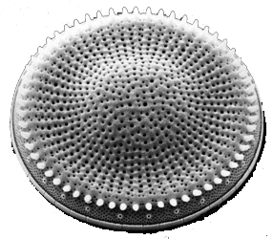
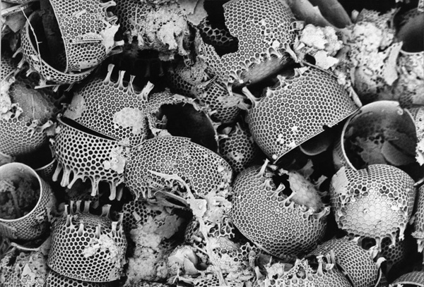
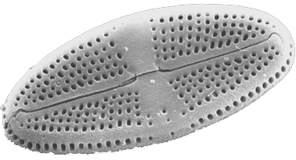
Diatoms

Slide 7
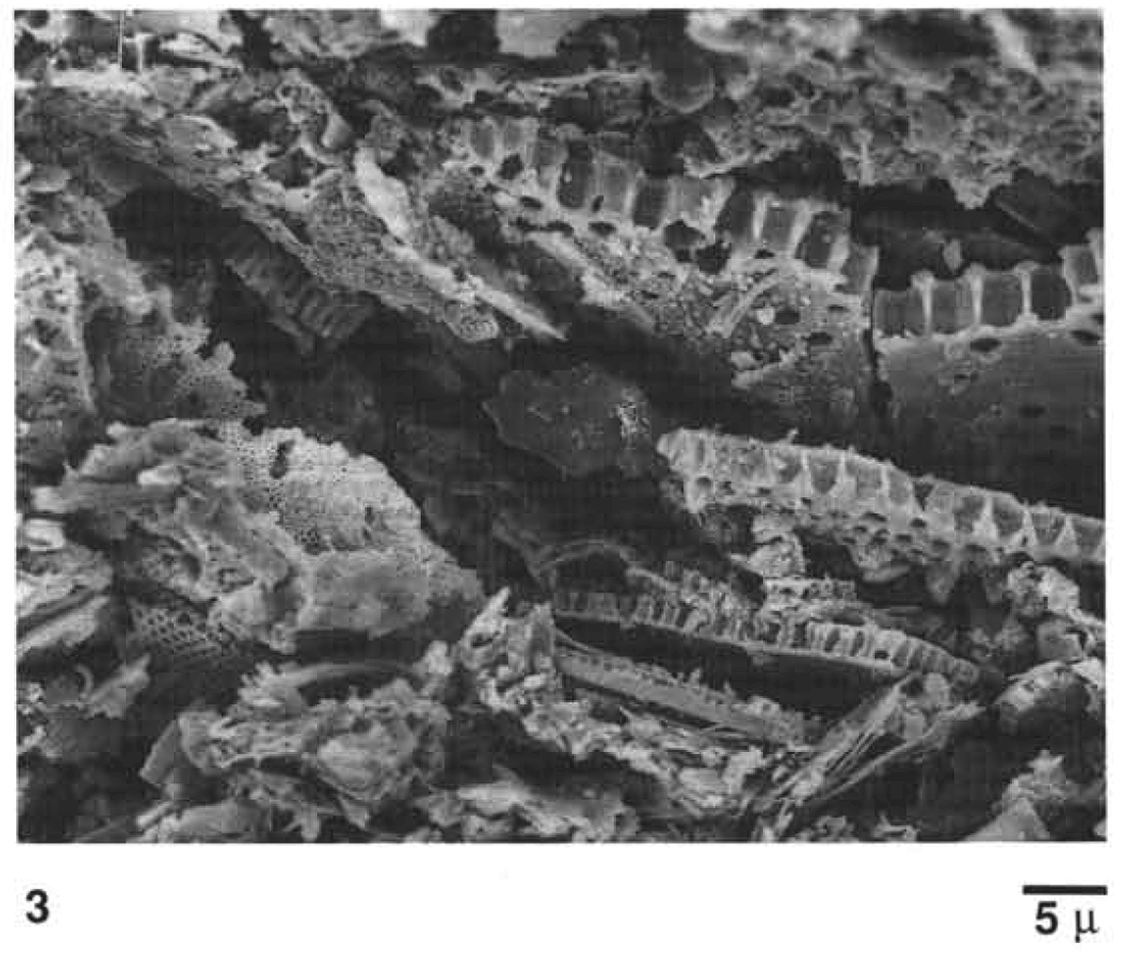
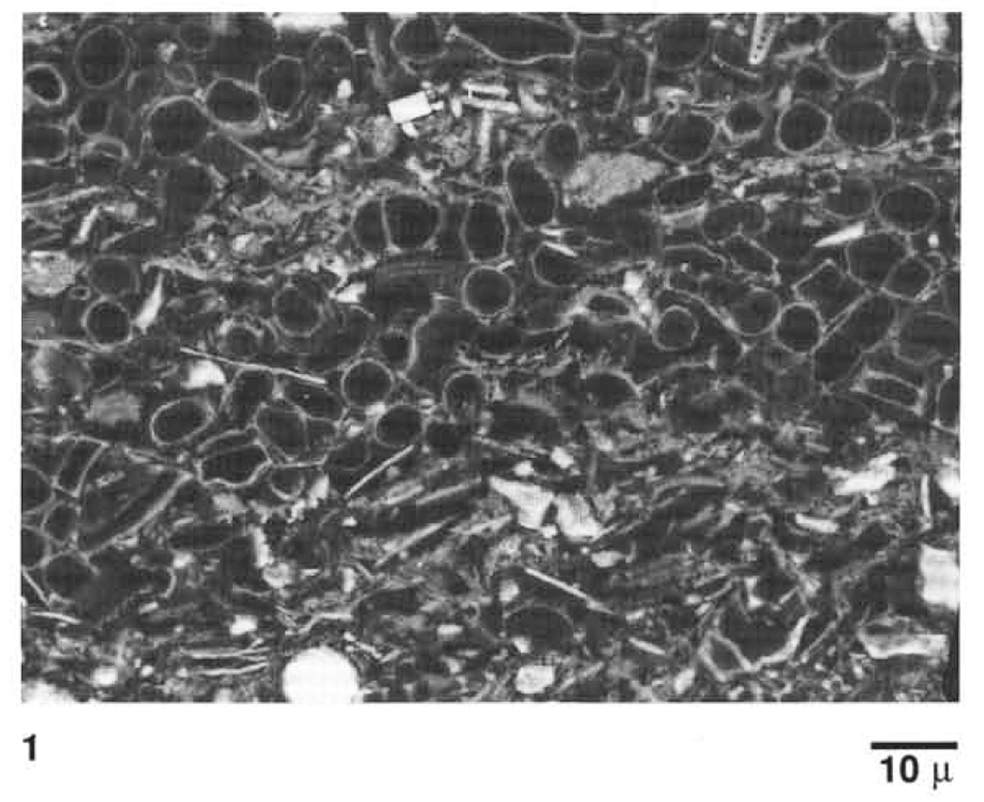
Highly porous diatomite
Grimm, 1992

Slide 8
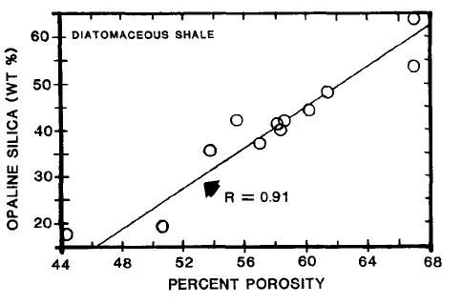
Point Pedernales, Calif.
Compton, 1991

Slide 9
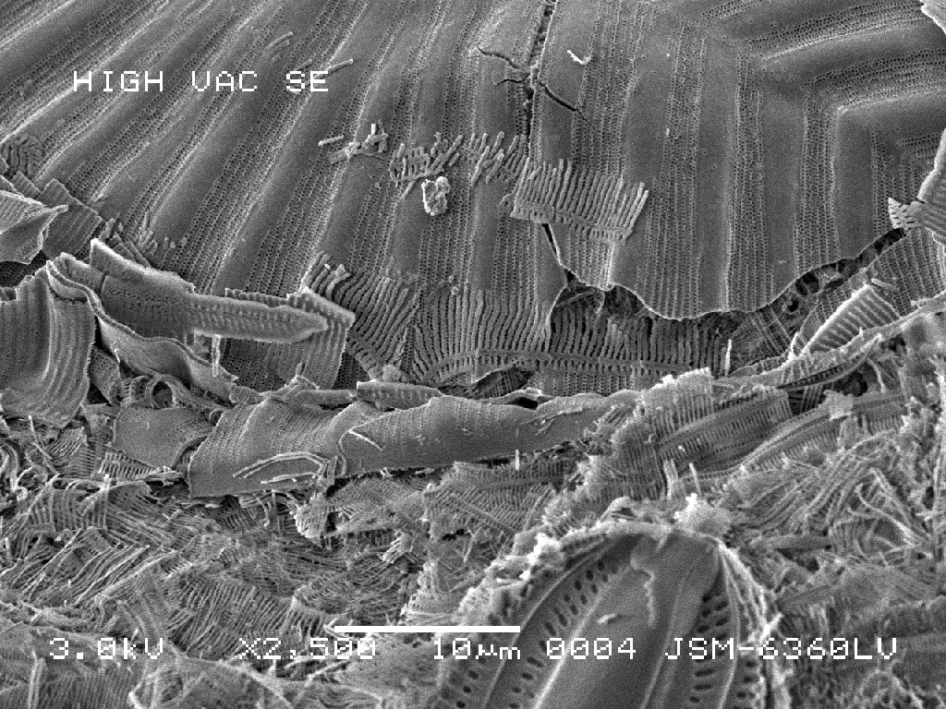
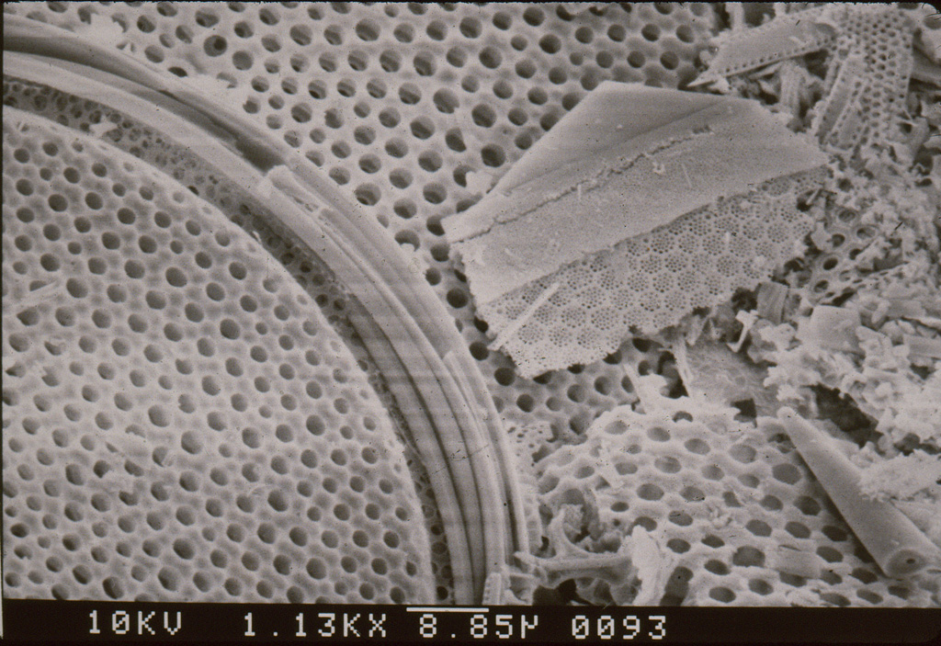
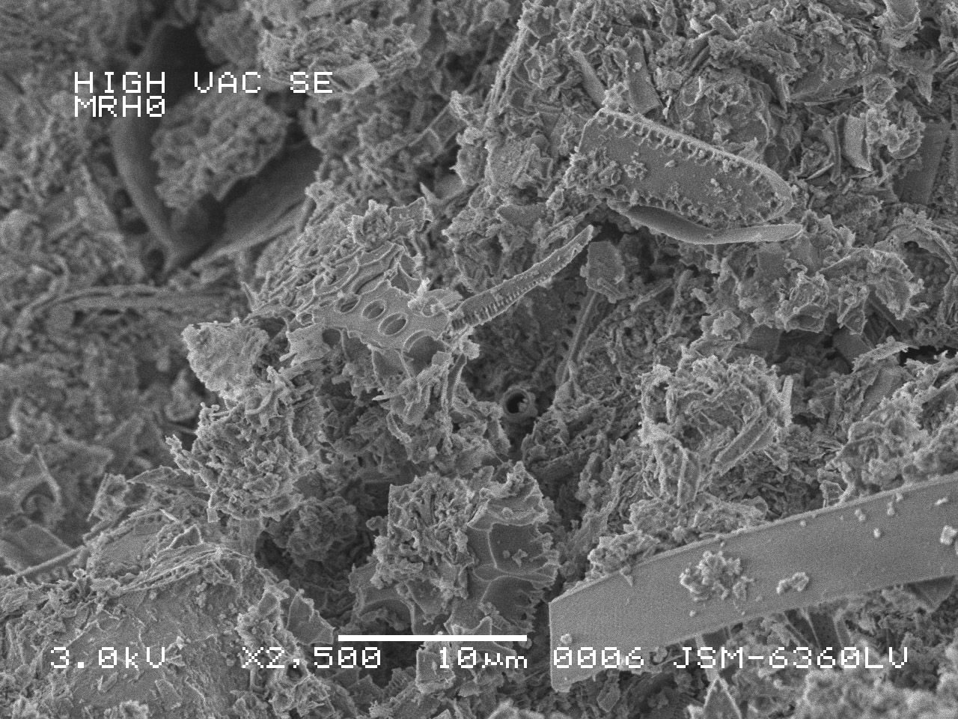
Purity & Fragmentation
  Silica
  Detritus (clay and silt)

Slide 10
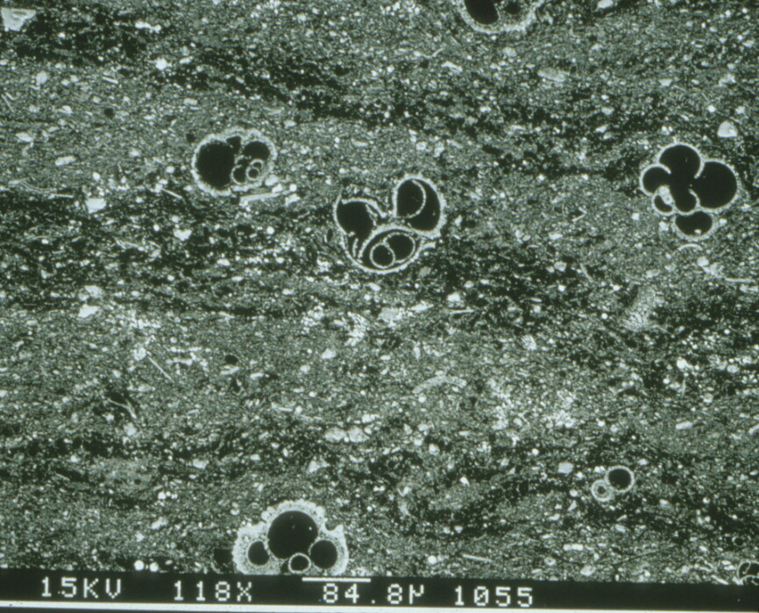
Environmental Conditions can trigger rapid sedimentation of single species of diatoms
100 μm
Grimm, 1992

Slide 11
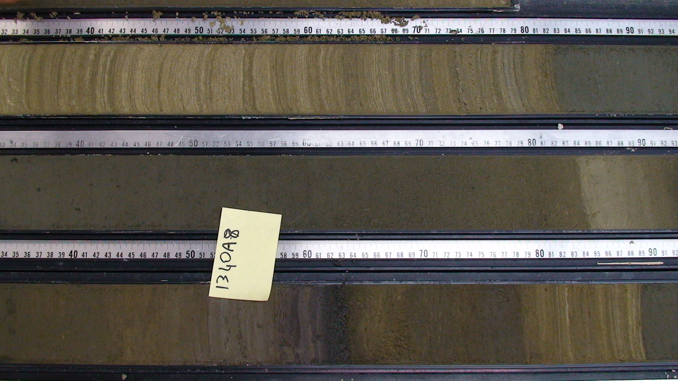
Laminated/Massive lithologic alternations Bering Sea, Site U1340A Core Photo
Drake & Aiello, 2013

Slide 12
Fragmentation & Environment
50 μm
50 μm
High-fragmentation
Massive
Oxic
High-preservation
Laminated
Anoxic
Drake & Aiello, 2013

Slide 13
Sediment density, packing and fragmentation
200 μm
500 μm
Oxic Setting
Packed, fragmented sediment high density
lower porosity
Anoxic Setting
Less-packed sediment
low density
higher porosity
Drake & Aiello, 2013

Slide 14
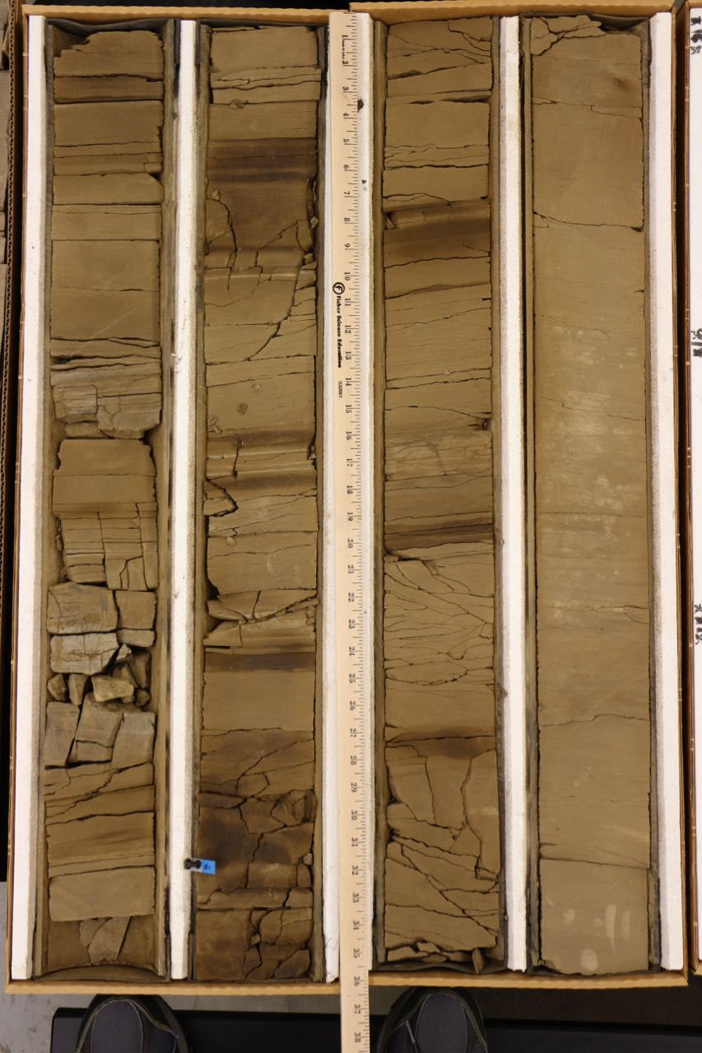
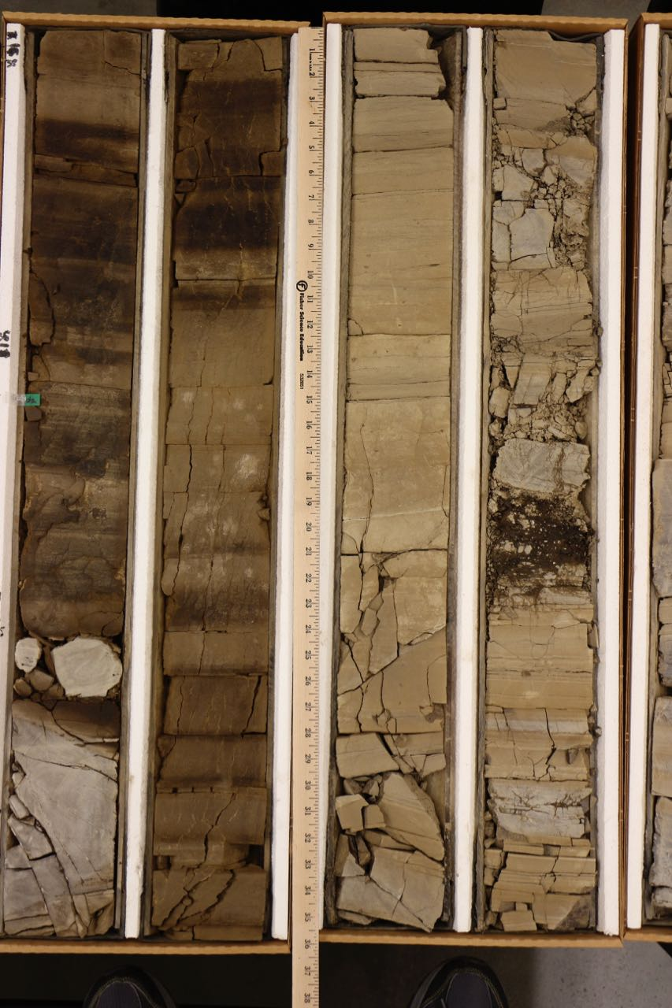
1586’
1643’
1670’
Unocal McKittrick 418

Slide 15
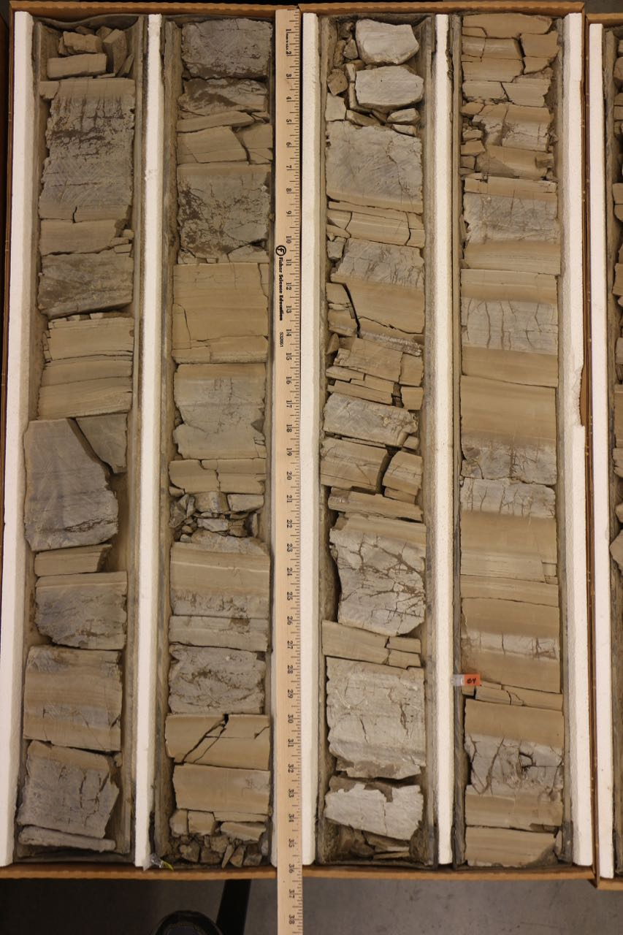
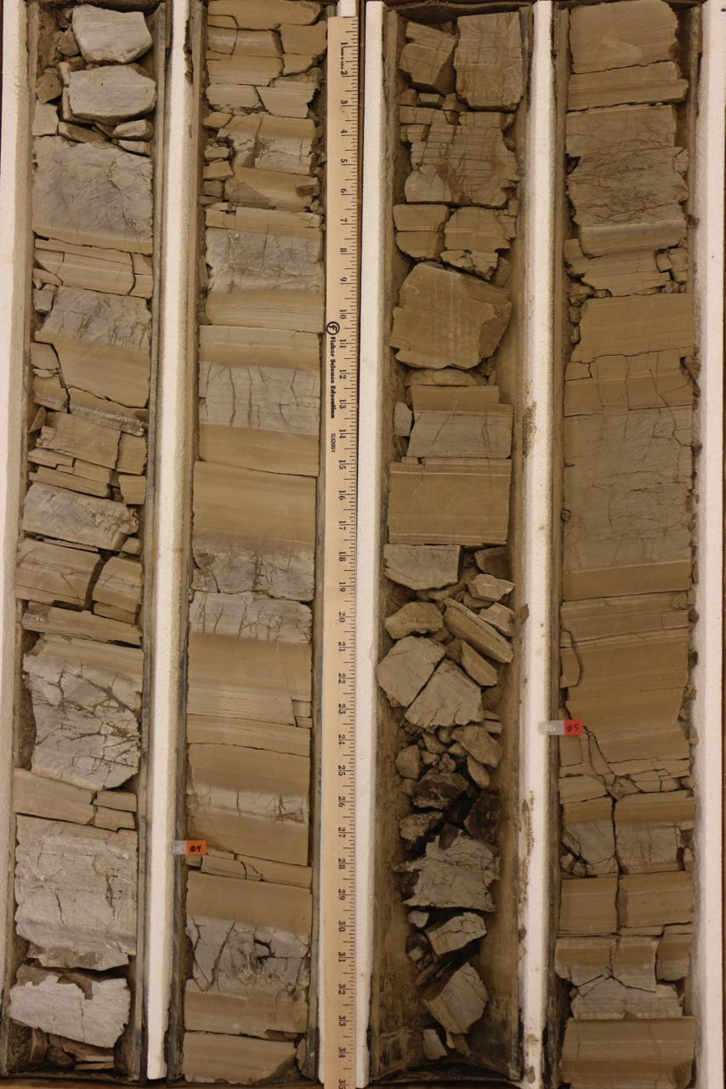
1725’
1717’
1722’
1755’
Unocal McKittrick 418

Slide 16
Permeability: Pore Throat Distribution
The Mercury Injection Capillary Pressure (MICP) technique uses a mercury (non-wetting) - air (wetting) system to investigate the pore system of a sample.
The incremental intrusion data is converted to equivalent pore throat sizes in the histogram display.
0.004
Mercury Volume
ml/g
0.002
0
100 10 1 0.1 0.01
Equivalent Pore Throat Diameter (microns)
Schwalbach et al., 2007

Slide 17
Silica Phase and Pore Throat Distribution
Mercury Injection Capillary Pressure (MICP)
Detritus 17%
Opal CT 79%
Porosity 30%
The histograms compare the pore throat diameters for porcelanite of similar silica/detrital ratios but of different silica phases.
Detritus 18%
Diagenetic Quartz 77%
Porosity 20%
Opal-CT sample’s pore throats are mostly 0.1 to 0.01 microns.
Quartz phase pore throats
are mostly 0.1 to 1.0 microns.
|
100
|
10
|
1
|
0.1
|
0.01
Pore Throat Diameter (microns)
Schwalbach et al., 2007

Slide 18
Clay Volume and Pore Size Distribution
Mercury Injection Capillary Pressure (MICP)
5262.5’ Quartz Porcelanite
Quartz: 83% Detritus: 16%
Porosity: 32.5% Kair: 3.3 md
5267.0’ Quartz Porcelanite
Quartz: 76% Detritus: 23%
Porosity: 24.7% Kair: 0.22 md
Quartz-Phase Porcelanite / Siliceous Shale Samples
5267.4’ Quartz Siliceous Shale
Quartz: 55% Detritus: 43%
Porosity: 15.1% Kair: 0.06 md
|
100
|
10
|
1
|
0.1
|
0.01
Pore Throat Diameter (microns)
Schwalbach et al., 2007

Slide 19
Typical reservoir parameters of
opal CT and quartz porcelanites.
 | Typical Porosity (%) | Grain Density (g/cc) | Permeability (air, md) | Pore-throat diameter (microns) | Oil Saturation (%)
Opal-CT | 25-40 | 2.25-2.35 | 0.01 – 0.1’s | 0.01 – 0.1 | 0 - 30
Quartz | 15-30 | 2.55-2.65 | 0.1 – 1.0’s | 0.1 – 1.0 | 30 - 60
Schwalbach et al., 2007

Slide 20
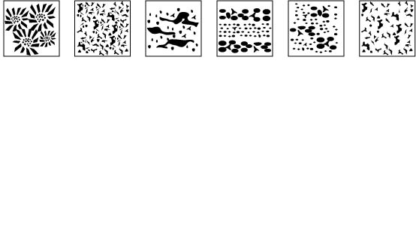
Porcelanite pore microfabrics
Effective porosity and permeability varies with silica phase, composition, macro- & microfabric
Opal-CT Opal-CT Opal-CT Quartz Quartz Quartz
Detrital-poor Detrital-rich Detrital-poor Detrital-poor Detrital-poor Detrital-rich Transition-zone Laminated Massive
Kassa (2016); Behl & Kassa (2016)

Slide 21
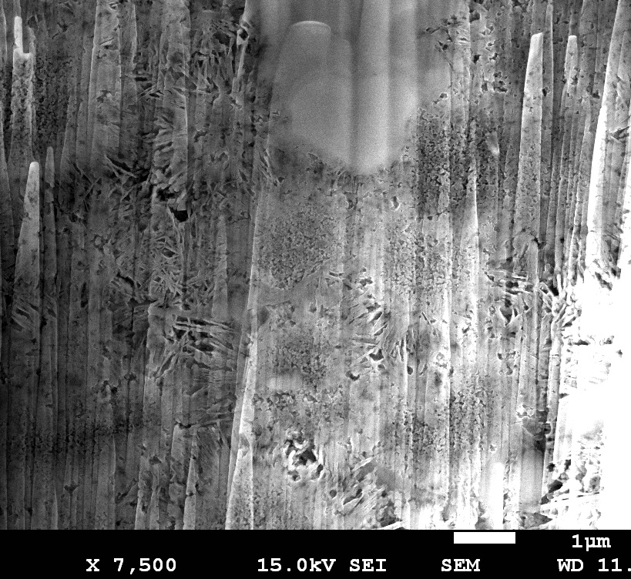
Massive Opal-CT Porcelanite
Detrital-poor (> .75 silica:detritus)
Lepisheric structure
with
three distinct zones
Kassa (2016);
Behl & Kassa (2016)
Notes:
Solating the core

Slide 22
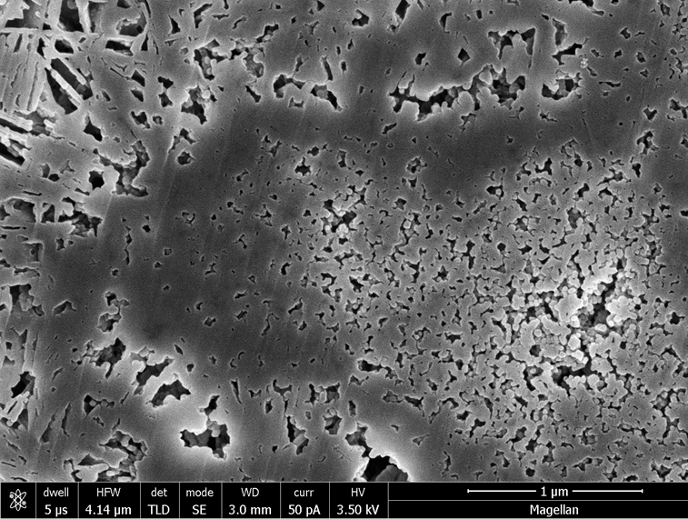
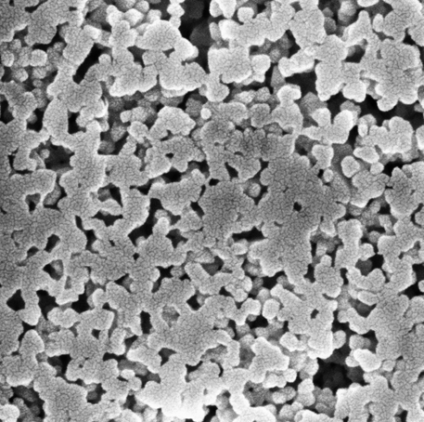
Opal-CT Lepispheric pore structure
Three distinct zones
  Core: highly porous and connected; 3-280 nm
  Mantle: isolated nanopores, virtually impermeable
  Interlepisphere: Very porous; 10-440 nm
500 nm
1 μm
500 nm

Slide 23
Detrital-poor Opal-CT Porcelanite
Three distinct lepispheric zones with isolated or connected pores
Inter-lepisphere
Mantle
Core
1 μm

Slide 24
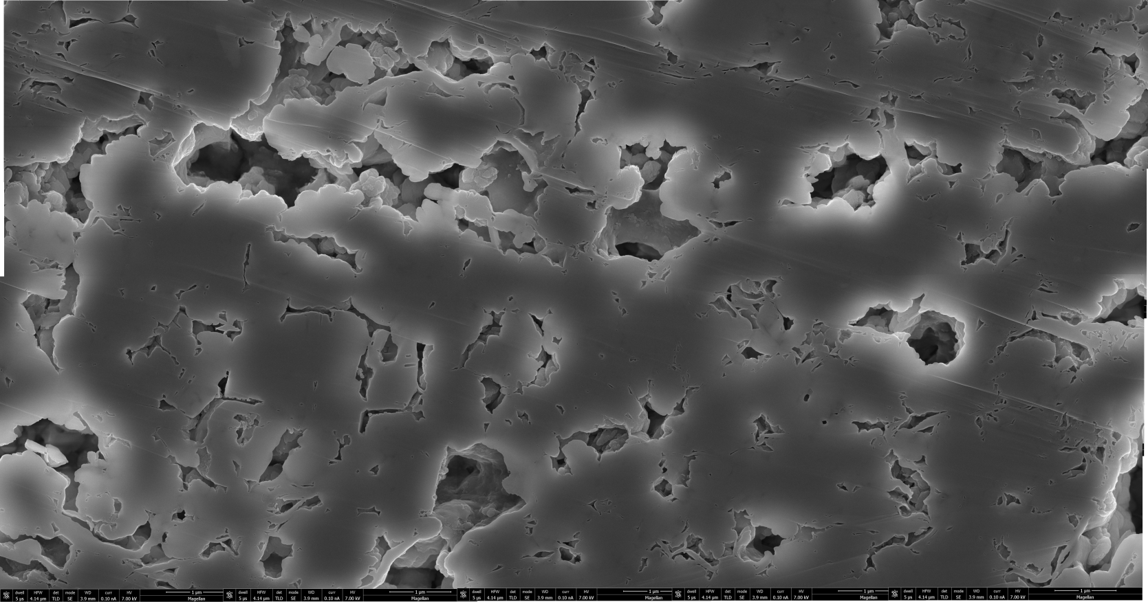
10x’s larger pores & pore throats
Massive Quartz Porcelanite
Detrital-poor (> .75 silica:detritus)
1 μm

Slide 25
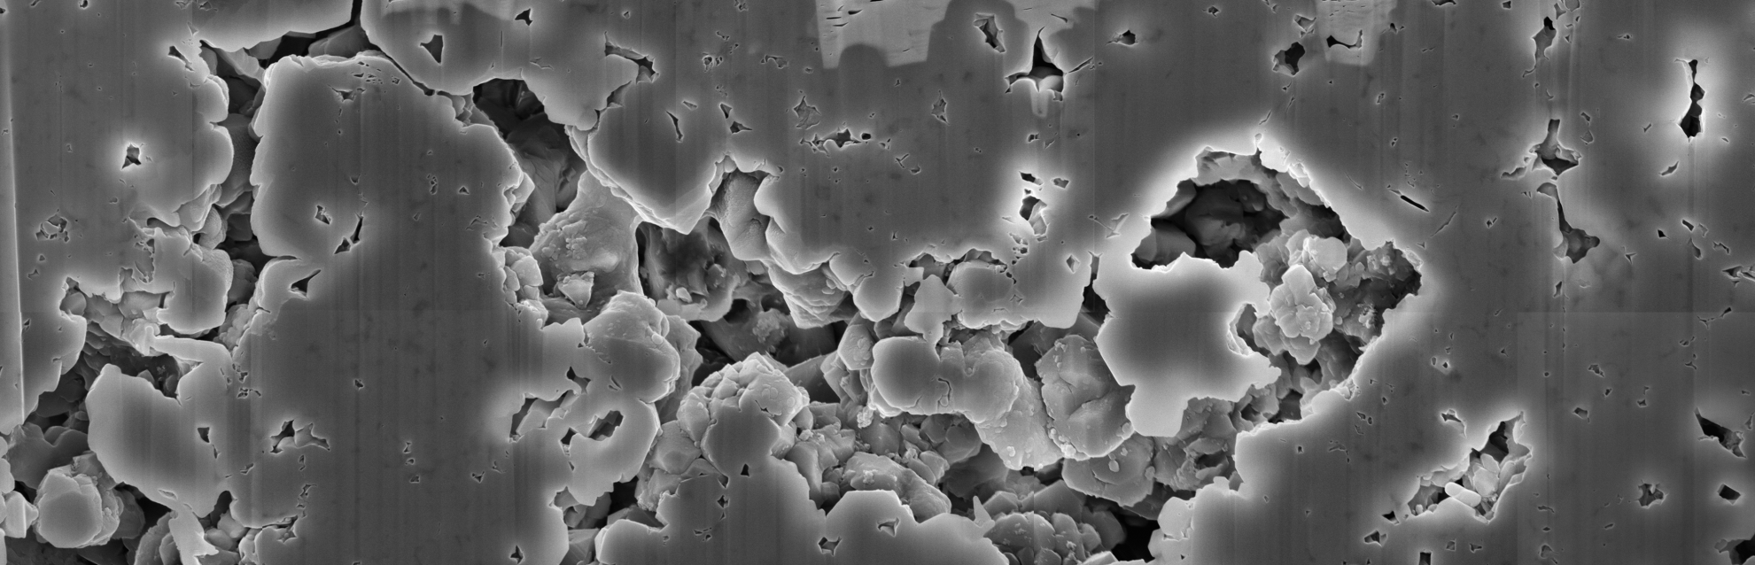
Microfabric: Laminated Quartz Porcelanite
Detrital-poor (> .75 silica:detritus)
~100 µm-thick laminations
Marked difference in porosity.
Good lateral connectivity
High-porosity lamination
400 μm
1 μm

Slide 26
Detrital-Rich Quartz Porcelanite
(< .75 silica:detritus)
Moderate porosity with poor connectivity
20 μm

Slide 27
Detrital-rich quartz porcelanite
(< .75 silica:detritus)
Small and large pores
Moderate bulk porosity, but with poor connectivity
1 μm

Slide 28
Hydrocarbon Columns: Porcelanite S_{o}
CT Porcelanite
Siliceous Shale
Transitional
CT - Quartz
Height
Above
Free-
Water
Level
(Ft)
For modeled
pore-throat
distribution
Quartz
Porcelanite
20-30% Detritus
Quartz
Porcelanite
< 20% Detritus
100 80 60 40 20 0
Predicted Oil Saturation
Schwalbach et al., 2007

Slide 29
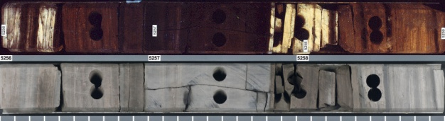
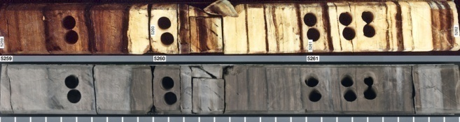
Interbedded opal-CT and quartz porcelanites
differentially saturated at same depth &
position in oil column
UV
Light
Siliceous Shale
Opal-CT Porcelanite
Quartz Porcelanite
Plain
Light
1 foot
Schwalbach et al., 2007

Slide 30
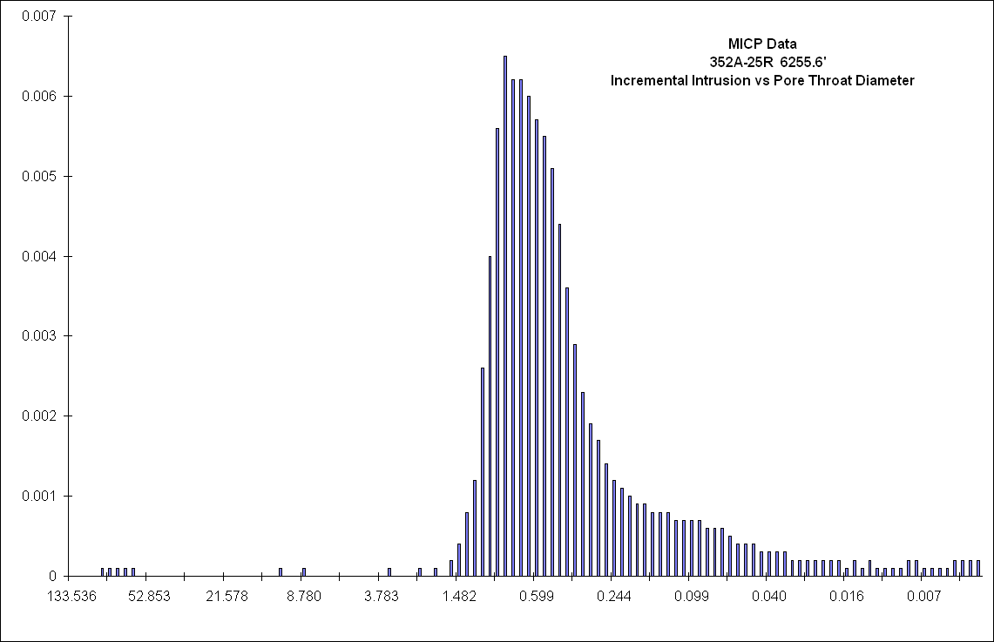
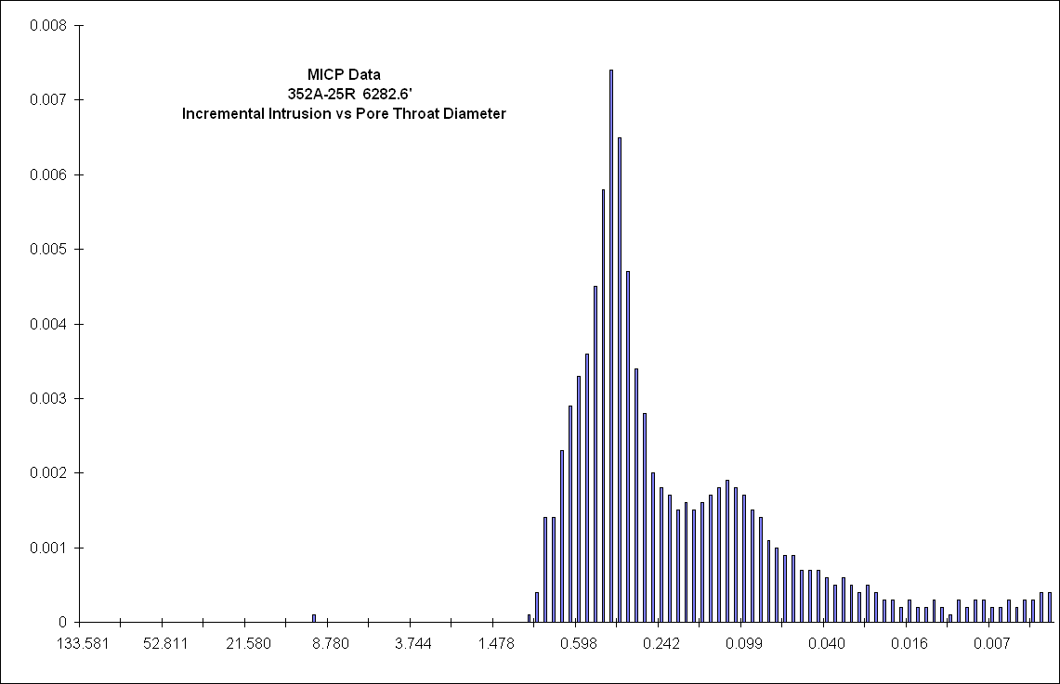
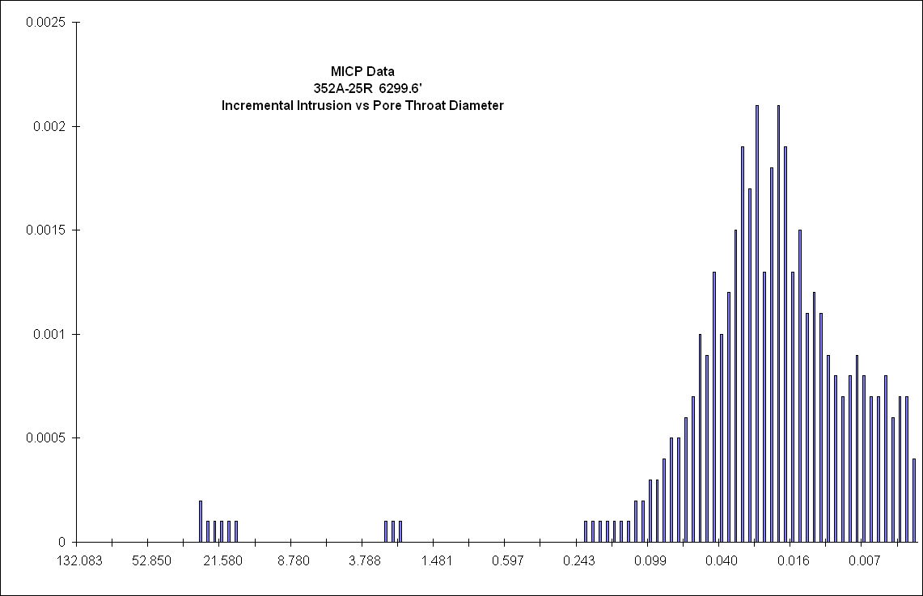
Porcelanite Pore Throat Radii
Schwalbach et al., 2007
Good Matrix Reservoir
Marginal Matrix Reservoir
Bad Matrix Reservoir
|
100
|
10
|
1
|
0.1
|
0.01
Pore Throat Diameter (microns)

Slide 31
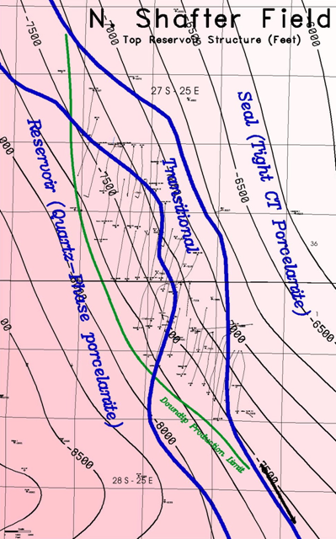
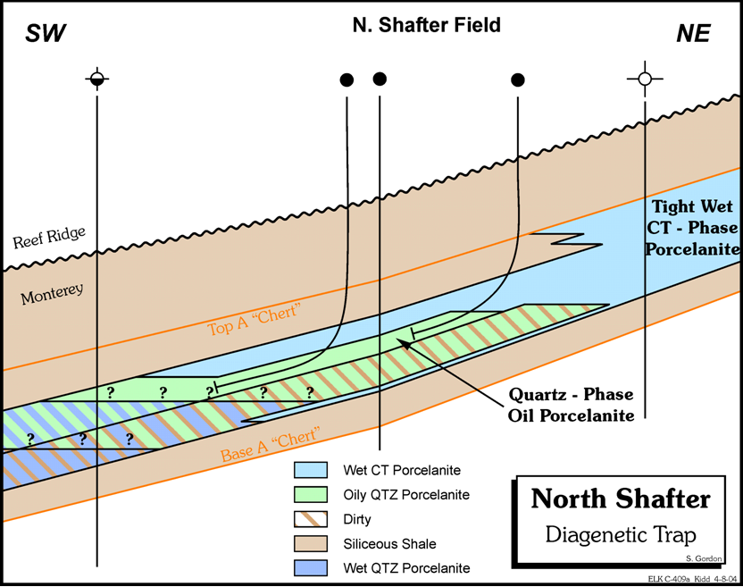
North Shafter Field
Diagenetic Trap
Mostly Porcelanite and Siliceous Shale
Gently-Dipping Homocline
Schwalbach et al., 2007

Slide 32
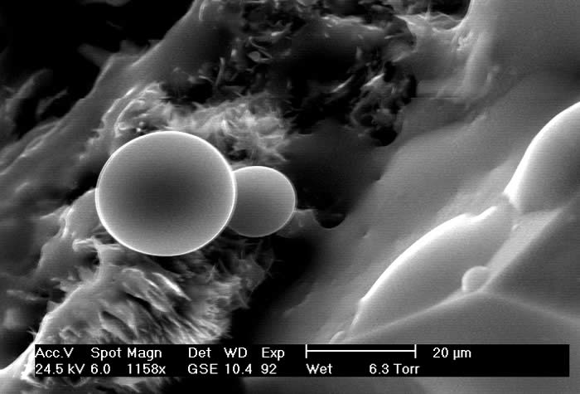
Wettability
Cuthbert, University of the West of Scotland and Heriot-Watt University

Slide 33
Water Imbibition Rates
More wetting Less wetting
Kristina Hill, 2015

Slide 34
Oil Imbibition Rates
More wetting Less wetting
Kristina Hill, 2015

