Slide 1
CSULB MARS Project Monterey & Siliceous Sediments Short-Course & Symposium Bakersfield, 5 December, 2016
Richard J. Behl
California State University
Long Beach, CA
MARS Project: Monterey and Related Sediments

Slide 2
Lithology
Part 3. Siliceous sedimentary rocks Types
Diatomite
Porcelanite
Chert
Siliceous mudstone
Controls & mechanisms
Phase change
Crystallographic ordering
Compositional controls

Slide 3
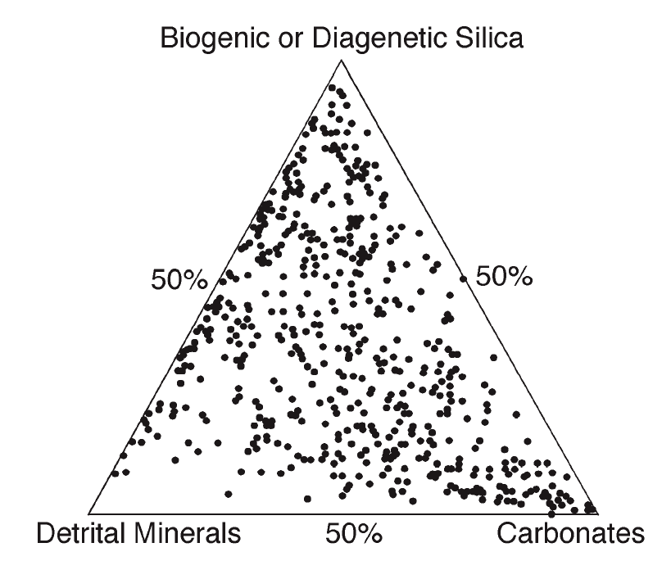
Mudrock Sedimentary Components
Detrital
Clay
Silt
Sand
Biogenic
Silica (opal-A)
Calcite/Aragonite
Organic Matter
Diagenetic / Authigenic
Opal-CT / Quartz
Calcite/Siderite/Dolomite
Phosphate
Chert
Diatomite
Porcelanite
Muddy Diatomite
Mudstone/ Shale
Limestone/ Dolostone

Slide 4
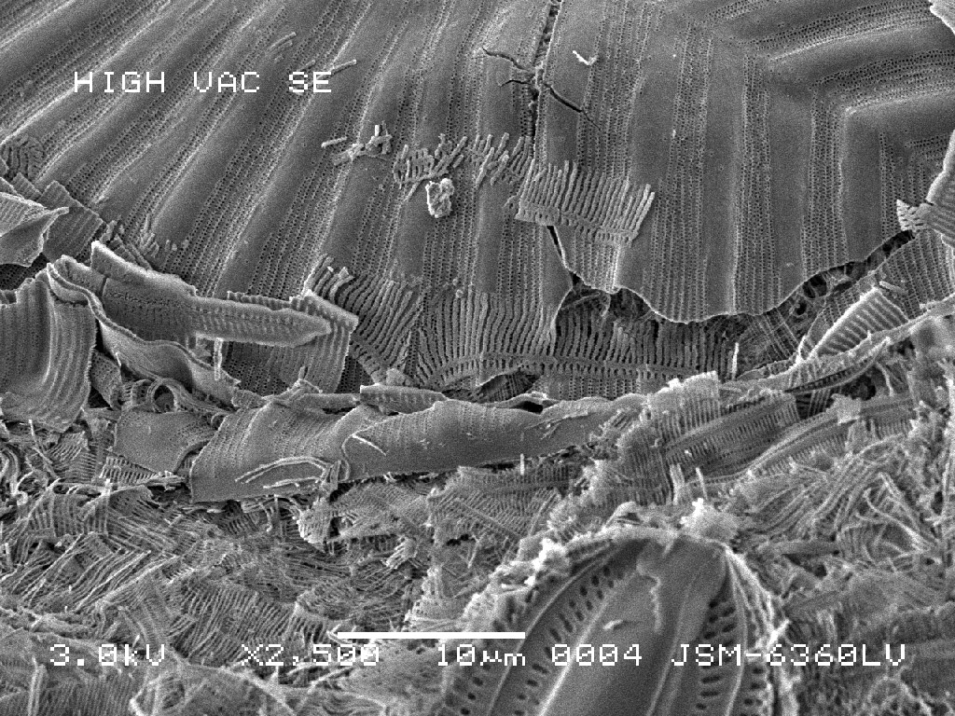
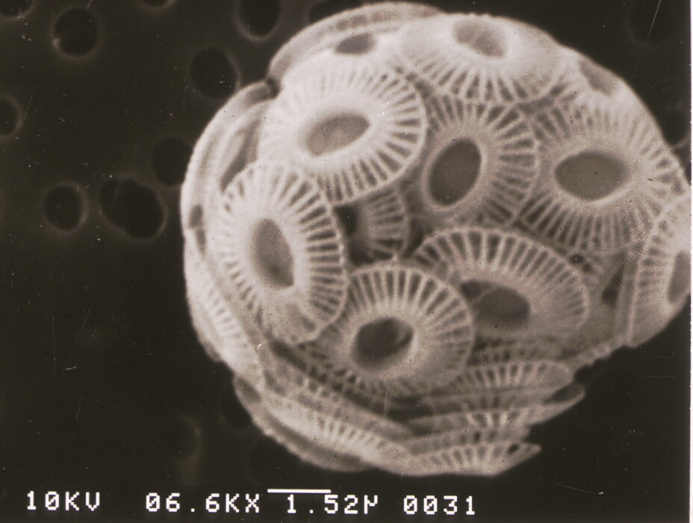
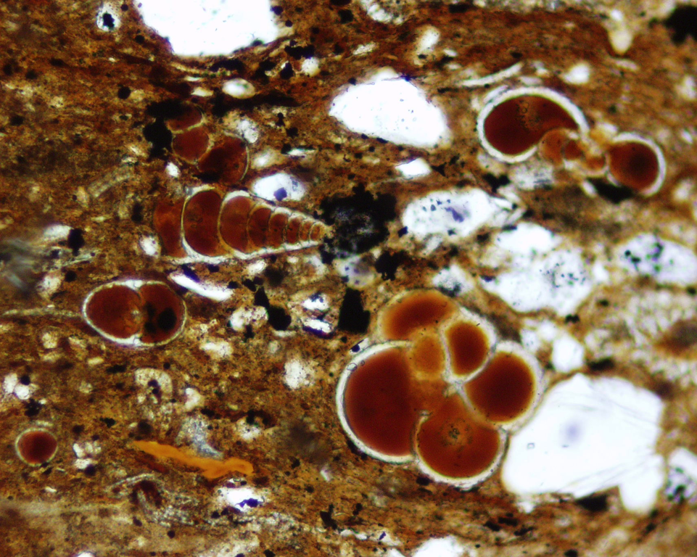
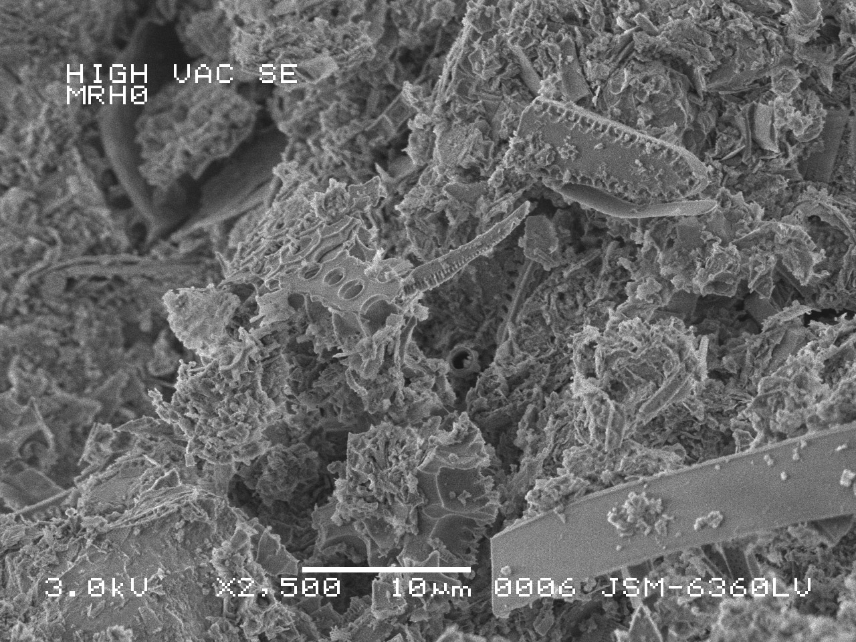

Slide 5
Physical Characteristics of Monterey Lithologies
Factors that control physical rock properties
Silica Phase
Detrital Content
Carbonate Content
Organic Matter
Porosity

Slide 6
Rock Types
Chert
Diatomite
Porcelanite
Siliceous/Diatomaceous Shale/Mudstone
Shale/Mudstone (generally sparsely siliceous)
(Also: Calcareous, Dolomitic)
Phosphatic Shale
Dolostone/Limestone/Marlstone
Siltstone/Sandstone
Silica

Slide 7
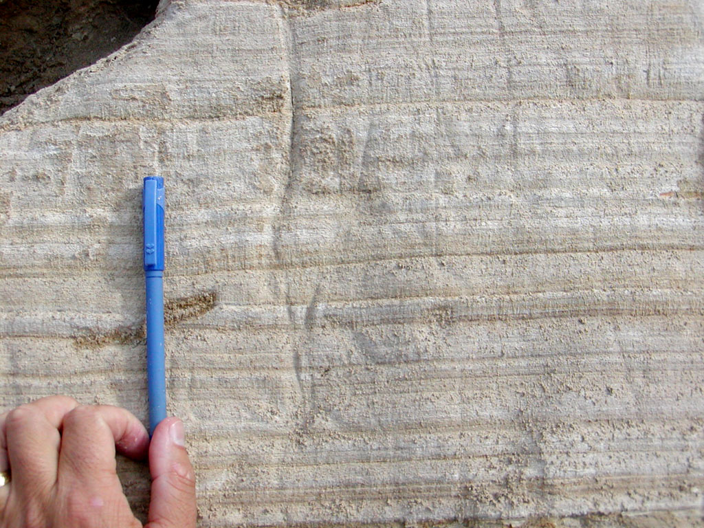
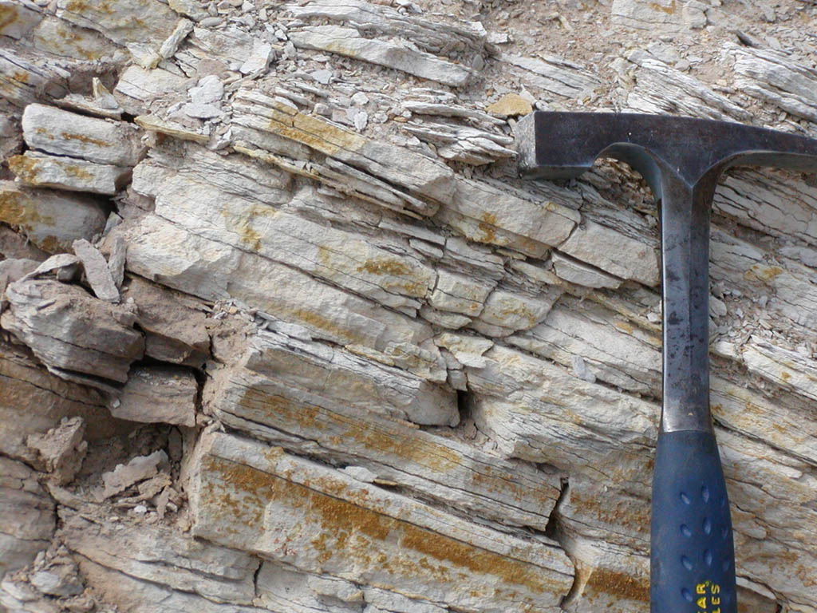
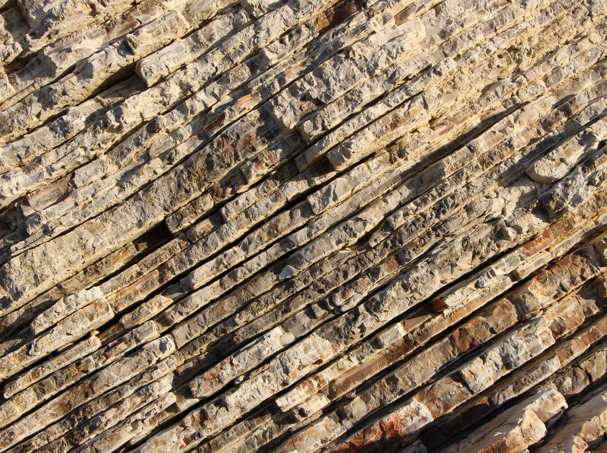
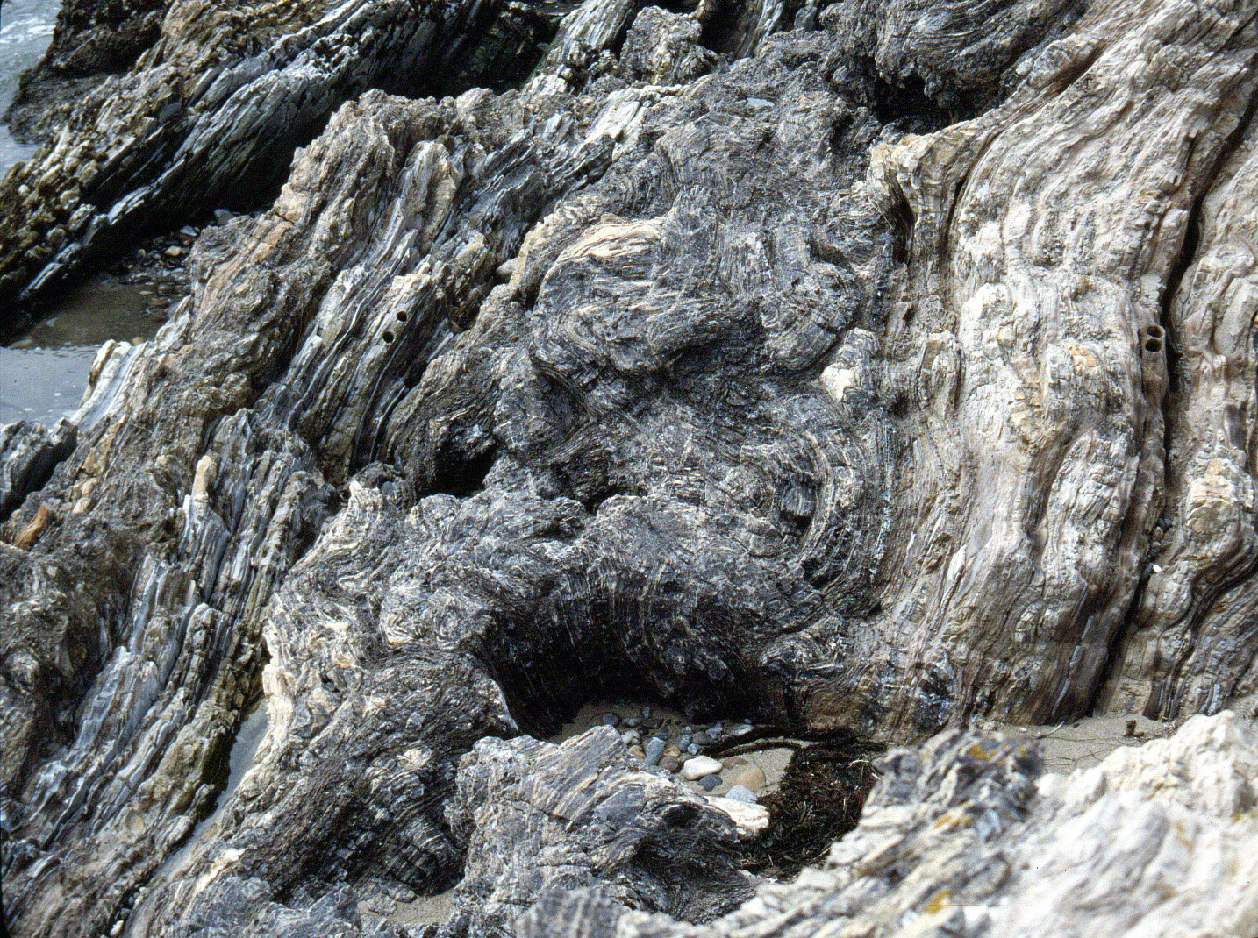
Diatomite
Siliceous Shale
Porcelanite
Chert

Slide 8
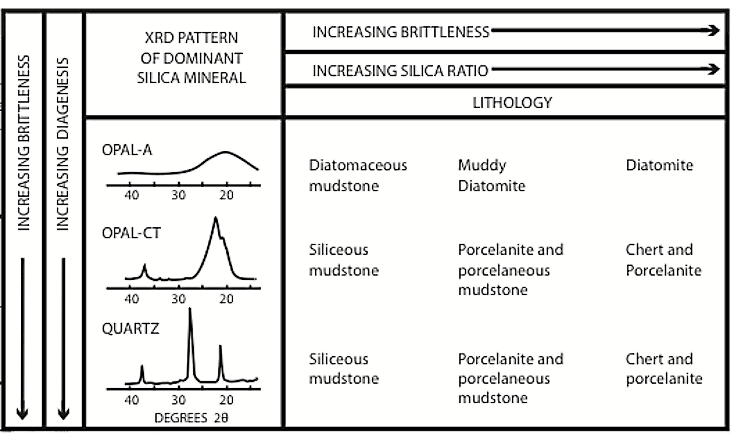
Pisciotto & Garrison, 1981
Silica phase = lithology!

Slide 9
Diatomites
Biogenic Silica
Opal-A (mostly diatoms, + silicoflagellates, radiolarians, and sponge spicules
Composition
Up to ~90% biogenic silica
Physical Properties
Very soft < 2
Highly porous (60-85%)
Firm (diatomites fracture!)
Can be calcareous, phosphatic, etc.
Density increases with detrital content
Brown in subsurface, white if weathered

Slide 10
Lompoc, California: weathered outcrop

Slide 11
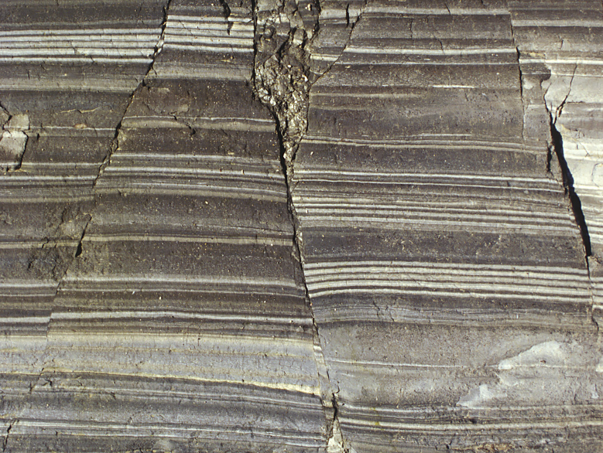
Laminations and event-deposit bands

Slide 12
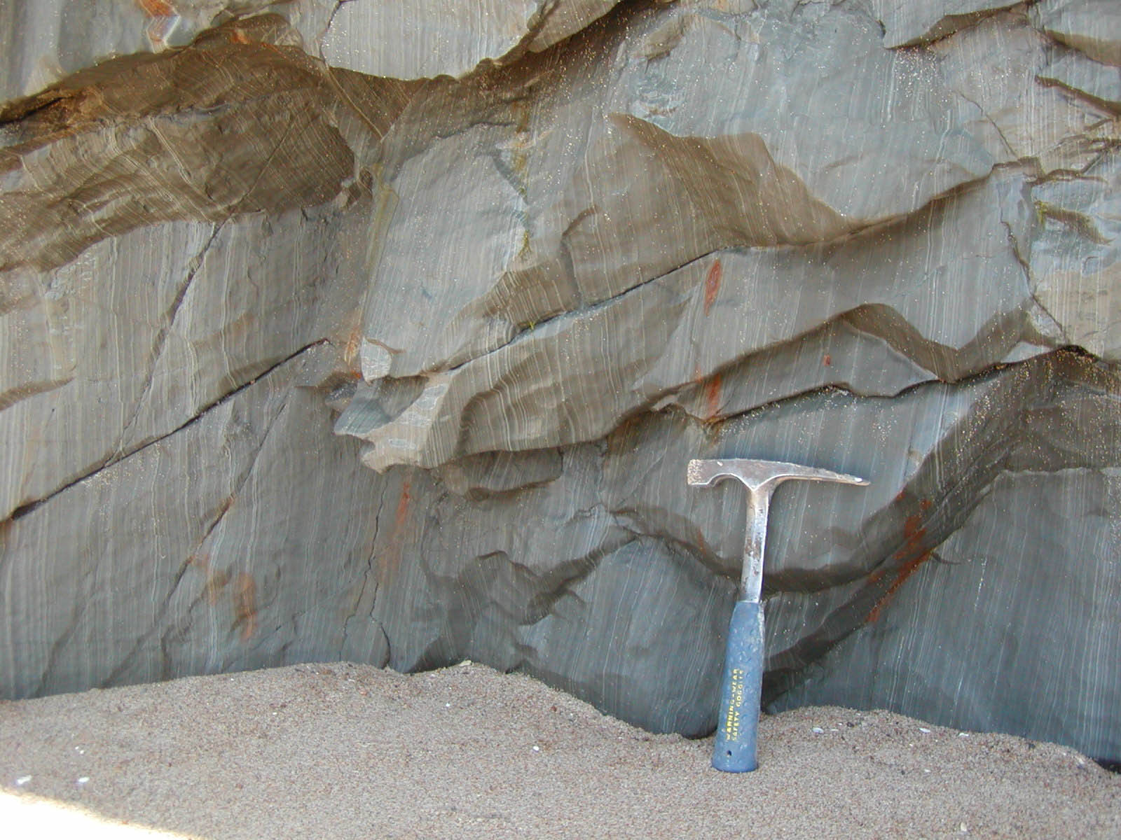
Mussel Rock, California
Laminated, but massive-bedded diatomite

Slide 13
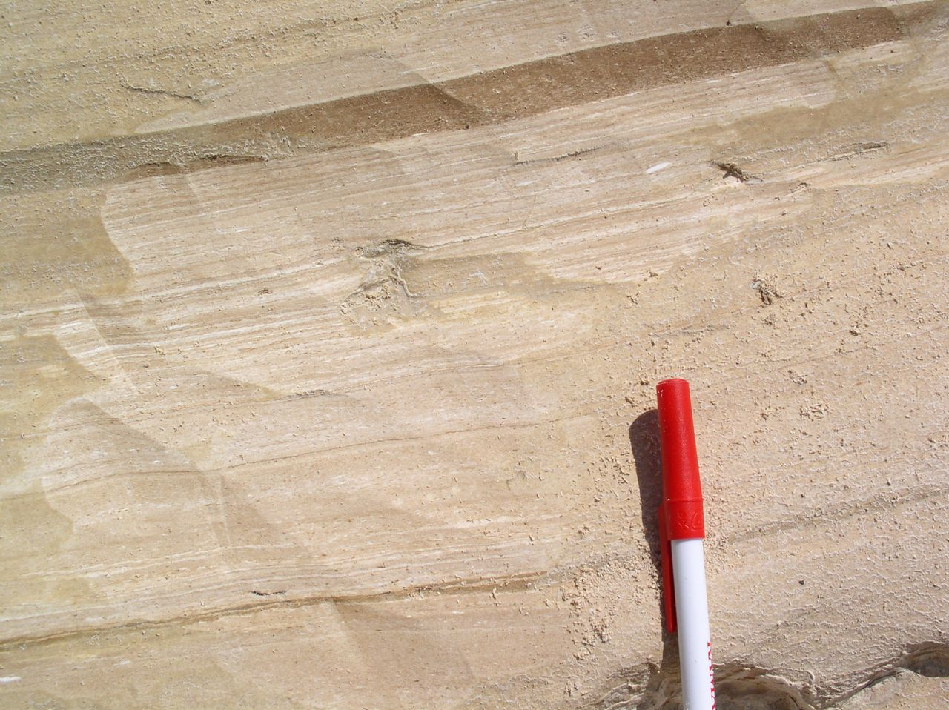
Lompoc, California: laminated diatomite and muddy speckled bed

Slide 14
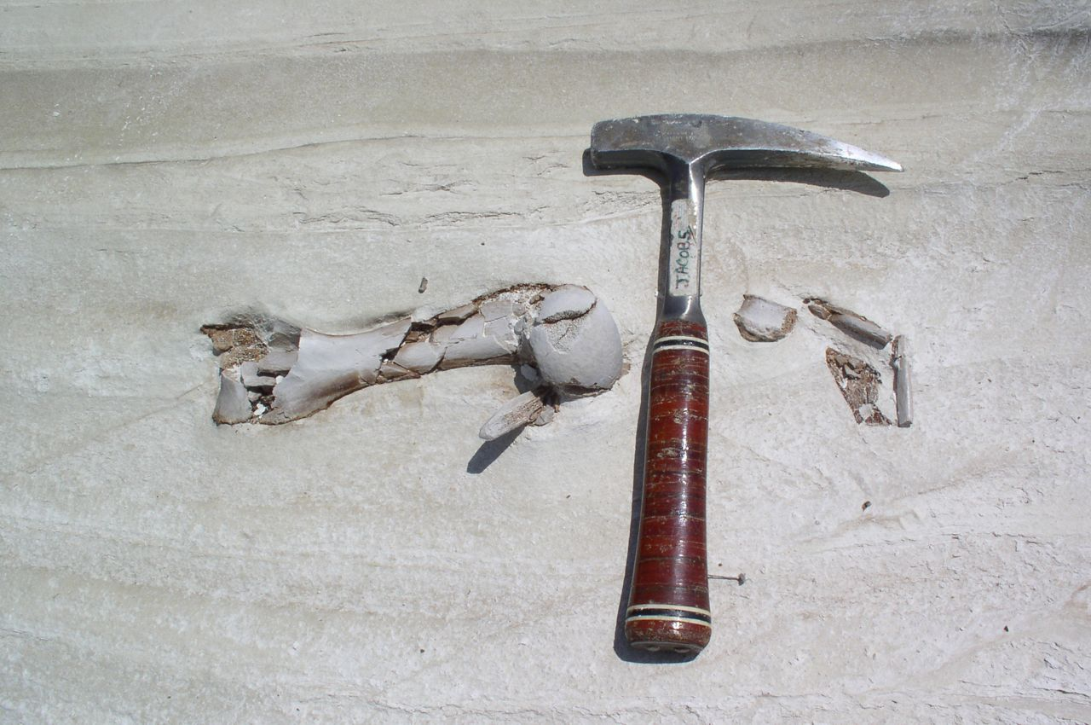

Slide 15
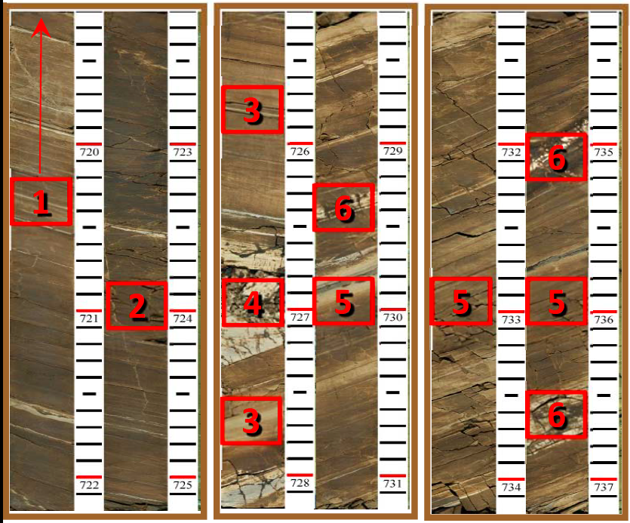
Opal-A to opal-CT transition with dark diatomite and light, brittle diagenetic beds
Lockman (2012)

Slide 16
Porcelanite
Characteristics
Diagenetic Phase
Opal-CT or Quartz
Composition
50-90% diagenetic silica
+Detritus, carbonate
Physical properties
Hardness Index ≤ 3
Luster – matte (lacks vitreous luster)
Rough, blocky to splintery fracture
Typically laminated (though not always)
Tan to brown in subsurface, white in outcrop

Slide 17
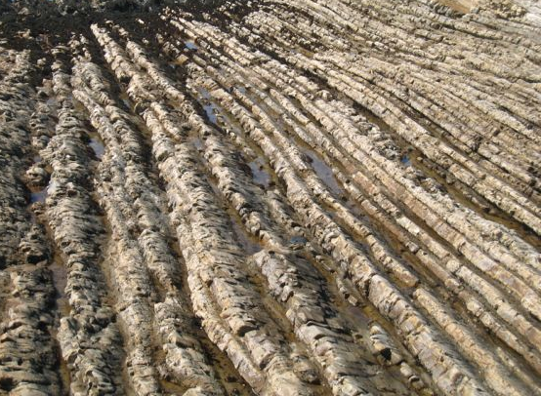
Climate Cycles & Litho-cyclicity
Montana de Oro, California

Slide 18
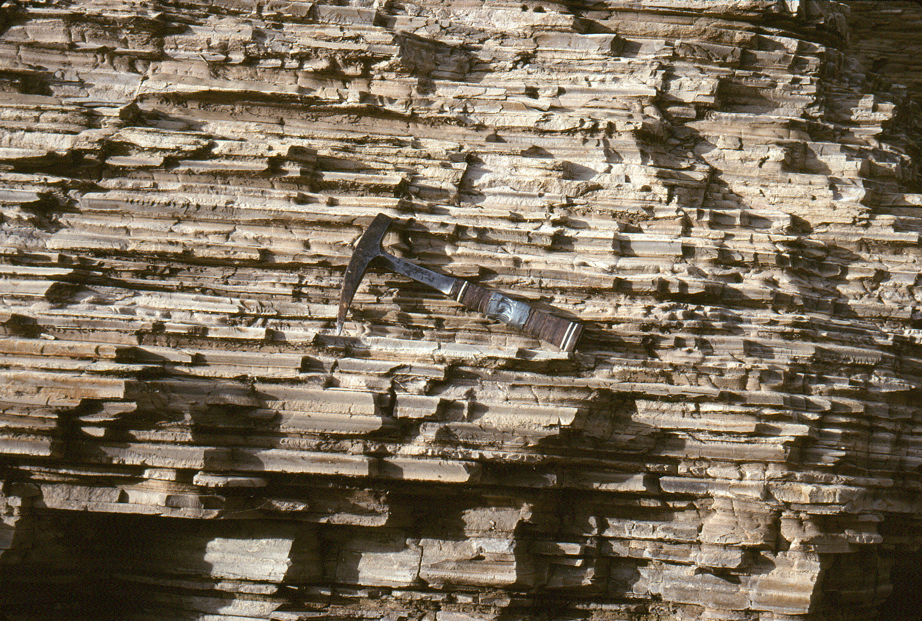
Point Buchon, California

Slide 19
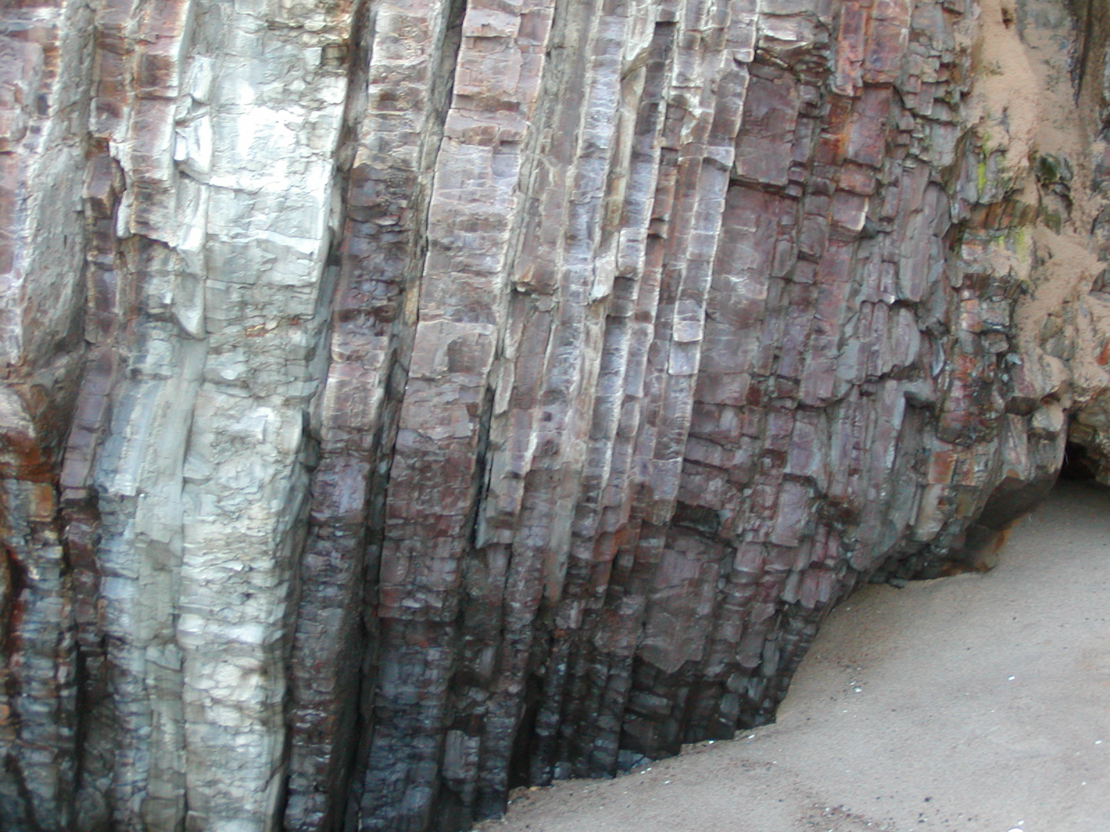
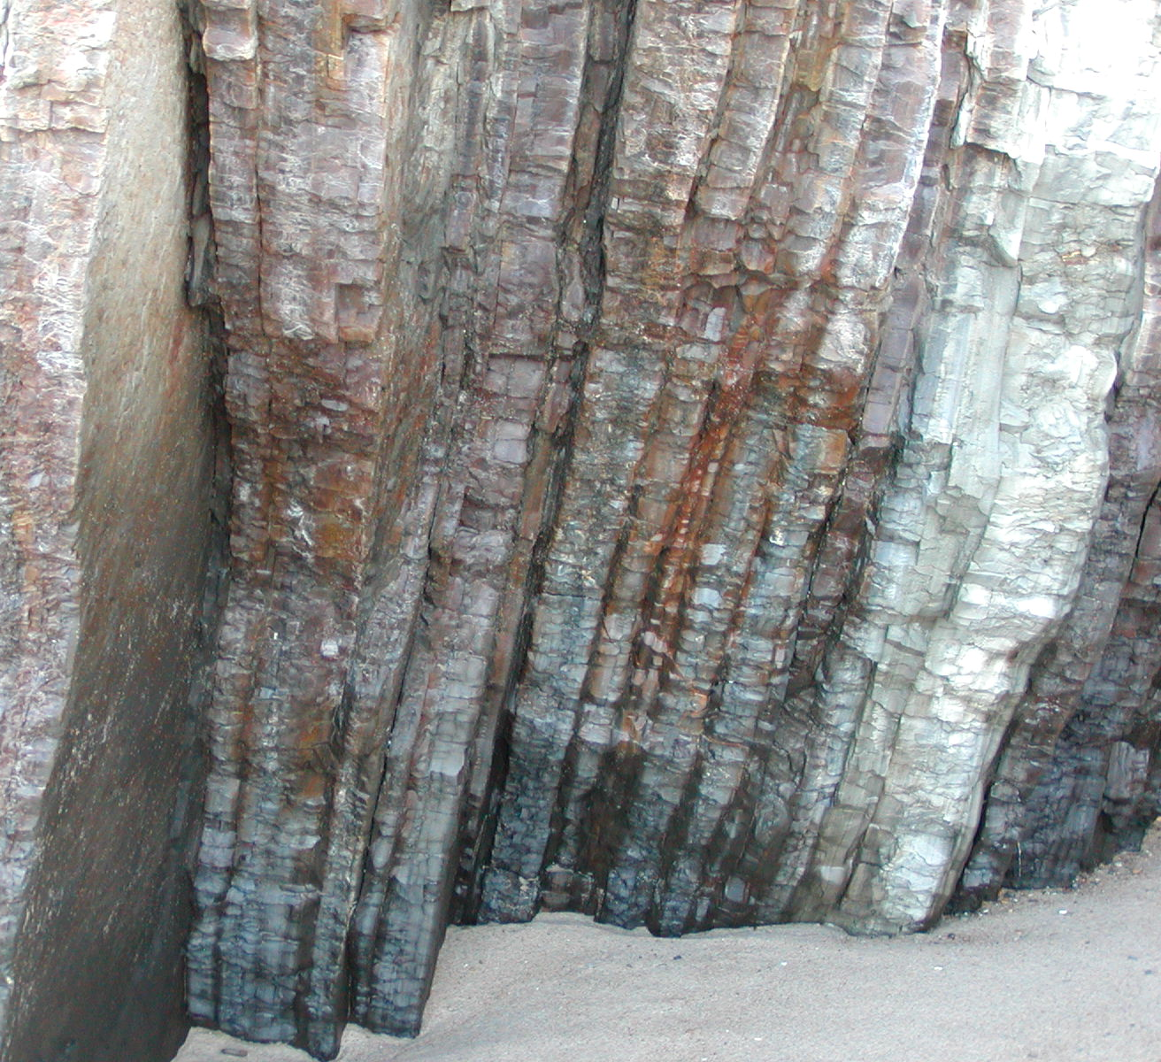
Mussel Rock, CA: Ribbon-bedded porcelanite

Slide 20
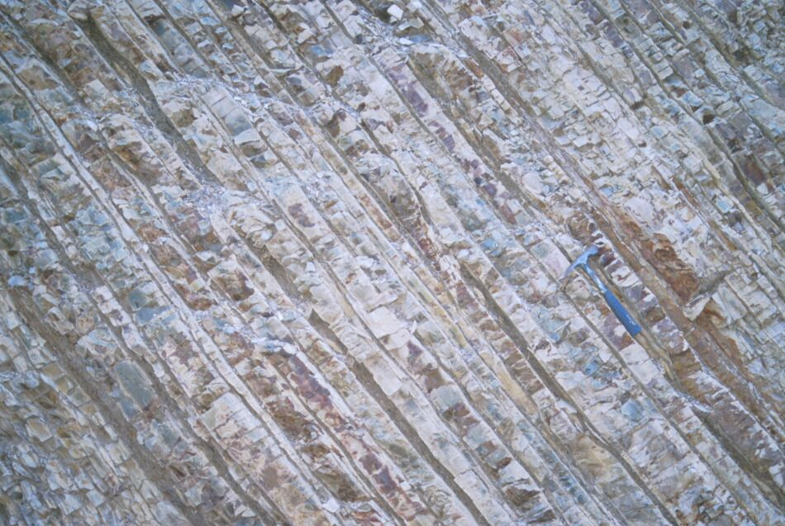
Arroyo Seco, California: planar bedding

Slide 22
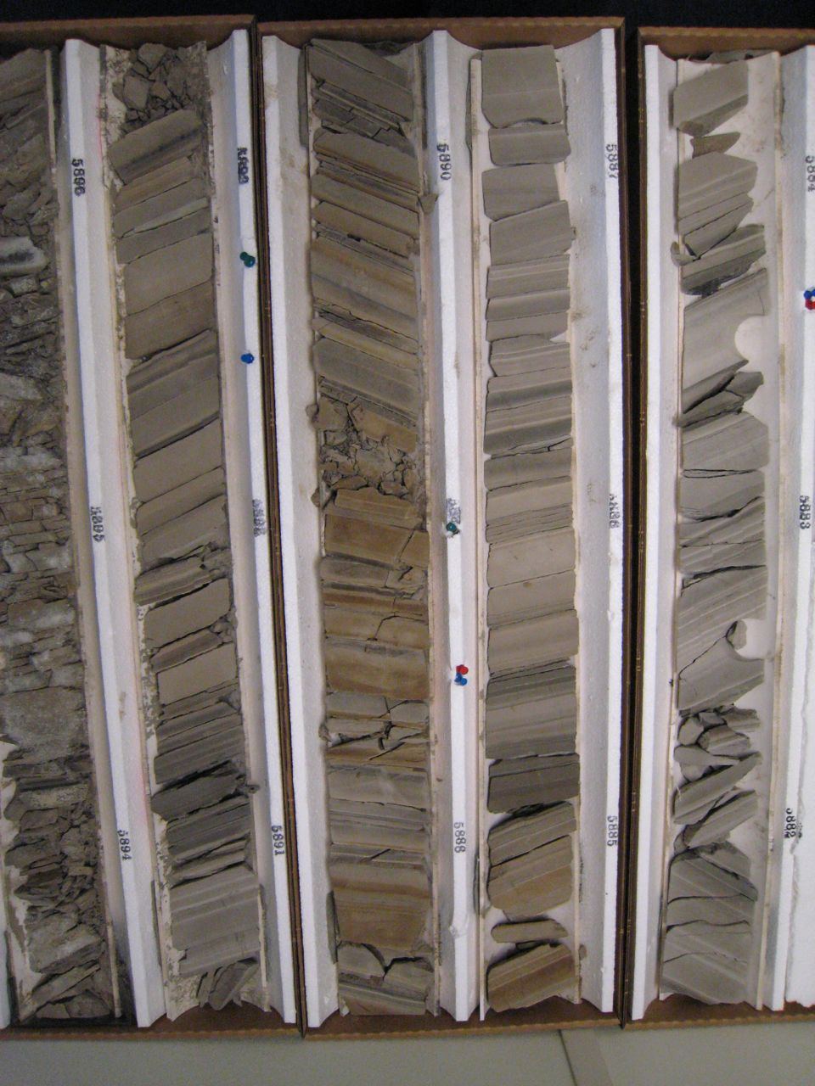
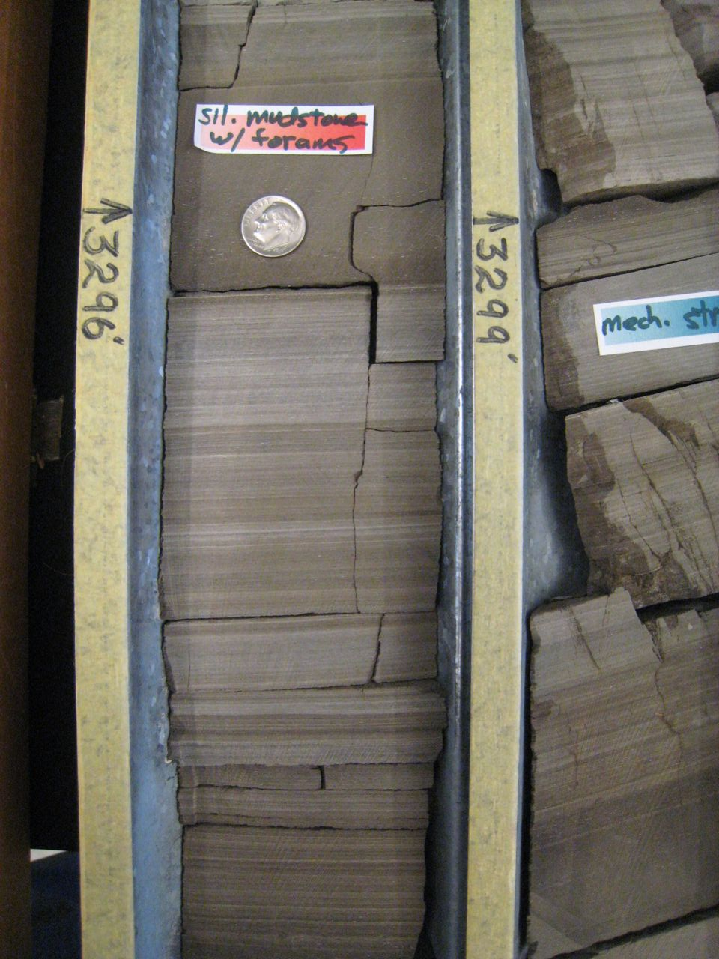
Elk Hill field, California: core

Slide 23
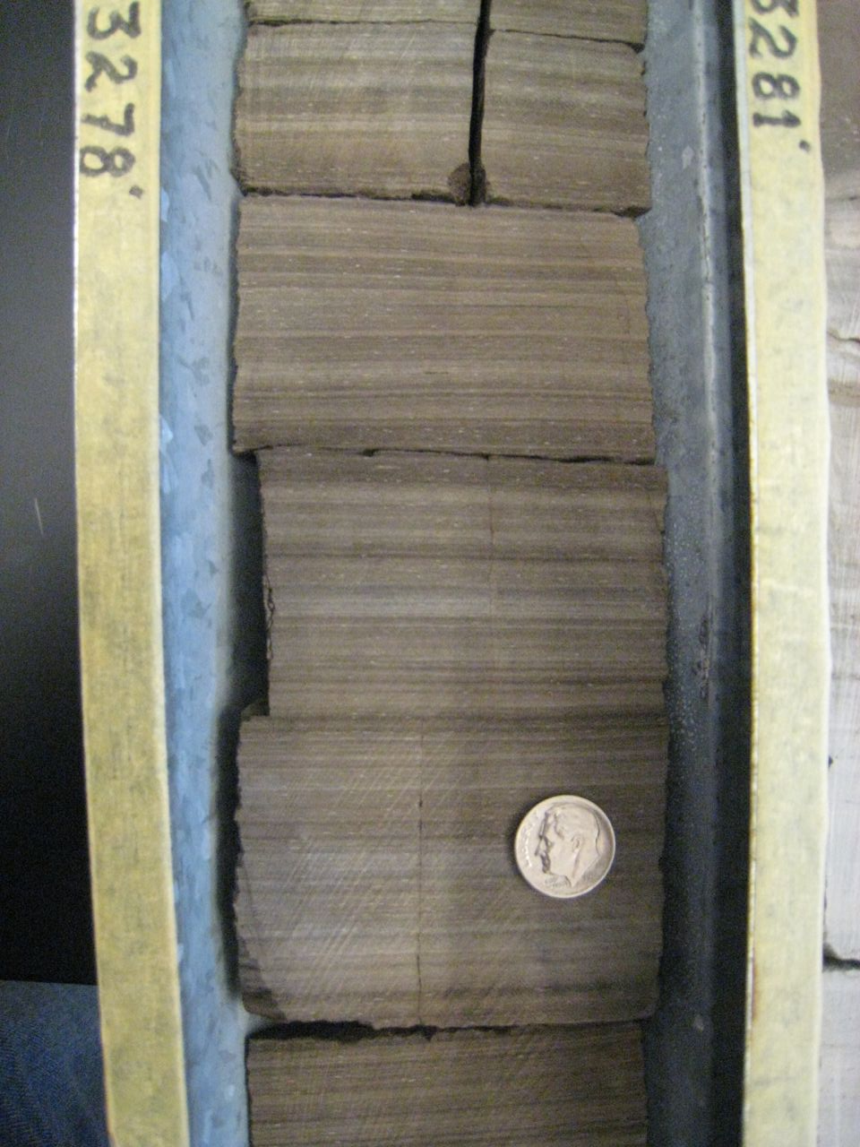
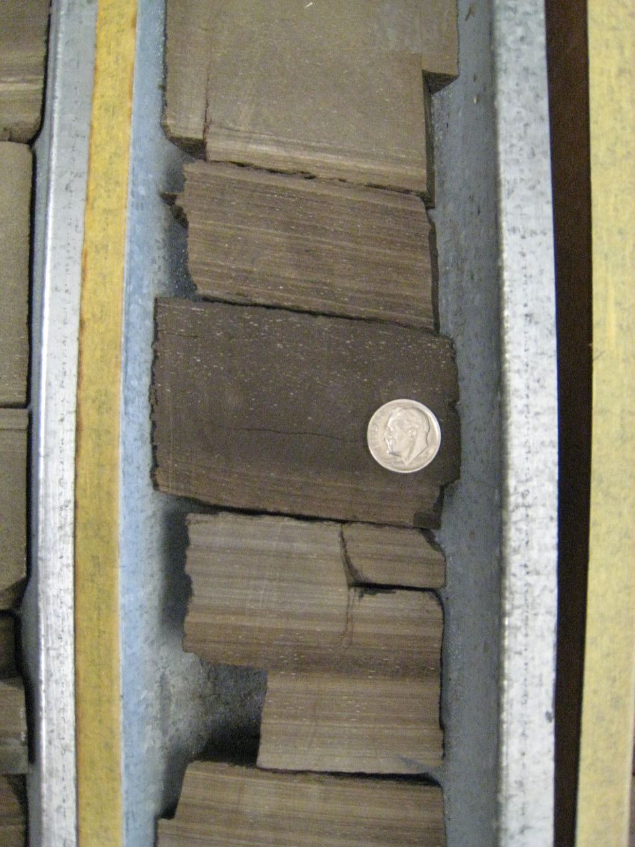
Elk Hill field, California: core

Slide 24
Barmer Hill Formation, India

Slide 25
Chert
Characteristics
Diagenetic Phase
Opal CT or Quartz
Composition
>90% diagenetic silica
Very minor detrital minerals, dolomite, calcite
Physical Properties
Hardness Index ≥ 5 (>steel probe)
Luster – vitreous (glass to waxy)
Fracture – conchoidal, sharp, smooth
Brittle
Black, brown to tan in both outcrop and core

Slide 26
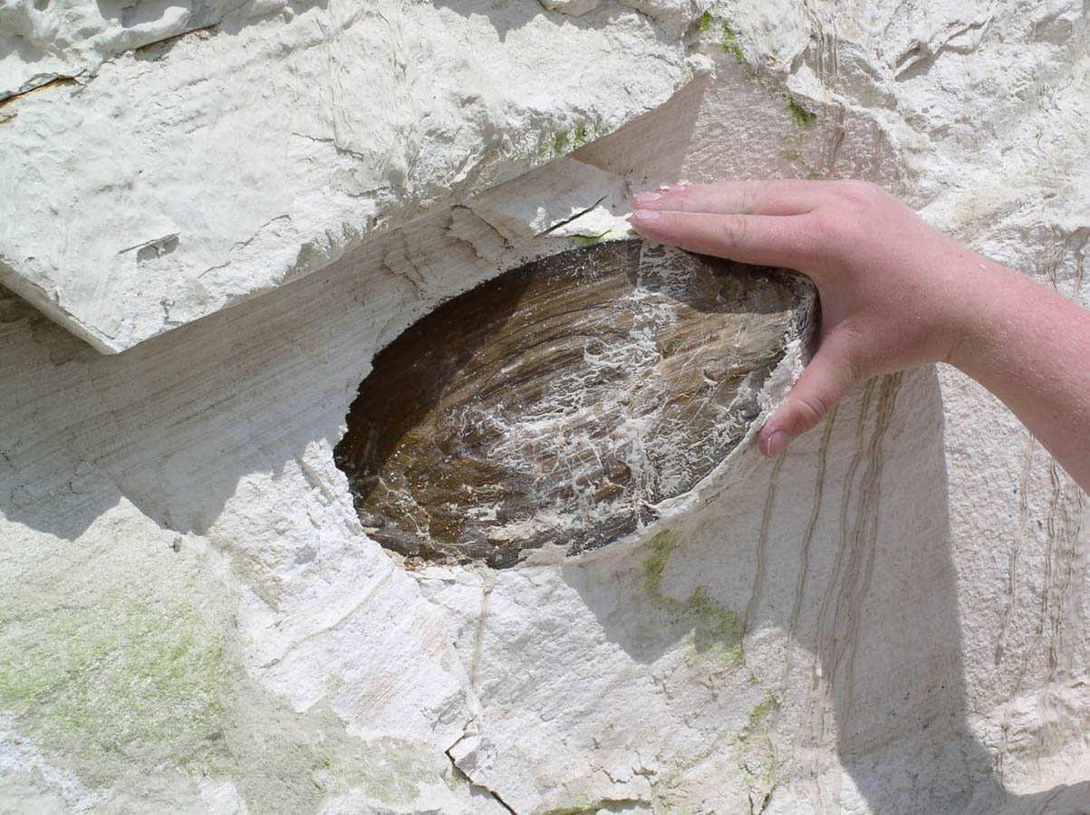
Lompoc, CA: Chert Nodule in Diatomite

Slide 27
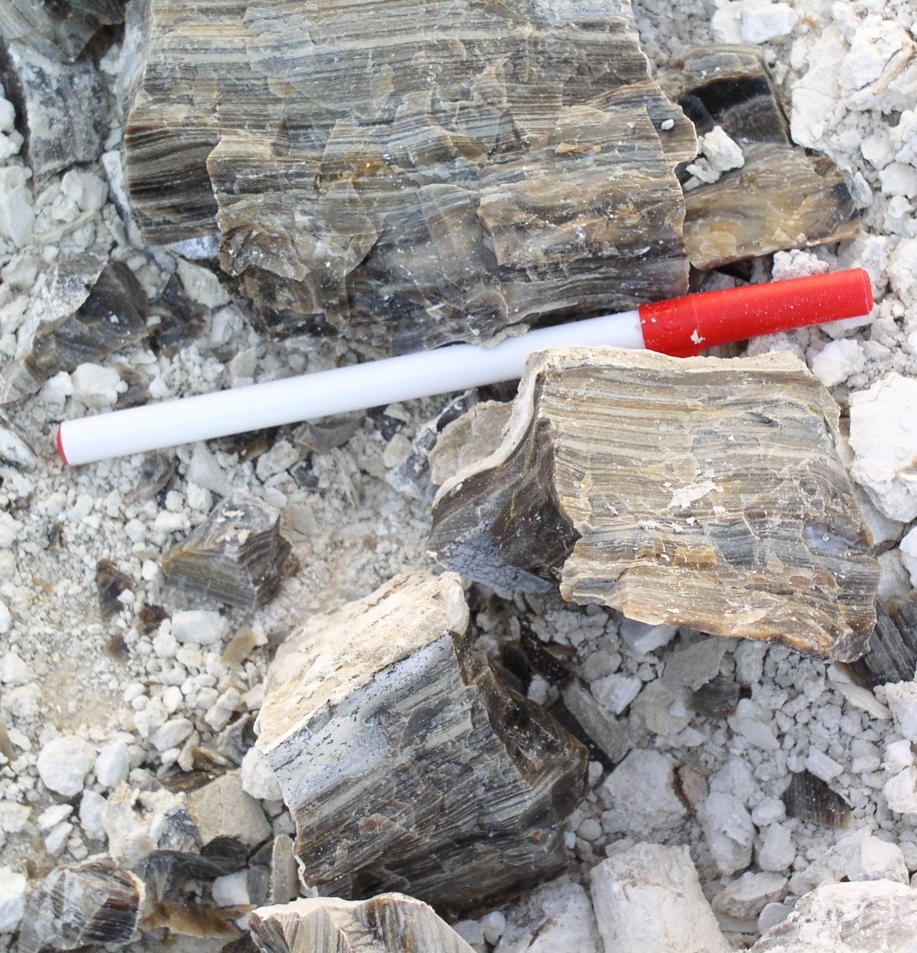
Lompoc, California: opal-CT chert

Slide 28
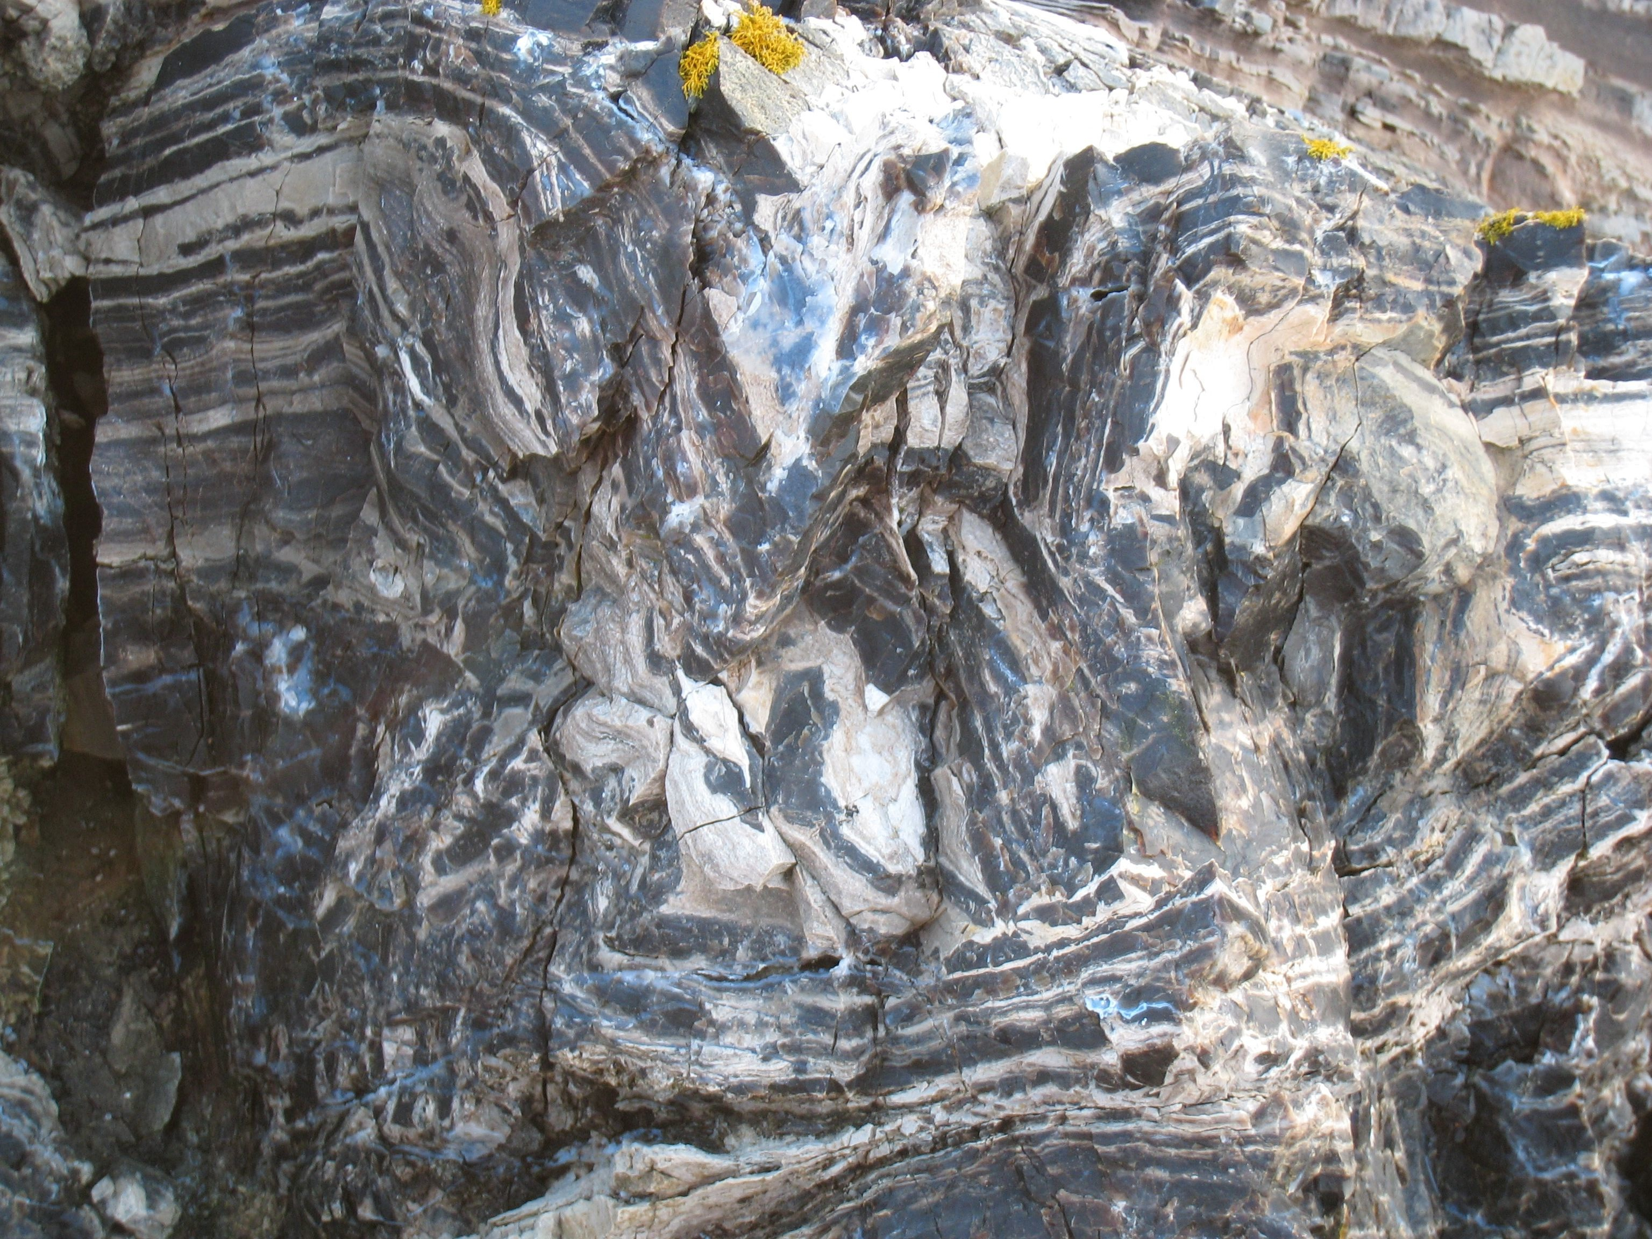
Lompoc, California: quartz chert

Slide 29
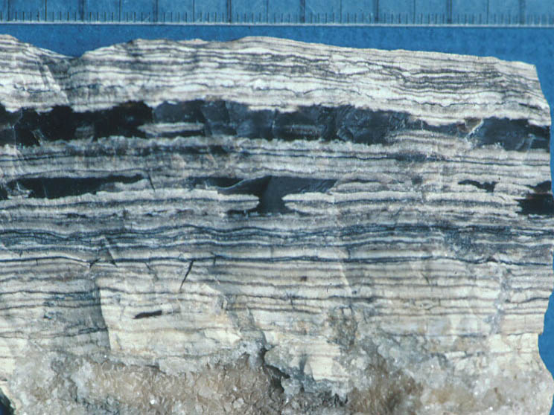
“Tiger-striped” interlaminated quartz chert, opal-CT porcelanite & dolomite

Slide 30
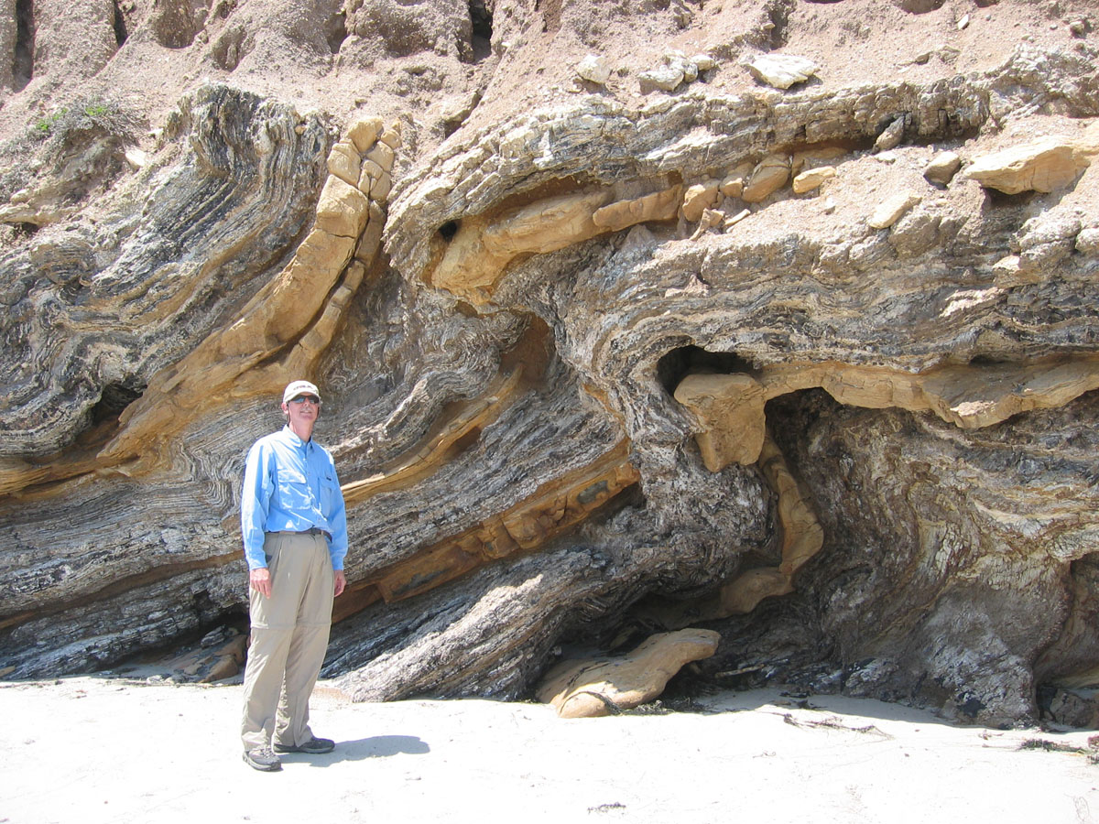
Interstratified tiger-striped chert & dolostone beds

Slide 31
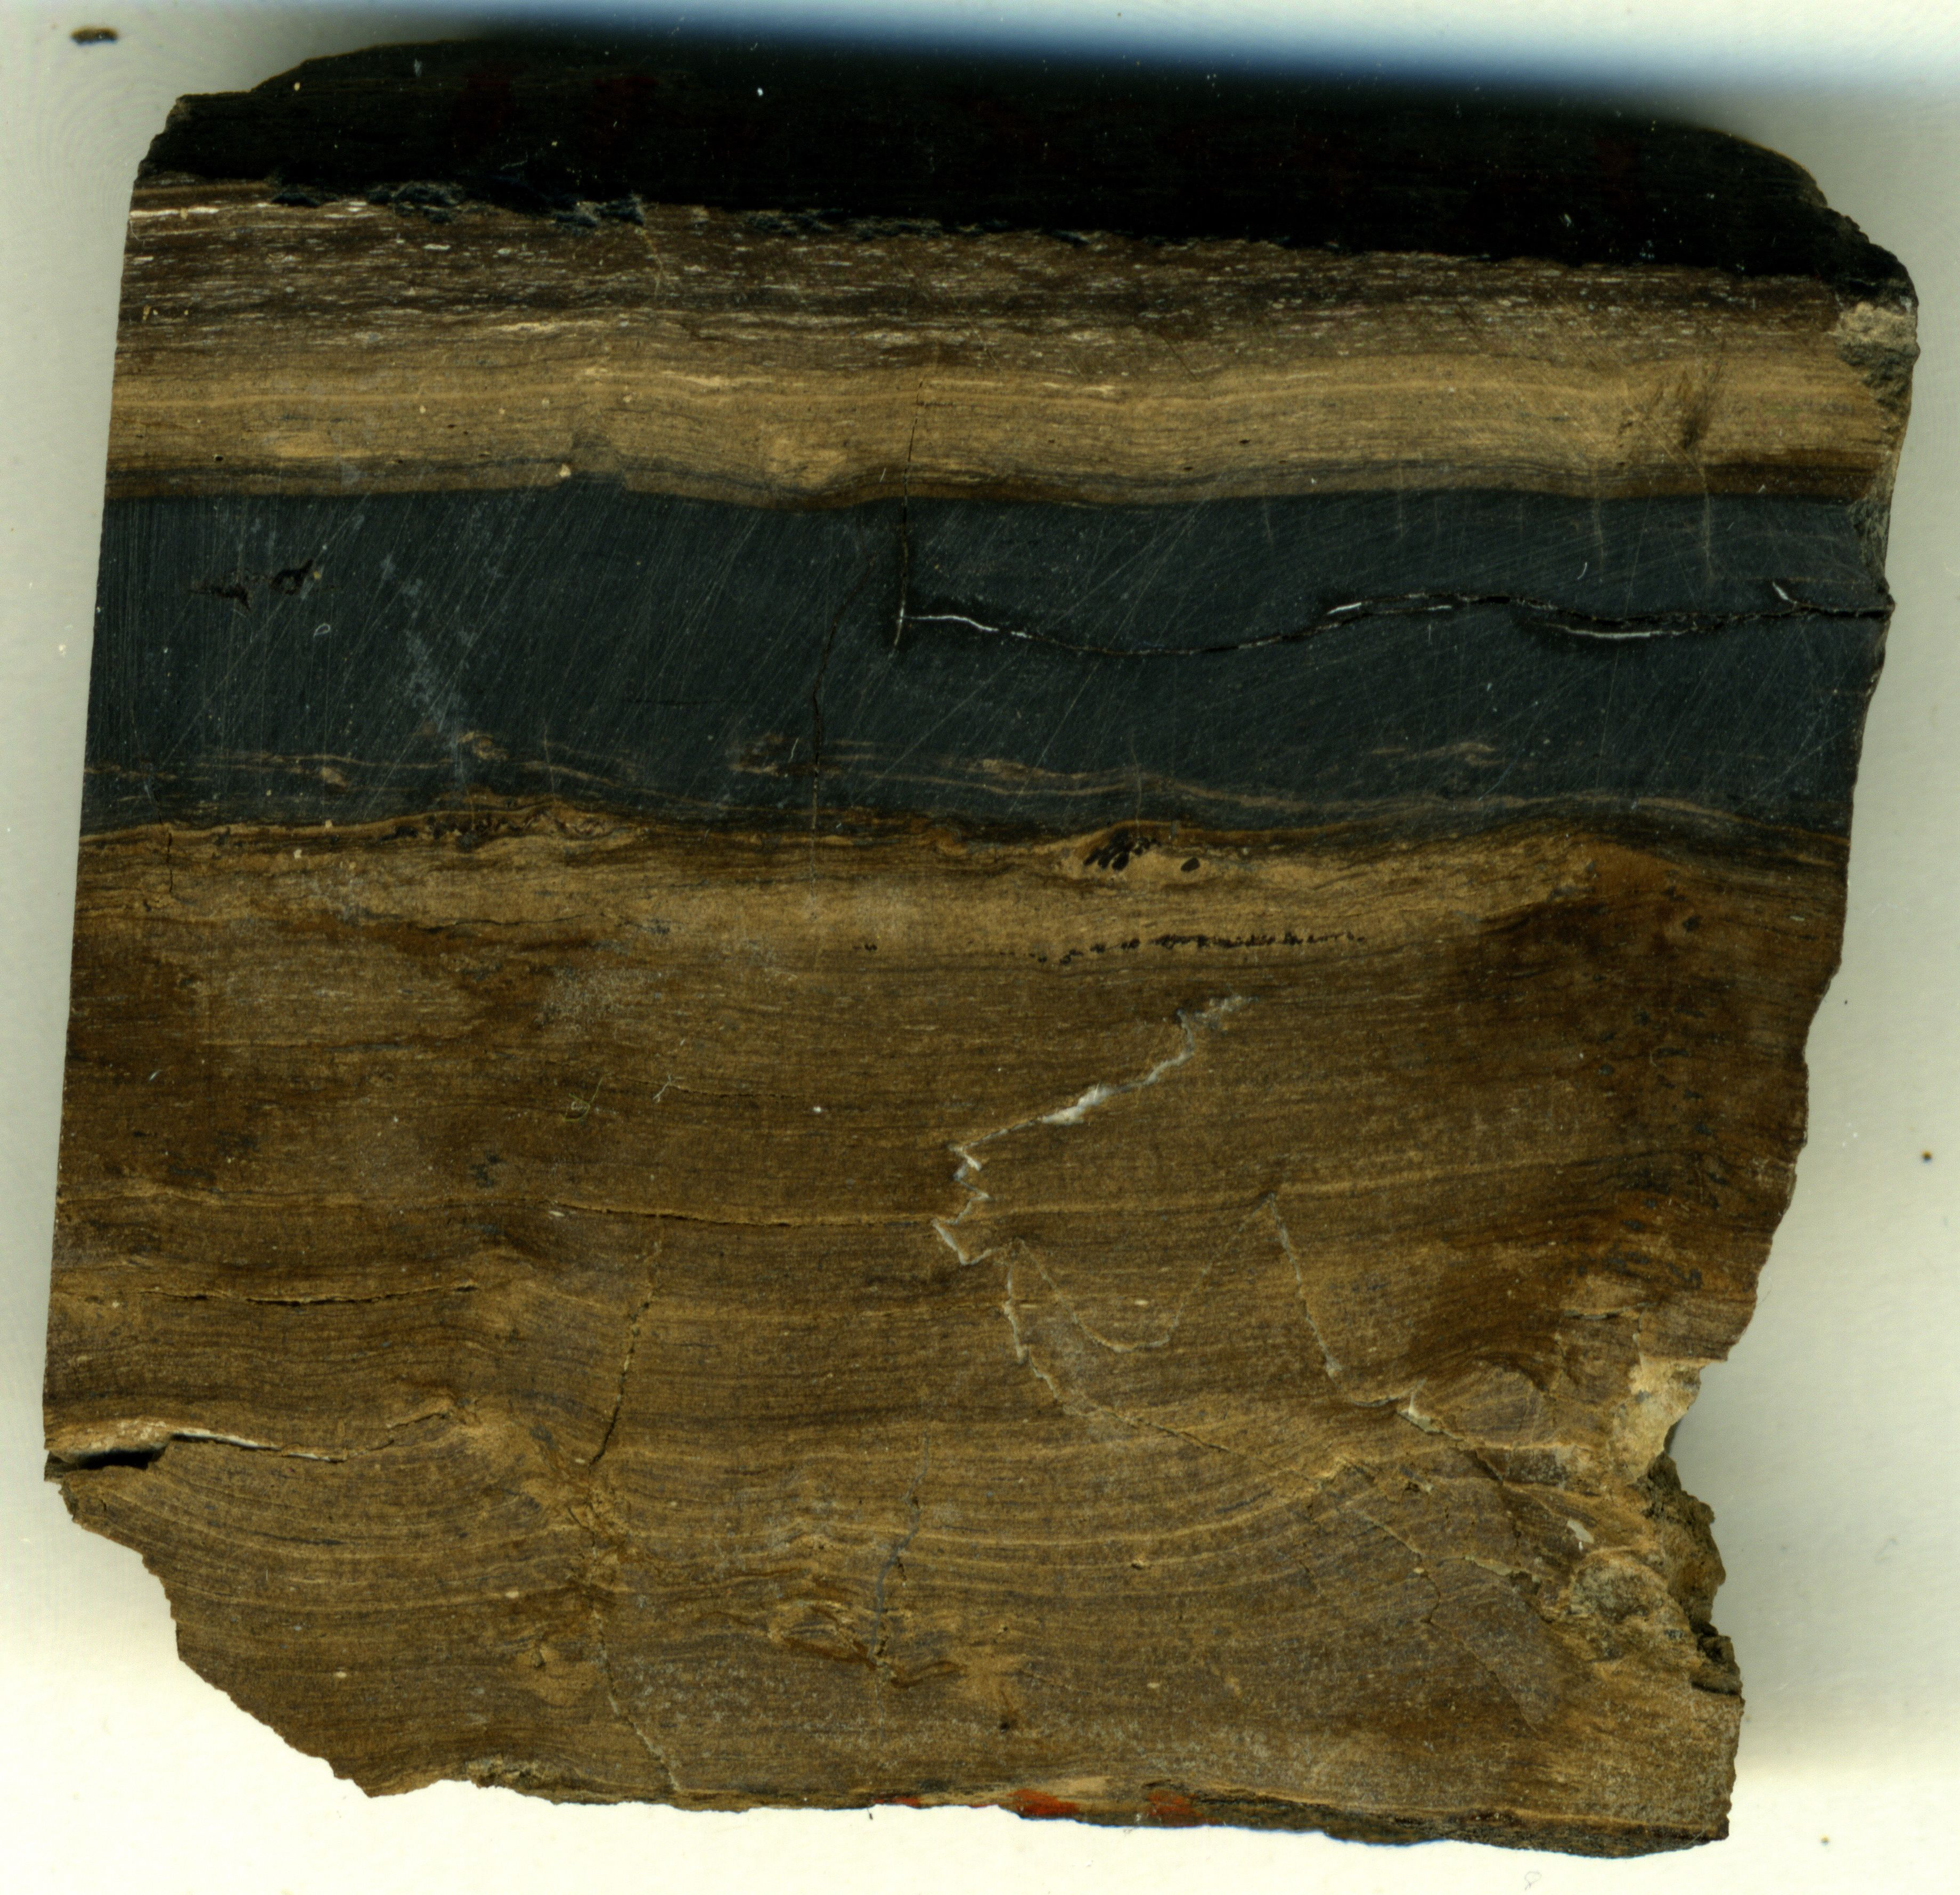
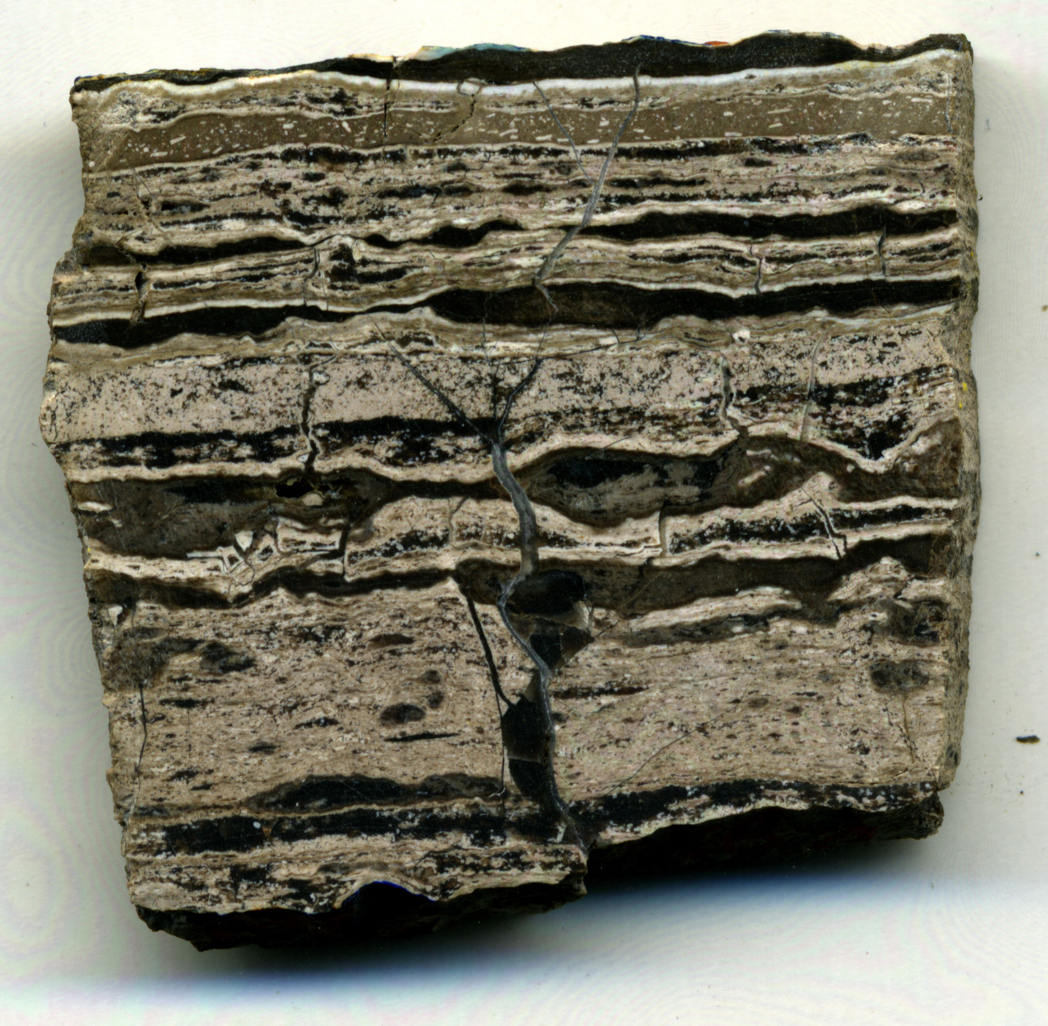
Offshore California core
Quartz chert and porcelanite
“Tiger-stripe” quartz chert, opal-CT porcelanite and dolomite

Slide 32
Siliceous Shale / Mudstone
Characteristics
Diagenetic Phase
Opal CT or Quartz
Composition
30-50% diagenetic silica
Detrital clay and silt
Physical properties
Surface luster - dull, matte
Fracture – curved, irregular
Fissile when disturbed or weathered
Harder than nonsiliceous mudrocks owing to the silica content
But still ductile, fractures close; brown in subsurface

Slide 33
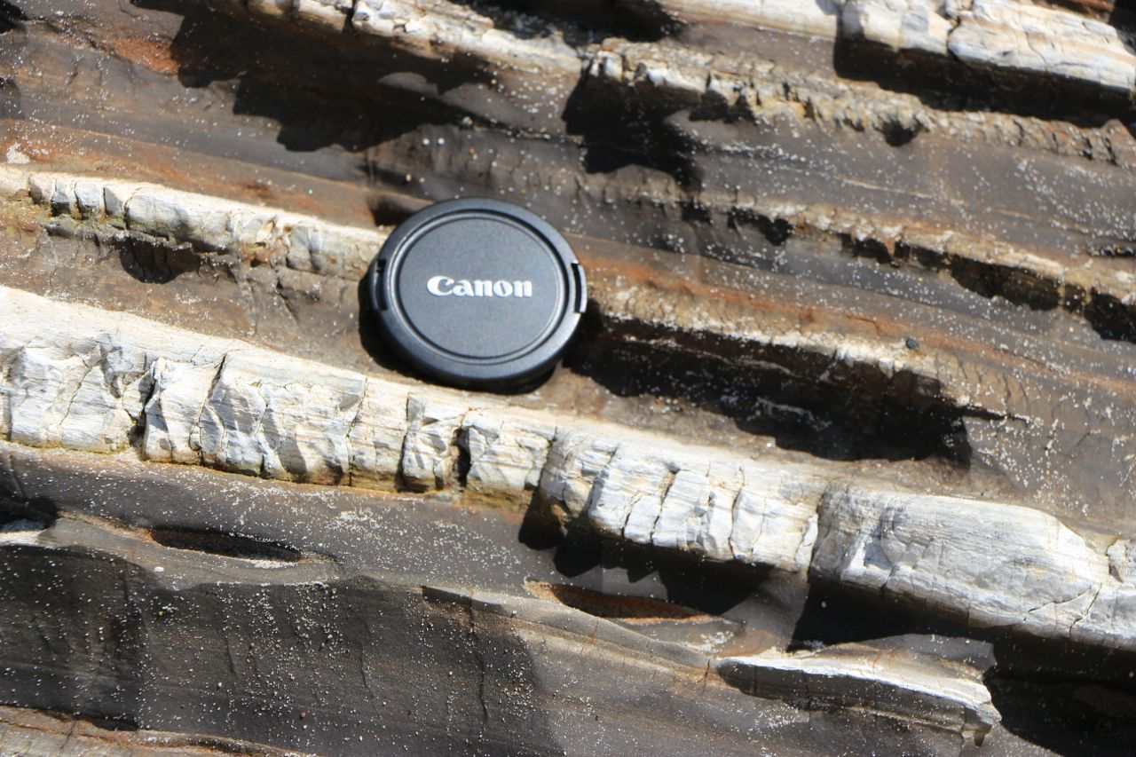
Siliceous Mudstone & Porcelanite

Slide 34
Organic-rich Mudstone & Calcareous Porcelanite

Slide 35
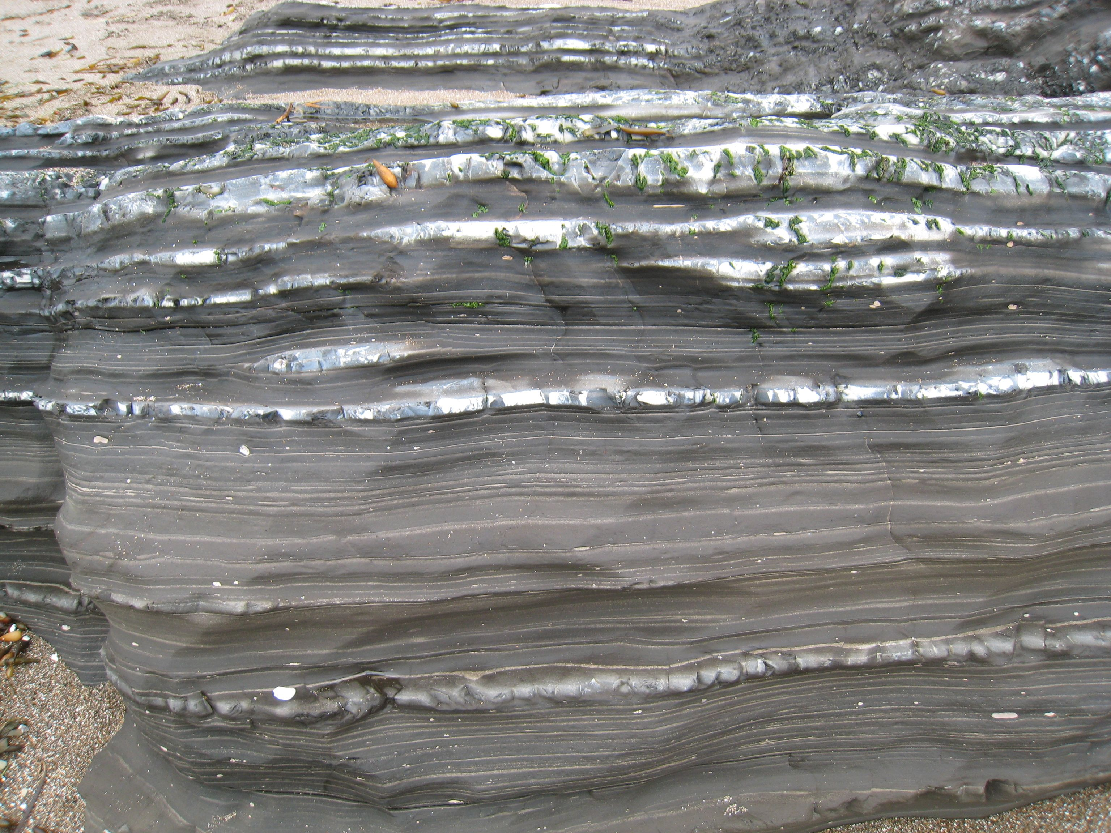
Shell Beach, California: mudstone and quartz porcelanite

Slide 36
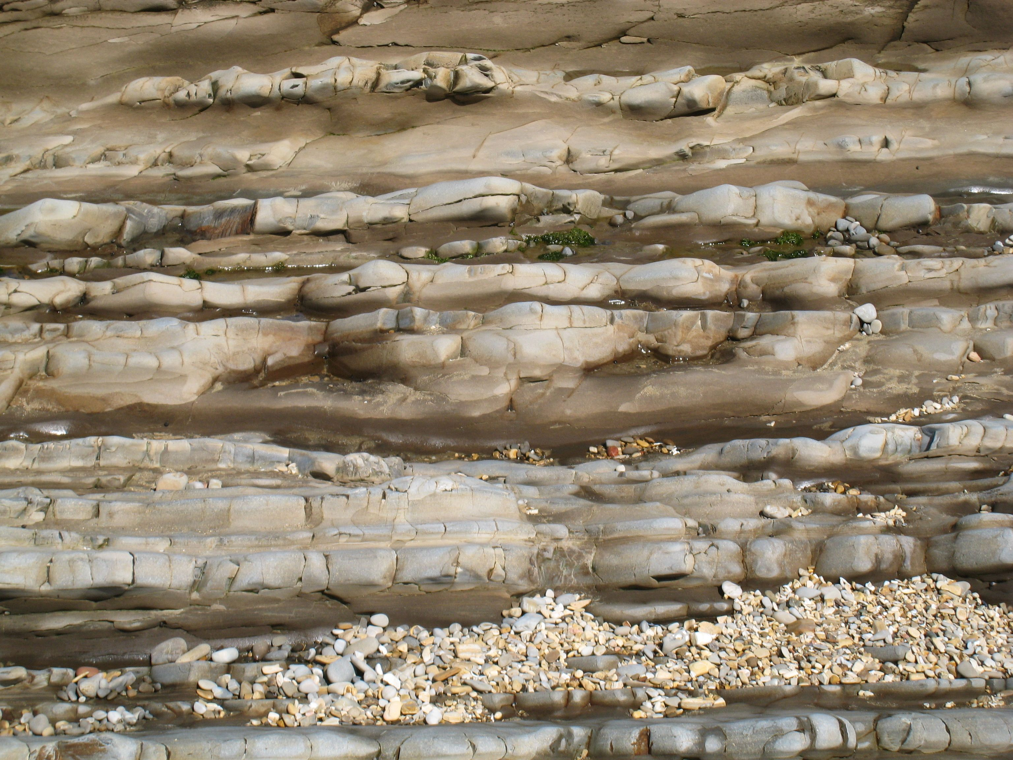
Mudstone & Siliceous Mudstone

Slide 37
Phosphatic / Carbonaceous Mudstone
Diagenetic Phase
Opal-A, opal-CT or quartz
Composition
Clastic mud,+/- calcite, +/- phosphate; usually <30% silica
Organic-rich (4-24% TOC)
Authigenic phosphate: CFA : carbonate fluorapatite
Physical properties
Fissile when disturbed or weathered
Ductile, difficult to fracture except for cemented horizons)
Black & white to red-brown & tan (fresh and in core); white to light gray when weathered
Phosphatic nodules, laminations and aggregated hardgrounds

Slide 38
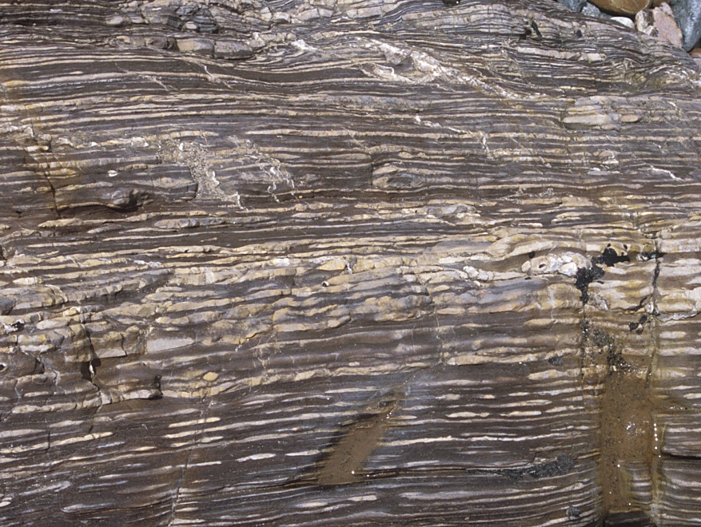
Phosphatic shales or marlstone

Slide 39
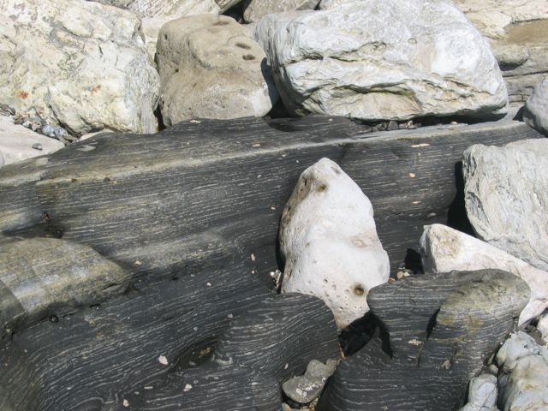
Phosphatic shales or marlstone

Slide 40
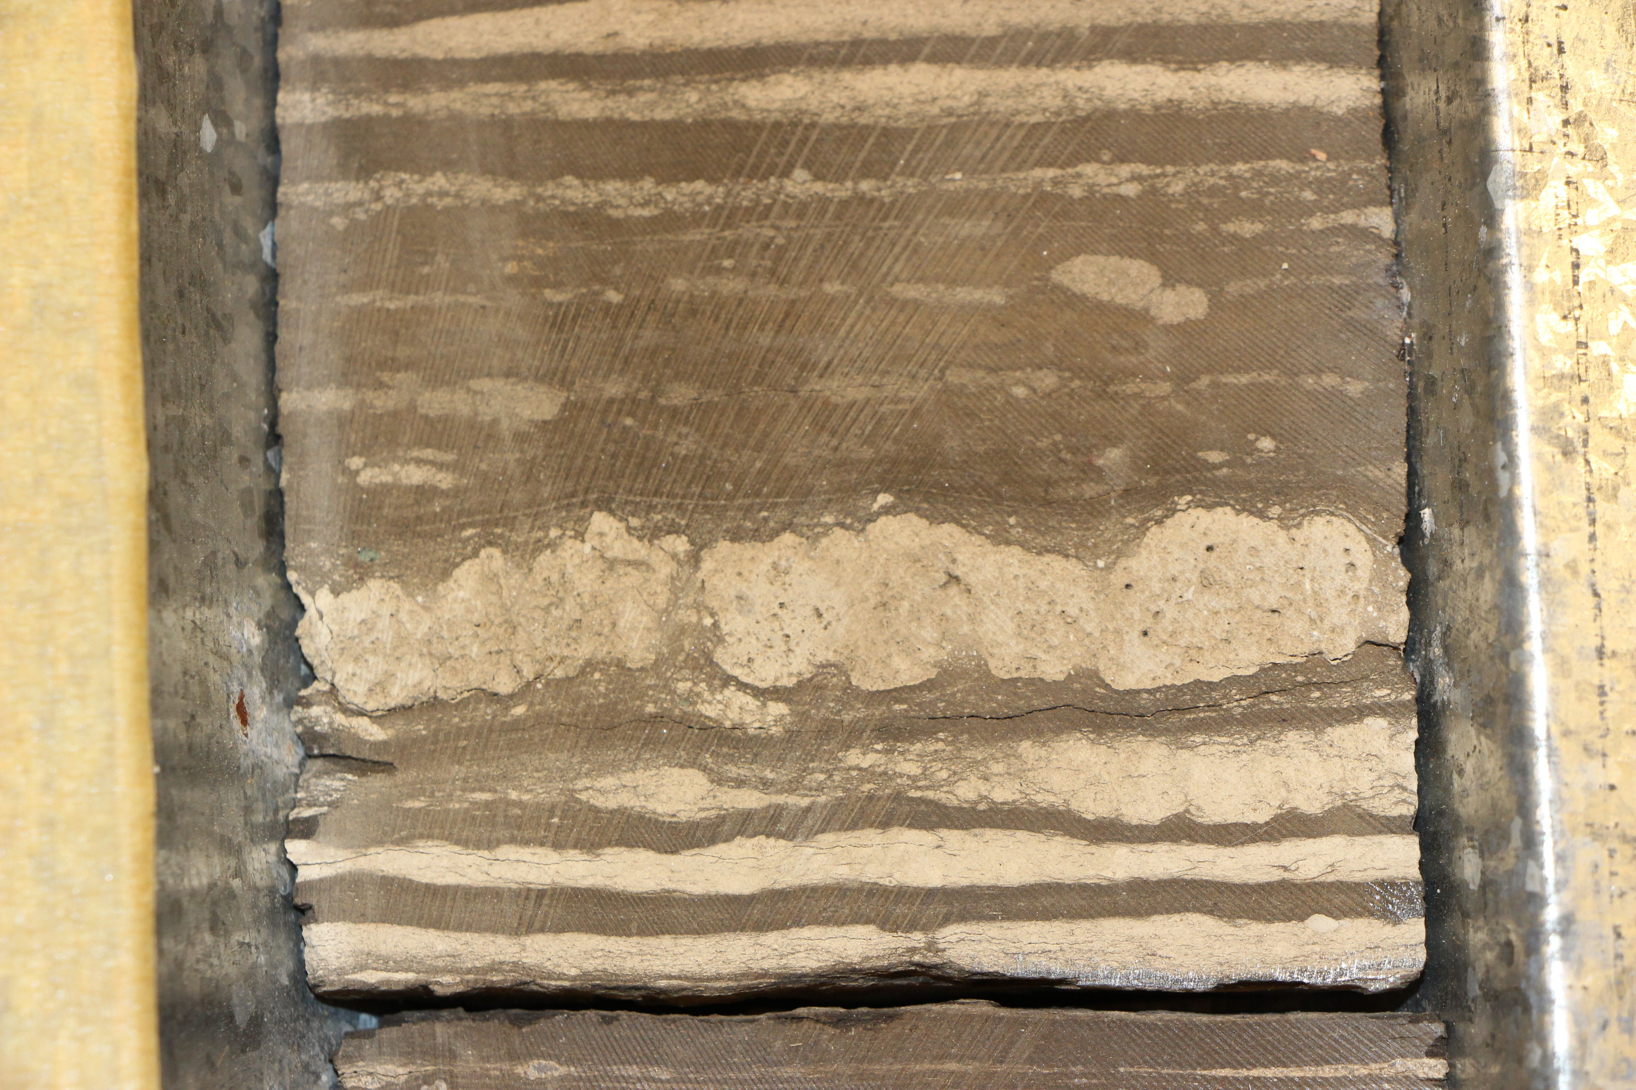
Offshore California core

Slide 41
Dolomite / Dolostone
Authigenic Precipitate
Mostly very shallow burial
Composition
From dolomitic rocks to nearly pure dolomite
If early formed in high-porosity diatom ooze, <25% silica & detritus by volume
Physical properties
Thick-bedded
Hard and dense
Dolomitized primary calcareous sediments can have intercrystalline porosity
Hydrothermal veins associated with petroleum migration

Slide 42
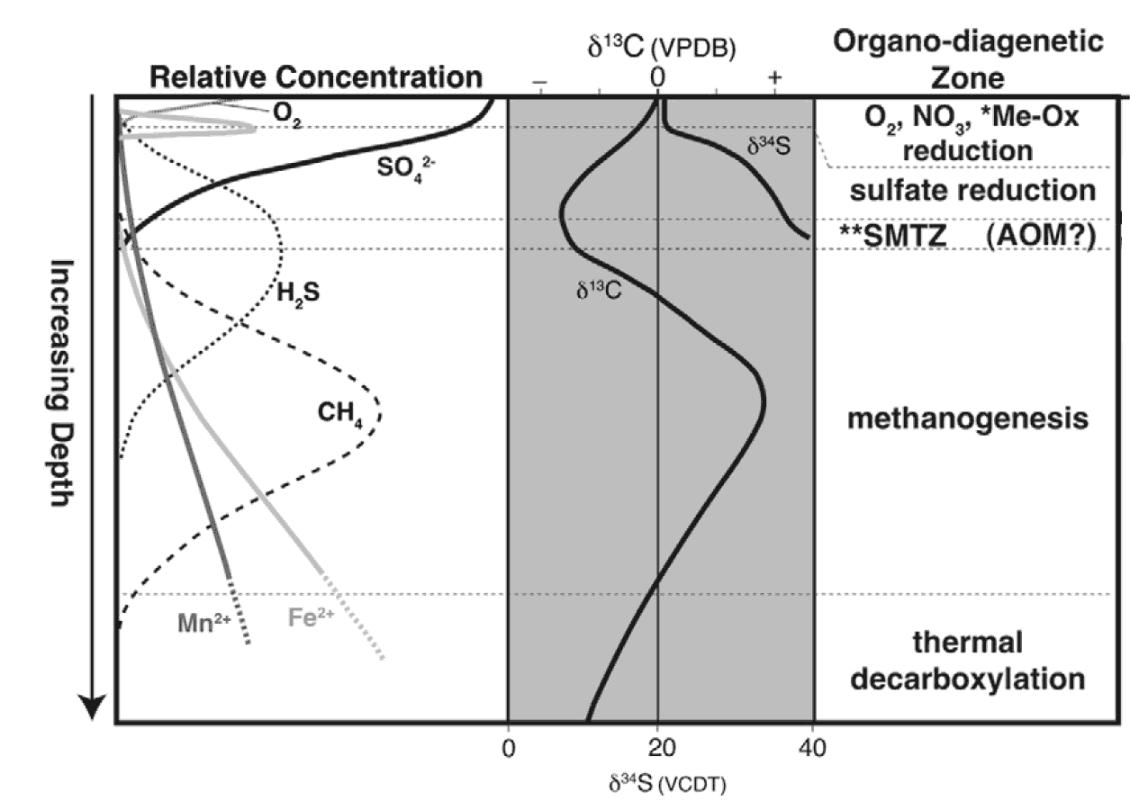
Organic Matter Diagenesis and Dolomite
Water
Sediment
Dolomite precipitation
Loyd et al. (2012), after Claypool & Kaplan (1974), Berner (1984)

Slide 43
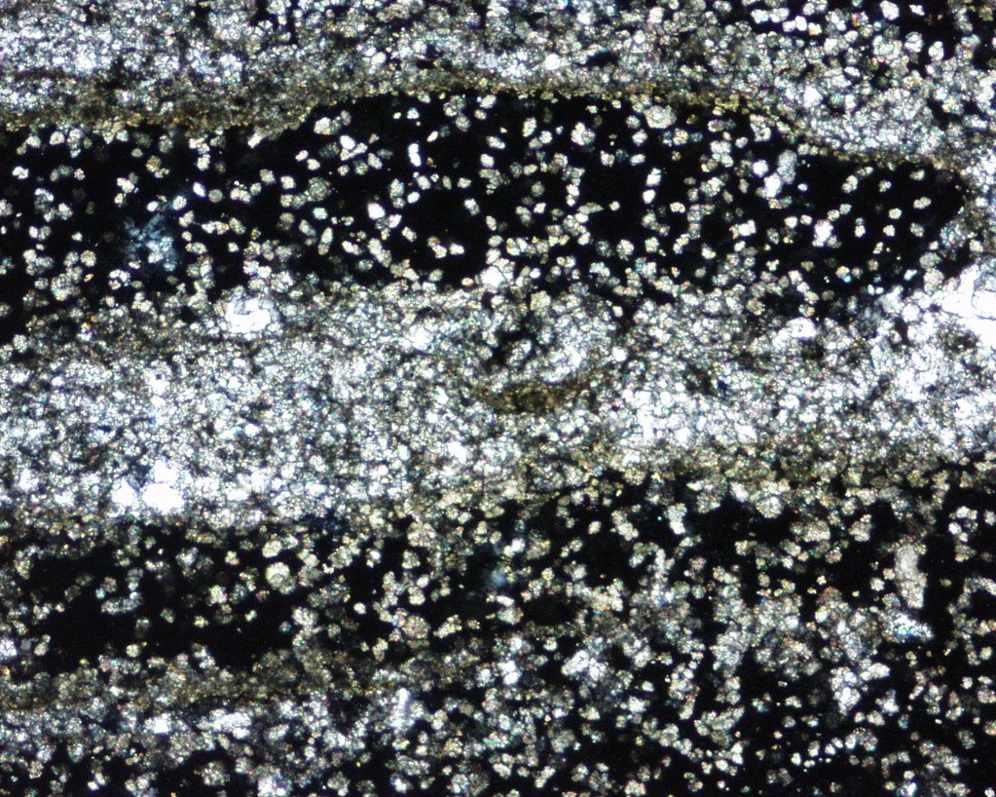
Disseminated Dolomite
Concentrated with favorable chemistry or enough time

Slide 44
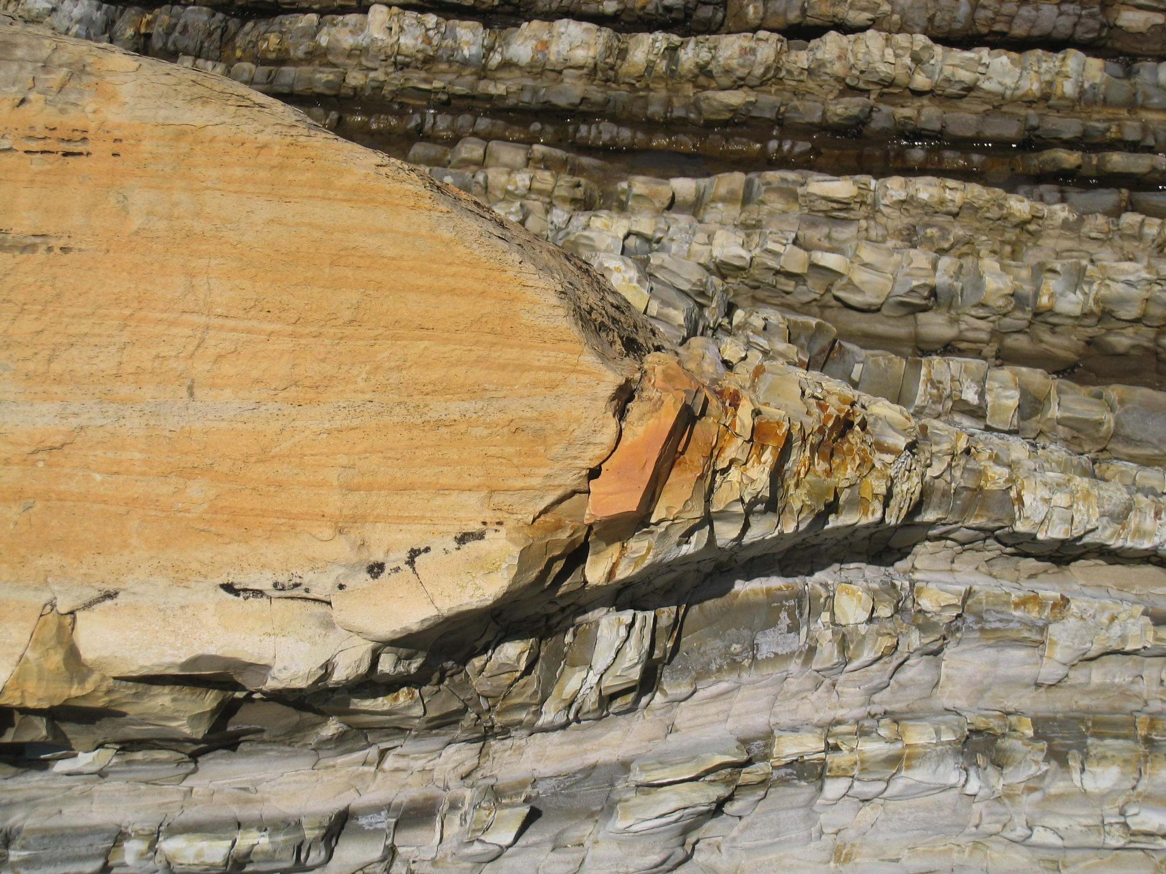
Dolostone Nodules
In massive mudstone
Gaviota Beach
In thin-bedded rocks
Montana de Oro

Slide 45
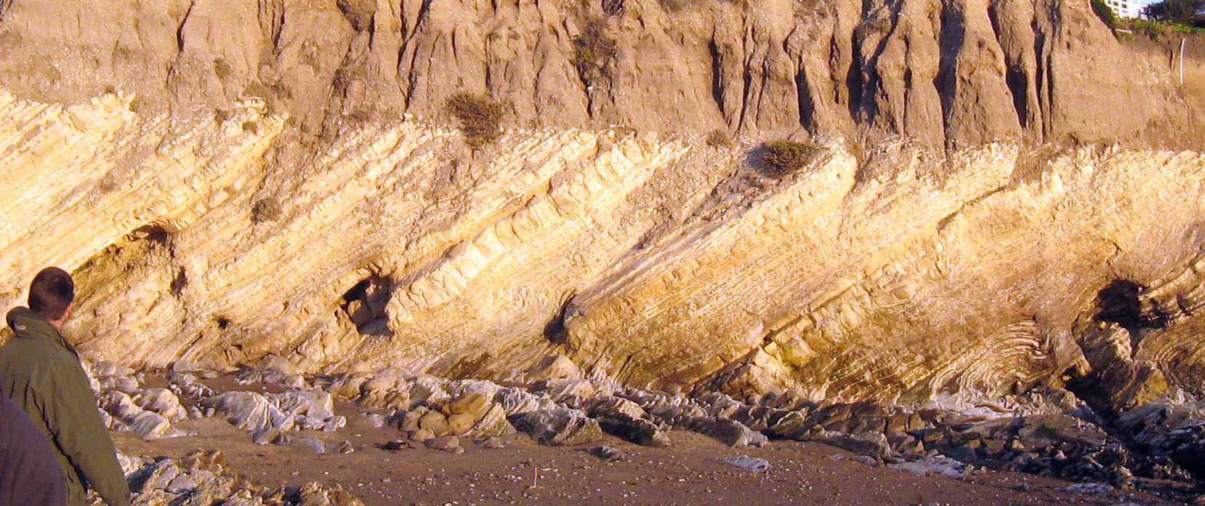
Dolostone Beds associated with parasequence boundaries
In massive mudstone
In thin-bedded rocks
Shell Beach

Slide 46
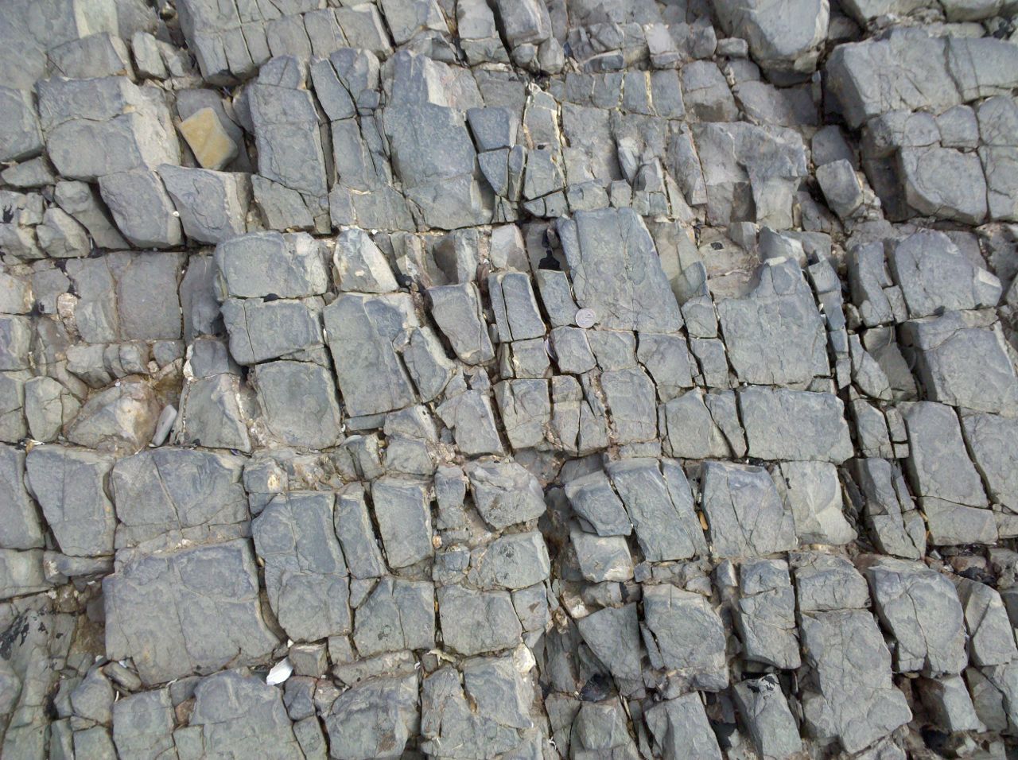
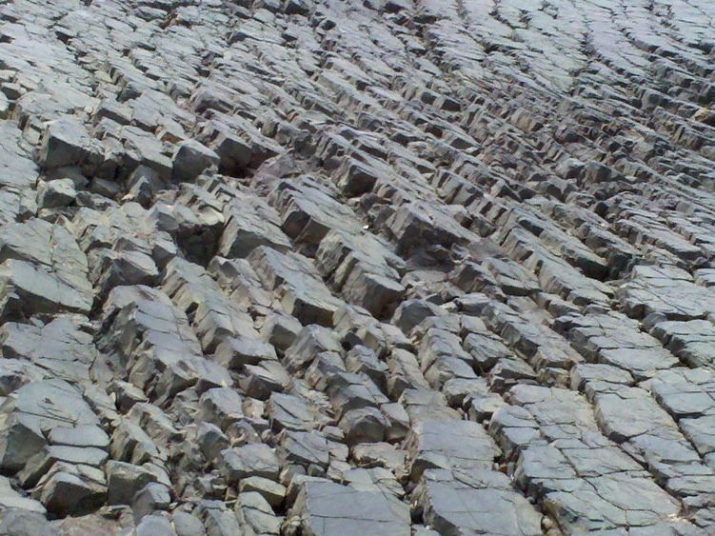
Fractured Dolostone
Crystal Cove
Thick, brittle beds form fractures with greater length & large apertures

Slide 47
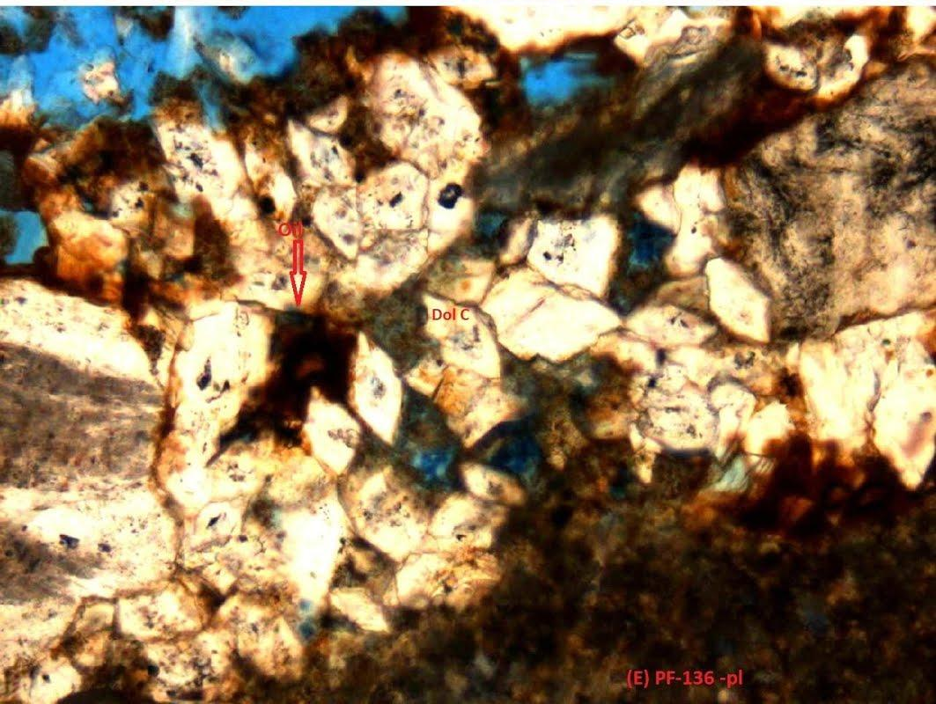
Dolostone Matrix Porosity
F.O.V= 1.28 mm
Oil
AlShammary (2013)

Slide 48
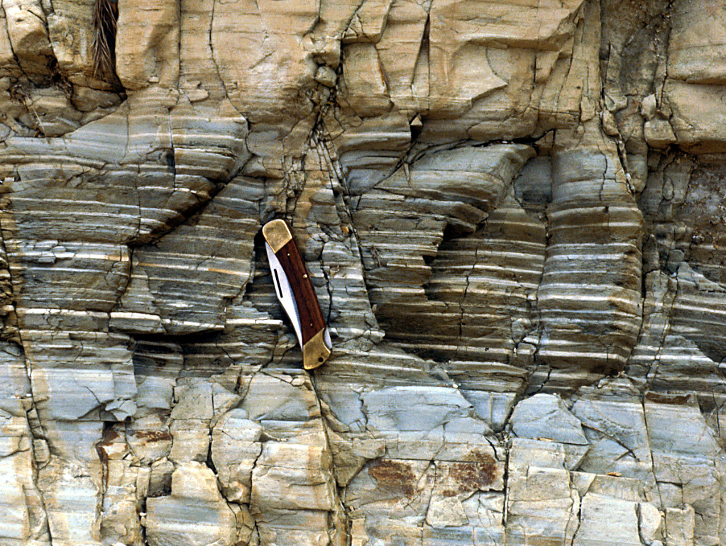
Environmental change shifts between siliceous, phosphatic and dolomitic sedimentation

