Slide 1
CSULB MARS Project Monterey & Siliceous Sediments Short-Course & Symposium Bakersfield, 5 December, 2016
Richard J. Behl
California State University
Long Beach, CA
MARS Project: Monterey and Related Sediments

Slide 2
Controls of Character and Composition
Silica Diagenesis
Silica phases
Structure
Identification
Characteristics
Controls & mechanisms
Phase change
Crystallographic ordering
Compositional controls
MARS Project: Monterey and Related Sediments

Slide 3
Controls of Character and Composition
Silica Diagenesis
Porosity evolution
Stepwise loss
Compositional controls
Influence of burial history
Types of reaction fronts
Secondary porosity
Silicification
MARS Project: Monterey and Related Sediments

Slide 4
Silica Diagenesis
2-step dissolution/reprecipitation:
Opal-A
Opal-CT
Quartz
Time +/or Temperature
Siever (1983)

Slide 5
Opal-A (X-ray amorphous)
Biogenic silica
Diatoms, radiolarians, sponge spicules, silicoflgellates, phytoliths
Hydrous opaline silica
No clear crystal structure
Broad “hump” in X-ray diffraction
Highly soluble
~60 - 130 ppm

Slide 6
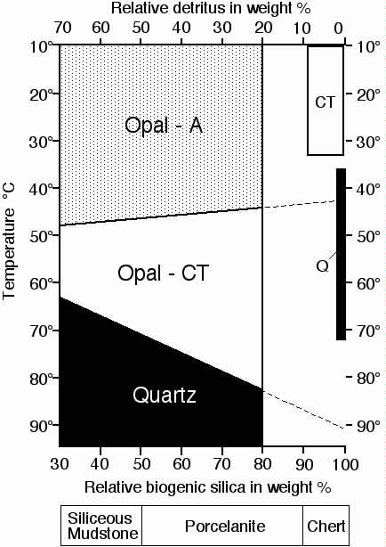
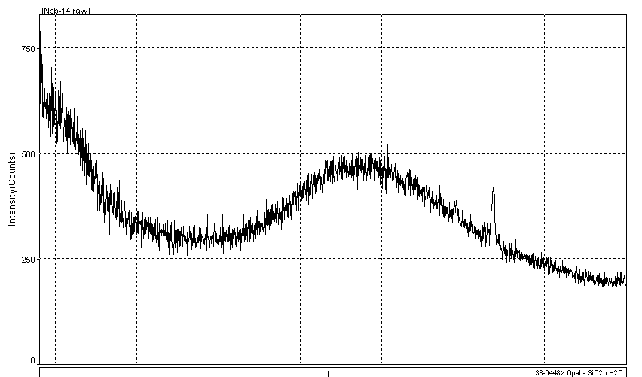
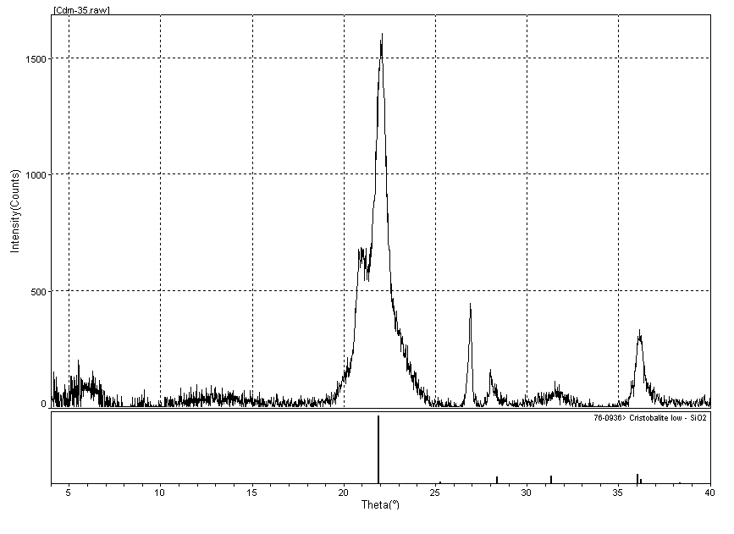
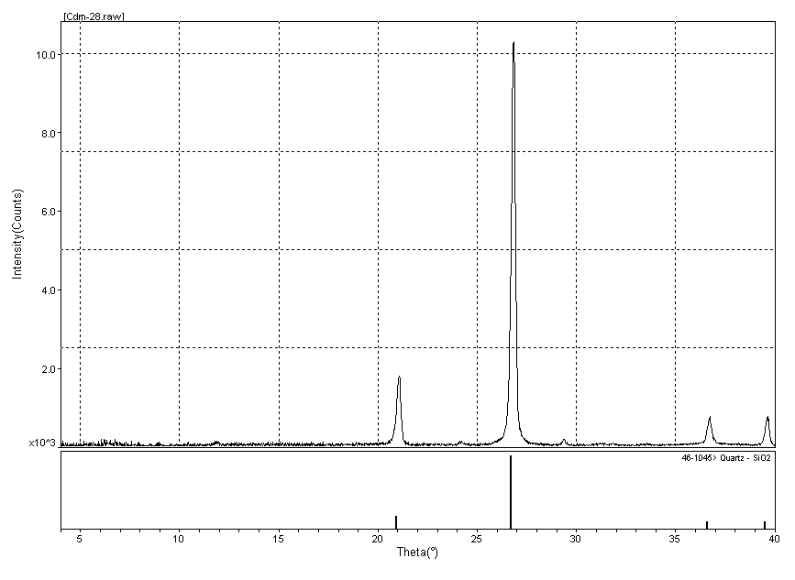

Slide 7
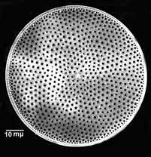
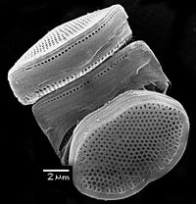
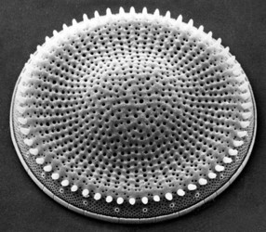

Slide 8
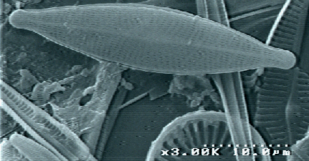
Diatoms - Chrysophyta
Algal Microfossils

Slide 9
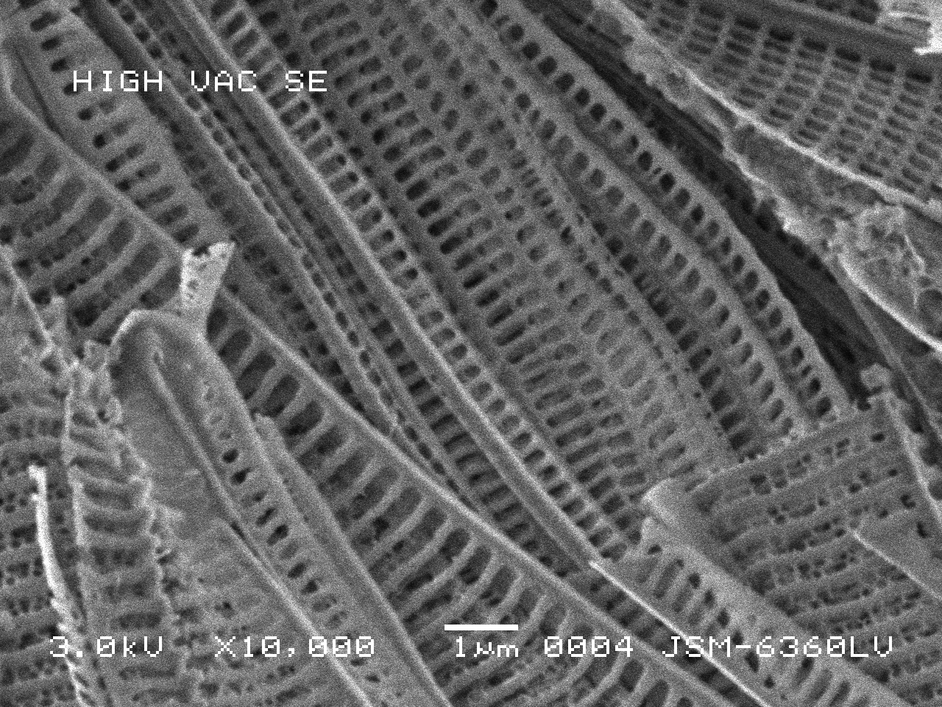
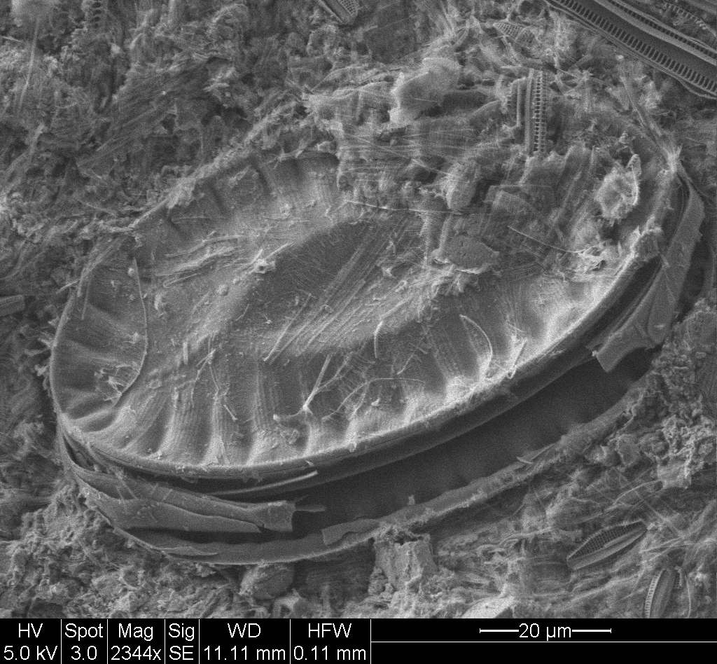
Diatoms

Slide 10
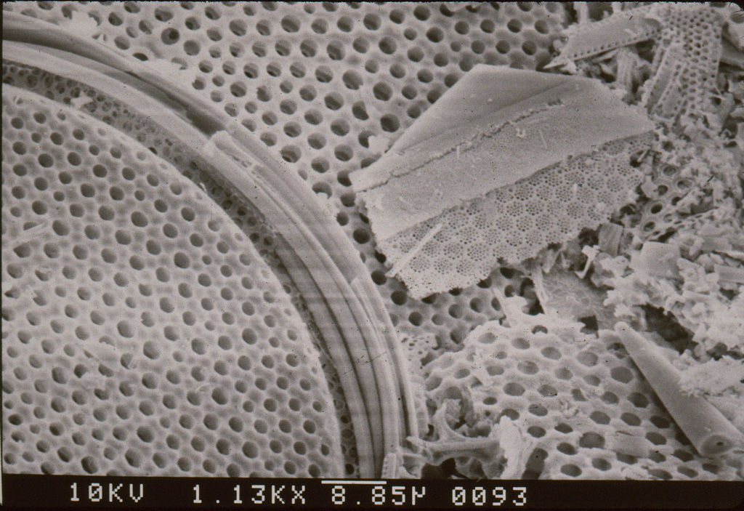

Slide 11
Opal-CT (cristobalite/tridymite)
Diagenetic silica
Complete dissolution of diatoms, etc.
Reprecipitation as opal-CT
Hydrous silica with poorly ordered structure of low-cristobalite and low-tridymite
Broad peaks in X-ray diffraction
Metastable state
Less soluble
~20 - 30 ppm

Slide 13
Well structured opal-CT

Slide 14
Quartz
Diagenetic silica
Complete dissolution of opal-CT.
Reprecipitation as quartz
Microcrystalline, chalcedonic, megacrystalline
Sharp peaks in X-ray diffraction
Stable state
Low solubility
~6 - 10 ppm

Slide 16
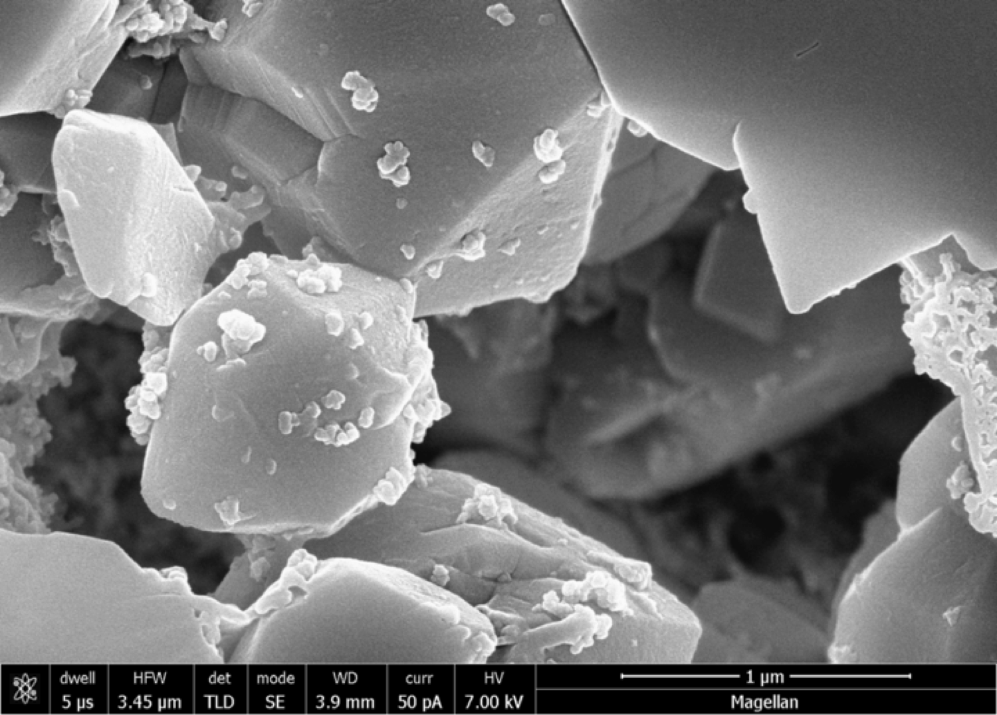
Quartz

Slide 17
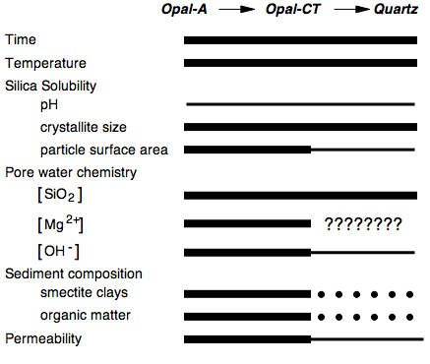

Slide 18
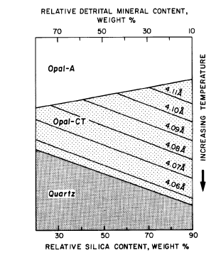
Composition: Detritus
The presence of detrital minerals changes the diagenetic sequence
Opal-A transforms to opal-CT sooner in purely siliceous rocks than in detrital rich rocks.
Opal-CT in detrital-rich rocks is initially better ordered (implied by smaller d-spacing) than opal-CT formed in detrital-poor rocks.
Finally, the transition of opal-CT to quartz occurs sooner in detrital-rich rocks than in detrital-poor rocks
Isaacs et al. 1983; copied from William and Crerar, 1985

Slide 19
Composition: Detrital
The presences of smectite clays interferes by absorbing Mg(OH)₂ ; which act as a catalyst for opal—CT precipitation
Isaacs et al. 1983; copied from William and Crerar, 1985
copied from William and Crerar, 1985

Slide 20
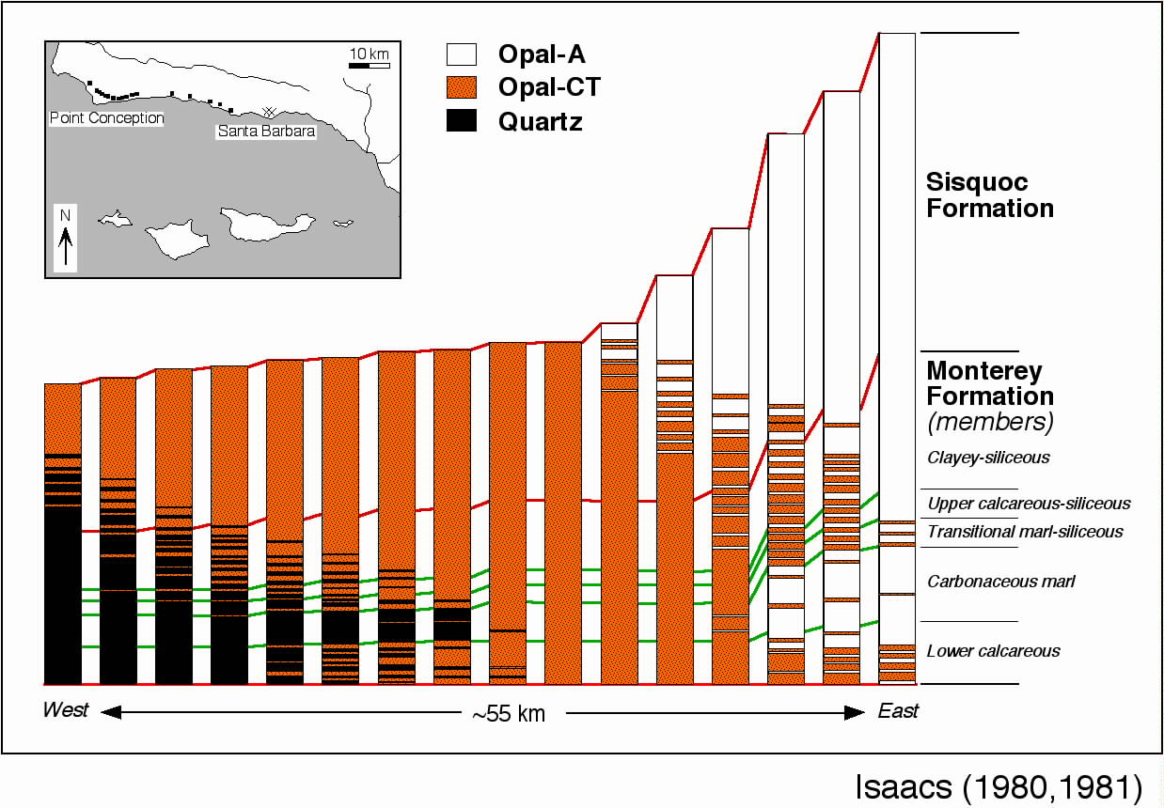

Slide 21
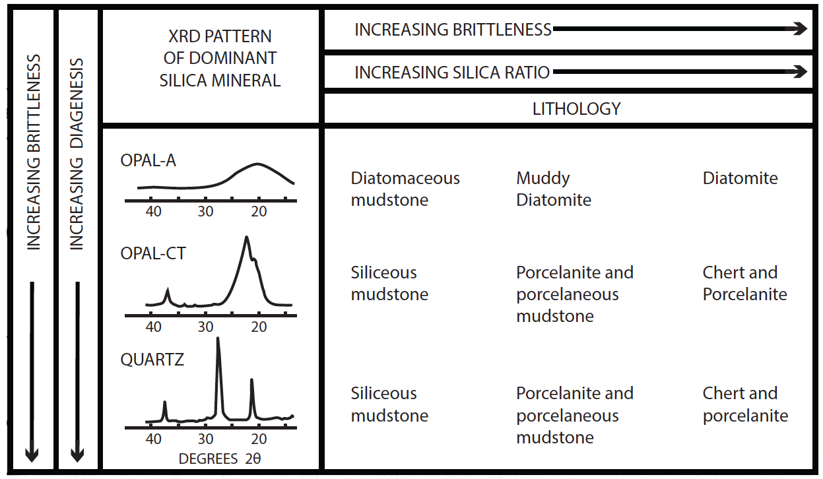
Silica phase = lithology!
Pisciotto & Garrison (1981); Snyder et al. (1983)

Slide 22
Two processes
Closed-system reorganization for porcelanites
Open system silicification for cherts, porefilling silicification
Behl & Garrison (1994)

Slide 23
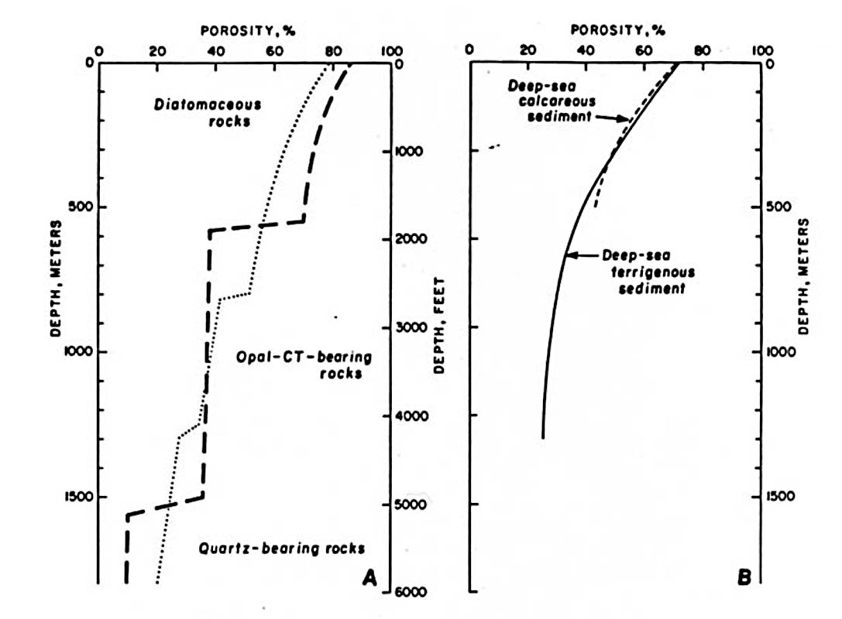
Stepped changes in porosity
Isaacs, 1981; after Hamilton, 1976

Slide 24
Theoretical Fluid Loss & Volume Change for Opal-A to Opal-CT to Quartz for Chert and Porcelanite
Pure diatomite
Impure diatomite
Grain density: 1.8 gm/cc
Porosity: 80%
Grain density: 1.8 gm/cc
Porosity: 65%
85%
H₂O
loss
75%
H₂O
loss
Grain density: 2.3 gm/cc
Porosity: 40%
Grain density: 2.3 gm/cc
Porosity: 15%
Grain density: 2.7 gm/cc
Porosity: 3%
Grain density: 2.7 gm/cc
Porosity: 15%
Chert
Porcelanite

Slide 25
Influence of Burial History
Different burial histories may impart a profound influence on the silica phase transitions and the characteristics of the resulting reaction fronts

Slide 26
Active Burial Reaction Fronts
In equilibrium with thermal gradient
Increased diagenetic grade with burial
Opal-A sediments of all clay contents are buried through each transition zone before there is much transfer of silica from beds of higher solubility phase to lower
Diagenesis is “compositionally conservative”.

Slide 27
Opal-A
Opal-CT
Quartz

Slide 28
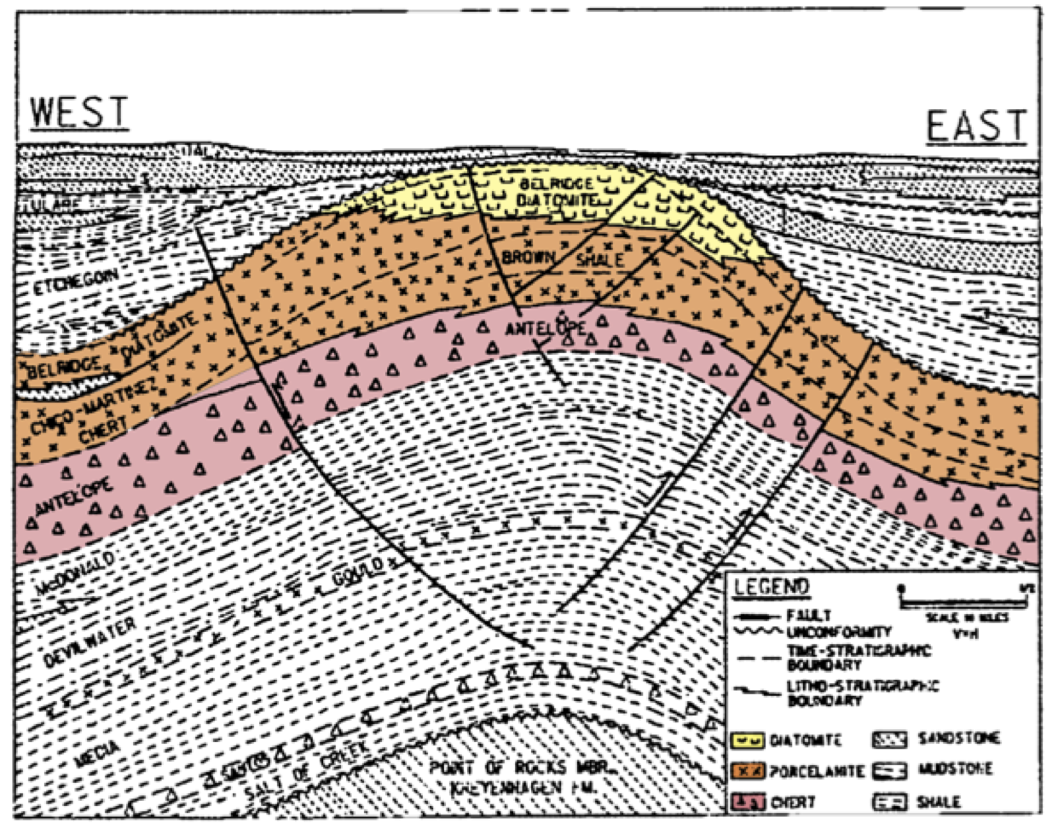
Belridge field
Schwartz (1988)

Slide 29
Fossilized Reaction Fronts
Out of equilibrium with thermal gradient (Brekke, 2000; Neagu et al., 2010)
Uplifted, or decreased heat flow
Paused with adjacent silica phases of different solubilities
Enough time for diffusional transport of silica to dissolve and cement

Slide 30
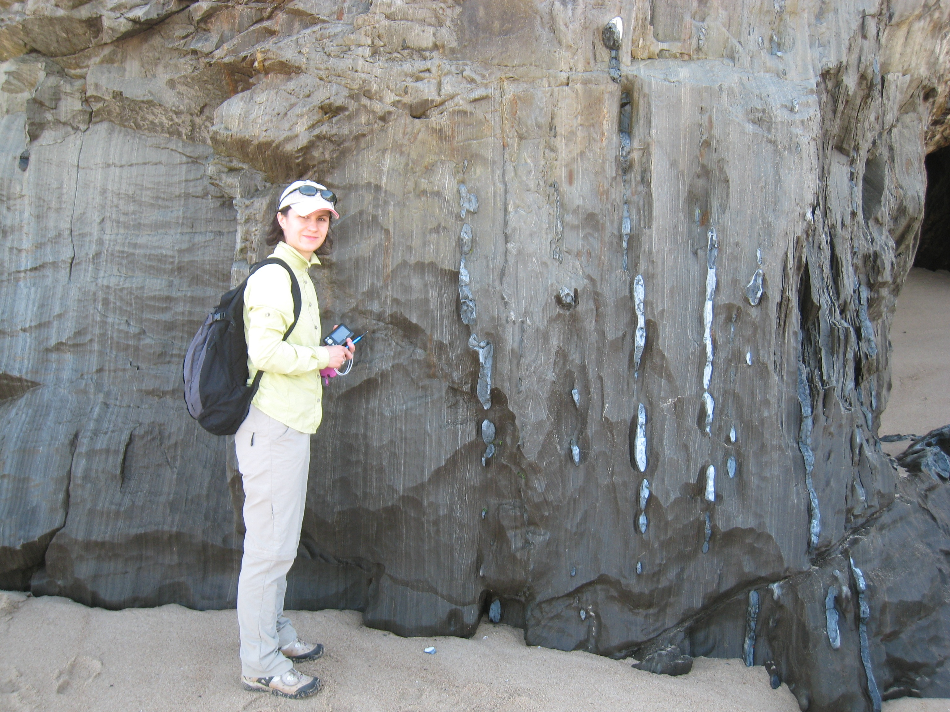

Slide 31
Inter- and intraparticle porosity infilled by opal-CT silica
Precipitation of opal-CT infilling microfossil void

Slide 32
Bed-to-Bed Diagenetic Segregation of Silica at Mussel Rock
Opal-A
Opal-A + Opal-CT
Cherty porcel & mudstone
Chert nodules & diatomite
Non-bedded diatomite

Slide 33
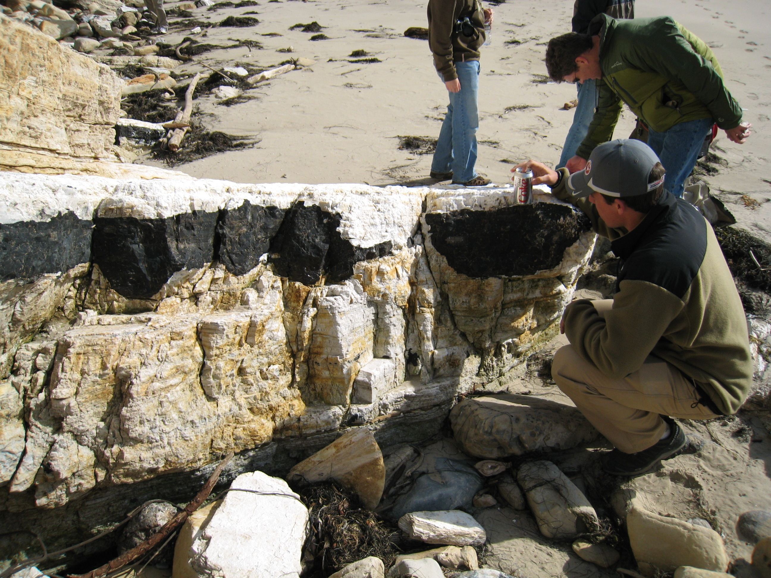
Quartz chert
Porous, pure opal-CT porcelanite

Slide 34
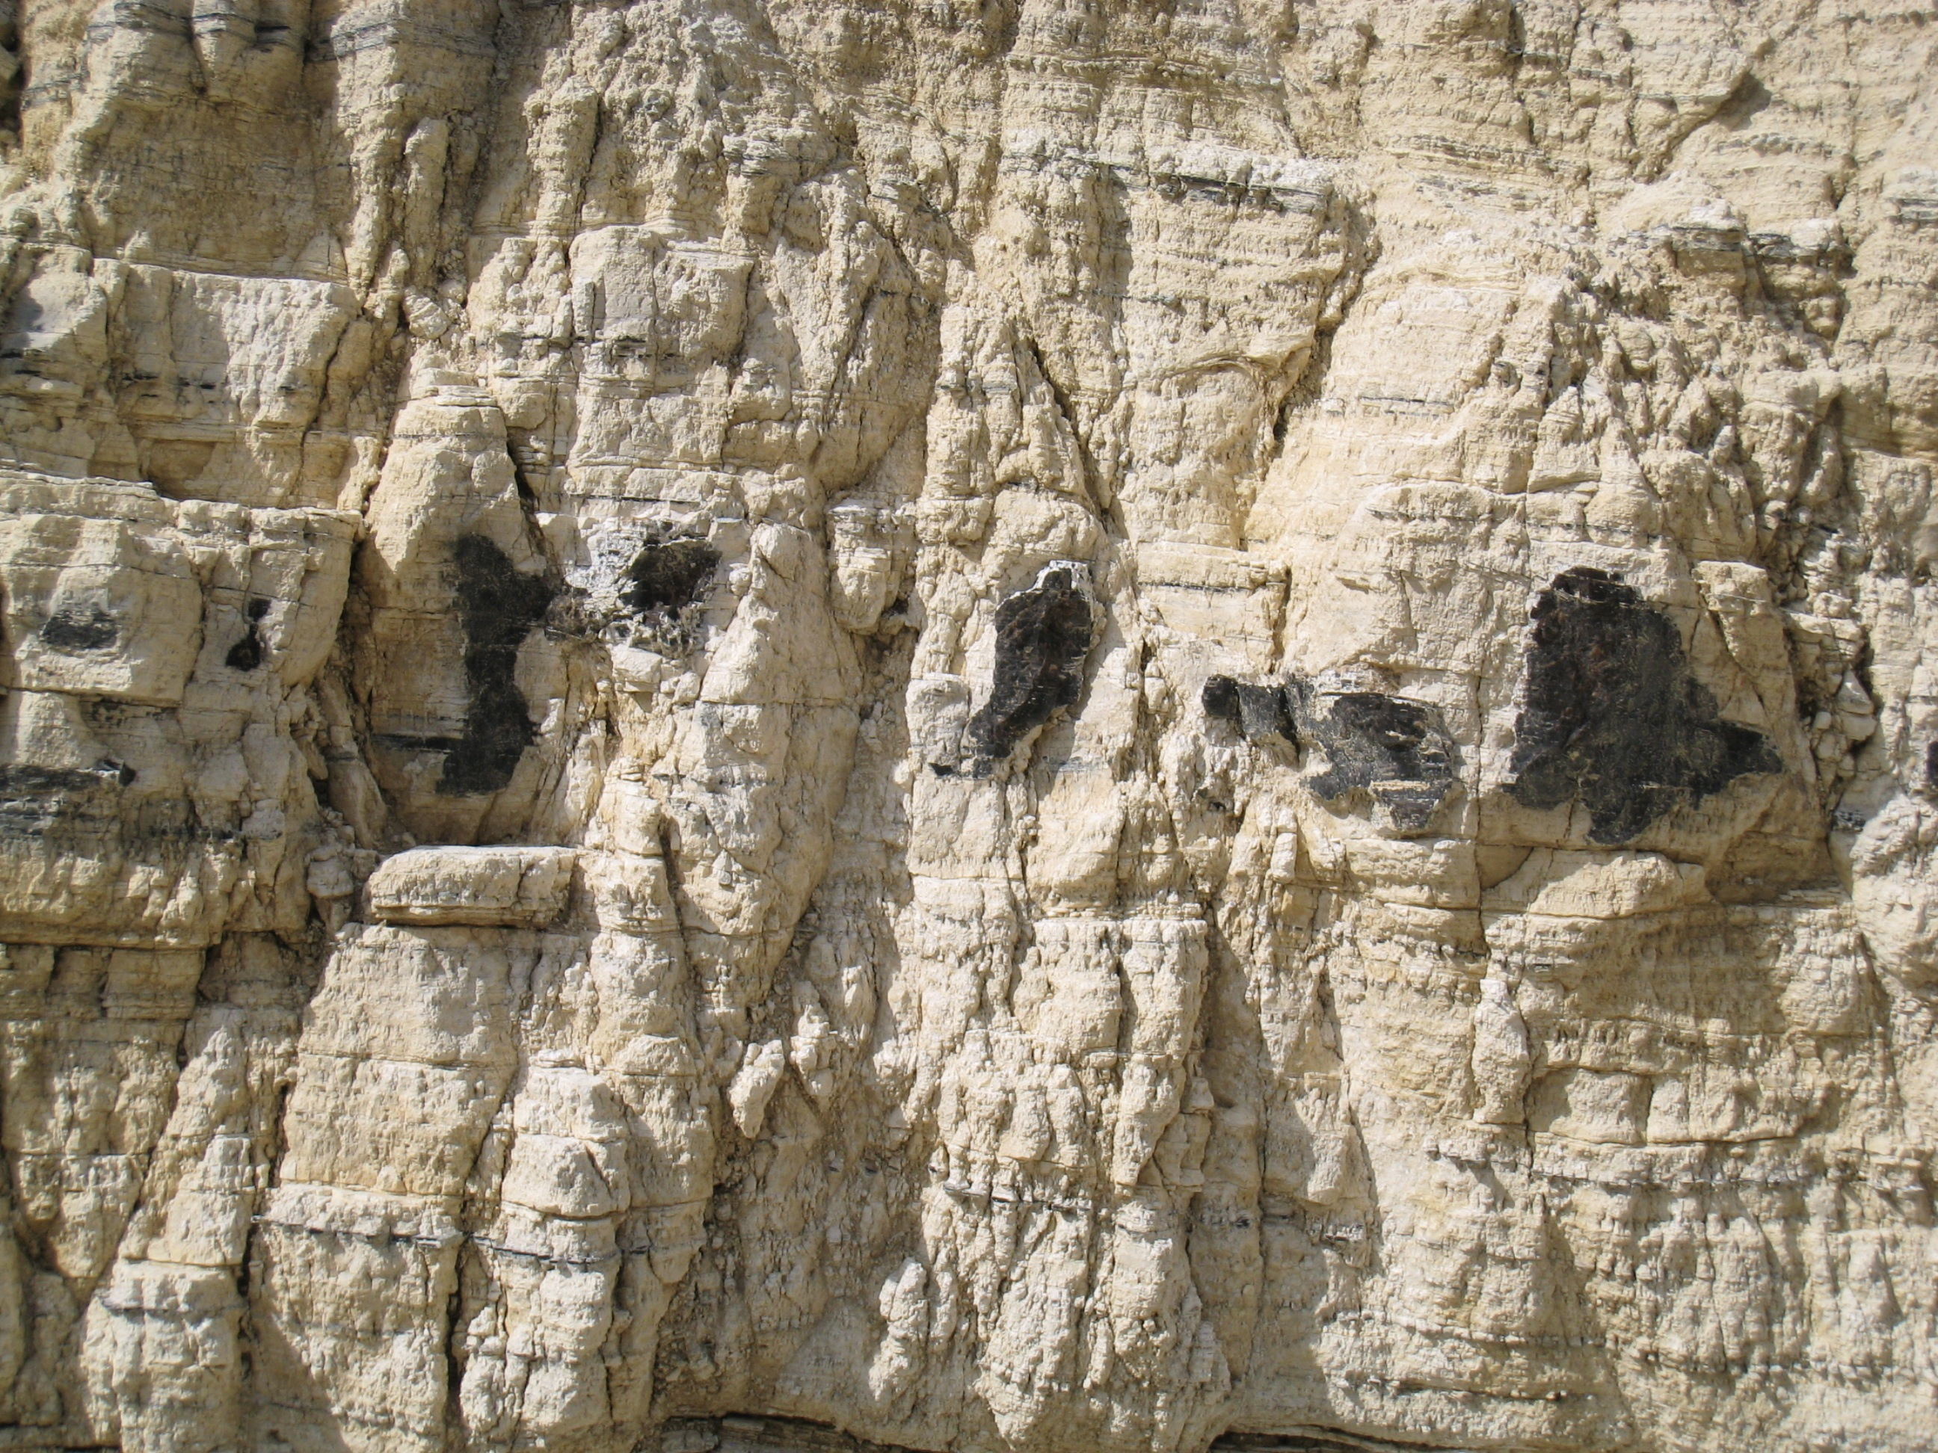
99-100% SiO2
1% porosity
2 feet
98-100% SiO2
56-65% porosity
7-9 millidarcies

Slide 35
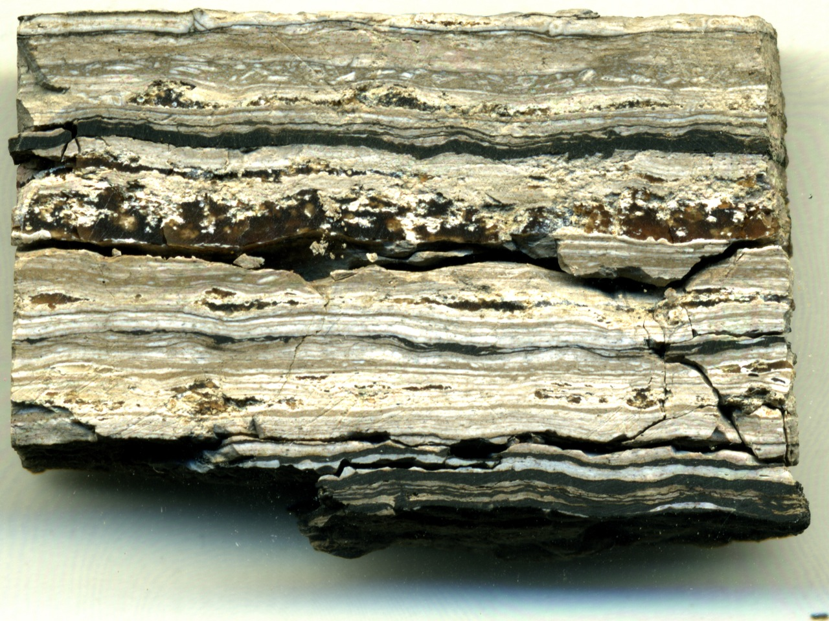
3”
Porous opal-CT and nonporous quartz chert

Slide 36
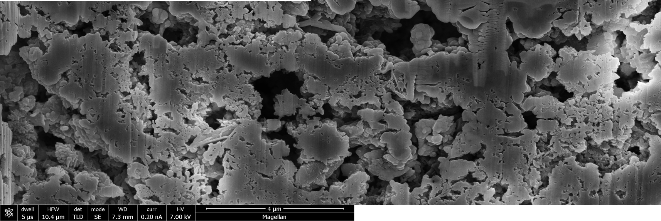
Fossilized transition-zone opal-CT porcelanite
Porosity as high as common diatomites (~65%)
Large, interconnected vuggy pores.
Associated with dissolution related to late quartz chert formation at cessation of burial
Fossilized reaction front
4 μm

Slide 37
Paleo Reaction Fronts
Site of paused reaction front
Now more deeply buried and no longer separating different silica phases

Slide 38
Opal-A
Opal-CT
Quartz

Slide 39
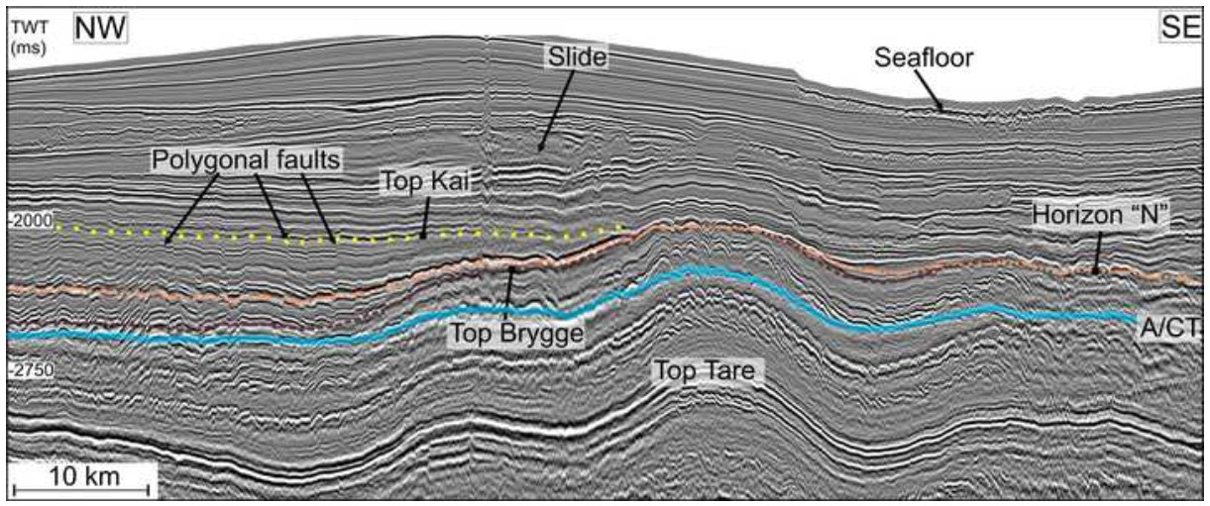
Diagenetic reflectors too hot and too deep are probably not active, but are relict or paleo fronts where excess silicicification took place before further burial
Interpreted opal-A/opal-CT boundary at 65-70°C
Neagu et al, 2010

Slide 40
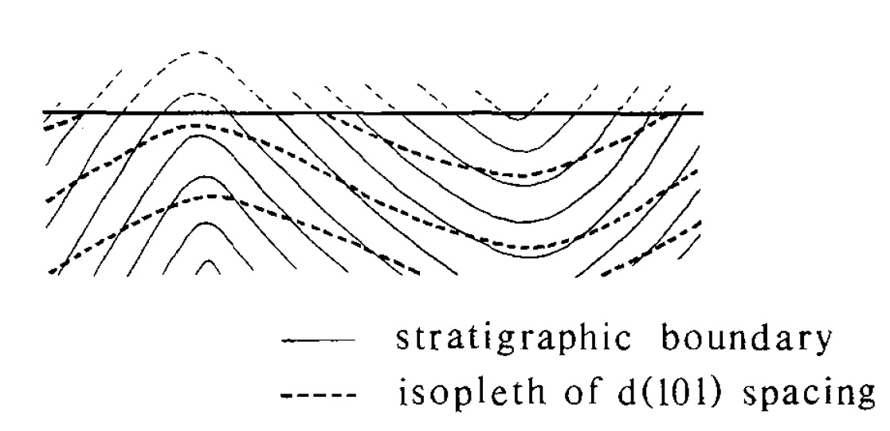
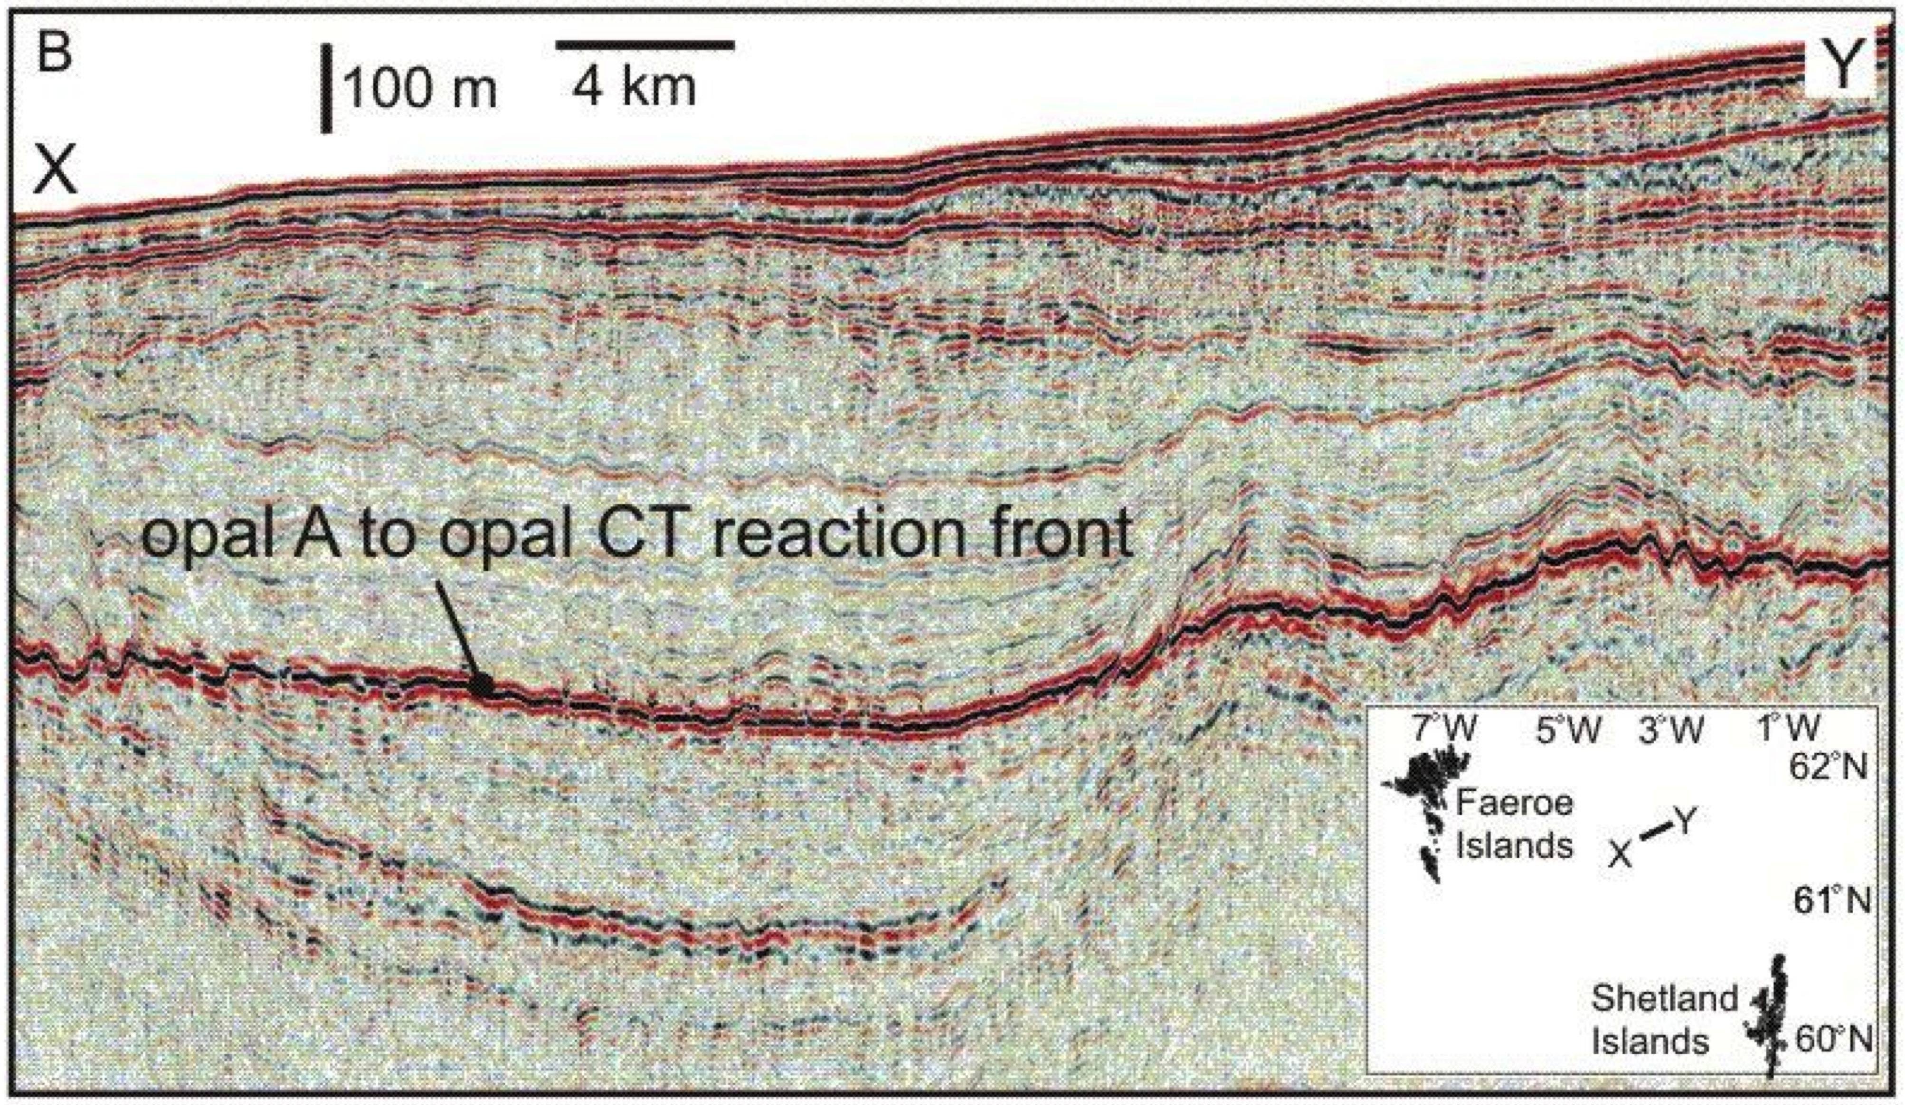
Mizutani, 1977
Interpreted
Davies et al., 2008

Slide 41
Paragenesis of Constituents in the Monterey Formation
Siliceous Sediments
Opal-A
Opal-CT
Diagenetic quartz
Calcareous Sediments
Early forming “Proto”-dolomite
Higher order stoichiometric dolomite
Clay Sediments
Mixed-layer smectite-illite
Increased illite component
Kerogen maturation
45-50°C
65-80°C
80-115°C
>60-80°C

