Slide 1
CSULB MARS Project Monterey & Siliceous Sediments Short-Course & Symposium Bakersfield, 5 December, 2016
Richard J. Behl
California State University
Long Beach, CA
MARS Project: Monterey and Related Sediments

Slide 2
Monterey Short-Course Outline
Part 1. Monterey Introduction
Part 2. Diatomite sedimentology
Part 3. Silica Diagenesis
Part 4. Siliceous sedimentary rocks
Associated rocks of upwelling zones
Part 5. Reservoir properties
Porosity and Permeability
Part 6. Mechanical Stratigraphy
MARS Project: Monterey and Related Sediments

Slide 3
Monterey Symposium
Ryan Weller – Rock properties & composition
Wanjiru Njuguna – Lithostratigraphy
Alex Sedlak - Chemostratigraphy
Maia Davis – Carbonate breccias
Yannick Wirtz – Deformation style
MARS Project: Monterey and Related Sediments

Slide 4
Monterey Formation:
tectonic and geologic overview

Slide 5
Monterey Formation
Unconventional reservoir rock
Chiefly conventional production
Naturally Fractured Reservoirs
Tremendous lithologic heterogeneity
Laminations – beds – members
Great outcrop exposures
Range of stress/strain conditions

Slide 6
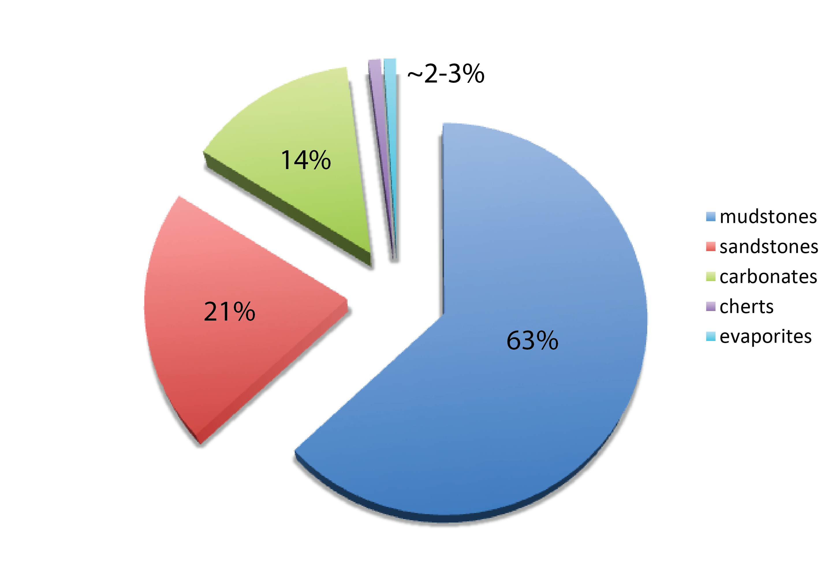
Sedimentary Rocks on Earth
siliceous rocks
Data from Railsback (1993)

Slide 7
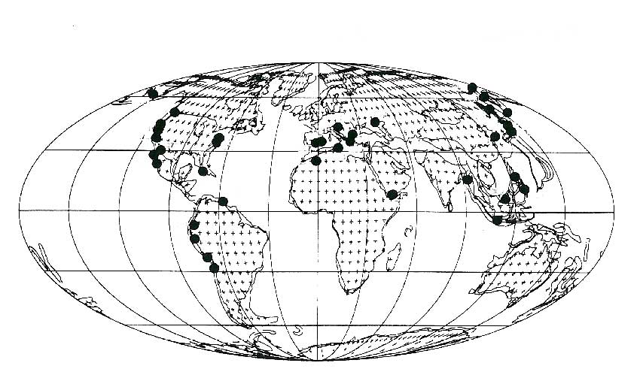
Negogene Marginal Diatomaceous Sediments
Modified from Hein & Parrish (1987)

Slide 8
Miocene Monterey Formation
Important source & reservoir of oil
Important link to Tertiary climate change
Characteristic sedimentology
Hemipelagic, thin-bedded, laminated
Siliceous
Organic-rich
Age: approximately 17-5 Ma
Related facies span the Pacific Rim

Slide 9
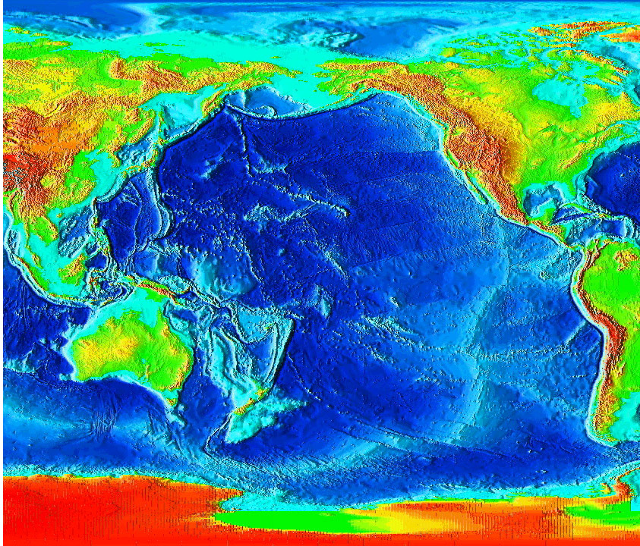
Circum-Pacific “Monterey” facies

Slide 10
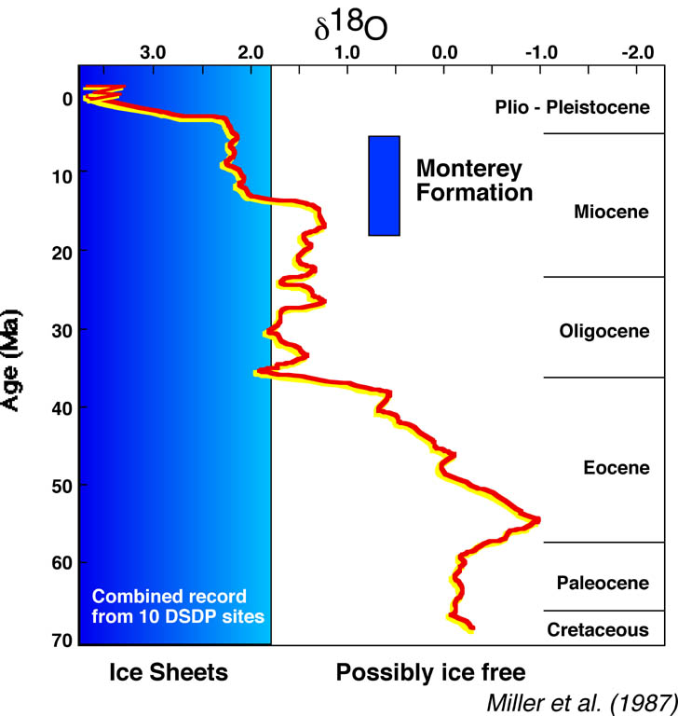
Cenozoic Climate Transition

Slide 11
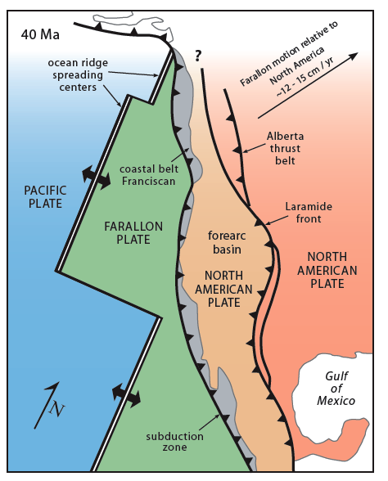
Mid-Miocene tectonic shift from convergent to transform margin formed numerous restricted and silled basins
Dickinson (1979)

Slide 14
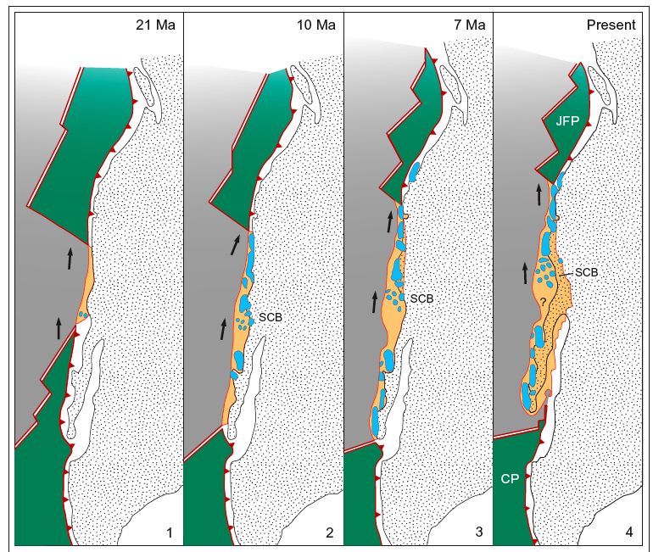
Blake et al. (1978)

Slide 16
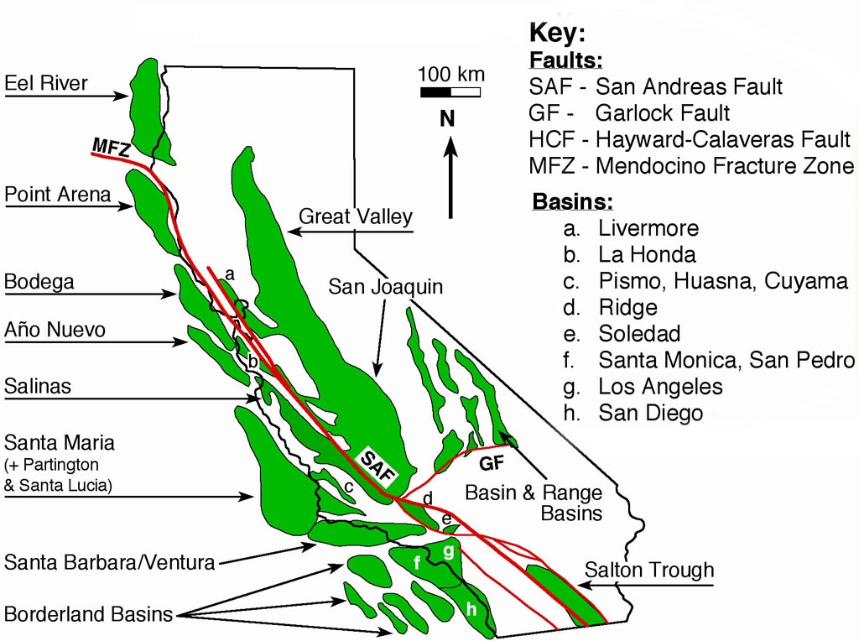

Slide 17
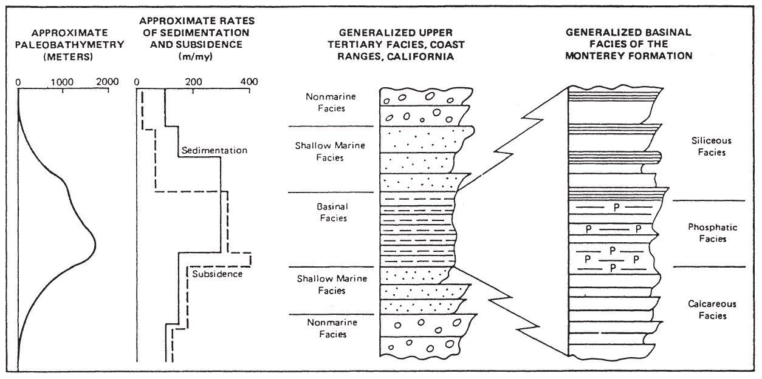
Tectonics and Stratigraphy
Generalized Basinal Facies of the Monterey Formation
Pisciotto & Garrison, 1981

Slide 18
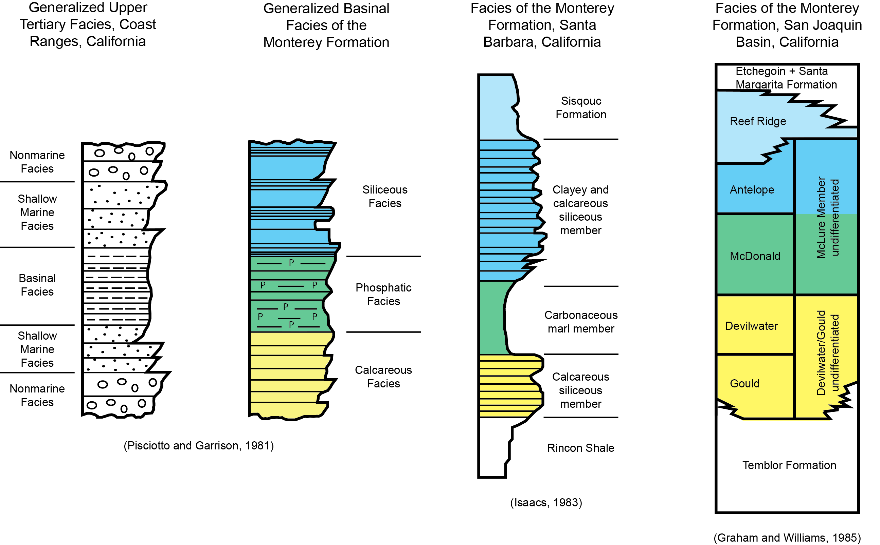
Neogene Basinal Stratigraphy
Generalized Basinal Facies of the Monterey Formation
Mosher (2013)

Slide 19
Main Sedimentary Components
Silica
Carbonate
Organic matter
Phosphate
Detritus (clay, silt & sand)

Slide 20
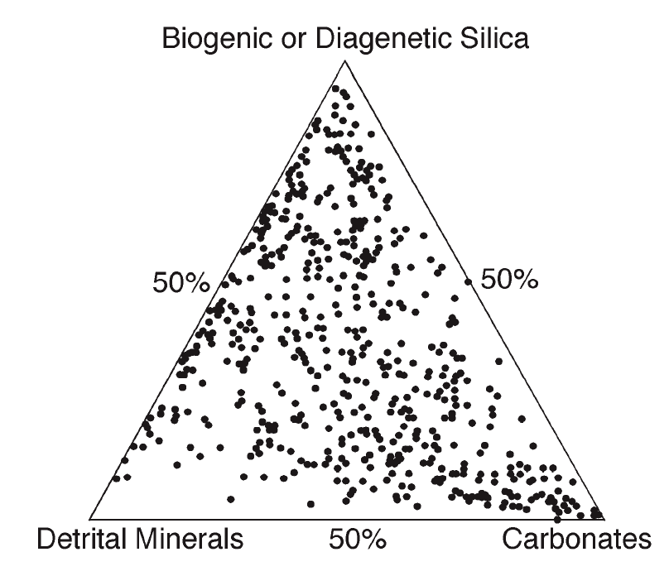
Chert
Diatomite
Compositional and lithologic variability
Porcelanite
Mudstone/ Shale
Dolomite/ Limestone
Compositional data of Isaacs (1985)

Slide 21
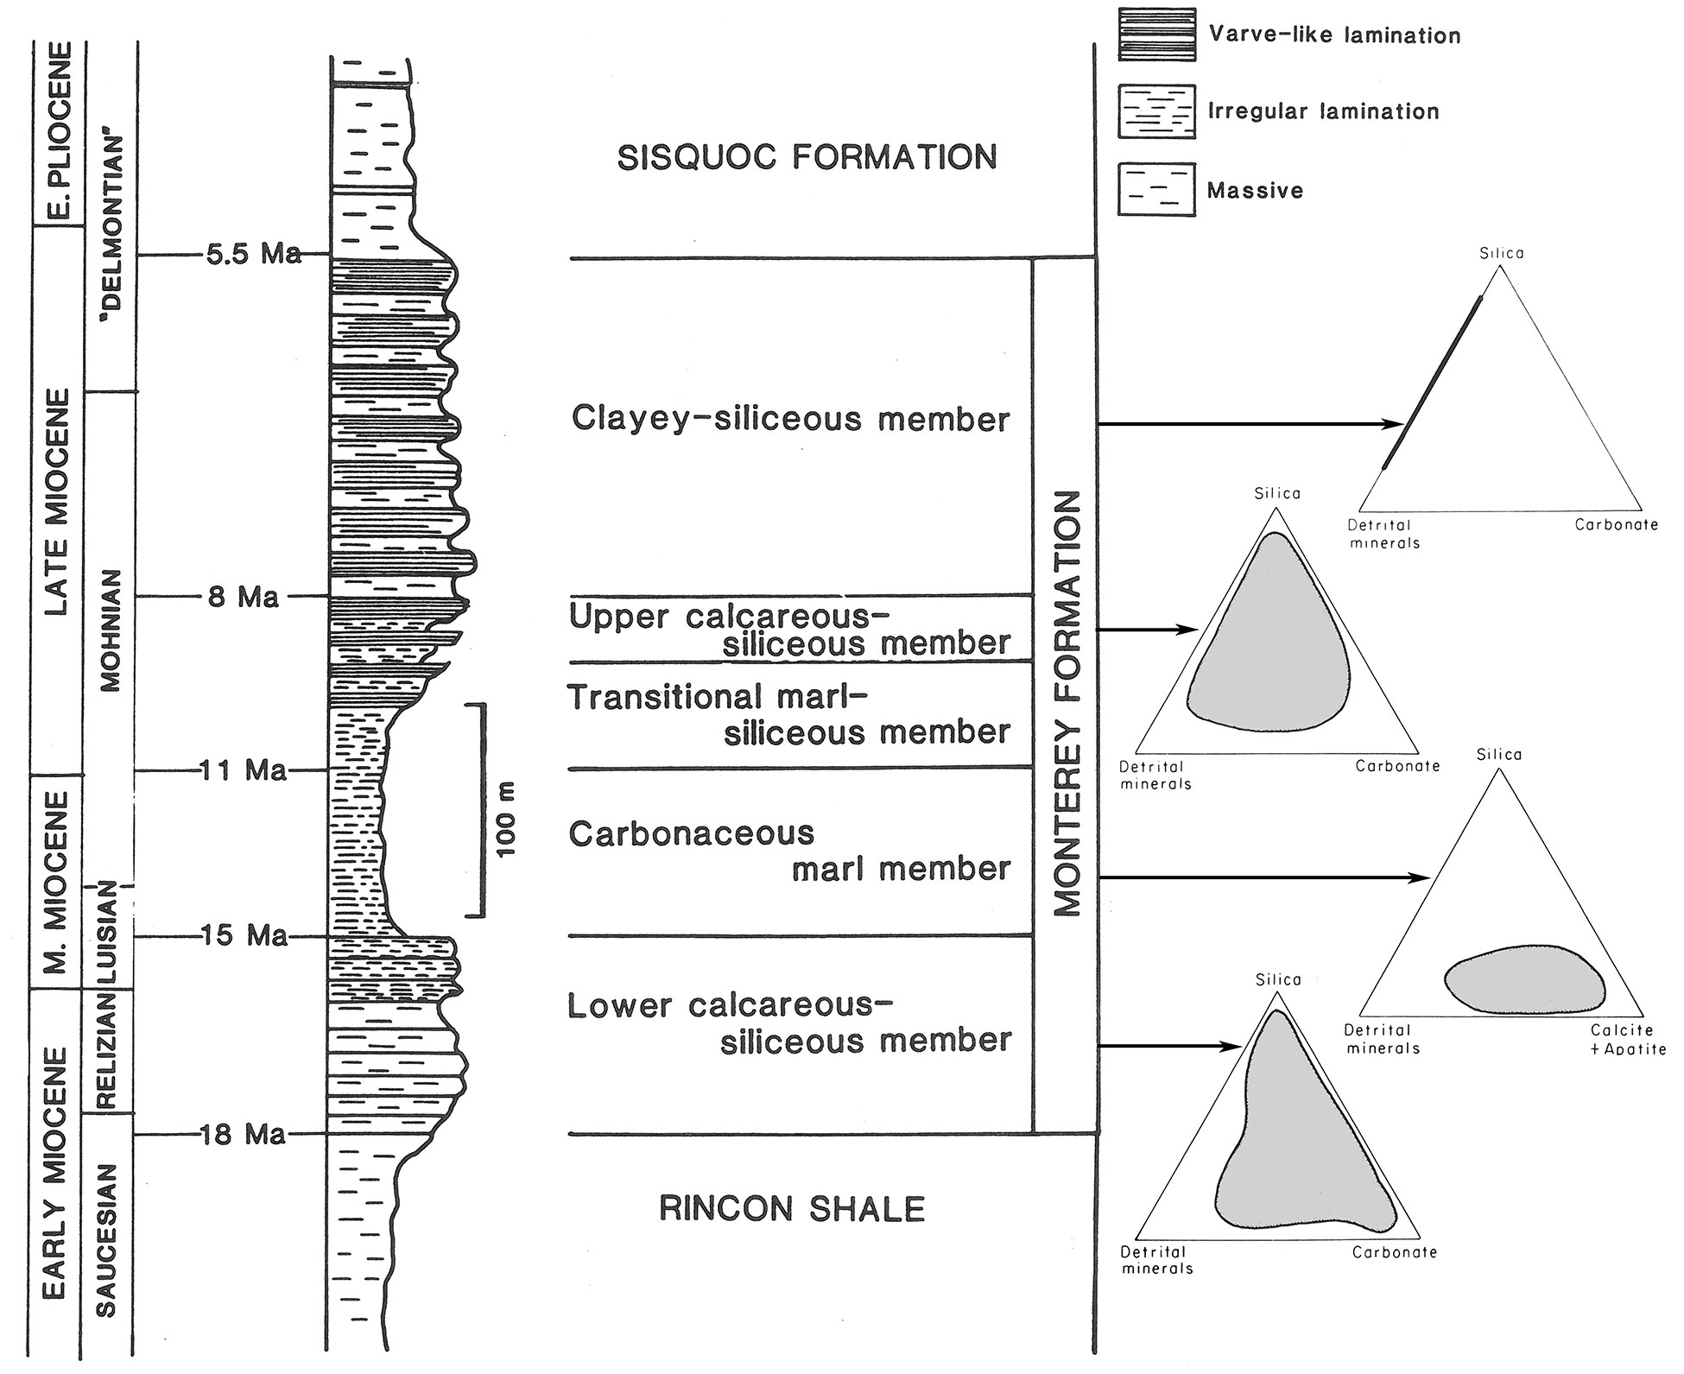
Isaacs (1980, 1983)

Slide 22
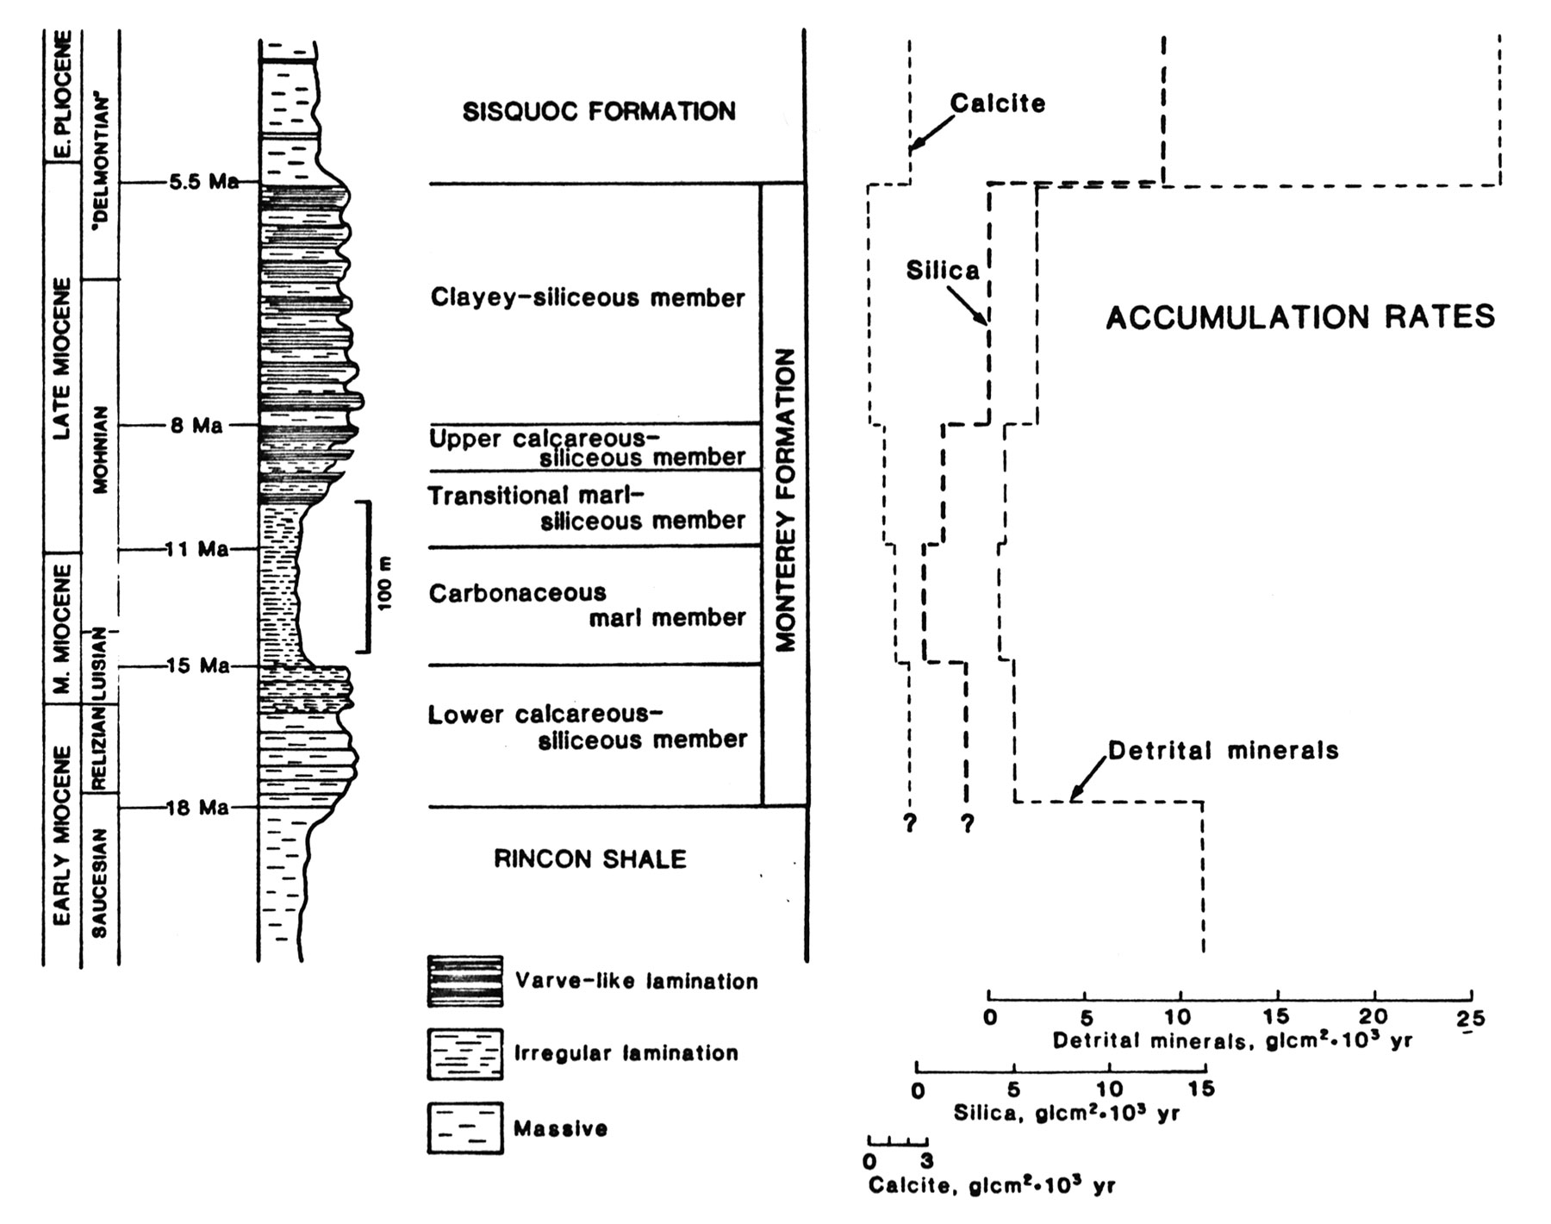

Slide 23
Organic Carbon
Mostly type II kerogen - marine algae
TOC mostly between 2% - 6%
Highest in phosphatic shale / carbonaceous marlstone
Up to 23% TOC (34% organic matter by weight)

Slide 24
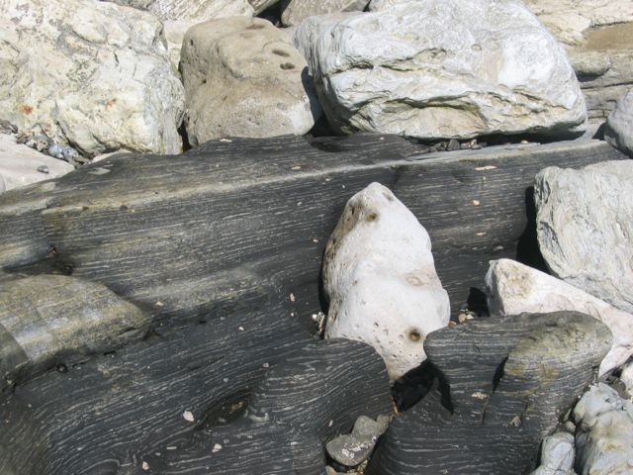
Phosphatic shales or marlstone

Slide 25
Early Miocene
Blakey (1997)
Late Miocene

Slide 26
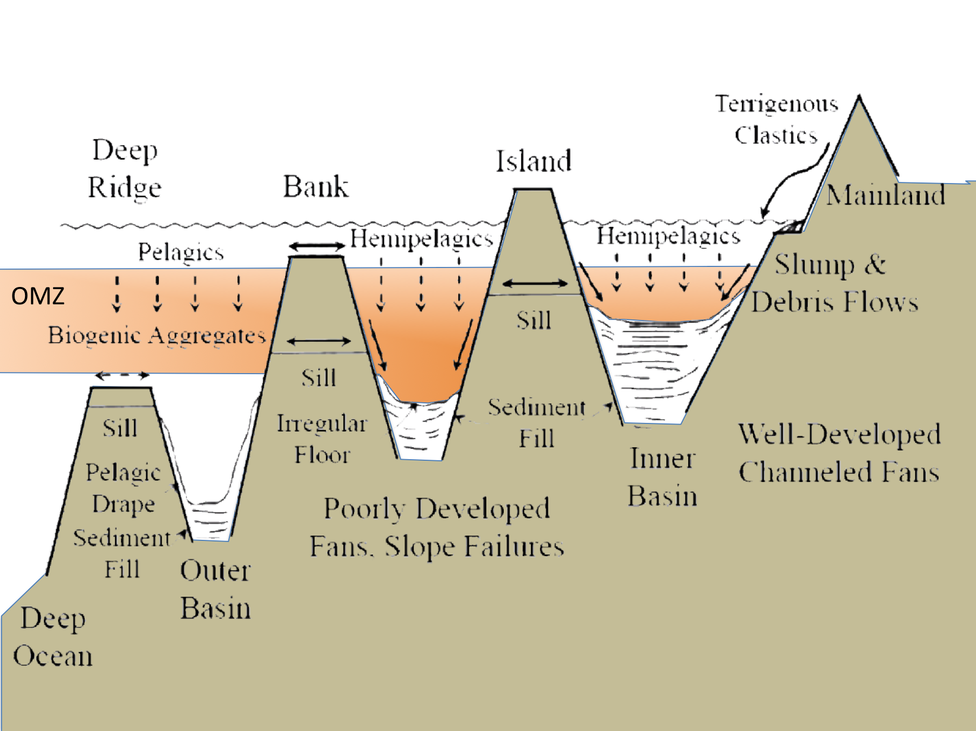
OMZ on an active margin

Slide 27
Monterey Summary
Important link to global change & tectonics
Spans the Pacific Rim
Organic-rich, highly siliceous, fine-grained
Vertical and lateral lithofacies variations
Global and local controls
Thin-bedded and cyclic bedding
Highly reactive of silica, carbonate, phosphate & organic matter
Composition and diagenesis controls physical properties of sediments and mechanical stratigraphy

