Slide 1
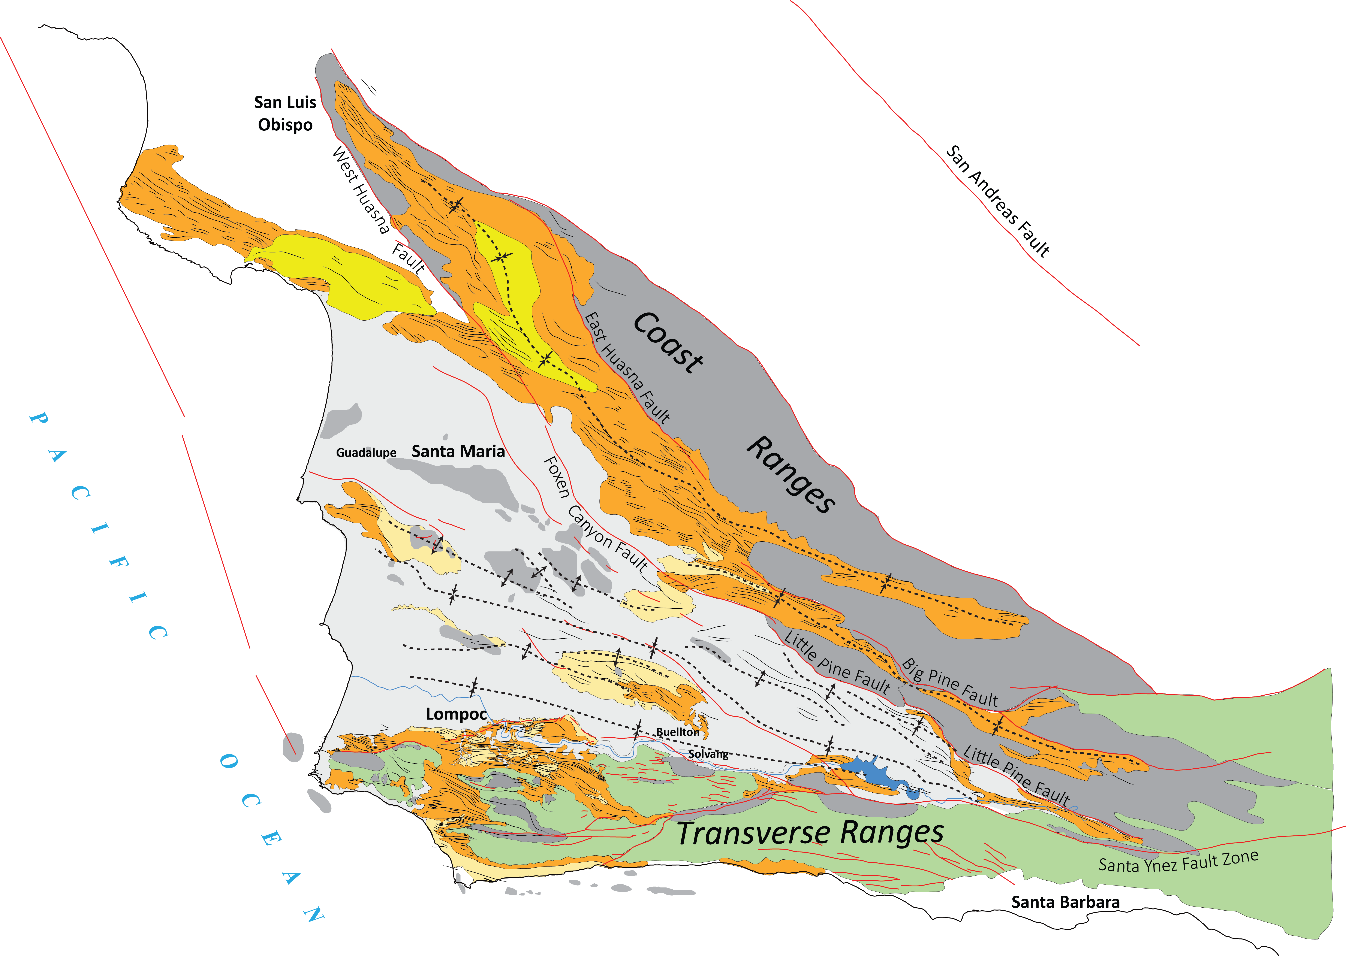
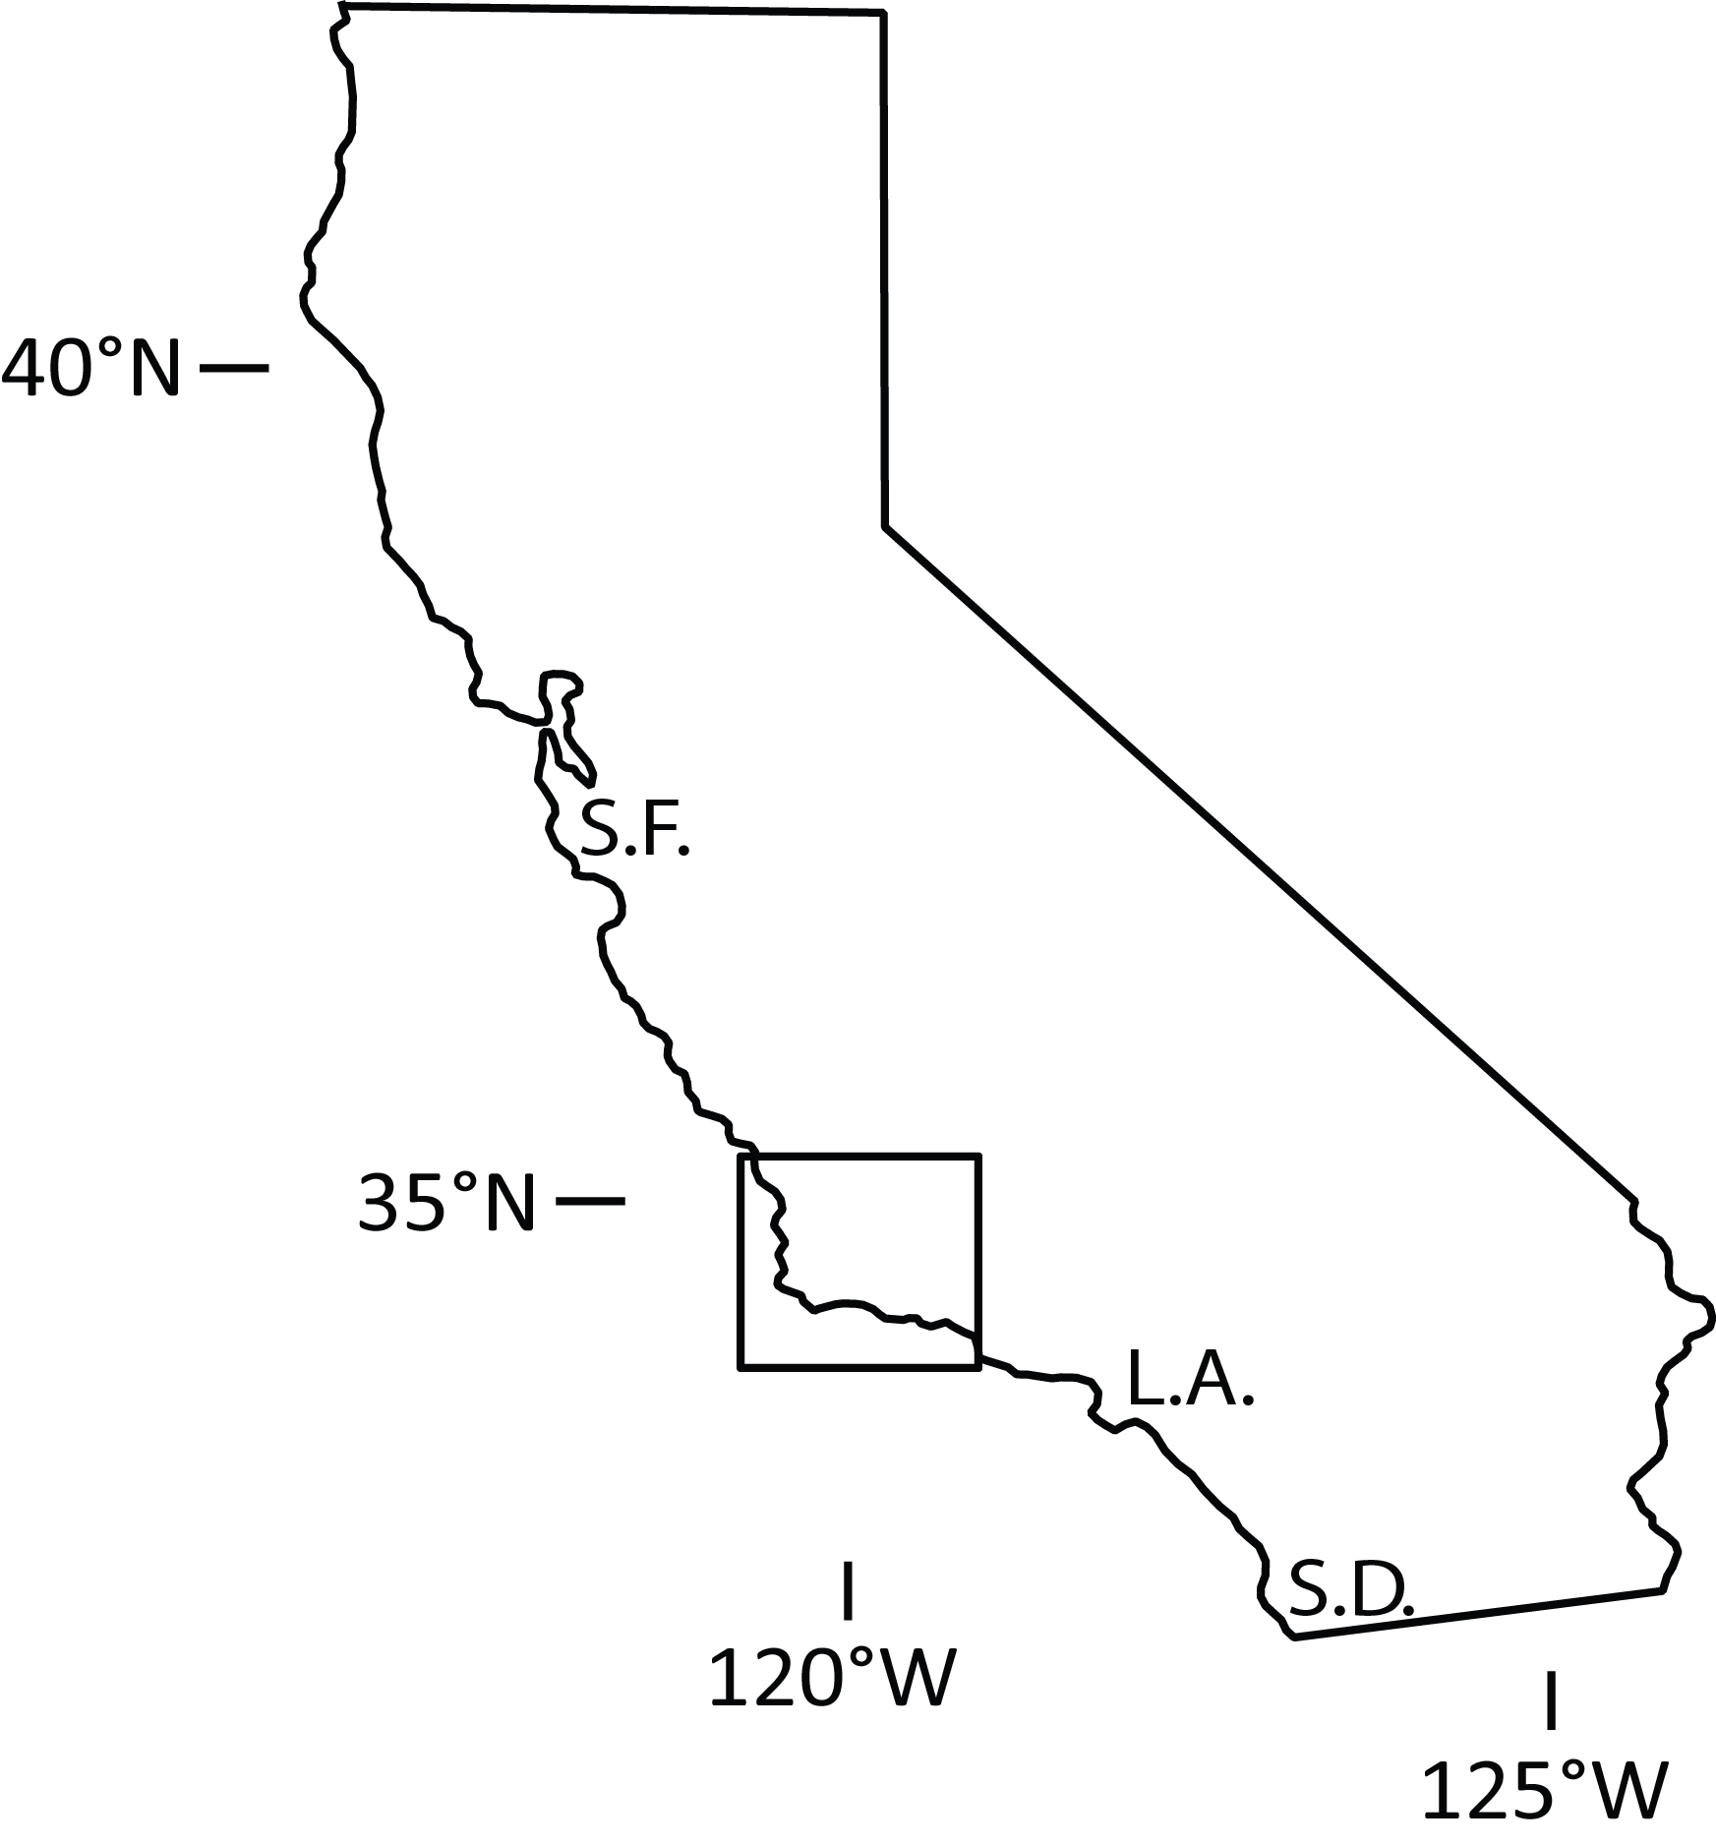
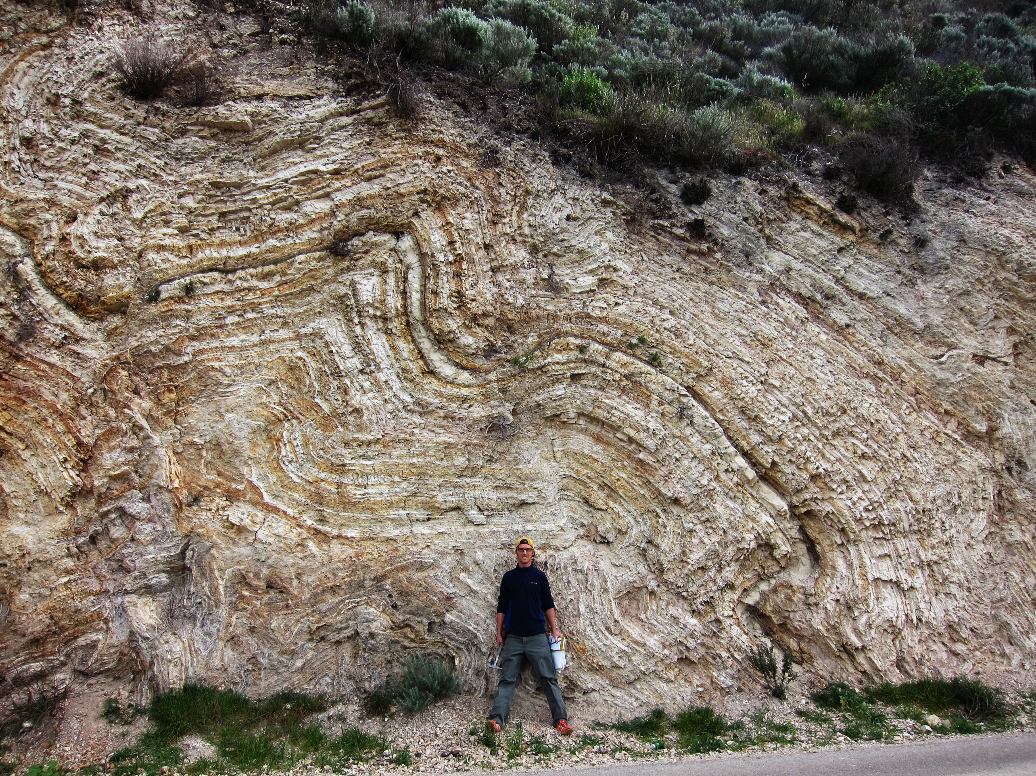
Comparing Scales of Tectonic Shortening in the Santa Maria Basin, CA
Important Insight Provided by
Structures in the Miocene Monterey Formation
Yannick Wirtz, Richard Behl, Nate Onderdonk
California State University, Long Beach
MARS Meeting - Solvang, CA
07-20-15

Slide 2
Santa Maria Basin Stratigraphy
Cenozoic
PS
Paso Robles Fm
Qa
PL
Foxen M.
Careaga Sand
6 Ma
Sisquoc Fm
Miocene
Monterey Fm
Modified after Sweetkind et al., 2010
15 Ma
Point Sal Fm
17 Ma
Lospe Fm
Oligocene
Vaqueros Fm
Eocene
Sespe Fm
Marine
Sandstones
PC
Mesozoic
Jur. / Cr
Undifferentiated Basement

Slide 3
Tectonic History
Ma
Wilson et al., 2005

Slide 4
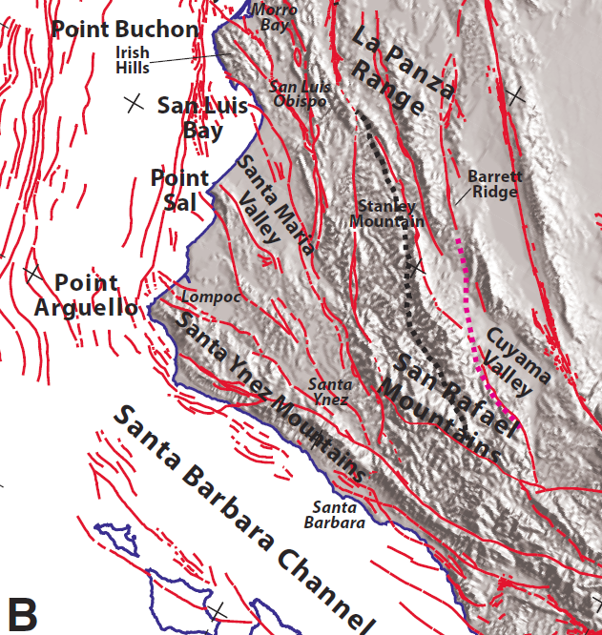
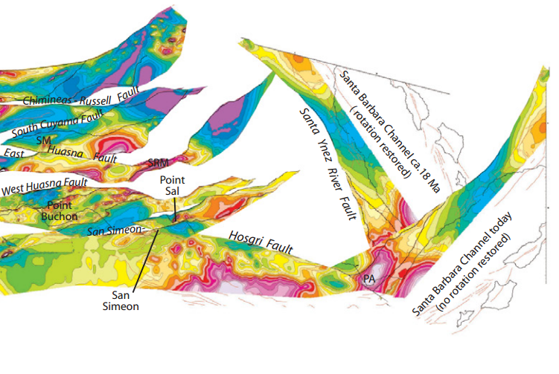
Strike-Slip Restoration
Langenheim et al., 2013

Slide 5
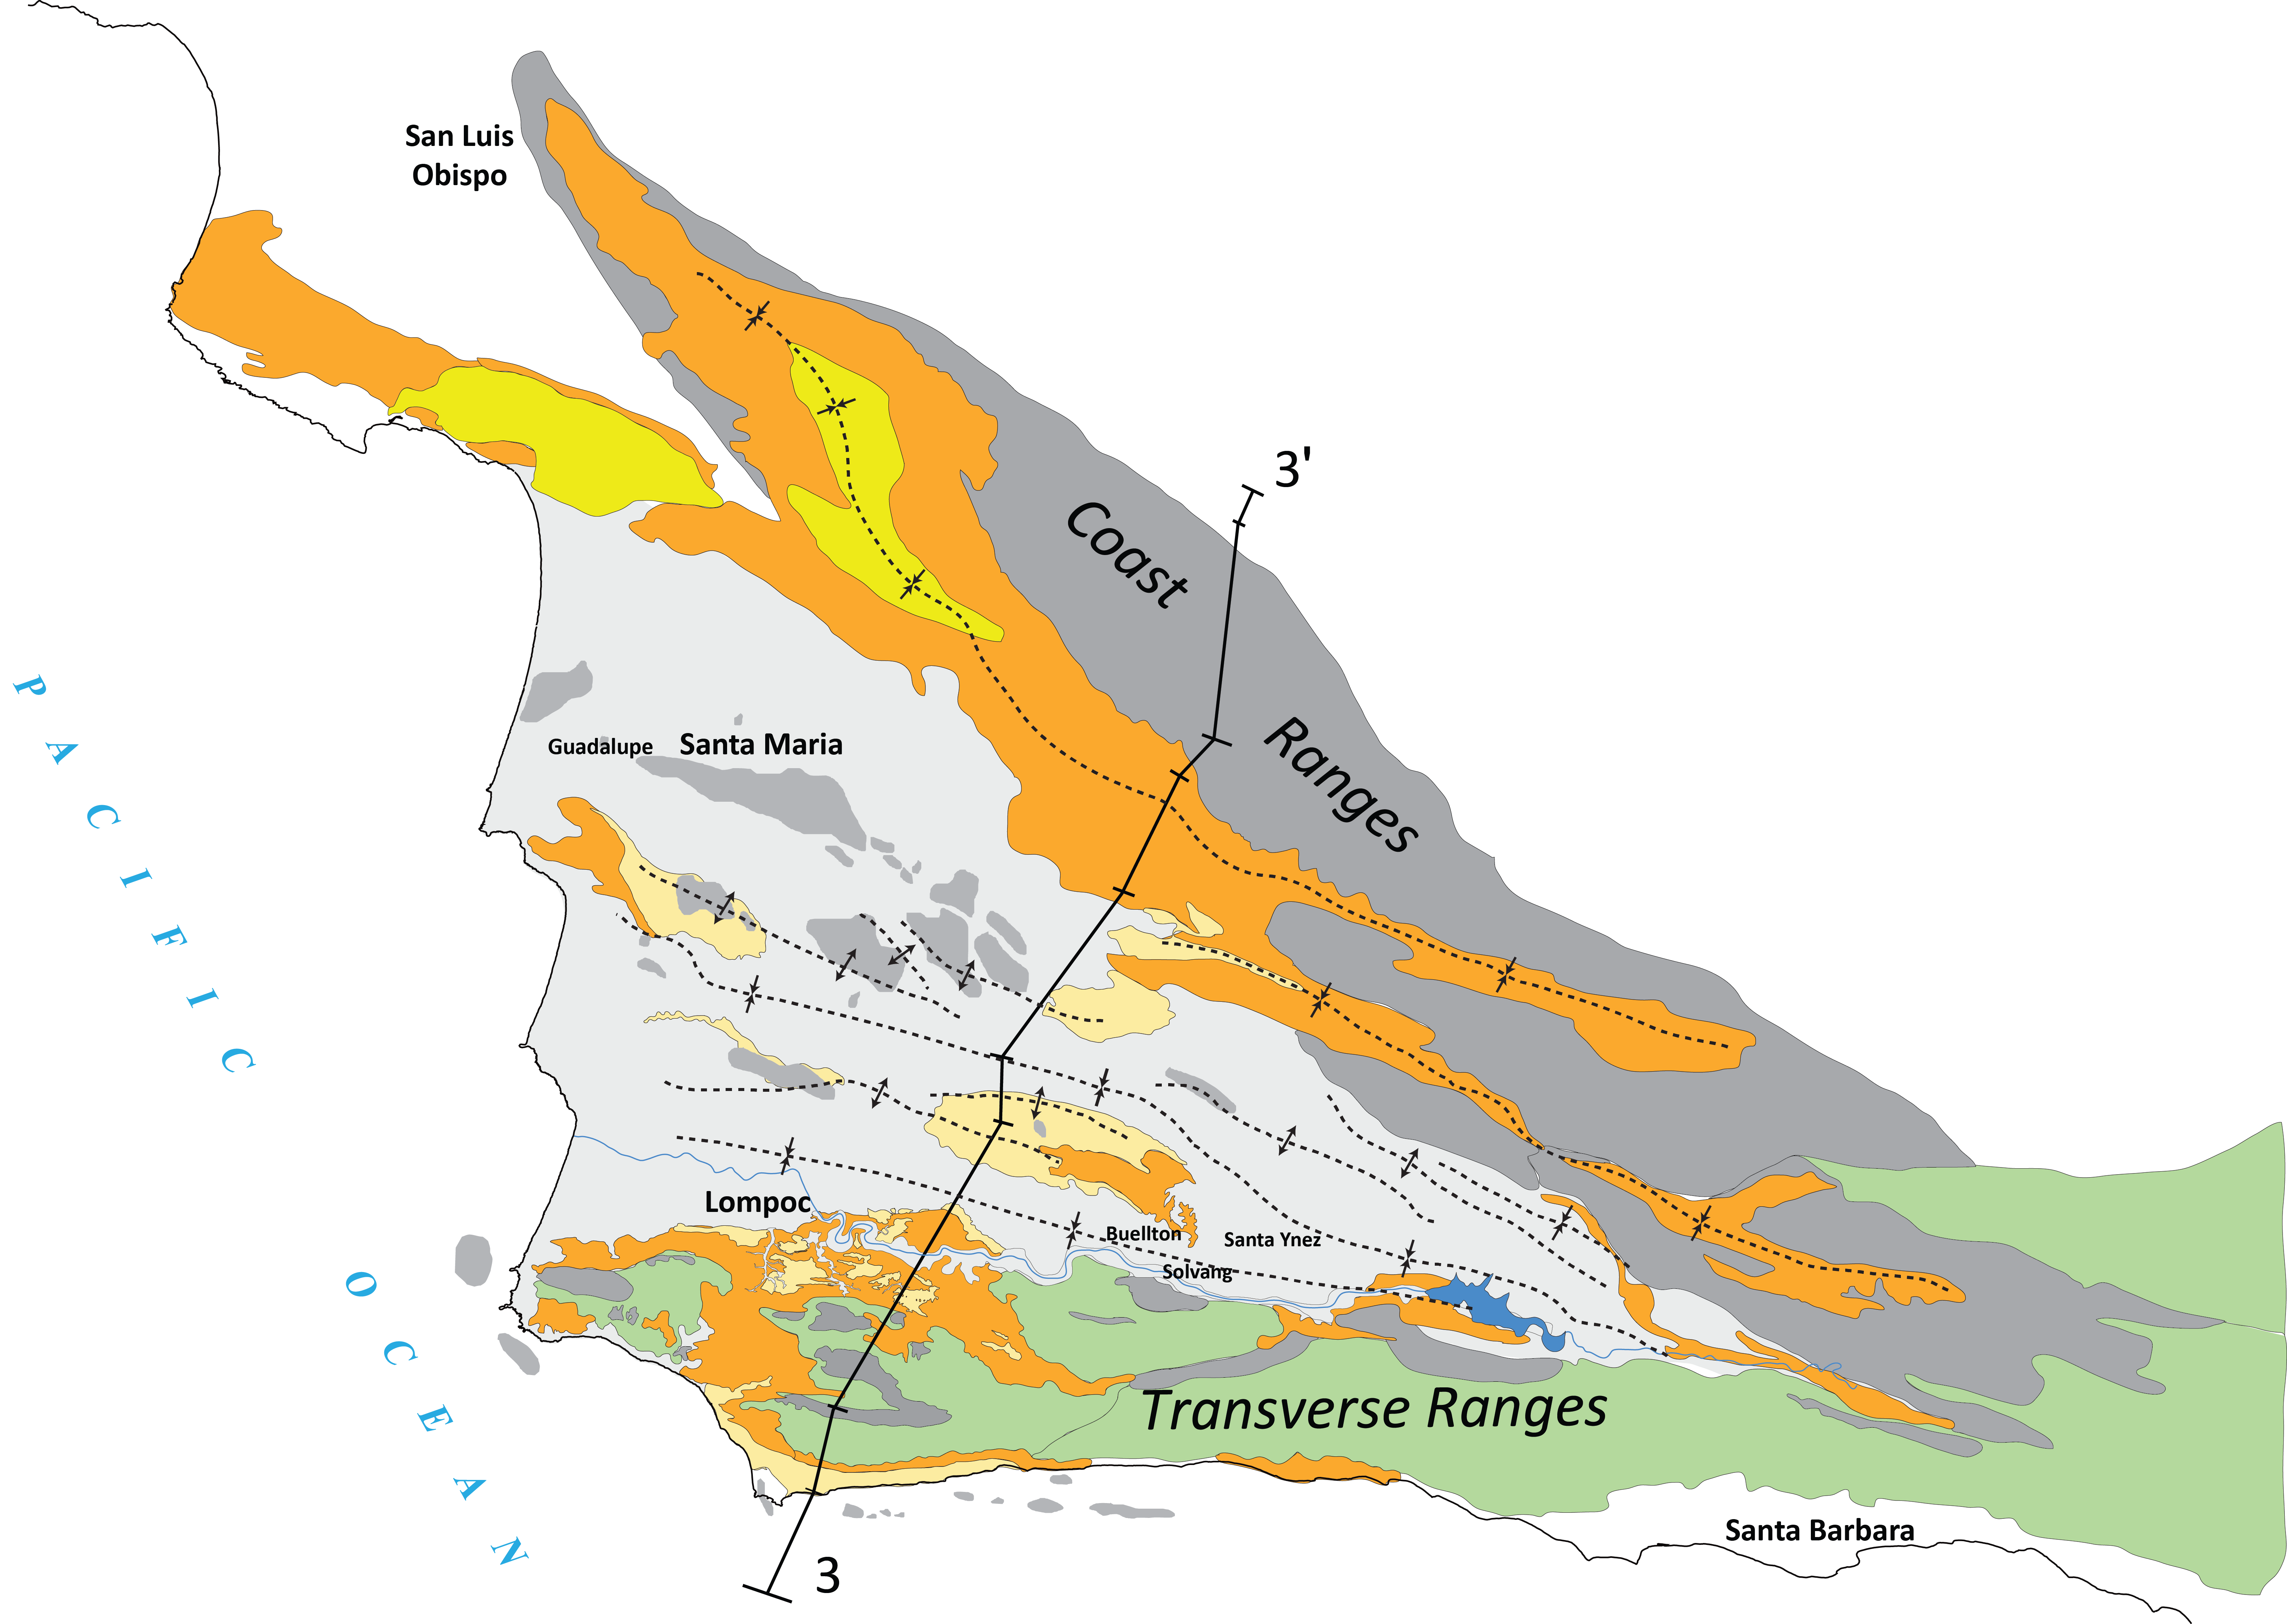
Namson and Davis, 1990
~ 16 % Total Shortening
Modified after Namson & Davis, 1990

Slide 6
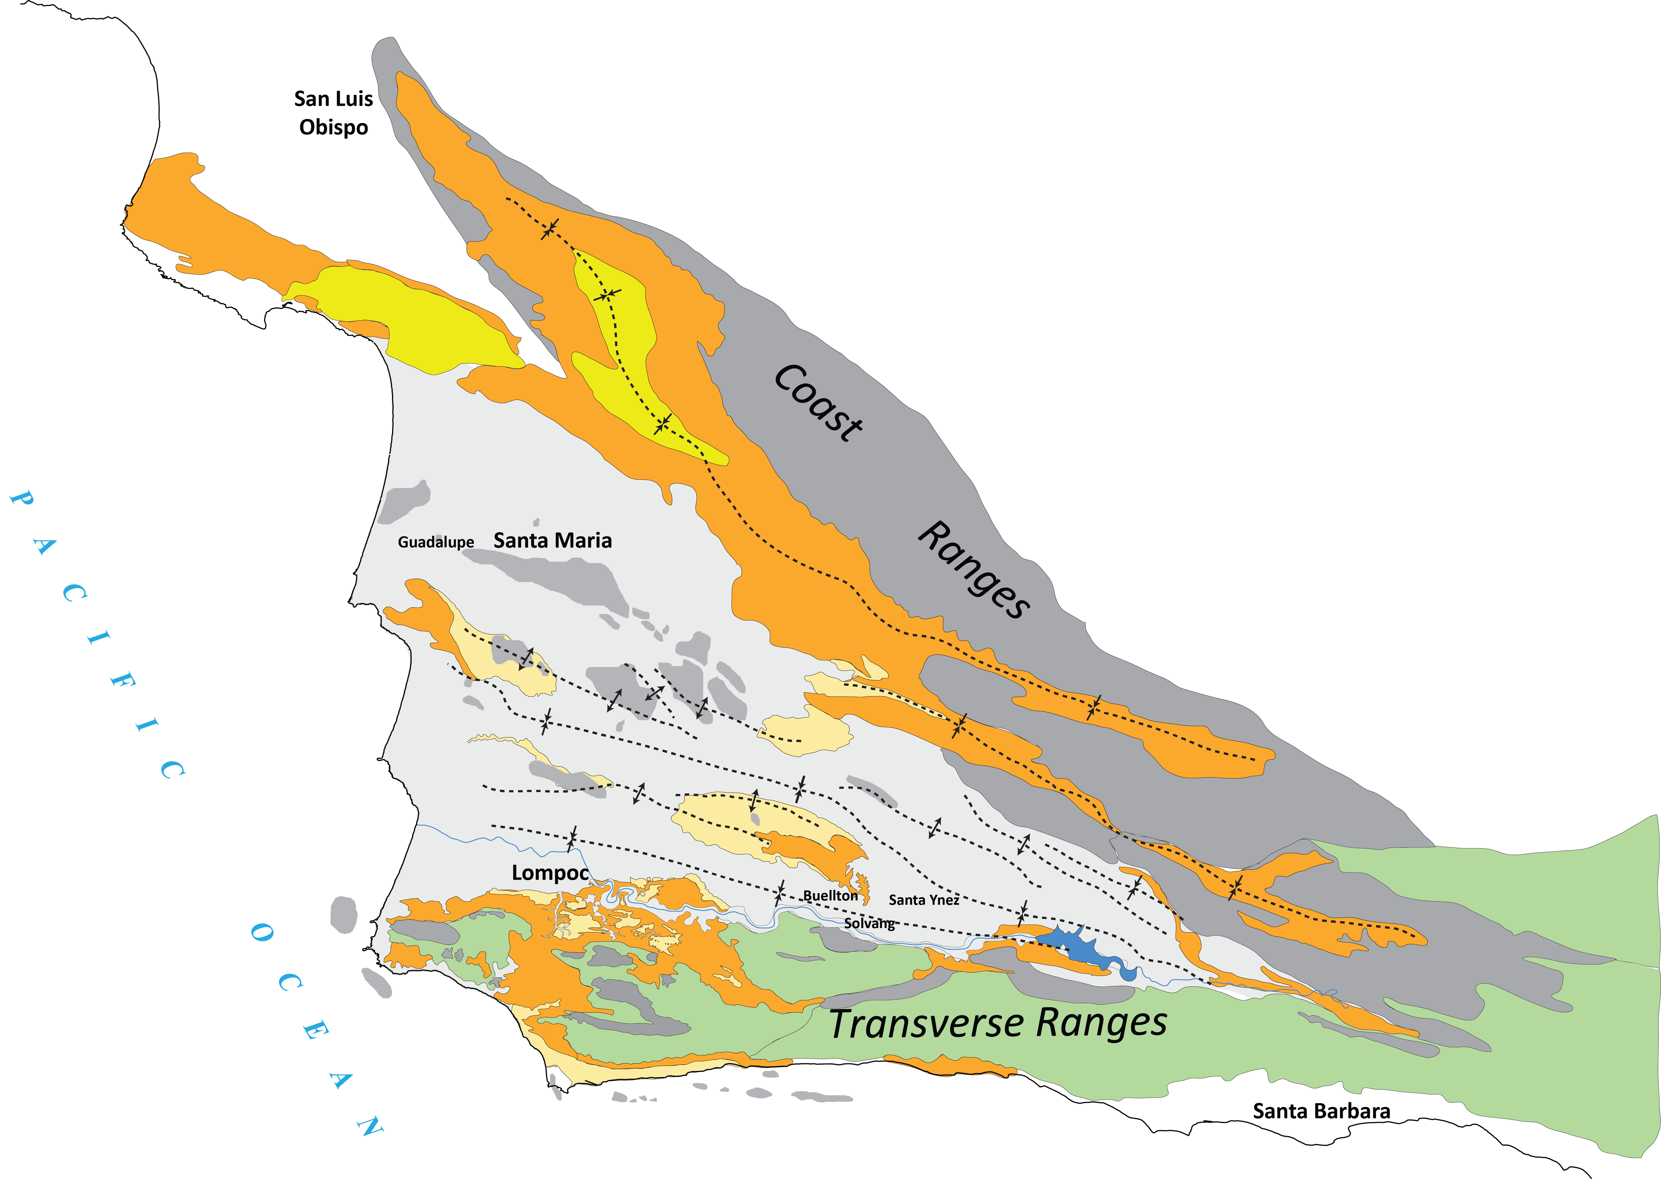
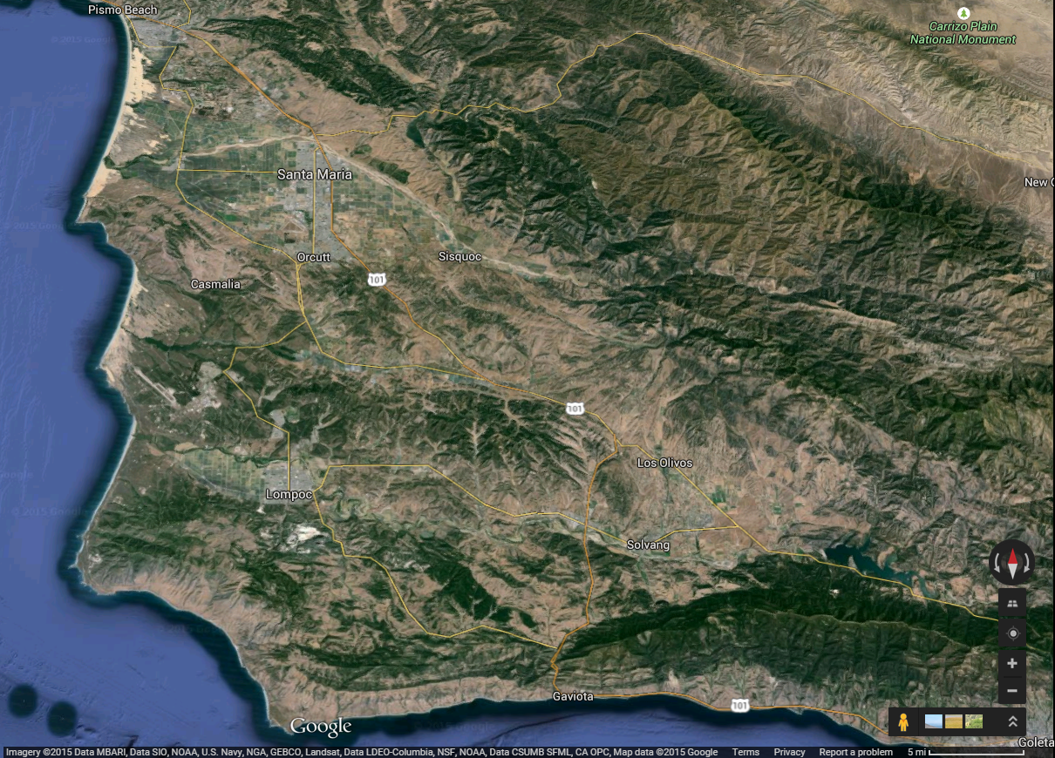
SMB Fold and Thrust Belt
Modified after Namson & Davis, 1990

Slide 7
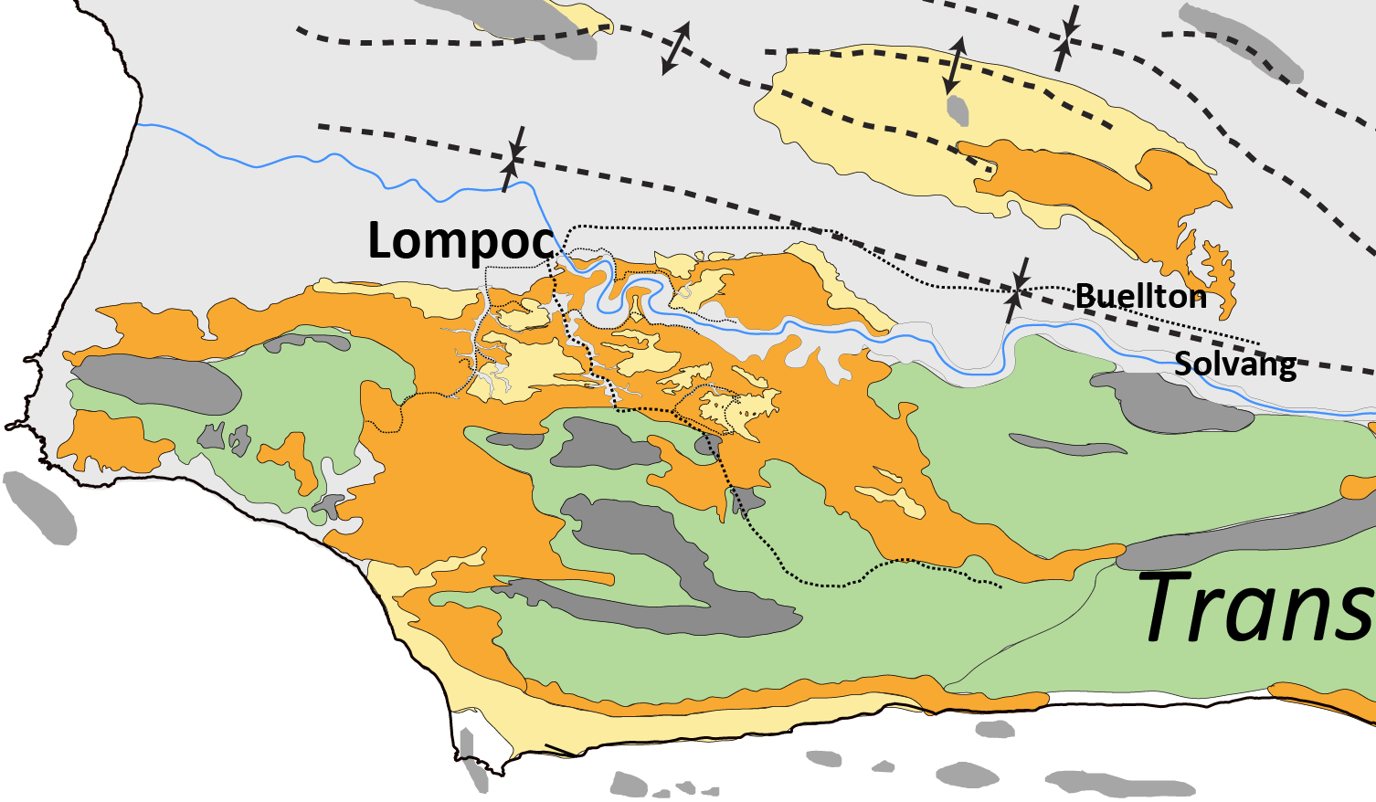
Map-Scale

Slide 8
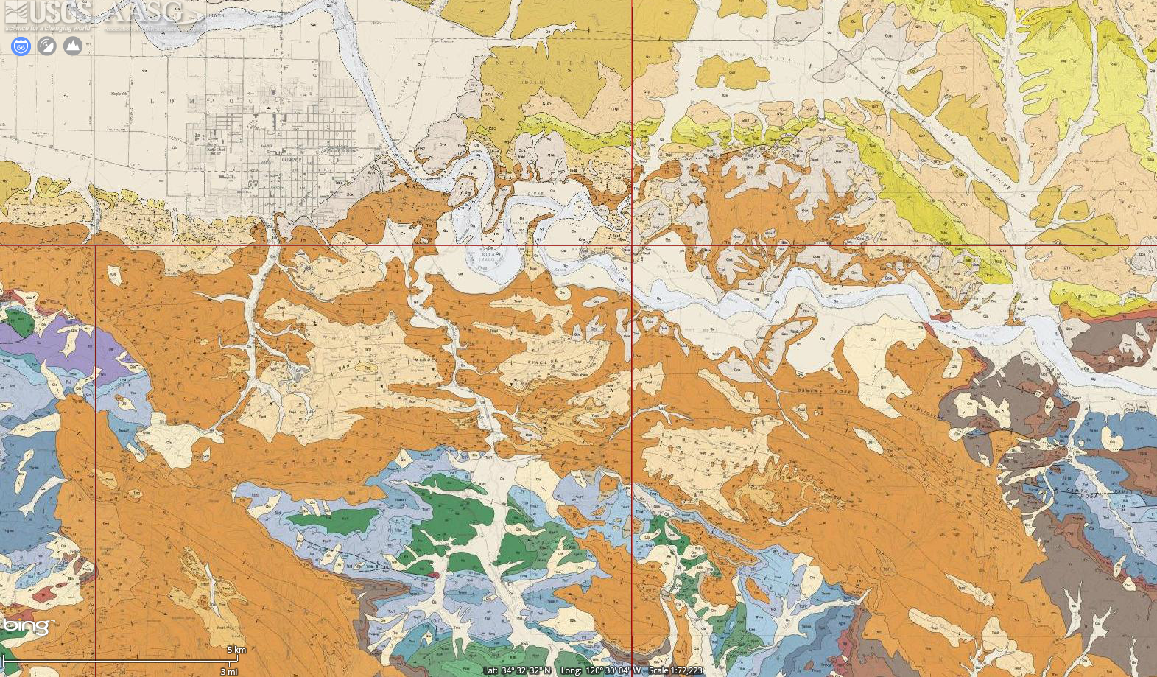
T. Dibblee, 1950

Slide 9
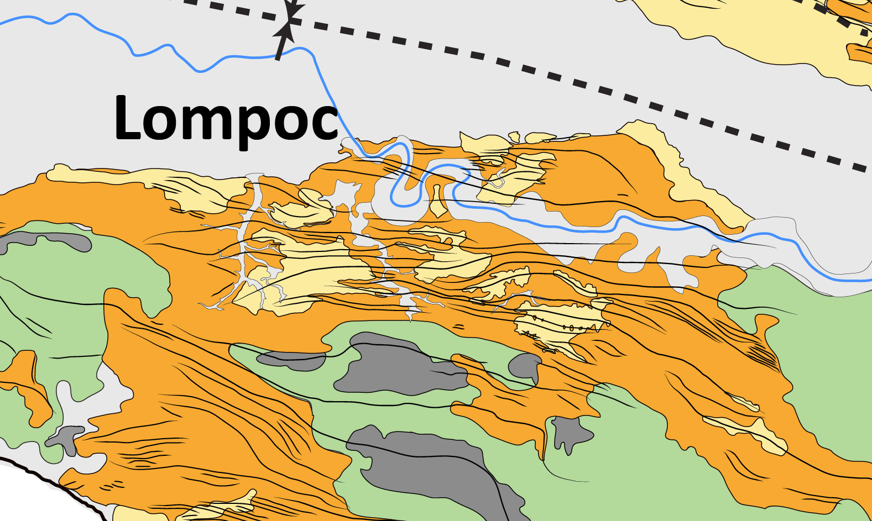
Monterey Map-Scale Fold Belt

Slide 10
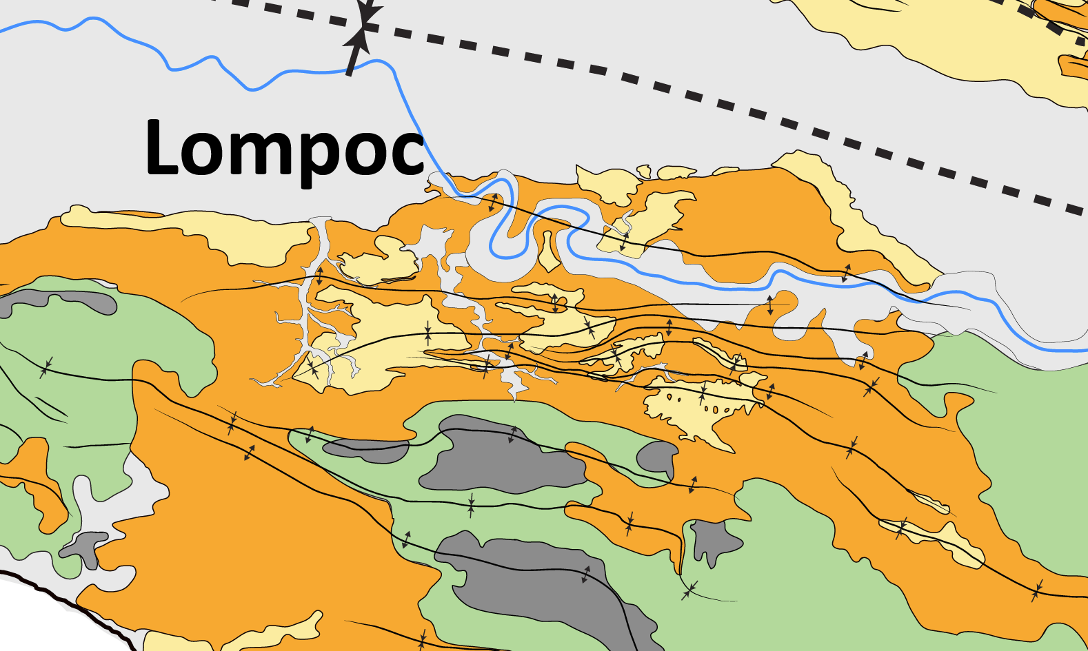
2nd Order Folds

Slide 11
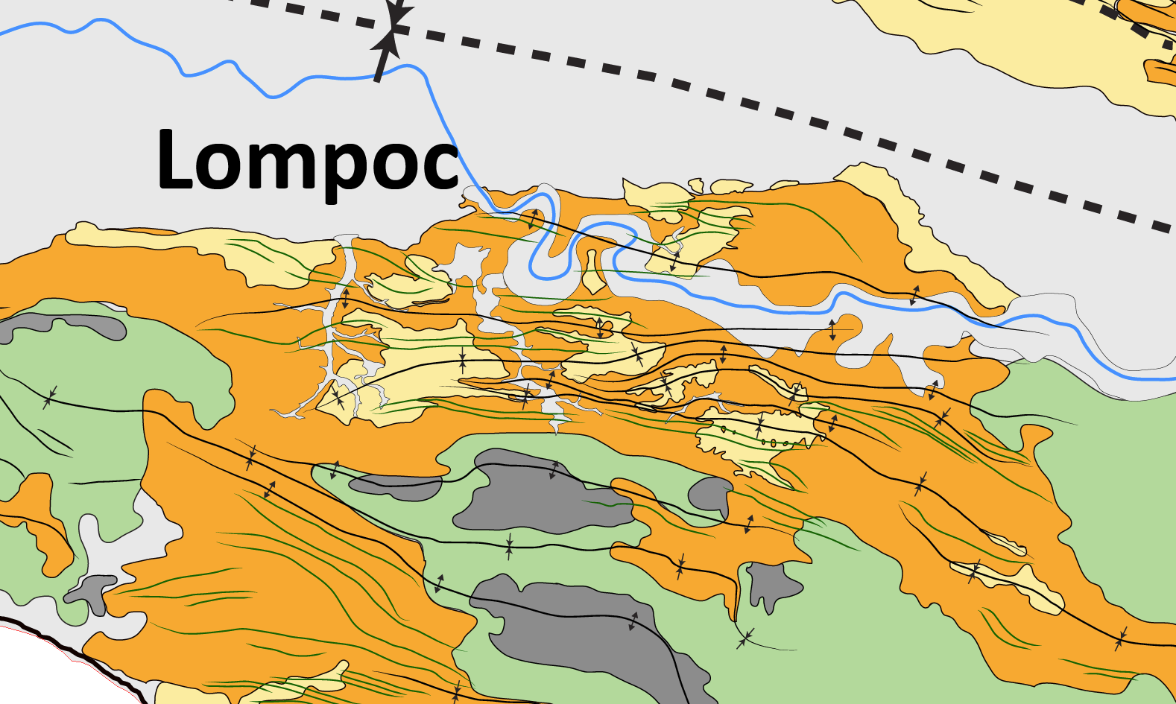
3rd Order Folds

Slide 12
4th Order Folds

Slide 13
4rd Order Folds
150 m

Slide 14
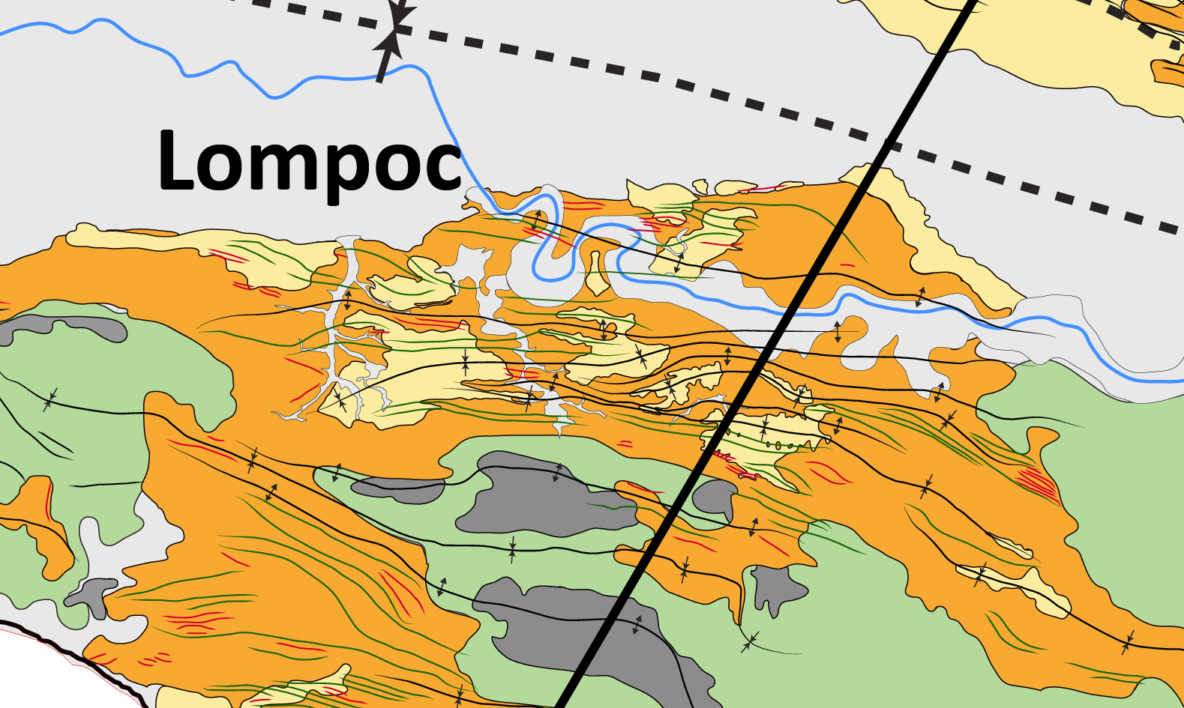
Map-Scale Contribution
3
Lompoc
Modified after Namson & Davis, 1990

Slide 15
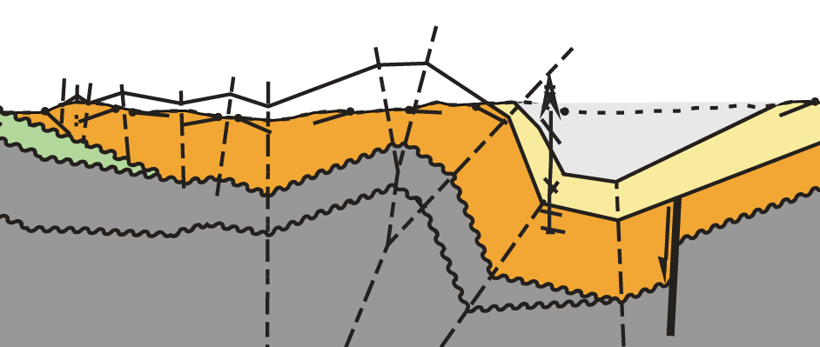
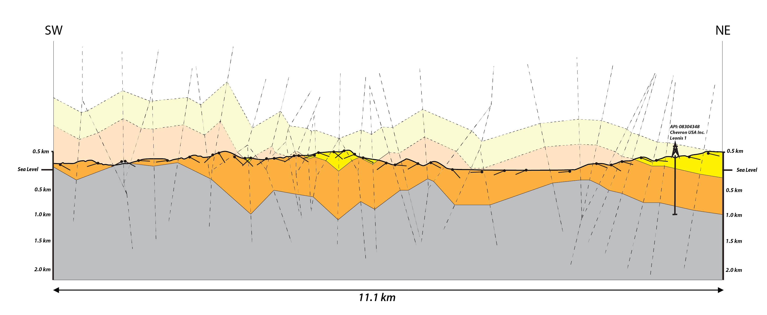
Structural Analysis
Modified after Namson & Davis, 1990
Data
Surface DEM
Surface Geology
Surface Structures
Well Control

Slide 16
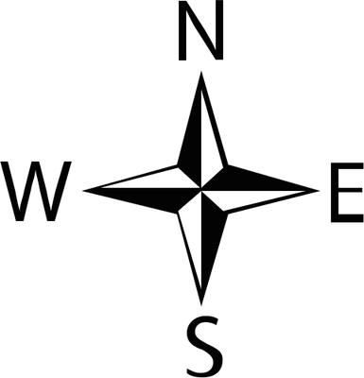
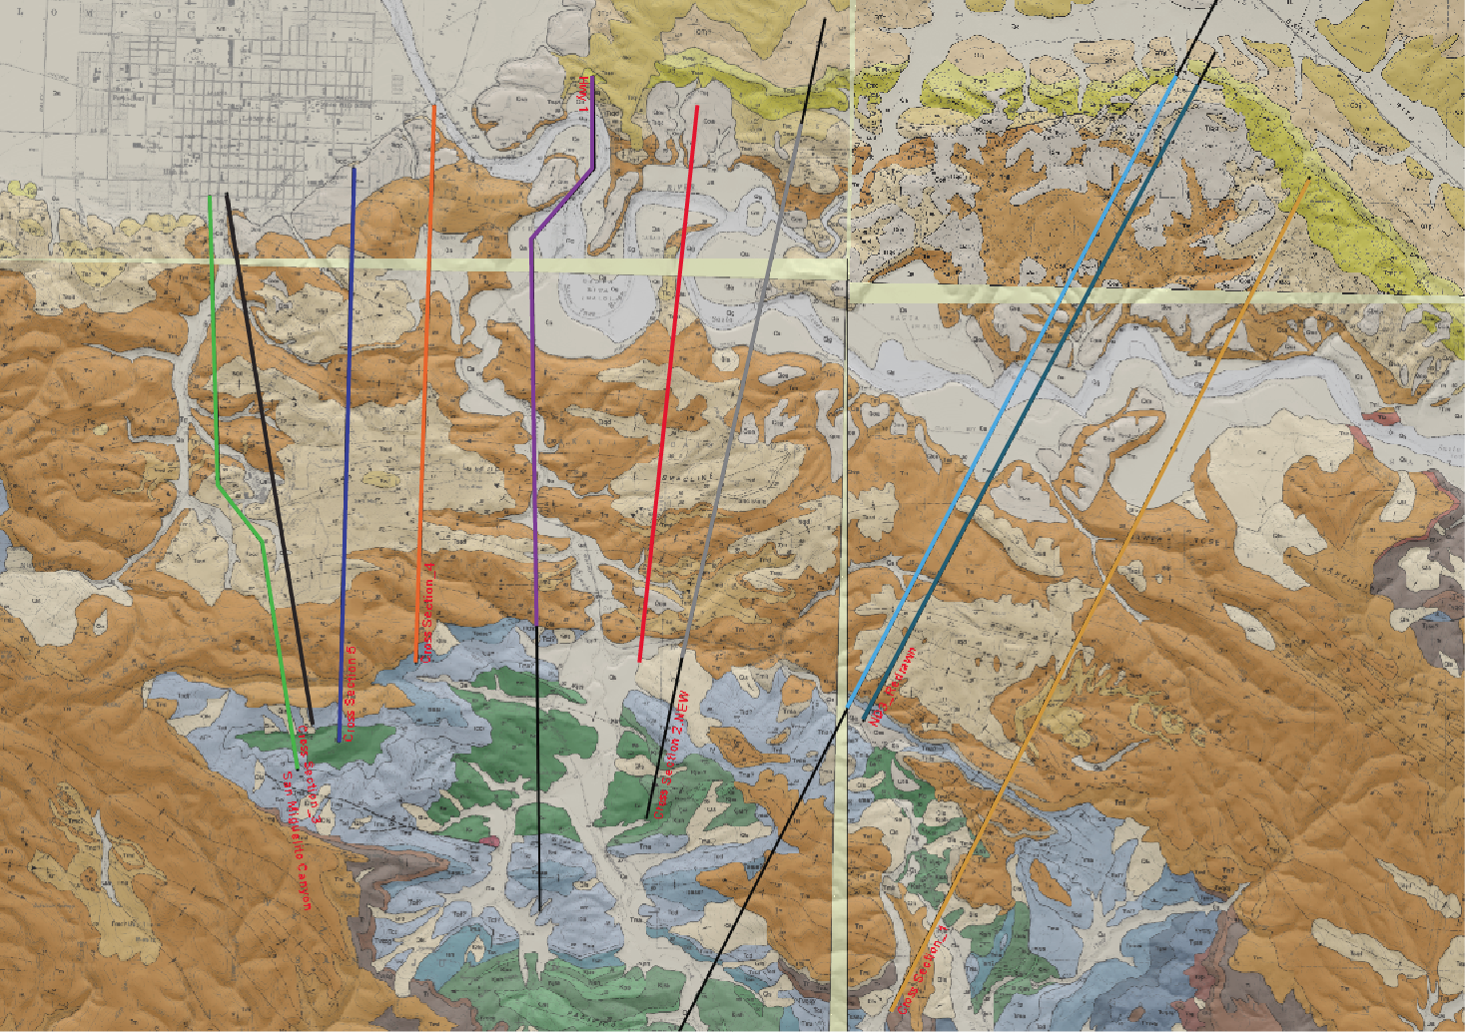
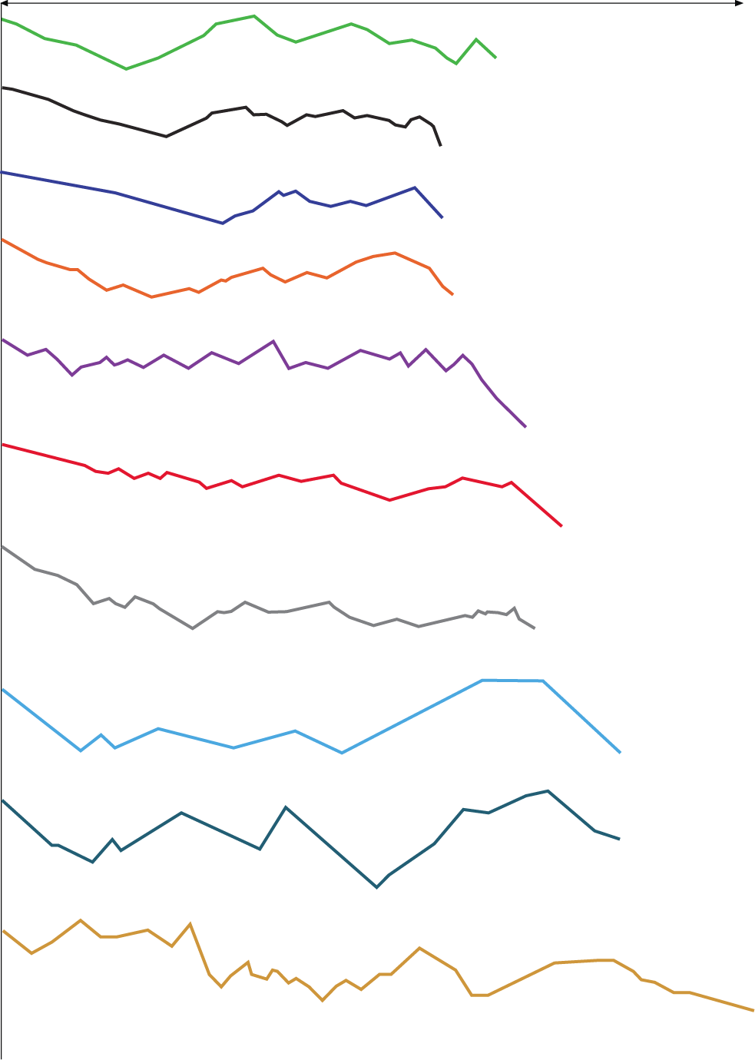
Map-Scale Quantification
Map-Length [km] | Line-Length [km] | Total Shortening [%]
6.03 | 6.79 | 12.6
6.83 | 7.97 | 16.7
7.7 | 8.1 | 5.2
11.1 | 12.73 | 14.7
Top Monterey Formation Line-Lengths
South
North
12.6 %
Lompoc
11 %
7.7 %
11.8 %
23.3 %
16.7 %
14 %
Significantly more shortening in SMC, SHR-1 and SHR-2
Uneven strain distribution in east-west and north-south direction
Future work:
- Create more cross-sections
- Model that explains strain distribution
5.5 %
13 %
14.6 %
Notes:
List petroleum systems
Namur-Murta
Hutton-Birkhead
Gidgealpa
Tilted Charge Model Graphic
3 plays
Structural play
3 prospects
Channel Stratigraphic Play
2 prospects
Coal Bed Methane Play
1 lead

Slide 17
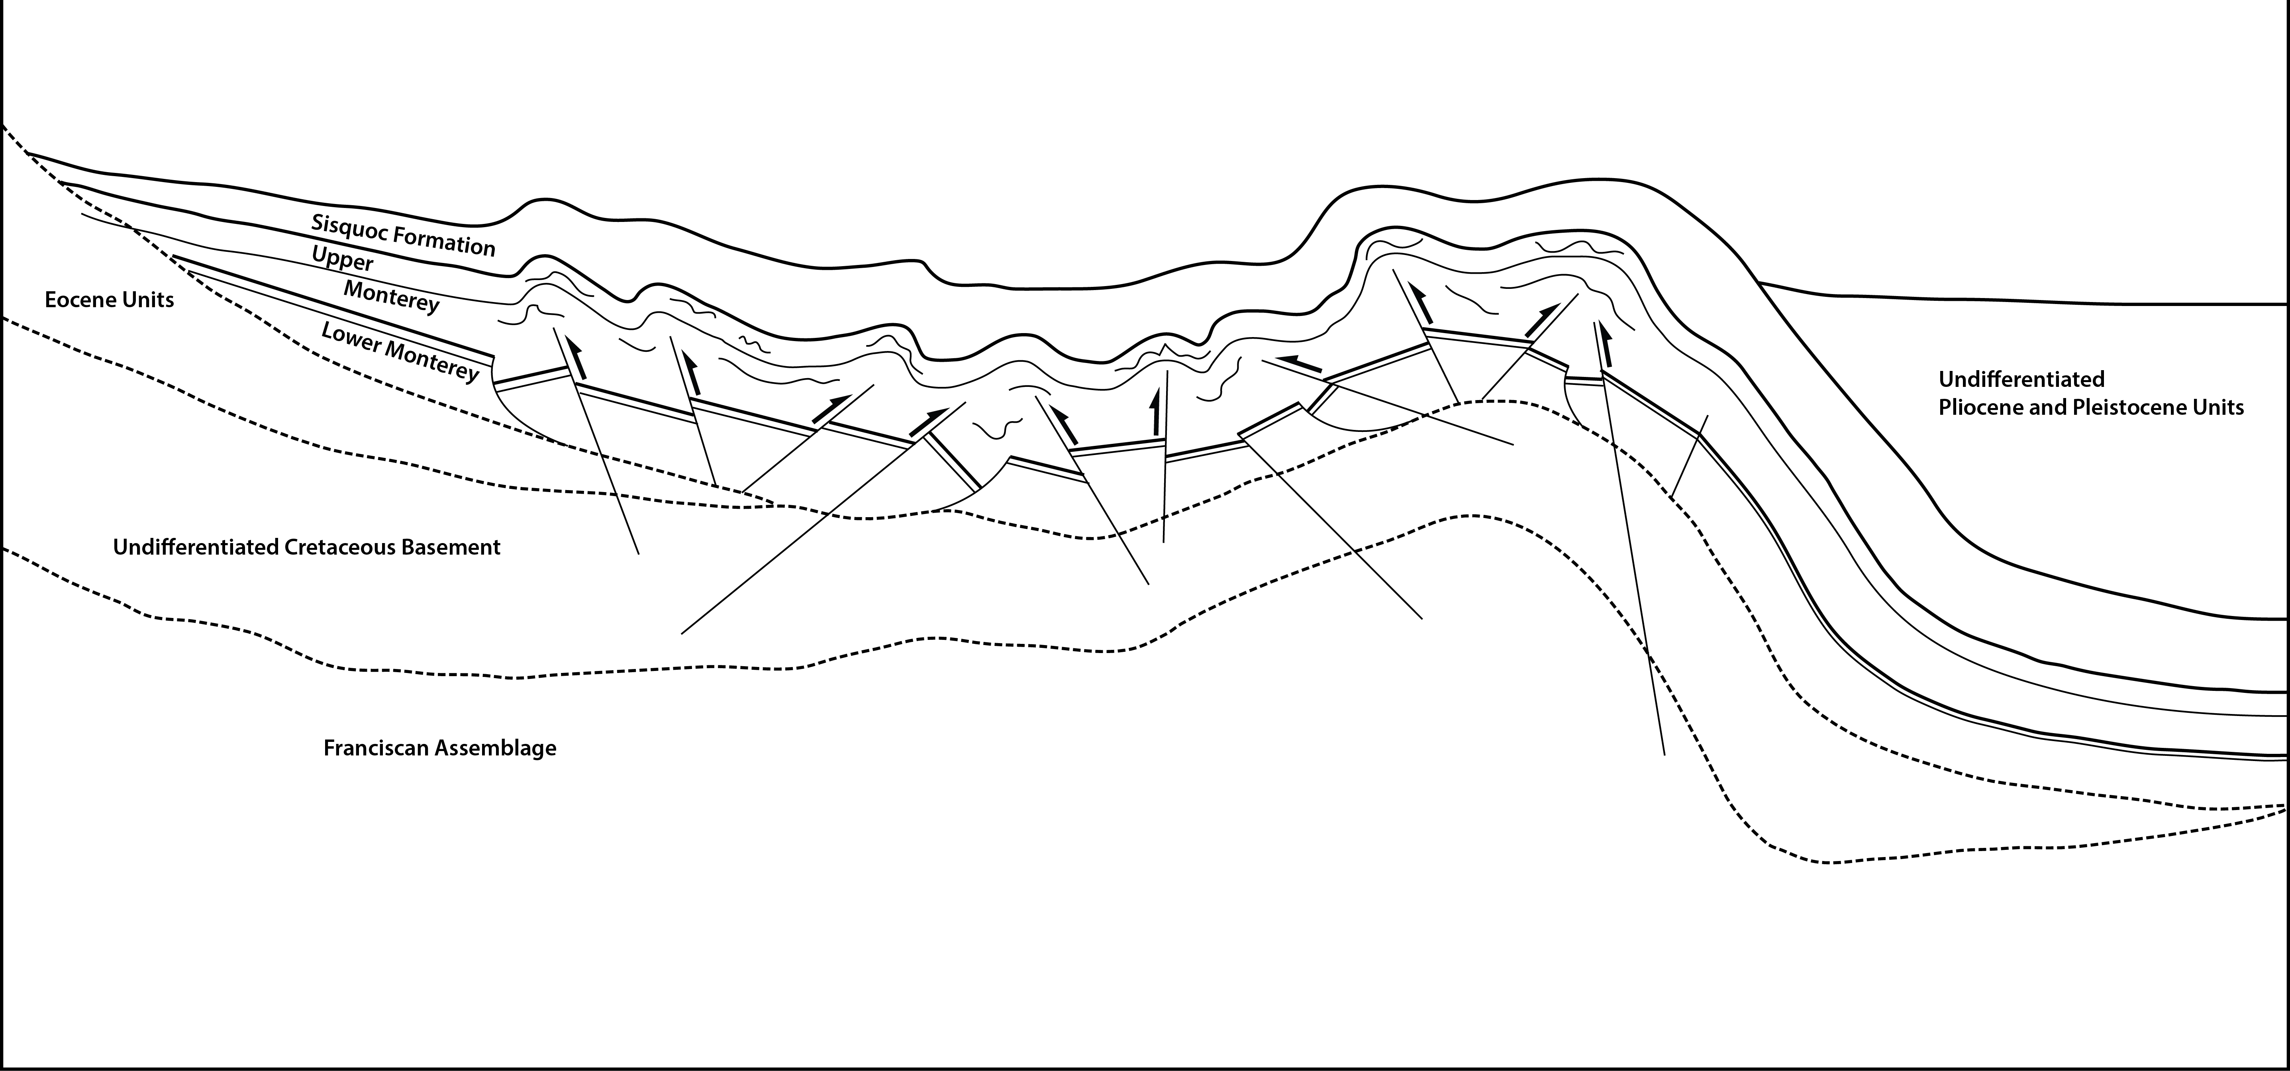
Deformation Mechanisms
North
South

Slide 18
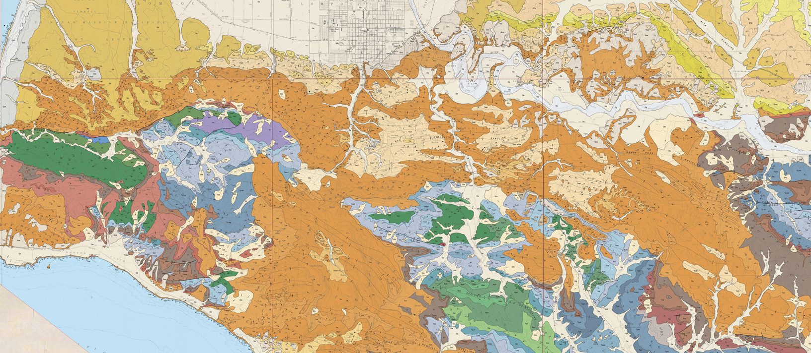
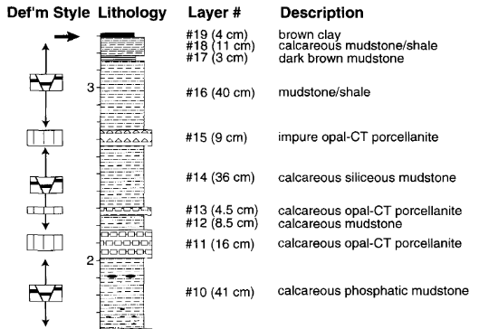
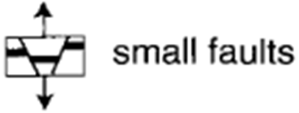
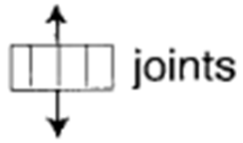
Outcrop-Scale
Lompoc
5 km
Dibblee, 1988
Outcrop continuation
Lithology and Deformational Styles
Structural/Stratigraphic Position and Bedding Thickness
Gross et al., 1997

Slide 19
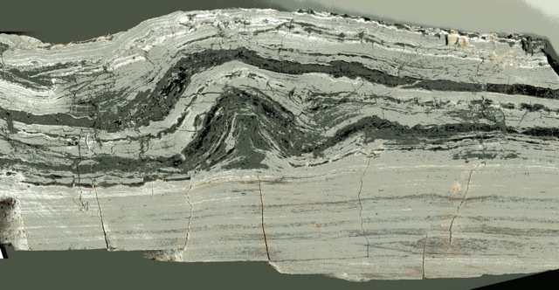
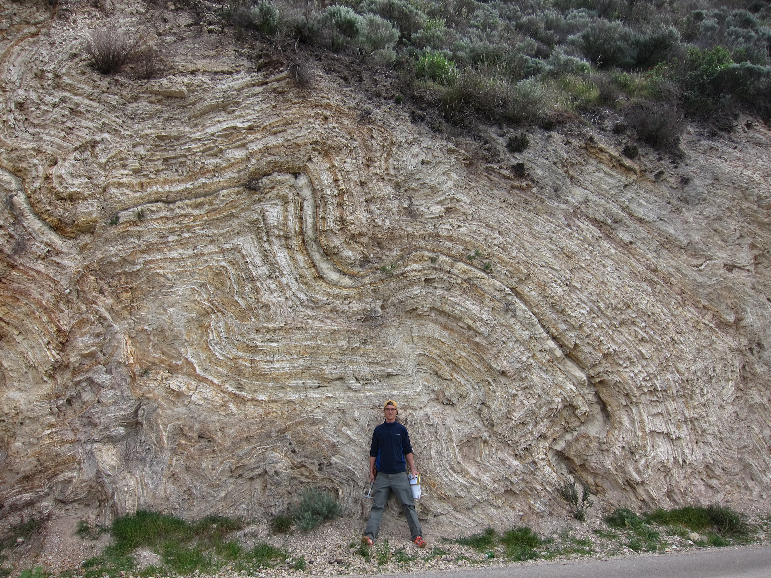
Outcrop-Scale Deformation
Sweeney Road near Lompoc
Hand Specimen from Lompoc Landing
10 cm
Sweeney Road near Lompoc
20 m

Slide 20
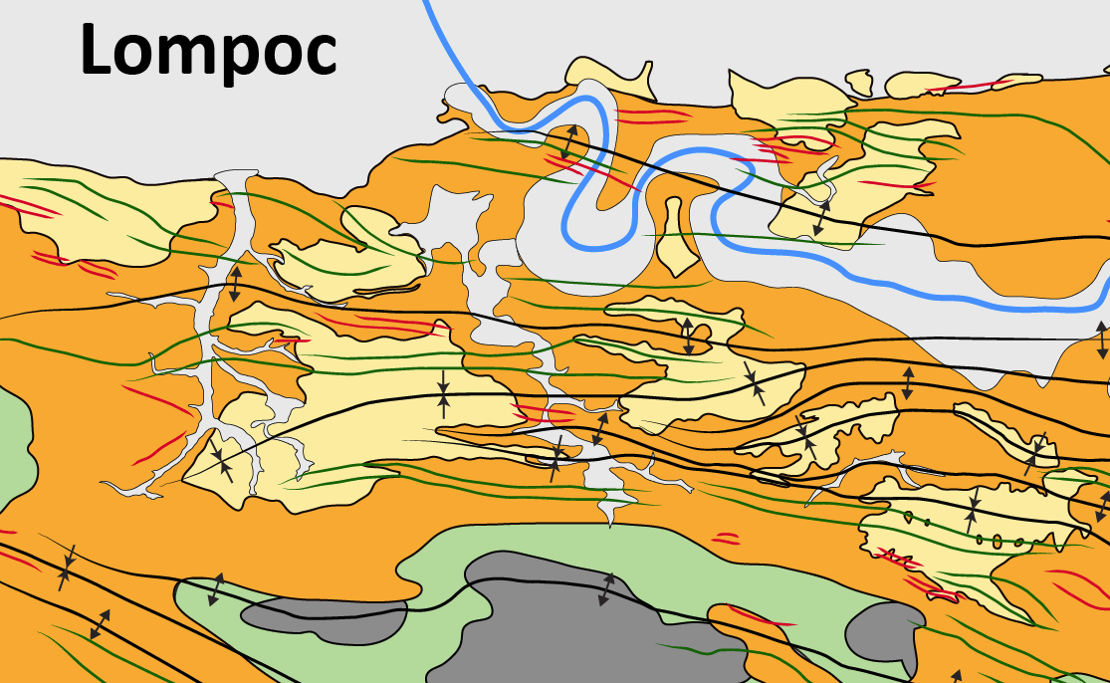
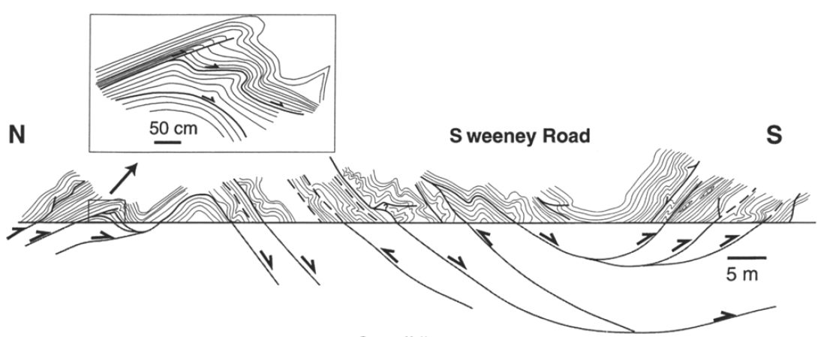
Sweeney Road
Gutiérrez-Alonso and Gross, 1997

Slide 21
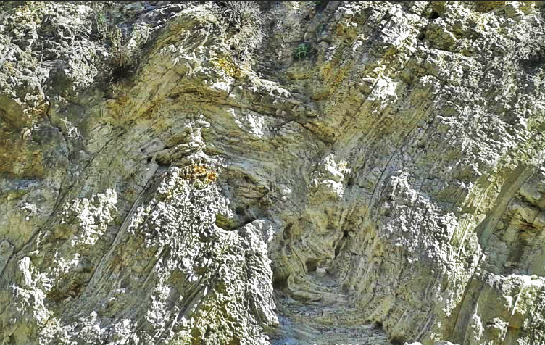
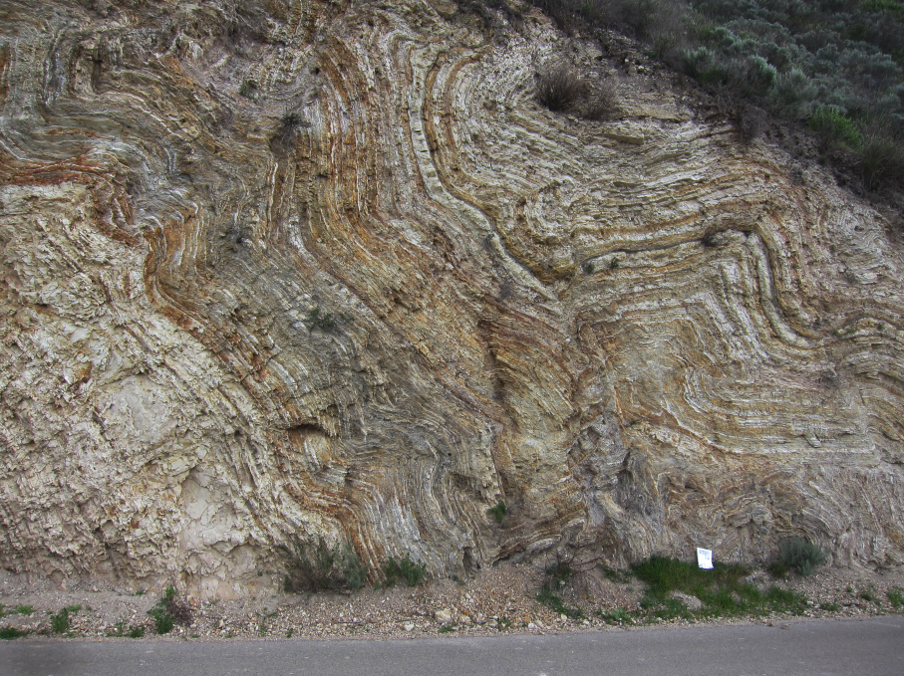
Intense Deformation
Lompoc
Dibblee, 1988
5 km
5 km
1 m
2 m
San Miguelito Canyon near Lompoc
Sweeney Road near Lompoc

Slide 22
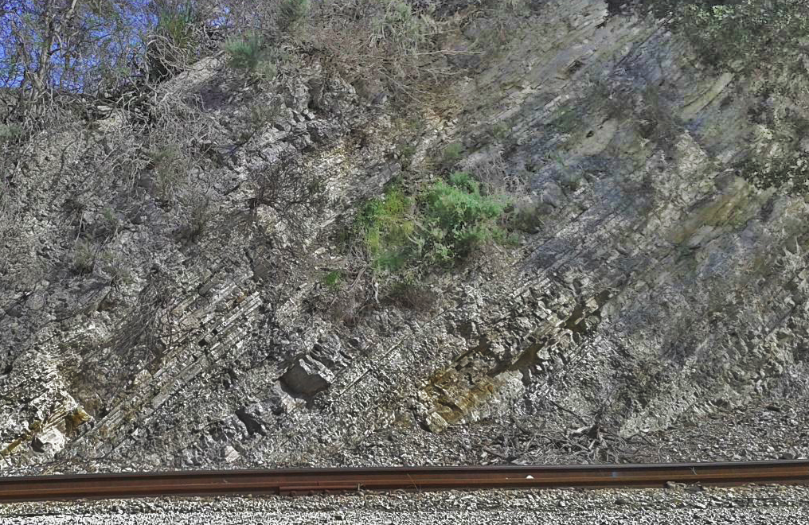
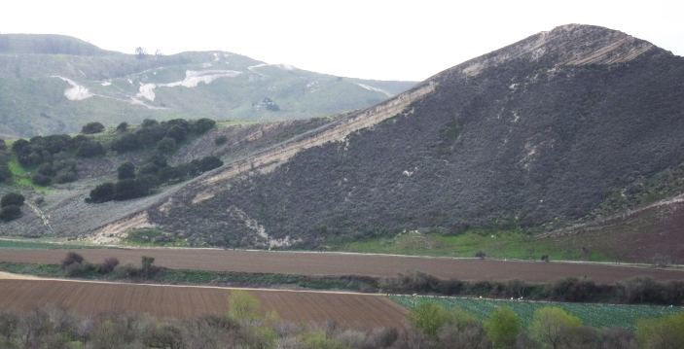
Parallel Bedding
Lompoc
5 km
Dibblee, 1988
San Miguelito Canyon near Lompoc
Santa Rosa Road near Lompoc

Slide 23
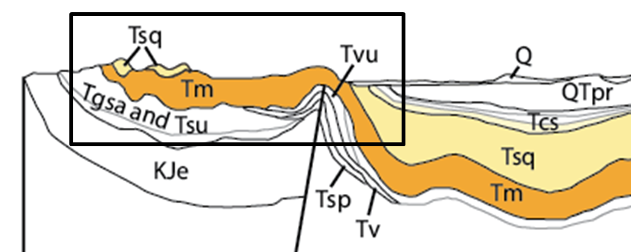
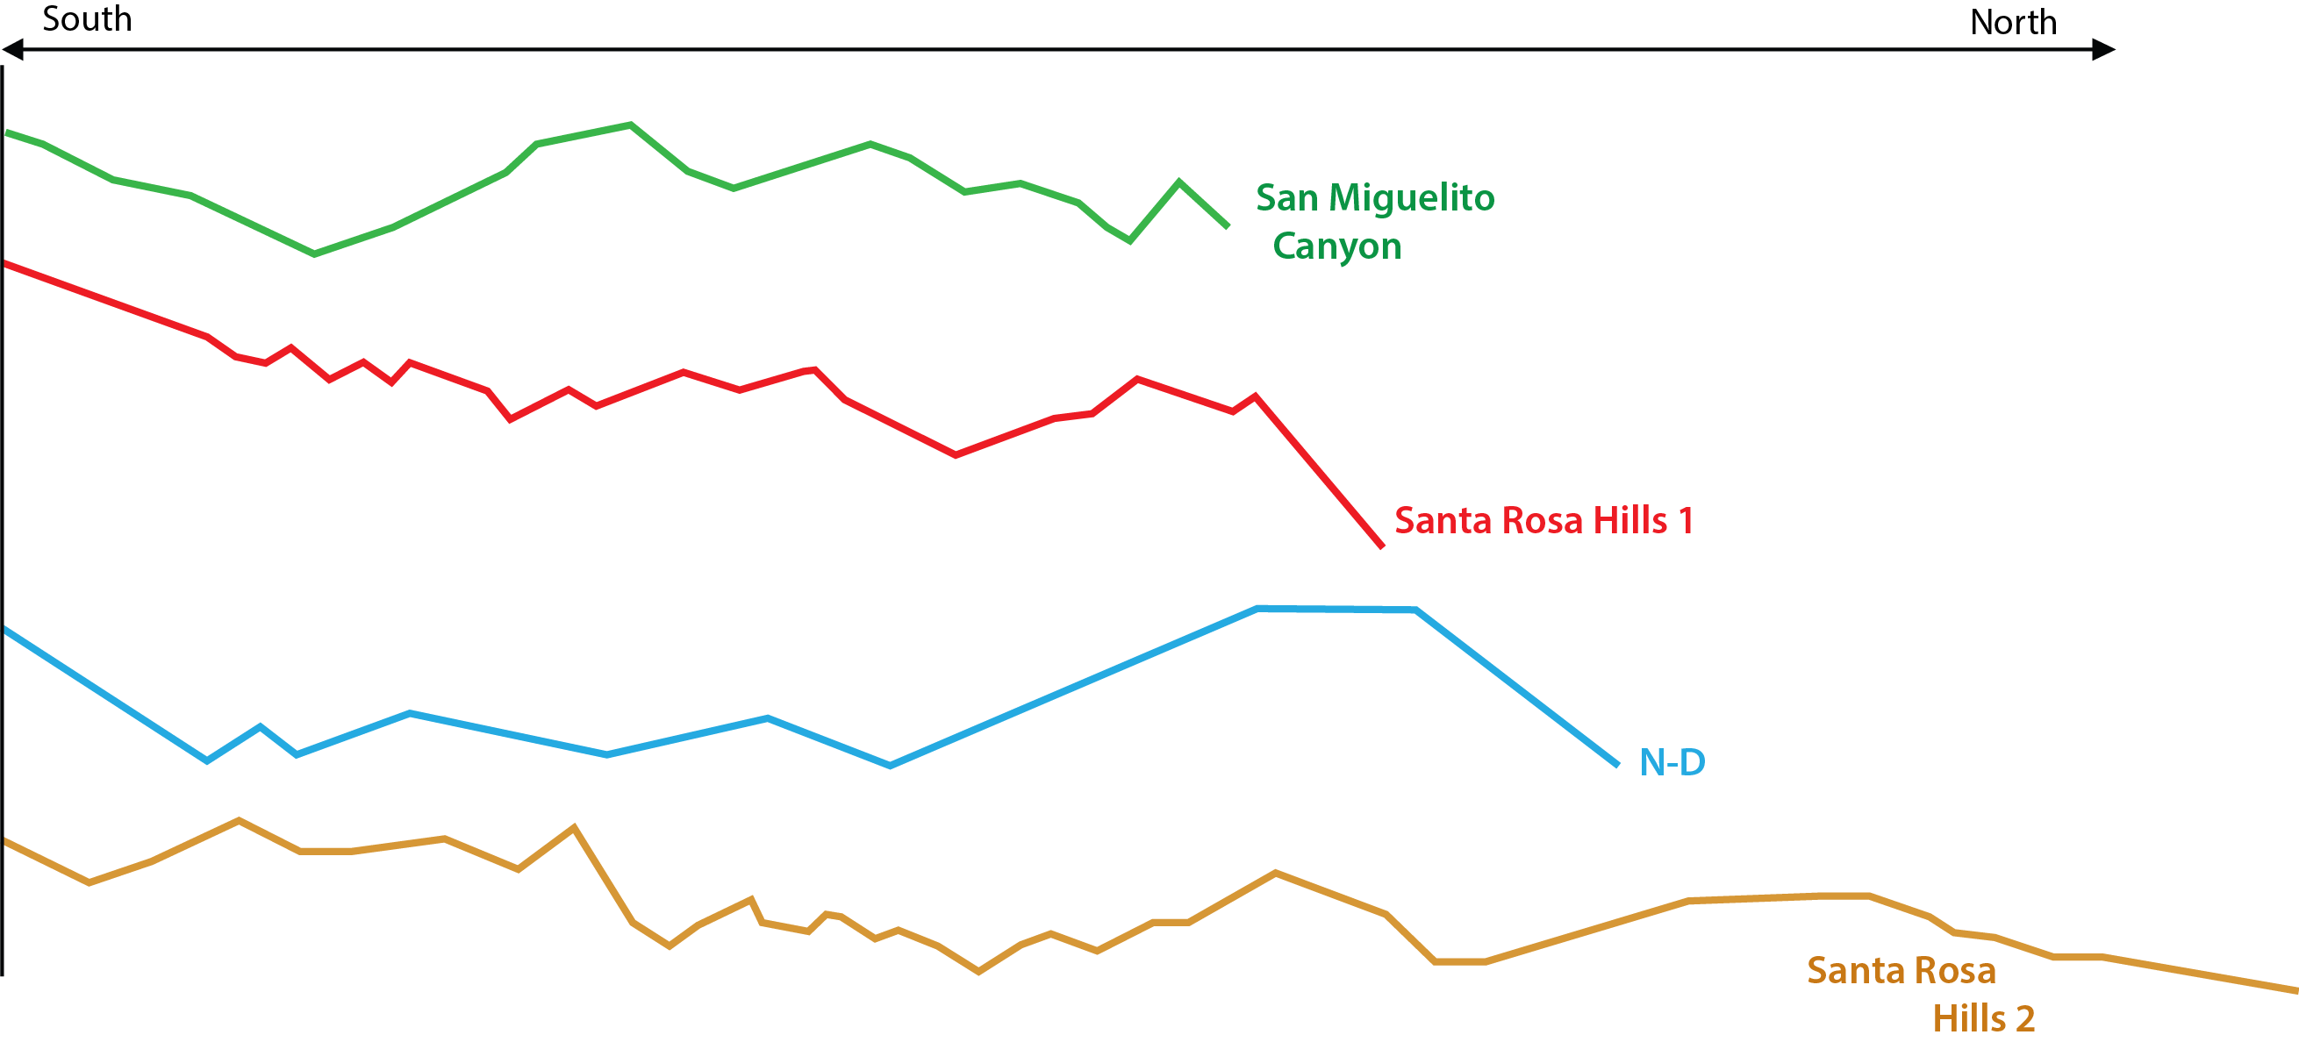
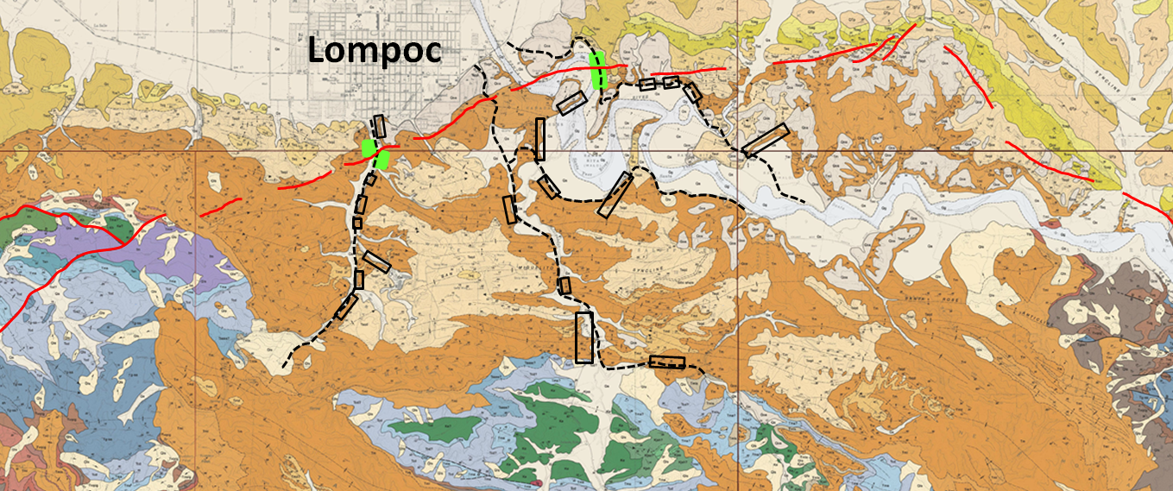
Summary
1. Rocks of the Monterey Formation are suitable to quantify tectonic shortening at map-scale and outcrop-scale
2. Strain measurements at map-scale appear to be additive to Namson and Davis, 1990
3. Intense deformation at outcrop-scale might be associated to the Santa Ynez River Fault

Slide 24
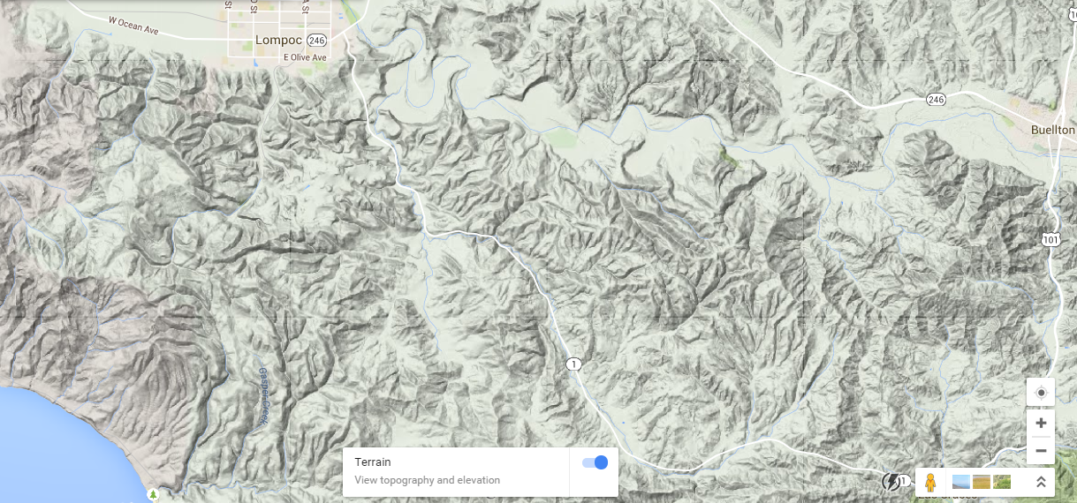
Yannick Wirtz Thesis Field Trip - 7/27/15
7
4
3
5
?
6
2
1
Stop 1: San Julio Ranch - Meet Jim Poett at his Ranch, see original Dibblee drafts
Stop 2: Possible Monterey detachment at the base, visit old diatomite quarry
Stop 3: Santa Rosa Road - Talk about fold classification at map-scale, x-sections, deformation mechanisms
Stop 4: 20 minutes hike to top of one of the highest peaks - overview: map-scale vs. outcrop-scale
Stop 5: Outcrop-Scale deformation at San Miguelito Canyon (meet Aubrey Arguello to get access to outcrops)
Stop 6: Outcrop-Scale deformation 2 Stop ?: Maybe see Diatomite quarry (if someone will respond)
Stop 7: Sweeney Road - Discuss how to quantify deformation at outcrop-scale, LithoTect project,
discussion: how representative is this deformation type for the whole area?

Slide 25
7
4
3
5
?
2
6
1

