Slide 1
Lithostratigraphy of the Miocene Monterey/Modelo Formation along Camino De La Cumbre, Sherman Oaks, CA
M.A.R.S. Project: Monterey and Related Sediments
Ben Davidson
Dept. of Geological Sciences,
California State University of Long Beach

Slide 2
Overview
M.A.R.S Project: Monterey and Related Sediments
Location
Geologic History
Methods
Data and Results
Conclusions
Future Work

Slide 3
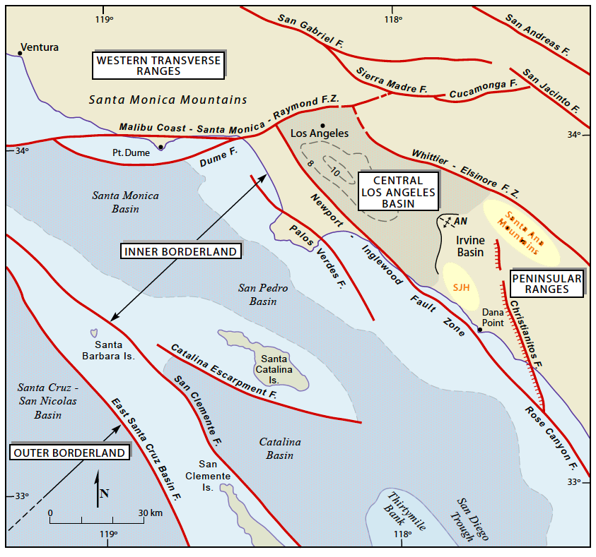
Notes:
The study area is in the eastern Santa Monica Mountains, more specifically in the city of Sherman Oaks. Major faults are in red. Note the proximity to the northwest of the LA Basin.

Slide 4
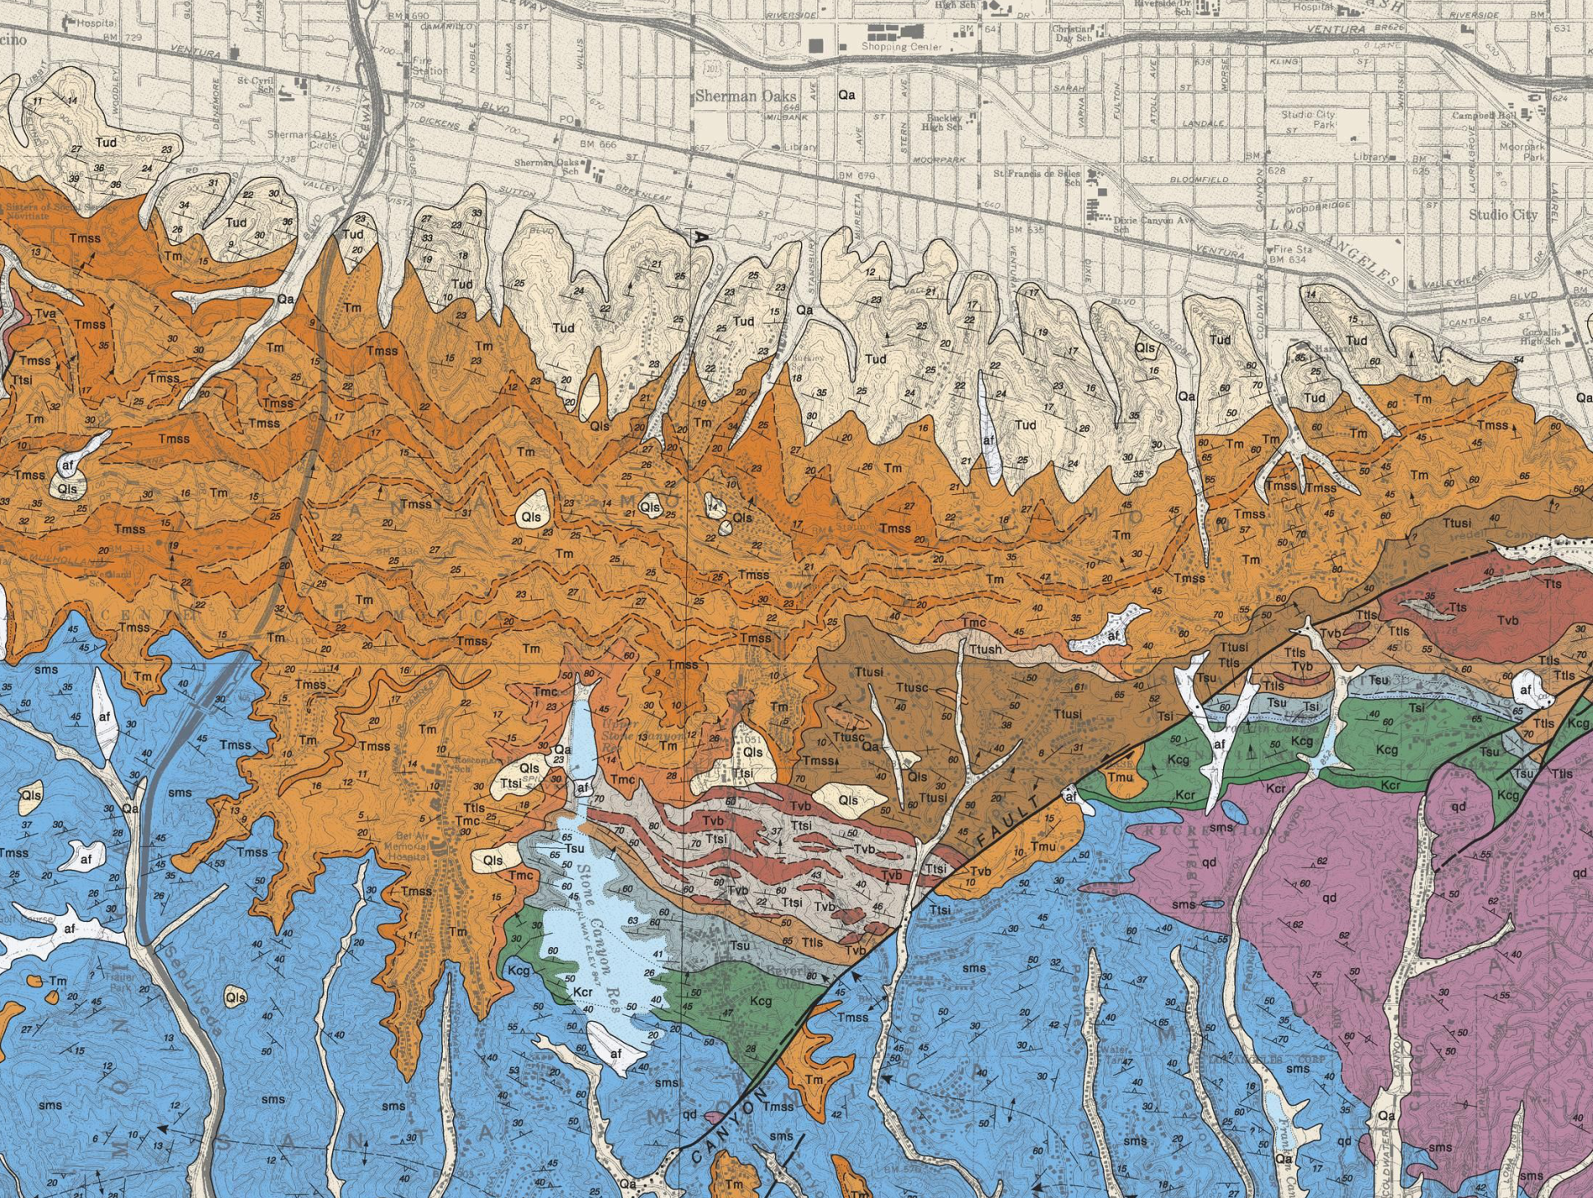
M.A.R.S. Project: Monterey and Related Sediments
Dibble and Ehrenspeck (1991)

Slide 5
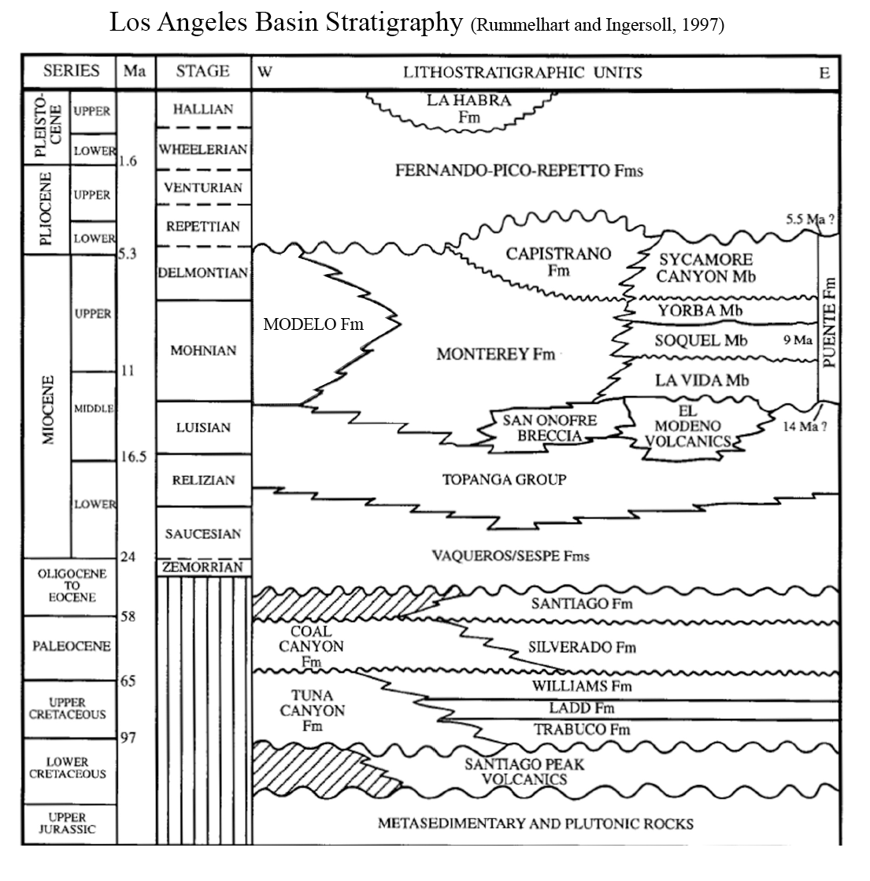
M.A.R.S. Project: Monterey and Related Sediments
Notes:
General stratigraphy of the Los Angeles Basin from West to East. The Modelo Formation, as numerous authors have pointed out, was deposited as a system of submarine fans at the start of rotation and subsidence of the LA Basin

Slide 6
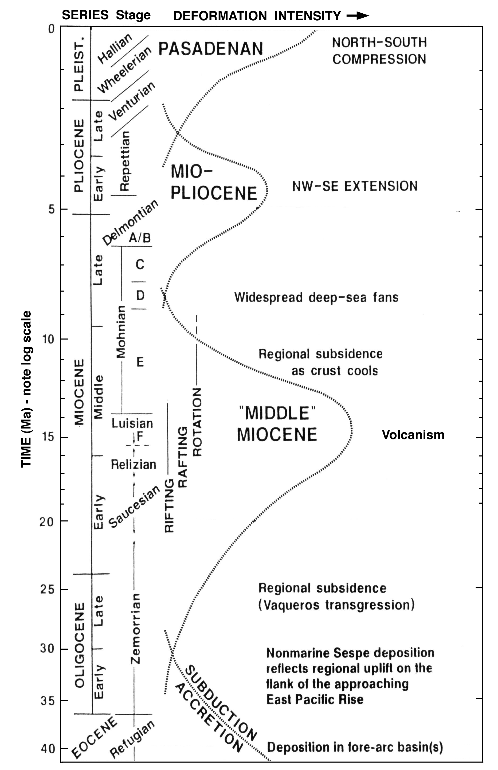
Modelo Formation
Wright (1991)
Notes:
Here is a diagram by Wright showing deformation intensity during geologic time. The Modelo Formation is bracketed, and as the figure shows, was deposited during regional subsidence of the LA Basin. The widespread deep-sea fans occurred towards the middle to late Mohnian stage.

Slide 7
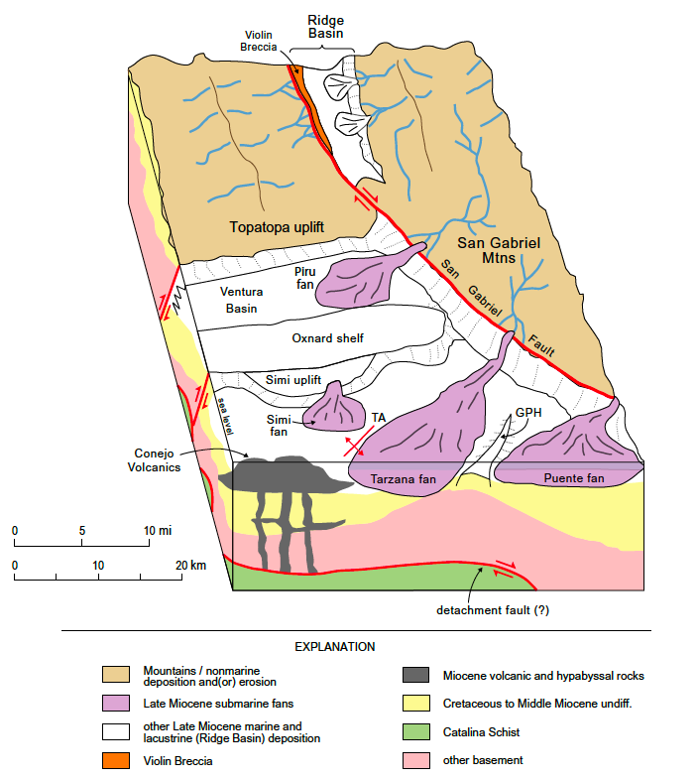
M.A.R.S. Project: Monterey and Related Sediments
Rummellhart and Ingersoll (1997)
Notes:
Here we have a block diagram by Rummelhart and Ingersoll showing the various submarine fans during the Late Miocene. Many Paleocurrent and depositional environment studies have been done that deal with the sandstones of the Modelo Formation. As you all may know, most of the Oil from the LA Basin is produced from these submarine fans (namely the Tarzana and the Puente)

Slide 8
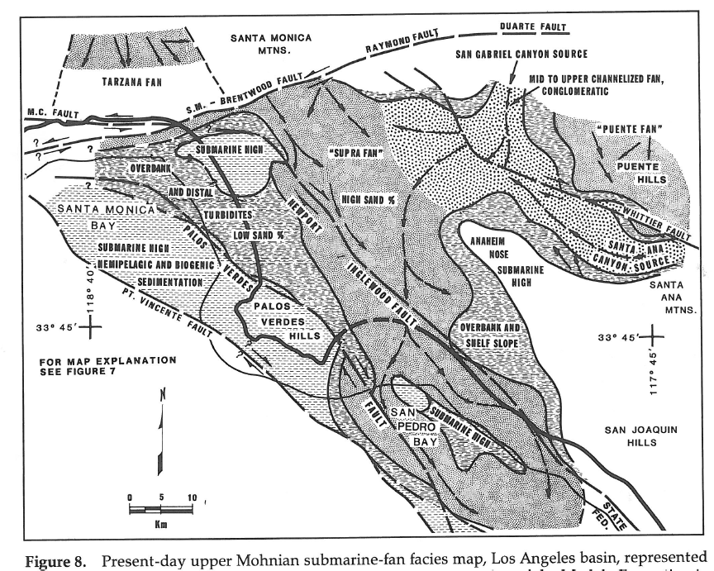
Upper Mohnian facies
Redin (1991)
Notes:
This diagram by Redin shows the various Upper Mohnian facies as well as paleocurrent directions. Our field area is located at the edge of the Tarzana fan.

Slide 9
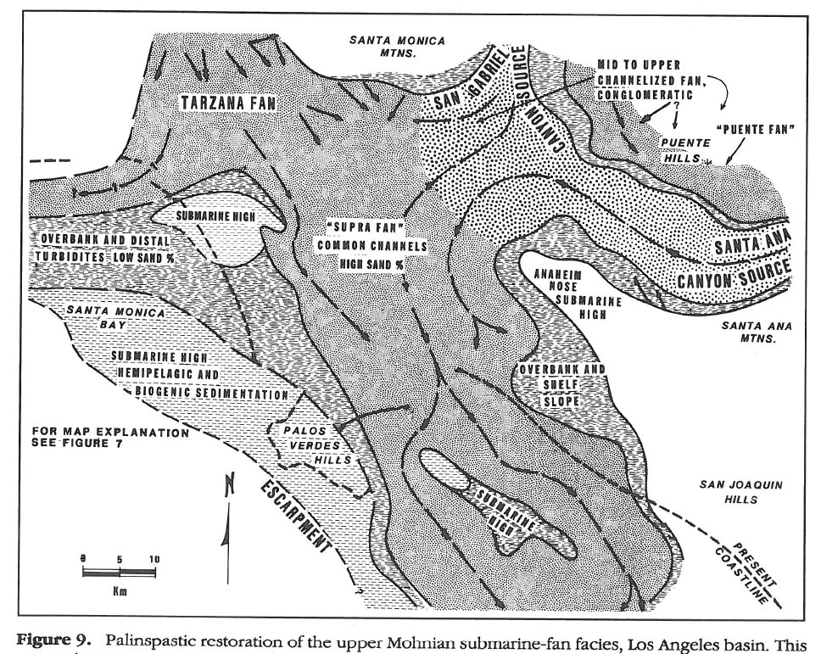
Upper Mohnian reconstruction
Redin (1991)
Notes:
This is a reconstruction of the Upper Mohnian facies, also by Redin. Here he shows the extent of the deposition of all the submarine fans. A previous study done by Sullwold in 1931 showed that the sandstone in the Eastern portion of the Santa Monica Mountains, specifically my area, had a paleocurrent direction that pointed directly East, shown by the arrow at the top in Redin’s diagram. The current may have been redirected by some sort of bathymetric/topographic high close to my area. While this information is plentiful, there is a general lack of information about the fine-grained sediments and the relationships with the sandstones. This information is very useful, not just to oil companies, but also for geology as a whole . And so that’s essentially the goal of this project: to gain a better understanding of the relationships between the fine-grained sediments and sandstones by performing a detailed analysis of the outcrops of Monterey/Modelo sandstones and interbedded mudstones.

Slide 10
Methods
M.A.R.S Project: Monterey and Related Sediments
Jacob’s staff for measuring the total stratigraphic thickness
Handheld spectral Gamma Ray – readings taken every two feet in stratigraphic thickness
Visual analysis of outcrop for lithological descriptions
Excel and Illustrator for graphs and data analysis
Notes:
My methods for this project include…. Next I’m going to show you the main types of lithologies in the section and then the strat column and well logs will follow.

Slide 11
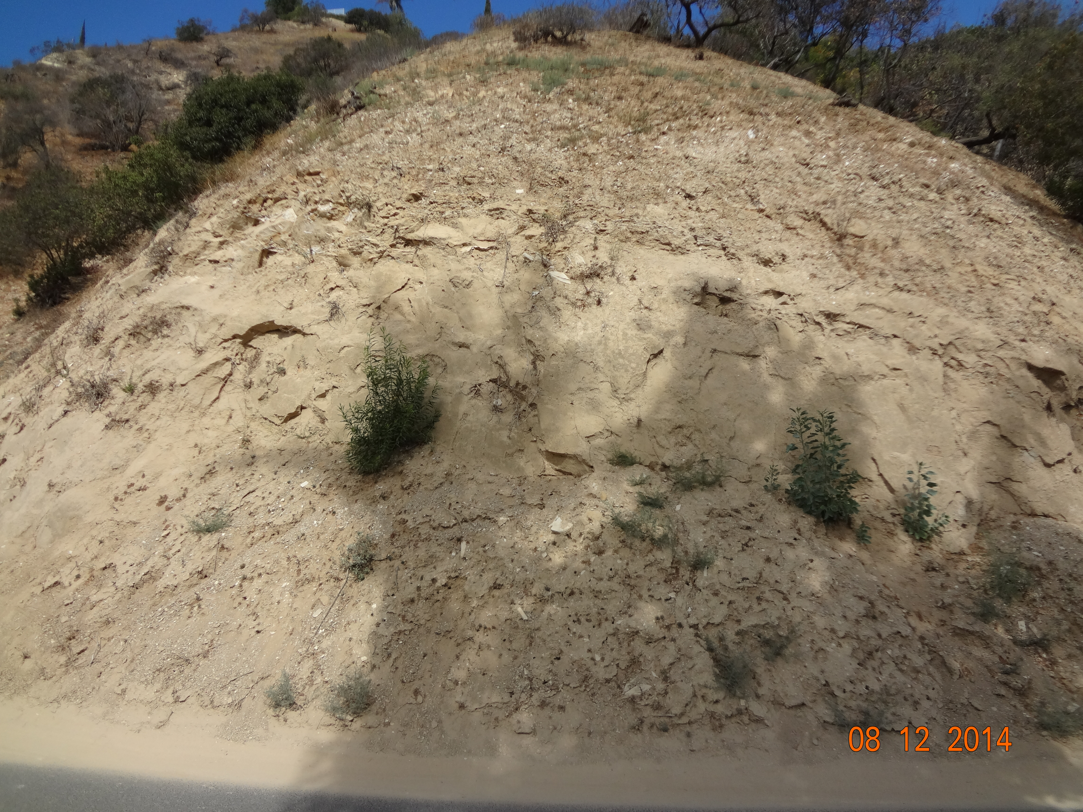
-Massive, fine- to coarse-grained, poor- to well-sorted, thick-bedded sandstone with a predominantly quartzofeldspathic composition. The matrix varies in clay content and is grain-supported.
Notes:
This is the Arkose-Wacke found at the base of the stratigraphic section. It’s (description). Hoots in the 1930’s, Sullwold in the 60s’, Rummelhart and Ingersoll in the late 90’s, as well as Blake, Wright, and Redin have all studied this Tarzana Fan sandstone in great detail.

Slide 12
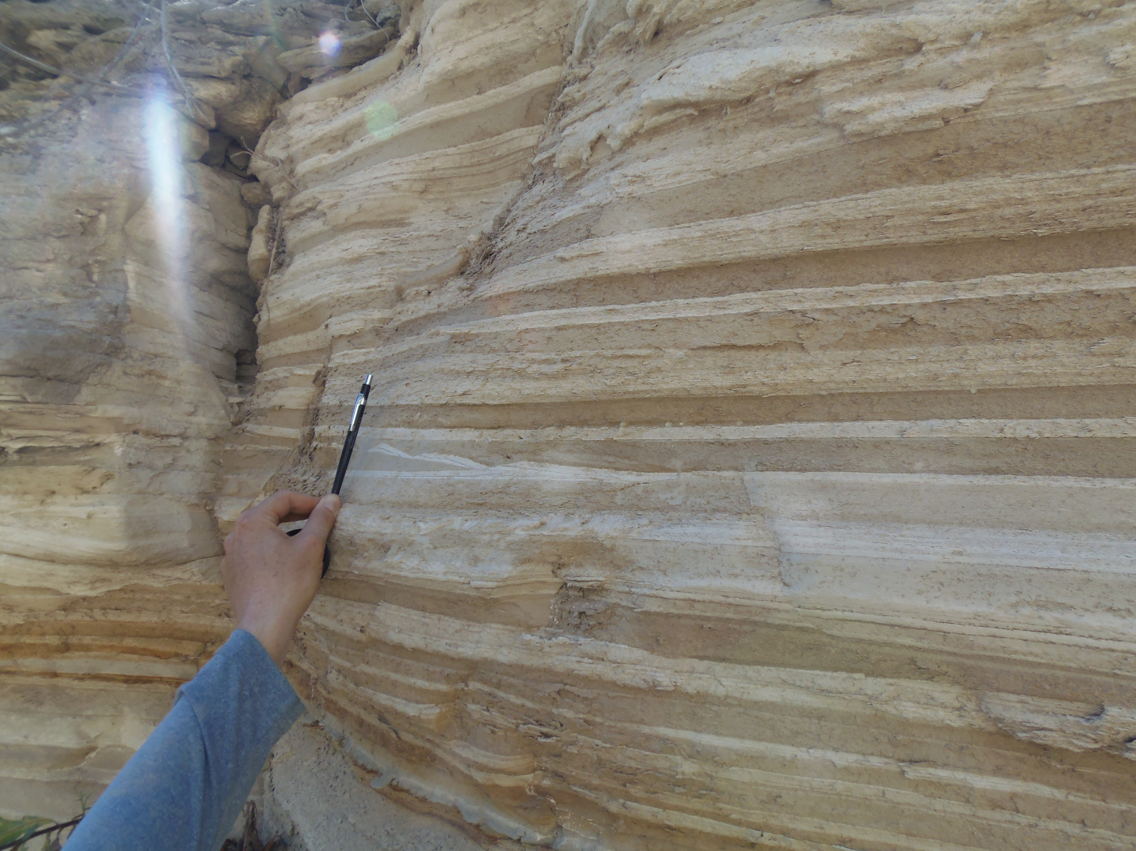
-Interbedded white, laminated diatomite with muddy, diatomaceous, “speckled beds”.
Notes:
Here is the (description). This is the lithology that is found throughout most of the stratigraphic section. There are varying amounts of either the white diatomite, or the muddy diatomite, as well as sandstone which is typically found as small lenses, or at the base of a few of the muddy diatomite layers. The muddy diatomaceous speckeled beds are gravity flow deposits, coming off of bathymetric/topographic highs. As they flow down the slope to the basin floor, they pick up the pelagic, pure diatomite which settles back as little “speckles” within the muddy diatomite. Dr. Behl pointed out that these “speckled beds” are more abundant in this area than any other. It would be interesting to see how the abundance of these speckled beds changes laterally throughout the Tarzana fan and Modelo Formation as a whole.

Slide 13
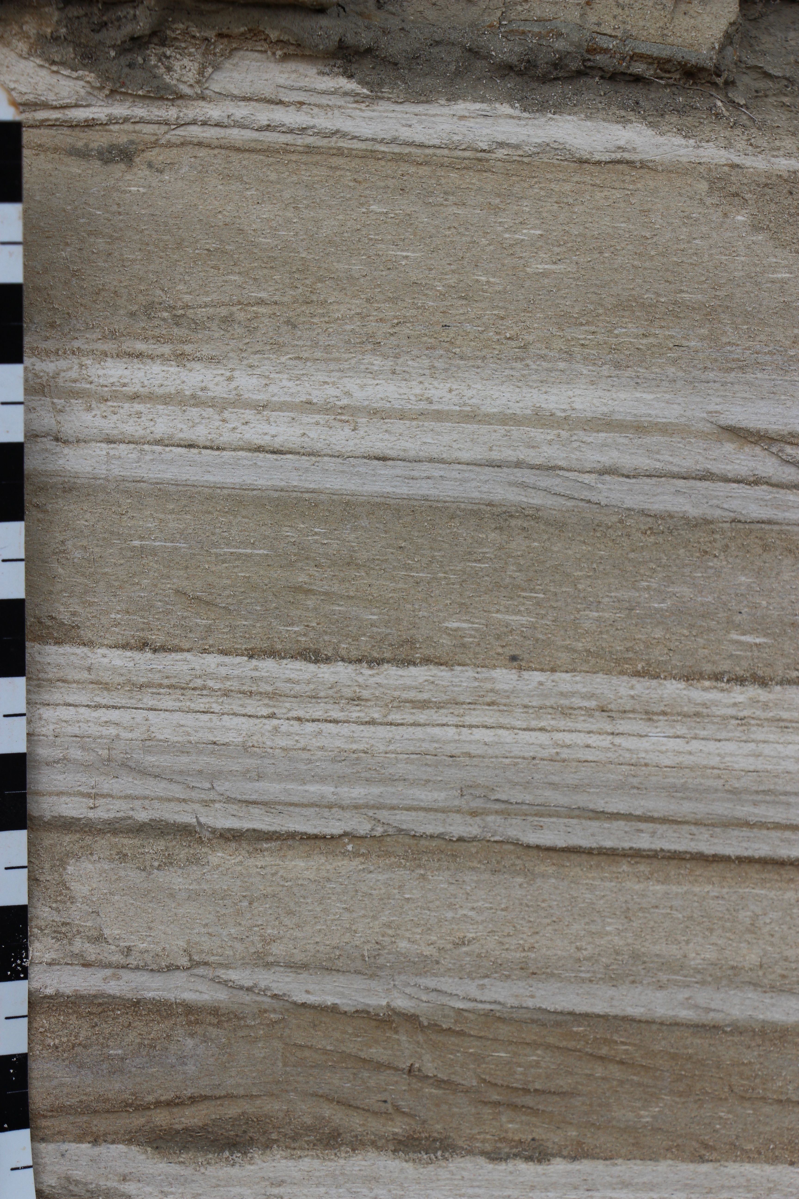
M.A.R.S Project: Monterey and Related Sediments
Notes:
This is a close up image showing the speckles within the muddy diatomite. Note the centimeter scale on the left.

Slide 14
Notes:
This is an example of the types of sedimentary features observed throughout the outcrop. In this case, we see some brown sand scouring into the finely-laminated diatomite.

Slide 15
M.A.R.S. Project: Monterey and Related Sediments
Lithology
Thorium Uranium Potassium
Formation
Thickness(ft)
Total API Gamma Ray
Age
Sand:Mud
Notes:
Finally, here is the real data for the project. The meat and potatoes. On the left we have a general strat column showing the sandstone at the base, interbedded diatomites throughout the rest of the section, a few dolostone beds, and the gaps. The strat column is only preliminary and will be completed in more detail when we do some quantitative assessments of the characteristic deposits (percent speckled beds for example). There were quite a few, really nice houses along that street that just had to cover up my outcrop. In the middle, we have the Total API GR log in black, along with the spectral logs on the right. Thorium is in blue, Uranium is shown in green, and potassium is in red. All the way to the right is the sand:mud ratio. In this case, I decided that anything that was greater than mud size was classified as sand. So the interbedded diatomites are mud, and if I found some sand lenses, I would add that into the ratio. Intervals with the large black blocks are 100% sand, and the intervals with very thin black lines, are relatively pure diatomites. The well logs turned out really nice. I haven’t had the chance to fully analyze these, as I would like to fill in some of the gaps, and also make a few other logs. But we do see some nice separation in the spectral logs. In the first 300 ft., the K and Th is generally higher and the Uranium is lower than in the middle of the section. Uranium can be used to show organic content, and K and Th shows clays. At the base, there is a large separation, which is telling us that the sandstone is very arkosic, or there is a lot of feldspar.

Slide 16
Future Work
M.A.R.S Project: Monterey and Related Sediments
To complete work thus far:
Fill in gaps on logs
Quantitative assessment of depositional facies (e.g., % speckled beds to pure diatomite)
Further analysis of the data
Possible Master’s Thesis
Repeat study on other outcrops in the area
Paleocurrent/environment analysis
Lateral facies relationships
Detailed XRD and geochemistry for stratigraphic trends

Slide 17
References
M.A.R.S Project: Monterey and Related Sediments
Dibblee, T.W., and Ehrenspeck, H.E., ed. : Dibblee Geological Foundation Dibblee Foundation Map
DF-31, scale 1:24,000.
National Park Service (NPS) Geologic Resources Inventory (GRI) program. 2013. Unpublished
Digital Geologic Map of Santa Monica Mountains National Recreation Area and Vicinity, California
(NPS, GRD, GRI, SAMO, SAMO digital map) adapted from CGS digital datasets by Wills et. al.
(2013), Irvine and McCrink (2012), and Tan et. al. (2004), and a USGS map by Yerkes et. al.
(2005). National Park Service (NPS) Geologic Resources Inventory (GRI) program. Geospatial
Dataset-2203467.
Redin, Tom.1991. Oil and Gas Production from Submarine Fans of the Los Angeles Basin. AAPG Memoir, v.
52, ch.8.
Rummelhart, Peter, and Ingersoll, Raymond. 1997. Provenance of the upper Miocene Modelo
Formation and Subsidence analysis of the Los Angeles basin, southern California: Implications
for paleotectonic and paleogeographic reconstructions: Geological Society of America Bulletin, v.
109, no. 7, p. 885-699.
Wright, T. L., 1991, Structural geology and tectonic evolution of the Los Angeles basin, California, in
Biddle, K. T., ed., Active margin basins: American Association of Petroleum Geologists Memoir
52, p. 35–134.

