Slide 1
Lateral changes of fine-grained facies of the Monterey Formation within the San Joaquin Basin
Hannah Erbele
MARS Project 2014 Fall Science Meeting

Slide 2
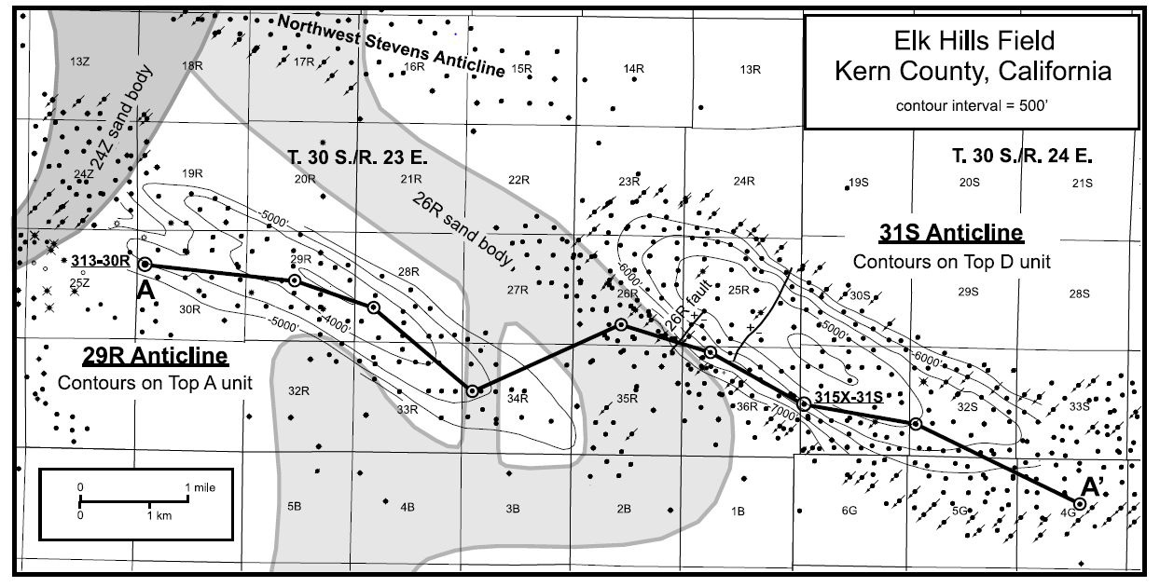
Introduction
San Joaquin Monterey differs from coastal/offshore Monterey Formation by:
Differing degrees of dilution from fine-grain terrigenous lithologies
Differing importance of processes (winnowing vs. bottom-seeking)
Reid and Mcintrye, 2001
Notes:
Image as an example of detrital input
Reid and Mcintrye, 2001

Slide 3
Biosiliceous Deposits
Periods of relative sea level highstands
Basinal deposits
Locally, in the central part of the basin, the lower middle Miocene (Gould-Devilwater members) shows development of highly siliceous intervals
Wrench tectonism
Shallower banks uplifted along strike-slip faults or atop growing anticlines
After the passing of the Triple Junction – anticlines such as Lost Hills and Kettleman Hills (Antelope Shale member)

Slide 4
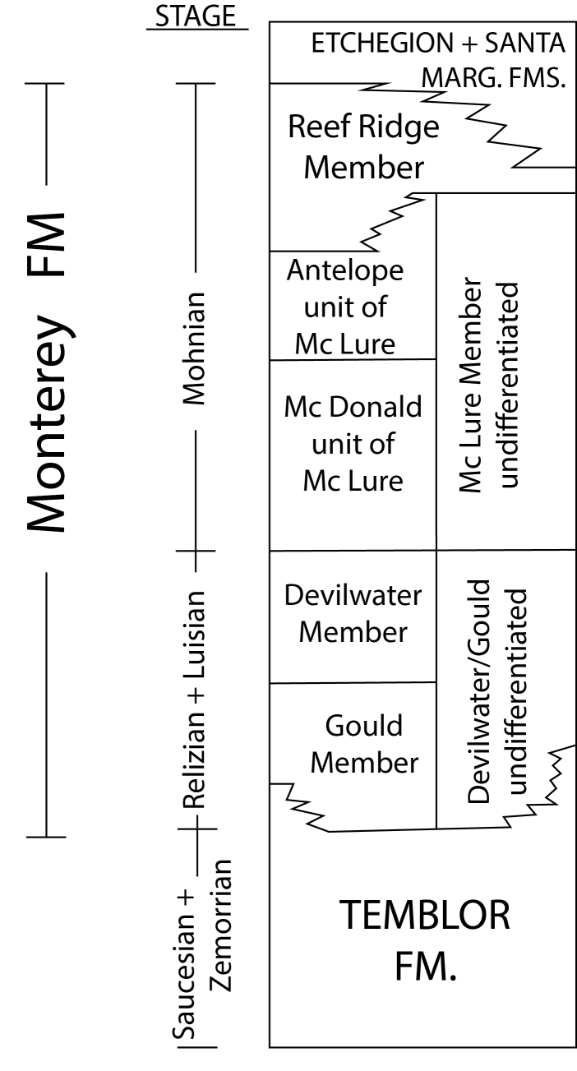
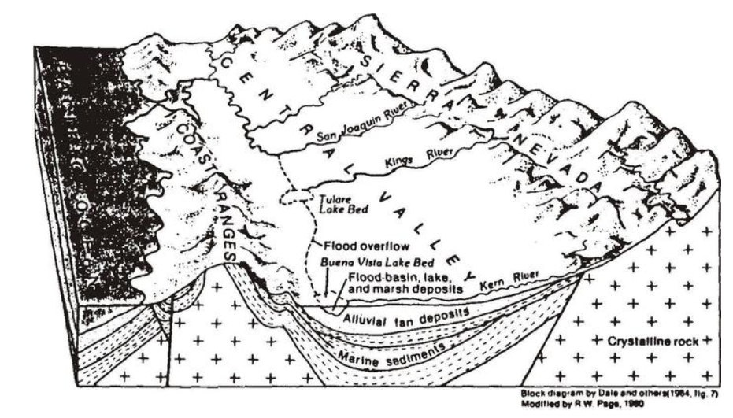
Background
Depositional Controls
Basin geometry
San Andreas related tectonics
Fluctuations in sea level
Changes in climate
Graham and Williams, 1985

Slide 5
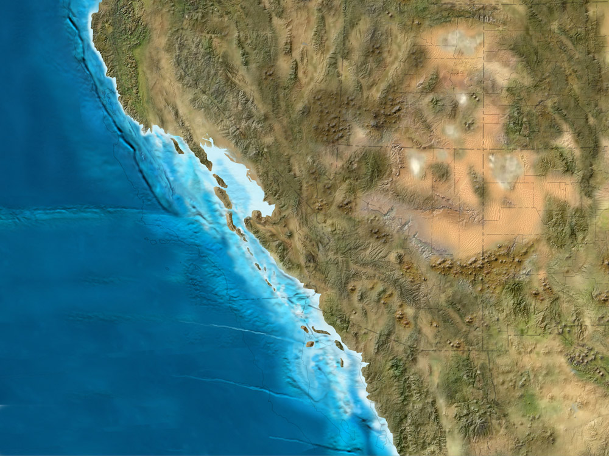
20 Ma
Blake, Colorado Plateau Geosystems

Slide 6
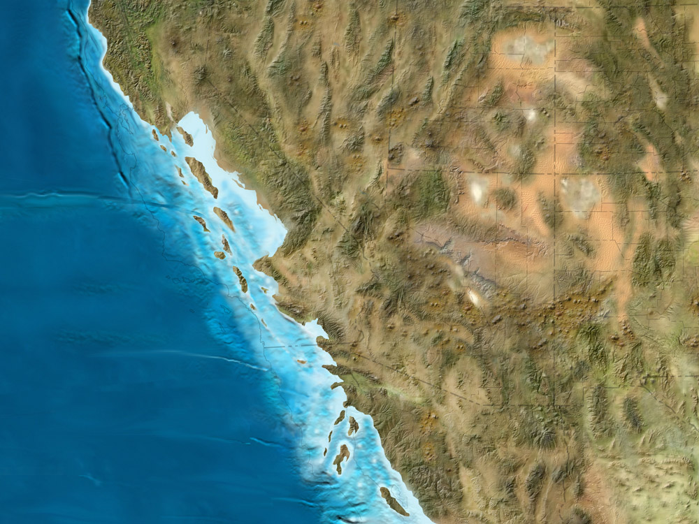
15 Ma
Blake, Colorado Plateau Geosystems
Notes:
subsidence

Slide 7
Relative Highstands
Graham and Williams, 1985
Notes:
Background – climate, sealevel
Graham and Williams 1985

Slide 8
Sedimentation Pattern for Relative Highstands?
Redistribution of siliceous sediments off highs via winnowing resulting in concentrated in depocenters in Santa Barbara Basin
Very fine grain and opal sedimentation pattern in Panama Basin
Highly siliceous
basin deposits
Hornafius, 1991 and Moore et al., 1973

Slide 9
Wrench Tectonism
Graham and Williams, 1985
Notes:
Background – climate, sealevel
Graham and Williams 1985

Slide 10
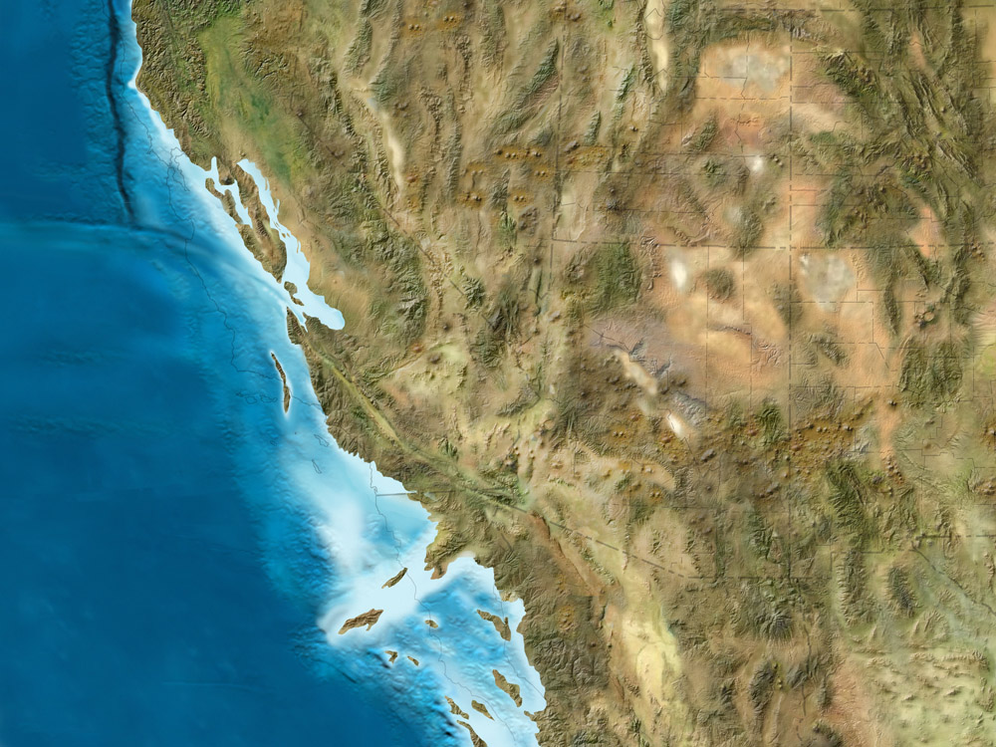
10 Ma
Blake, Colorado Plateau Geosystems

Slide 11
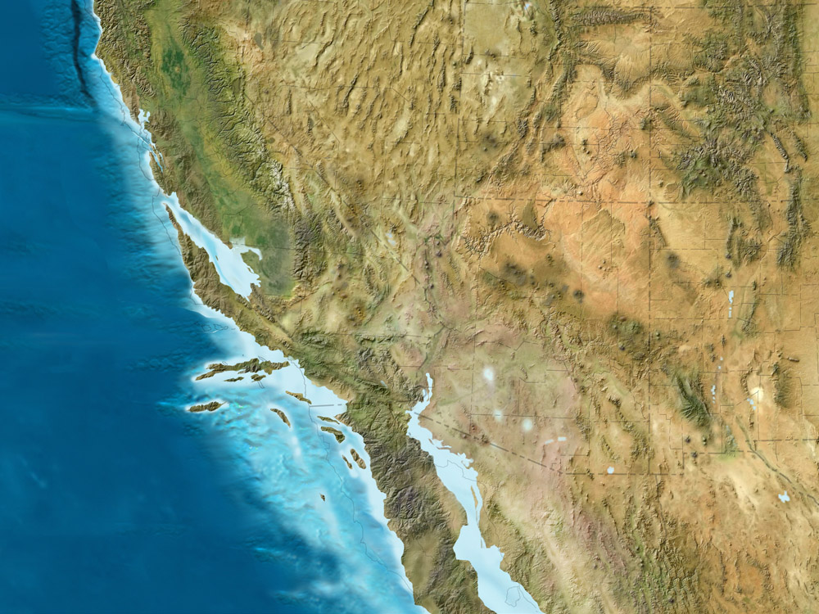
5 Ma
Blake, Colorado Plateau Geosystems

Slide 12
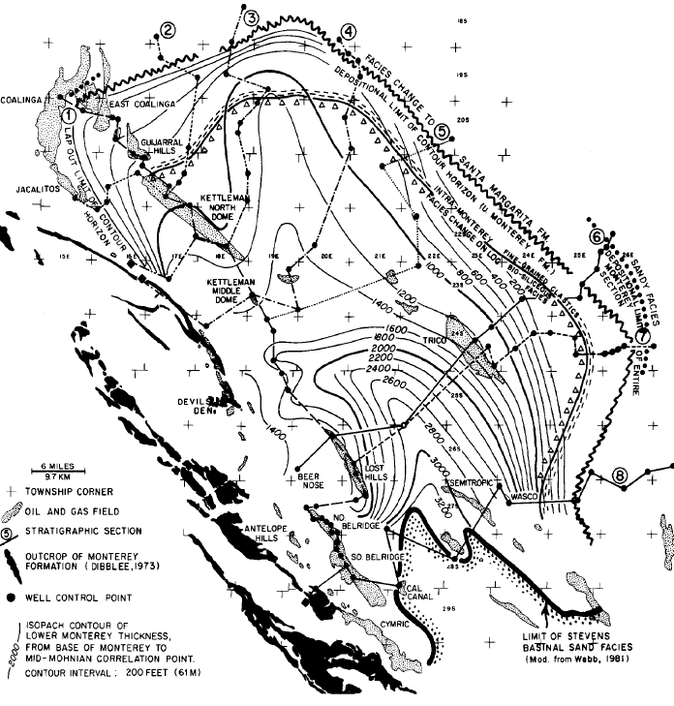
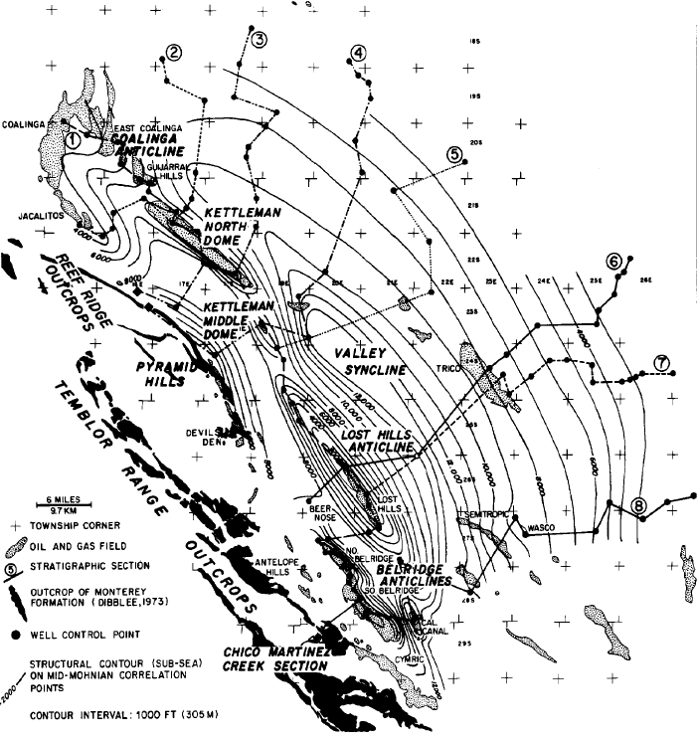
Wrench Tectonism
Base of Monterey to mid-Mohnian
Mid-Mohnian contour horizon
(Graham and Williams, 1985)
Notes:
Basin relief to show Wrench Tectonism pervasive active until Mid-Mohnian
Slip rates increase during Late Mohnian

Slide 13
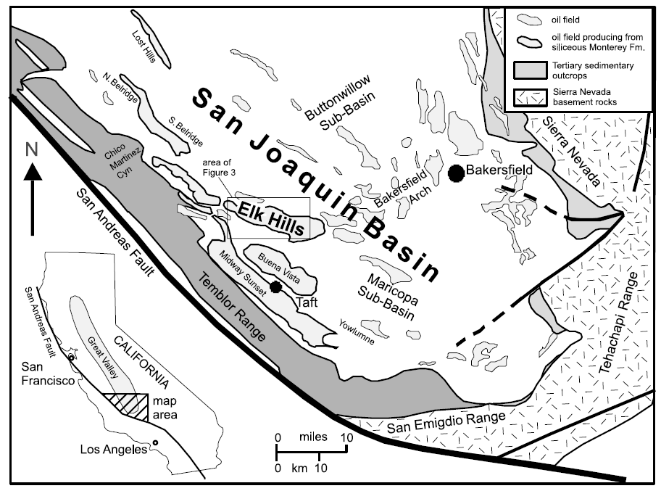
Reid and Mcintrye, 2001
Notes:
Locations with Wrench tectonism type Patterns
Reid and Mcintrye, 2001

Slide 14
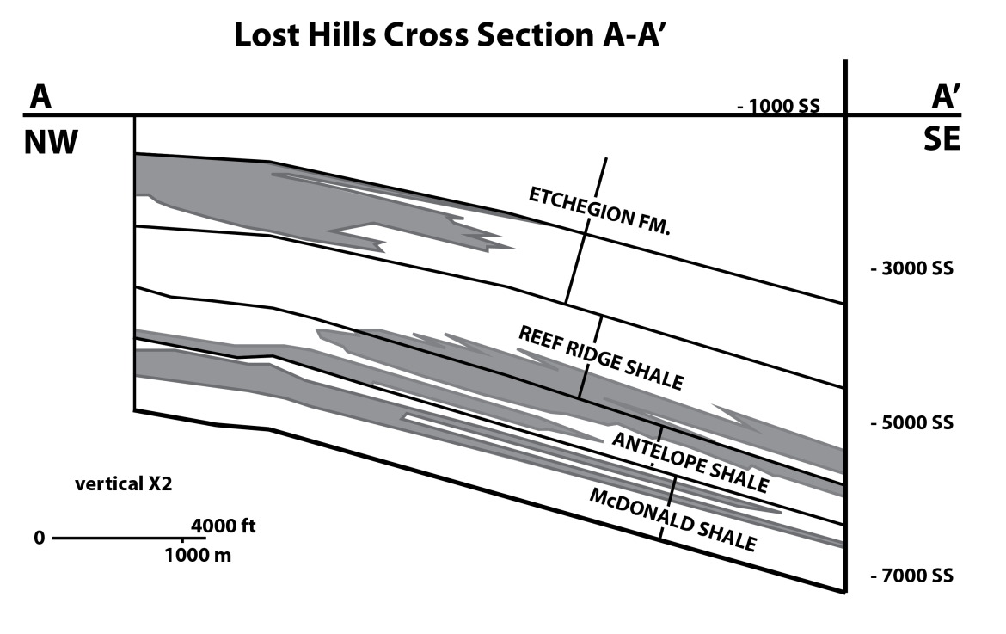
Updip Facies Variation
A
Porcelanite
Diatomaceous
Mudstone
A’
Reef Ridge Shale: Diatomaceous & siliceous mudstones lens (~36% clay) out updip to porcelanites (~2% clay)
Modified from McGuire et al., 1983

Slide 15
South Belridge
More highly siliceous?
Fan sedimentation and diatomaceous ooze accumulation
Schwartz, 1987
Notes:
What kind of patterns will be seen?

Slide 16
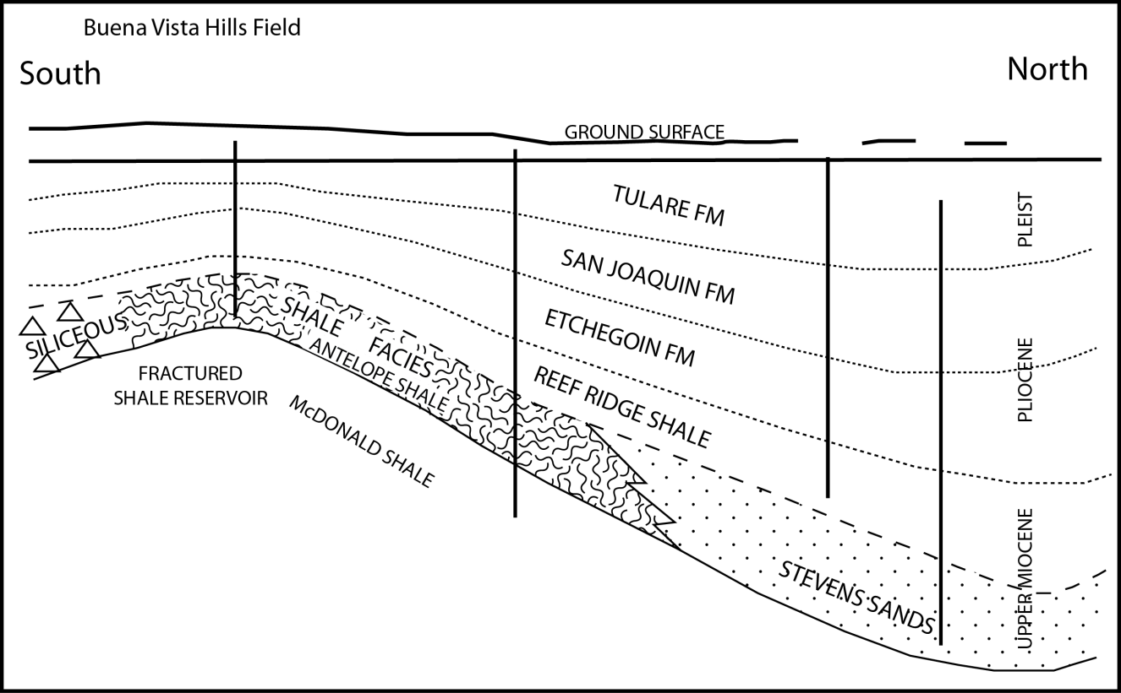
Buena Vista Hills
Basin-Margin Wedging: Low energy, sheet-like sandstone from turbidites encroach upon local bathymetric highs it forms wedge shape prisms with rapid sand loss.
Modified from MacPherson, 1978
Notes:
LH Model

Slide 17
Research Objectives
Document distribution patterns of detrital material vs. siliceous deposits and thicknesses
Detailed cross-section or map
Compare between different stages of basin evolution
Graham and Williams, 1985
Reid and Mcintrye, 2001
Notes:
Graham and Williams 1985

Slide 18
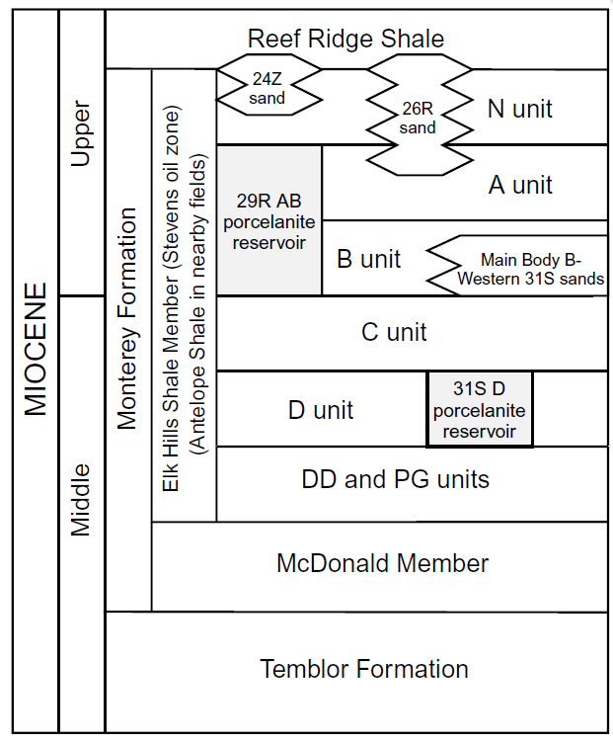
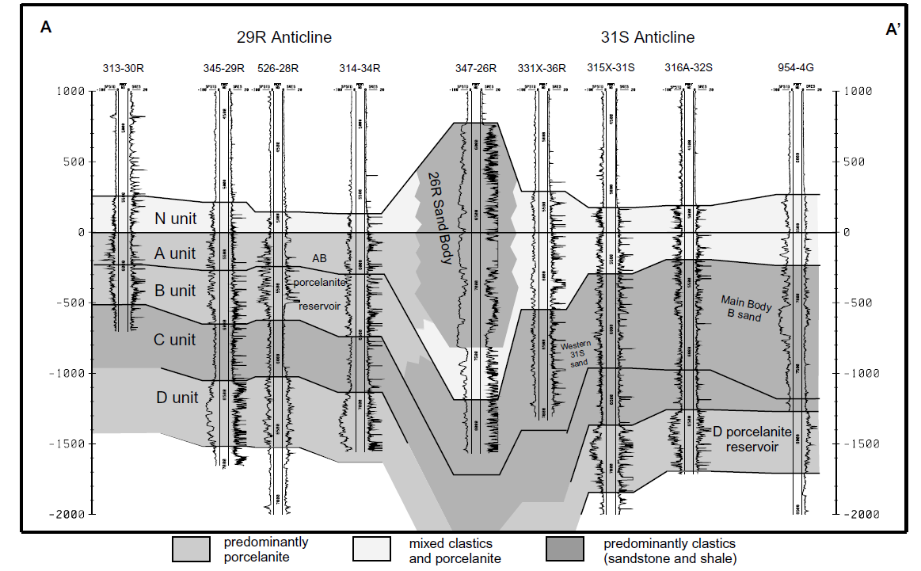
Potential Target Units
Antelope N Shale +/or Gould
Reid and Mcintrye, 2001
Notes:
Example of lateral changes within Antelope Shale

Slide 19
Project Requirements
Site Location:
Large enough area or x-section to see trends and patterns
Distribution and availability of modern wells logs
Possibly – 2 stages of basin evolution
Antelope Shale Member
Gould Member (enough penetrations?)
Quantitate Approach:
Petrophysical (Vclay/Vshale)?
Log type availability?
Composition verification (cuttings)?
DOGGR/MARS Afilliates?
Reid and Mcintrye, 2001

Slide 20
Thank You

Slide 21
References
Graham, S. A., and Williams, L. A., 1985, Tectonic, Depositional, and Diagenetic History of Monterey Formation (Miocene), Central San Joaquin Basin, California: American Association of Petroleum Geologists Bulletin, v. 69, p. 385-411.
Hornafius, J. S., 1991, Facies Analysis of the Monterey Formation in the Northern Santa Barbara Channel: American Association of Petroleum Geologists Bulletin, v. 75, p. 894-909.
MacPherson, B. A., 1978, Sedimentation and trapping mechanisms in upper Miocene Stevens and older turbidite fans of southeastern San Joaquin Valley: Am. Assoc. of Petroleum Geologist Bulletin, v. 62, p. 2243-2274.
McGuire, M. D., Bowersox, J. R., and Earnest, L. J, 1983, Diagenetically enhanced entrapment of hydrocarbons - Southeastern Lost Hills fractured shale pool, Kern County, California: Am. Assoc. of Petroleum Geologists Bulletin, v. ?, p. 171-183.
Moore, T. C., Heath, G. R., and Kowsman, R. O., 1973, Biogenic sediments of the Panama Basin: Journal of Geology, v. 81, p. 458-472.
Schwartz, D. E., 1987, Characterizing the Lithology, Petrophysical Properties, and Depositional Setting of the Belridge Diatomite, South Belridge Field, Kern County, California.

