Slide 1
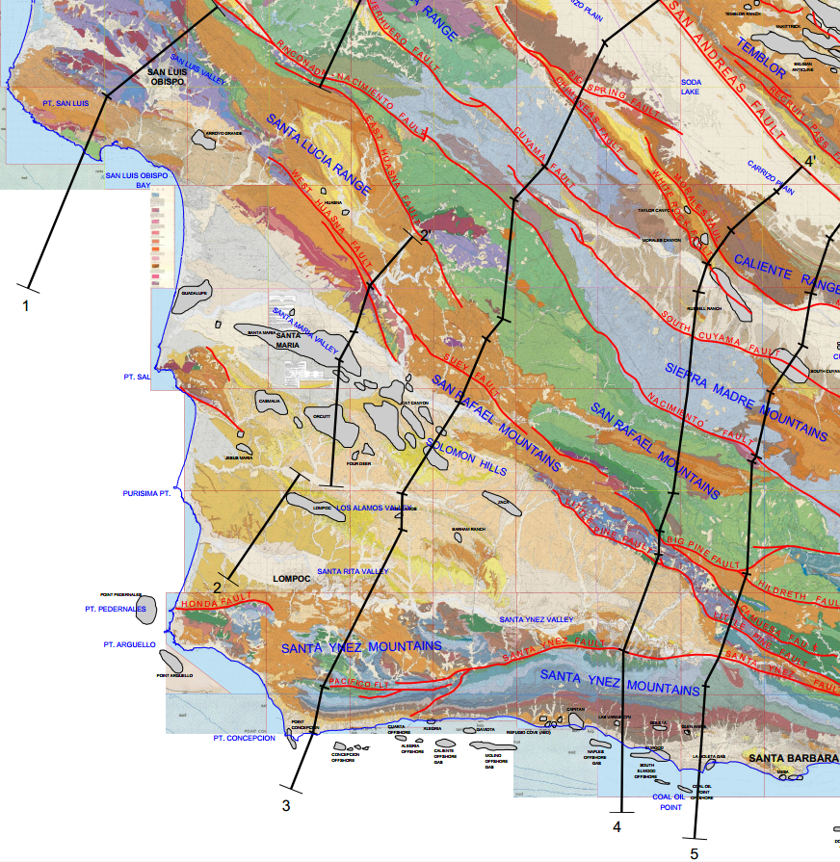
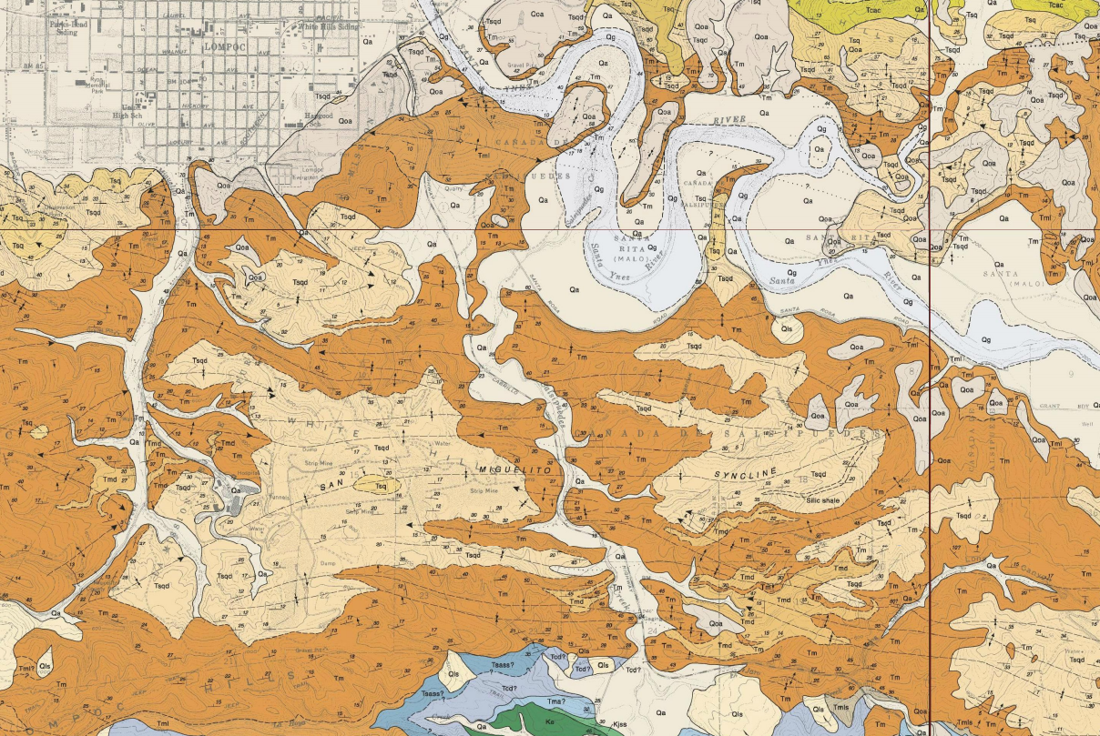
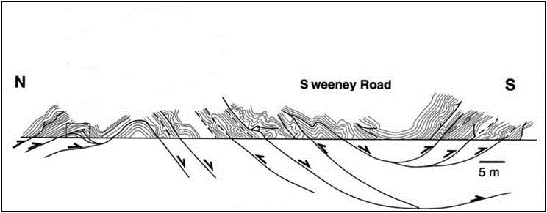
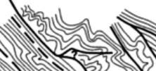
Comparison of Shortening at Different Scales Across the
Santa Maria Basin, California
Lompoc
Outcrop at Sweeney Road
16.8 %
shortening
Dibblee, 1988
Sweeney Road
After Namson & Davis and Dibblee, 1988
Gutiérrez-Alonso & Gross, 1997
Yannick Wirtz
10/17/2014
Monterey And Related Sediments - Fall Meeting, 2014

Slide 2
Topics
Geologic Setting and Tectonic History
Previous Work on Restoration of Fold and Thrust Belts
The Monterey and Sisquoc Formation
Hypotheses to Test
Methods

Slide 3
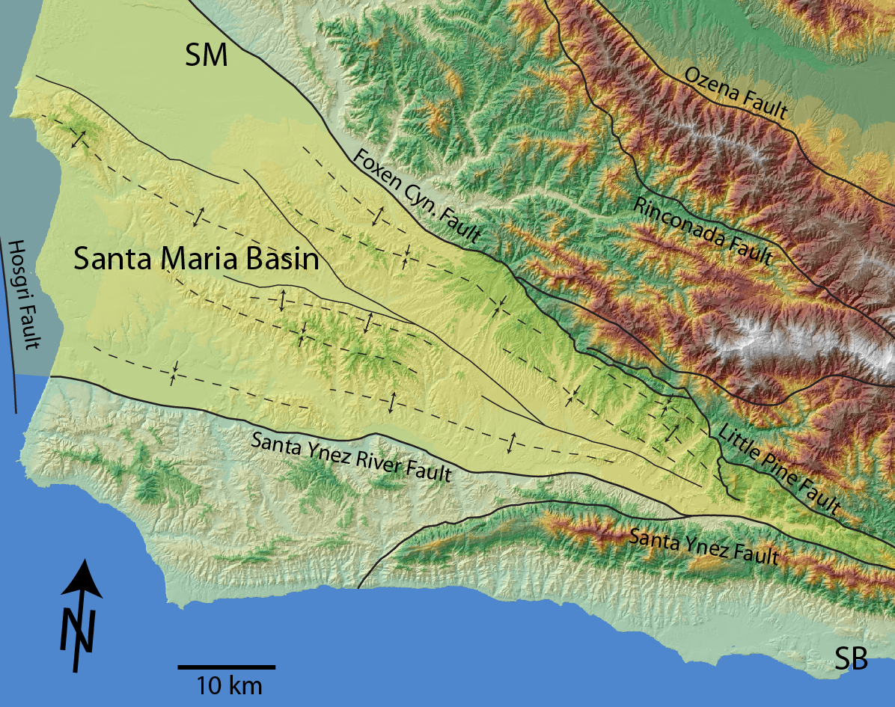
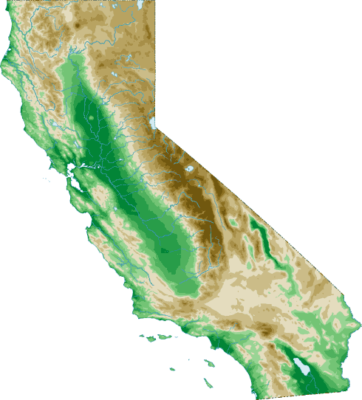
Geographic and Geological Setting
Santa Maria Valley
Orcutt Anticline
Cat Canyon Anticline
San Antonio -
Lompoc
Los Alamos
Purisima
Anticline
San Miguelito Syncline
Syncline
Tequepis Anticline
San Marcos Anticline
california-map.org
Modified after Onderdonk, 2007

Slide 4
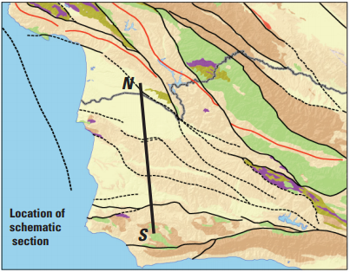
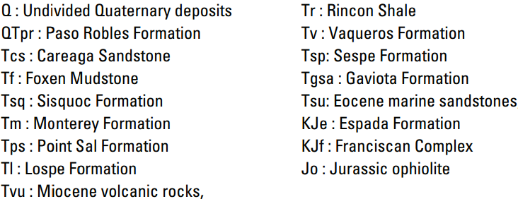
Stratigraphy
Sweetkind and Langenheim, 2010

Slide 5
Tectonic History
Wilson et al., 2005

Slide 6
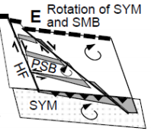
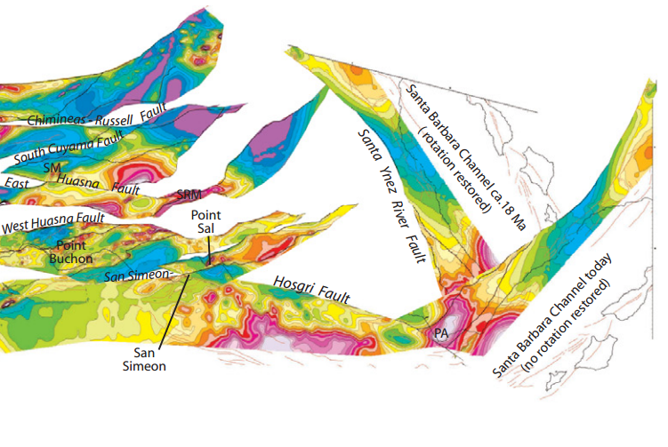
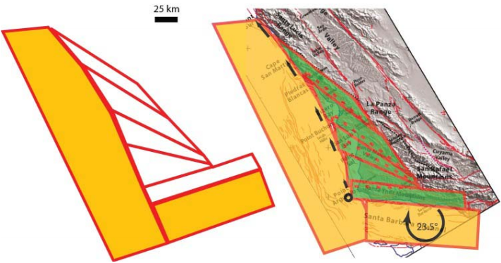
Deformation Models
Langenheim et al., 2013
Sorlien et al., 1999
Sorlien et al., 2014

Slide 7
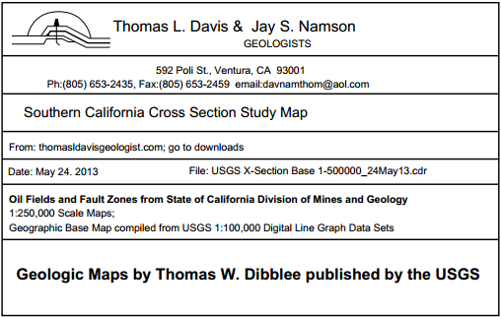
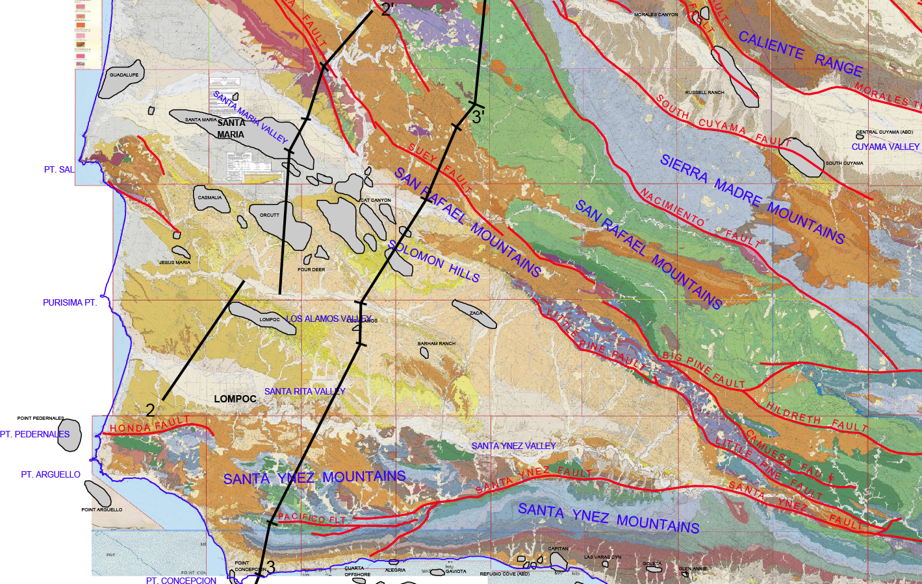
Quantification of Deformation

Slide 8
SMB Fold and Thrust Belt
2
2’
Namson & Davis, 1988
3
3’
Namson & Davis, 1988

Slide 9
Restoration
Total Shortening: 9.2km ~ 16.8 %
Namson & Davis, 1988
3
3’
Namson & Davis, 1988

Slide 10
Significance of Layer Internal Strain and
Structural Position
Mukul and Mitra, 1998 (Idaho-Utah-Wyoming fold and thrust belt)
Duebendorfer, 2002 (Ventura Basin, California)
Koyi et al., 2007 (Sand Box Models and Spanish Pyrenees)
44% bulk shortening
Koyi et al., 2007

Slide 11
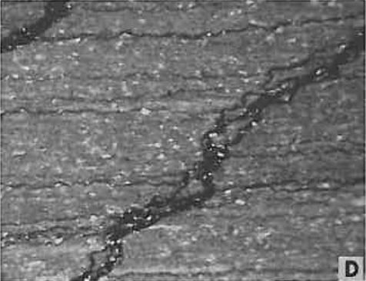
Pressure Solution
Detritus-rich opal-CT porcelanite
Snyder, 1983

Slide 12
Significance of Stiff Layers
Homogeneous
Rock Matrix
Stiff Layer
Stiff Layer Displays Internal Folds
Internal Penetrative Strain
Graphic after Frehner, 2014
Mukul and Mitra, 1998
Duebendorfer, 2002
Koyi et al., 2007
Thomas, 2007
Frehner, 2014

Slide 13
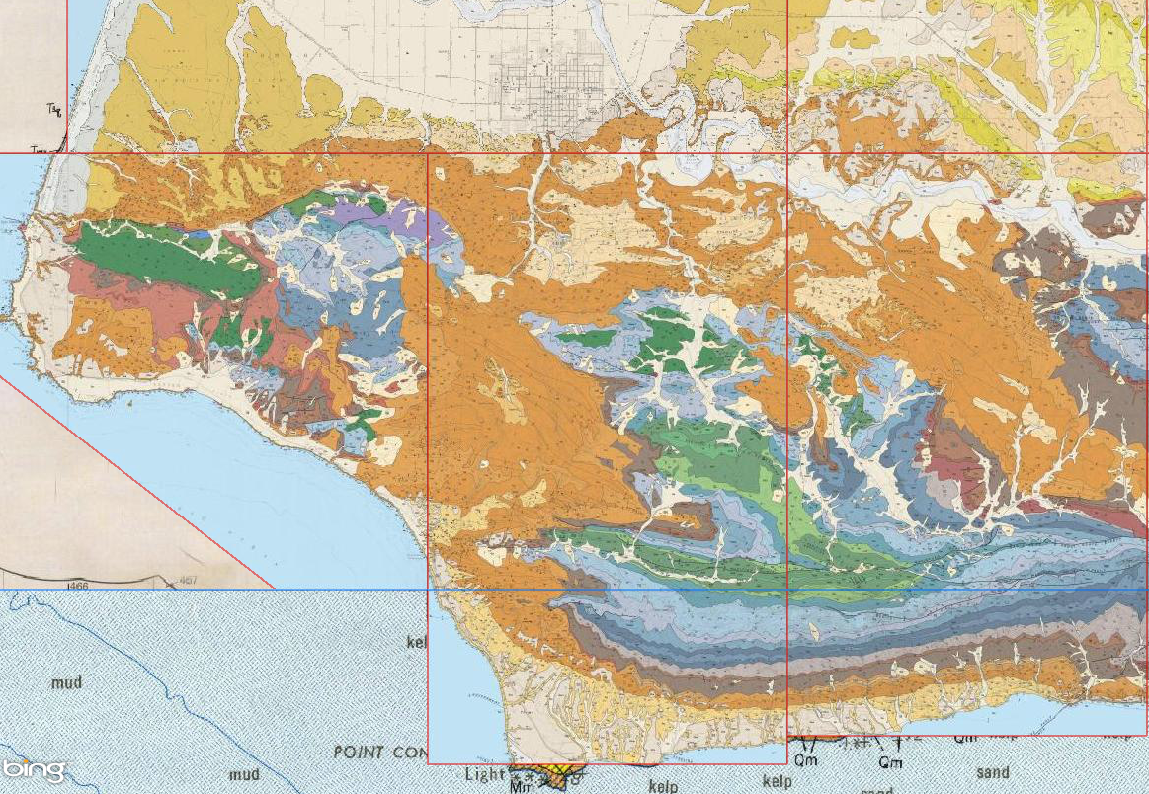
Monterey and Sisquoc Exposures
Lompoc
Lompoc
Outcrop at Sweeney Road
Outcrop at San Miguelito Canyon
Dibblee, 1988
Dibblee, 1988

Slide 14
Depositional Stages
McCrory, 1995
Gutiérrez-Alonso and Gross, 1997

Slide 15
Deformational Stages
McCrory, 1995
Gutiérrez-Alonso and Gross, 1997

Slide 16
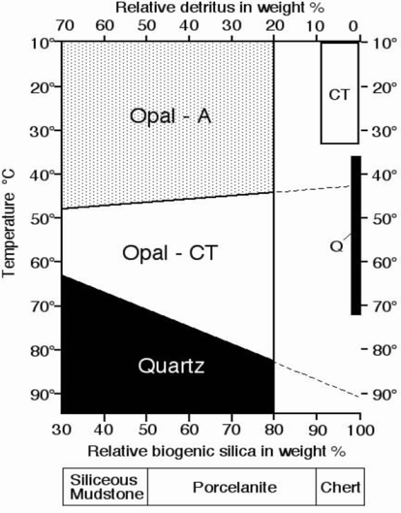
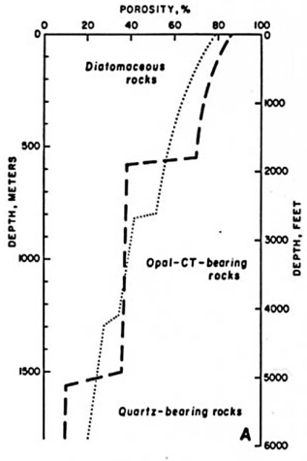
Silica Diagenesis
Silica Phase Changes
Stepped Changes in Porosity with Depth
Behl and Garrison, 1994
Isaacs, 1981

Slide 17
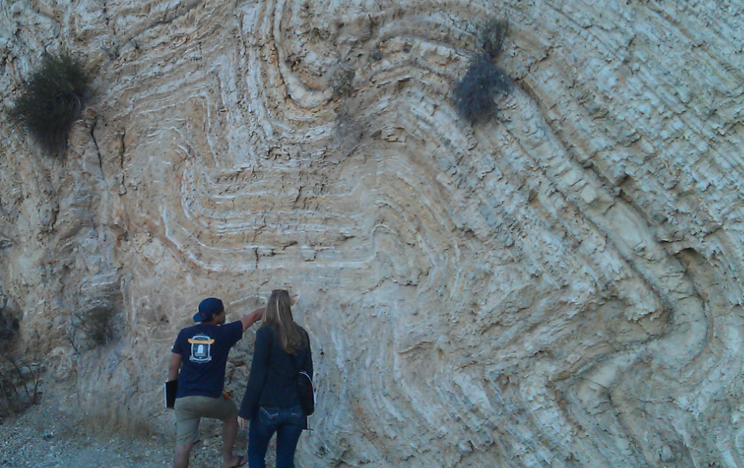
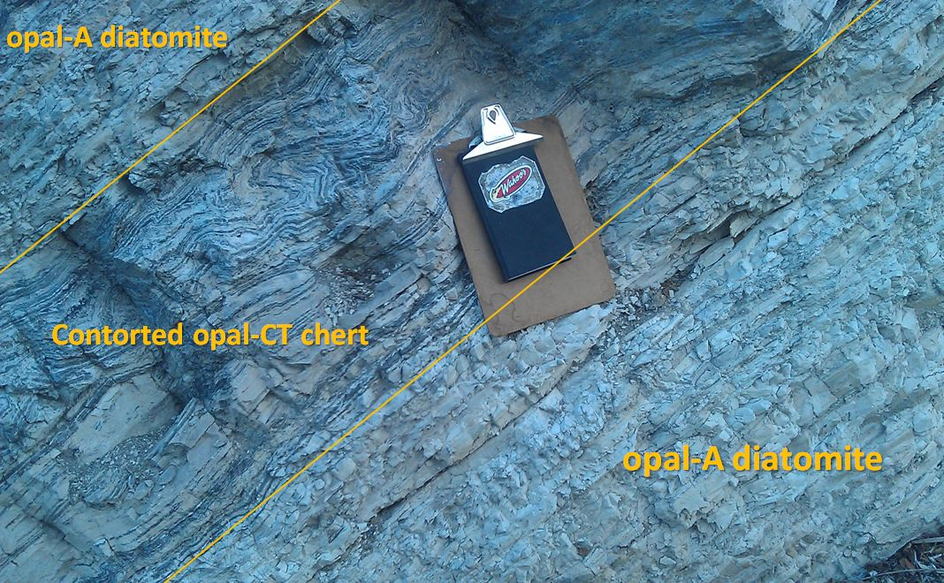
Variety of Deformational Styles
Snyder et al., 1983
Gutiérrez-Alonso and Gross, 1997
Behl and Garrison, 1994
Outcrop at Sweeney Road
Lompoc
Outcrop at San Miguelito Canyon
Dibblee, 1988
San Miguelito Canyon near Lompoc
Sweeney Road near Lompoc
Layer Parallel Compaction
Deposition
Diagenesis
Tectonics

Slide 18
Questions to Address
How is shortening in the Santa Maria Basin ... ?
Accommodated
Recorded
Distributed

Slide 19
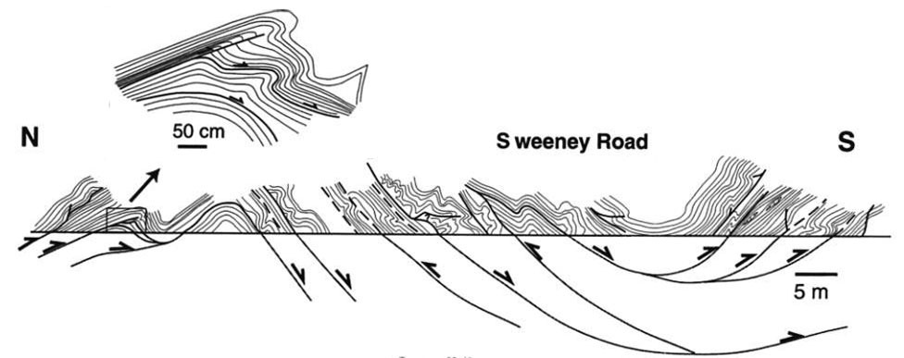
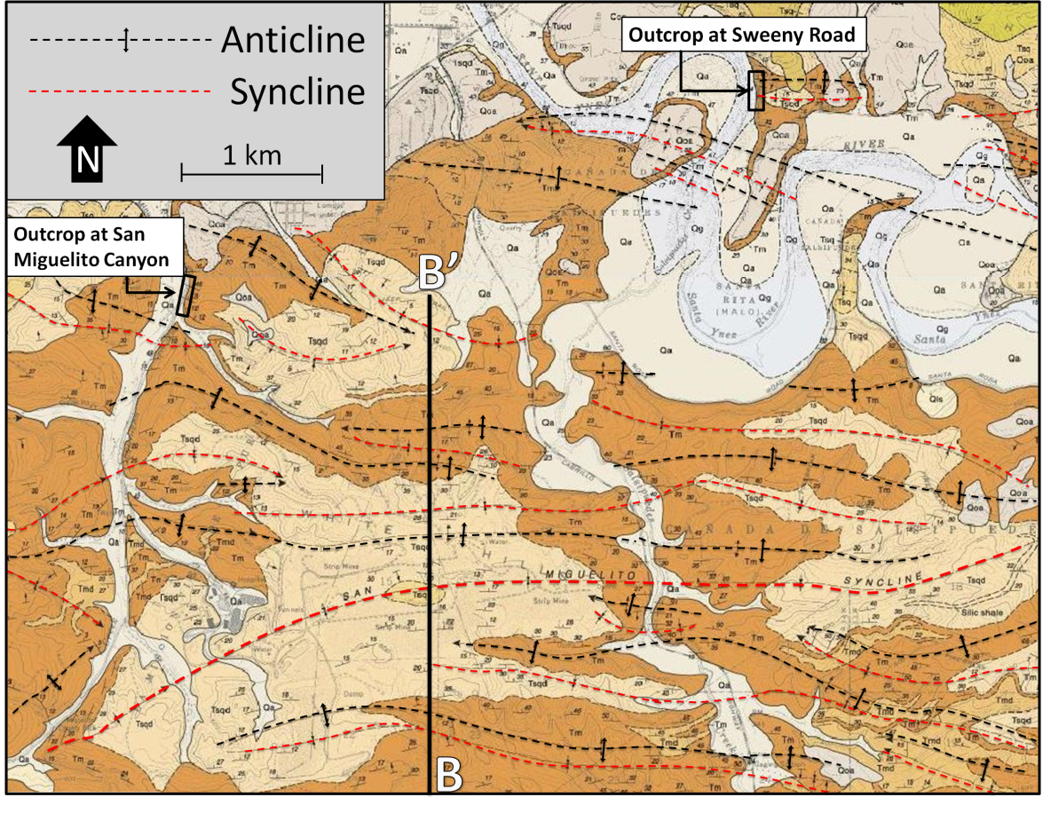
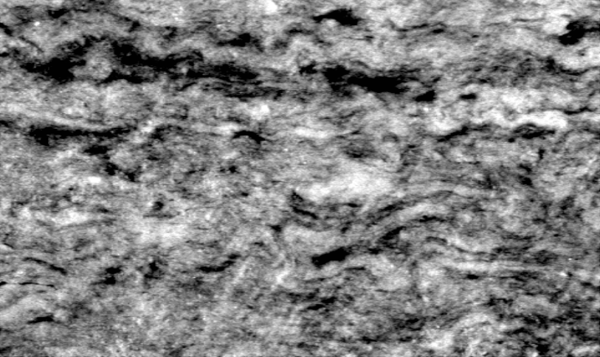
Hypothesis I
There is a significant amount of shortening that is additive to larger models
Namson & Davis, 1988
16.8 % shortening
+
Map-Scale
Outcrop-Scale
Gutiérrez-Alonso & Gross, 1997
Behl, 1992
Micro-Scale
5 mm
Dibblee, 1988

Slide 20
Hypothesis II
Outcrop structures differ in style and amount of deformation depending on map-scale synclinal and anticlinal wavelengths, diagenetic state, and structural position.
Style and amount of deformation at outcrop-scale is spatially variable and does not necessarily represent the overall regional strain.
Gutiérrez-Alonso & Gross, 1997
Gutiérrez-Alonso & Gross, 1997
Dibblee, 1988

Slide 21
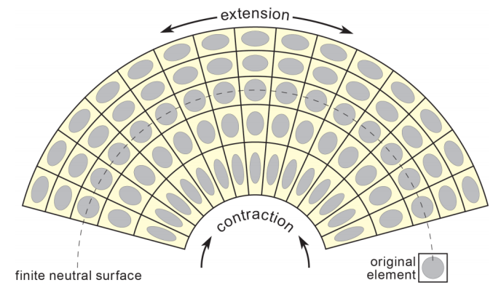
Hypothesis III
Extensive folding or faulting at outcrop-scale would reflect the geometric position in an anticline
This can be of different degree at different structural locations
Frehner, 2011

Slide 22
Map-Scale Analysis
Dibblee, 1988

Slide 23
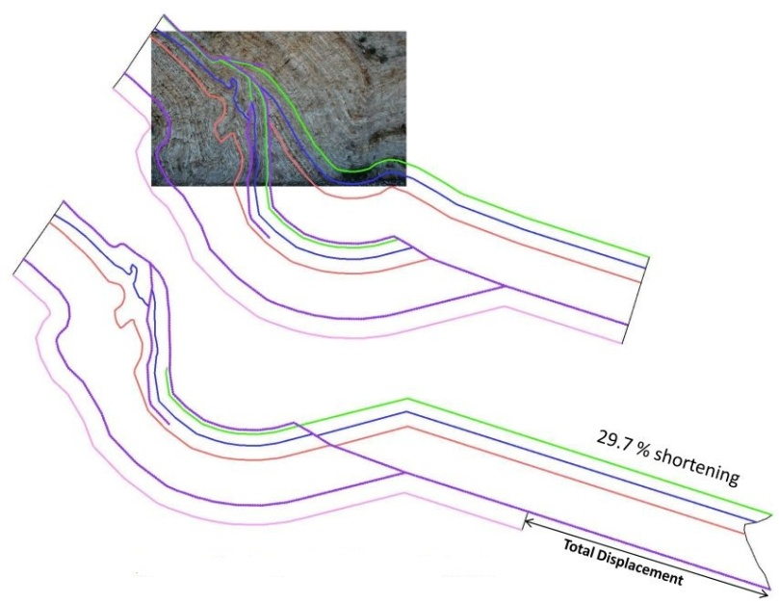
Outcrop-Scale Analysis
Sweeney Road
Gutiérrez-Alonso & Gross, 1997
Dibblee, 1988
Interpretation by Stefano Mazzoni

Slide 24
References
Behl, R.J., 1992, Chertification in the Monterey Formation of California and deep- sea sediments of the west Pacific: University of California, Santa Cruz, 313 p
Behl, R.J., and Garrison, R.E., 1994, The Origin of Chert in the Monterey Formation of California (USA): Siliceous, Phosphatic and Glauconitic Sediments of the Tertiary and Mesozoic,, p. 101–132
Dibblee, T.W., 1988, Geologic Map of the Lompoc Hills and Point Conception, Lompoc and Surf, Los Alamos, Point Arguello and Tranquillon Mountain, Santa Rosa Hills and Sacate Quadrangles, Santa Barbara County, California: Dibblee Geological Foundation
Duebendorfer, E., 2002, Penetrative strain at shallow crustal levels: The role of pressure solution in accommodating regional shortening strain, Ventura basin, western Transverse Ranges, California: Geological Society of America Special Papers
Frehner M., 2011, The neutral lines in buckle folds, Journal of Structural Geology 33, 1501-1508
Gutiérrez-Alonso, G., and Gross, M.R., 1997, Geometry of inverted faults and related folds in the Monterey formation: implications for the structural evolution of the southern Santa Maria basin, California: Journal of Structural Geology
Isaacs, C.M., 1981, Porosity Reduction During Diagenesis of the Monterey Formation, Santa Barbara Coastal Area, California: , p. 257–271.
Koyi, H.A. et al., 2007, The Significance of Penetrative Strain in the Restoration of Shortened Layers - Insights from Sand Models and the Spanish Pyrenees: Thrust tectonics and hydrocarbon systems: AAPG Memoir, v. 82
Mukul, M., and Mitra, G., 1998, Finite strain and strain variation analysis in the Sheeprock Thrust Sheet: an internal thrust sheet in the Provo salient of the Sevier Fold-and-Thrust belt, Central Utah: Journal of Structural Geology
Namson, J., and Davis, T.L., 1990, Late Cenozoic Fold and Thrust Belt of the Southern Coast Ranges and Santa Maria Basin, California: AAPG Bulletin, v. 74, p. 467–492.
Namson, J., and Davis, T.L., 1988, Structural transect of the western Transverse Ranges, California: Implications for lithospheric kinematics and seismic risk evaluation
Snyder, W.S., Brueckner, H.K., and Schweickert, R.A., 1983, Deformational Styles in the Monterey Formation and Other Siliceous Sedimentary Rocks: , p. 151–170.
Snyder, W.S., 1987, Structure of the Monterey Formation: stratigraphic, diagenetic, and tectonic influences on style and timing. In: Cenozoic Basin Development of Coastal California: Rubey Volume VI (Eds R.V. Ingersoll and W.E. Ernst), pp. 321–347. Prentice-Hall, Englewood Cliffs.
Thomas, W.A., 2007, Balancing tectonic shortening in contrasting deformation styles through a mechanically heterogeneous stratigraphic succession: Geological Society of America Special Papers

