Slide 1
Diagenetic and Compositional Controls of Wettability in Siliceous Sedimentary Rocks, Monterey Formation, California
Kristina Hill
MARS Project
CSULB 2014
Committee:
Dr. Richard J. Behl
Dr. Matthew Becker
Dr. Hilario Camacho

Slide 2
Overview
Introduction
Review of Wettability
Importance of Project
Experiment Objective
Methods
Results
Preliminary Discussion

Slide 3
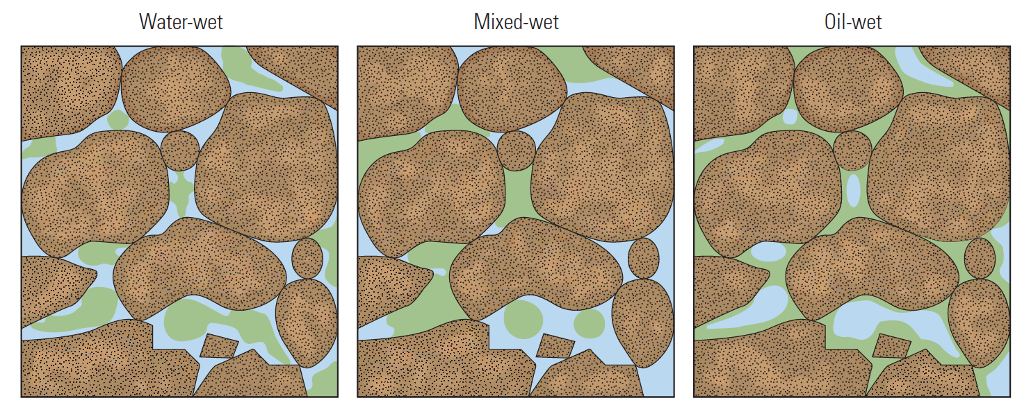
Introduction
Wettability is …
The relative affinity between a surface and a fluid.
And is affected by
temperature
fluid chemistry
rock mineralogy
Secondary constituents
(Abdullah, et al., 2007, top & bottom)
Notes:
Figure 1. Contact angle. An oil drop (green) surrounded by water (blue) on a water-wet surface (left) forms a bead. The contact angle θ is approximately zero. On an oil-wet surface (right), the drop spreads, resulting in a contact angle of about 180°. An intermediate-wet surface (center) also forms a bead, but the contact angle comes from a force balance among the interfacial tension terms, which are γ_{so} and γ_{sw} for the surface-oil and surface-water terms, respectively, and γ_{ow} for the oil-water term. (Abdullah, et al., 2007)
Wettability is …
The relative affinity between a surface and a fluid.
demonstrated in a fluids propensity to spread or bead on a surface
the product of the hydrostatic intermolecular interactions between the rocks and a fluid phase (Hirasaki, 1991, as cited in Civan, 2004)
Wettability affects
location, flow and fluid distribution in a reservoir (Karabakal and Bagci, 2003).
And is affected by
temperature
fluid chemistry
rock mineralogy
Secondary, or non-matrix rock constituents (clay, carbonate, clastics, etc.)
Wettability in the Monterey Formation must be better understood in order to produce at maximum potential

Slide 4
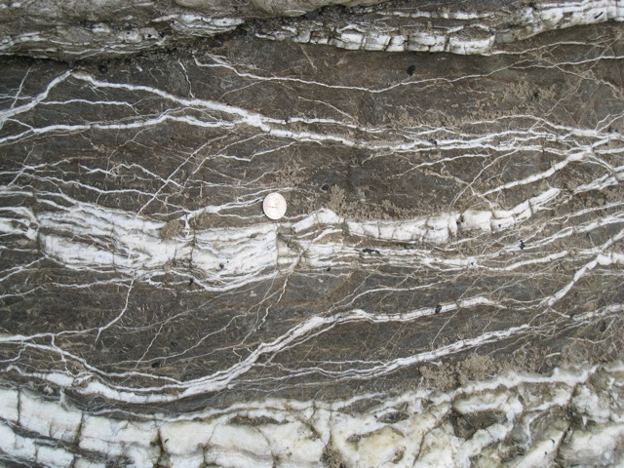
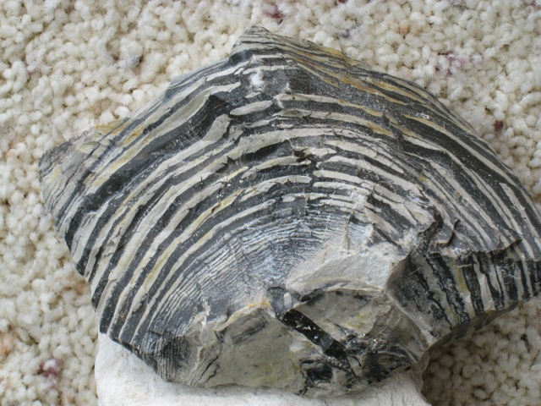
Introduction
Importance of project
Extensive reserves in Monterey
Still highly underdeveloped
Low porosity and permeability (quartz and opal-CT phase)
high surface area to volume ratio of reservoir fluids
More interaction between fluid and rock surface
Silica diagenesis expels water from crystal structure
may impact hydrocarbon distribution
Notes:
The Monterey is currently estimated to hold 64%, or 15.42 billion barrels of recoverable shale oil in the U.S. (Intek, 2011). (Need to update this data – now considered untrustworthy)

Slide 5
Objective
Identify and quantify alteration in wettability of siliceous rocks due to silica diagenesis
Characterize and Quantify alteration in siliceous rock wettability due to abundance of detritus

Slide 6
Methods
Approach
Goals
Measure wettability on actual reservoir samples of each silica phase; opal-A, opal-CT and quartz
Eliminate permeability and porosity geometry differences between phases as variables
Eliminate reservoir fluid chemistry as a variable
Limitations:
Ultra low permeability opal-CT and quartz phase porcelanites and cherts
Porous core samples

Slide 7
Methods
Wettability Measurements
Oil/Water Imbibition Rate
Contact Angle
Rock Composition
XRD/Elemental Analysis
FTIR
Characterize & Quantify Variable Correlations
Data trends
Multivariate Statistics

Slide 8
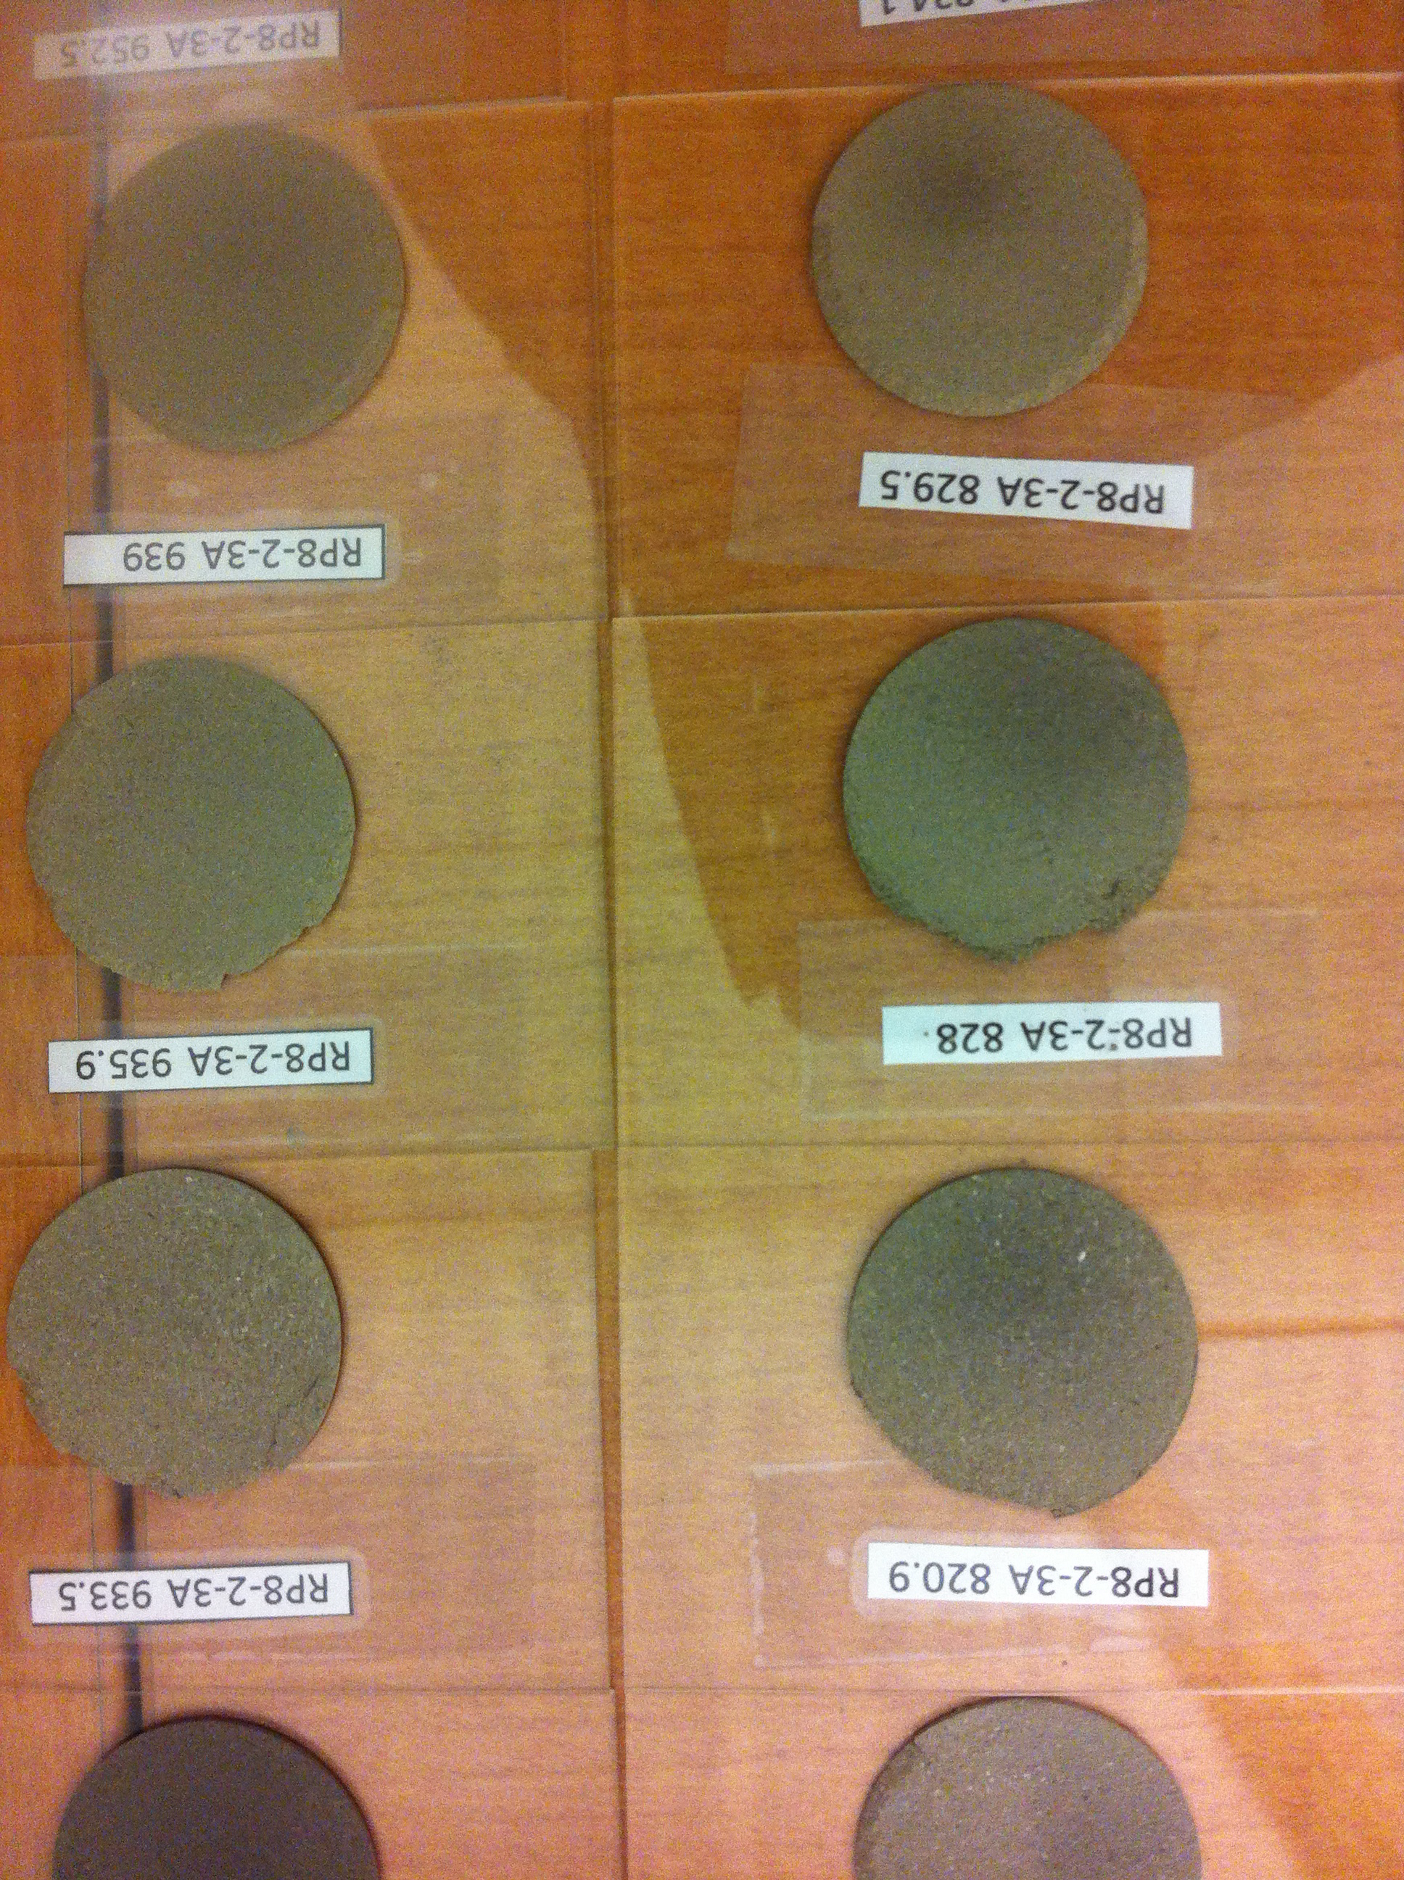
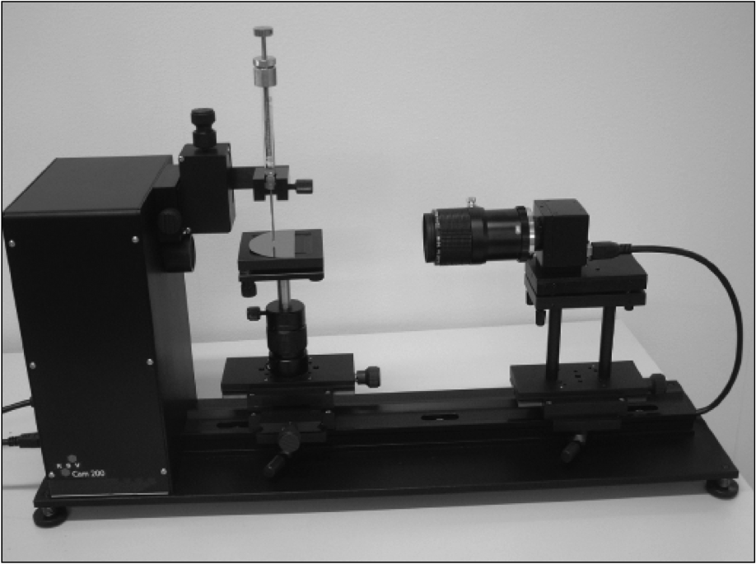
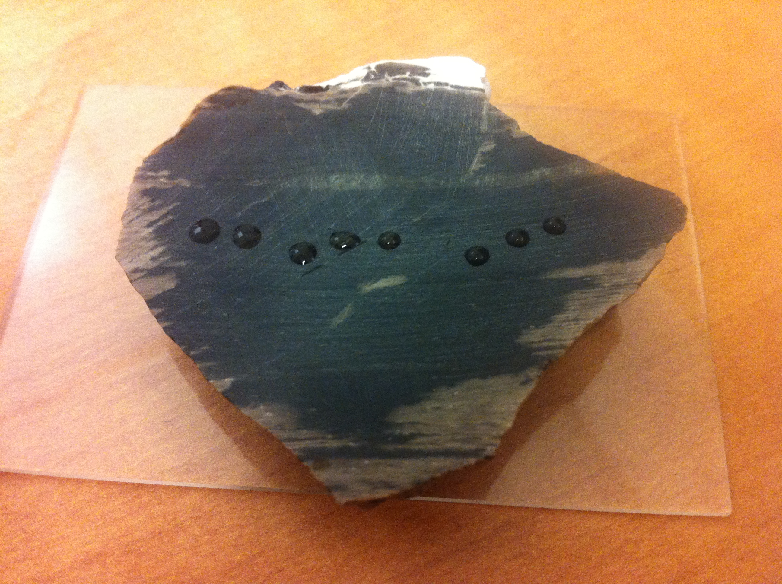
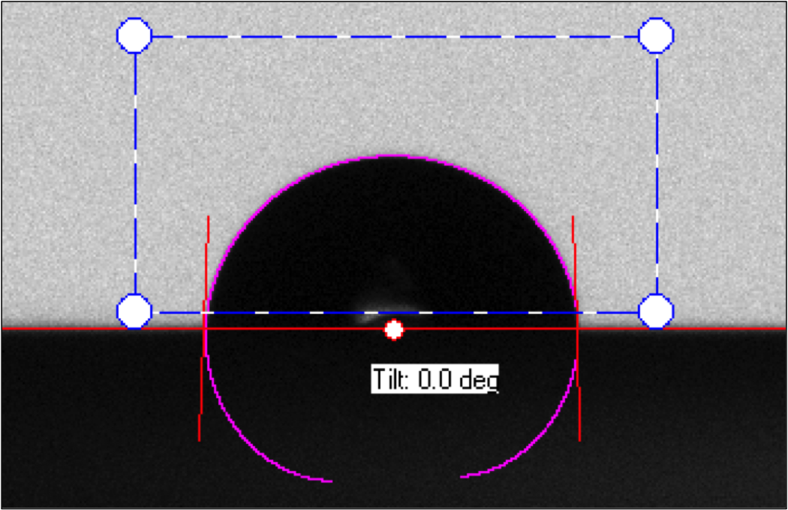
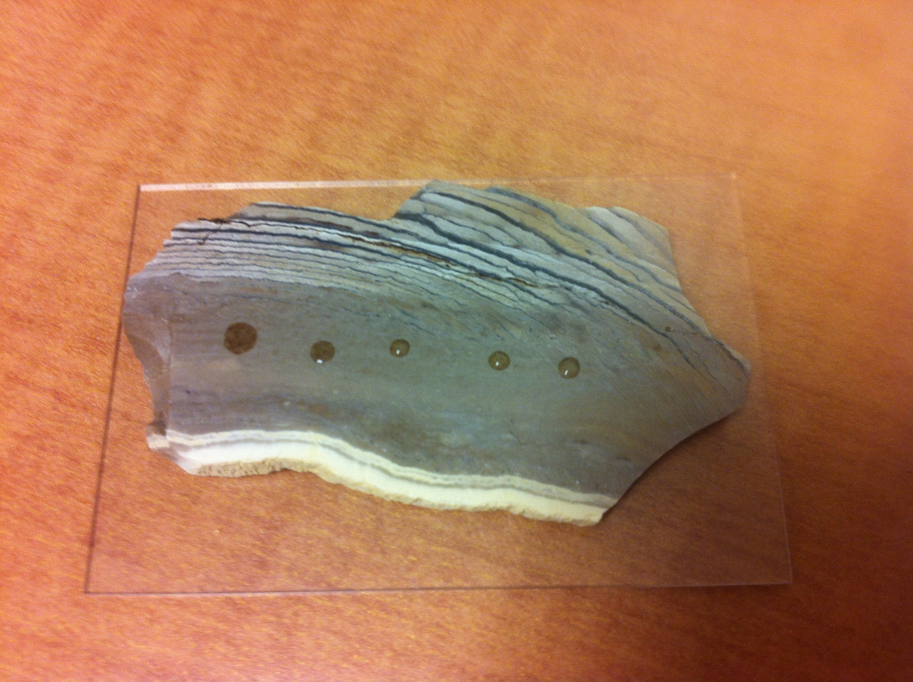
Methods
Imbibition Tests
Distilled H₂O
Castrol HD40
69 Core Samples
Controls:
Sample density (wt, size & compaction)
Fluid drop size
Contact Angle Tests
Distilled H₂O
Castrol HD40
6 Chert samples (opal CT & quartz)
3 non-biogenic mineral samples
one from each phase

Slide 9
Results
Data Collected:
Contact Angle Measurements
Imbibition Tests
XRD
Elemental Analysis
Basic Trend Analysis
Silica phase vs. wettability
% Detritus vs. wettability

Slide 10
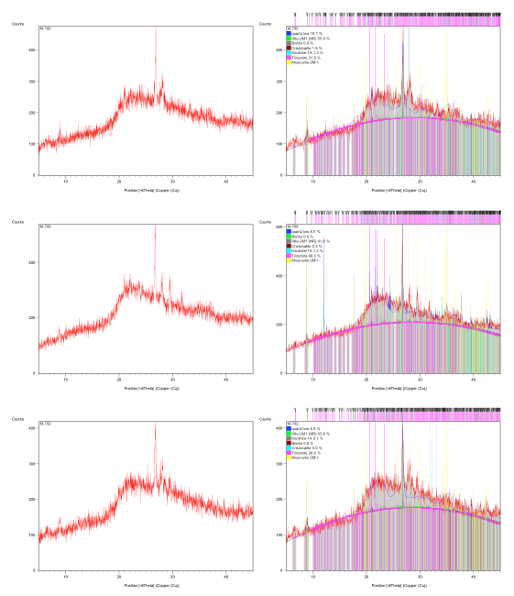
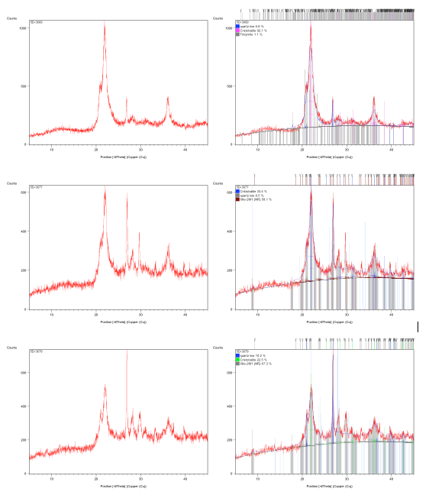
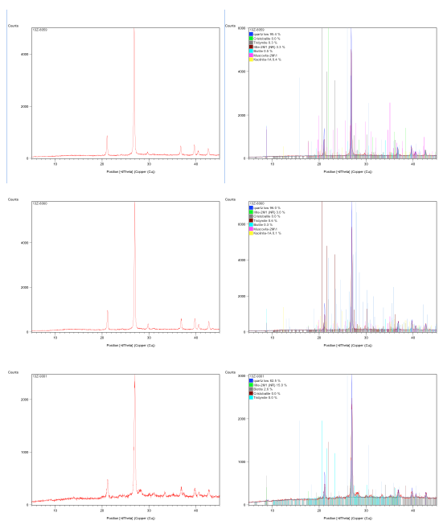
Results - XRD

Slide 11
Results – Elemental Analysis
OXIDES
ELEMENTAL ABUNDANCES
By ActLabs
Notes:
78 Samples

Slide 12
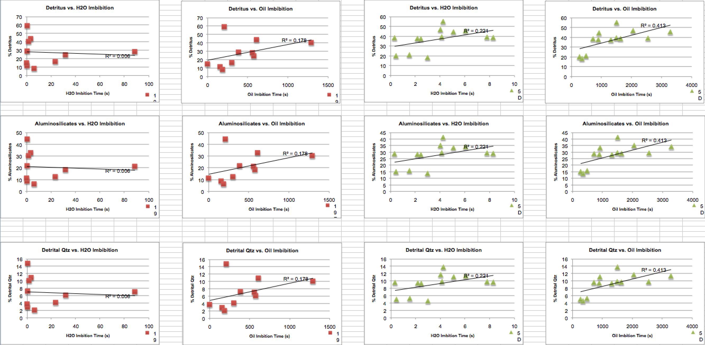
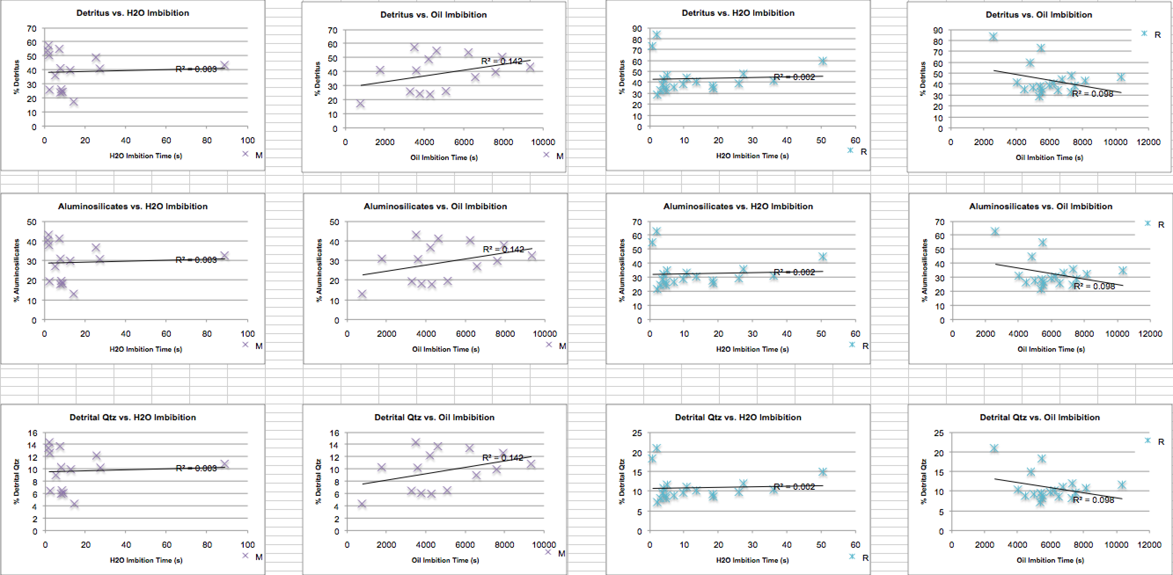
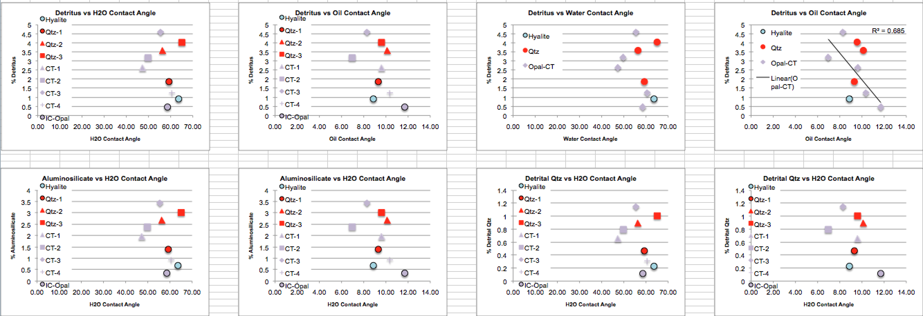
Results – Elemental Analysis vs Imbibition Rates & Contact Angles

Slide 13
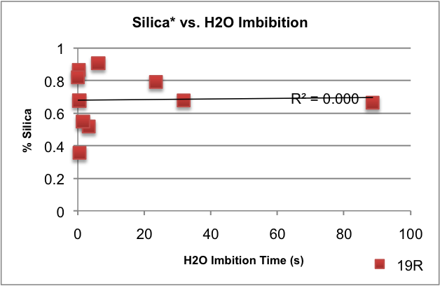
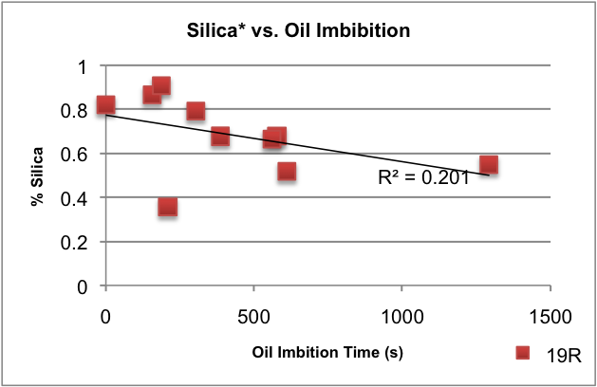
Results – Quartz Trends
Weak Water trends
Stronger Oil Trends
Notes:
*Silica is calculated from Isaac’s (1980) dissertation, where
Si = SiO₂ – (3.5*Al₂O₃) to distinguish biogenic & diagenetic silica from detrital quartz
This value is then normalized by dividing the bio & dia silica by the total combined bio & dia silica and detritus (also calculated from Isaac’s equation, Detritus = 5.6*Al₂O₃)

Slide 14
Silica Phase vs. Oil Contact Angle
Notes:
Maybe Qtz has the opposite trend as CT?

Slide 15
Future Work
FTIR
Quantify the ratio of biogenic & diagenetic silica to detritus
Multivariate Analysis
Characterize & quantify relationships between wettability and other compositional variables

Slide 16
Special Thanks to:
Occidental Petroleum and Aera Energy for core sample donation
Dr. Varenka Lorenzi and staff of the IIRMES Lab at CSULB for Soxhlet extraction materials, instruction & supervision
Dr. Young Shon, CSULB Chemistry Dept., for CAM-101 Tensiometer use

Slide 17
References
F. Civan, Temperature dependence of wettability related rock properties correlated by the Arrhenius equation, Petrophysics (Houston, Tex.), August 2004, 45(4):350-362
U. Karabakal and S. Bagci, Determination of wettability and its effect on waterflood performance in limestone medium, Energy & Fuels, April 2004, 18(2):438-449
Isaacs, Caroline M., 1980,Diagenesis in the Monterey Formation examined laterally along the coast near Santa Barbara, California, USGS Open-File Report: 80-606

