Slide 1
3D Subsurface Model of Monterey-Related Sediments and the Syntectonic Distribution of Clastic and Biogenic Facies, Offshore Santa Maria Basin, California by Nelson Doris
PSAAPG Conference, 4/28/14
Thesis Committee Chair:
Richard Behl, Department of Geological Sciences, California State University, Long Beach, CA 90840
Thesis Committee Advisors:
Nate Onderdonk, Department of Geological Sciences, California State University, Long Beach, CA 90840
Christopher C. Sorlien, Earth Research Institute, University of California, Santa Barbara, CA 93106

Slide 2
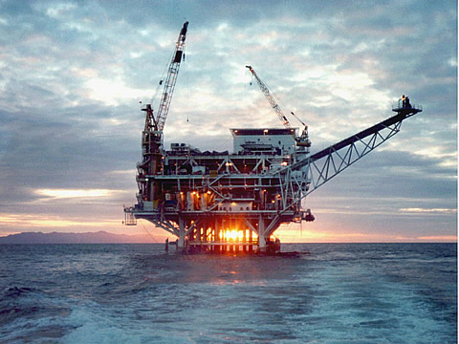
Overview
Introduction
Objective
Geology and History
Dataset
Structural and Thickness Maps
Future Work
Platform Irene, Point Pedernales Unit, Offshore Santa Maria

Slide 3
Objective
Study the distribution of Monterey sediments on a basin scale
Create subsurface maps of Monterey thickness and chert abundance using seismic and well log data
Formulate a mechanism that can account for the observed variability of biosiliceous facies
Create a predictive tool for estimating the biosiliceous abundance prior to drilling

Slide 4
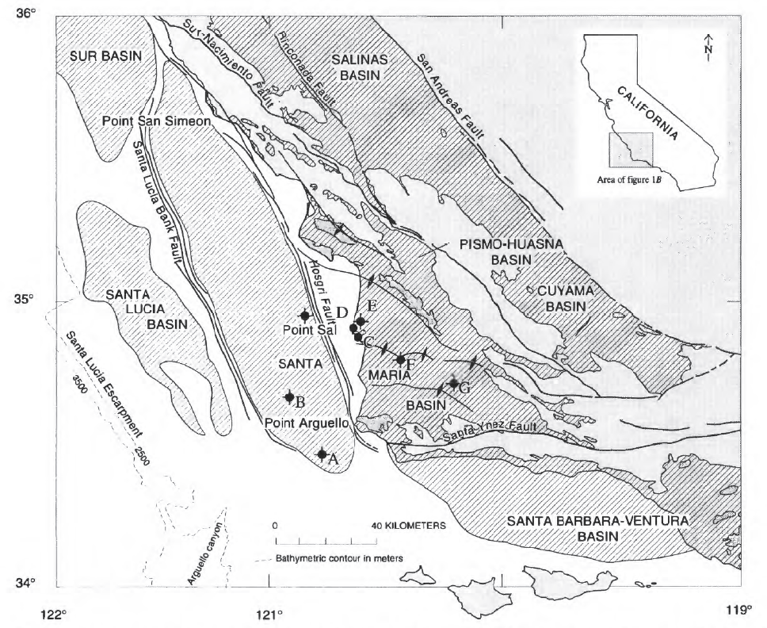
Offshore Santa Maria Basin
McCrory et al., USGS, 1995

Slide 5
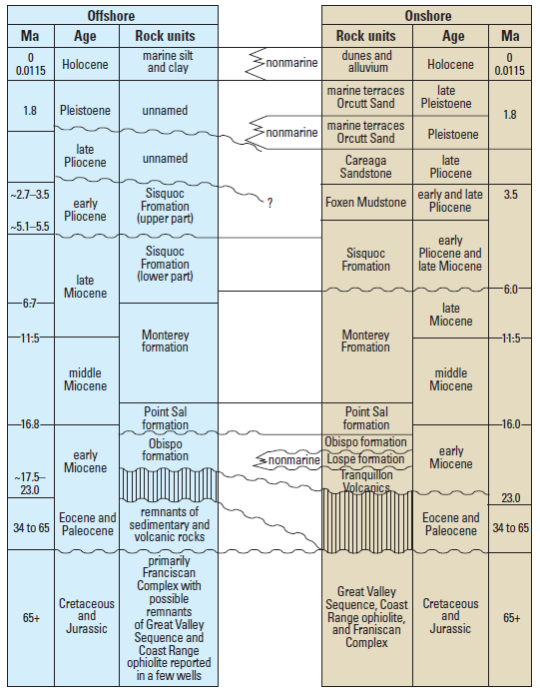
Generalized Stratigraphy and
Correlation to Onshore SMB
The Monterey is conformably overlain by the Sisquoc Formation consisting of massive to weakly laminated biosiliceous rocks, siltstone and sandstone.
The Mid-upper Miocene Monterey Formation consists of massive to well laminated biosiliceous and calcareous strata representing an extended period of bathyal sedimentation.
Lower-mid Miocene Point Sal Formation composed of calcareous marine mudstone interbedded with dolostone and sandstone.
Cretaceous and Jurassic Basement unconformably overlain by volcanic assemblages.
Willingham et al., USGS, 2013

Slide 6
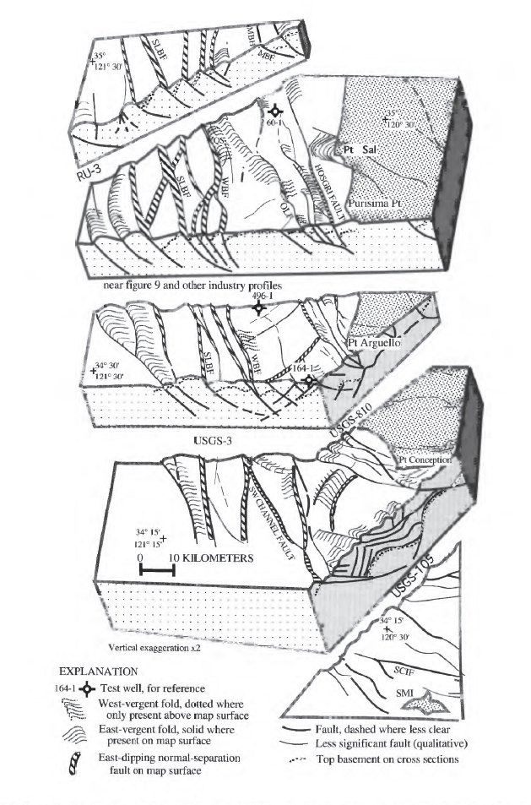
Miocene Structural Block Model
Rapid subsidence and continual displacement on Miocene normal faults created abundant accommodation space.
The tilted basement fault blocks created a highly variable basin bathymetry during Monterey deposition.
  Several en echelon N-S trending paleo-highs
Post-Miocene compression caused folding, faulting, and fracturing of Miocene deposits.
  Some Miocene sub-basins have been completely inverted.
Sorlien et al., USGS, 1999

Slide 7
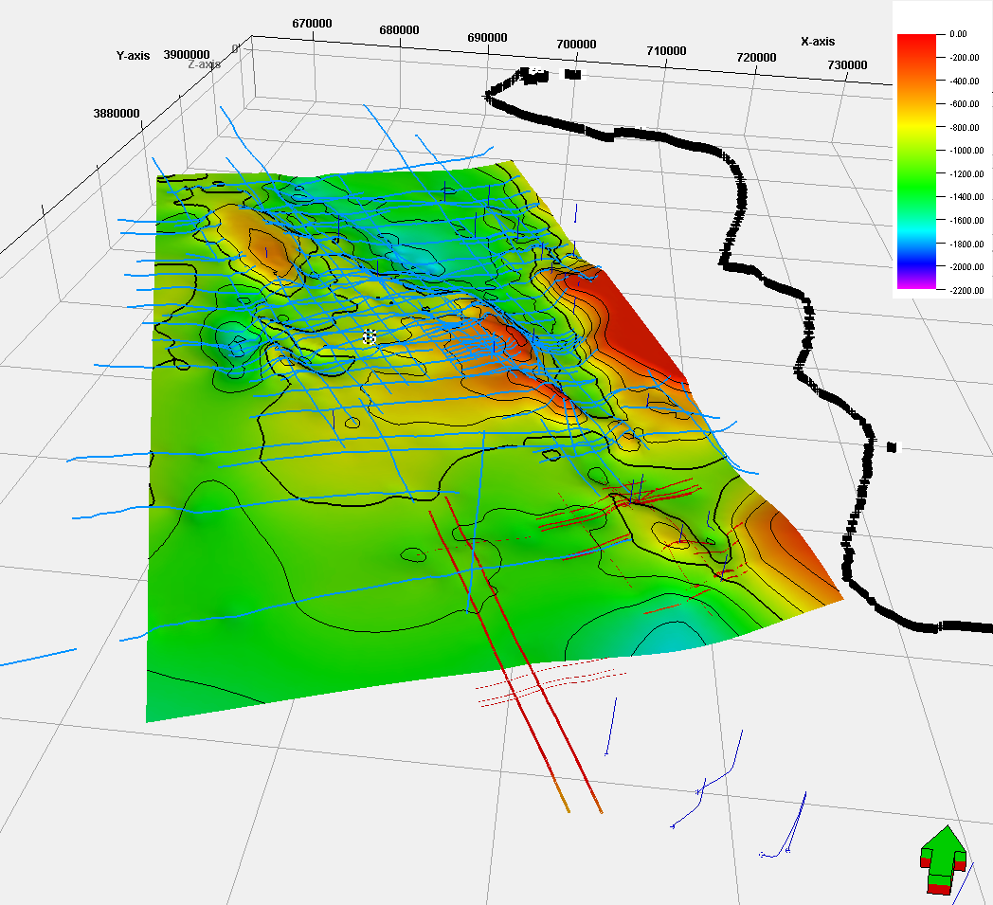
Project Area
Top Sisquoc
Time, 5x vert. exag.
Pt. Sal
Plentiful 2D and 3D seismic.
22 exploration wells within project boundary.
  E-logs
  Mudlogs
  Checkshots
63km
Pt. Arguello
32km

Slide 8
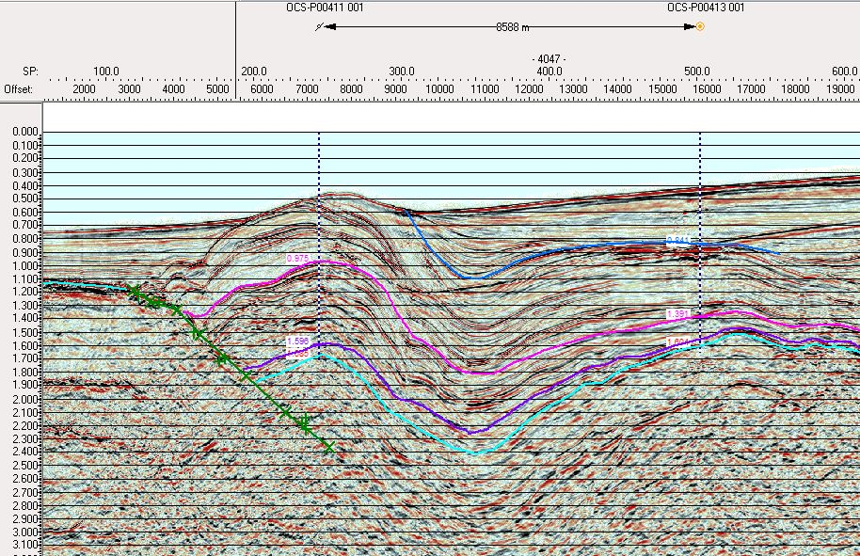
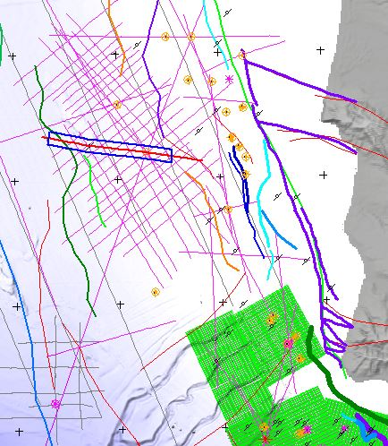
2D Seismic Interpretation
A
A’
Pt. Sal
A
A’
Hosgri flt.
Sisquoc
Monterey
Volcanic
Franciscan

Slide 9
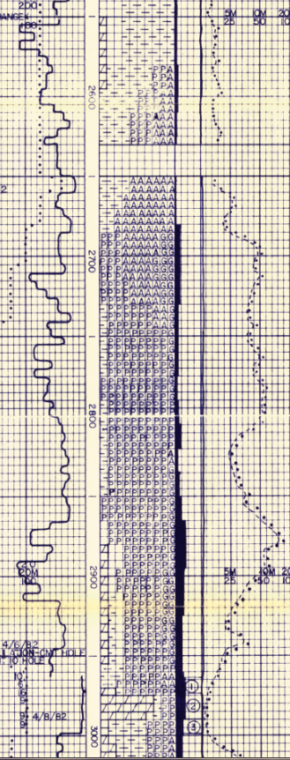
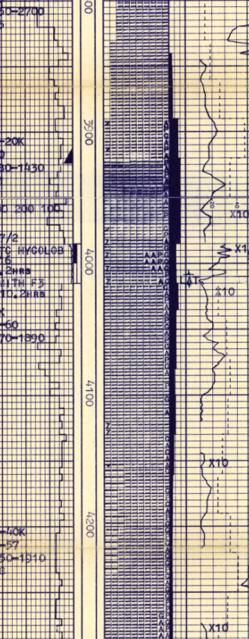
Chert Shows
SW
OCS-P00411_001
OCS-P00413_001
NE
Top Monterey,
~8.5km apart
20’ of 40% chert, abundant clastics
200’ of 90-100% chert

Slide 10
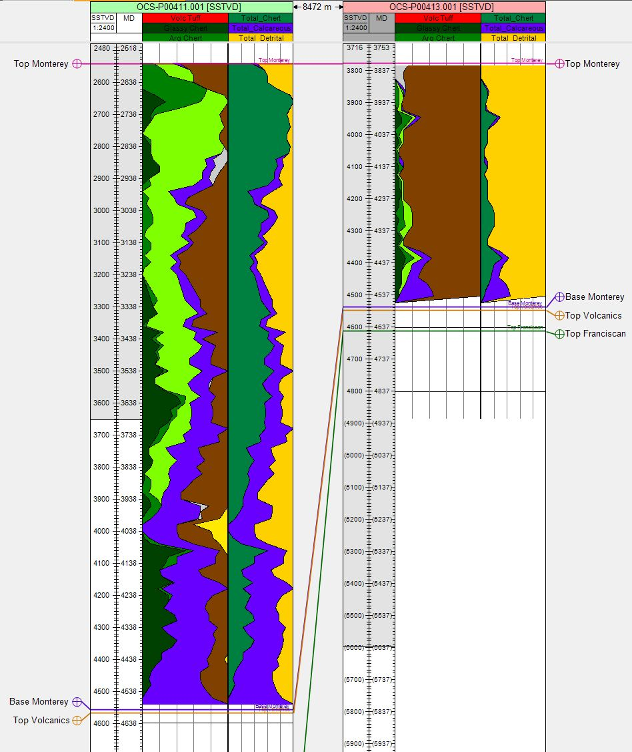
Same Two Wells
SW
NE
Digitized 13 different rock fractions measured in 31 mudlogs.
  Upscaled from 5’ to 20’
Grouped like facies into three major groups: CHERT, CARBONATE, and SILICICLASTIC. (right side)
Calculated maximum, average, and net values of the grouped facies through Monterey interval.
OCS-P00411_001
OCS-P00413_001

Slide 11
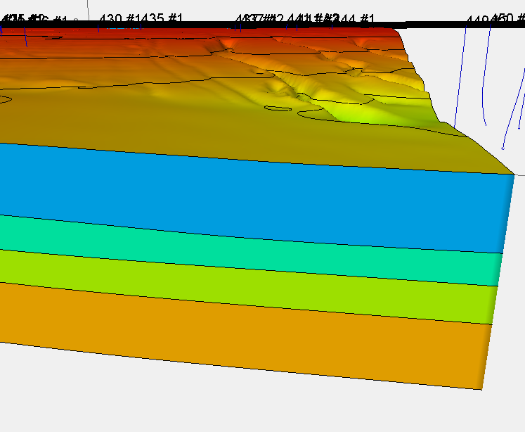
Simple Velocity Model
SRD = Mean Sea Level
Seafloor
Sea Water = ~4921 ft/s
Shallow = ~5200 ft/s
Top Sisquoc
Top Monterey
Sisquoc = ~5500 ft/s
Base Monterey
Monterey = ~6500 ft/s
B. Mont. +500ms
Sub Monterey = ~7500+ ft/s

Slide 12
Structure Map
Pt. Sal
Pt. Arguello

Slide 13
Structure Map
Pt. Sal
Pt. Arguello

Slide 14
True Stratigraphic Thickness
The stratigraphic thickness is measured perpendicular from the dip of the Top Monterey surface down to the Base Monterey surface

Slide 15
Average Chert Percentage
Avg. chert percentage measured through Monterey interval

Slide 16
Average Biogenic Percentage
Avg. chert percentage measured through Monterey interval

Slide 17
Net Chert Thickness
Avg. chert percentage
X
Stratigraphic thickness

Slide 18
Net Biogenic Thickness
Avg. biogenic percentage
X
Stratigraphic thickness

Slide 19
Future Work
Extend digitization of mudlogs ~300’ above and below Monterey zone to more easily identify trends related to bounding strata.
  Possibly digitize some GR and other wireline logs to further enhance correlations.
Continue refining structure and thickness maps.
  Areas with very steep dips and/or near faults seem to be an issue.
Refine velocity model to more closely tie seismic interpretations to actual depth.

Slide 20
Acknowledgements
Rick Behl – For sharing with me his bottomless pool of knowledge on all things Monterey
Chris Sorlien – For his past and future help with interpreting seismic.
Robert Dame and the BOEM\BSEE – For providing me with a bounty of 3D seismic and well data.
USGS’s NAMSS repository – For providing hundreds of 2D seismic lines.
And finally, to the MARS Project – For making this research possible.
THANK YOU!

Slide 21
References
Behl, Richard J., 1999, Since Bramlette (1946): The Miocene Monterey Formation of California revisited. Classic Cordilleran Concepts: A View from California: Geological Society of America, Special Paper 338, p. 301-313.
McCrory, P.A., Wilson, D.S., Ingle, J.C. Jr., and Stanley, R.G., 1995, Neogene geohistory analysis of Santa Maria basin, California, and its relationship to transfer of central California to the Pacific plate. Keller, M.A., ed., Evolution of Sedimentary Basins/
Onshore Oil and Gas Investigations-Santa Maria Province: U.S. Geological Survey Bulletin 1995-J, p. J1-J38.
McCulloch, D.S., 1987, Regional geology and hydrocarbon potential of offshore central California. Scholl, D. W., Grantz, A., and Vedder, J.G., eds., Geology and resource potential of the Continental Margin of Western North America and adjacent ocean basins-Beaufort Sea to Baja California: Circum-Pacific Council for Energy and Mineral Resources Earth Science Series, v. 6, Houston, Texas, p. 353-395.
Mero, W. E., Thurston, S. P. , and Kropschot, R. E., 1992, The Point Arguello Field: giant reserves in a fractured reservoir, California. Giant oil and gas fields of the decade 1988, p. 3-25.

Slide 22
References (cont.)
Sorlien, Christopher C., Nicholson, Craig, Luyendyk, Bruce P., Miller, Kate C., Meltzer, Anne S, 1999, Miocene extension and post-Miocene transpression offshore of south-central California. Structure and tectonics of the central offshore Santa Maria and Santa Lucia basins, California; results from the PG&E/EDGE seismic reflection survey. Evolution of Sedimentary Basins/Offshore Oil and Gas Investigations--Santa Maria Province, p. Y1-Y38, p. Z1-Z12
Willingham, C.R., Rietman, J.D., Heck, R.G., and Lettis, W.R., 2013, Characterization of the Hosgri Fault Zone and adjacent structures in the offshore Santa Maria Basin, south-central California, Evolution of sedimentary basins/onshore oil and gas investigations—Santa Maria province: U.S. Geological Survey Bulletin 1995-CC, 105 p.

