Slide 1

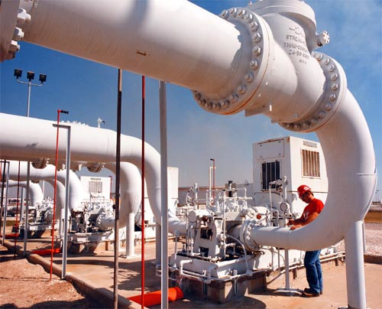
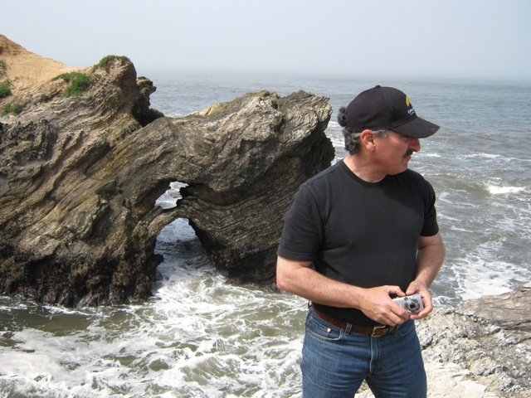
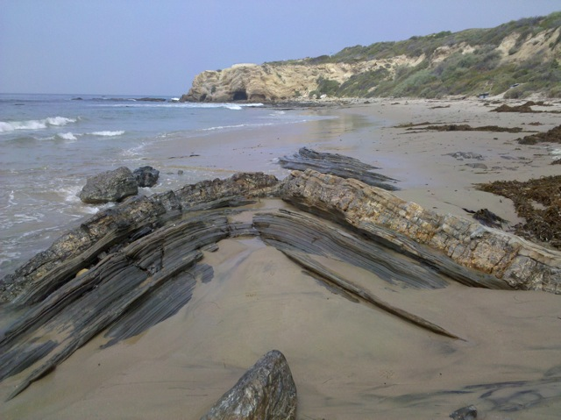
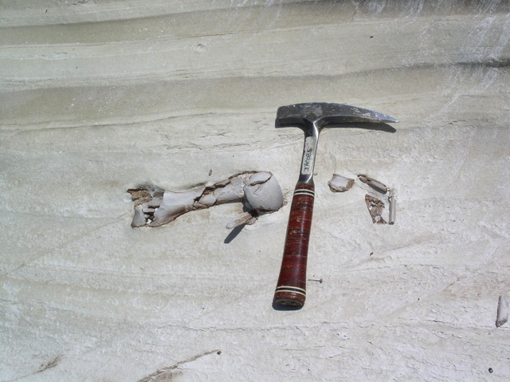

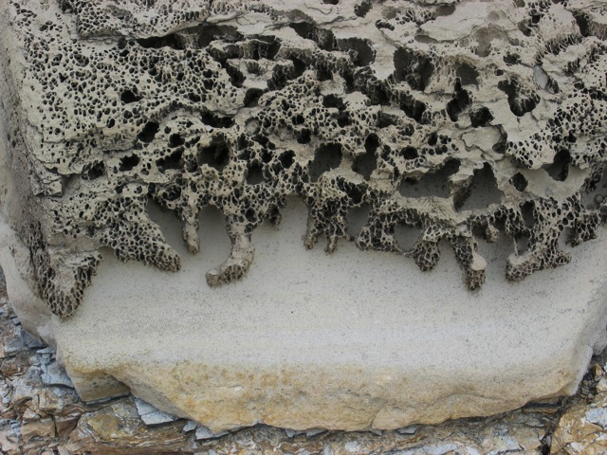

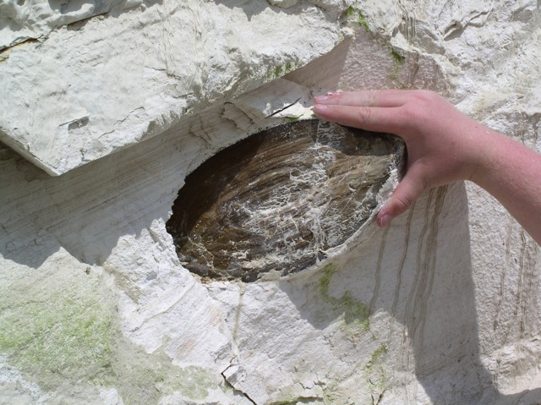
Sedimentology and Stratigraphy of Diatomaceous Sediments in the Casmalia Hills and Orcutt Oil Fields, Santa Maria Basin, CA
Daniel Torn
M.S. Graduate, California State University Long Beach
Thesis Committee Chair: Dr. Richard J. Behl
Committee Members: Dr. Tom Kelty and Dr. Dan Francis
Notes:
Thesis submitted in March, 2014
Thesis available on MARS website?

Slide 2



Presenter Background
Education
MS, Geological Sciences (2014), California State University, Long Beach
- President of AAPG Student Chapter
BS, Geological Sciences (2011), San Diego State University
- President of Associated Geology Students
Professional Experience
Devon Energy Corporation, Oklahoma City, OK (June 2014-Current)
Geologist -- Anadarko Basin Business Unit
-Emerging professional rotational program
-Unconventional oil-rich horizontal plays
-Exploration, development, operations, and project management
Unconventional Geoscience Intern (Summer 2013) -- Devon Energy Corporation
New Ventures Geoscience Intern (Summer 2012) -- Chesapeake Energy Corporation
Notes:
Undergrad in geology from SDSU in 2011 →
Went right into graduate school @ CSULB → Completed 2 summer internships with Chesapeake Energy Corp. and Devon Energy Corp. in OKC , accepted offer at Devon →
Currently working Anadarko Basin in unconventional oil rich horizontal plays (>mile long horizontals >8,500 ft TVD)

Slide 3
Presentation Outline
Introduction
Geology Overview of Study Area
Data and Methodology
Results, Interpretations, and Discussion
Conclusions

Slide 4
Importance
Santa Maria Basin
1 billion barrels of produced oil (on and offshore) SMB
Primary production from Monterey Formation
Increasing production from low permeability diatomite in upper Miocene Monterey and late Miocene to early Pliocene Sisquoc
New interest in diatomaceous sediments
General conception that diatomaceous deposits are simple and homogenous rocks

Slide 5
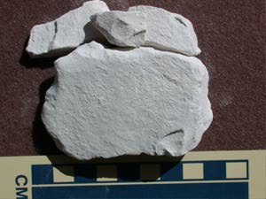
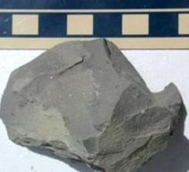
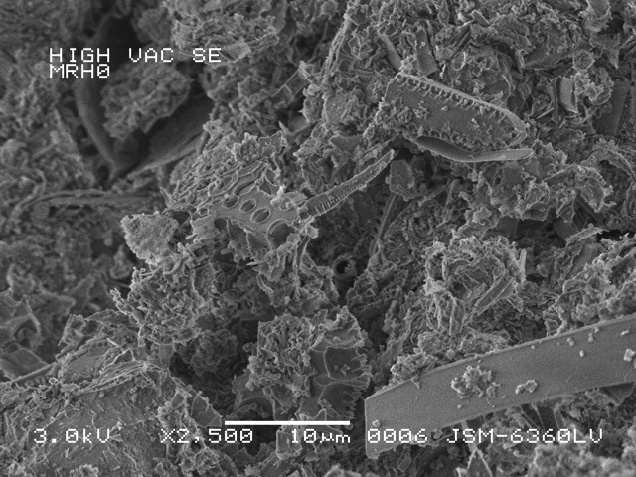
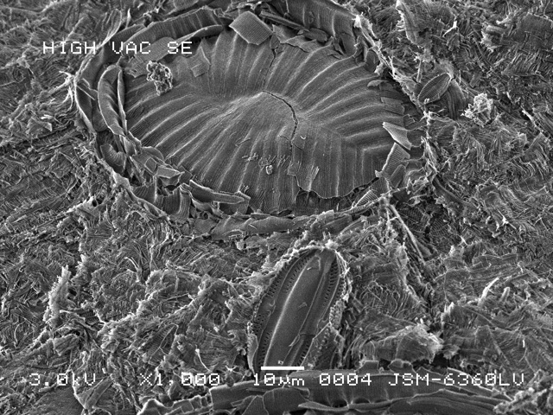
Variations in Diatomaceous Sediments
Composition:
Highly porous (50-75%) biogenic deposits (proven petroleum reservoir rock)
Diatom frustules + silicoflagellates + radiolarians +/- calcareous microfossils, clay, silt, and detrital minerals
Vary in composition of clays and other detrital, sedimentary fabric, and interbedded lithologies because of the complex and irregular bathymetry during deposition on a tectonically deformed and active margin
Pure
Diatomite
Diatomaceous
Mudstone
SEM: Muddy Diatomite
SEM: Clean Diatomite

Slide 6
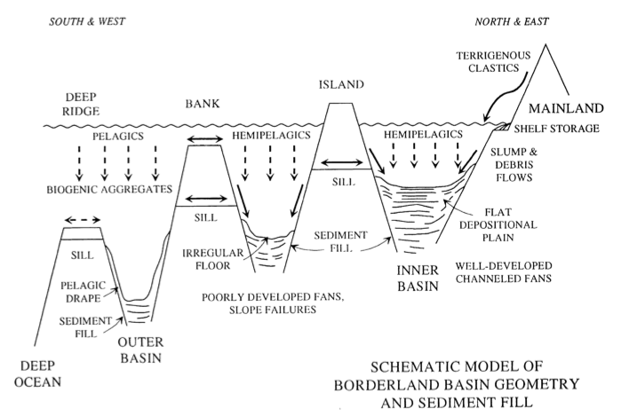
Deposition of Diatomite in California Basins
Diatomaceous Deposition
Schematic Model of Borderland Basin Geometry and Sediment Fill
Variation in compositions likely control the reservoir properties of these sediments
Understanding relationship of depositional environment, facies, and related variations in physical properties of diatomaceous sediments may provide insight to better understand petroleum system in a diatom-rich margin
Consequently, aid in targeting petroliferous diatomaceous facies in CA basins
(Gorsline, 1990) after (Gorsline and Emery, 1959)

Slide 7
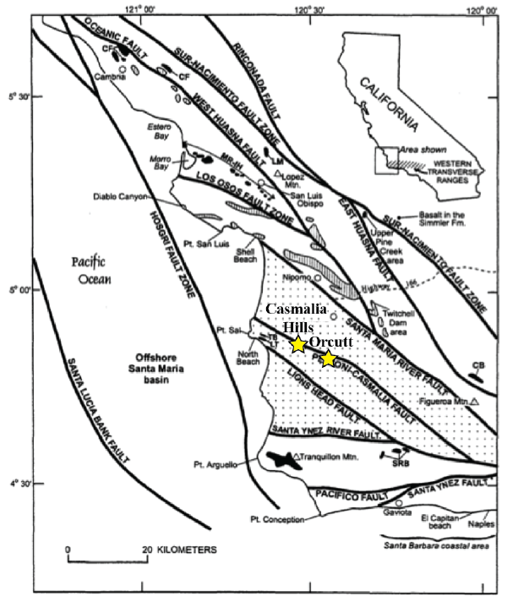
Regional Map
Triangular onshore sedimentary Santa Maria basin situated between junction of Western Transverse Ranges and Coast Ranges
Structurally bounded by Hosgri, Santa Yanez River, and Santa Maria River faults
Basin formed in geologically complex location that records a history of extension, shortening, and basin inversion due to rotation of the Transverse Ranges

Slide 8
Santa Maria Basin Stratigraphy
Continued Infilling of Basin:
-Foxen Mudstone, Careaga Sandstone and Paso Robles Formation
Sisquoc Formation:
-Continuation of siliceous organic rich diatomaceous deposits with an increase of accumulation rate of detritus
Monterey Formation:
-Abundance of diatomaceous productivity
-Siliceous organic-rich deposits
Pt. Sal Formation:
-Hemipelagic and submarine fan deposition
Lospe Formation:
-Initial subsidence of basin
-Nonmarine deposition
Mesozoic Basement Rocks:
-Point Sal Ophiolite
-Franciscan Complex
-Great Valley Sequence

Slide 9
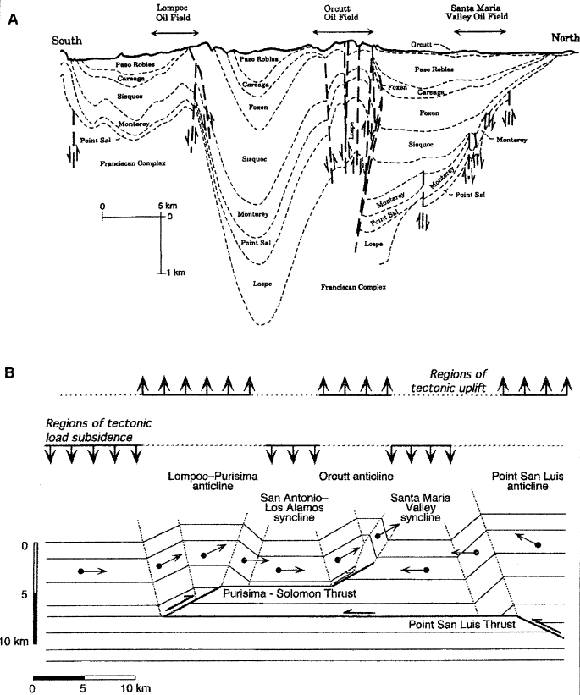
Santa Maria Basin Structure
Uplift of the basin formed the anticlinal structures first as submarine ridges
Anticlines form the structural traps for the Santa Maria basin oil fields
Source: Monterey Fm.
Reservoirs: Monterey Fm. and Sisquoc Fm.
N-S cross section through the onshore Santa Maria basin showing stratigraphy and structure of major oil fields (California Division of Oil and Gas, 1974)
Compressional structure of the onshore Santa Maria basin from Namson and Davis (1990)

Slide 10
Santa Maria Basin Petroleum System
Production of heavy low API gravity oil chiefly from fractured rocks (chert, porcelanite, dolostone). However, increasing production from the diatomaceous Sisquoc Formation
SMB diatomite facies varies in clay, detrital content, sedimentary fabric, and interbedded lithologies
Focus of study on Casmalia Hills and Orcutt located on the Casmalia-Orcutt anticlinal trend

Slide 11
Purpose & Importance of this study
Goal: Use proprietary industry-acquired core data from two different oil fields (Orcutt and Casmalia Hills) to compare and contrast sedimentology and stratigraphy within the same basin
Characterize diatomaceous lithofacies
-Descriptive analyses (bedding, thickness, sedimentary features)
-Laboratory analyses (composition, bulk + clay mineralogy, microfabric)
-Petrophysical analyses (characteristics of GR signatures in logs)
Understand relationships between diatomaceous facies, depositional environment, and their effects on petroleum development and exploitation
Provide geologic interpretations of sedimentologic and stratigraphic variability

Slide 12
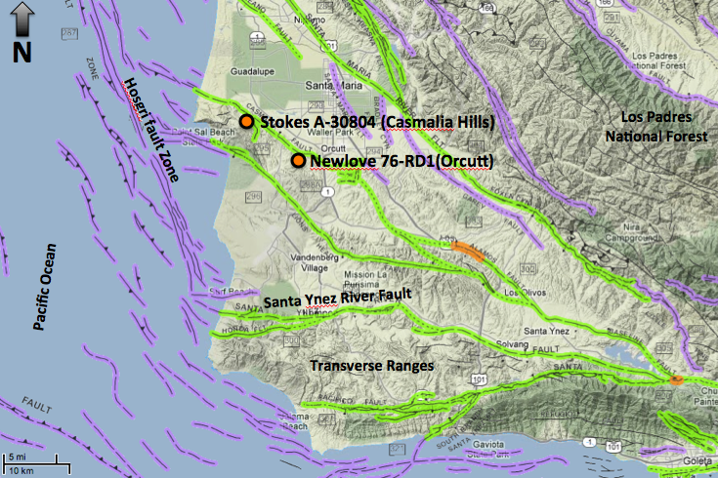
Location of Core Data
(Modified from http://www.quake.ca.gov/gmaps/FAM/faultactivitymap.html#)
Notes:
Stokes A-30804 and Newlove 76-RD1 are spatially 8 miles apart

Slide 13
Location of Core Data
Core #2: Newlove 76-RD1 (Orcutt)
Core #1: Stokes A-30804 (Casmalia Hills)
Company: Santa Maria Energy, LLC
Location: Casmailia Hills
Total Depth of Well: 1350 ft.
Core Length: 406 ft. from 1/3 core slabs
Data: Core, core photos (normal and UV light), sparse XRD and SEM data, porosity, oil and water saturation data , petrophysical data (GR and resistivity curves)
Company: BreitBurn Energy, LLC
Location: Orcutt Oil Field
Total Depth of Well: 893 ft.
Core Length: 282 ft. from 2/3 core slabs
Data: Core, core photos (normal and UV light), petrophysical data (GR and resistivity curves)
(Modified from http://www.quake.ca.gov/gmaps/FAM/faultactivitymap.html#)
Notes:
Stokes A-30804 and Newlove 76-RD1 are spatially 8 miles apart

Slide 14

Core #1: Stokes A-30804 (Casmalia Hills)
Core #2: Newlove 76-RD1 (Orcutt)
0
API
150
0
API
150
XRD
300 ft.
200 ft.
SEM
Core
300 ft.
400 ft.
400 ft.
500 ft.
500 ft.
600 ft.
600 ft.
700 ft.
800 ft.
700 ft.
900 ft.
1000 ft.
800 ft.
Total Core: 406 ft.
1100 ft.
Total Core: 282 ft.
1200 ft.
900 ft.

Slide 15
Core #1: Stokes A-30804 (Casmalia Hills)
Core #2: Newlove 76-RD1 (Orcutt)
0
API
150
0
API
150
XRD
300 ft.
200 ft.
SEM
Core
300 ft.
400 ft.
400 ft.
Foot by foot core characterization
Samples ~ every 3 ft.
Strategically took samples at various depths with visual differences for XRD and SEM
500 ft.
500 ft.
600 ft.
600 ft.
700 ft.
800 ft.
700 ft.
900 ft.
1000 ft.
800 ft.
Total Core: 406 ft.
Samples for XRD : 34
Samples for SEM: 8
1100 ft.
Total Core: 282 ft.
Samples for XRD : 25
Samples for SEM: 6
1200 ft.
900 ft.
Notes:
Samples collected at average of every 3 feet.

Slide 16
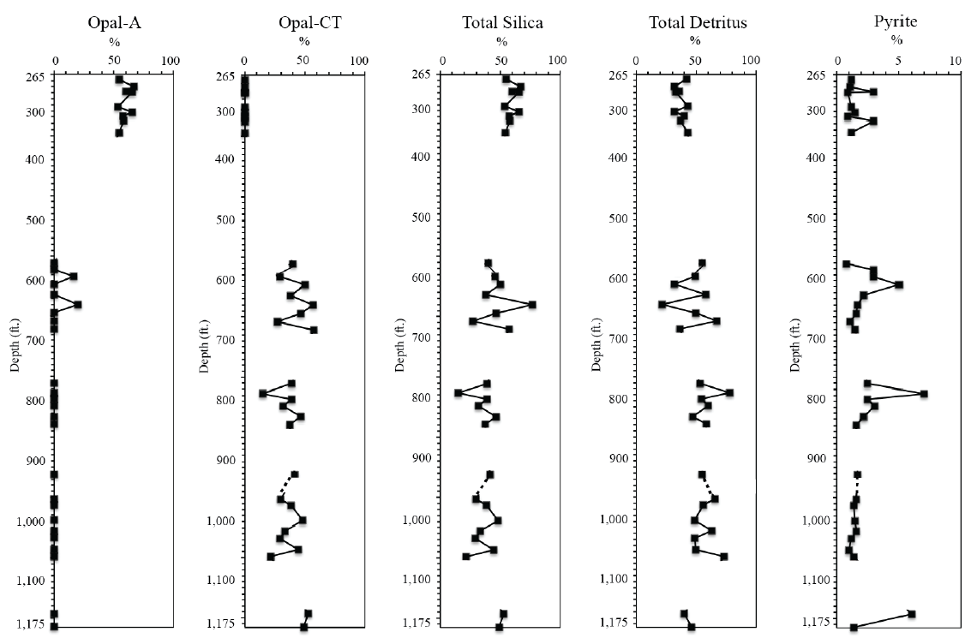
Stokes A-30804 Compositional Trends
Opal-A
Opal-CT
Total Silica
Total Detritus
Pyrite

Slide 17
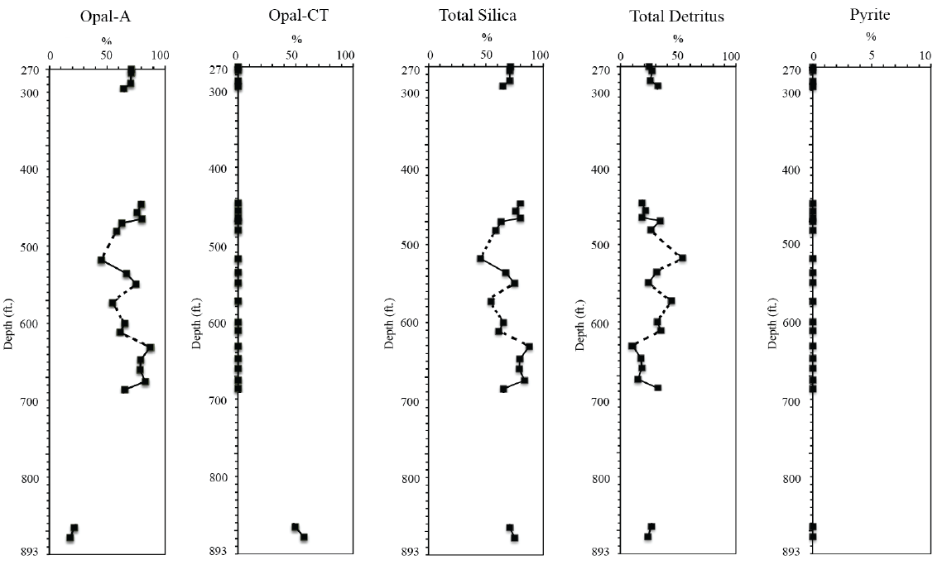
Newlove 76-RD1 Compositional Trends
Opal-A
Opal-CT
Total Silica
Total Detritus
Pyrite

Slide 18
Classification Scheme
Major Component (s)
Principle Name
>50% Total Silica
(Opal-A > Opal-CT)
+ Minor Detritus
Muddy Diatomite
>50% Total Silica
(Opal-A < Opal-CT)
+Minor Detritus
Diatomaceous
Porcelanite
>50% Total Silica
(Opal-A < Opal-CT)
+Minor Detritus
(<20% phylloslicates)
Clayey Diatomaceous
Porcelanite
>50% Total Detritus
+Minor Total Silica
(Opal-A > Opal-CT)
Diatomaceous
Mudstone
>50% Total Detritus
+Minor Total Silica
(Opal-A < Opal-CT)
Porcelaneous
Mudstone

Slide 19
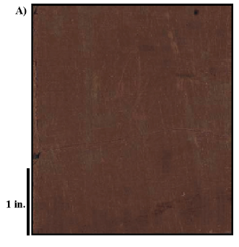
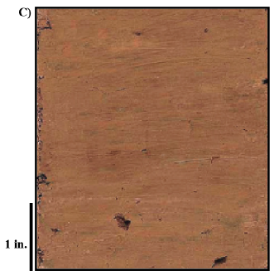
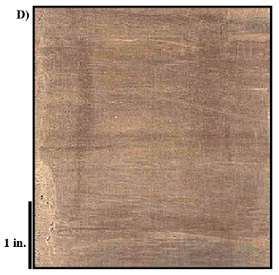
Newlove 76-RD1 Lithofacies
3 Primary Lithofacies:
1) Muddy
Diatomite
2) Diatomaceous
Mudstone
3) Diatomaceous
Porcelanite
muddy diatomite
(massive)
muddy diatomite
(discontinuously laminated)
Notes:
3 types of lithofacies identified in Newlove 76-RD1:
Muddy diatomite
Diatomaceous mudstone
Diatomaceous porcelanite
Distinguished by XRD

Slide 20
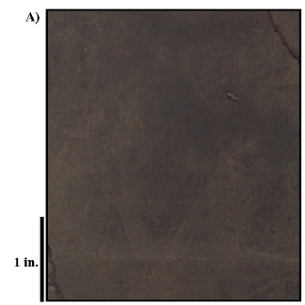
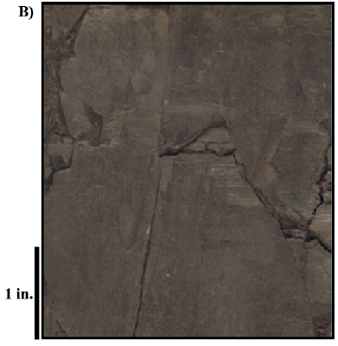
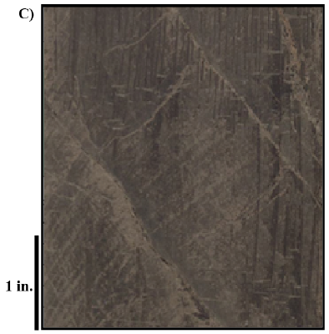
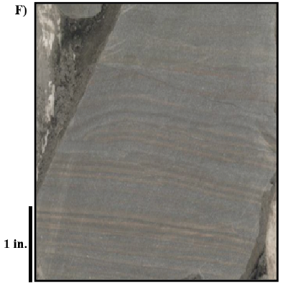
Stokes A-30804 Lithofacies
4 Primary Lithofacies:
1) Muddy
Diatomite
2) Porcelaneous
Mudstone
3) Diatomaceous
Porcelanite
4) Clayey Diatomaceous
Porcelanite
Notes:
4 types of lithofacies identified in Newlove 76-RD1:
Muddy diatomite
Porcelaneous mudstone
Diatomaceous porcelanite
Clayey diatomaceous porcelanite
Distinguished by XRD

Slide 21
Sedimentary Features
Slump Folds, Erosional Surfaces, and Faults:
Stokes A-30804
Depth: 672’
Stokes A-30804
Depth: 601’

Slide 22
Sedimentary Features
Slump Folds, Erosional Surfaces, and Faults:
Newlove 76-RD1
Depth: 510’
Newlove 76-RD1
Depth: 522’
Newlove 76-RD1
Depth: 281’

Slide 23
Sedimentary Features
Fossils and Burrows :
Stokes A-30804
Depth: 272’
Stokes A-30804
Depth: 577’

Slide 24
Sedimentary Features
Fossils and Burrows :
Newlove 76-RD1
Depth: 289’
Newlove 76-RD1
Depth: 529’

Slide 25
Sedimentary Structures
Fine-grained Laminations:
Stokes A-30804
Depth: 1,152
Stokes A-30804
Depth: 1,172

Slide 26
Sedimentary Structures
Sandstone and Siltstone Laminations:
Newlove 76-RD1
Depth: 888’

Slide 27
Sedimentary Structures
Debris flow deposits:
Stokes A-30804
Depth: 657’
Stokes A-30804
Depth: 309’

Slide 28
Sedimentary Structures
Debris flow deposits:
Newlove 76-RD1
Depth: 519’
Newlove 76-RD1
Depth: 529’

Slide 29
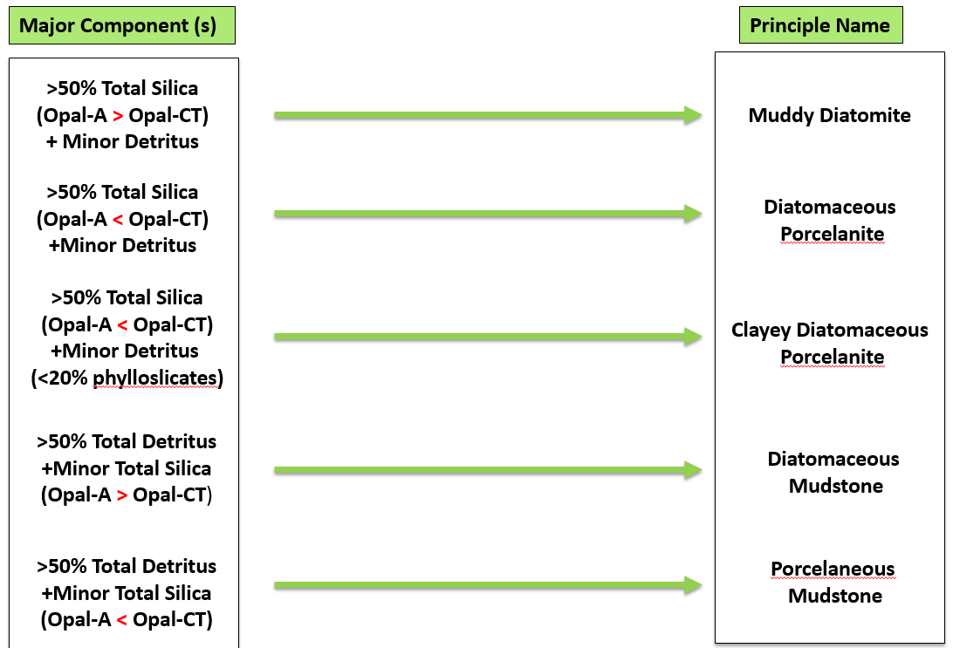
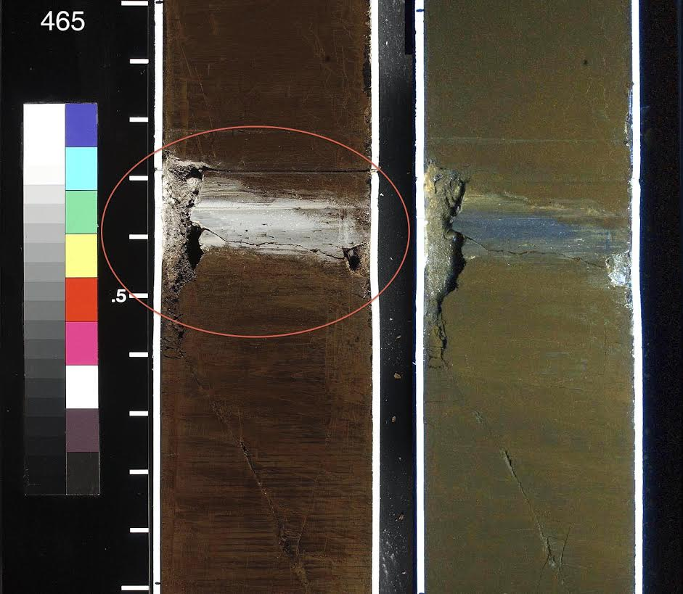
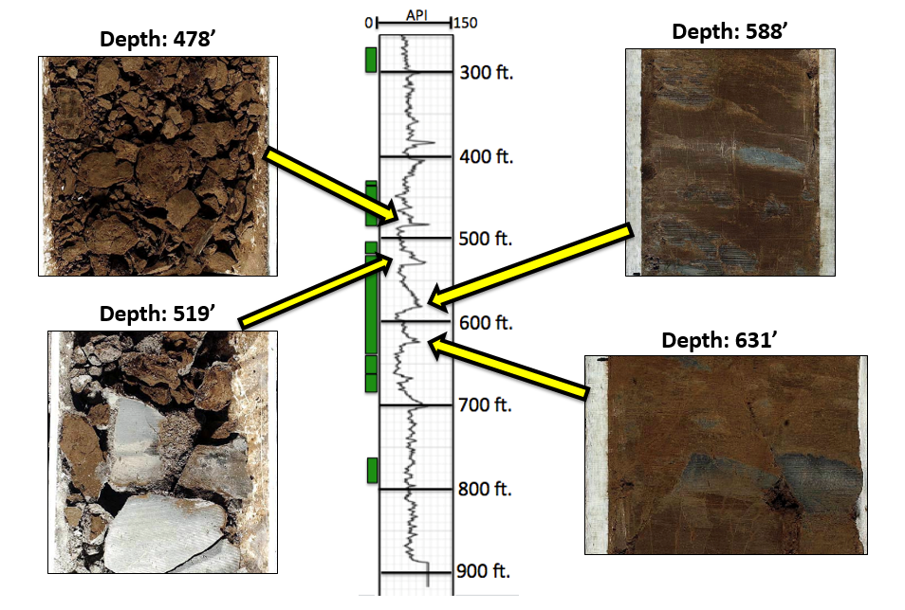
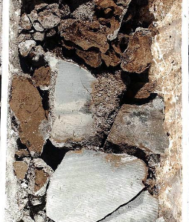
Integration of Datasets
XRD- Bulk and Clay Mineralogy
Nomenclature System
Core Characterization Stratigraphic Columns for Stokes A-30804 and Newlove 76-RD1
Foot by Foot Core Descriptions
Petrophysical Properties

Slide 30



Features
Sedimentary
Laminations
Features
Sedimentary
Depth (ft.)
Lithofacies
Laminations
Core Data
Depth (ft.)
Lithofacies
GR
Core Data
GR
Well
Well
Lithofacies Key
Lithofacies Key
Muddy Diatomite
Newlove 76-RD1
Muddy Diatomite
Stokes A-30804
Porc. Mudstone
Diat. Mudstone
Diat. Porcelanite
Diat. Porcelanite
Clayey Diat. Porcelanite
Sed. Features Key
Sed. Features Key
Laminations
Laminations
Faults
Faults
Slump Folds
Slump Folds
Erosional Surface
Erosional Surface
Debris Flow
Debris Flow
SS/Siltstone Lam.
SS/Siltstone Lam.
Breccia
Breccia
Hardgrounds
Hardgrounds
Fossil
Fossil
Burrow
Burrow

Slide 31
Features
Sedimentary
Laminations
Features
Lithostrat.
Sedimentary
Depth (ft.)
Lithofacies
Lithostrat.
Laminations
Core Data
Depth (ft.)
Lithofacies
Unit
Core Data
Well
GR
Unit
GR
Well
Newlove 76-RD1
Stokes A-30804
Notes:
Integrate lithofacies+sedimentary features+GR log to segregate both wells into lithostratigraphic units.

Slide 32
Features
Sedimentary
Laminations
Features
Lithostrat.
Sedimentary
Depth (ft.)
Lithofacies
Lithostrat.
Laminations
Core Data
Depth (ft.)
Lithofacies
Unit
Core Data
Well
GR
Unit
GR
Well
absence of
debris-flow
deposits
Cannot identify
interpreted
contact (missing
continuous core)
?
absence of
discontinuous
laminations
Newlove 76-RD1
Stokes A-30804
commencement of
any laminations
onset of debris-
flow deposits
onset of debris
flow deposits +
commencement of
prominent continuous
stratification
Notes:
Integrate lithofacies+sedimentary features+GR log to segregate both wells into lithostratigraphic units.

Slide 33
Features
Sedimentary
Laminations
Features
Lithostrat.
Sedimentary
Depth (ft.)
Lithofacies
Lithostrat.
Laminations
Core Data
Depth (ft.)
Lithofacies
Unit
Core Data
Well
GR
Unit
GR
Well
Newlove 76-RD1
Stokes A-30804
Newlove Lithostratigraphic Unit A
Depths 700’ to 893’
Only unit containing diatomaceous porcelanite
(discontinuous to continuous)
Faults, minor breccia, void of debris flow deposits
GR consistent without large variations (~55-65 API)

Slide 34
Features
Sedimentary
Laminations
Features
Lithostrat.
Sedimentary
Depth (ft.)
Lithofacies
Lithostrat.
Laminations
Core Data
Depth (ft.)
Lithofacies
Unit
Core Data
Well
GR
Unit
GR
Well
Newlove 76-RD1
Newlove Lithostratigraphic Unit B
Depths 550’ to 699’
Alternating discon. laminated to massive muddy diatomite with onset of debris-flow deposits
Faults, breccia, fossils, hardgrounds, burrows, slumps, erosional surfices and laminations
GR values “cyclic”, high values every ~30-50 ft. (~60-100 API)
Stokes A-30804
Newlove Lithostratigraphic Unit A
Depths 700’ to 893’
Only unit containing diatomaceous porcelanite
(discontinuous to continuous)
Faults, minor breccia, void of debris flow deposits
GR consistent without large variations (~55-65 API)

Slide 35
Features
Sedimentary
Laminations
Features
Lithostrat.
Sedimentary
Depth (ft.)
Lithofacies
Lithostrat.
Laminations
Core Data
Depth (ft.)
Lithofacies
Unit
Core Data
Well
GR
Unit
GR
Well
Newlove Lithostratigraphic Unit C
Depths 430’ to 549’
Massive muddy diatomite w/ minor diat. mudstone interval
Faults, breccia, fossils, hardgrounds, burrows, slumps, erosional surfaces, debris flow deposits and laminations
GR values “cyclic”, high values every ~30-50 ft. (~60-100 API)
Newlove 76-RD1
Newlove Lithostratigraphic Unit B
Depths 550’ to 699’
Alternating discon. laminated to massive muddy diatomite with onset of debris-flow deposits
Faults, breccia, fossils, hardgrounds, burrows, slumps, erosional surfices and laminations
GR values “cyclic”, high values every ~30-50 ft. (~60-100 API)
Stokes A-30804
Newlove Lithostratigraphic Unit A
Depths 700’ to 893’
Only unit containing diatomaceous porcelanite
(discontinuous to continuous)
Faults, minor breccia, void of debris flow deposits
GR consistent without large variations (~55-65 API)

Slide 36
Features
Sedimentary
Laminations
Features
Lithostrat.
Sedimentary
Depth (ft.)
Lithofacies
Lithostrat.
Laminations
Core Data
Depth (ft.)
Lithofacies
Unit
Core Data
Well
GR
Unit
GR
Well
Newlove Lithostratigraphic Unit D
Depths 270’ to 377’
Massive muddy diatomite faults, breccias, fossils, and burrows absent of debris-flow deposits
GR fairly consistent every (~45-80 API)
Newlove Lithostratigraphic Unit C
Depths 430’ to 549’
Massive muddy diatomite w/ minor diat. mudstone interval
Faults, breccia, fossils, hardgrounds, burrows, slumps, erosional surfaces, debris flow deposits and laminations
GR values “cyclic”, high values every ~30-50 ft. (~60-100 API)
Newlove 76-RD1
Newlove Lithostratigraphic Unit B
Depths 550’ to 699’
Alternating discon. laminated to massive muddy diatomite with onset of debris-flow deposits
Faults, breccia, fossils, hardgrounds, burrows, slumps, erosional surfices and laminations
GR values “cyclic”, high values every ~30-50 ft. (~60-100 API)
Stokes A-30804
Newlove Lithostratigraphic Unit A
Depths 700’ to 893’
Only unit containing diatomaceous porcelanite
(discontinuous to continuous)
Faults, minor breccia, void of debris flow deposits
GR consistent without large variations (~55-65 API)

Slide 37
Features
Sedimentary
Laminations
Features
Lithostrat.
Sedimentary
Depth (ft.)
Lithofacies
Lithostrat.
Laminations
Core Data
Depth (ft.)
Lithofacies
Unit
Core Data
Well
GR
Unit
GR
Well
Newlove 76-RD1
Stokes A-30804
Stokes Lithostratigraphic Unit A
Depths 1,037’ to 1,176’
Alternating discon. to continuous lam. porcelaneous mudstone and clayey diatomaceous porcelanite
Void of debris flow deposits
GR consistent (averages ~65 API)

Slide 38
Features
Sedimentary
Laminations
Features
Lithostrat.
Sedimentary
Depth (ft.)
Lithofacies
Lithostrat.
Laminations
Core Data
Depth (ft.)
Lithofacies
Unit
Core Data
Well
GR
Unit
GR
Well
Stokes Lithostratigraphic Unit B
Depths 778’ to 1,036
Alternating discon. laminated porcelaneous mudstone mudstone and diat. porcelanite
Onset of debris-flow deposits, absent of prominent lam.
GR consistent (averages ~60 API)
Newlove 76-RD1
Stokes A-30804
Stokes Lithostratigraphic Unit A
Depths 1,037’ to 1,176’
Alternating discon. to continuous lam. porcelaneous mudstone and clayey diatomaceous porcelanite
Void of debris flow deposits
GR consistent (averages ~65 API)

Slide 39
Features
Sedimentary
Laminations
Features
Lithostrat.
Sedimentary
Depth (ft.)
Lithofacies
Lithostrat.
Laminations
Core Data
Depth (ft.)
Lithofacies
Unit
Core Data
Well
GR
Unit
GR
Well
Stokes Lithostratigraphic Unit C
Depths 567’-777’
Alternating diatomaceous porcelanite and porcelaneous mudstone
Debris flow deposits, erosional surfaces, faults, breccia and fossils
Absent of discontinuous laminations
GR consistent (averages ~60 API)
Stokes Lithostratigraphic Unit B
Depths 778’ to 1,036
Alternating discon. laminated porcelaneous mudstone mudstone and diat. porcelanite
Onset of debris-flow deposits, absent of prominent lam.
GR consistent (averages ~60 API)
Newlove 76-RD1
Stokes A-30804
Stokes Lithostratigraphic Unit A
Depths 1,037’ to 1,176’
Alternating discon. to continuous lam. porcelaneous mudstone and clayey diatomaceous porcelanite
Void of debris flow deposits
GR consistent (averages ~65 API)

Slide 40
Stokes Lithostratigraphic Unit D
Depths 265’ to 356’
Massive muddy diatomite
Debris flow deposits, erosional surfaces, faults, breccia and fossils
GR consistent (averages ~65 API)
Features
Sedimentary
Laminations
Features
Lithostrat.
Sedimentary
Depth (ft.)
Lithofacies
Lithostrat.
Laminations
Core Data
Depth (ft.)
Lithofacies
Unit
Core Data
Well
GR
Unit
GR
Well
Stokes Lithostratigraphic Unit C
Depths 567’-777’
Alternating diatomaceous porcelanite and porcelaneous mudstone
Debris flow deposits, erosional surfaces, faults, breccia and fossils
Absent of discontinuous laminations
GR consistent (averages ~60 API)
Stokes Lithostratigraphic Unit B
Depths 778’ to 1,036
Alternating discon. laminated porcelaneous mudstone mudstone and diat. porcelanite
Onset of debris-flow deposits, absent of prominent lam.
GR consistent (averages ~60 API)
Newlove 76-RD1
Stokes A-30804
Stokes Lithostratigraphic Unit A
Depths 1,037’ to 1,176’
Alternating discon. to continuous lam. porcelaneous mudstone and clayey diatomaceous porcelanite
Void of debris flow deposits
GR consistent (averages ~65 API)

Slide 41
Features
Sedimentary
Laminations
Features
Lithostrat.
Sedimentary
Depth (ft.)
Lithofacies
Lithostrat.
Laminations
Core Data
Depth (ft.)
Lithofacies
Unit
GR
Core Data
Well
Unit
GR
Well
Upper Slope
+
Oxic
Lower to Mid Slope
+
Oxic
Slope (unstable, steep, or active)
+
Oxic
Newlove 76-RD1
Lower to Mid Slope
+
Anoxic to Oxic
Stokes A-30804
Slope (unstable, steep, or active)
+
Anoxic to Oxic
Base of Slope
or Basin Floor
+
Anoxic to Oxic
Base of Slope
or Basin Floor
+
Anoxic to Oxic

Slide 42
Depositional Model
Simplified Schematic Depositional Model of
Newlove 76-RD1 and Stokes A-30804
Varying slope positions of both wells expressed by differences in dominant lithofacies, composition, and sedimentary features
Newlove 76-RD1 dominant in total silica, lower detrital content, and fewer unstable slope setting sedimentary features
Stokes A-30804 lower in total silica, higher detrital content, and more abundant unstable slope setting sedimentary features
(Torn, 2014)
Notes:
Schematic depositional model of Newlove 76-RD1 and Stokes A-30804
This model roughly approximates the orientation of bathymetric ridges and troughs during Sisquoc Formation deposition (~4 to 5 Ma).
Yellow stars indicate interpreted positions during depositions of deposits within Newlove 76-RD1 and Stokes A-30804

Slide 43
Depositional Model
Simplified Schematic Depositional Model of
Newlove 76-RD1 and Stokes A-30804
Varying slope positions of both wells expressed by differences in dominant lithofacies, composition, and sedimentary features
Newlove 76-RD1 dominant in total silica, lower detrital content, and fewer unstable slope setting sedimentary features
Stokes A-30804 lower in total silica, higher detrital content, and more abundant unstable slope setting sedimentary features
Purer diatomaceous sediment accumulation forming higher abundances of diatomite and diatomaceous porcelanite
Higher detrital accumulation forming higher abundances of diatomaceous/porcelaneous mudstones and clay-rich diatomaceous porcelanites
(Torn, 2014)
Notes:
Schematic depositional model of Newlove 76-RD1 and Stokes A-30804
This model roughly approximates the orientation of bathymetric ridges and troughs during Sisquoc Formation deposition (~4 to 5 Ma).
Yellow stars indicate interpreted positions during depositions of deposits within Newlove 76-RD1 and Stokes A-30804

Slide 44
Porosity Vs. Oil Saturation of Lithofacies
Stokes A-30804
Phyllosilicate abundance plays a primary role in decrease oil saturation, porosity, and permeability with opal-CT having a lesser secondary role
Notes:
Quartz + Feldspars + Phyllosilicates = Total Detritus

Slide 45
Porosity Vs. Oil Saturation of Lithofacies
Newlove 76-RD1
Lithofacies Averages of:
1)Muddy Diatomite
2) Diat. Mudstone
3) Diat. Porcelanite
Phyllosilicate abundance plays a primary role in decrease oil saturation, porosity, and permeability with opal-CT having a lesser secondary role
Notes:
Newlove 76-RD1 Muddy Diatomite: Ave 67% Porosity and 50% Oil Saturation
Newlove 76-RD1 Diatomaceous Mudstone: Ave 61% Porosity and 39% Oil Saturation
Newlove 76-RD1 Diatomaceous Porcelanite: Ave 56% Porosity and 33% Oil Saturation

Slide 46
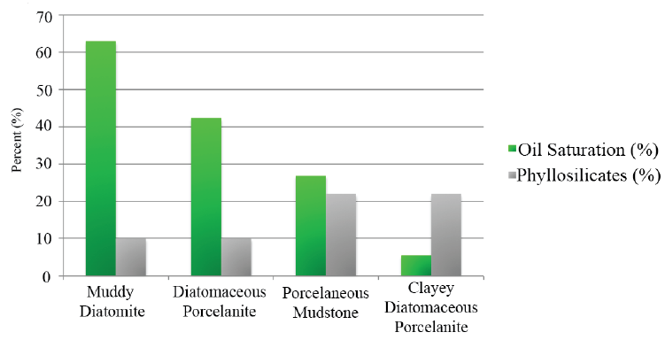
Oil Saturation and Phyllosilicate % in Stokes A-30804

Slide 47
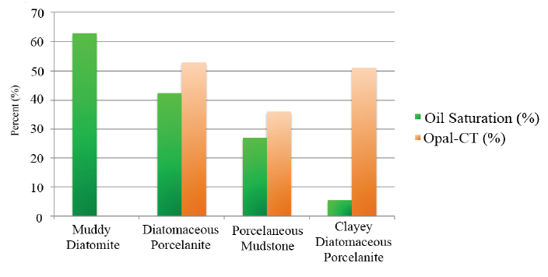
Oil Saturation and Opal-CT % in Stokes A-30804

Slide 48
Conclusions
Five lithofacies were characterized by direct observation, laboratory analysis, and subsurface gamma-ray logs within Newlove 76-RD1 and Stokes A-30804
Nine sedimentary features were identified and characterized that provided insight to the depositional environment of both wells
Quantitative X-ray diffraction of various samples from both wells determined the varying composition of total silica (opal-A and opal-CT), total detritus (phyllosilicates, feldspars, and quartz)
Lithofacies, gamma-ray log, sedimentary features, and compositional trends of Newlove 76-RD1 and Stokes A-30804 indicate an upward shallowing succession on the Pliocene slope of the Santa Maria basin with a fluctuating OMZ to oxygenated waters
Variations of total silica and total detritus between Newlove 76-RD1 and Stokes A-30804 were likely caused by different depositional positions on the paleo-slope (Newlove 76-RD1 likely situated shallower and higher on flank of paleobathymetric high than Stokes A-30804)
Notes:
1) Now lets briefly go over some of the geology of my field area

Slide 49
Conclusions
Core analysis from Stokes A-30804 revealed opal-A dominant lithofacies contain highest porosities and oil saturation, intermixed opal-A and opal-CT silica phase lithofacies without high abundances of phyllosilicates contain 2nd highest oil saturation
Phyllosilicate-rich lithofacies contain lowest oil saturations and is primary driver in reducing porosity, permeability, and oil saturation
Notes:
1) Now lets briefly go over some of the geology of my field area

Slide 50
Thank You
BreitBurn Energy
Santa Maria Energy
OXY/CRC
Freeport-McMoRan Oil & Gas
Signal Hill Petroleum
Bayswater Exploration & Production
Aera Energy
Venoco
ExxonMobil

Slide 51
Backup Slides

Slide 52
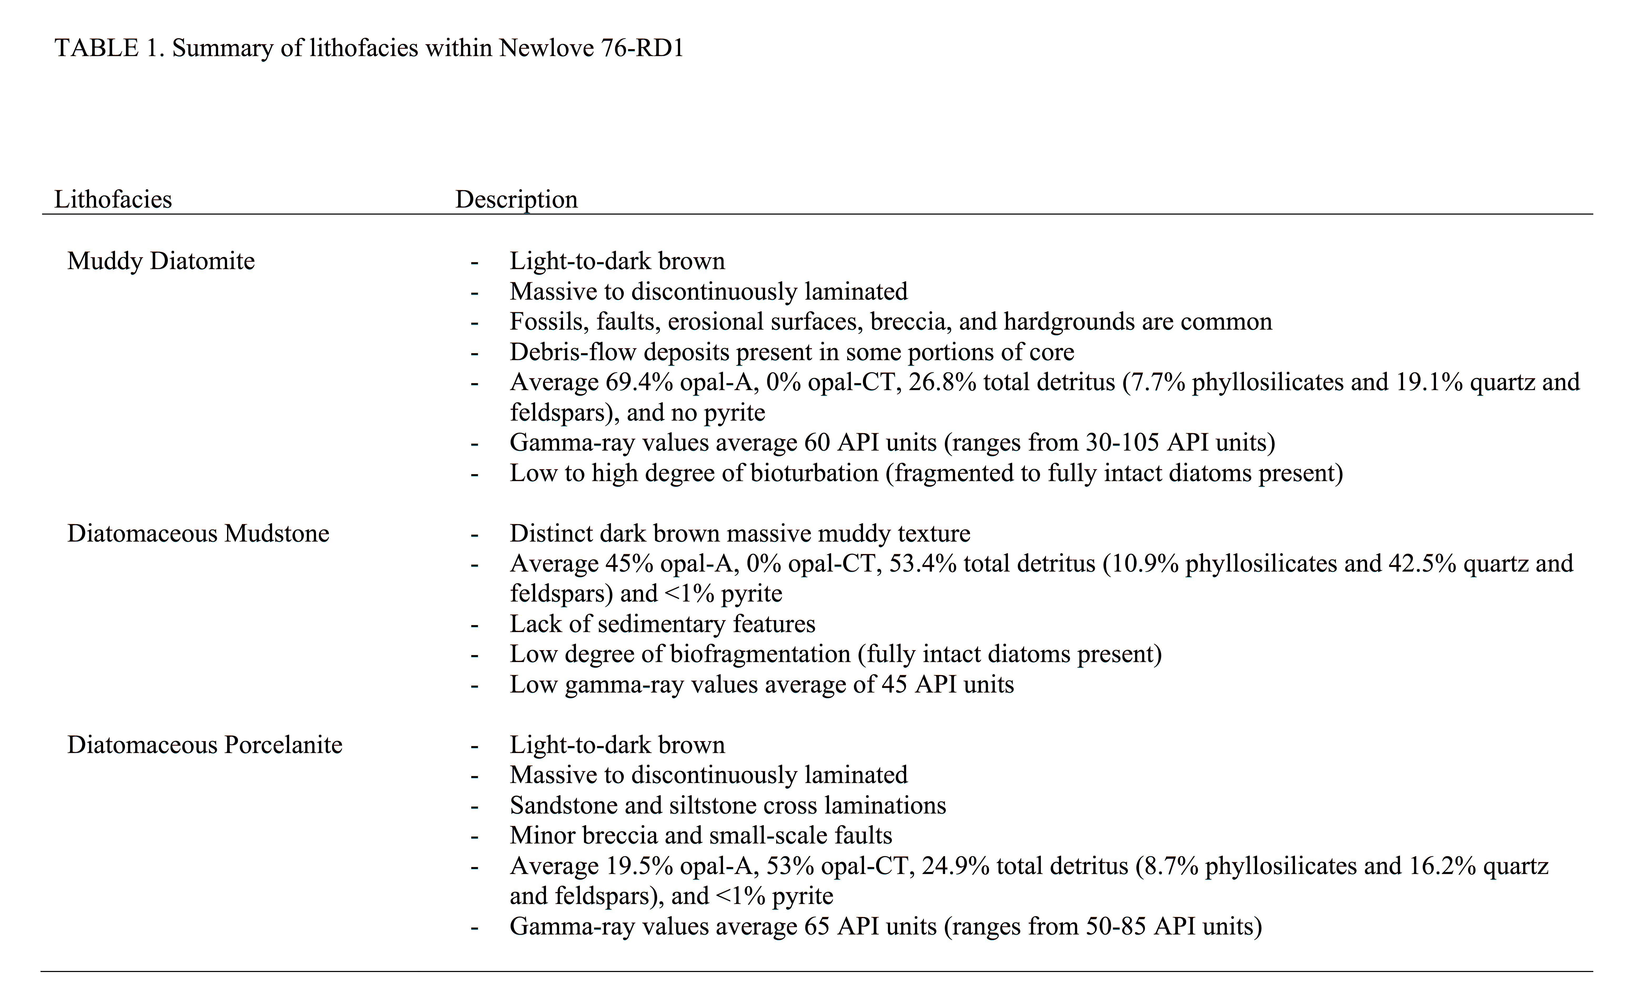
Newlove 76-RD1 Lithofacies Details

Slide 53
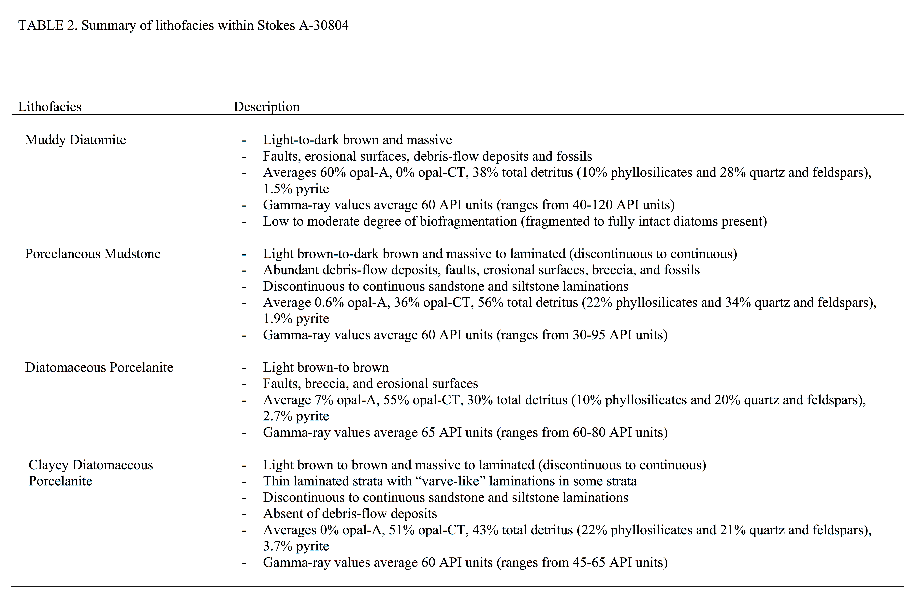
Stokes A-30804 Lithofacies Details

Slide 54
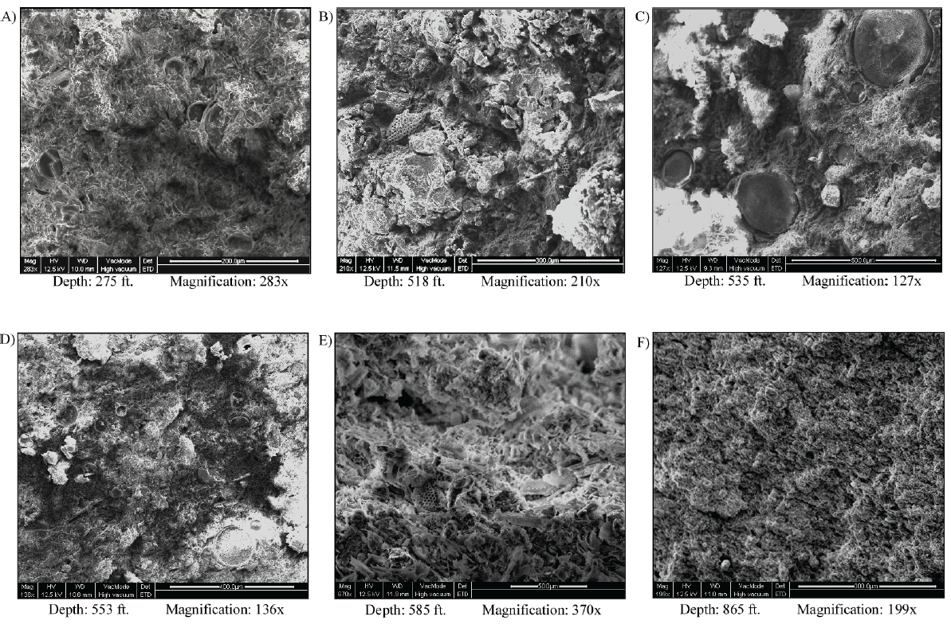
Newlove 76-RD1 SEM Photos
Notes:
SEM images of lithofacies within Newlove 76-RD1. Images show:
full centric diatoms within muddy diatomite (massive) at 275’
fragmented diatoms within muddy diatomite (massive) at 518’
full centric diatoms within diatomaceous mudstone (massive) at 535’
full centric diatoms within muddy diatomite (discontinuously laminated) at 553’
fragmented diatoms within muddy diatomite (massive) at 585’
diatomaceous porcelanite (discontinuously laminated) at 865’.

Slide 55
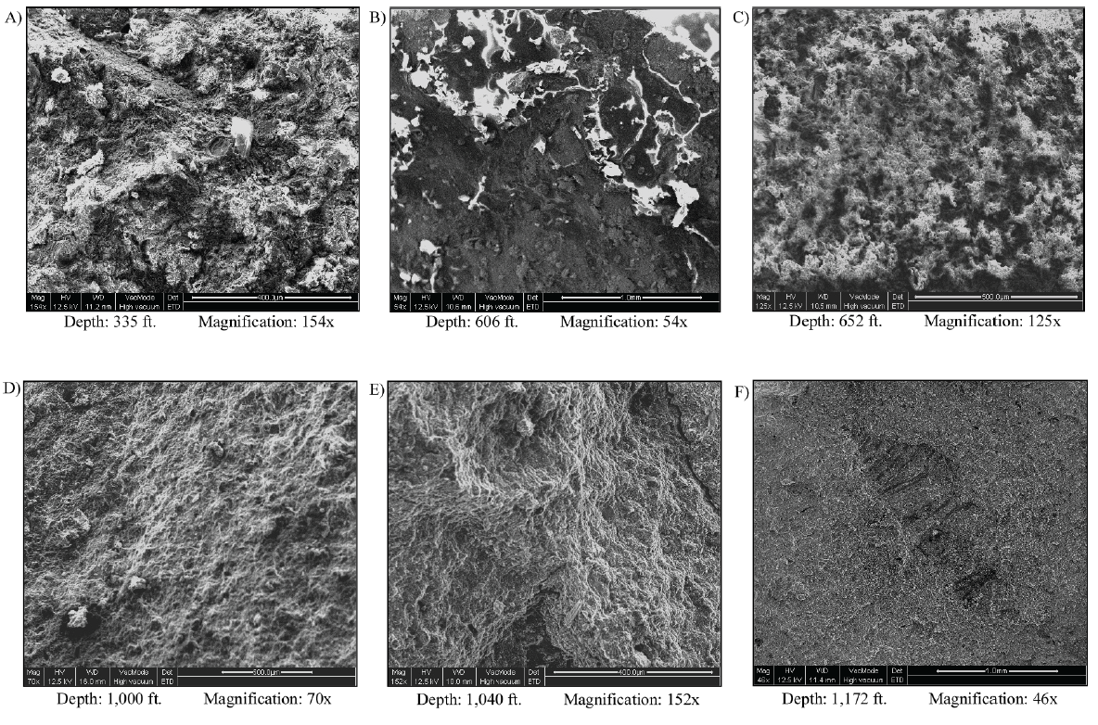
Stokes A-30804 SEM Photos
Notes:
SEM images of lithofacies within Stokes A-30804. Images show:
(A) muddy diatomite (massive) at 335’
(B) diatomaceous porcelanite (massive) at 606’
(C) porcelaneous mudstone (massive) at 652’
(D) porcelaneous mudstone (discontinuously laminated) at 1,000’
(E) porcelaneous mudstone (discontinuous to continuously laminated) at 1,040’
(F) clayey diatomaceous porcelanite (continuously laminated) at 1,172’ showing microfossil mold.

Slide 56
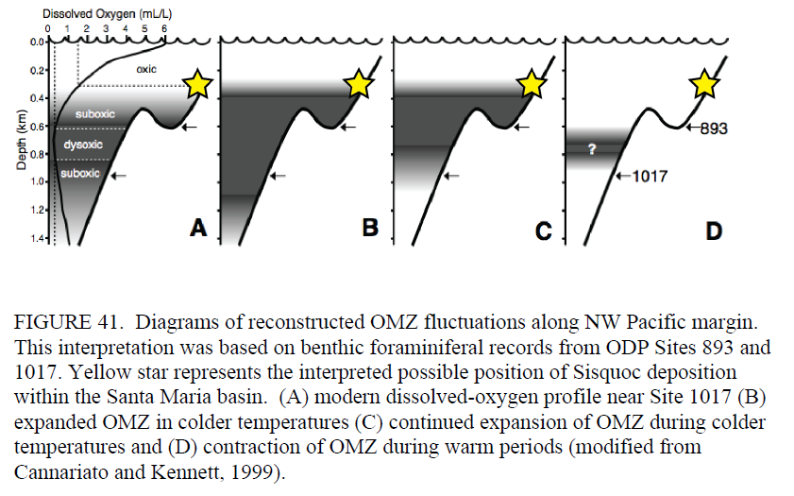
OMZ Interpreted Position of Sisquoc in SMB

Slide 57
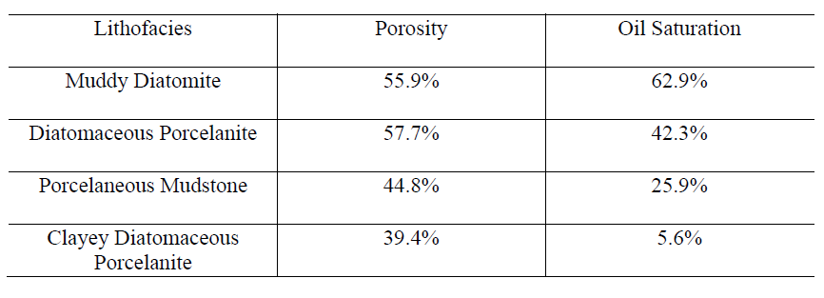
Statistical Averages of Porosity + Oil Saturation
Stokes A-30804 Samples:

