Slide 1
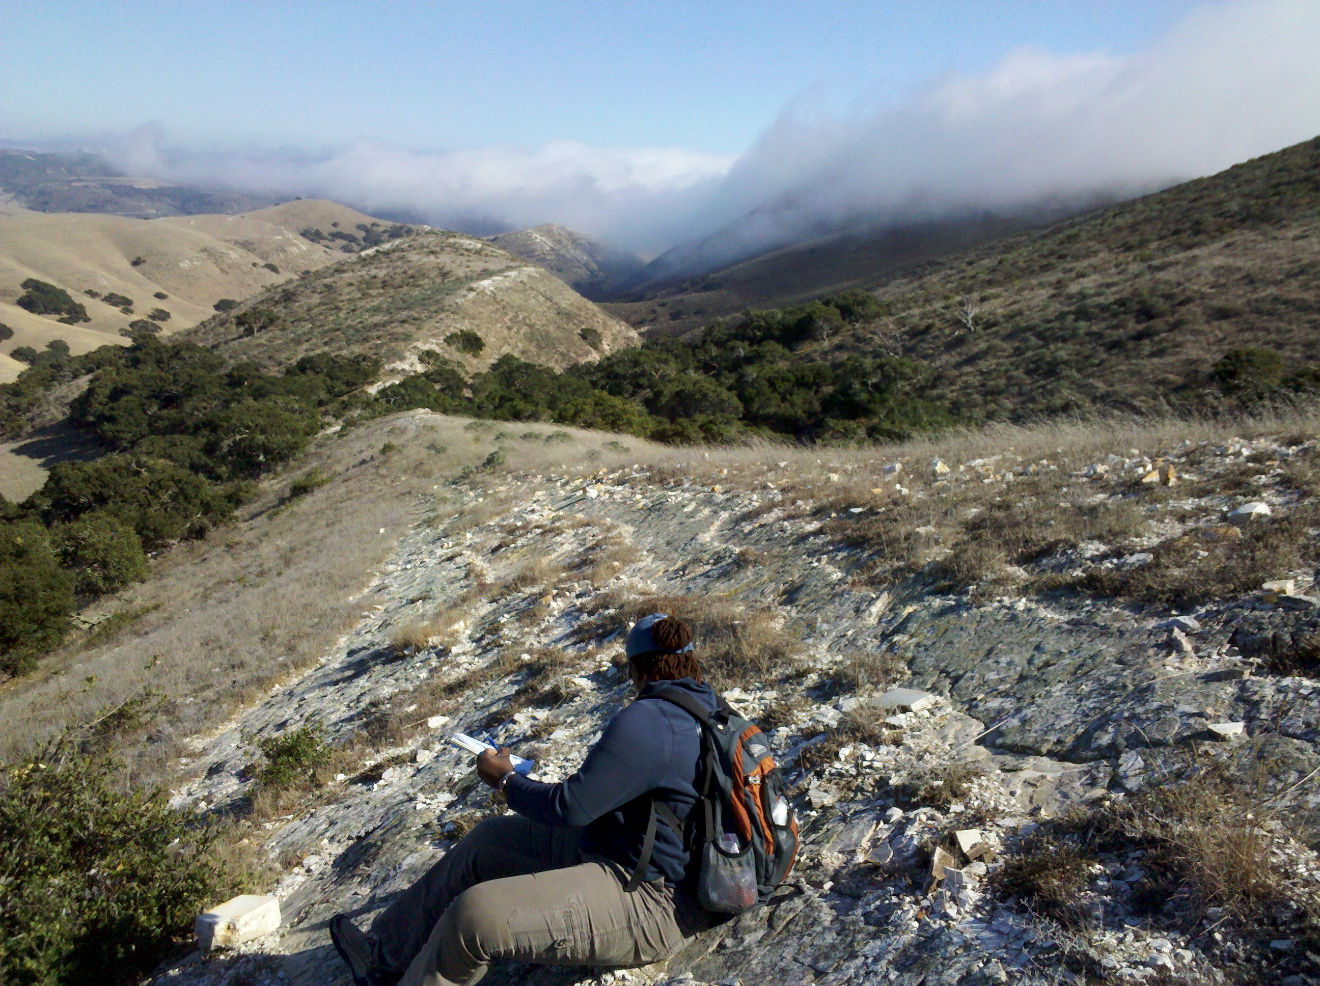
A test of diagenetic ordering in siliceous lithofacies, Monterey Formation, southwestern Casmalia Hills,
Santa Maria basin, California
By. Idu Opral Ijeoma and Richard J. Behl

Slide 2
Introduction
The general understanding of silica diagenesis
is that there is a smooth curvilinear or linear
progression of opal-CT d₁₀₁-spacing with depth for all compositional ranges.

Slide 3
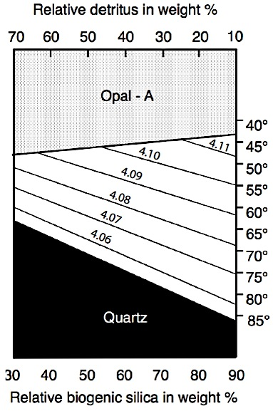
Murata and Nakata (1974) & Murata and Larson (1975)
Isaacs (1980, etc.) &
Keller and Isaacs (1985)

Slide 4
Our Study
Undertook a detailed study with a very dense dataset in a single stratigraphic succession to test established models of silica diagenesis
The southwestern Casmalia Hills was noted by Woodring and Bramlette (1950) as the best continuous exposure of siliceous section of the Monterey Formation in the Santa Maria basin
230 samples of porcelanites and siliceous mudstones were analyzed for composition, silica phase, and d₁₀₁-spacing using combined EDS/XRF and XRD techniques
Notes:
The initial hypothesis was that we were going to see the same trends and would be able to add to the model to make is more concise and detailed.

Slide 5
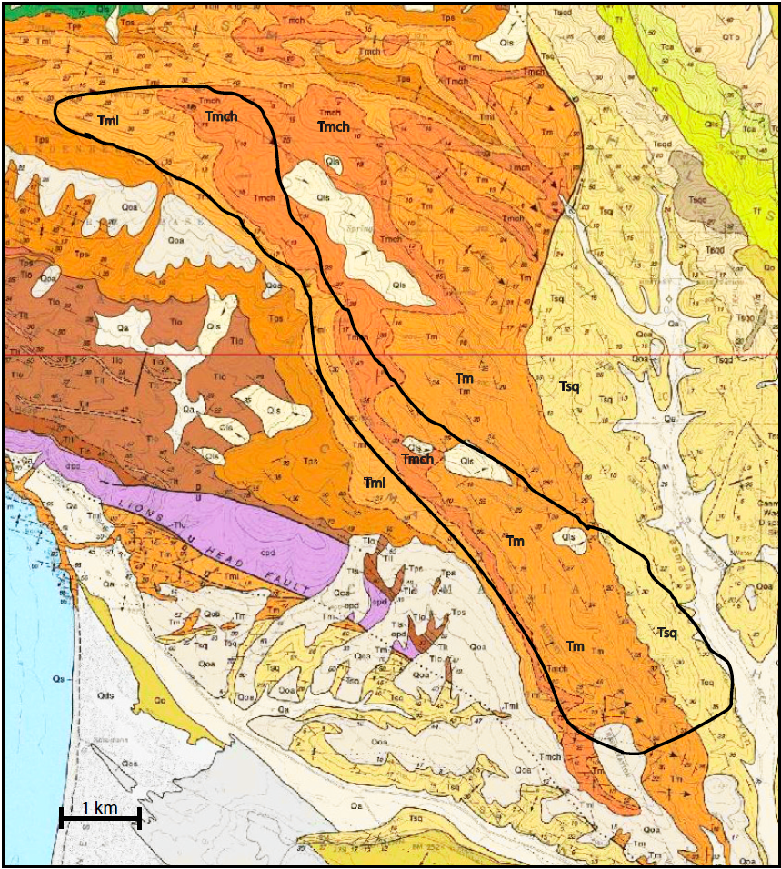
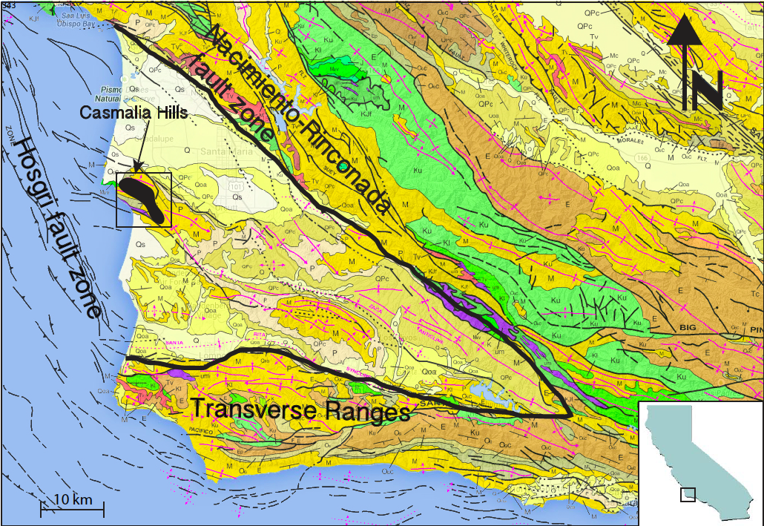
Santa Maria Basin
Study Area

Slide 6
Lower Sisquoc
Shows a weak trend of increasing opal-CT d₁₀₁-spacing depth
Notes:
The following slides will show opal-CT d101-spacing plotted vs. depth for each member of the Sisquoc and Monterey Formations. This trend is opposite of what is predicted.
50-60 range shows a good trend

Slide 7
Upper Monterey
Shows a wide scatter with no trend present with depth, except for the >80 % which shows a weak trend of
decreasing opal-CT d₁₀₁-spacing with depth

Slide 8
Middle Monterey
The < 50%-60%, and 60%-70% silica ranges show very weak trends of decreasing opal-CT d₁₀₁-spacing with stratigraphic depth, while the 70%-80% and > 80% silica showed no apparent trends with a wide scatter

Slide 9
Lower Monterey
All the compositional ranges show slight to moderate trends of decreasing opal-CT d₁₀₁-spacing with stratigraphic depth

Slide 10
Results
The data shows a very weak trend of decreasing opal-CT d₁₀₁-spacing with stratigraphic depth for certain narrow compositional ranges within individual members of the Sisquoc and Monterey formations
These highly scattered data with generally only weak trends are not at all similar to the smooth linear to curvilinear progressions shown by Murata and co-workers (1974; 1975) or suggested by Isaacs (198)
Are these results completely inconsistent with previous studies?

Slide 11
Murata and Nakata (1974)
& Murata and Larson (1975)
Observed a curvilinear progression of decreased opal-CT d₁₀₁-spacing with depth in a single uplifted stratigraphic section a Chico Martinez Creek
Few samples and without compositional constraint except to visually separate chert from porcelanites
They were all in the Antelope Shale (upper Monterey)

Slide 12
Mizutani (1966, 1967, 1977)
Observed opal-CT
d₁₀₁-spacing with increased temperature and time in hydrothermal
experiments
His study identified temperature and time as controlling factors in the diagenetic ordering of opal-CT

Slide 13
Pisciotto (1978, 1981) – Santa Maria Basin
Most of his oil wells showed a slight trend, but did not observe a smooth curvilinear trend of decreasing opal-CT d₁₀₁-spacing with depth
Notes:
The Point Conception COST Well is located

Slide 14
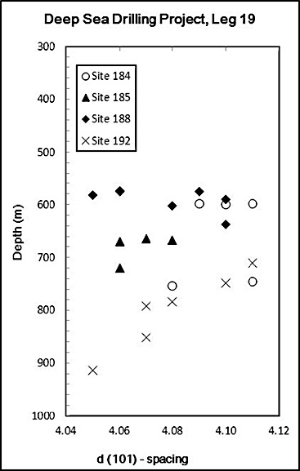
Hein et al. (1978)
Deep Sea Drilling Project core holes, Bering Sea and Gulf of Alaska
Only one site out of four showed a predicted trend of decreased d₁₀₁-spacing with depth, while the other three show wide scatter
Notes:
Bearing Sea gulf of Alaska
ODP
Three showed scatter

Slide 15
Behl and Smith
(1992)
3 ODP core holes from the deep West Pacific
Mesozoic and Cenozoic sediments
Results for all compositions showed opal-CT d₁₀₁-spacing decreased only generally with depth with wide scatter
Notes:
Deep west pacific mesozic and cenozic sediments
3 different core holes
The overall composition
Very weak trends

Slide 16
Behl and Smith (1992)
Even with compositional control, only very weak trends are seen
Notes:
But when plotted for composition it show very weak correlations with depth, trends are weakly linear

Slide 17
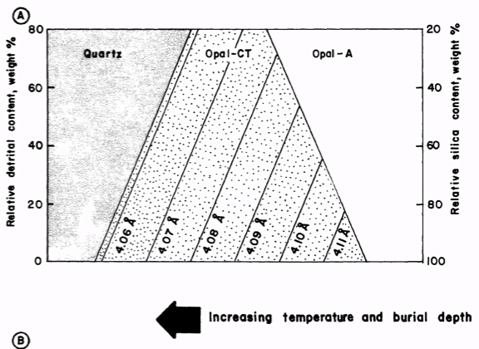
Isaacs (1980, 1981)
In outcrops along the Santa Barbara coast, closely associated rocks existed at different silica phases
At any location, the opal-CT ordering varied with composition in a very predictable way
West
East
Note: Not a stratigraphic study
Notes:
As this ratio decreases opal-CT forms later (because the initial orders was higher) and quartz forms earlier

Slide 18
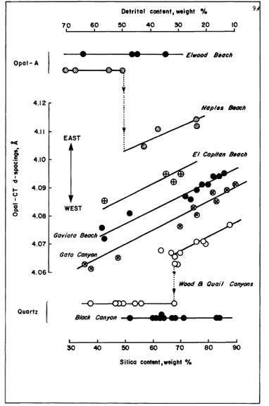
Isaacs (1980, 1981)
In fact, Isaacs studied differences in d₁₀₁- spacing with composition at many individual locations
No stratigraphic relations shown here
Some sites are very close together and experienced similar burial depths and temperatures
Notes:
Go back to Keller and Isaacs figure
This figure was not contructed from stratigraphic sucession
It was constructed using rock the were lateral and were probably buried to different depths
A trend of decreased of d101 spacing with composition, from a single member of the Mont take laterlly
Based on her observation and from previous studies,

Slide 19
Casmalia Hills
Plot for each member of d₁₀₁-spacing vs. silica content show great scatter, but all of the members display a distinct upper cut-off.
Upper cut-off has a trend of decreasing opal-CT d₁₀₁-spacing with decreasing silica and increased depth
Notes:
There are no (or few) rocks with higher d(101) than the limit-line for an specific composition in each member

Slide 20
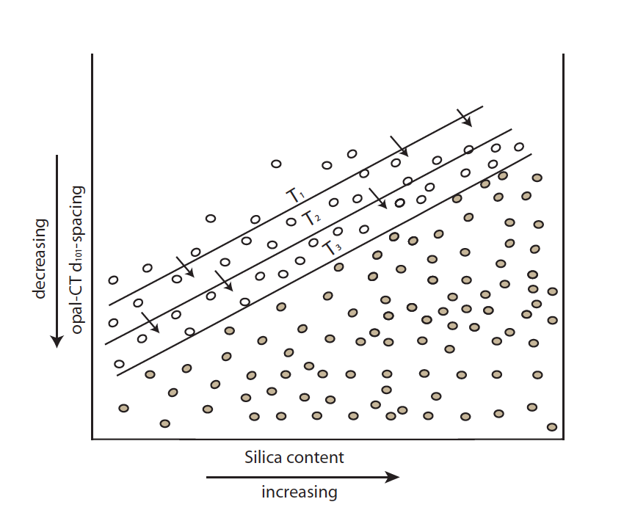
Model for evolution of opal-CT d₁₀₁-spacing
Initially opal-CT is varied, but with burial, the most poorly ordered crystallites become increasingly destabilized and are dissolved or removed from the system. T₁ thru T₃ represent the limit lines at different burial depths. The unfilled circles are the poorly ordered crystals that are being removed from the system.

Slide 21
The new data supports the hypothesis that:
Silica migration at and beyond the bed-scale is important for silica diagenesis
Silica migration can occur on both the submicron scale of lepispheres and a larger scale migration between beds
Notes:
Explain that the silica migration relates to dissolution of the highest solubility, least ordered opal-CT crystallites and re-precipitation as lower solubility, better ordered opal-CT

Slide 22
The new data also supports the hypothesis that:
Pore-water chemistry from other beds can influence silica diagenesis
The timing of silica phase transitions and the ordering of opal-CT in one bed may be impacted by diffusion of ions from surrounding beds that influence alkalinity and pH by carbonate and organic mater content
Notes:
The Point Conception COST Well is located

Slide 23
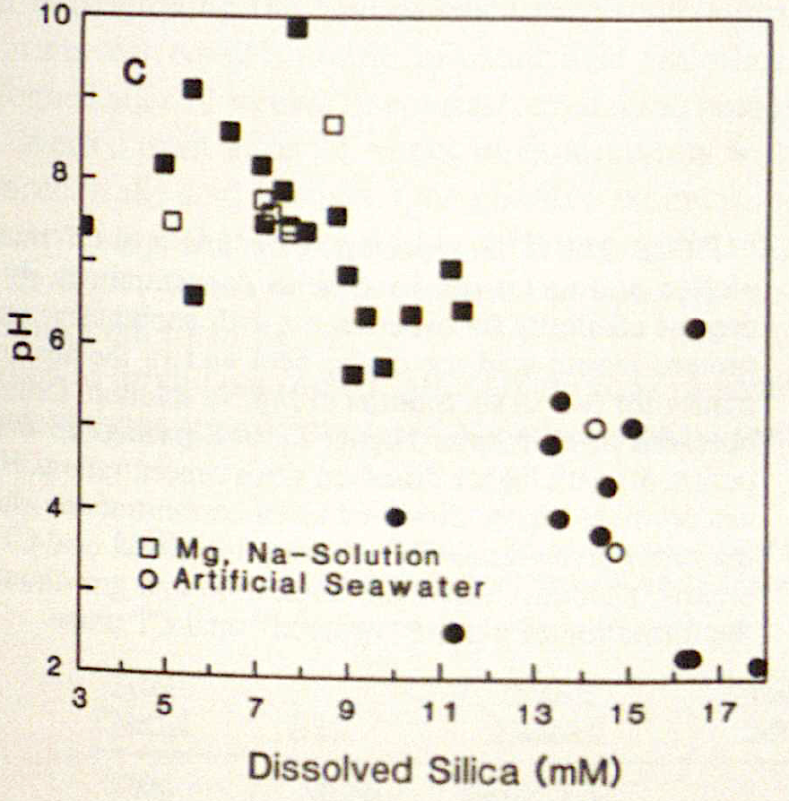
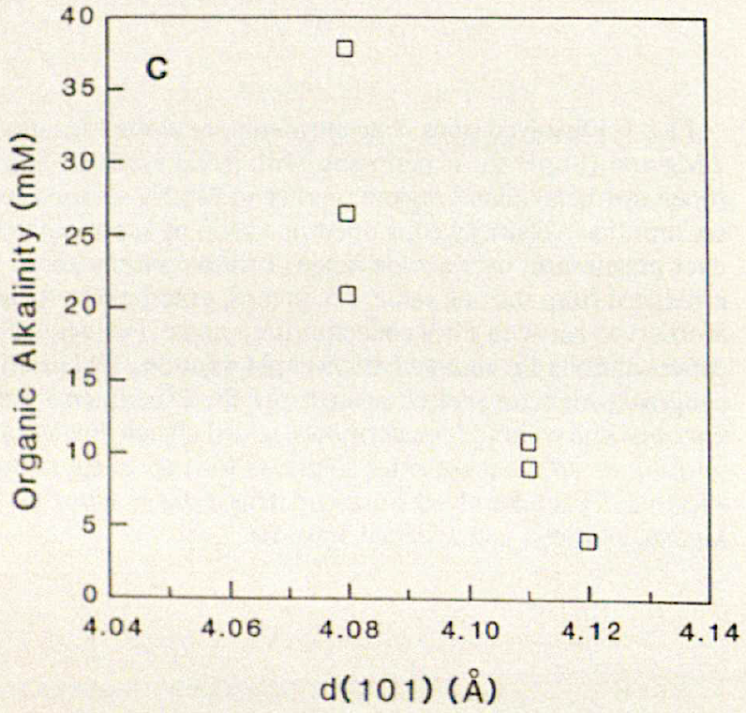
Organic acids produced by the breakdown of organic matter lowers the pH of the solution by consuming alkalinity, which reduces the rate of opal-CT nucleation and controls initial opal-CT d₁₀₁-spacing formation (Hinman, 1990).

Slide 24
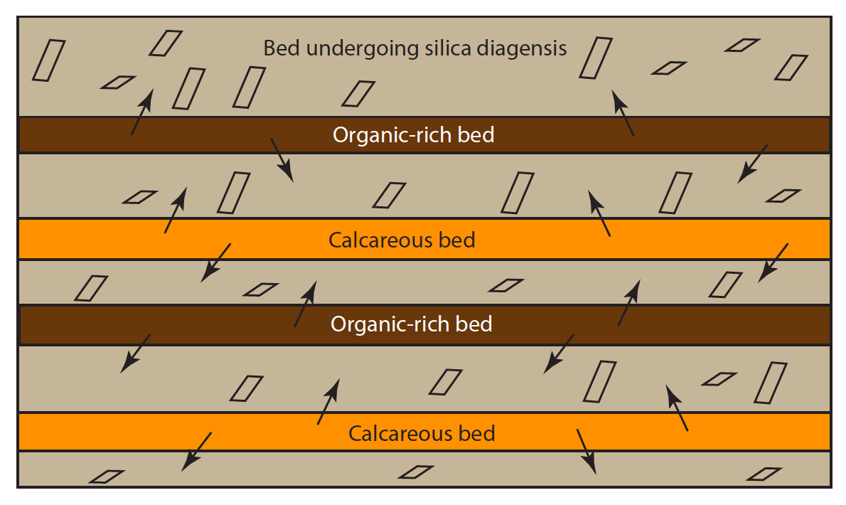
The basis of these models are:
1) The initial ordering of opal-CT at one location is influenced by pore-water composition controlled diffusion thought and between beds
Notes:
The Point Conception COST Well is located

Slide 25
  2) the final whole-rock opal-CT d₁₀₁-spacing is controlled by progressive dissolution of disordered, high d₁₀₁-spacing opal-CT crystallites and new precipitation of better-ordered opal-CT.
Notes:
The Point Conception COST Well is located

Slide 26
In spite of these complexities and variability, opal-CT d₁₀₁-spacing may still be useful as a geothermometer.
Each of the stratigraphic members (lower Sisquoc and Upper, Middle, Upper Monterey) have distinct upper limits of opal-CT d₁₀₁-spacing with somewhat different slopes
We suggest the only the maximum opal-CT d₁₀₁-spacing for a given composition in a stratigraphic interval be used to determine maximum burial depth and temperature for tectonic reconstructions.
Notes:
The Point Conception COST Well is located

Slide 27
Casmalia Hills
Plot for each member of d₁₀₁-spacing vs. silica content show great scatter, but all of the members display a distinct upper cut-off.
Upper cut-off has a trend of decreasing opal-CT d₁₀₁-spacing with decreasing silica
Notes:
There are no (or few) rocks with higher d(101) than the limit-line for an specific composition in each member

Slide 28
CONCLUSIONS
The expected linear trend is rarely present or well developed even when composition is controlled or when the data is plotted and evaluated in other restricted fashions (i.e., by single beds, by members).
Opal-CT-phase silica can be initially precipitated with a large range of d₁₀₁-spacings within any one stratigraphic interval and for any silica:detritus ratio, but with increased burial, opal-CT with higher d₁₀₁-spacings dissolves and silica is diffusionally transported to precipitate better-ordered crystals

Slide 29
CONCLUSIONS
Favorable conditions for the simple progressive ordering (decreasing d₁₀₁-spacing with burial depth or temperature) are likely restricted to those environments where the composition of the sediments and pore waters are fairly homogeneous
Dissolved silica and other ions from carbonate, phosphate, organic matter, etc. are likely transported within and between beds by diffusion

Slide 30
CONCLUSIONS
The initially wide scatter of opal-CT d₁₀₁-spacing with burial depth and silica:detritus suggests that the relationship cannot be portrayed in a 2-D graph with these variables alone, but must be considered in a multidimensional perspective to account for other variables (carbonate, organic matter, etc.) that can influence the timing of opal-CT precipitation or degree of crystal ordering
The opal-CT d₁₀₁-spacing of any individual sample may have too complex diagenetic influences to permit it to be used as a geothermometer, the maximum opal-CT d₁₀₁-spacing for a specific composition rock in a stratigraphic interval may still have significance as a geothermometer.

Slide 31
Thank You
Katheleen Gerber for sponsoring us on Vandenburg Airforce Base
Roy Bognuda Sr. for letting us on his ranch
The MARS Project affiliates for funding of this research

Slide 32
Notes:
The Point Conception COST Well is located

