Slide 1
Yannick Wirtz
-
BSc in Geology at RWTH Aachen University, Germany
-
1st Semester Graduate Student
Advisors: Dr. Richard Behl
& Dr. Nate Onderdonk

Slide 2
Comparison of Microstructural through Macrostructural Scales of Shortening Across the Santa Maria Basin and Implications for Tectonic History

Slide 3
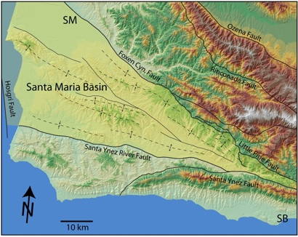
N. Onderdonk

Slide 4
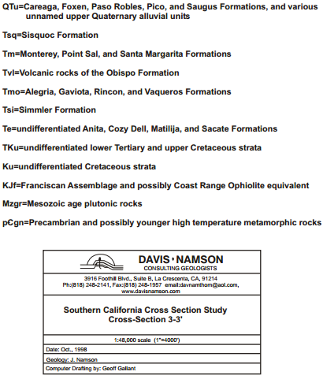
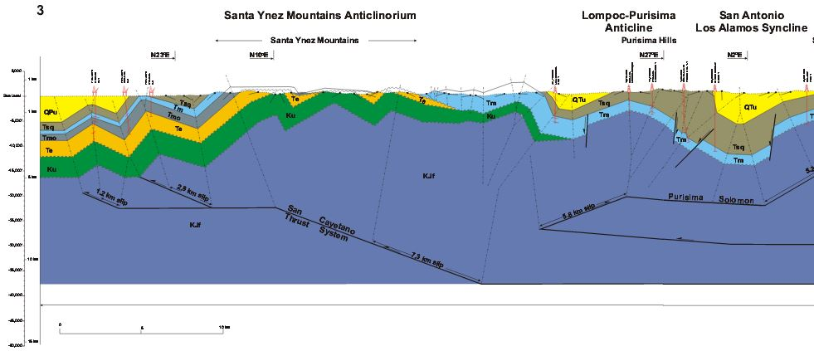
Davis and Namson Cross Section Study, 1998

Slide 5
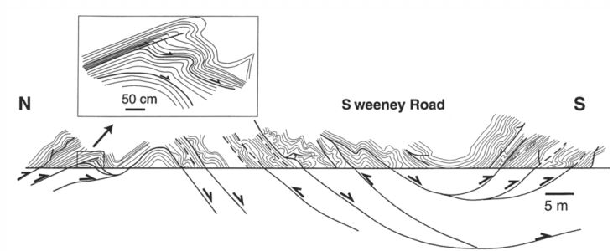
Gutiérrez-Alonso and Gross, 1997

Slide 6
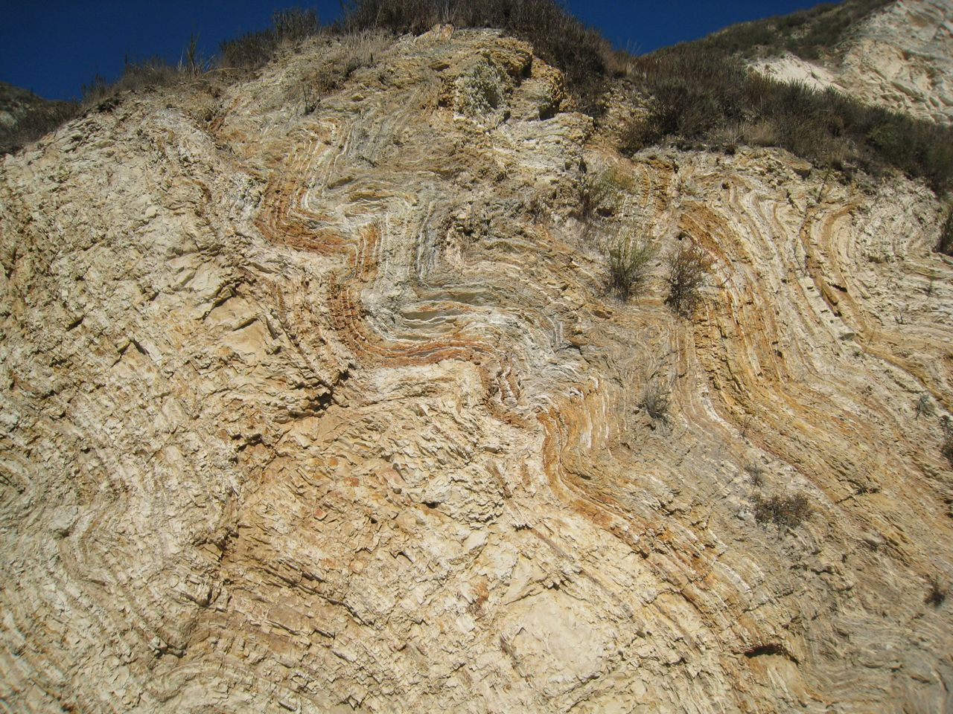

Slide 7
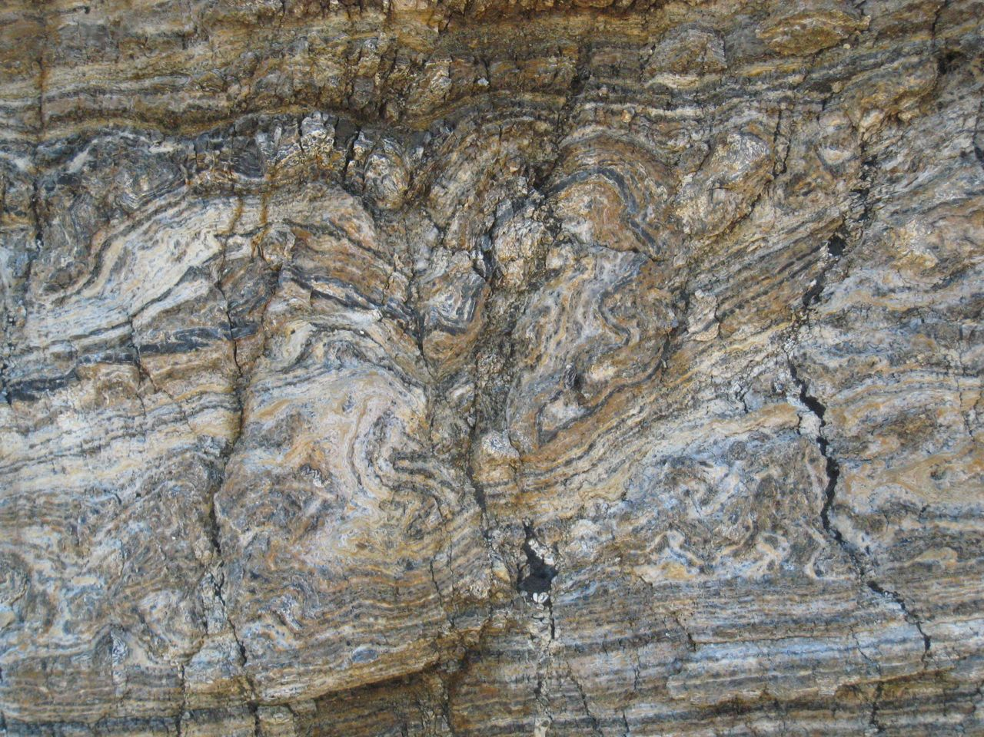

Slide 8
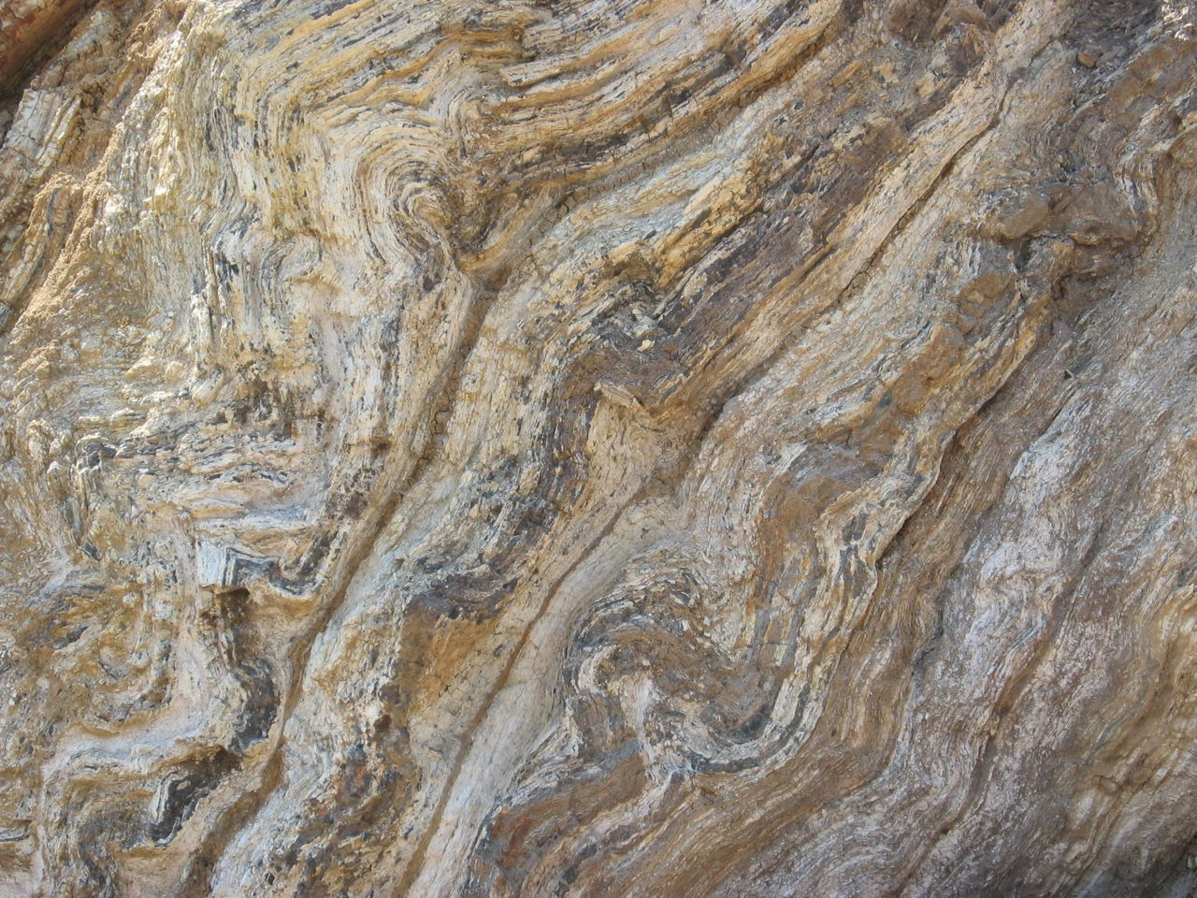

Slide 9
Large Scale
25km
N. Onderdonk

Slide 10
Short Scale
1-5 km
N. Onderdonk

Slide 11
What allows us to accurately measure shortening in the basin?

Slide 12
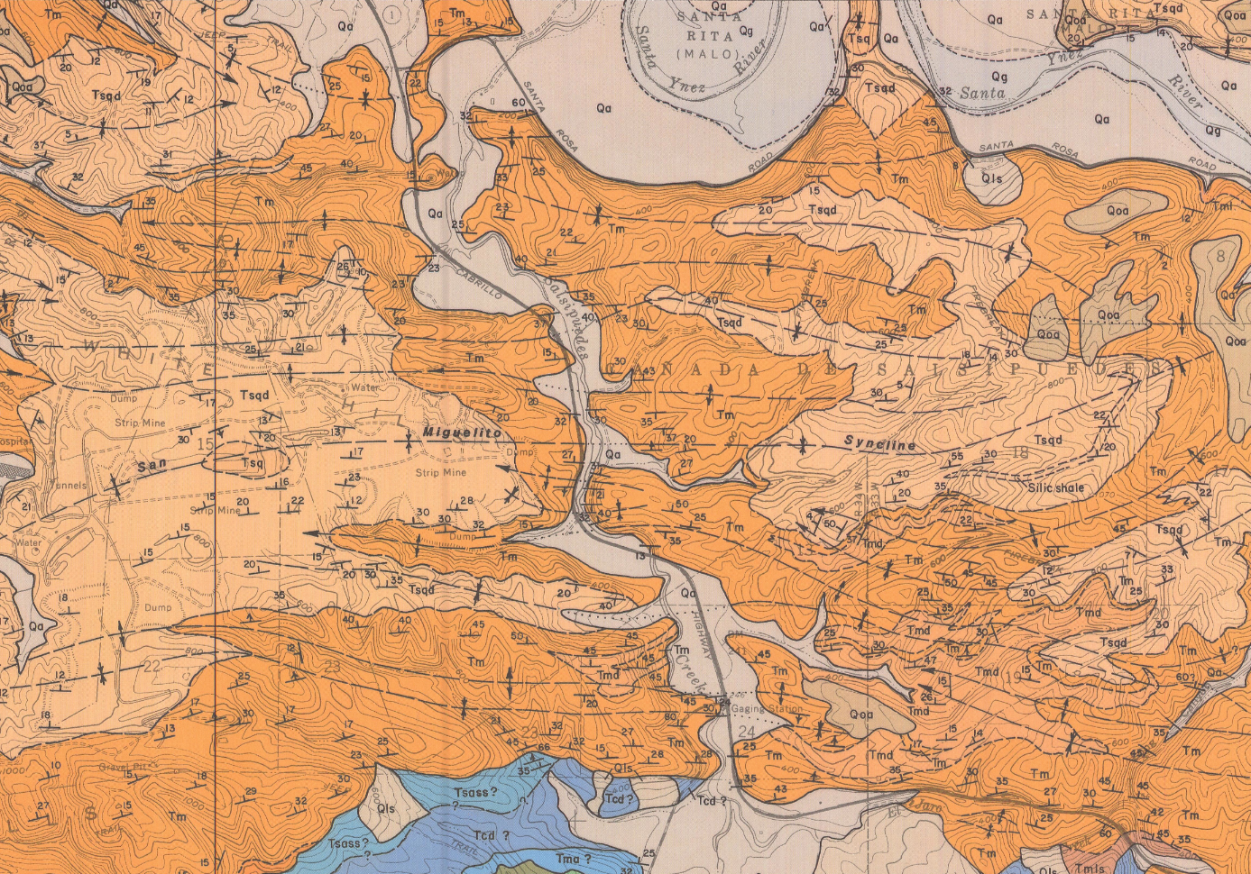
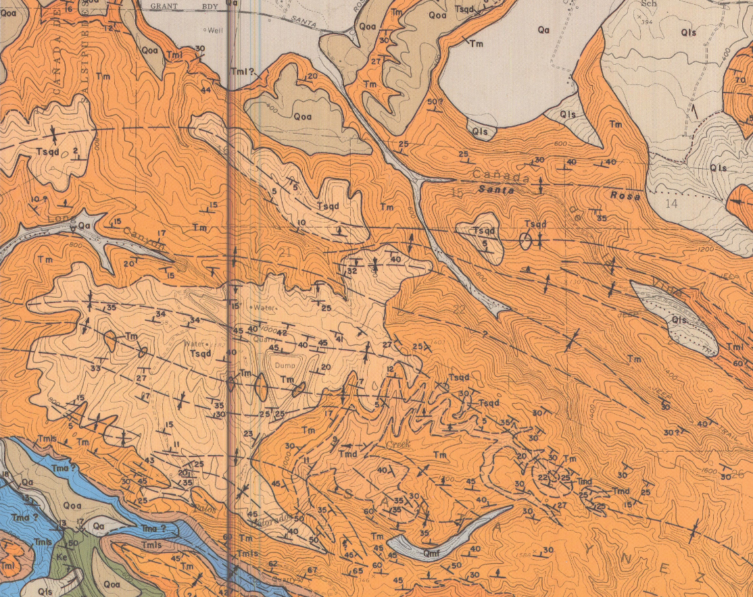
METHODS
Construct cross-sections and calculate strain from published maps (e.g., Dibblee maps)

Slide 13
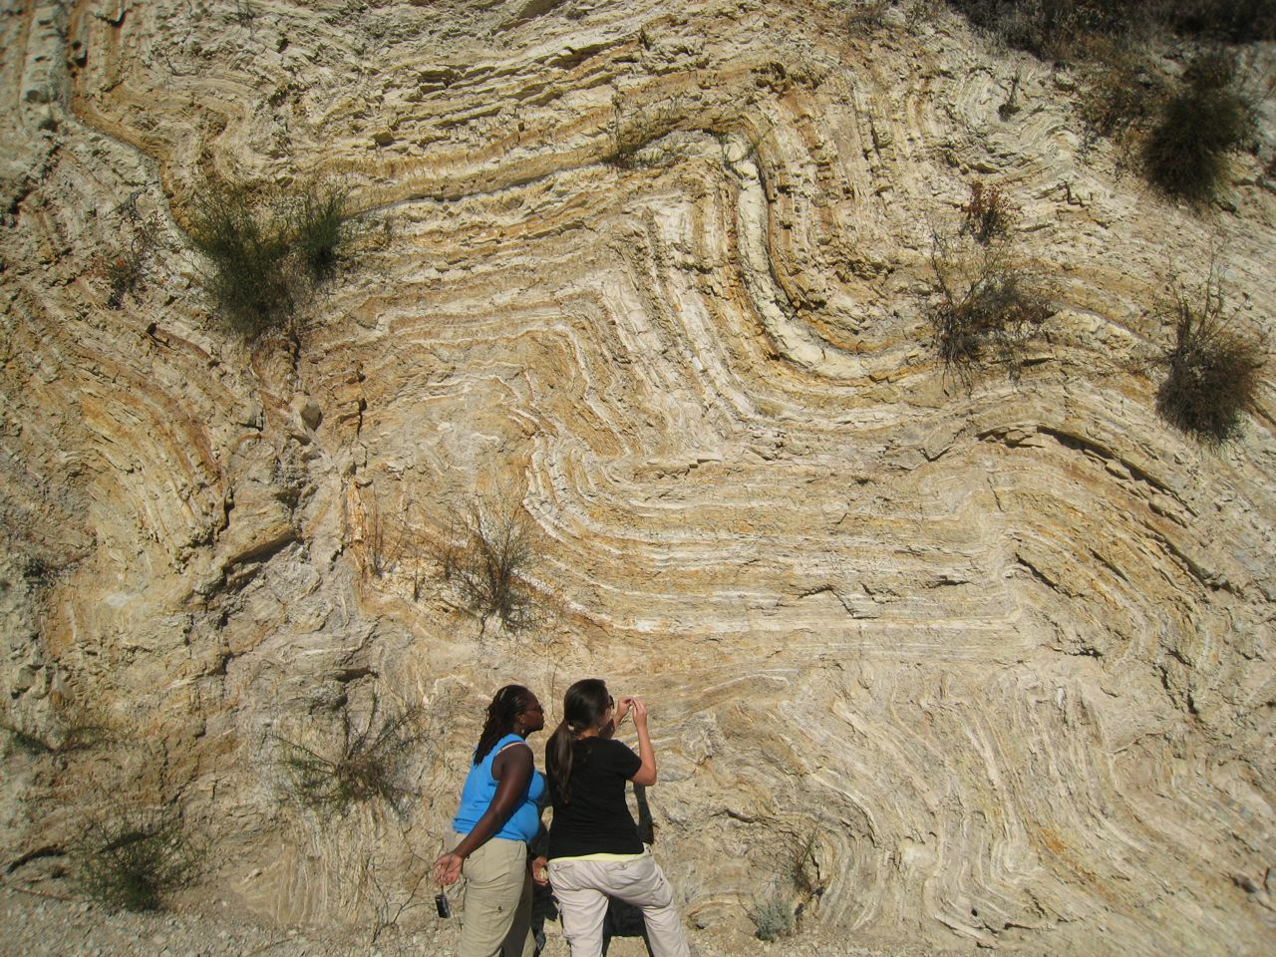
…Field Work: Outcrop Scale

Slide 14
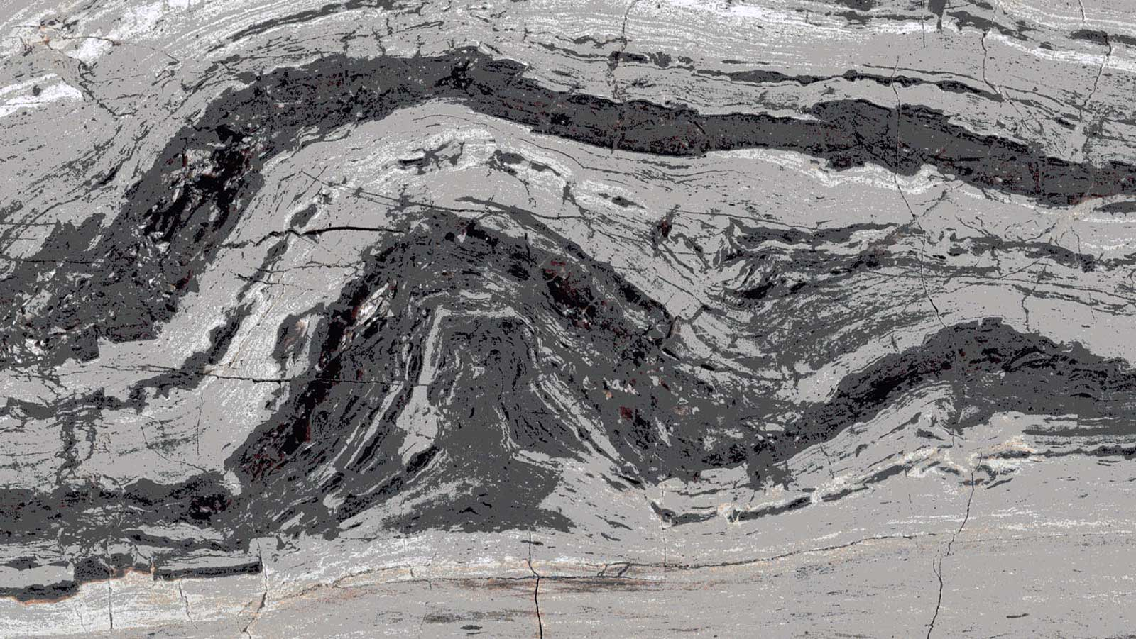
…Lab Work: Microstructural Analysis

Slide 15
IDEAS?

