Slide 1
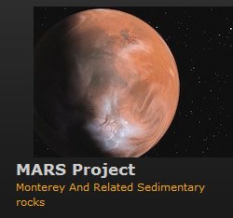
Stratigraphy and Sedimentology of the Mixed Clastic-Biogenic Monterey Formation, Point Dume to Paradise Cove, Malibu, California
By: Wanjiru Njuguna
MS Candidate in Geology
Thesis Advisor: Dr. Rick Behl
Committee Members: Dr. Nate Onderdonk and Dr. Hilario Camacho
Long Beach MARS Project: Monterey and Related Sediments

Slide 2
Presenter back-ground
Education:
Master of Science Graduate Student, CSULB
Master of Arts in Geography, CSULB
Graduate Certificate in Geographic Information Science, USC
Bachelor of Science, Geology, Tufts University
Employment:
Staff Geologist, Oxy Long Beach (2010 to present)
Geologist Technician, Oxy Long Beach (2007 to 2010)
Long Beach MARS Project: Monterey and Related Sediments

Slide 3
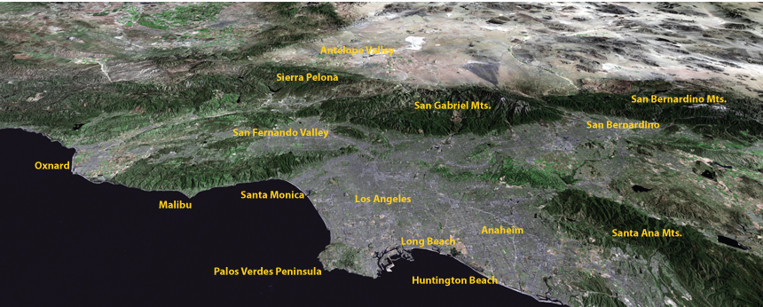
Point Dume and Paradise Cove, Malibu, CA
Presentation Structure
Study area location
Why studying this section is important?
What are the goals of the project?
Findings from field visits and pilot study
Pacific Coast Highway
Paradise Cove
Point Dume SB
Long Beach MARS Project: Monterey and Related Sediments

Slide 4
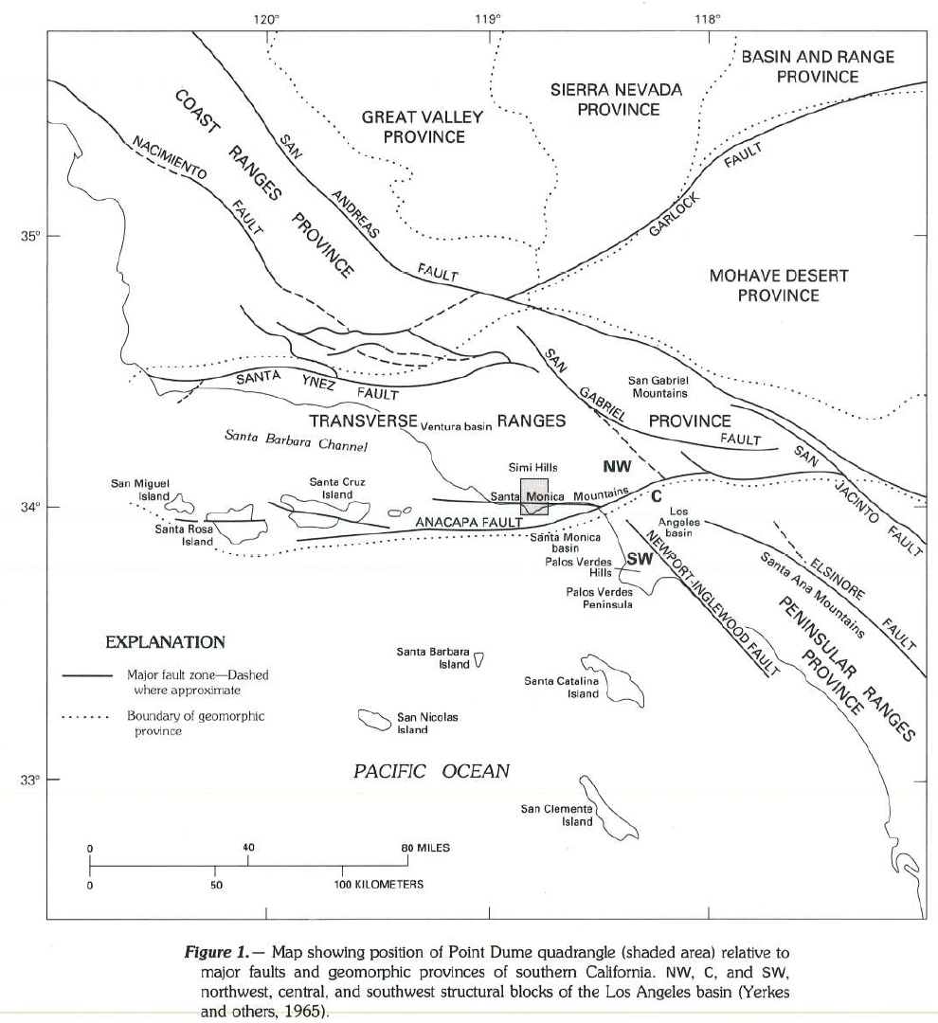
Location
Malibu is at the southernmost edge of the rotating Western Transverse Ranges (WTR)
At the boundary between the LA Basin, Inner Borderland &WTR
Likely was outboard of Palos Verdes during deposition
Long Beach MARS Project: Monterey and Related Sediments

Slide 5
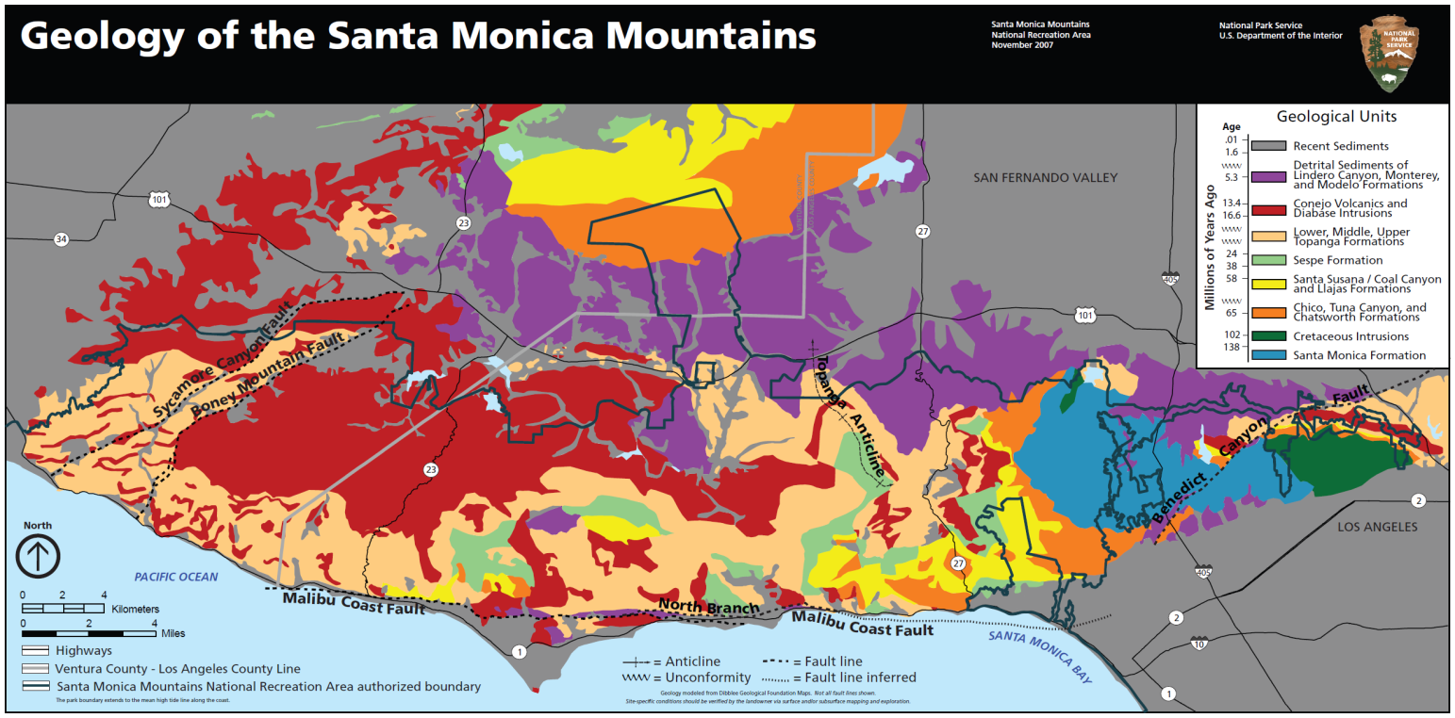
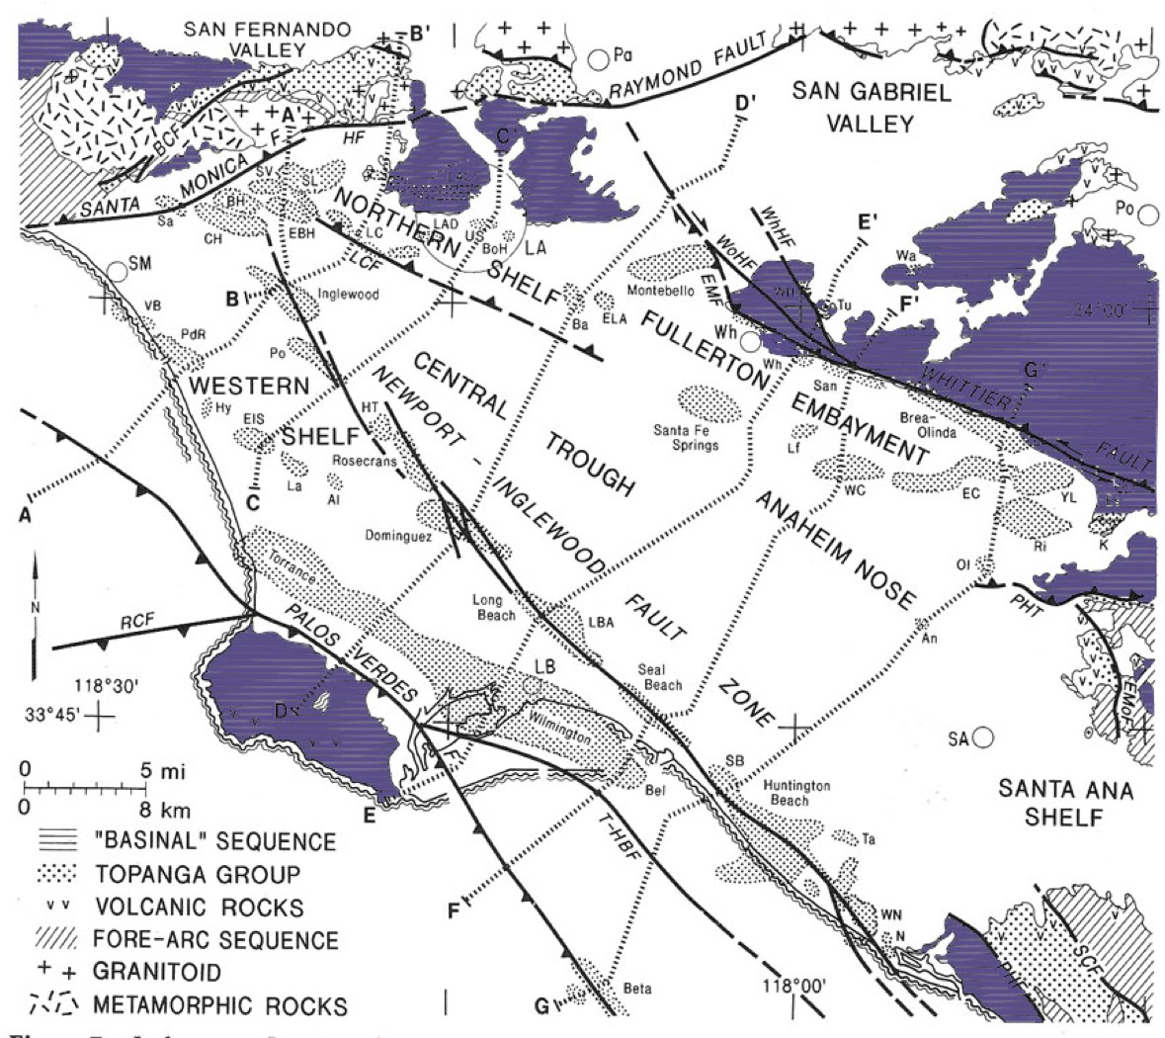
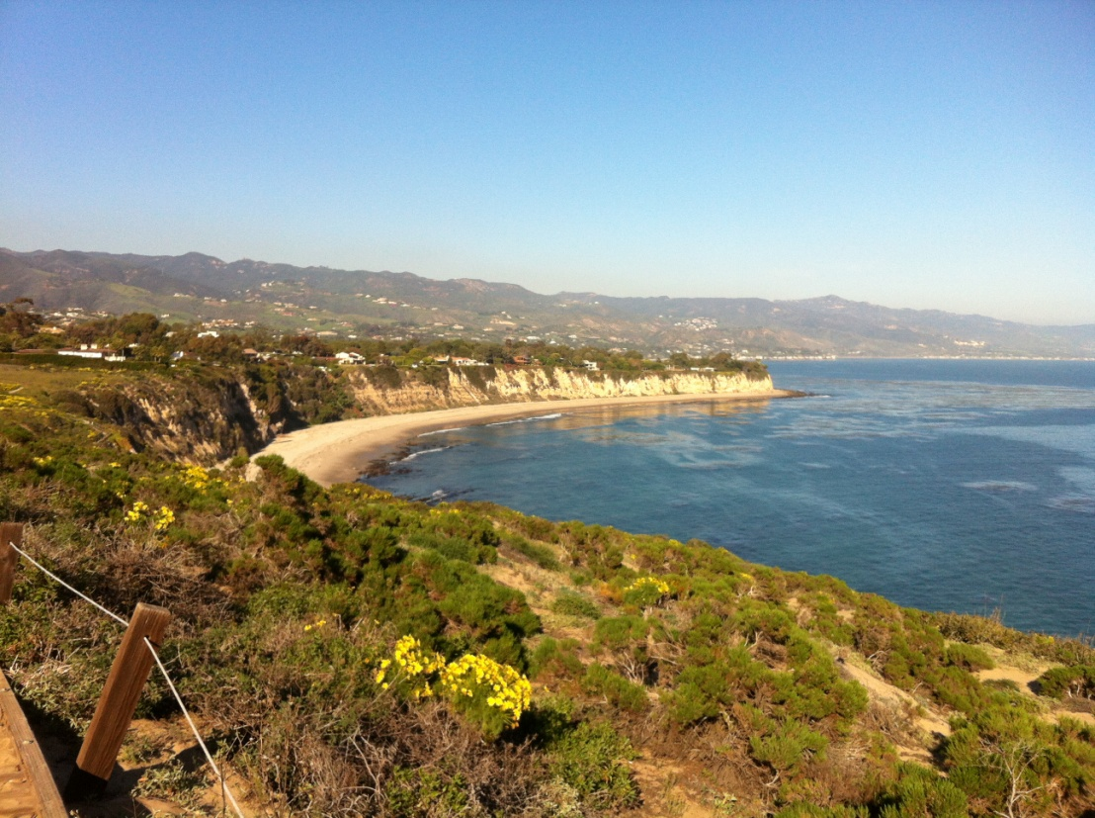
Location
Unknown relationship with outcrops Monterey, Modelo and Puente outcrops around LA basin
Palos Verdes or Newport Beach may be closest original settings
Looking south from Point Dume
Paradise Cove
Long Beach MARS Project

Slide 6
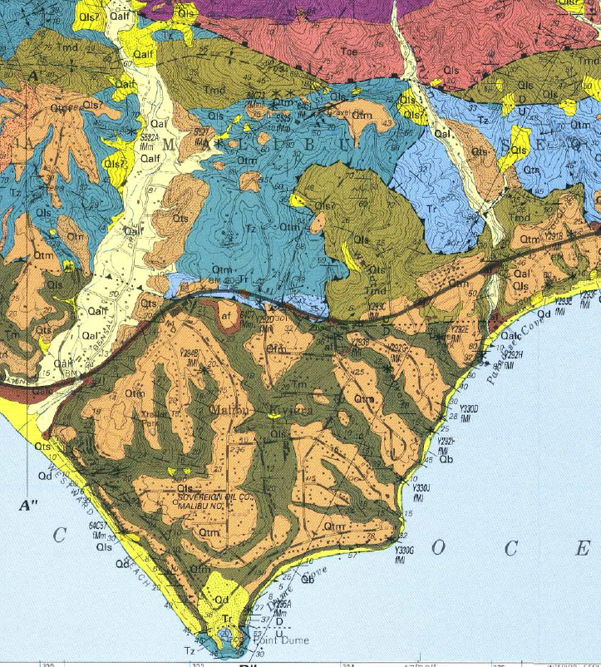
Study area relevance
Late middle to early late Miocene age (Yerkes and Campbell, 1979)
Possibly, one of the most complete sections of the Monterey Formation in outcrop in the Los Angeles Basin.
Monterey Formation dips to the north at ~ 30-50 degrees
Bottom of the section at Point Dume to Paradise Cove section thickness is ~1635 meters
Monterey Shale overlies the Trancas Formation and Zuma Volcanics (Campbell et. al. 1996)
Malibu Coast Flt
Paradise Cove Flt
Long Beach MARS Project: Monterey and Related Sediments
Notes:
Cosine 40 times 7000’ (estimated from google maps) and then convert that number to meters.

Slide 7
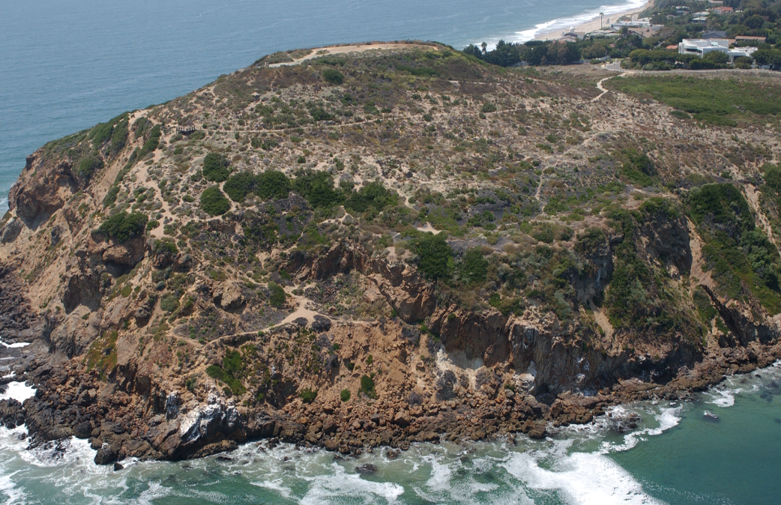
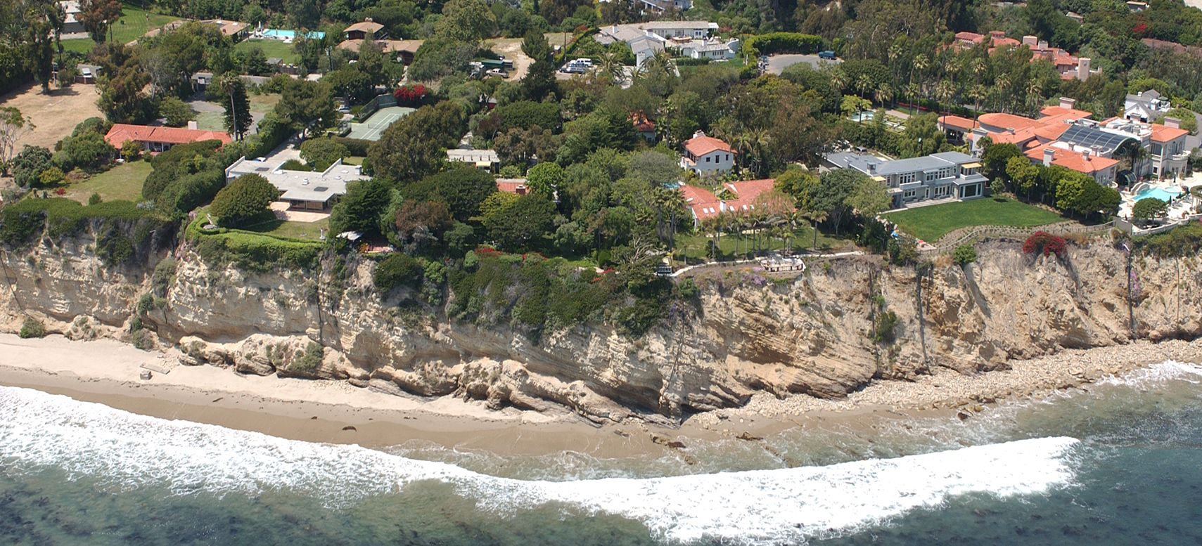
Point Dume to Paradise Cove stratigraphic Section
Base of section
Point Dume (Zuma Volcanics)
Lower part of section
East from Point Dume
California Coastal Records

Slide 8
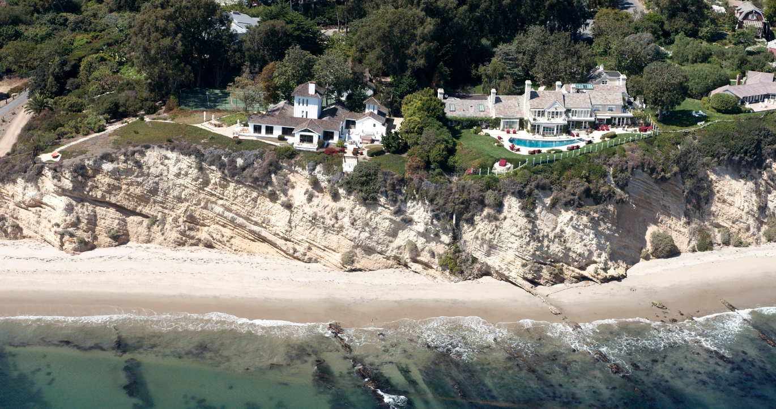
Continuous even-dipping section – Point Dume to Paradise Cove
Upsection to right
Middle part of section
California Coastal Records
Long Beach MARS Project: Monterey and Related Sediments

Slide 9
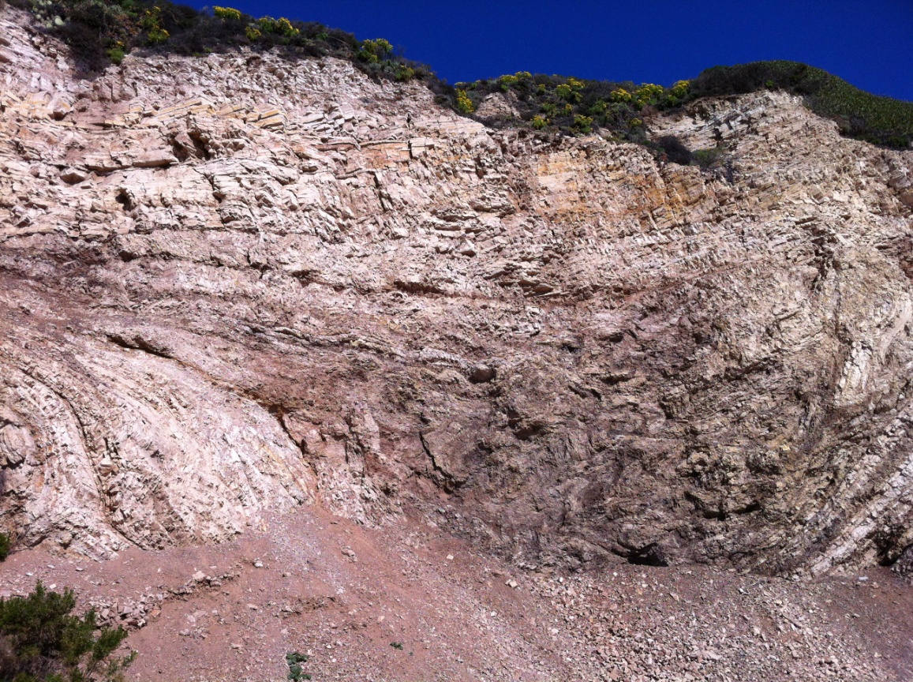
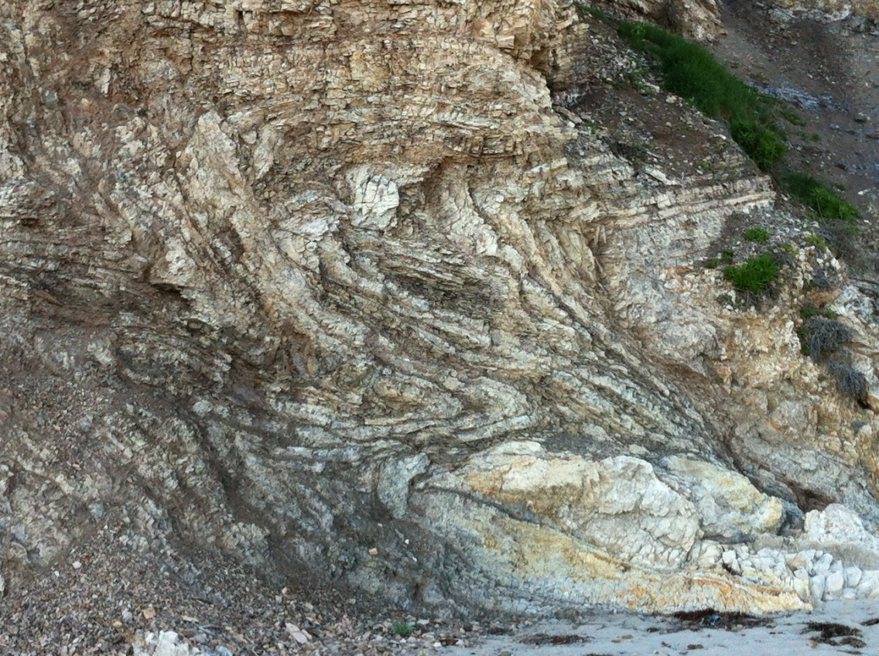
On Other Side of Point Dume – Close to Malibu fault system More Structurally Complex!
Isoclinal folds
Imbricated fault duplexes
Long Beach MARS Project: Monterey and Related Sediments

Slide 10
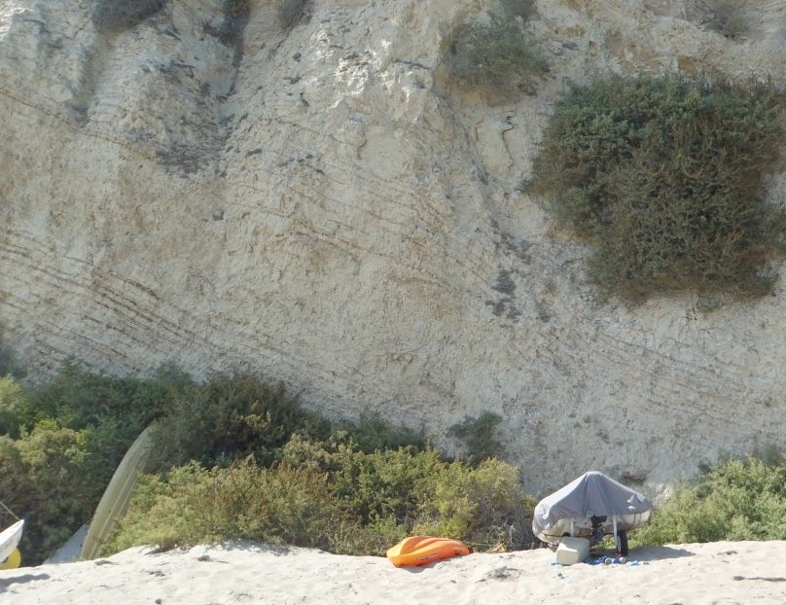
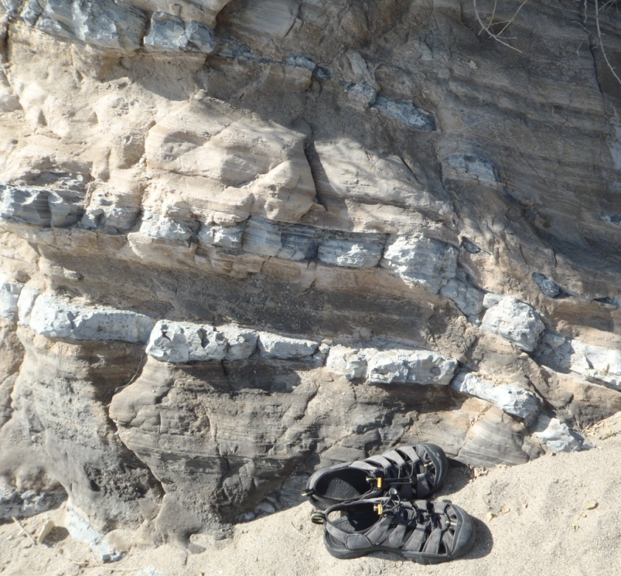
Outcrops – Preliminary Observations
Lithology
Diatomite, mudstone, sandstone and dolomite
Opal-CT chert and porcelanite
Conglomerate and volcanics
Bedding
Alternating packages: thin-bedded laminated and massive lithofacies.
Evidence of slope deposits, slumps and turbidites
High-energy deposits alternating with hemipelagic sediments
Features
Graded beds, scoured surfaces, flame structures, load casts and other soft sediment deformation
Long Beach MARS Project: Monterey and Related Sediments

Slide 11
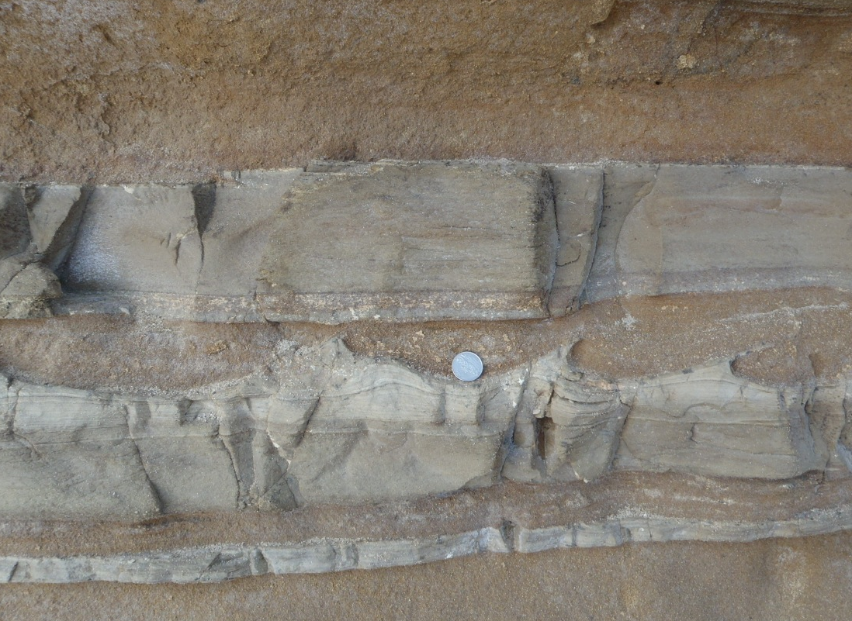
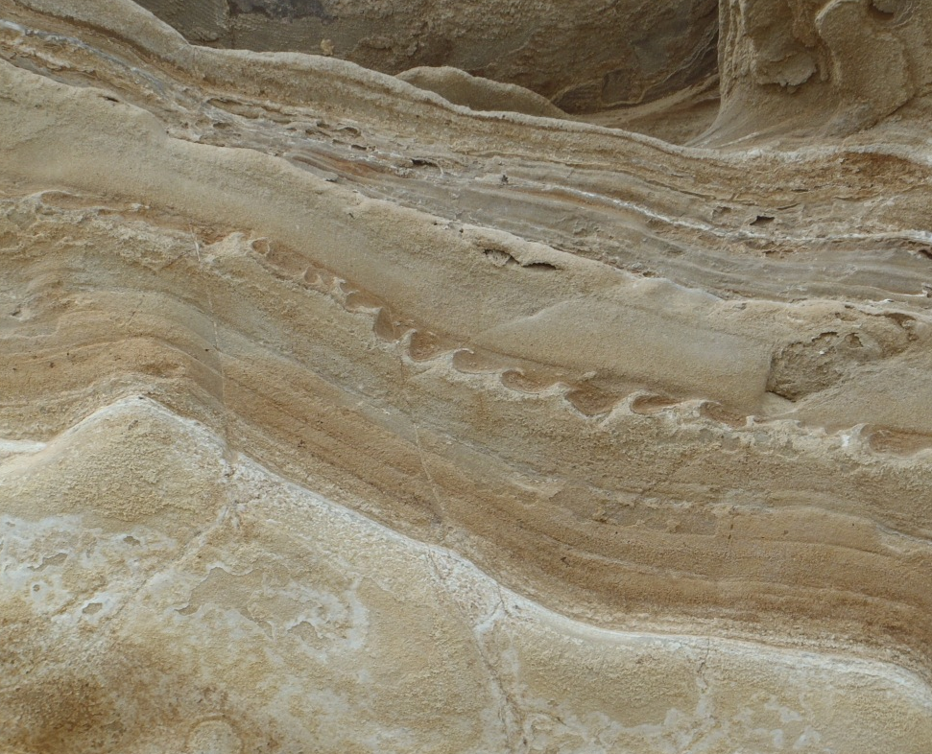
Sedimentary features
Interbedded sand turbidites and siliceous mudstone
Graded beds
Flame structures
Scoured surfaces
Long Beach MARS Project: Monterey and Related Sediments

Slide 12
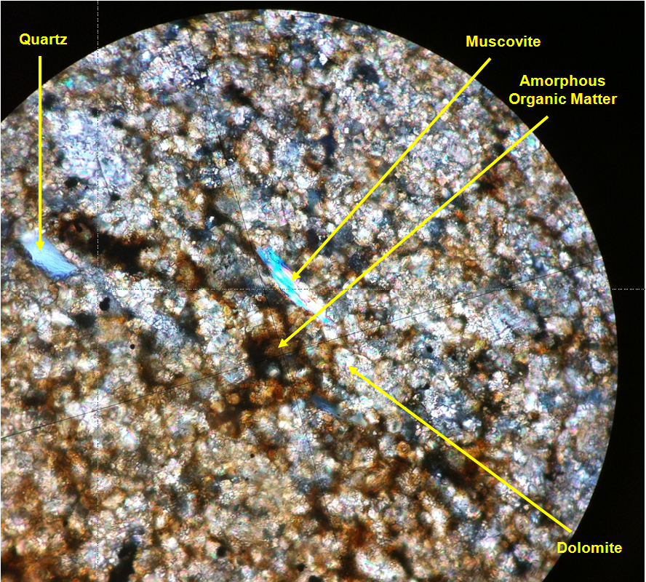
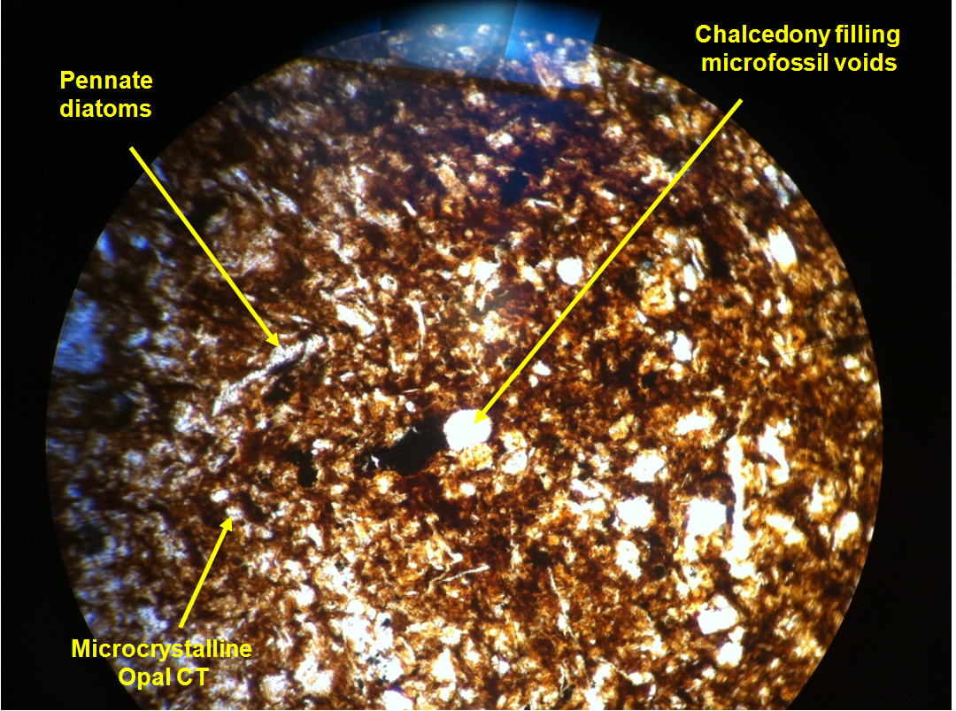
Petrography of samples
XRD and photomicrographs confirm the presence of diatoms, opal-CT, dolomite and the mineral composition of the sandstones
Long Beach MARS Project: Monterey and Related Sediments

Slide 13
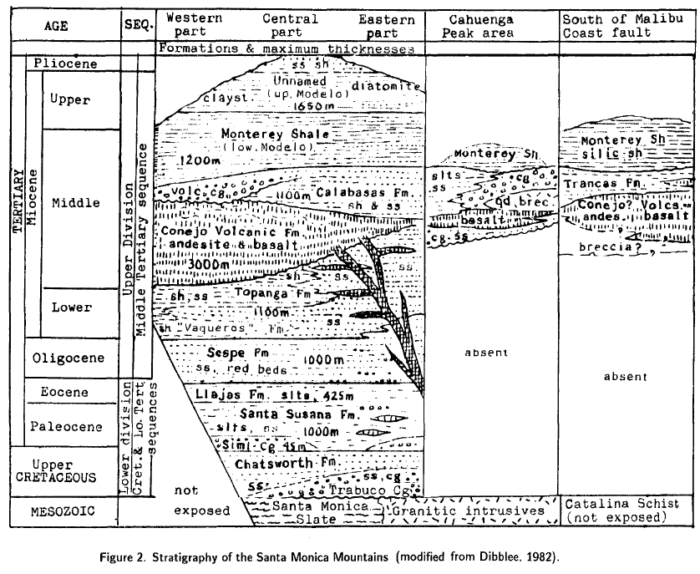
Suggestions? Questions? Future plans?
There is a need for a detailed stratigraphy and sedimentology study of this area
The objective will be to describe the section in detail and come up with a description of the Monterey succession between Point Dume and Paradise Cove
A new stratigraphic section will provide information on sediments south of the Malibu Coast fault from the outer part of the LA basin
Relate to other Monterey facies in LA basin.
Long Beach MARS Project: Monterey and Related Sediments

