Slide 1
Characterization of heterogeneous pore structure in quartz phase porcelanites, Monterey Formation, California
Tesfalidet Kassa 2012
Thesis Chair:
Dr. Richard Behl
Thesis Committee:
Dr. Greg Holk
Dr. Robert Francis

Slide 3
Investigation
Role of sedimentary fabric on porosity and pore distribution
Porcelanite fabrics
Massive- Bioturbated
Deposition in oxic conditions
Massive to Graded- Gravity flow deposition
Deposition in slope setting, “Speckled beds”
Laminated- Varves
- Thin gravity flows
Deposition in anoxic setting
Basin, slope or banktop
Does original sedimentary fabric control porosity after
2 steps of silica diagenesis ?
Notes:
Distinctive nonlaminated intervals we term speckled beds (SBs) are common in finely laminated diatomites of the Monterey Formation at Celite Quarry, Lompoc, California. SBs have sharp and bedding-parallel upper and lower contacts, tabular geometry, and are less than or equal to 10 cm thick. SBs are characterized by a bedding-parallel arrangement of sand- to granule-size diatomaceous and detrital aggregates that are uniformly distributed in a fine-grained matrix of macerated biosilica and detrital mud. The unique physical properties of diatomaceous sediments provided cohesive substrates and high fluid content that were prerequisite for the formation of SBs. Abundant hybrid fault/vein structures, slump folds, and complexly deformed laminae in the quarry attest to syndepositional deformation of laminated diatomaceous sediments on a subaqueous slope within the oxygen-minimum zone. The unique features of SBs permit an interpretation of stepwise rheological transformation during mass movement, via passage through critical-point transformations, from Bingham plastic (slump and/or slide block) to turbulent fluid (turbidity current) to viscous fluid exhibiting laminar flow (debris flow). The recognition of SBs clarifies the origin of these distinctive yet problematic deposits, and clearly differentiates them from other nonlaminated intervals. SB composition indicates provenance from an oxygen-minimum zone and further illustrates that a hiatus is not required to form cohesive firmgrounds in diatomaceous sediments. The recognition of SBs as recorders of slope failure events complements paleoseismic studies of Holocene diatomaceous laminites from Saanich Inlet, British Columbia (Ocean Drilling Program Sites 1033 and 1034).

Slide 4
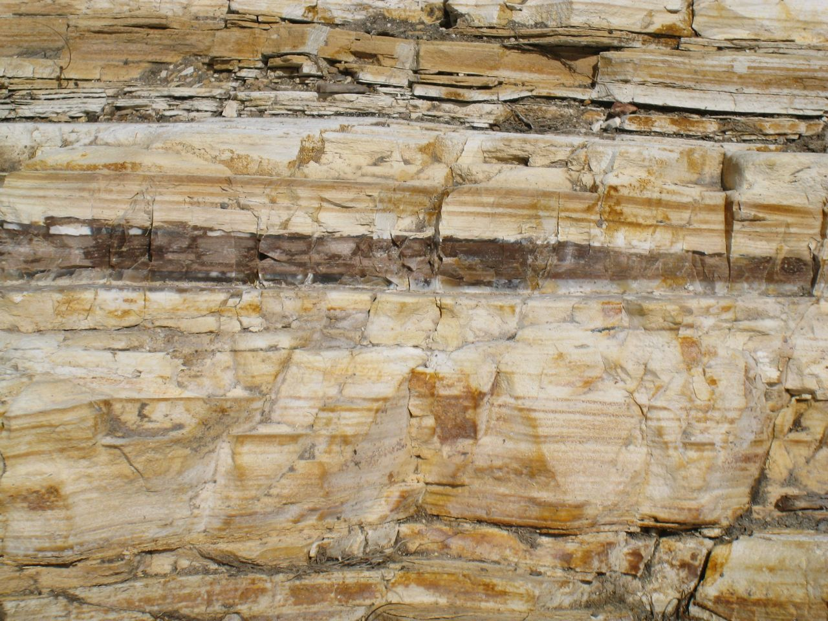
Outcrop – quartz phase rocks
Interbedded laminated and massive porcelanites
Behl

Slide 5
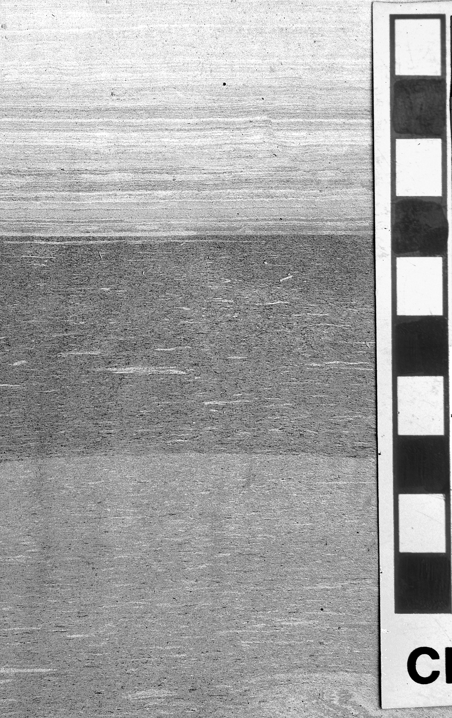
Original Diatomaceous deposits
Laminated diatomite –
Varve-like with thin gravity flows
“Speckled Beds”: diatom gravity flows
“Speckled Beds”: diatom gravity flows
CM
Behl

Slide 6
Interbedded laminated and massive porcelanites in core, with “speckled beds”
Behl

Slide 7
The test of the experiment
We compare 2 porcelanite samples
Both quartz phase
Both nearly identical composition
Very pure , high-silica quartz porcelanite
BK12-15 |  | BK12-16
Detritus % | Silica % | Detritus % | Silica &
12.15 | 87.85 | 11.13 | 88.87

Slide 8
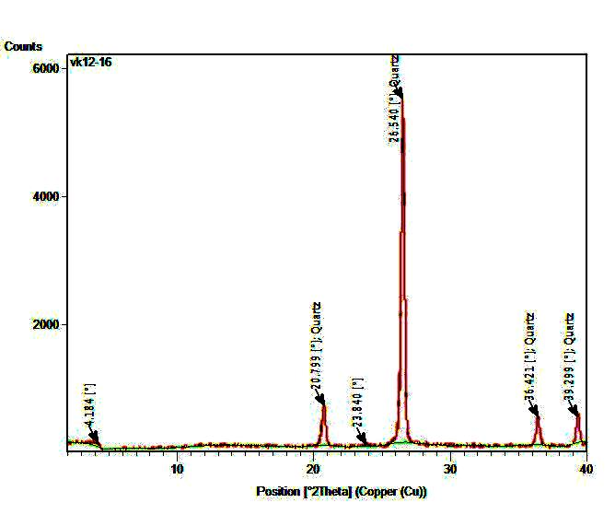
XRD – Quartz Phase
BK12-15 | BK12-16

Slide 9
Methods
Silica Phase and Composition:
XRD- X-ray diffraction
EDS and XRF combination:
Energy-Dispersive X-Ray Spectroscopy (EDS)
X-Ray Fluorescence Spectroscopy (XRF)
Imaging
SEM- Scanning Electron Microscope
Secondary Electron Imaging
Backscattered Electron Imaging
Planned
Dual Ion Beam Electron Microscopy

Slide 10
Variations in Pore Structure
Two or three types of porosity microfabric:
Massive bed
Heterogeneous
Low porosity matrix
High porosity lenticular patches
Nonconnected, ineffective porosity?
Homogeneous
Not observed yet
Laminated bed
Heterogeneous
100 µm-thick laminations
Highly porous and interconnected
Low porosity with isolated pores
Some degree of heterogeneity within laminations
The microstructures can have an implication on permeability.

Slide 11
Patchy vs. laminated porosity
VK12-15 | VK12-16
500.0 µm
400.0 µm

Slide 12
Patchy porosity in massive porcelanite
BK12-15
400 µm
20 µm

Slide 13
Lamination-scale differences in porosity
BK12-16
400.0 µm
50.0 µm

Slide 14
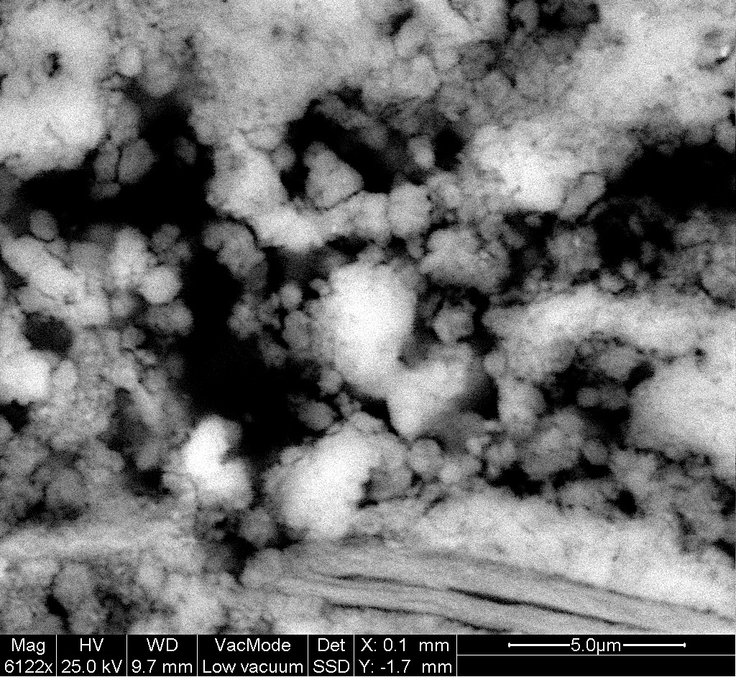
High-Porosity laminations: Interconnected and very porous
10.0 µm
5.0 µm

Slide 15
Heterogeneous porosity in high-porosity laminations
10.0 µm
10.0 µm

Slide 16
Small pore size and less Interconnected in low porosity laminations
1 µm
1 nm

Slide 17
Calculated Porosities from Image Analysis
Three types of porosity :
Massive bed – Heterogeneous with patchy porosity
Bulk porosity 19%
Porous layers *35%
Porosity 18%
Laminated bed - Heterogeneous with layered porosity
Bulk porosity 26%
Highly porous layers 35%
Less porous layers 19%
Massive bed – Homogeneous porosity
Not yet observed, but postulated

Slide 18
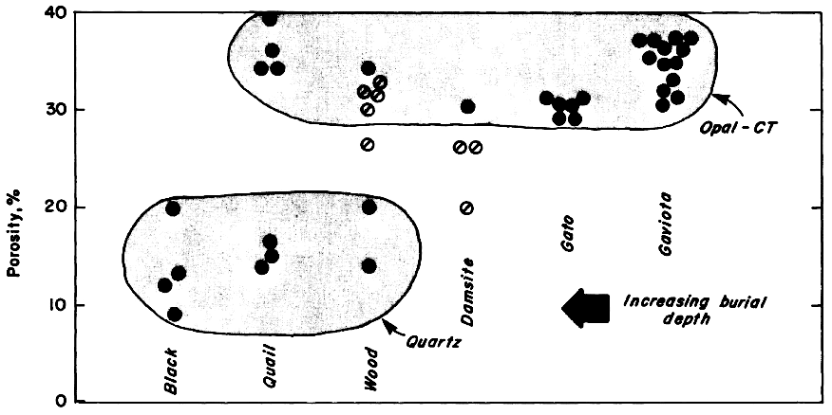
Comparison With Previous Studies
1. Isaacs, 1980 | 2. Schwalbach et al., 2007
Quartz porosity 9-22 % | Quartz porosity 15-30%
3. Chaika and Dvorkin, 2000
Quartz Porosity 12-26%
4. This Investigation
Quartz Porosity 19%-26%

Slide 19
Conclusion
This study finds that low-detritus quartz-phase porcelanites with identical composition can have significant differences in microstructure affecting both bulk and effective porosity.
The study identified:
Massive beds
Heterogeneous
Low porosity matrix
High porosity lenticular patches
Laminated beds
Heterogeneous- 100 µm-thick laminations
Highly porous and interconnected
Low porosity with isolated pores
Follow-up work:
Backscatter electron imaging
Dual Ion Beam electron microscopy

