Slide 1
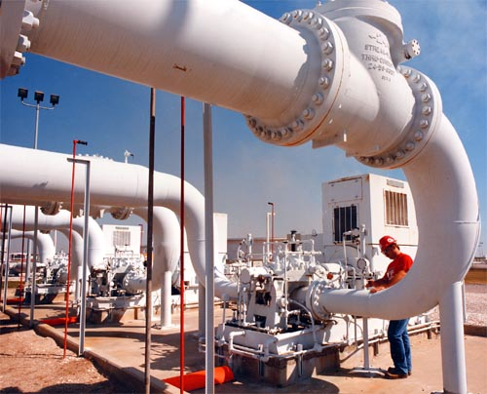
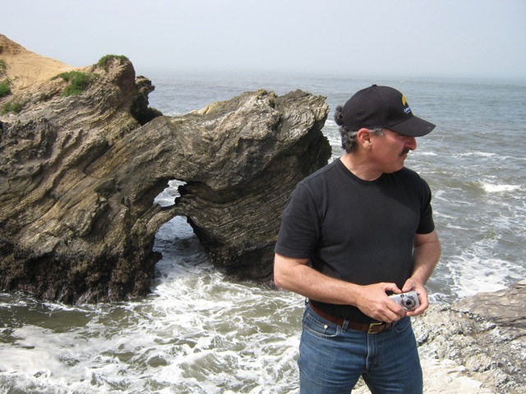
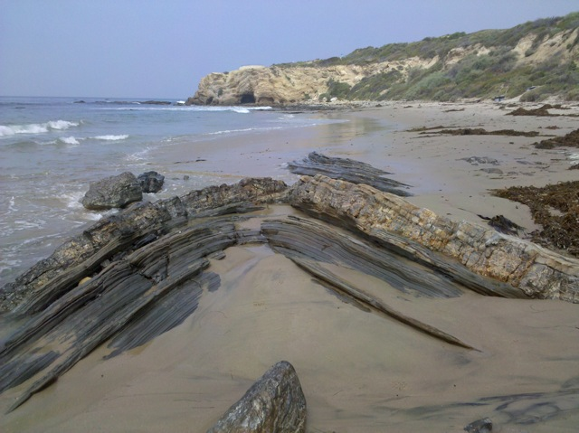
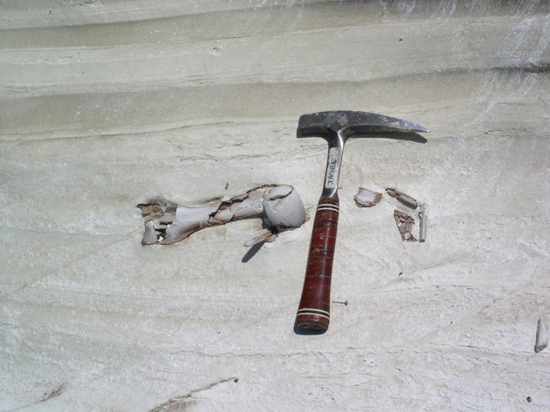
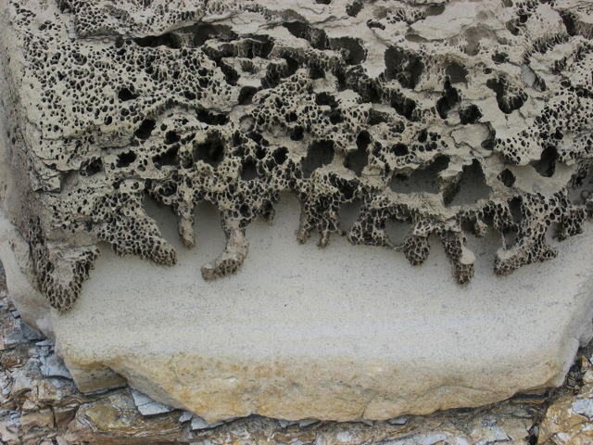
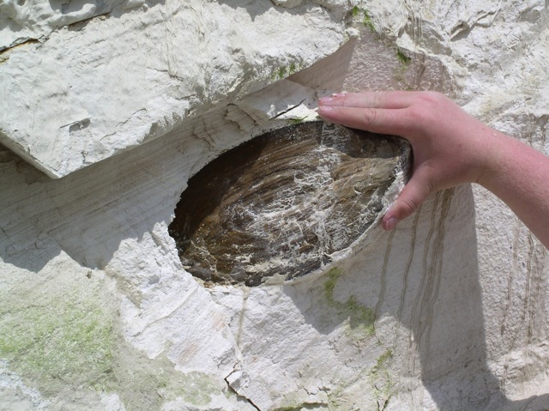
Sedimentology and Stratigraphy of Diatomaceous Sediments in the Casmalia Hills and Orcutt Oil Fields, Santa Maria Basin, CA
Daniel Torn
M.S. Candidate, California State University Long Beach
Thesis Committee Chair: Dr. Richard J. Behl
Committee Members: Dr. Tom Kelty and Dr. Dan Francis
Notes:
Good afternoon and thank you all for being here today. As Dr. Behl indicated, my name is Daniel Torn and my thesis is about the Sedimentology and Stratigraphy of Diatomaceous Sediments in the Santa Maria Basin. More specifically, in the Casmalia and Orcutt Oil fields.

Slide 2
Presenter Background
Education
MS, Geological Sciences (Exp. March, 2014)
California State University, Long Beach
BS, Geological Sciences (2011)
San Diego State University
Professional Experience
Geoscience Internship (Summer 2013)
Devon Energy Corporation, Oklahoma City, OK
Starting as a Geologist at Devon in May, 2014
Previous geoscience internships:
-Chesapeake Energy Corporation
-Occidental Petroleum Corporation
-BreitBurn Management Company
-
Devon Tower
Oklahoma City, OK
Notes:
So before I start, I’d like to tell you a little about myself.
I graduated in 2011 with a BS in geology from SDSU.
I then went on to pursue my masters under Dr. Behl here at CSULB and I am expected to finish early this school year.
I recently finished a geoscience internship with Devon Energy Corporation this summer in OKC and I will be starting Full time with Devon in May 2014 as a geologist.

Slide 3
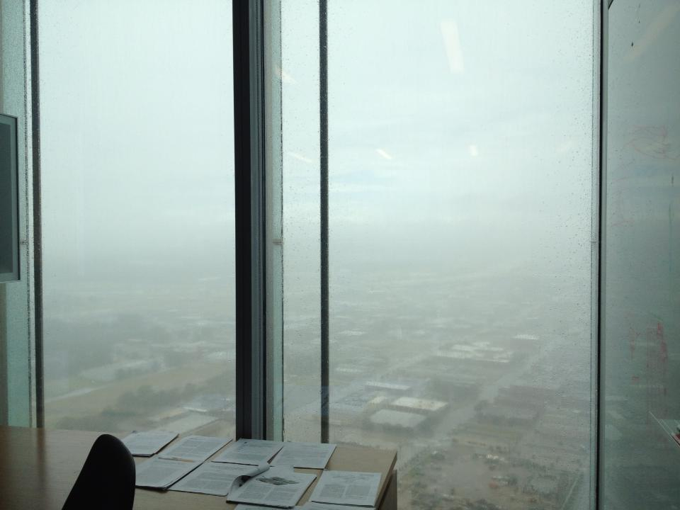
Presenter Background
Education
MS, Geological Sciences (Exp. March, 2014)
California State University, Long Beach
BS, Geological Sciences (2011)
San Diego State University
Professional Experience
Geoscience Internship (Summer 2013)
Devon Energy Corporation, Oklahoma City, OK
Starting as a Geologist at Devon in May, 2014
Previous geoscience internships:
-Chesapeake Energy Corporation
-Occidental Petroleum Corporation
-BreitBurn Management Company
-
Devon Tower
Oklahoma City, OK
Notes:
So before I start, I’d like to tell you a little about myself.
I graduated in 2011 with a BS in geology from SDSU.
I then went on to pursue my masters under Dr. Behl here at CSULB and I am expected to finish early this school year.
I recently finished a geoscience internship with Devon Energy Corporation this summer in OKC and I will be starting Full time with Devon in May 2014 as a geologist.

Slide 4
Presentation Outline
Introduction/Purpose/Importance
Geology/Stratigraphy/Structure
Data and Methodology
Current Progress
Conclusion
Notes:
So, lets go over the outline of my presentation
First I will go over a quick introduction, and talk about the purpose and importance of this study
Then I will briefly go over some geologic aspects of the SMB and talk about its stratigraphy and structure
Then I will go into the Data and Methodology for the study
Show some of my current progress
And finally, I will end my presentation with a quick conclusion

Slide 5
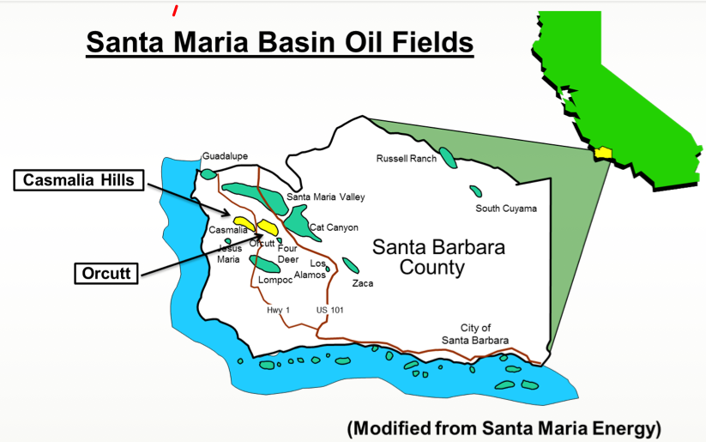
Importance
Santa Maria Basin
1 billion barrels of produced oil (on and offshore)
Most production from Monterey Formation
Increasing production from low permeability diatomite in upper Miocene Monterey and late Miocene to early Pliocene Sisquoc (cyclic steaming)
New interest in diatomaceous sediments
General conception that diatomaceous deposits are simple and homogenous rocks
Notes:
The SMB is one of the most prolific basins in CA producing over 1 billion barrels of oil in the onshore and offshore fields
Historically, most of the oil production have derived from the Monterey Fm. More Specially, the fractured reservoirs of the Monterey
But now, with high oil prices and advances in EOR techniques, there is an increasing interest in low permeability diatomite reservoirs in the upper Miocene Monterey and late Miocene to early Pliocene Sisquoc Fms.
Several companies have been able to produce oil from these diatomaceous sediments
So there is a general conception that diatomaceous deposits are simple and homogenous rocks, but in reality, they can vary

Slide 6
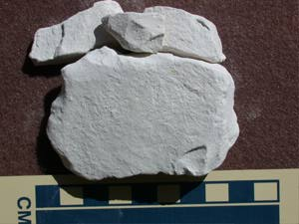
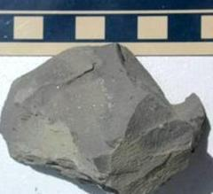
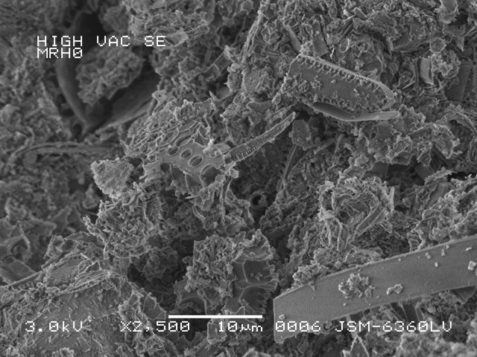
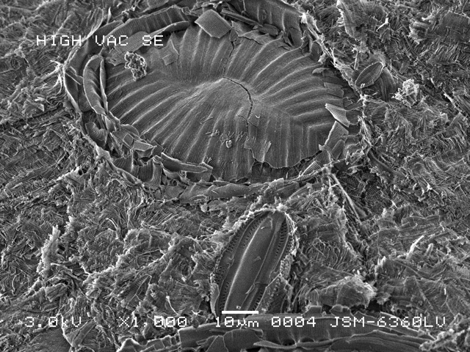
Introduction- What are diatomaceous sediments?
Composition:
Pure
Diatomite
Diatomaceous
Mudstone
Highly porous (50-75%) biogenic deposits (proven petroleum reservoir rock)
Diatom frustules + silicoflagellates + radiolarians +/- calcareous microfossils, clay, silt, and detrital minerals
Vary in composition of clays, silt, detritus, and other components because of varied environment and irregular bathymetry during deposition on an active continental margin
Different styles of sedimentation may effect petroleum production
SEM: Muddy Diatomite
SEM: Clean Diatomite
Notes:
So first, what are diatomaceous sediments?
They are highly porous (up to 75% porosity) biogenic deposits that are proven petroleum reservoir rocks not just in the SMB but in other basins as well (such as the San Joaquin)
They are mainly composed of diatom frustules, but may also contain silicoflagellates, radiolarians, calcareous microfossils, clay silt, and other detrital minterals
Diatomaceous sediments within a system may vary in compositions of clays, silt, detritus, and other deposits because of the complex and irregular bathymetry in the depositional environment in CA
So, these different styles of sedimentation can effect the physical properties of the rock, which then may effect petroleum development and exploitation
The pictures show some of the variations of diatomaceous sediments ranging form a pure diatomite to diatomaceous mudstone.
Below are pictures if various biofrabric of diatomite rocks, on the left you have a higher degree of biofragmentation with the right having less.

Slide 7
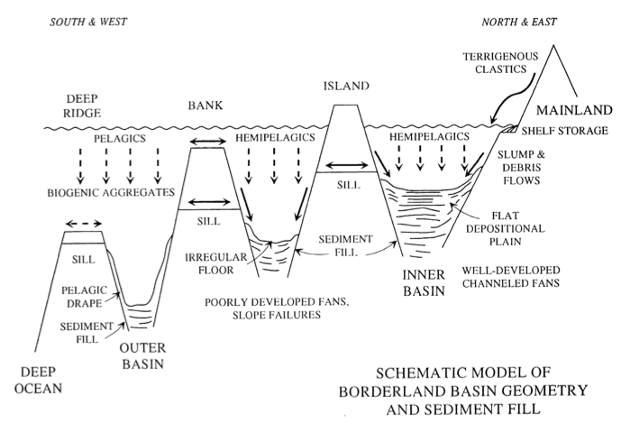
Deposition of Diatomite in California Basins
Diatomaceous Deposition
Schematic Model of Borderland Basin Geometry and Sediment Fill
Diatomaceous deposits in California basins vary in composition (vertically and laterally) because of the complex and irregular bathymetry during deposition on a tectonically deformed and active margin
Important to understand variations for petroleum plays
(Gorsline, 1990) after (Gorsline and Emery, 1959)
Notes:
As mentioned before, diatomaceous deposits can very in composition (in a vertical and lateral sense) because of the irregular bathymetry during the deposition on a tectonically active margin
So lets take a look at the schematic model of the Borderland Basin Geometry and Sediment Fill after Gorsline and Emergy
So you have the Inner basin and outter basin with large variations in paleobathymetry with influx and sourcing from a terrigenous source onshore
You have Islands, Bank tops and deep ridges with various sill depths that control the OMZ.
In addition you have various processes such as pelagic drapes, slope failures, slump and debris flows and more
So in summary, there are various components that can produce variable compositions
And it is important to understand these variations for petroleum exploration and exploitation

Slide 8
Presentation Outline
Introduction/Purpose/Importance
Geology/Stratigraphy/Structure
Data and Methodology
Current Progress
Conclusion
Notes:
1) Now lets briefly go over some of the geology of my field area

Slide 9
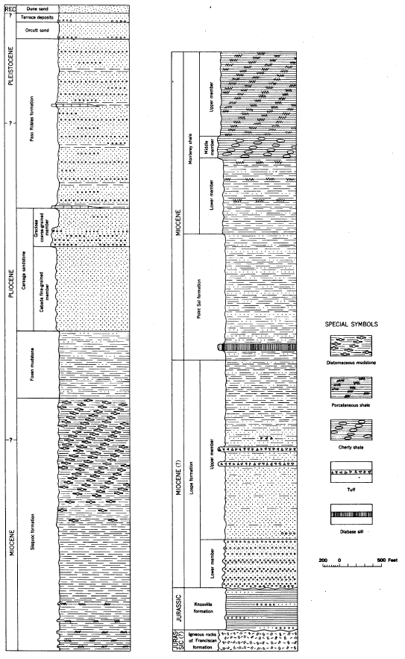
Santa Maria Basin Stratigraphy
Modified from
Woodring and Bramlette (1950)
Continued Infilling of Basin:
-Foxen Mudstone, Careaga Sandstone and
Paso Robles Formation
Sisquoc Formation:
-Continuation of siliceous organic rich diatomaceous deposits with an increase of accumulation rate of detritus
Monterey Formation:
-Abundance of diatomaceous productivity -Siliceous organic-rich deposits
Pt. Sal Formation:
-Hemipelagic and submarine fan deposition
Lospe Formation:
-Initial subsidence of basin
-Nonmarine deposition
Mesozoic Basement Rocks:
-Point Sal Ophiolite
-Franciscan Complex
-Great Valley Sequence
Santa Maria Basin Stratigraphy
Paso Robles Fm.
Monterey Fm.
Carreaga Sandstone
Pt. Sal Fm.
Foxen Mudstone
Lospe Fm.
Sisquoc Fm.
Knox-ville
Fm.

Slide 10
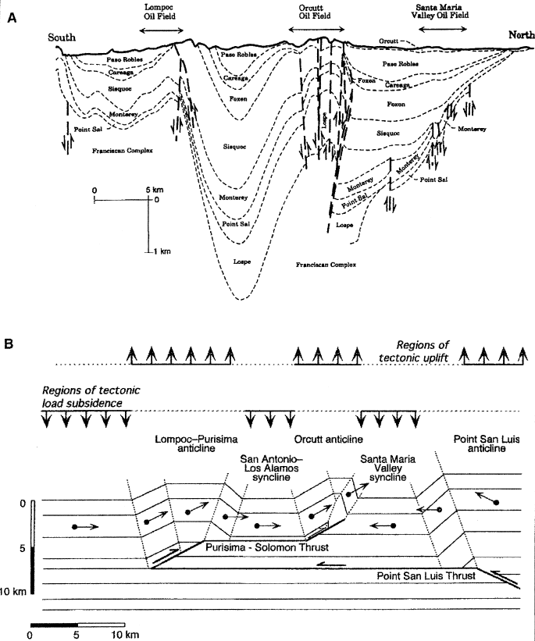
Santa Maria Basin Structure
Uplift of the basin formed the anticlinal structures first as submarine ridges
Anticlines form the structural traps for the Santa Maria basin oil fields
Source: Monterey Fm.
Reservoirs: Monterey Fm. and Sisquoc Fm.
N-S cross section through the onshore Santa Maria basin showing stratigraphy and structure of major oil fields (California Division of Oil and Gas, 1974)
Compressional structure of the onshore Santa Maria basin from Namson and Davis (1990)

Slide 11
Presentation Outline
Introduction/Purpose/Importance
Geology/Stratigraphy/Structure
Data and Methodology
Current Progress
Conclusion

Slide 12
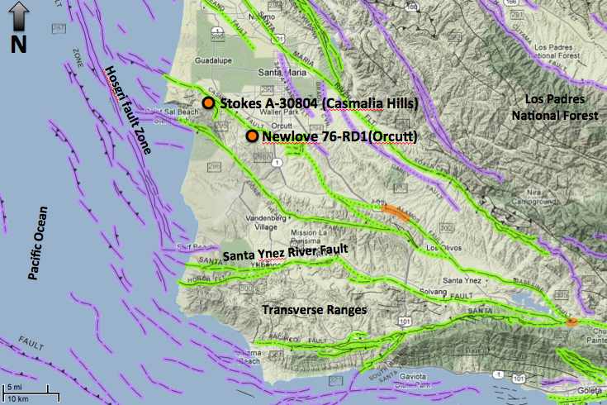
Location of Core Data
(Modified from http://www.quake.ca.gov/gmaps/FAM/faultactivitymap.html#)
Notes:
So the data that we are using for this study derives from 2 cores in the SMB in the Casmalia Hills and Orcutt Oil fields. Jon Kuespert of BreitBurn and Mark Wilson of SME were generous enough to give us permission to use these two cores for my thesis.
So the core from the Casmalia hills is the Stokes A 30804 and core from Orcutt is the Newlove 76RD1
Spatially they are ~8 miles apart

Slide 13
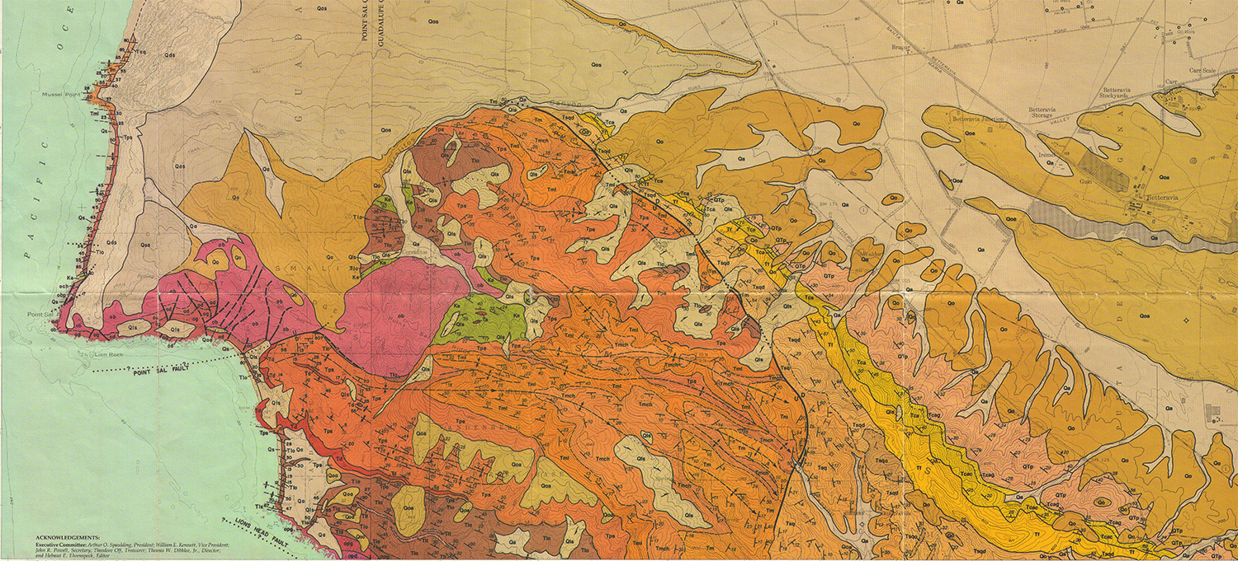
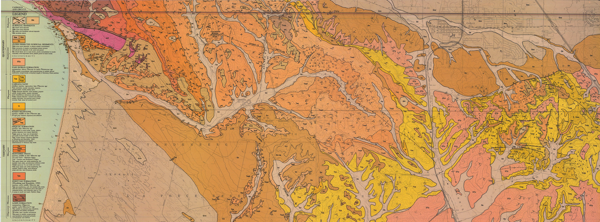
Core #1: Stokes A-30804 (Casmalia Hills)
Location of Core Data
Company: Santa Maria Energy, LLC
Location: Casmailia Hills
Total Depth of Well: 1350 ft.
Core Length: 406 ft. from 1/3 core slabs
Data: Core, core photos (normal and UV light), XRD (bulk and clay mineralogy), porosity, and water saturation for depths 288 ft., 336 ft., 582 ft., 607 ft., 787 ft., 1153 ft., SEM photos for depths 607 ft. and 336 ft., petrophysical data (gamma ray and resistivity curves)
Total Number of Core Samples: 176 at various depths
Stokes A-30804 (Casmalia Hills)
Newlove 76-RD1 (Orcutt)
Core #2: Newlove 76-RD1 (Orcutt)
Company: BreitBurn Energy, LLC
Location: Orcutt Oil Field
Total Depth of Well: 893 ft.
Core Length: 282 ft. from 2/3 core slabs
Data: Core, core photos (normal and UV light), petrophysical data (gamma ray and resistivity curves)
Total Number of Core Samples: 115 at various depths

Slide 14
Core #1: Stokes A-30804 (Casmalia Hills)
Core #2: Newlove 76-RD1 (Orcutt)
0
API
150
0
API
150
300 ft.
Core
200 ft.
300 ft.
400 ft.
400 ft.
500 ft.
500 ft.
600 ft.
600 ft.
700 ft.
800 ft.
700 ft.
900 ft.
1000 ft.
800 ft.
1100 ft.
Total Core: 406 ft.
Total Core: 282 ft.
1200 ft.
900 ft.
Notes:
To illustrate this visually, shown are the GR logs of both wells with 0API on the left and 150API to the right of the logs
Shown in the green boxes are depths to which we have CORE
So as you can see, we have a abundant coverage though out both wells

Slide 15
Purpose & Importance of this study
Characterize diatomaceous facies using core data
-Observational analyses
-Laboratory analyses
-Petrophysical analyses
Understand relationships between diatomaceous facies, depositional environment, and their effects on petroleum development and exploitation
Data and interpretations from these two cores have yet to be published and the data in this research can expand into several other theses
Notes:
So what is the purpose and importance of this study and what do we want out of the given cores. This can be summarized in 4 main points

Slide 16
Analyses
Observational Analyses
Characterize bedding and laminations (compositions, thickness, alternating intervals, stacking patterns, and cyclicity (if any))
Analyze sedimentary structures and indicators for depositional environment (slump folds, discontinuities, contacts, scours, fossils, laminations vs. massive units, debris flows, faults and more)
Laboratory Analyses
XRD- analyze composition, detrital vs. opal A content, bulk and clay mineralogy
SEM- analyze variations in morphology, packing, fragmentation of diatoms, microfabric, detrital content, matrix content, and diagenetic alteration
Petrophysical Analyses
Analyze petrophysical characteristics (GR & resistivity curves)
Correlate nearby wells to examine the lateral extent of the identified units
Notes:
So lets take a look at our 3 main analyses and what we want:

Slide 17
Presentation Outline
Introduction/Purpose/Importance
Geology/Stratigraphy/Structure
Data and Methodology
Current Progress
Conclusion

Slide 18
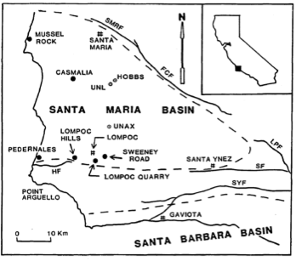
Previous Research on Sisquoc Formation Diatomaceous Sediments
Outcrop Studies:
Ramirez, 1990
-Sedimentary structures (laminations, grading, microfossils, sandstone laminations, scour surfaces, discontinuities, faults, slump folds, breccias and more)
-Pedernales, Mussel Rock, Sweeney Road, Lompoc Hills and, Casmalia Hills
Core Studies:
Henderson et al., 1984 (Union Oil)
Identified various lithologies:
-Claystone, diatomaceous claystone, opal-CT bearing claystone
-Mudstone, diatomaceous mudstone, opal-CT bearing mudstone, pebbly mudstone
-Conglomerate
-Sandstone
-Dolomite
-Interpretations of environments
(Ramirez, 1990)

Slide 19
Core #1: Stokes A-30804 (Casmalia Hills)
Core #2: Newlove 76-RD1 (Orcutt)
0
API
150
0
API
150
XRD
300 ft.
200 ft.
SEM
Core
300 ft.
400 ft.
400 ft.
500 ft.
500 ft.
600 ft.
600 ft.
700 ft.
800 ft.
700 ft.
900 ft.
1000 ft.
800 ft.
Total Core: 406 ft.
Samples for XRD : 28
Samples for SEM: 7
1100 ft.
Total Core: 282 ft.
Samples for XRD : 25
Samples for SEM: 8
1200 ft.
900 ft.
Notes:
So now lets look at the two GR logs for both wells.
High lighted in red are depths where we have XRD data, which was completed about 4 days go
High light in blue dashed lines are depths where we will have SEM data, which we will complete within the next 3-4 weeks.
So at this point in my research, we are approximately 3-4 weeks from getting all the data that we need for this thesis.
So in the end. What we want is to be able to give a name for lithostratigraphic units for various units in both wells based on our data and interpretations, describe in detail its composition (from XRD data), describe the microfabric (via SEM), show the well log reseponses of these units, and give interpretations of the dep environemnt
So that’s where we are now at this time. What I would like to show you are some sedimentary structures we have identified in both of the ores

Slide 20
Sedimentary Structures
Massive Bioturbated Facies:
Interpretation:
Aerobic environment
Weak or no developed oxygen minimum zone
High sedimentation rate
Abundant bottom dwelling marine life
Newlove 76-RD1
Depth: 467’
Stokes A-30804
Depth: 312’

Slide 21
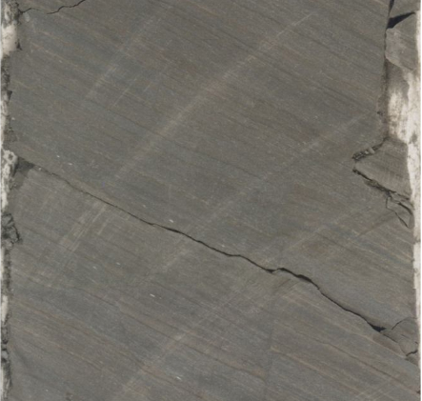
Sedimentary Structures
Planar Laminated Facies:
Interpretation:
Low oxygen environment
Weak to well-developed oxygen minimum zone
Low sedimentation rate
Little bottom dwelling marine life
Recurrent depositional events
Newlove 76-RD1
Depth: 550’
Stokes A-30804
Depth: 1155’

Slide 22
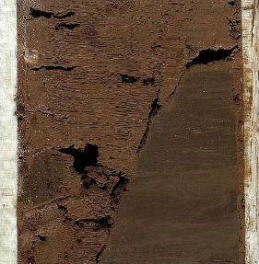
Sedimentary Structures
Slump folds and Discontinuities/Truncation Surfaces:
Interpretation:
Deposition on an unstable slope
Debris flow and/or turbidity current driven
Slump-triggering mechanisms
-Sedimentation rate
-Earthquakes
-Tectonic activity
Newlove 76-RD1
Depth: 510’
Newlove 76-RD1
Depth: 522’

Slide 23
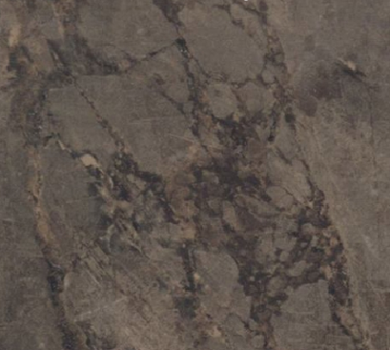
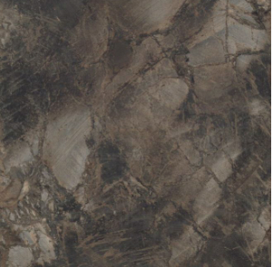
Sedimentary Structures
Intraformational Breccias:
Interpretation:
Deposition on an unstable slope
Diatomaceous sediment deforms in somewhat brittle fashion
Failure-triggering mechanisms
-Sedimentation rate
-Earthquakes
-Tectonic activity
-Oversteep slopes
Stokes A-30804
Depth: 626’
Stokes A-30804
Depth: 322’

Slide 24
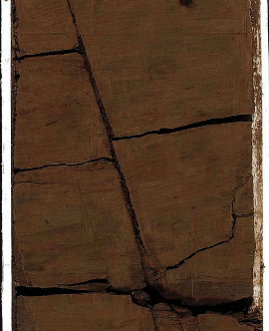
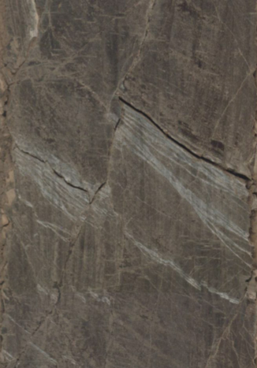
Sedimentary Structures
Faults:
Interpretation:
Deposition on an unstable slope
Tectonic activity
Newlove 76-RD1
Depth: 281’
Stokes A-30804
Depth: 602’

Slide 25
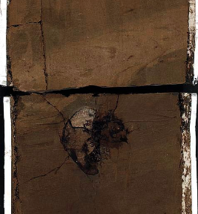
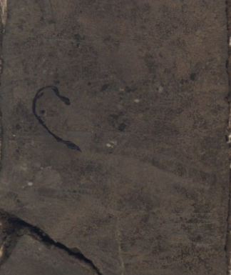
Sedimentary Structures
Fossils and Burrows:
Interpretation:
In situ and transported and re-deposited
Paleoxygen indicators
Reworking of deposits
Generally in massive beds
Newlove 76-RD1
Depth: 272’
Stokes A-30804
Depth: 289’

Slide 26
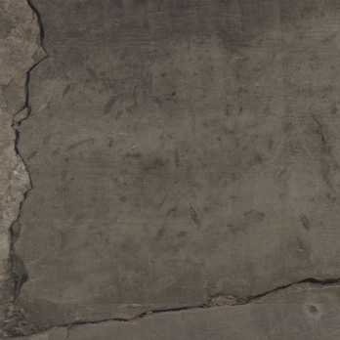
Sedimentary Structures
Scour Surfaces or Hardgrounds:
Interpretation:
Depositional hiatuses
Paleoxygen changes
Shallow penetration of sediments by organisms
Authigenic surficial cementation
Chondrites identified in Stokes A-30804
Newlove 76-RD1
Depth: 447’
Stokes A-30804
Depth: 577’
Notes:
chondrities

Slide 27
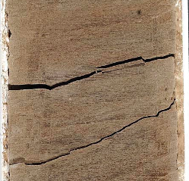
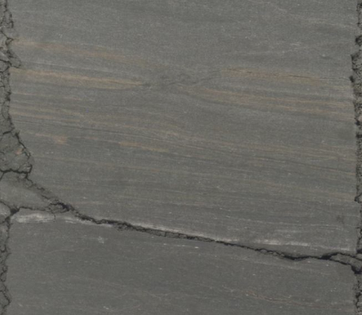
Sedimentary Structures
Sandstone/Sandstone Laminations:
Interpretation:
Influx of terrigenous sediment
High accumulation rate
Turbidites or Contourites
Newlove 76-RD1
Depth: 891’
Stokes A-30804
Depth: 1027’

Slide 28
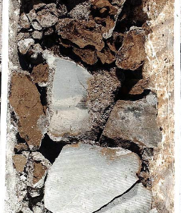
Sedimentary Structures
Small to Large Scale Conglomerate Units:
Interpretation:
Transported via debris flows (poor sorting and grading)
Formed by tectonic stresses and/or lack of accommodation space at upper depths
Moderately to highly oil saturated
“Conduit” for oil migration into the Sisquoc Fm. from underlying Monterey Fm.
Represents high GR signatures in well logs
Newlove 76-RD1
Depth: 519’
Stokes A-30804
Depth: 317’

Slide 29
Conglomerate Debris Flow Units
Core #2: Newlove 76-RD1 (Orcutt)
v

Slide 30
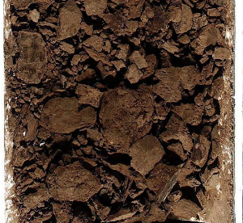
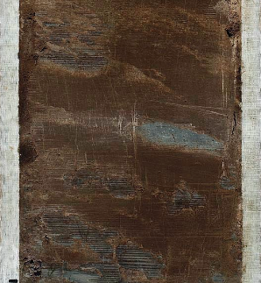
Conglomerate Debris Flow Units
Core #2: Newlove 76-RD1 (Orcutt)
Depth: 478’
Depth: 588’
Depth: 519’
Depth: 631’
v

Slide 31
Questions- Application for Petroleum Development
Are the conglomerate units major conduits for oil migration and charging the Sisquoc Formation diatomites from the Monterey?
How laterally continuous are these conglomerate units? And in what direction?
Did they occur in a certain stage and location on the paleo-bathymetric ridge?
Does total thickness of conglomerate beds correlate with high oil saturation?
Do massive and laminated diatomites have different physical properties that may effect oil saturation?

Slide 32
Presentation Outline
Introduction/Purpose/Importance
Geology/Stratigraphy/Structure
Data and Methodology
Current Progress
Conclusion

Slide 33
Early Conclusions- so far…..
Changes in the depositional environment produced compositionally different variations of diatomaceous sediments and sedimentary structures identified in cores Newlove 76-RD1 and Stokes-A30804
Sedimentary structures reveal that the Sisquoc Fm. in both cores was deposited on an active unstable inner basin slope
Conglomerate debris flow material may be a conduit for oil migration into the Sisquoc Fm. from the underlying Monterey Fm.

Slide 34
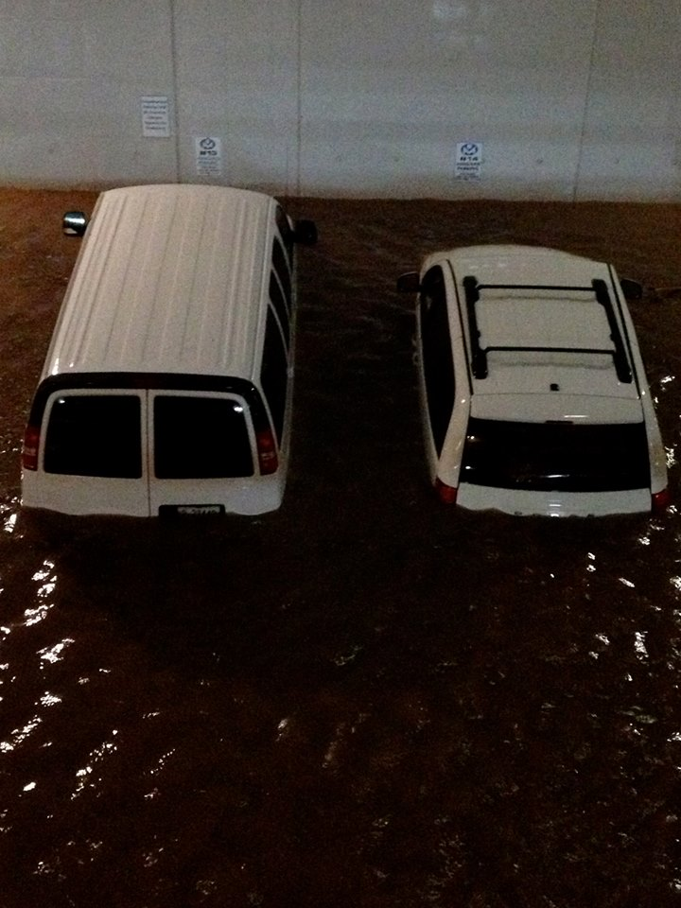
Thank You
Questions?

Slide 35
References
Behl. R.J. and J. Ingle. (1998). The Sisquoc Formation-Foxen Mudstone Boundary in the Santa Maria Basin, California: Sedimentary response to the new tectonic regime. U.S. Geological Bulletin 1995-V:V1-V16
Behl, R.J., 1999, “Since Bramlette (1946): The Miocene Monterey Formation of California revisited”, Geological Society of America Special Paper 338, p. 301-309
Behl, R.J., and Ramirez, P.C., 2000, Field Guide to the Geology of the Neogene Santa Maria Basin: From Rift to Uplift Field Guide to the Geology of the Neogene Santa Maria Basin: From Rift to Uplift, Special Publication Pacific Section SEPM, Book 86, p. 1-31
Canfield, C.R. (1939). Subsurface stratigraphy of Santa Maria Valley Oil Field and adjacent parts of Santa Maria Valley, California. American Association of Petroleum Geologists Bulletin 23: 45-81
Henderson, N.C., Jr., 1983, Relationship of diagenetic dolomite to depositional facies in diatomaceous strata, upper Sisquoc Formation, Casmalia Hills, Santa Barbara County, California: University of Southern California, masters thesis, 200 p.
Ingle, J. C. Jr., 1981, Origin of Neogene Diatomites around the north Pacific rim, in the Monterey Formation and Related Siliceous Rocks of California: Los Angeles, Pacific Section, Society of Economic Paleontologists and Mineralogists, p. 159-179
Isaacs, C. M., 1981a, Outline of Diagenesis in the Monterey Formation Examined Laterally along the Santa Barbara Coast, California, Pacific Section AAPG, Vol. 52, pg. 25-38
Isaacs, C. M., 1981b, Field Characterization of Rocks in the Monterey Formation along the Coast near Santa Barbara, California”, Pacific Section AAPG, Vol. 52, pg. 39-53
McCrory, P.A., Wilson, D.S., Ingle, J.C., and Stanley, R.G. (1995) Neogene Geohistory Analysis of Santa Maria Basin, California, and Its Relationship to Transfer of Central California to the Pacific Plate, U.S. Geological Survey Bulletin, v. 1995 J, 38p.
Ramirez, P.C. and Garrison, R.G., (1995) Stratigraphy of the Fine-Grained Facies of the Sisquoc Formation, Santa Maria Basin, California-Paleoceanographic and Tectonic Implications, U.S. Geological Survey Bulletin, 1995, Ch. T,V,U
Woodring, WP and Bramlette, MN, 1950, Geology and Paleontology of the Santa Maria District California, Geological Survey Profession Paper 222, p. 1-179

Slide 36
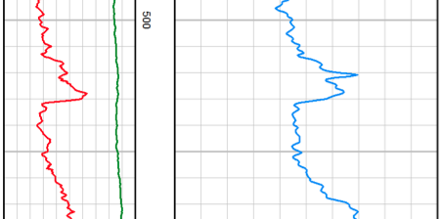
Lithostratigraphic Units
Lithostratigraphic
Unit
Description, Composition and Lithology
SEM Microfabric Analysis
Petrophysical
Analysis
Dep. Environment Interpretation
Massive bioturbated diatomaceous mudstone
Dark brown massive bioturbated diatomaceous mudstone, weak mud-like texture, indistinct discontinuous bedding
Primarily composed of opal-A (67.3%), plagioclase (10.8%), illite & mica (7.2%), minor k-feldspar (2.2%), and trace amounts of kaolinite (0.5%), and chlorite (0.4%)
Will complete by end of October-early November
SEM will show the microfabric, morphology, packing, fragmentation of diatoms and matrix content of the unit
Unit represents a relatively low gamma ray signature (ranging from approximately 43 to 50 API)
Unit represents a relatively low resistivity (RHOB) signature (approximately 2.4 G/C3)
The bioturbated and massive characteristics of this unit likely resulted from deposition in an aerobic environment with a weak to non-developed oxygen minimum zone
In addition, a high sedimentation rate and an abundant bottom dwelling marine ecosystem could have attributed to the unit’s characteristics
0
RHOB G/C3
GR
2
150
3
Newlove 76-RD1
Depth: 535’

Slide 37
Questions- Application for Petroleum Development
Are the conglomerate units major conduits for oil migration and charging the Sisquoc Formation diatomites from the Monterey?
How laterally continuous are these conglomerate units? And in what direction?
Did they occur in a certain stage and location on the paleo-bathymetric ridge?
Does total thickness of conglomerate beds correlate with high oil saturation?
Do massive and laminated diatomites have different physical properties?
Do they occur in certain stratigraphic positions or locations on the paleo-bathymetric ridge?
What is the significance of minor amounts of opal-CT in Stokes well?

Slide 38
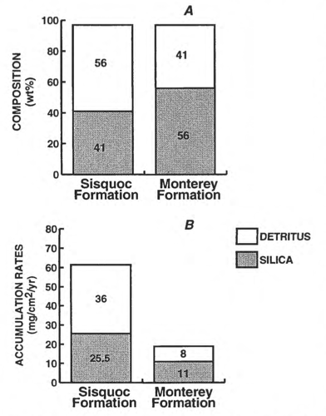
Differentiating the Monterey and Sisquoc Fms.
Upper Monterey Formation
-41% detritus & 56% Silica
-Highly siliceous sedimentation
-Laminated strata
-Lower accumulation rates
Sisquoc Formation
-56% detritus & 41% silica
-Consist of predominantly massive diatomaceous mudstone
-Massive to laminated strata
-Higher accumulation rates
Contact of the Monterey and Sisquoc Formations can range from gradational to unconformable
(Ramirez, 1990 after Issacs, 1980)
Notes:
Increase in detritus likely caused by continued tectonic reorganization of the CA continental Margin causing uplift of the Coast Ranges leading to an increased supply of clastic material to the SMB .
Phosphatic conglomerate marks boundary between Monterey and Sisquoc

Slide 40
Location of Core Data
Stokes A-30804 (Casmalia Hills)
Newlove 76-RD1 (Orcutt)
Hosgri fault Zone
(Modified from http://www.quake.ca.gov/gmaps/FAM/faultactivitymap.html#)

Slide 41
Location of Core Data
Stokes A-30804 (Casmalia Hills)
Newlove 76-RD1 (Orcutt)
Core #1: Stokes A-30804 (Casmalia Hills)
Company: Santa Maria Energy, LLC
Location: Casmailia Hills
Total Depth of Well: 1350 ft.
Core Length: 406 ft. from 1/3 core slabs
Data: Core, core photos (normal and UV light), XRD (bulk and clay mineralogy), porosity, and water saturation for depths 288 ft., 336 ft., 582 ft., 607 ft., 787 ft., 1153 ft., SEM photos for depths 607 ft. and 336 ft., petrophysical data (gamma ray and resistivity curves)
Total Number of Core Samples: 176 at various depths
Core #2: Newlove 76-RD1 (Orcutt)
Company: BreitBurn Energy, LLC
Location: Orcutt Oil Field
Total Depth of Well: 893 ft.
Core Length: 282 ft. from 2/3 core slabs
Data: Core, core photos (normal and UV light), petrophysical data (gamma ray and resistivity curves)
Total Number of Core Samples: 115 at various depths
(Modified from http://www.quake.ca.gov/gmaps/FAM/faultactivitymap.html#)

