Slide 1
3D Subsurface Model of Monterey-Related Sediments and the Syntectonic Distribution of Clastic and Biogenic Facies, Offshore Santa Maria Basin, California by Nelson Doris
Fall, 2013
Thesis Committee Chair:
Richard Behl, Department of Geological Sciences, California State University, Long Beach, CA 90840
Thesis Committee Advisors:
Nate Onderdonk, Department of Geological Sciences, California State University, Long Beach, CA 90840
Christopher C. Sorlien, Earth Research Institute, University of California, Santa Barbara, CA 93106

Slide 2


Nelson Doris: Presenter Background
Education
MS, Petroleum Geology, CSU Long Beach (2011-Present)
BS, Geology, University of California, Davis (2003-2007)
Professional Experience
Development Geologist - Signal Hill Petroleum, Inc. (2013 – Present)
Development Geologist - Warren Resources, Inc. (2008 – 2012)

Slide 3
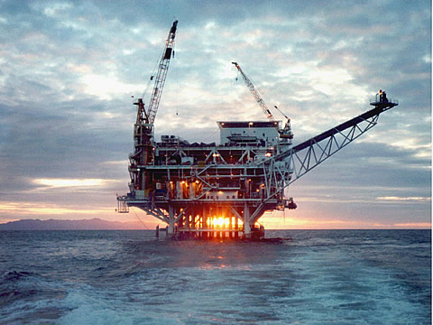
Overview
Introduction
Geology and History
Define the Problem
Objectives
Dataset
Initial Results
Status
Platform Irene, Point Pedernales Unit, Offshore Santa Maria

Slide 4
Introduction
Offshore oil-rich Santa Maria Basin, with Miocene Monterey as both source and reservoir.
Outboard basin that developed irregular bathymetry during rifting and subsidence.
Syntectonic sedimentation led to variability in the thickness and lithology of Monterey rocks.
  Clastic sediment abundance a key factor in determining the ultimate lithology.
The relationship between the paleobathymetry and the lithology of biogenic sediments is not well understood.

Slide 5
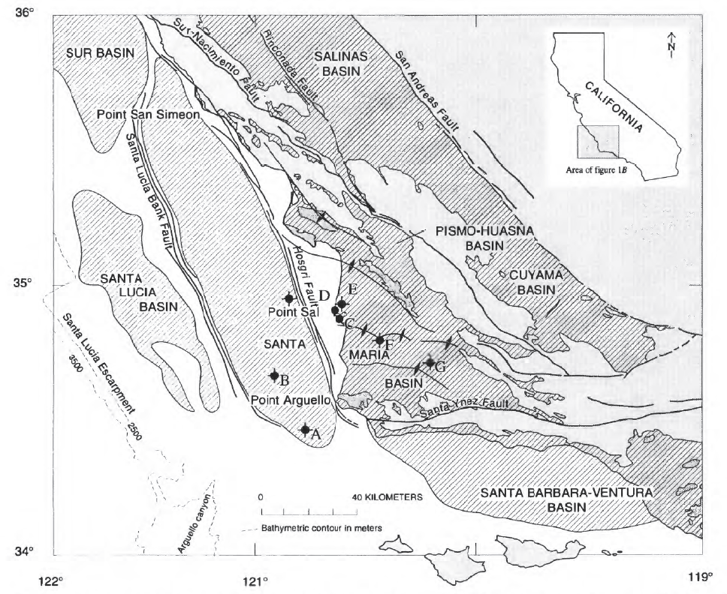
Offshore Santa Maria Basin
McCrory et al., USGS, 1995

Slide 6
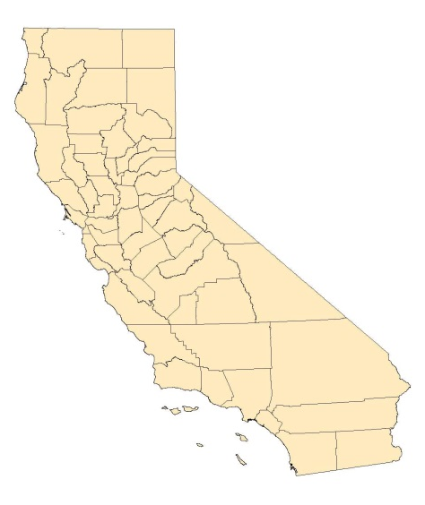
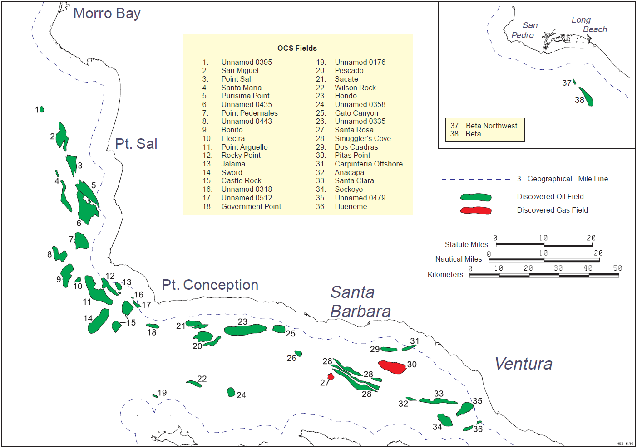
Recognized Oil Fields
OCS Report, 1995

Slide 7
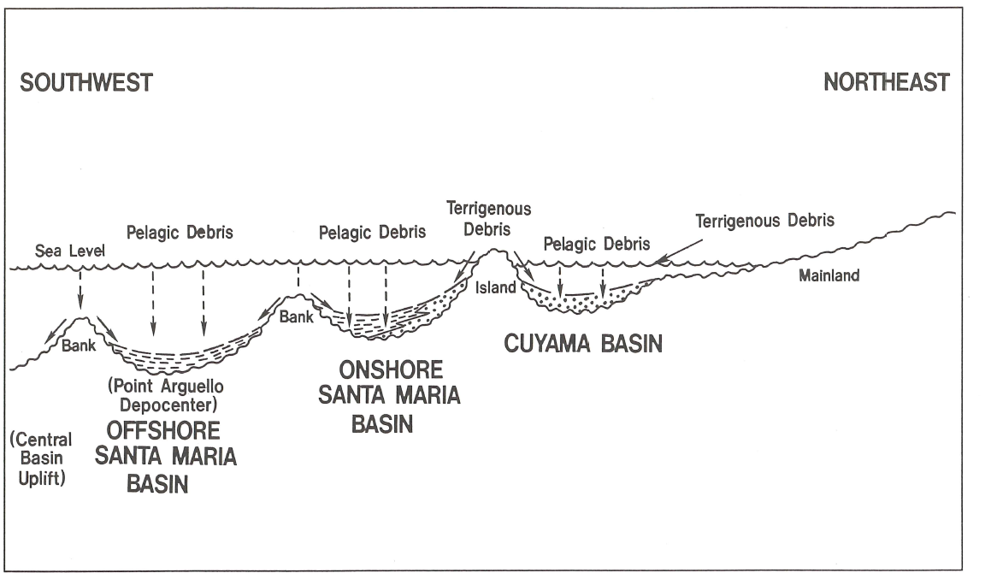
Neogene Depositional Model
Mero et al., AAPG, 1992

Slide 8
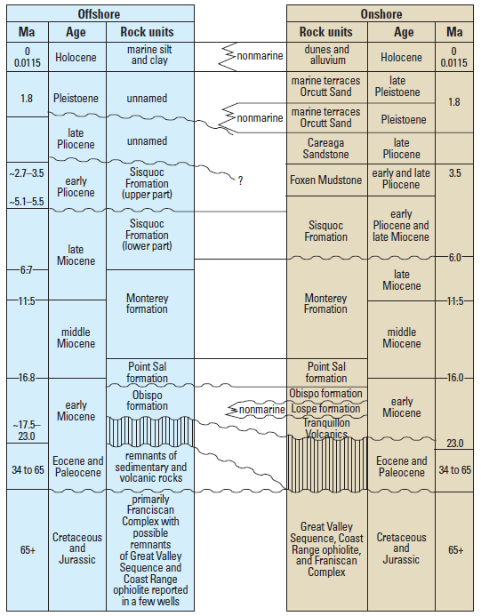
Generalized Stratigraphy and
Correlation to Onshore SMB
The Monterey is conformably overlain by the Sisquoc Formation consisting of massive to weakly laminated biosiliceous rocks, siltstone and sandstone.
The Mid-upper Miocene Monterey Formation consists of massive to well laminated biosiliceous and calcareous strata representing an extended period of bathyal sedimentation.
Lower-mid Miocene Point Sal Formation composed of calcareous marine mudstone interbedded with dolostone and sandstone.
Cretaceous and Jurassic Basement unconformably overlain by volcanic assemblages.
Willingham et al., USGS, 2013

Slide 9
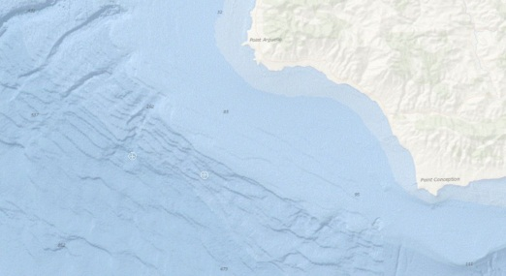
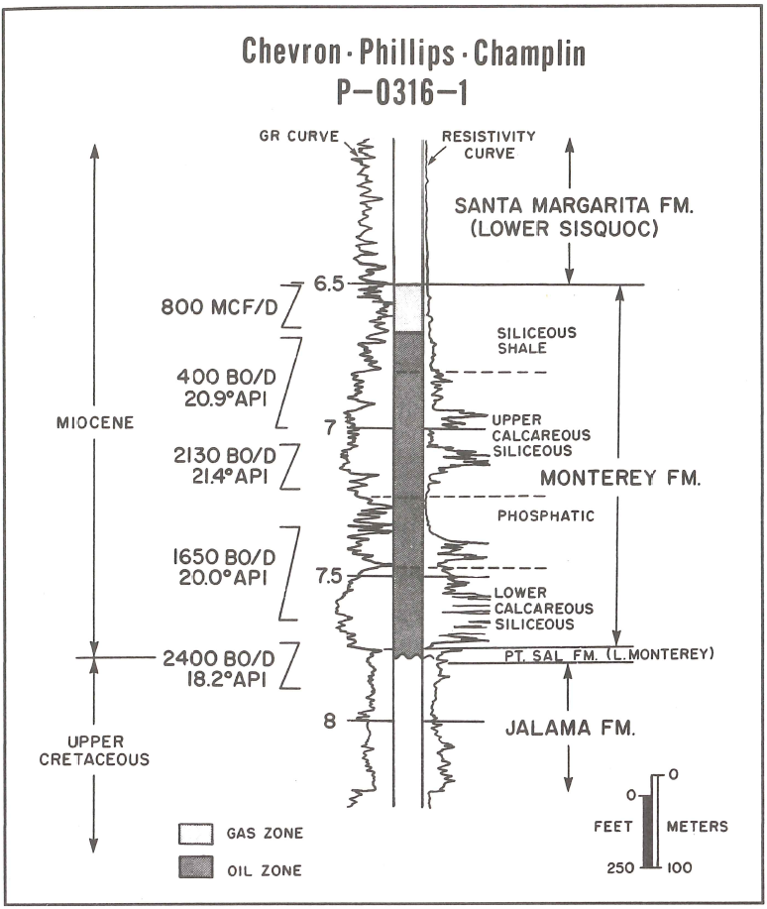
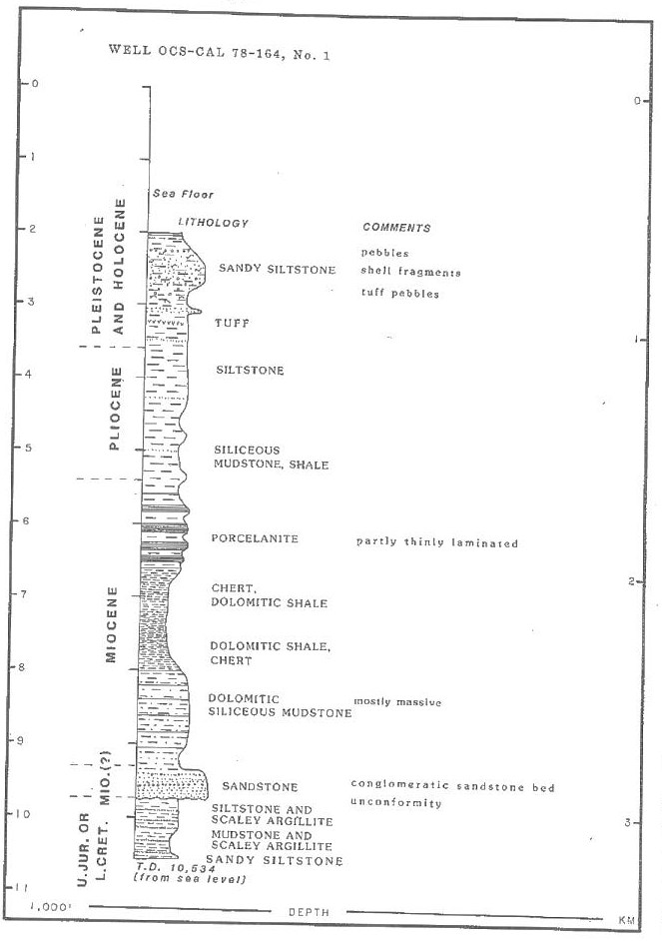
COST Well and Pt. Arguello Type Log
NW
~10 miles
SE
OCS-Cal 78-164 No. 1
McCulloch, 1987
Mero et al., AAPG, 1992

Slide 10
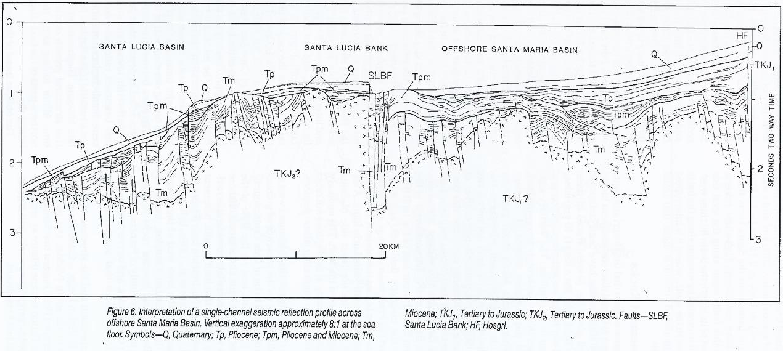
Structural Cross Section
W
E
McCulloch, 1987
Early Miocene extension caused rifting and rapid subsidence.
Normally faulted, tilted basement blocks created several en echelon N-S trending paleo-highs with narrow sub-basins in between.
Extension slowed or even stopped during late Miocene.
Post-Miocene transpression reactivated old normal faults as thrust faults and created restraining bend folds of Miocene and younger strata.

Slide 11
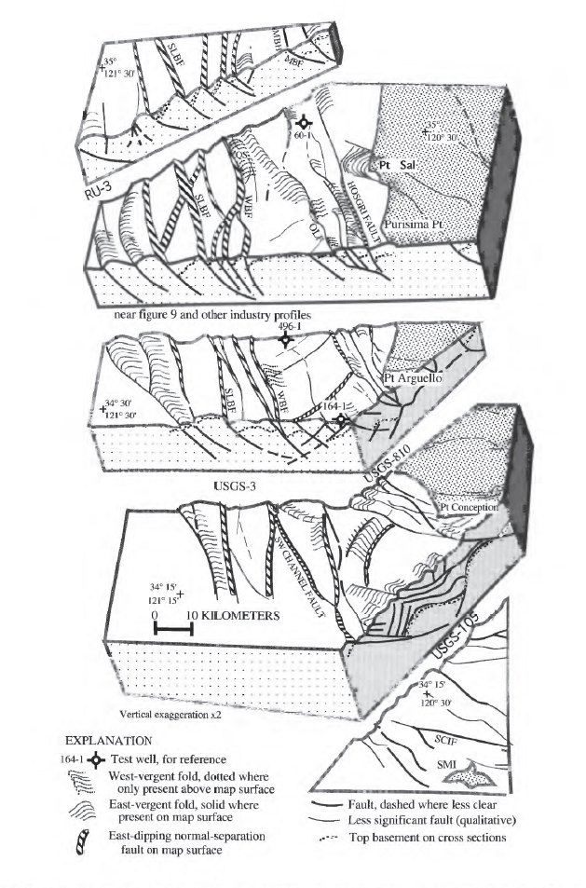
Miocene Structural Block Model
Rapid subsidence and continued displacement along Miocene normal faults created abundant accommodation space.
The tilted basement fault blocks created a highly variable basin bathymetry during Monterey deposition.
Post-Miocene compression caused folding, faulting, and fracturing of Miocene deposits.
  Some Miocene sub-basins have been completely inverted.
Sorlien et al., USGS, 1999

Slide 12
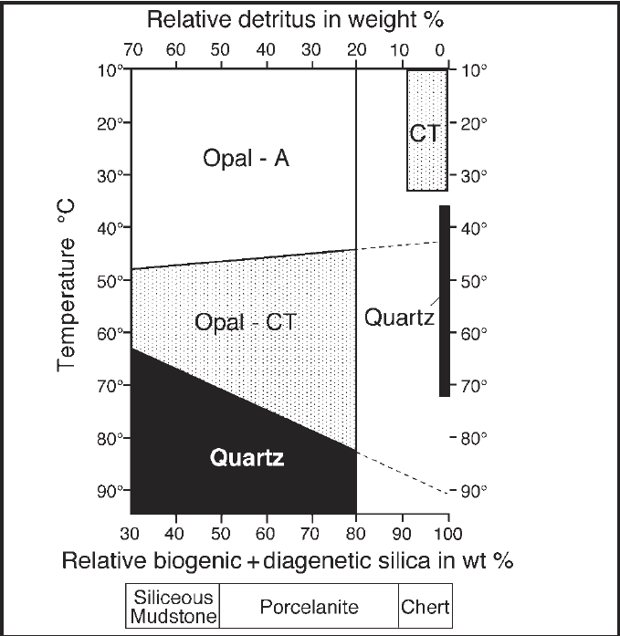
Lithologic Variability
The Monterey Formation is notoriously heterogeneous.
The relative abundance of detritus buried with biosiliceous sediments greatly impacts the diagenesis of these rocks.
Only the purest biosiliceous strata will alter to chert (<10% detritus).
  These cherts start forming very shortly after burial.
The amount of Monterey chert encountered while drilling in the basin varies significantly.
Behl, 1999

Slide 13
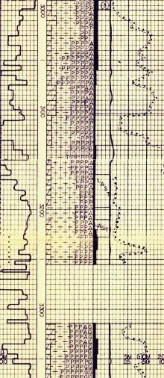
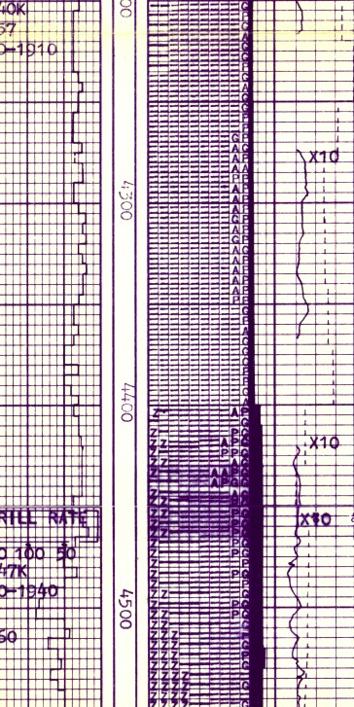
The Problem
SW
OCS-P00411_001
OCS-P00413_001
NE
~400’ below top Monterey,
~8.5km apart
200’+ of ≥ 40% chert plus 10-20% dolomite
20’ of 40% chert

Slide 14
Objectives
The objective of this study is to use seismic reflection and well data from the offshore Santa Maria Basin to find a relationship between the paleobathymetric setting of Monterey deposits across the basin and the ultimate lithology of those deposits upon burial and diagenesis.
We want to test hypotheses for the mechanisms that could cause localized changes in biogenic purity. For example:
  Winnowing of diatoms from paleo-highs via currents, and redeposition in paleo-lows.
  Increased terrigenous sedimentation in paleo-lows from the erosion of local paleo-highs.
  Variable biogenic sedimentation due to localized upwelling.
  Increased terrigenous supply from landward point sources.
Devise a method to predict the lateral variations of Monterey type deposits across a basin when given an interpretation of the paleobathymetry at deposition.

Slide 15
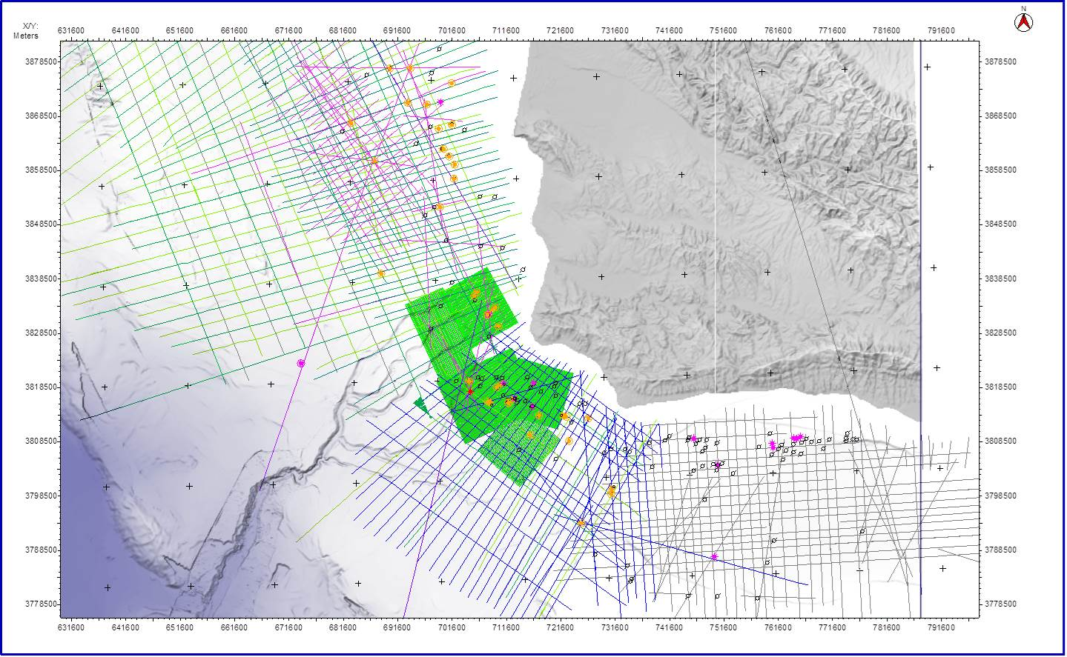
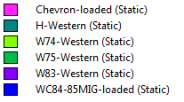
Dataset Basemap

Slide 16
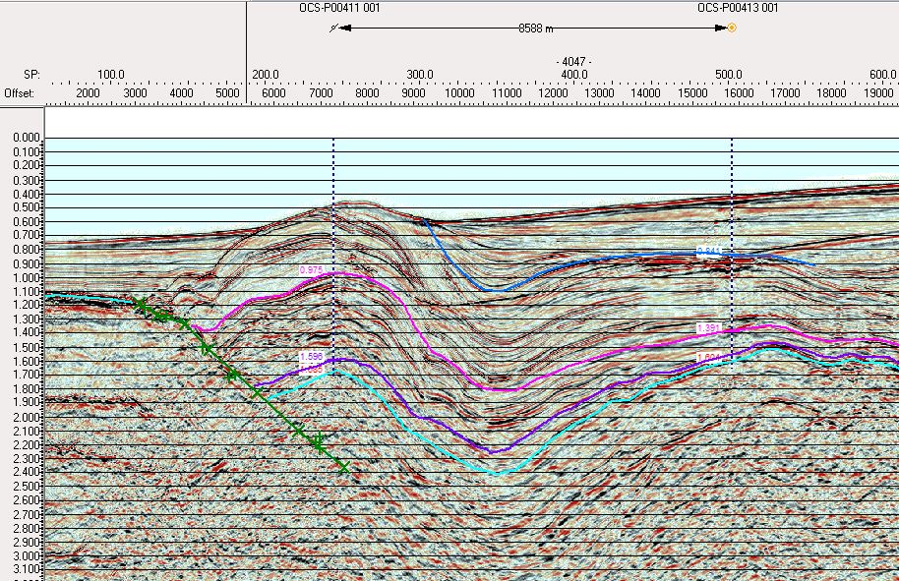
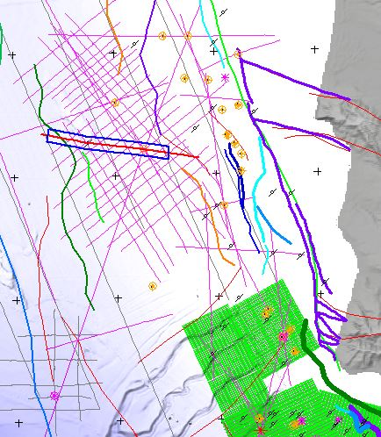
Initial Findings:
Thinning and Inversion
A
A’
Pt. Sal
A
A’
Hosgri flt.
Sisquoc
Monterey
Volcanics
Franciscan

Slide 17
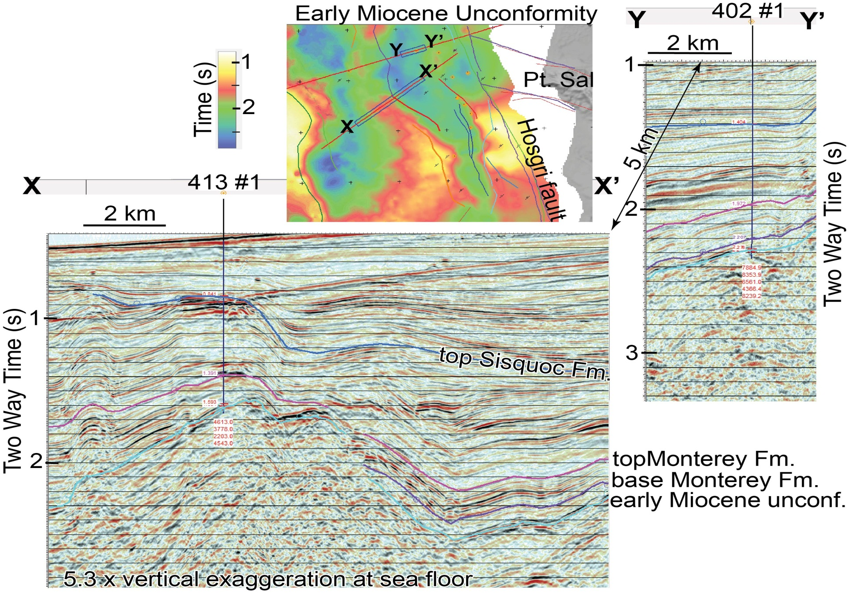
Initial Findings:
Chert Surrounding Highs

Slide 18
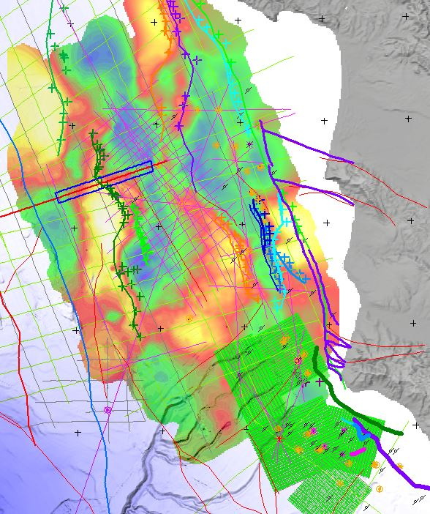
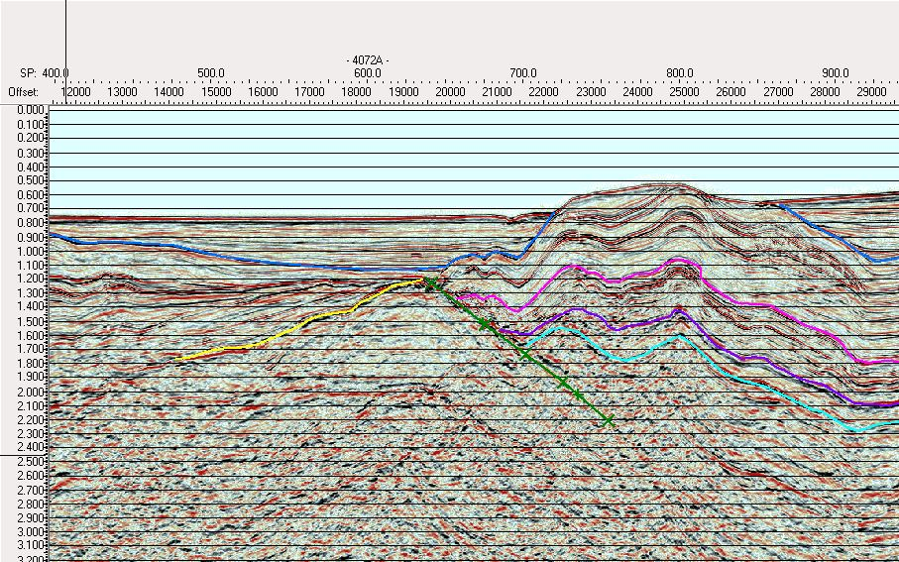
Initial Findings: Tilted Blocks
Y
Y’
Y’
Pt. Sal
Y
Hosgri flt.
Unconformity
Sisquoc
Monterey
Volcanic
Franciscan

Slide 19
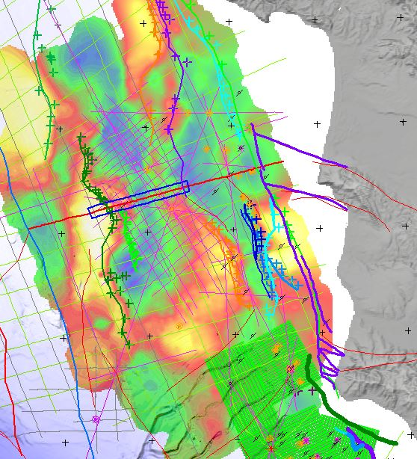
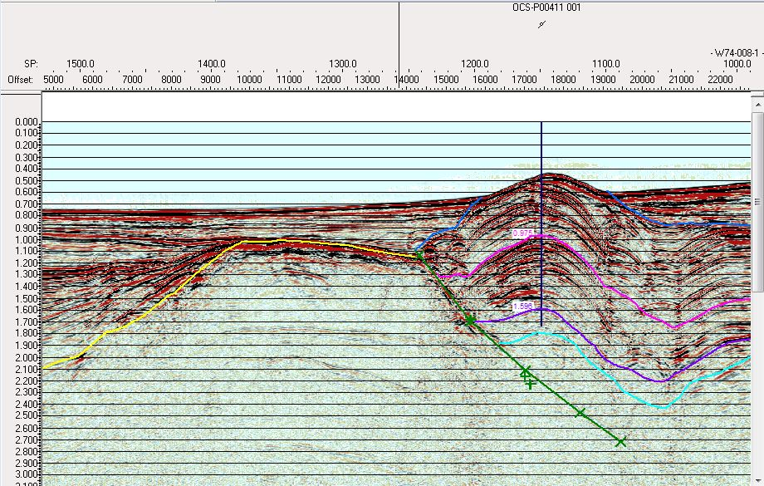
Initial Findings: Erosion
X
X’
X’
Pt. Sal
Wavecut Platform?
X
Hosgri flt.
Sisquoc
Monterey
Volcanic
Franciscan

Slide 20
Workflow
Import Data into Kingdom and Petrel
Quality Control Seismic and Well Data
Input Formation Tops from Well Data
Input Available Time-Depth Data to tie well tops to seismic
Interpret Faults and Horizons over the Study Area
Create Surfaces from Interpreted Lines
Create a Time-Depth Model from Wells and New Surfaces
Convert Surfaces to the Depth Domain
Create 3D Grid and Cell Model
Incorporate Well Data into Grid and Propagate
Create Property Maps to Show Data Distribution
Compare Property Maps to Paleo-bathymetry
Done \ Mostly Done
In Progress
Pending

Slide 21
Acknowledgements
Rick Behl – For teaching me way more than anyone in their right mind should know about the Monterey Formation, and for his continued patience while I slowly go through this program as a part time student.
Chris Sorlien – For holding my hand through seismic loading and using Kingdom Suite, and even more so for his past and future help with interpreting seismic.
Robert Dame and the BOEM\BSEE – For providing me with a bounty of 3D seismic and well data.
USGS’s NAMSS repository – For providing hundreds of 2D seismic lines.
And finally, to the MARS Project – For making this research possible.
THANK YOU!

Slide 22
References
Behl, Richard J., 1999, Since Bramlette (1946): The Miocene Monterey Formation of California revisited. Classic Cordilleran Concepts: A View from California: Geological Society of America, Special Paper 338, p. 301-313.
McCrory, P.A., Wilson, D.S., Ingle, J.C. Jr., and Stanley, R.G., 1995, Neogene geohistory analysis of Santa Maria basin, California, and its relationship to transfer of central California to the Pacific plate. Keller, M.A., ed., Evolution of Sedimentary Basins/
Onshore Oil and Gas Investigations-Santa Maria Province: U.S. Geological Survey Bulletin 1995-J, p. J1-J38.
McCulloch, D.S., 1987, Regional geology and hydrocarbon potential of offshore central California. Scholl, D. W., Grantz, A., and Vedder, J.G., eds., Geology and resource potential of the Continental Margin of Western North America and adjacent ocean basins-Beaufort Sea to Baja California: Circum-Pacific Council for Energy and Mineral Resources Earth Science Series, v. 6, Houston, Texas, p. 353-395.
Mero, W. E., Thurston, S. P. , and Kropschot, R. E., 1992, The Point Arguello Field: giant reserves in a fractured reservoir, California. Giant oil and gas fields of the decade 1988, p. 3-25.

Slide 23
References (cont.)
Sorlien, Christopher C., Nicholson, Craig, Luyendyk, Bruce P., Miller, Kate C., Meltzer, Anne S, 1999, Miocene extension and post-Miocene transpression offshore of south-central California. Structure and tectonics of the central offshore Santa Maria and Santa Lucia basins, California; results from the PG&E/EDGE seismic reflection survey. Evolution of Sedimentary Basins/Offshore Oil and Gas Investigations--Santa Maria Province, p. Y1-Y38, p. Z1-Z12
Willingham, C.R., Rietman, J.D., Heck, R.G., and Lettis, W.R., 2013, Characterization of the Hosgri Fault Zone and adjacent structures in the offshore Santa Maria Basin, south-central California, Evolution of sedimentary basins/onshore oil and gas investigations—Santa Maria province: U.S. Geological Survey Bulletin 1995-CC, 105 p.

