Slide 1
Heterogeneous oil saturation in submarine channel and adjacent facies, Monterey Formation, Point Fermin, Palos Verdes Peninsula, California.
Nawaf AlShammary¹ and Richard J. Behl²
¹nawafalshammary@yahoo.com, ²richard.behl@csulb.edu
Department of Geological Sciences, California State University, Long Beach

Slide 2
Research Objectives
Understand the lateral and vertical heterogeneity in hydrocarbon saturation in closely associated sandstones at Point Fermin
Compare the petrology of sandstone samples from the Point Fermin Sandstone and the adjacent Altamira Shale facies
Characterize and explain porosity and permeability differences between the two units
Create a map to show the stratigraphic architecture

Slide 3
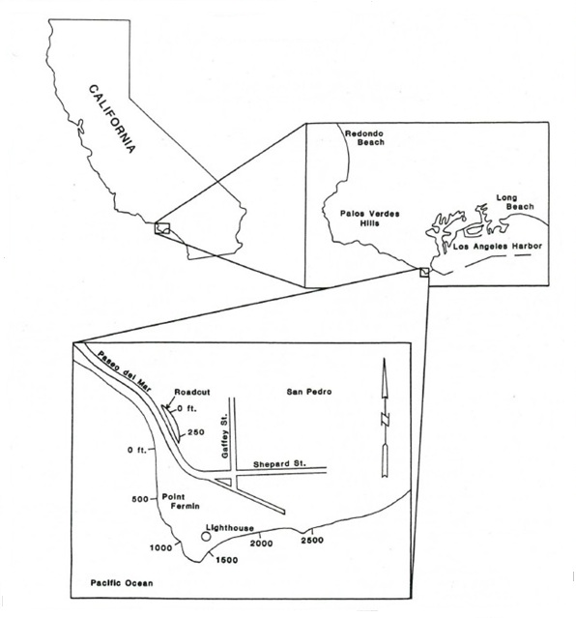
Location
(Russell, 1987)

Slide 4
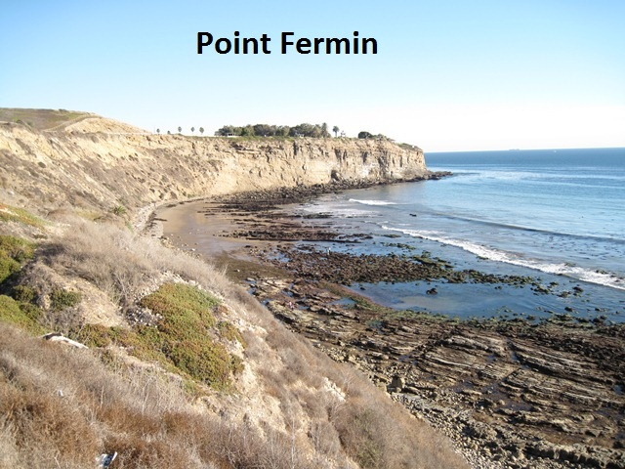
North

Slide 5
Importance of Study
Importance of the provenance for the sandstone oil reservoirs
Understanding stratigraphic traps
The effect of diagenesis on oil saturation
Difference in porosity types and their connection to oil saturation

Slide 6
Methods
Field measurement and sampling
Petrographic analysis
Gazzi-Dickinson method (300 point counts)
Best for provenance studies
32 samples
Conventional core analysis of reservoir properties by a commercial laboratory
Porosity, permeability, and HC saturation, etc.

Slide 7
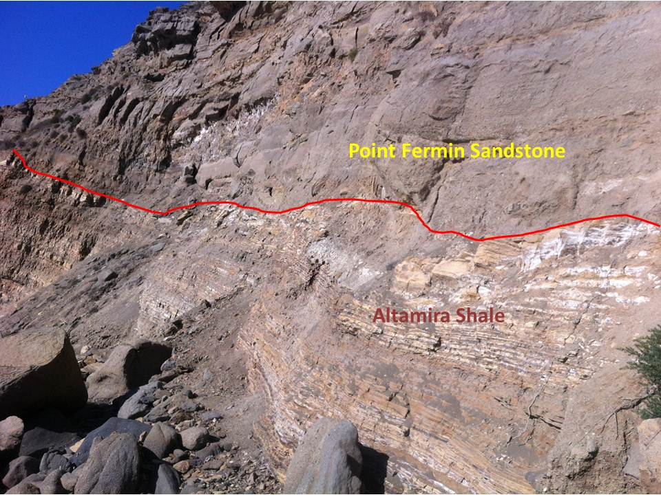
Stratigraphy & Lithofacies
Monterey Formation in Palos Verdes
Malaga Mudstone
Valmonte Diatomite
Altamira Shale
Altamira Shale
Phosphatic lithofacies
Cherty lithofacies
Tuffaceous lithofacies
Point Fermin Sandstone
Altamira Shale
The Altamira Shale (tuffaceous lithofacies)
Sandy hemipelagic sediments
Point Fermin Sandstone
Submarine channel coarse sediments

Slide 8
Sample locations and map
A
B
North
South
B
C
Notes:
The mapped cross section here is the sandstone beds in both the Altamira Shale and the Point Fermin. There were 11 sandstone layers in Altamira Shale that met the criteria of being thicker than 10 cm and somewhat continuous. The red dots are the 32 sample locations (9 in Altamira Shale and 23 in Point Fermin). In the Point Fermin, we took 3 samples vertically in the same horizontal location and in the same bed to cover the difference in grain size that is caused by the normal grading. The apparent dip is around 17 degrees for the Altamira Shale and around 15 degrees for the Point Fermin member.

Slide 9
Sandstone interbedded with dolomite !
Altamira Shale
Point Fermin
Point Fermin
Notes:
Usually sandstone is interbedded with shale but this is not the case in Point Fermin. The sandstone we found is interbedded with dolomite. The pictures show locations of the interbedded dolomite in both the Point Fermin and in Altamira Shale. Some deep sea drilling studies, found such relation in other places.

Slide 10
Sandy dolomite thin sections
F.O.V= 3.2 mm
Epoxy
Altamira Shale - plain
Point Fermin - plain
Point Fermin - plain
Quartz
Altamira Shale - XP
Point Fermin - XP
Point Fermin - XP
Notes:
These are the thin sections of the same previous outcrop samples in the previous slide. The blue is epoxy. The dolomite is partially sandy.

Slide 11
Sponge spicules in sandy dolomite
F.O.V= 3.2 mm
Point Fermin - plain
Notes:
This thin section of Point Fermin shows the sponge spicules. They are marked by the yellow arrows. They must have deposited during an interval of prolific growth of sponges in the local benthic environment, or they were transported from their original environment of growth to the Point Fermin submarine channel, as their ultimate depositional environment.

Slide 12
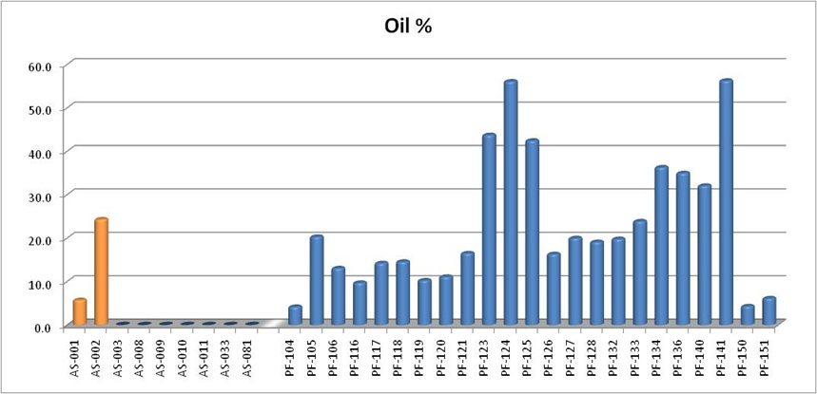
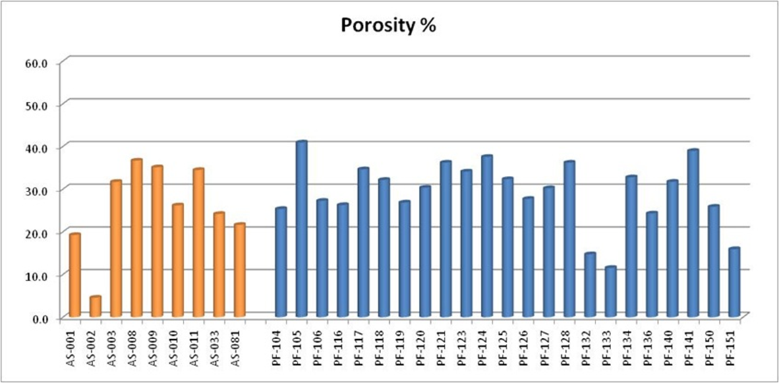
Conventional core analysis
Notes:
We sent our outcrop samples to do conventional core analysis on them. As we see in the slide, the oil saturation percentage shows a clear difference between the Point Fermin which in blue and the Altamira Shale which is in orange. On the bottom diagram, the porosity percentage based on the weathered outcrop samples might be misleading especially if it was high because of the weathering and handling fractures. We counted porosity based on the point counting and it was less than the conventional core analysis. I would bring your attention to sample AS-002 which has high oil saturation compared to other Altamira Shale samples but the porosity was the lowest among all 32 samples.

Slide 13
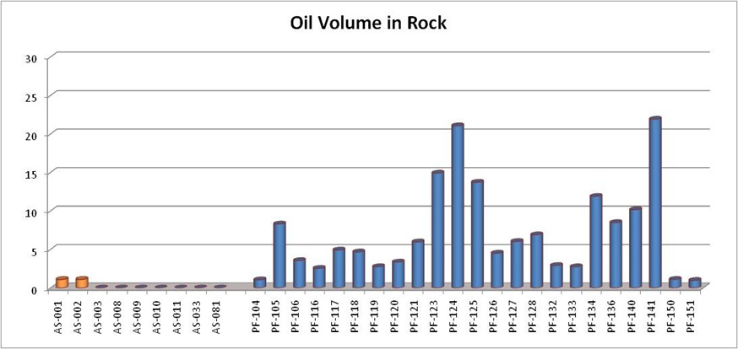
Calculated Oil Volume in Rock -more important than S_{oil}
Notes:
In order to better represent the percentage of oil in the samples, we came up with another diagram that calculates oil saturation percentage times the porosity percentage all divided by 100. The oil in volume better represent oil volume in the rock. Now we see a clear difference between the Altamira Shale and the Point Fermin members. It also shows the highest oil filled samples that coincides with well sorted fine grained sandstone on top of the channel bed. These samples are exceptional in the since that they don’t have cement!

Slide 14
Question 1
Is difference in oil saturation due to different grain provenance?

Slide 15
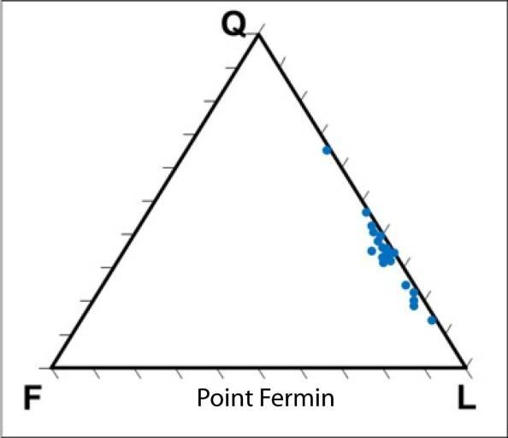
Sandstone provenance
Quartz – Feldspar - Lithics
Notes:
Those are Q-F-L tertiary diagrams, that are used to indicate the composition of the sandstone. On the left, we have on the left Altamira Shale samples and on the right Point Fermin. We can see clearly that both have the same composition and have the same provenance.

Slide 16
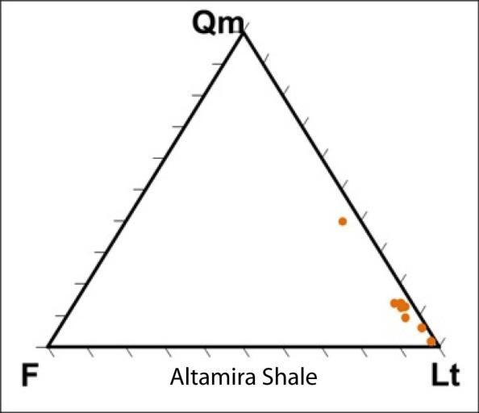
Monocrystalline Quartz – Feldspar – (Lithic + Polycrystalline Quartz)
Notes:
This another Tertiary diagram where Qm is the monocrytalline quartz while Lt is the sum of Qp polycrystalline quartz and L lithic grains. Qm-F-Lt differentiate provenance terranes. Based on this tertiary diagram, the diagram, indicates that both are from recycled orogeny provenances. It also observed in the thin sections, that some of the monocrystalline quartz are actually fragmented polycrystalline quartz.

Slide 17
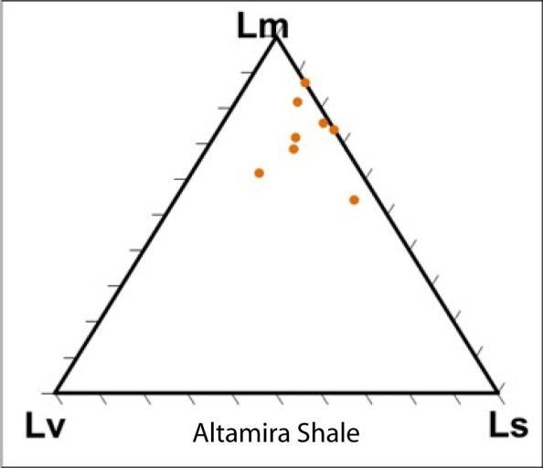
Lithic Metamorphic – Lithic Volcanic – Lithic sedimentary
Notes:
The lithic grains tertiary diagram, indicates similarities between the two members. We can notice that most of the lithic grains are metamorphic and they match the “Catalina Schist”. On Point Fermin samples, there are some samples with higher than usual sedimentary lithic grains. This can be explained in the next slides.

Slide 18
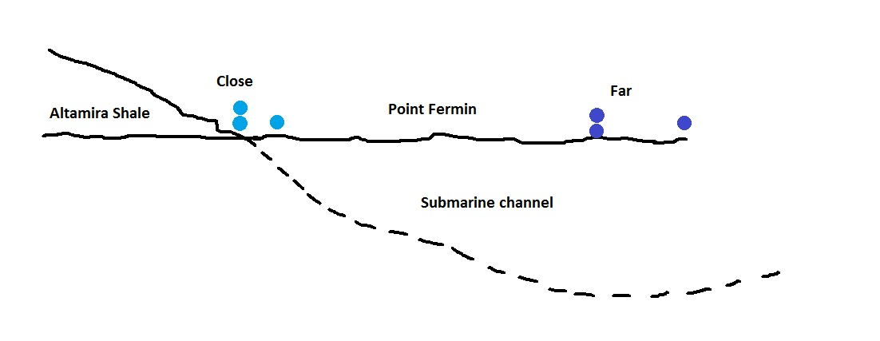
Submarine channel diagram
Notes:
These early or lower deposits of the submarine channel cut through and incorporated underlying Monterey deposits, explaining the higher percentage of Ls in these Point Fermin samples. While far or higher samples because we have (15 degree dip) as we see in the cross section, were not exposed or eroded much of the underlying Monterey deposits.

Slide 19
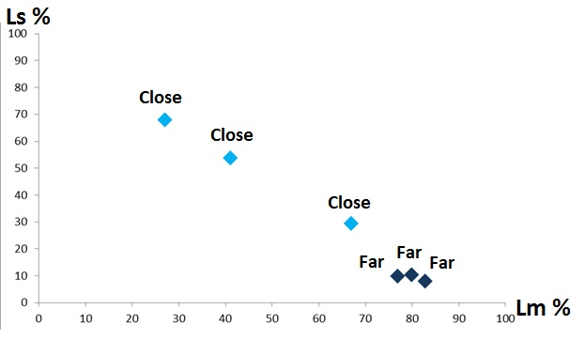
Point Fermin samples relation to lateral position with respect to channel margin
Notes:
By comparing the location of the Point Fermin samples to the contact between the Point Fermin Member and Altamira Shale Member, we found out that the close to the contact have much higher sedimentary lithic grains while far away samples from the contact have much lower sedimentary lithic grains or cleaner samples.

Slide 20
Question 2
Is difference in oil saturation due to difference in grain size?

Slide 21
Grain size
Notes:
This grain size diagram based on thin section analysis, show that Point Fermin has in general coarser grains. So is the grain size difference is the cause for the oil heterogeneity. We have to take into account that, the Point Fermin is a submarine channel while Altamira Shale is a hemi pelagic deposits so, the deposition energy level is really different. Back to our question, (next slide)

Slide 22
Very fine - Coarse
Notes:
If we only compare the sandstone samples that are very fine to coarse, we will compile the following samples

Slide 23
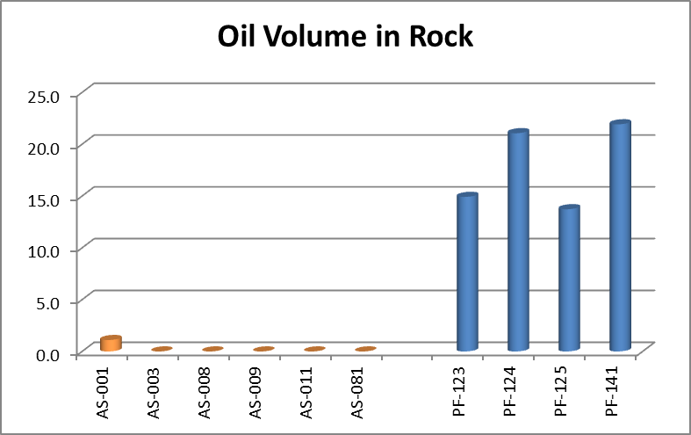
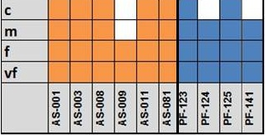
Notes:
And if we compare the Oil Volume in Rock in those samples, the difference is clear between the two members. Furthermore, Point Fermin samples with finer grains (PF-124 and PF-141) show somewhat greater oil volume in rock than coarser samples in the same member. These observations show that the grain size is not the key factor that causing the dramatic difference in oil volume in rock between the sandstones in Altamira Shale and Point Fermin.

Slide 24
Question 3
Is difference in oil saturation due to depositional environment and burial diagenesis?

Slide 25
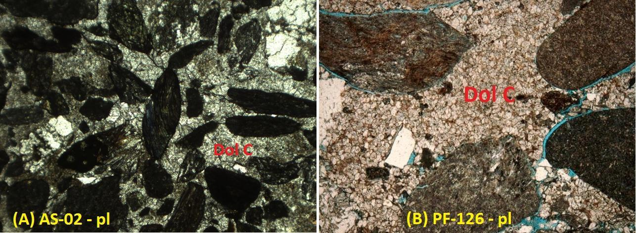
Dolomite cement
F.O.V= 3.2 mm
Dol C
Dol C
Altamira Shale
Point Fermin
Notes:
The sandstone in both Point Fermin and Altamira Shale have dolomite cement. In those thin sections you can see the dolomite cement between the grains. The dolomite cement have a distinct rhombohedral crystal shape. As we can see here, the grains are kind of floating in the dolomite cement/matrix.

Slide 26
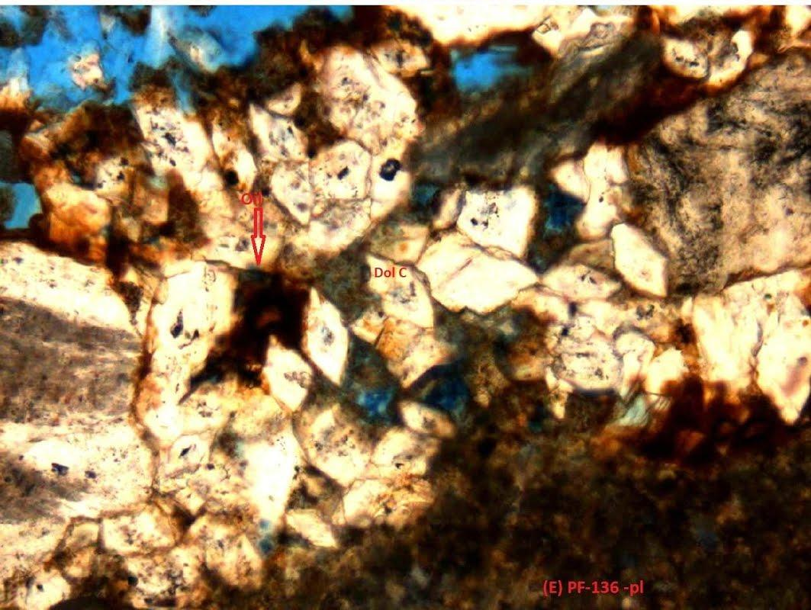
Rhombohedral dolomite and oil
F.O.V= 1.28 mm
Oil
Point Fermin
Notes:
If we look in a magnified thin section, we can see that oil is heavily present between the rhombohedral dolomite crystals and also we can see the blue epoxy between the cement which indicates porosity.

Slide 27
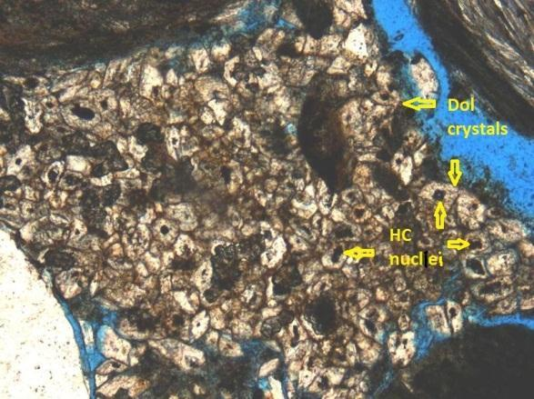
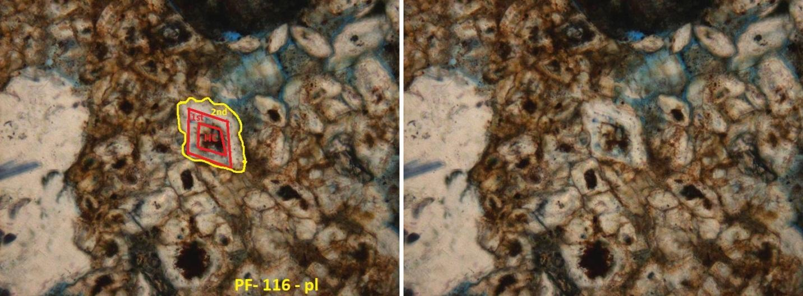
Hydrocarbon nuclei
F.O.V= 3.2 mm
Point Fermin
PF-116 - pl
F.O.V= 640 µm
Point Fermin
Notes:
We observed that some of the dolomite crystals have hydrocarbon nuclei. This observation also been noted by other researchers. Based on these studies dolomite that is associated with hydrocarbon nuclei can be subdivided to two types: rhombohedral and spherical. In our case we have rhombohedral. There is no clear explanation why dolomite with hydrocarbon nuclei would have one or either of these two habits - rhombohedral or spherical - but their formation is thought to be associated with methanogenesis and sulfate reduction at shallow burial depths. the occurrence of dolomite with hydrocarbon nuclei can be a good indicator of an active petroleum system during their diagenesis and an indicator of the possibility of other hydrocarbon traps because the oil or gas present as nuclei must have been seeps from deeper sources and potential reservoirs.
Also we can see in the bottom part the growth of the dolomite crystal from rhombohedral crystal shape to anhedral crystal shape. We called it 2nd stage growth. This growth plays an important part in the distinction and the heterogeneity between the Altamira Shale and Point Fermin because this 2nd stage growth is much better developed in the Altamira Shale compared to the Point Fermin.

Slide 28
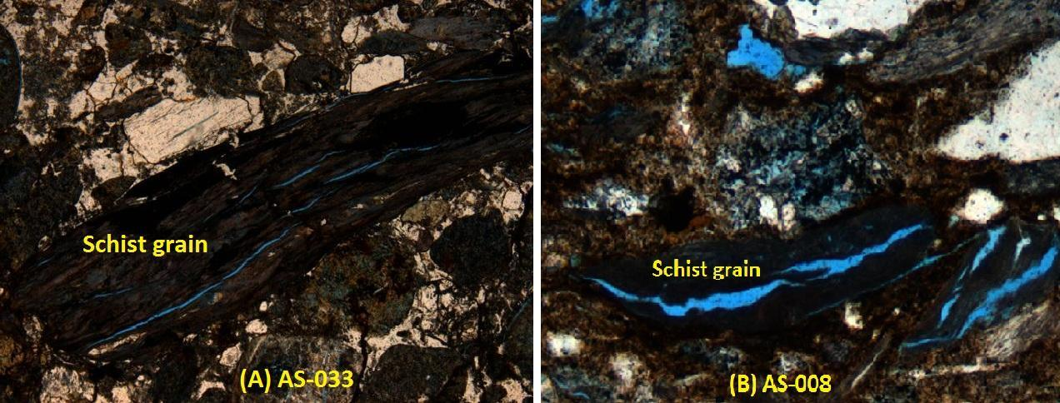
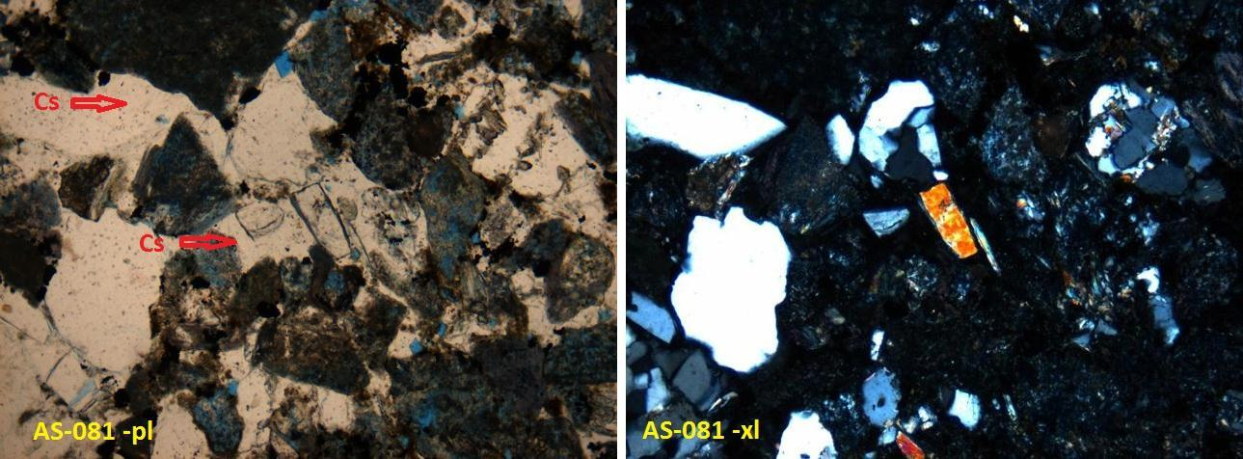
Altamira Shale diagenesis
F.O.V= 3.2 mm
Schist intragranular porosity
Altamira Shale
Altamira Shale
Zeolite cement
F.O.V= 1.28 mm
Altamira Shale
Altamira Shale
Notes:
What distinguishes The Altamira Shale from the Point Fermin, is the diagenesis. In the upper 2 images, we can see cracks or partings in schistose metamorphic rock fragment. These partings we don’t see them well developed in the Point Fermin. Another diagenesis effect, we can see it in the lower 2 images. Here we can see zeolite cement. Zeolite cement is not easily identified in thin sections and need to be confirmed by XRD analysis. We confirmed the zeolite by the XRD. Zeolite diagenesis in sedimentary successions generally occurs with deeper burial depths and requires higher temperature (~90°C) . Zeolite is formed mainly by the alteration of volcanic material. There was intermittent volcanic activity during the middle to late Miocene in this vicinity that ceased around 12-14 Ma. The thickest of the subdivisions of the Altamira Shale is the tuffaceous lithofacies that was deposited prior to the Point Fermin.

Slide 29
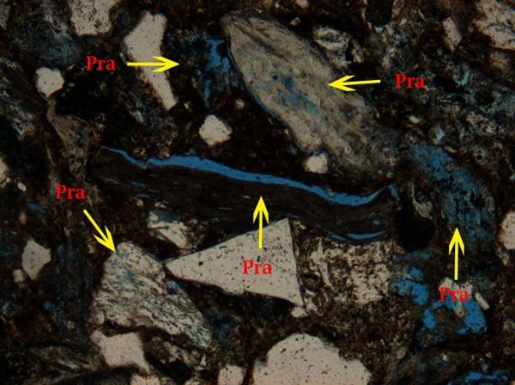
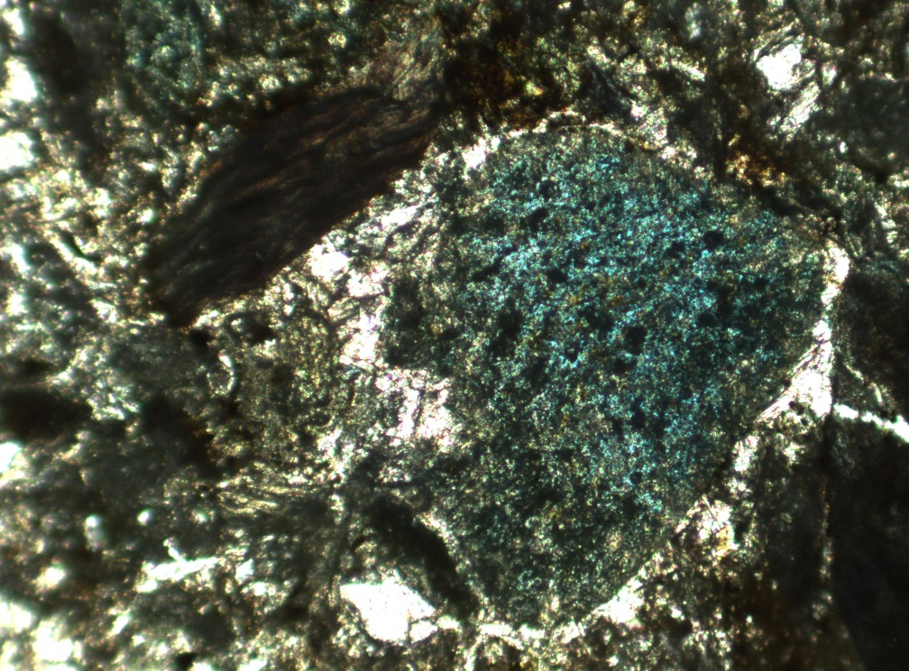
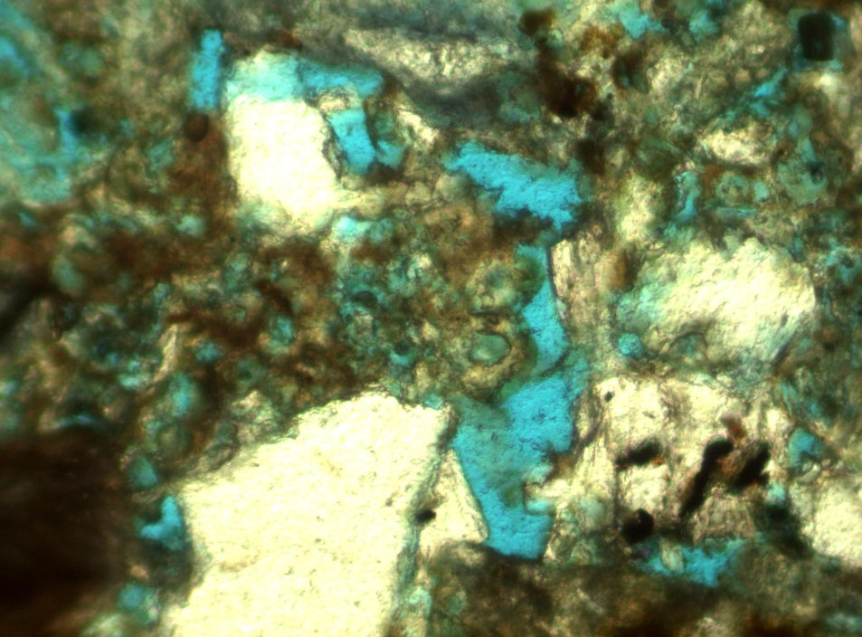
Intra Ø
Intra Ø
Intra Ø
Intra Ø
Intra Ø
Altamira Shale
Altamira Shale
AS-001
AS-008
PF-106
Point Fermin
Point Fermin
PF-106
Notes:
Those images, show the intragranular porosity which is well developed in the Altamira Shale grains compared to Point Fermin grains. In the upper 2 images, we can see the different kinds of intragranular porosity. We have parting and dissolution in other lithic grains, and minor quartz grains dissolution related to mineral alteration or deformation. In the lower 2 images, we can see a different kind of intragranualr porosity in Point Fermin. Here we have intragranular porosity developing in the dolomite cement crystals, so we can also more call it intracrystalline porosity!. The difference between the two members is that in the Altamira Shale, the grains developed intragranualr porosity while the dolomite cement grow to the 2nd stage and closed the porosity and pore spaces, therefore, we have much lower permeability in Altamira Shale. The case is different in Point Fermin, the dolomite cement have and in part developed its own intragranular porosity which increased the permeability in it and the grains didn’t go through a higher degree of diagenesis to develop intragranlar porosity even though some grains have developed as we see in the lower right which is filled with oil.

Slide 30
Intra Granular Volume
porosity +cement
Notes:
Intergranular volume (IGV) is a measurement of the degree of compaction. It measures the space between the grains. Compaction measured by IGV shows a difference between the Altamira Shale and the Point Fermin sandstone samples. The average IGV for the Altamira Shale is 41% while for Point Fermin it is 33%. The Altamira Shale values indicate that the sandstones are composed of nearly half intergranular volume that consists mainly of cement with little to no porosity. This value is very close to values typical at initial deposition, indicating that the Altamira Shale sandstones were cemented at very shallow burial depths.

Slide 31
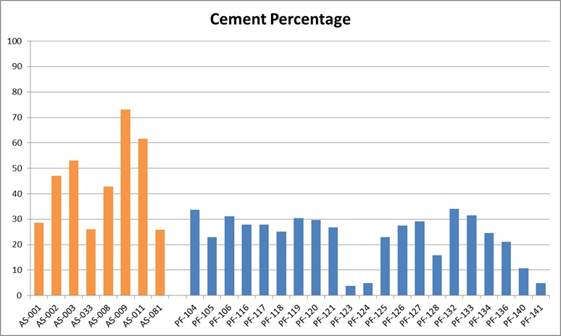
Notes:
Breaking the IGV down to intergranular porosity and cement volumes provide a better understanding of the difference between the two members. In the upper diagram, the intergranualr porosity of Altamira Shale has an average of 1%, while Point Fermin has an average of 11%. The difference in intergranular porosity between the two members is striking because the Altamira Shale has almost no intergranular porosity, whereas the Point Fermin has good intergranular porosity.
In the lower diagram of the total cement, Altamira Shale has average of 40% while Point Fermin has an average of 22%. The difference in cementation is clear. The Altamira Shale has more cement per rock volume than the Point Fermin, with a difference around 20% on average. This information guides us to understand why oil is not present in the Altamira Shale sandstones, yet is relatively abundant in the Point Fermin samples.
Please note that these measurments are based on point counting.

Slide 32
Diagenesis History Diagram
Notes:
The coexistence of rhombohedral dolomite, anhedral dolomite, calcite, carbonate cement , zeolites, and gypsum in many samples assists determination of the relative sequence of cement precipitation. Based on the relation we see in more than one sample, the carbonate cements (subhedral rhombohedral dolomite, anhedral dolomite, and calcite) are older than the zeolite and gypsum cements. By adding seepage, compaction, intragranular porosity, and francture with the different cements, we have made a diagenesis history diagram as you see here. Based on our study, the anherdral dolomite cement had a better development and longer time to from in Altamira Shale. Also the zeolite had the same thing. Compaction has affected the Altamira Shale more than Point Fermin because we saw some of it effects on the metamorphic lithic grains in Altamira Shale. Intragranular porosity as you saw earlier, was more developed in the Altamira Shale compared to Point Fermin.

Slide 33
Conclusions
Petrographic data confirms the two members have the same provenance (Catalina Schist) and have the same composition.
Grain size is not cause of the difference in oil saturation.
Depositional and burial diagenesis environments were different to allow for different timings of diagenesis and pathways.
The sandstone beds in Point Fermin are interbedded with sandy dolomite.
Substantial rhombohedral dolomite crystals are nucleated on hydrocarbons.
Significant intragranular porosity is present in the samples.
The rhombohedral structure of the dolomite crystals preserved some porosity and allowed oil saturation.

Slide 34
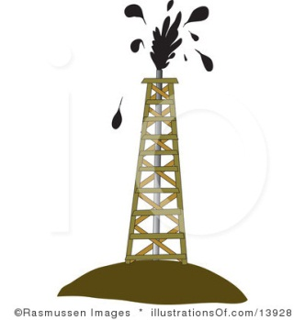
Thank you and appreciate your comments

