Slide 1
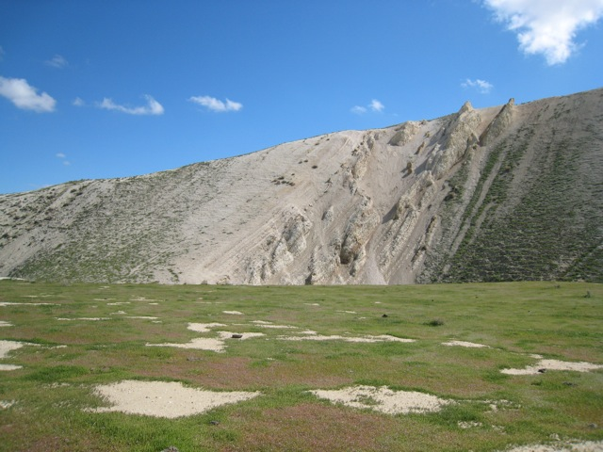
Detailed Lithostratigraphic Characterization of the Monterey Formation at
Chico Martinez Creek, CA
By
Annie Mosher
Notes:
Good morning my name is Annie Mosher and today I’m going to share the results of my masters thesis with you which was a lithologic characterization of the Monterey at Chico Martinez Creek. I’m sure many of you who have worked in the SJ basin have either been out to this section or at least heard of it.

Slide 2
About me
Previous Experience
University of California Santa Cruz (UCSC) – 2008
Mudlogger with Canrig Drilling (Epoch) ~2 years
Future Endeavors
Geologist with Occidental Petroleum
Notes:
I’m excited to say I’m starting a full time position with occidental petroleum next week

Slide 3
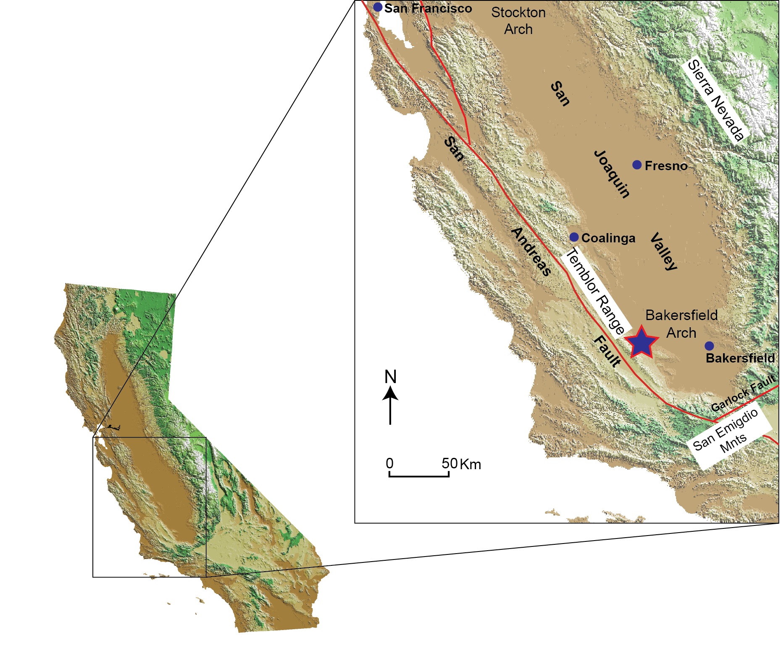
Location
Notes:
CMC is located in the southwestern region of the San Joaquin basin approximately 50km west of Bakersfield in the foothills of the Temblor range which is bound to the west by the San Andreas fault

Slide 4
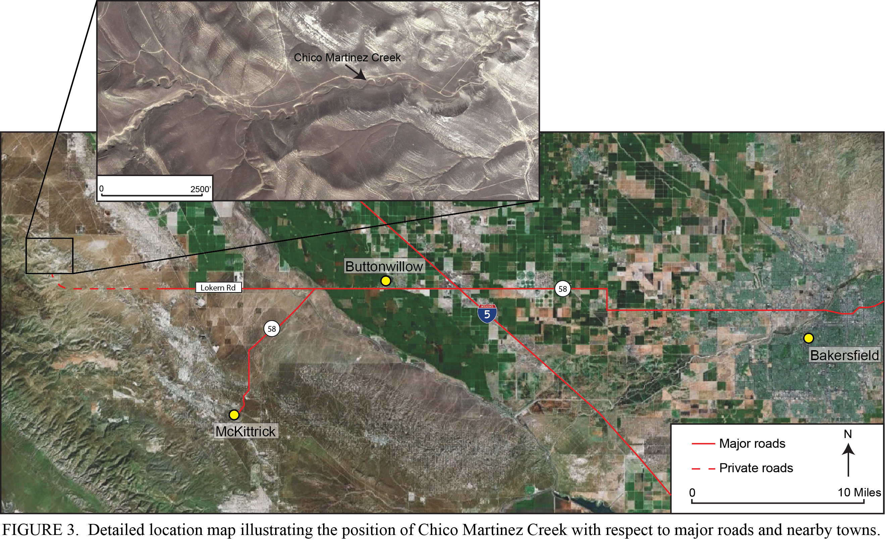
Location
Chico Martinez Creek
Buttonwillow
Bakersfield
Notes:
Since most of you are familiar with the Bakersfield area, heres a more detailed location map. Basically you take Hwy 58 (Rosedale Hwy) west until it turns into Lokern Rd which eventually becomes a private road onto the Twisselman Ranch. This is a zoomed in satellite image of the CMC section which is approximately 2 miles across.

Slide 5
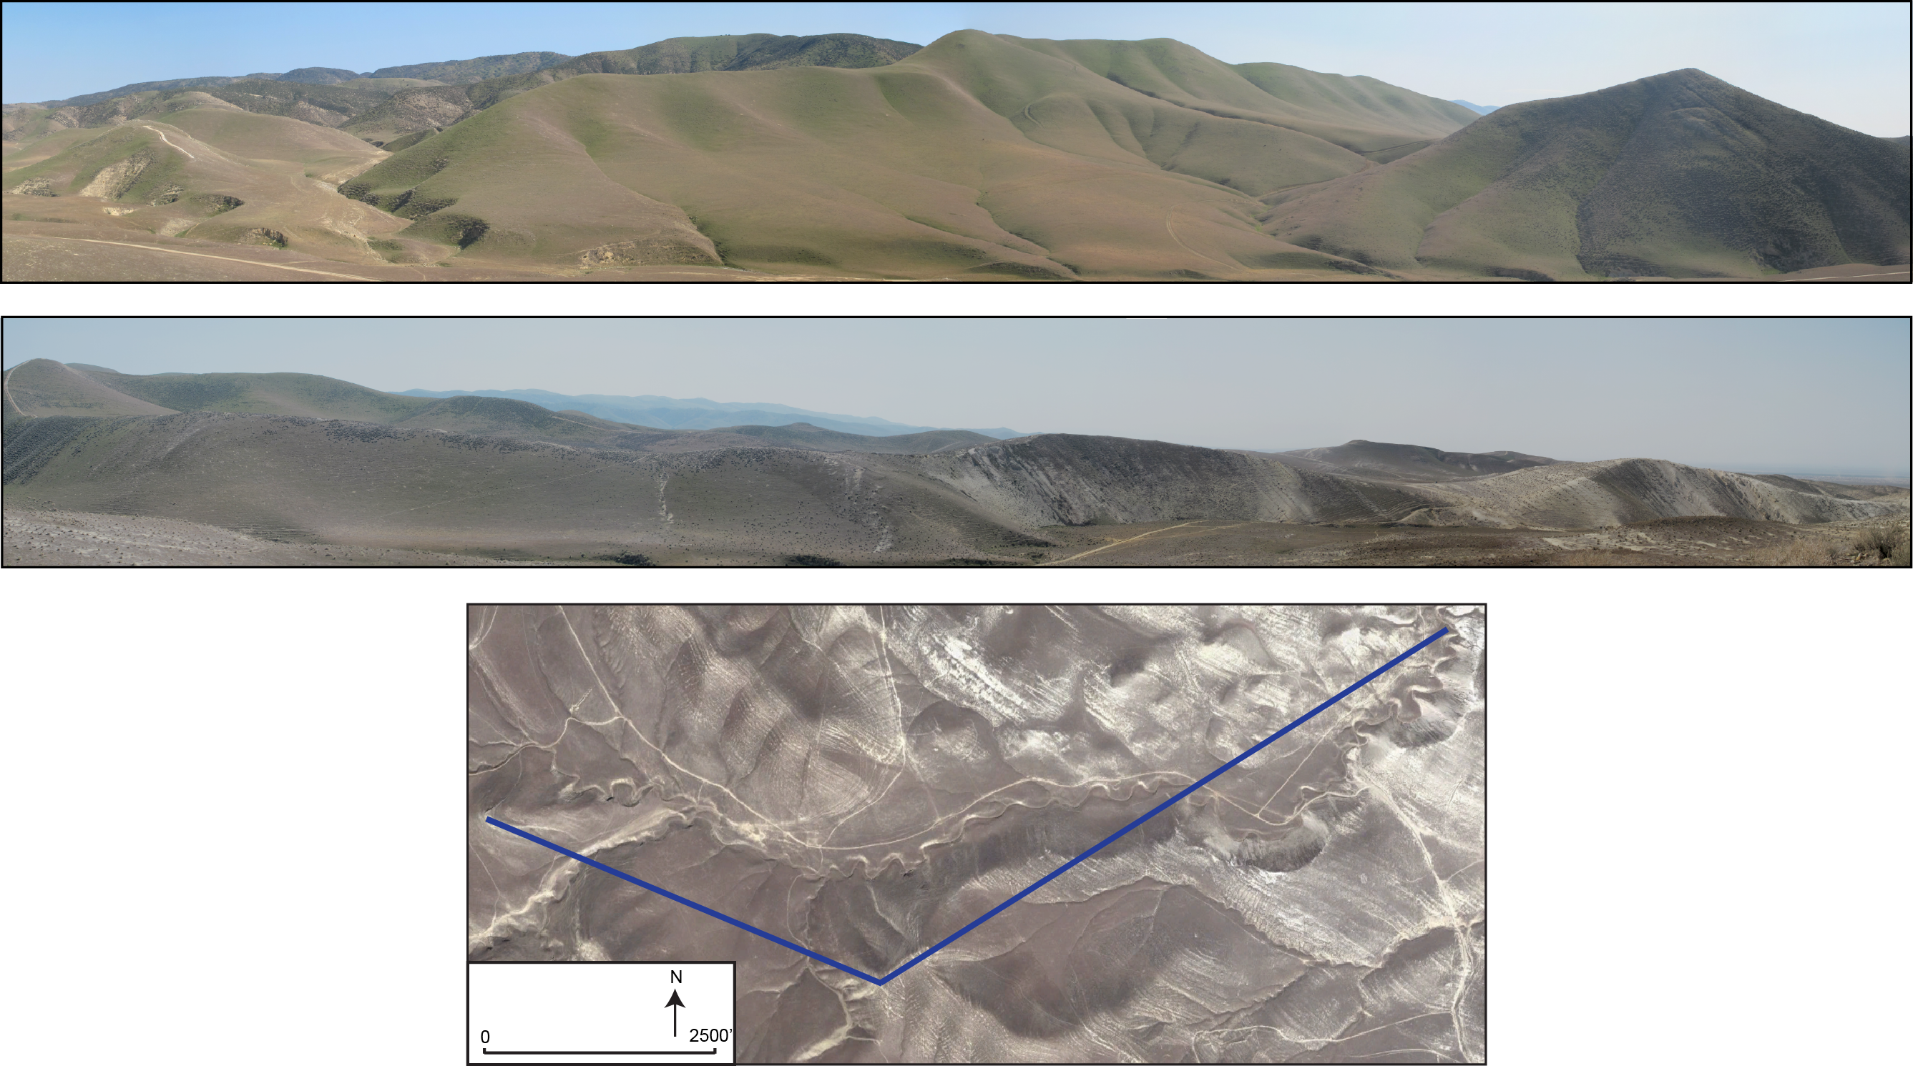
Location
A
B
B
C
C
View
A
B
Notes:
These are panoramic photos of the section looking south to give you a better idea of what the section looks like and how large this succession is going from west to east. The top panoramic is the view looking south from A-B – it’s about ¾ mile long, and the bottom photo is the view looking south from B-C – it’s about 1 ¼ mile long

Slide 6
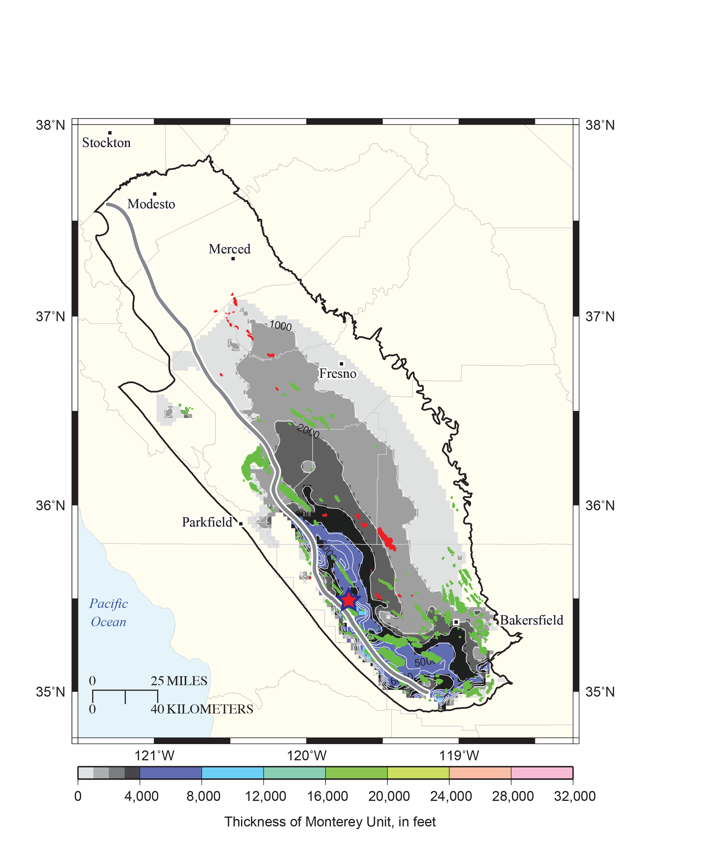
Stratigraphy
Isopach Map of the Monterey Formation
Southern SJ Basin Stratigraphy
West
East
Thickness (ft)
From Scheirer and Magoon (2007); Scheirer (2013)
Notes:
Left Figure: This figure is a stratigraphic chart of the southwestern SJ basin. The Monterey includes the lower Gould, Devilwater, McDonald and upper Antelope members which were deposited between approx 16-6 Ma (middle to late Miocene). Although the Reef Ridge is technically considered the top of the Monterey it was excluded from this study due to poor exposure.
Right Figure:
To the right is an isopach map of the Monterey and as you can see these sediments are predominately restricted to the southwestern margin of the SJ basin
the Monterey attains a maximum thickness of 10,000 feet at CMC including the Reef Ridge
average thickness is approx 5000 ft.

Slide 7
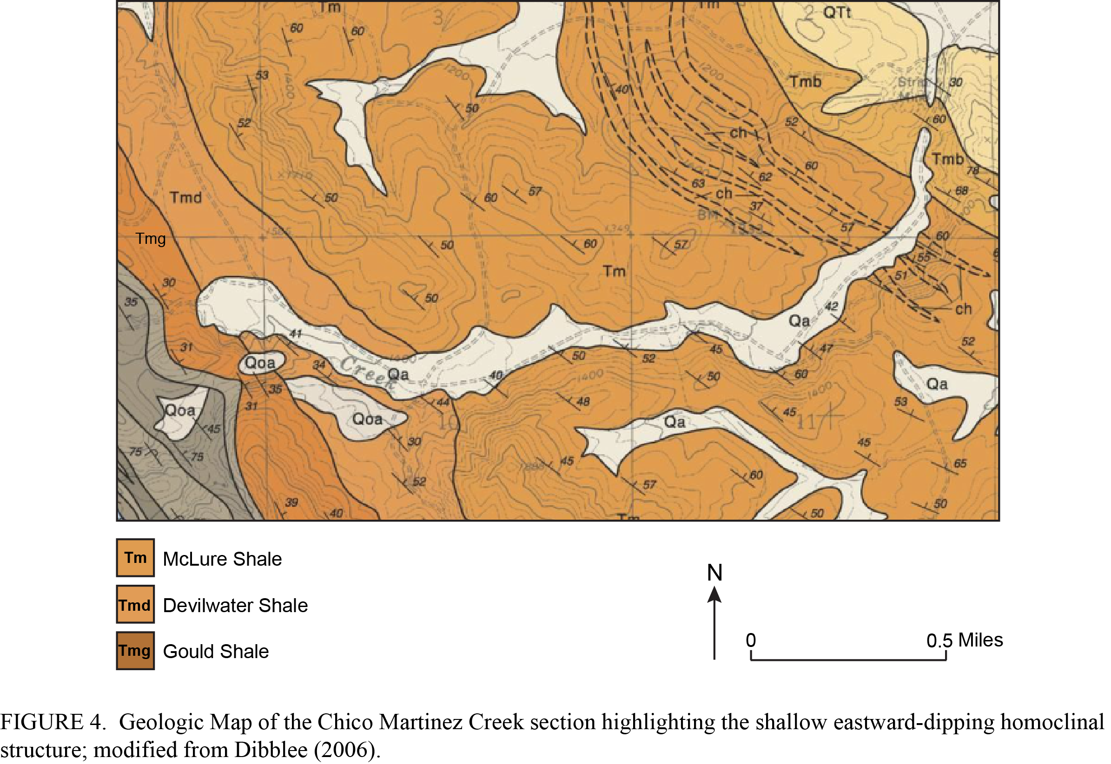
Geologic Map
Dibblee,1973; modified with color in 2006
Notes:
This is a Dibble map of the Monterey Fm at CMC. The sediments form a gentle basinward dipping approx 40 degree homoclinal structure with no known major faults or unconformities. Aside from tilting, the sediments have undergone very little structural deformation.

Slide 8
Background
Type section of the Monterey in the SJ basin
  > 6000 ft
Notes:
Type section of the Monterey in the SJ basin – and is actually one of the thickest exposed sections in California

Slide 9
Background
Type section of the Monterey in the SJ basin
  > 6000 ft
Lack of detailed lithostratigraphy in published literature
Notes:
Many studies conducted at this location included CMC not as the main focus, but incorporated it as apart of a larger regional study.

Slide 10
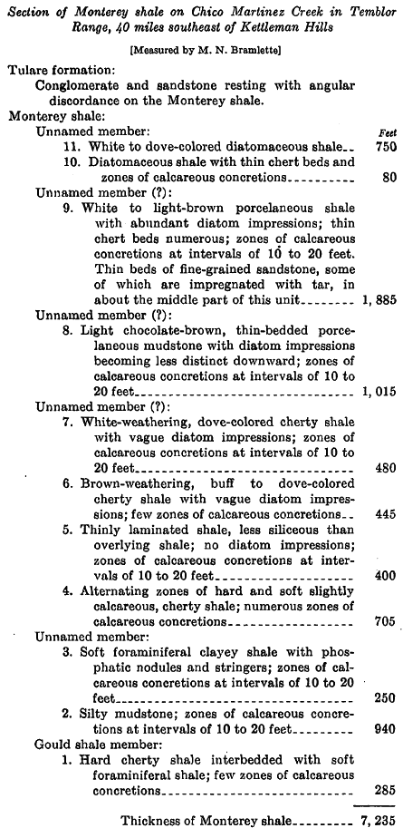
Background
Type section of the Monterey in the SJ basin
  > 6000 ft
Lack of detailed lithostratigraphy in published literature
Woodring, Steward and Richards, 1940
Notes:
In fact this is the most detailed description found in the literature and again this was a very small section that was incorporated into a larger study on the SJ basin.

Slide 11
Background
Type section of the Monterey in the SJ basin
  > 6000 ft
Lack of detailed lithostratigraphy in published literature
Proprietary studies focused mainly on biostratigraphy.
  Shell Oil (1937)
  Unocal (1986)
Notes:
Proprietary studies mainly focused establishing biostratigraphy – for the purpose of subsurface correlation and in the case of Unocal also determining the timing of depositional events at CMC.

Slide 12
Study Objectives
Detailed lithostratigraphic characterization
  Lithologic descriptions
  Spectral gamma-ray (U, Th, K) measurements (2 ft)
  Subsurface correlations
Establish chronostratigraphic framework
  Industry acquired biostratigraphic data
  New paleomagnetic data
Identify changes in linear sediment accumulation rates
Notes:
Detailed lithostratigraphic characterization-
Achieved through detailed lithologic descriptions, collection of spectral gamma-ray data which includes U, Th and K every 2 feet – a resolution that’s somewhat equivalent to industry-acquired subsurface logs (typically .5 to 1 foot). This was done using a portable handheld unit loaned courtesy of exxon mobile. Subsurface correlations were done using total gamma-ray due to the lack of public spectral gamma-ray data.
Establish chronostratigraphic framework-
Done by incorporating previously acquired industry data into the measured section and by acquisition of new paleomagnetic data.
Identify changes in linear sediment accumulation rates
With that said, now I’m going to launch into the results of this study
----- Meeting Notes (10/9/13 12:02) -----
these rates were determined using the biostratigraphic and paleomagnetic data

Slide 13
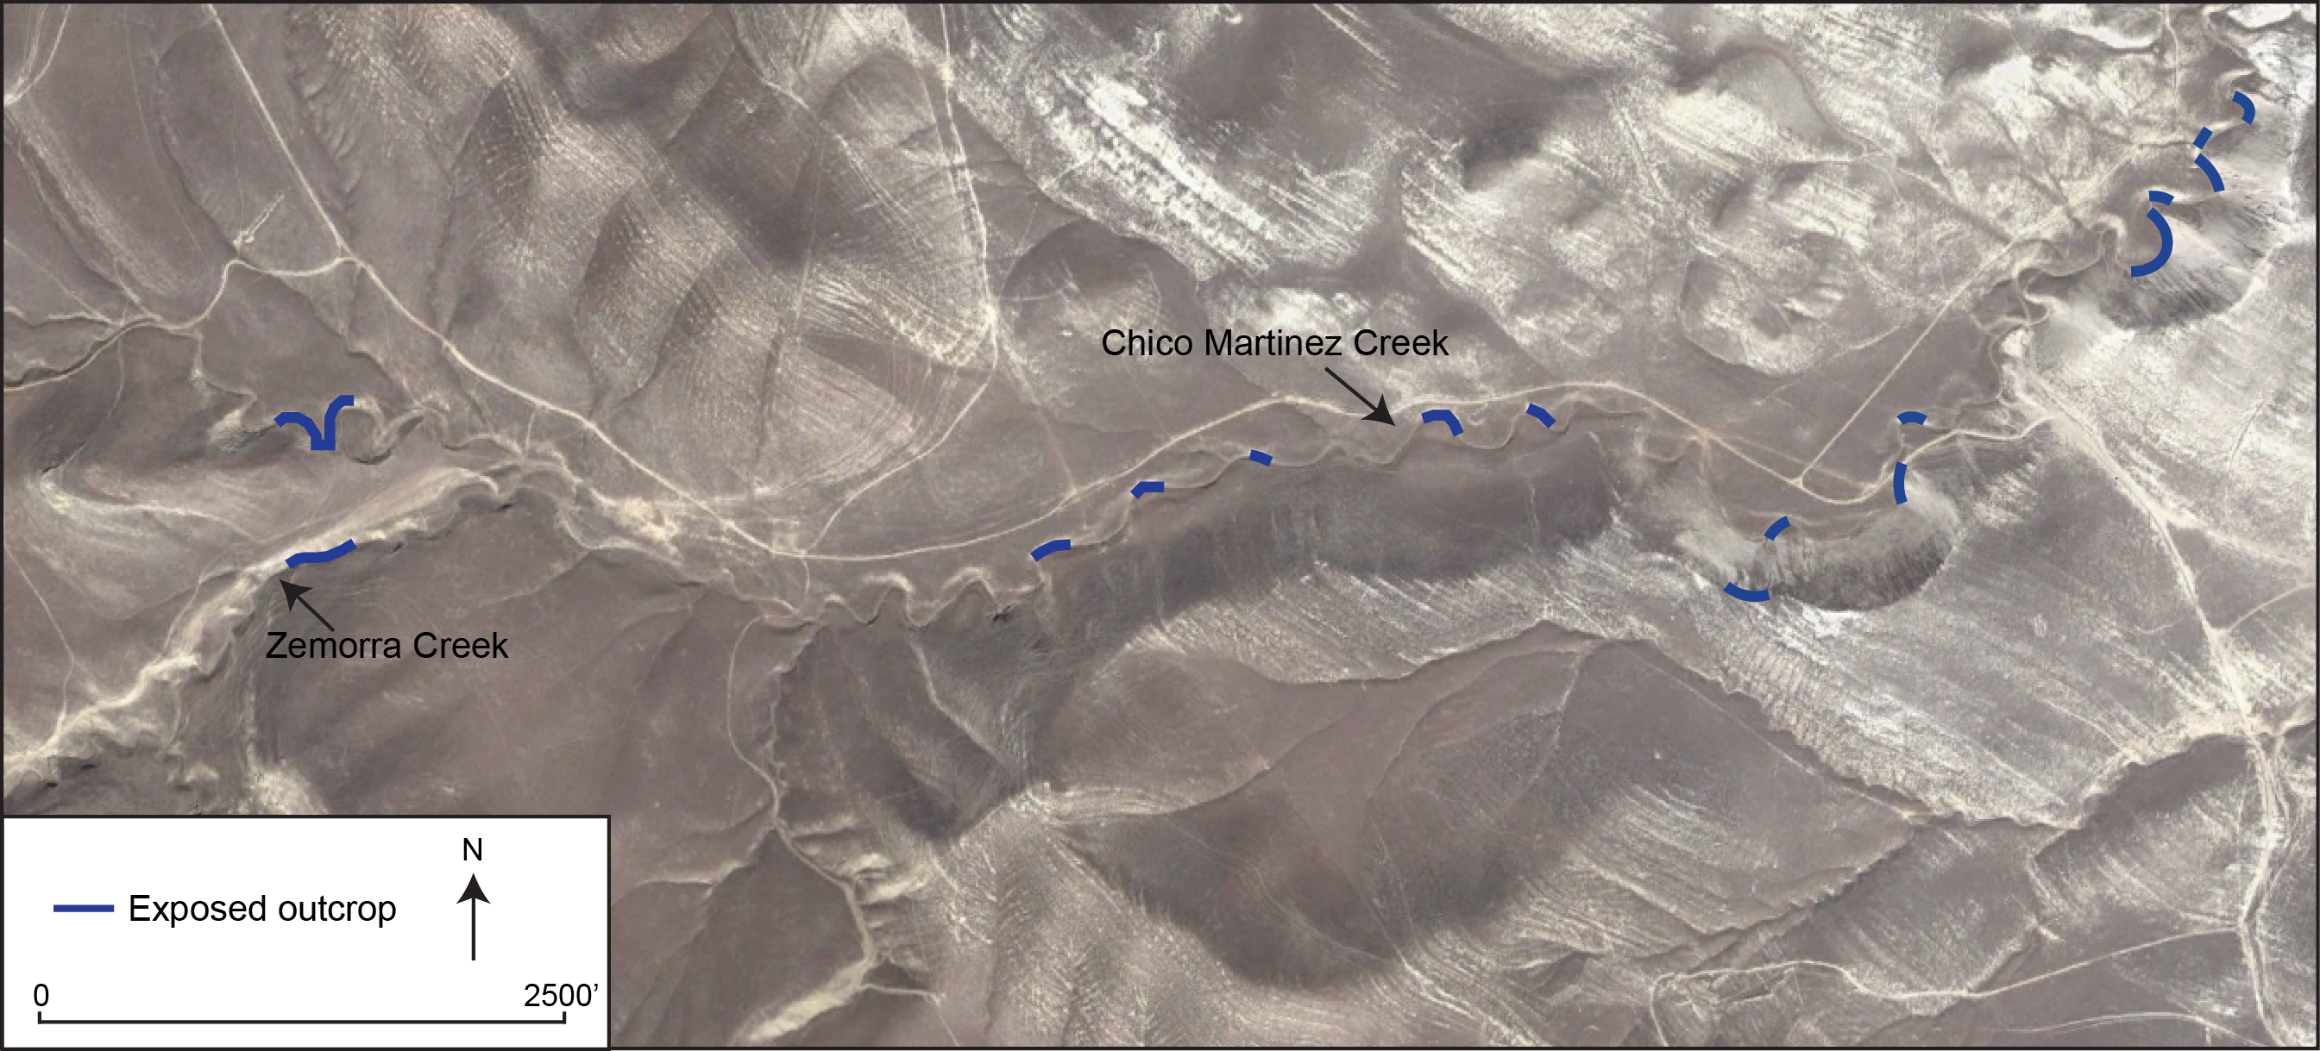
Data Acquisition
Outcrop Exposure ~30%
Notes:
When Rick and I first visited this field area we were pretty disappointed in the lack of exposed outcrop and it was questionable as to whether or not this study was going to be possible. Segmented and patchy exposure would make subsurface correlations and changes in lithology very difficult to identify.

Slide 14
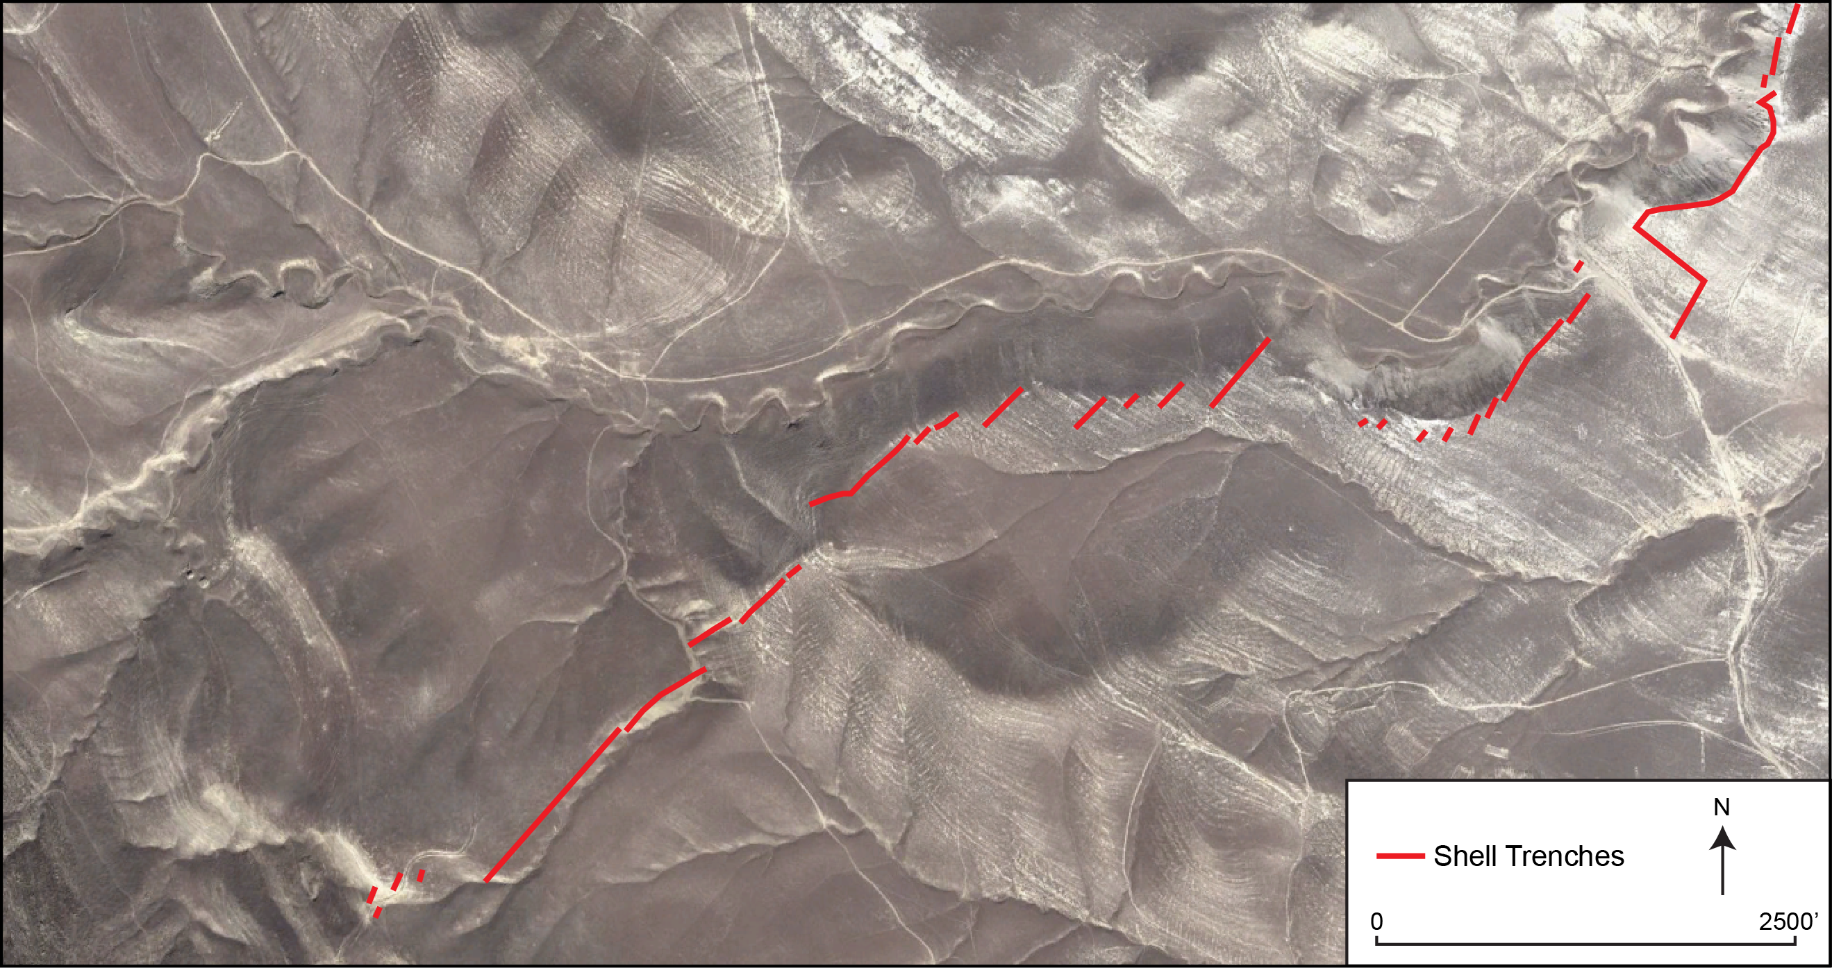
Data Acquisition
Shell Oil Trenches - 100% Exposure
Notes:
After reviewing the biostratigraphy data that shell collected in the 30s we noticed that the data was collected along trenches, but were again disappointed when we found that these had either been backfilled or naturally infilled with sediment over time.

Slide 15
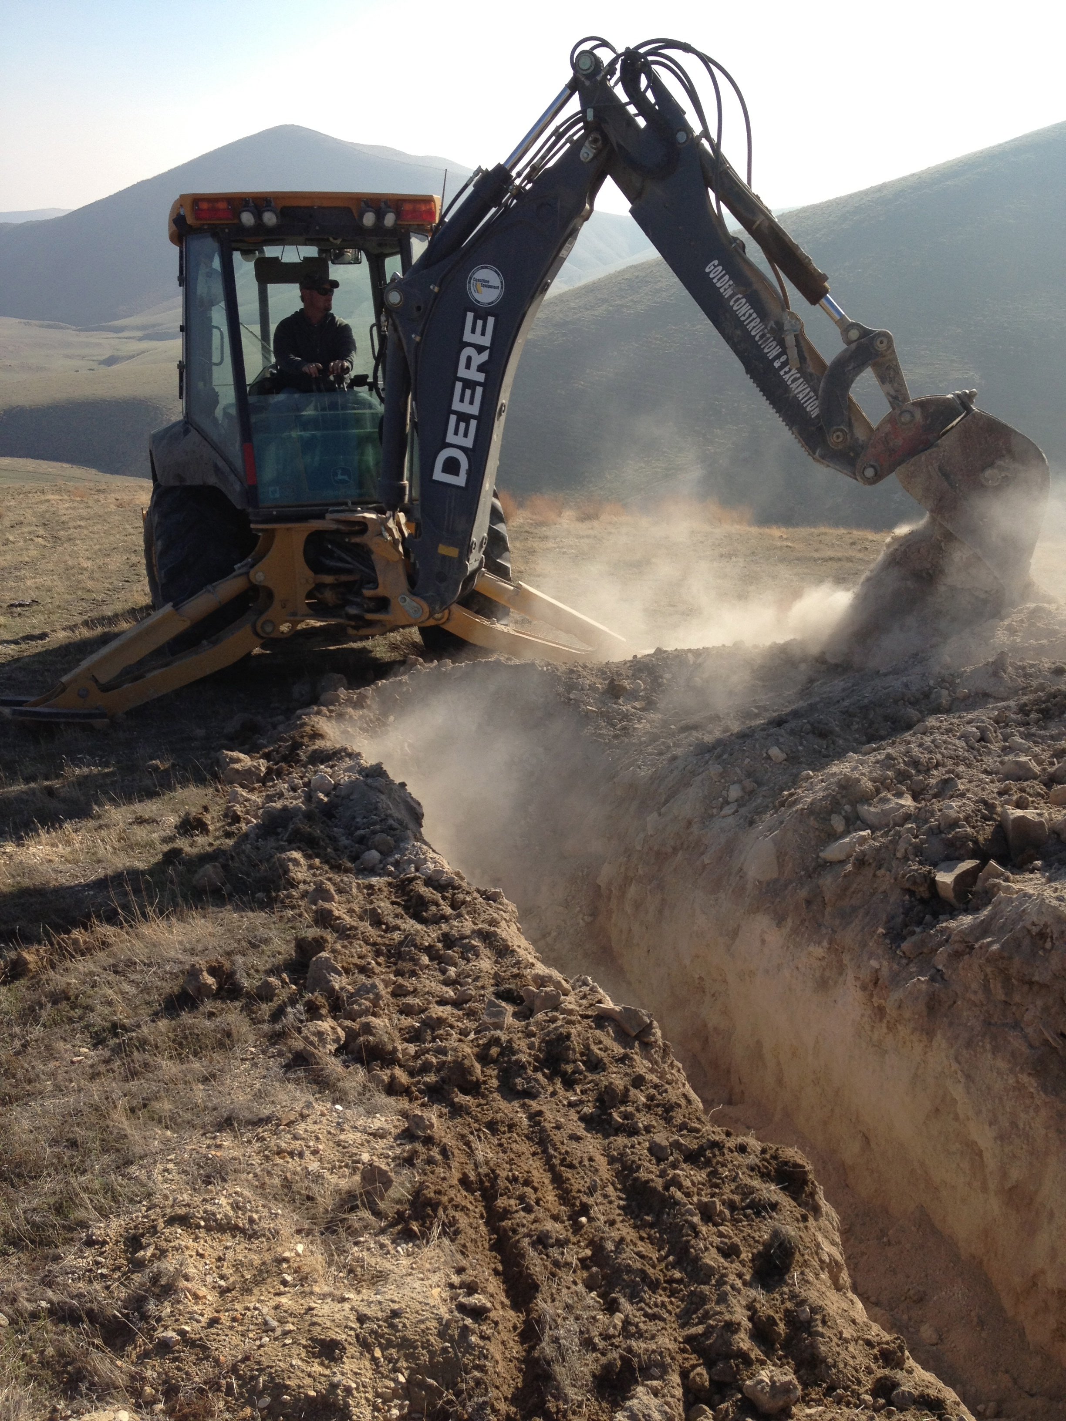
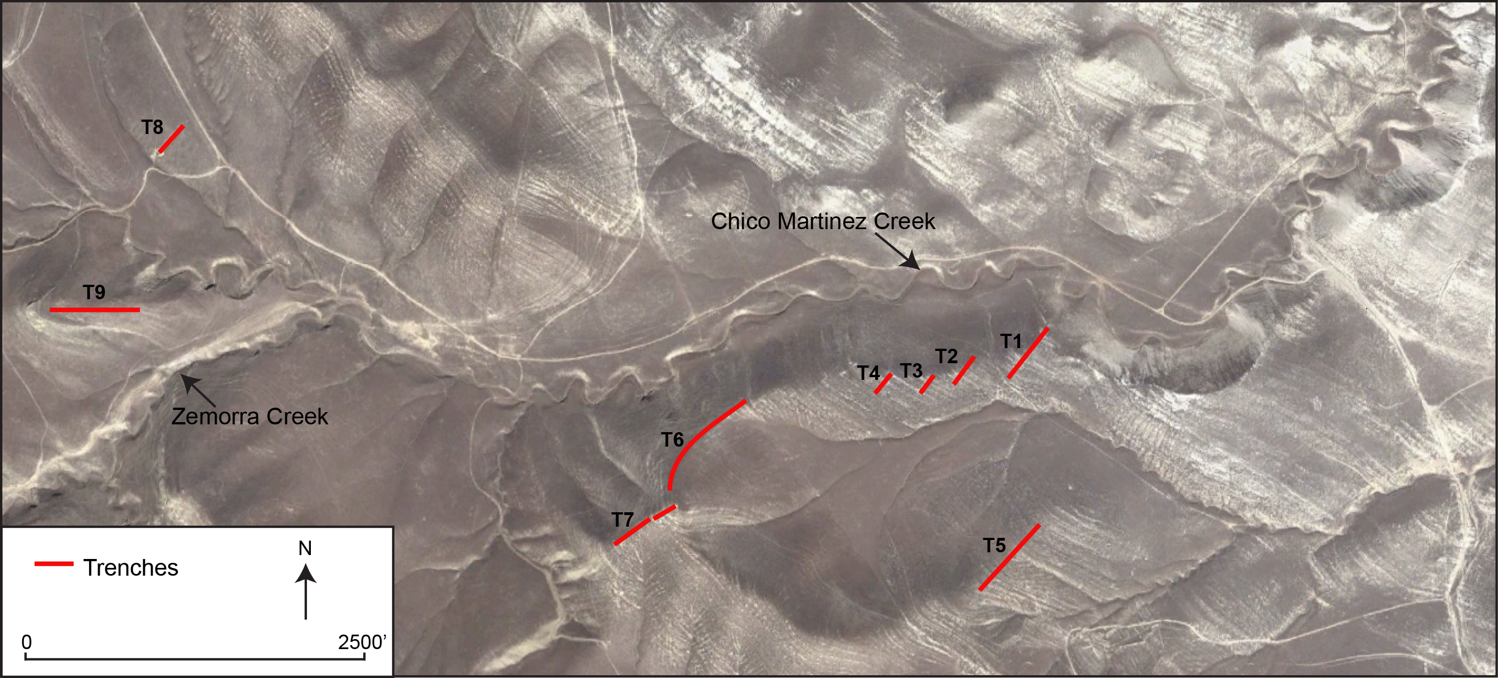
Data Acquisition
2,400 stratigraphic feet along trenches (~ 1 mile)
Notes:
After getting consent from the landowner and evaluating costs, we decided to go in with a backhoe and re-excavate some of these trenches. However many of these trenched intervals could not be re-excavated because they were on state owned BLM land where land disturbance was prohibited.
----- Meeting Notes (10/9/13 12:02) -----
Image of trench excavation in action!

Slide 16
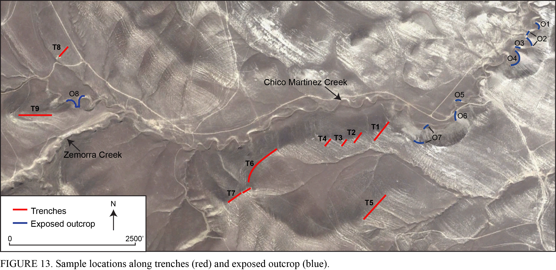
Data Acquisition
2,400 stratigraphic feet along trenches (~ 1 mile)
1,220 stratigraphic feet exposed outcrop
Increased exposure from 30 to 60%
Notes:
2400 stratigraphic feet of trenches were re-excavated or newly unearthed
Took data coverage from approx patchy 30% to 60% with some intervals being more that 1000 consecutive feet of exposure
This project and the interpretations made would not be possible without these trenches

Slide 17
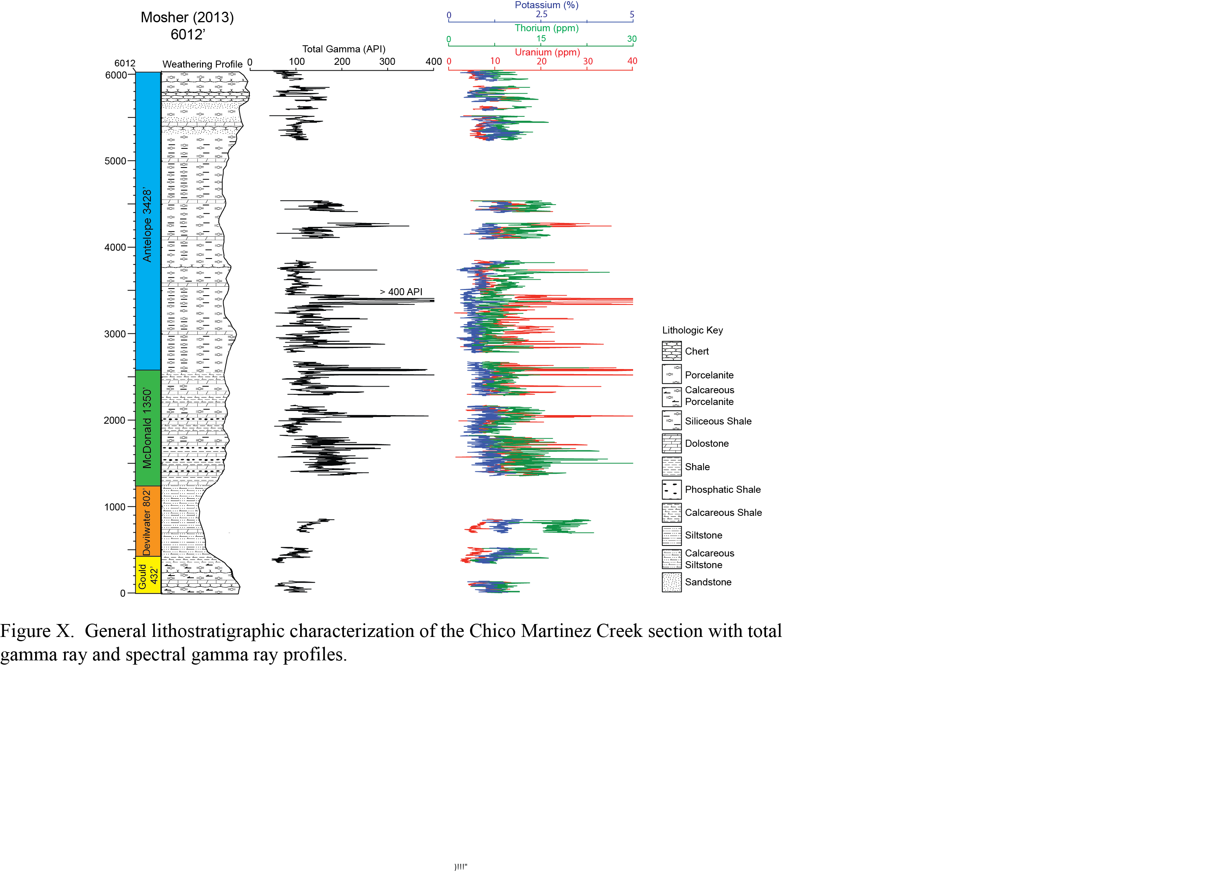
* Detailed surface mudlog with 5 ft lithology and detailed descriptions also available in PDF and LAS format
Total API = 8U(ppm) + 4Th(ppm) + 16K(%)
(Ellis, 1987)
Notes:
This is a compilation of all my data in one figure
from left to right the total length of the Monterey Formation and each Monterey member at CMC, a weathering profile showing general lithology, Total API gamma and the spectral breakdown of Potassium (blue), Thorium (green) and Uranium (red).
The total API was calculated from the spectral gamma using the following formula.
A more detailed surface mudlog is going to be made available with a 5ft lithologic breakdown and detailed descriptions in PDF and LAS format.
----- Meeting Notes (10/9/13 12:02) -----
The final compilation of all the data in one illustration

Slide 18
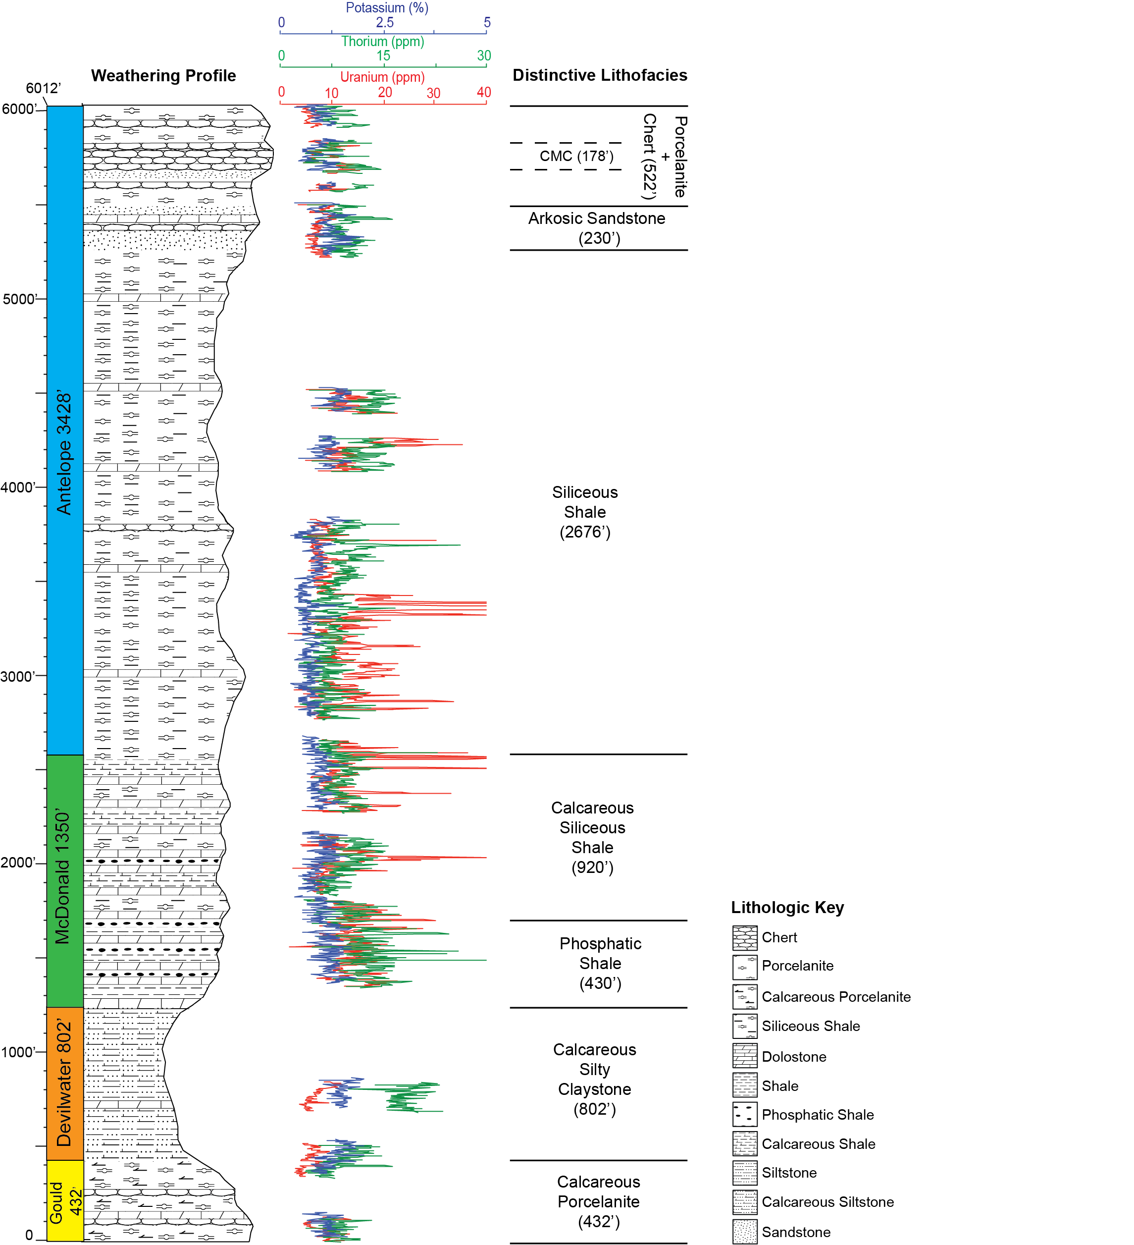
Lithologic characterization based on:
Field-documented lithology every 2 feet
Microscope analysis of 10-foot composite samples
X-ray diffraction (XRD)
Fourier transform infrared spectroscopy (FTIR)
Unique spectral log character
Notes:
The lithology at CMC creek was previously broken down into 4 members. In this study, I further subdivided into 7 distinctive lithofacies which I’ll take you through briefly in a moment.
These lithofacies I’m about to describe are the characteristic or distinctive lithologies within these units but these contain other types of rocks as well
This lithologic characterization was based on a combination of
Field documented lithology every 2 feet – this was basically documented as gamma-ray readings were collected.
Microscope analysis of 10-foot composite samples – these were collected in the field and then analyzed for more detailed characteristics such as carbonate content and the presence of visible grains
XRD on a limited number of samples to identify mineralogy and FTIR also for mineralogy but is especially useful in identifying clays.
And unique log character

Slide 19
Calcareous Porcelanite
Calcareous quartz-phase porcelanite interbedded with siliceous shale
Notes:
----- Meeting Notes (10/9/13 12:02) -----
So I'm going to take you through these in ascending age order starting from the oldest deposits and work my way up.

Slide 20
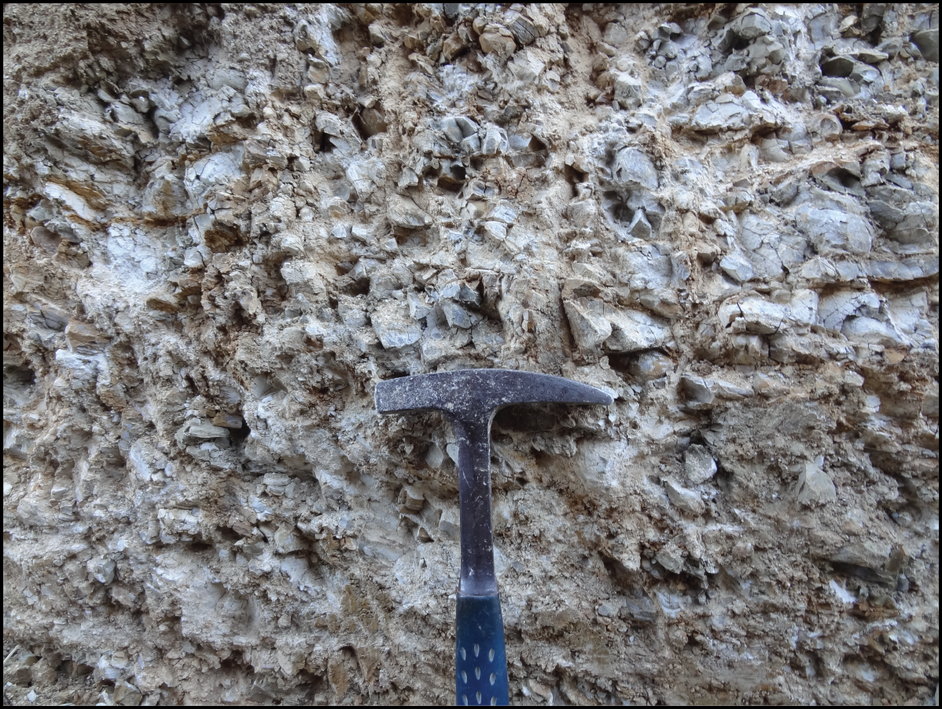
Calcareous Silty Claystone
Detrital quartz and muscovite with an illite clay matrix.
Highest average Th
Poorest exposure
Notes:
This claystone is mostly composed of detrital quartz and muscovite with illitic clays

Slide 21
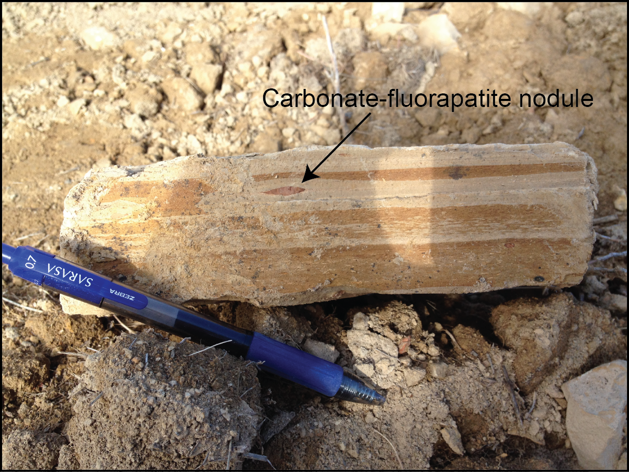
Phosphatic Shale
Quartz-phase siliceous shale with an illite clay matrix
Abundant dolostone beds
Highest average Uranium
Notes:
The phosphatic shale is characteristic of the lower McDonald
Within interval abundance of dolostone beds

Slide 22
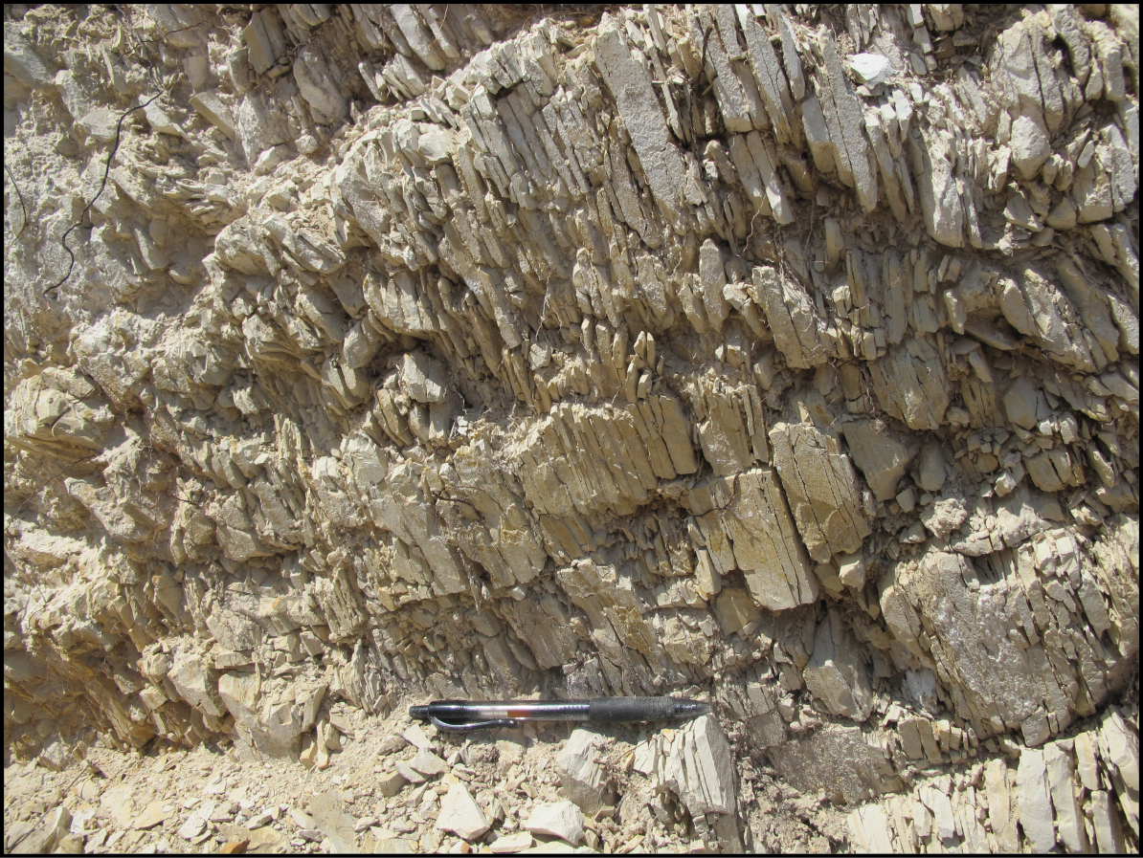
Calcareous Siliceous and Siliceous Shale
>3500 ft
Transition from opal-CT siliceous shale to mostly quartz-phase siliceous shale at around 2800 ft
Notes:
And then in the upper McDonald the lithology become more siliceous and this continues into the Antelope. This calcareous siliceous and siliceous shale package combined is over 3500’ thick, making it the dominant lithology in the CMC section

Slide 23
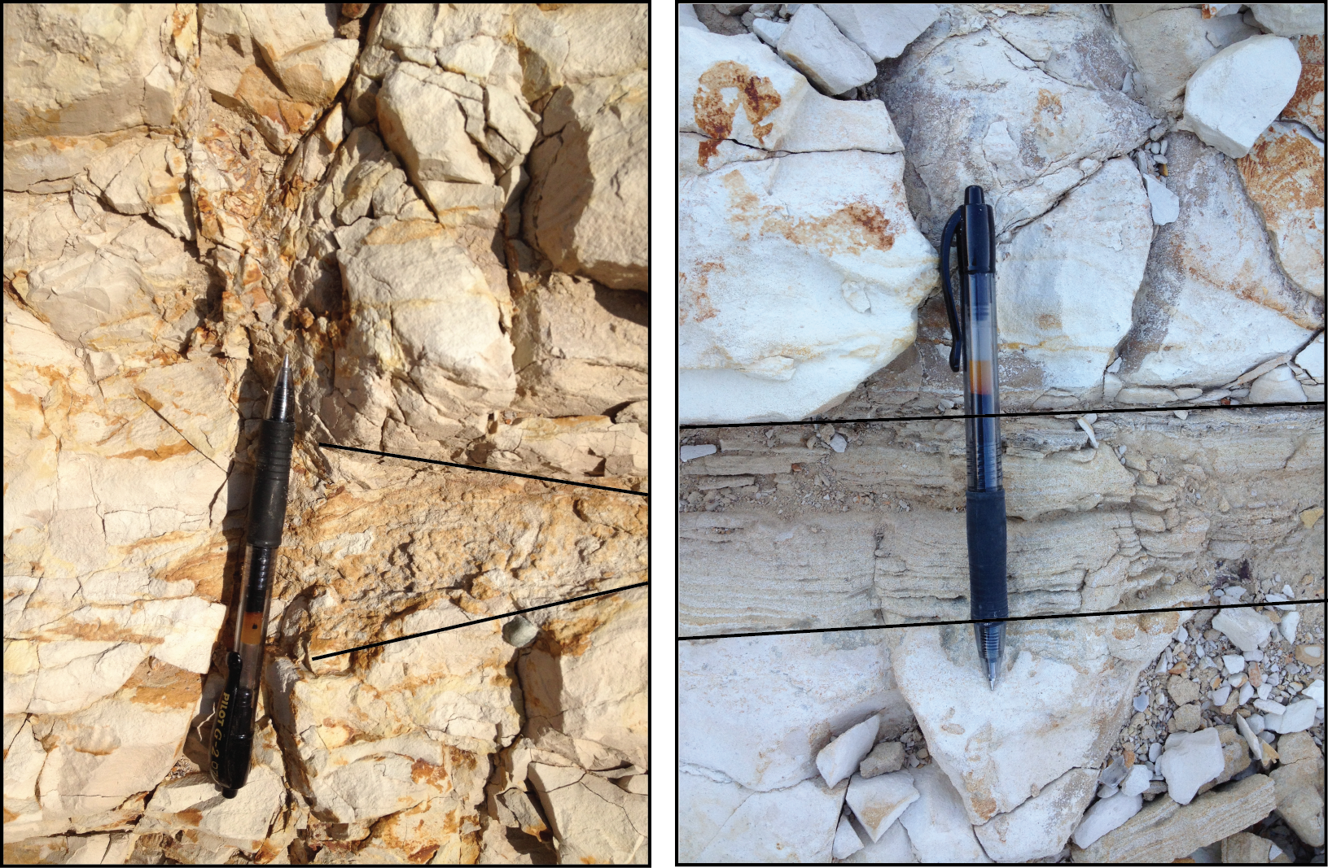
Arkosic Sandstone
Fine-grained sandstone interbedded with opal-CT siliceous shale and porcelanite
Both 1-2” beds and thin cm-scale discontinuous laminations
Quartz, feldspar and minor illite clay matrix
Notes:
Although characteristic feature is sandstone it makes up only about 20% of interval – interbedded with siliceous shale and porcelanite.

Slide 24
Arkosic Sandstone
Notes:
Could be genetically equivalent to the Steven sands, a turbidite sand prevalent in the upper Antelope in the SJ basin

Slide 25
Porcelanite and Chert
Opal-CT porcelanite and chert with sandstone and silt lenses.

Slide 26
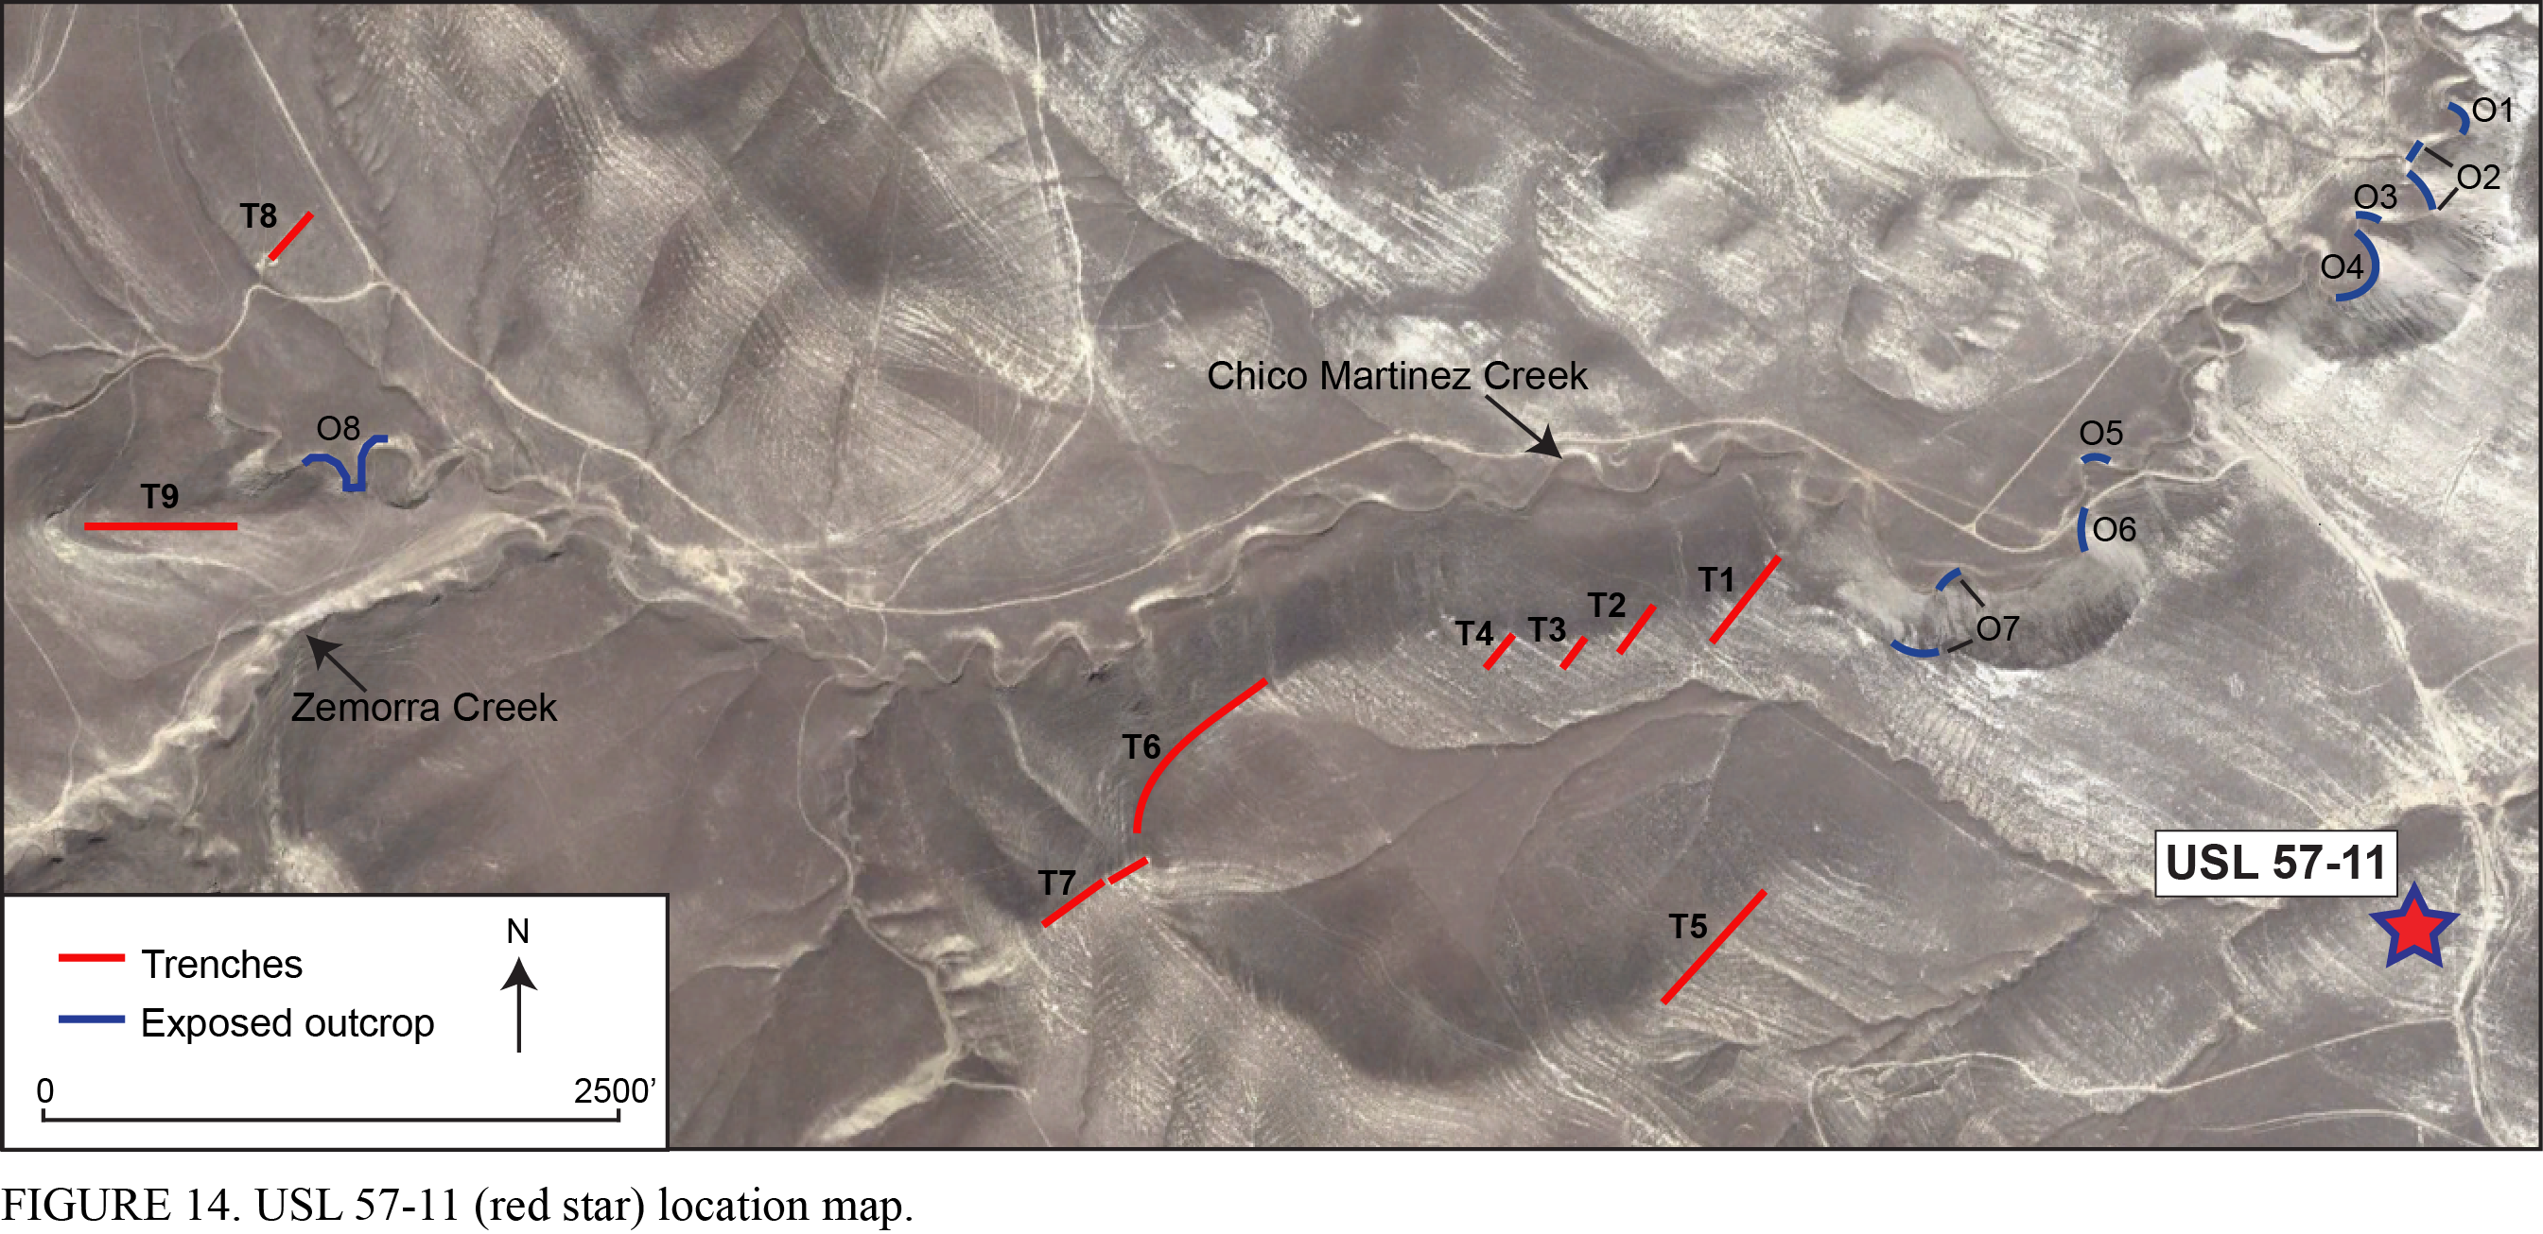
Subsurface Correlation
Notes:
The next phase of this project was to evaluate how the surface gamma-ray log correlated to the subsurface. In an effort to fill more covered intervals of missing gamma-ray data the CMC profile was correlated with well USL 57-11. If you follow this well along strike you can it pretty much starting drilling at the stratigraphic equivalent of the first trench which made data infill only possible from this part of the section west.

Slide 27
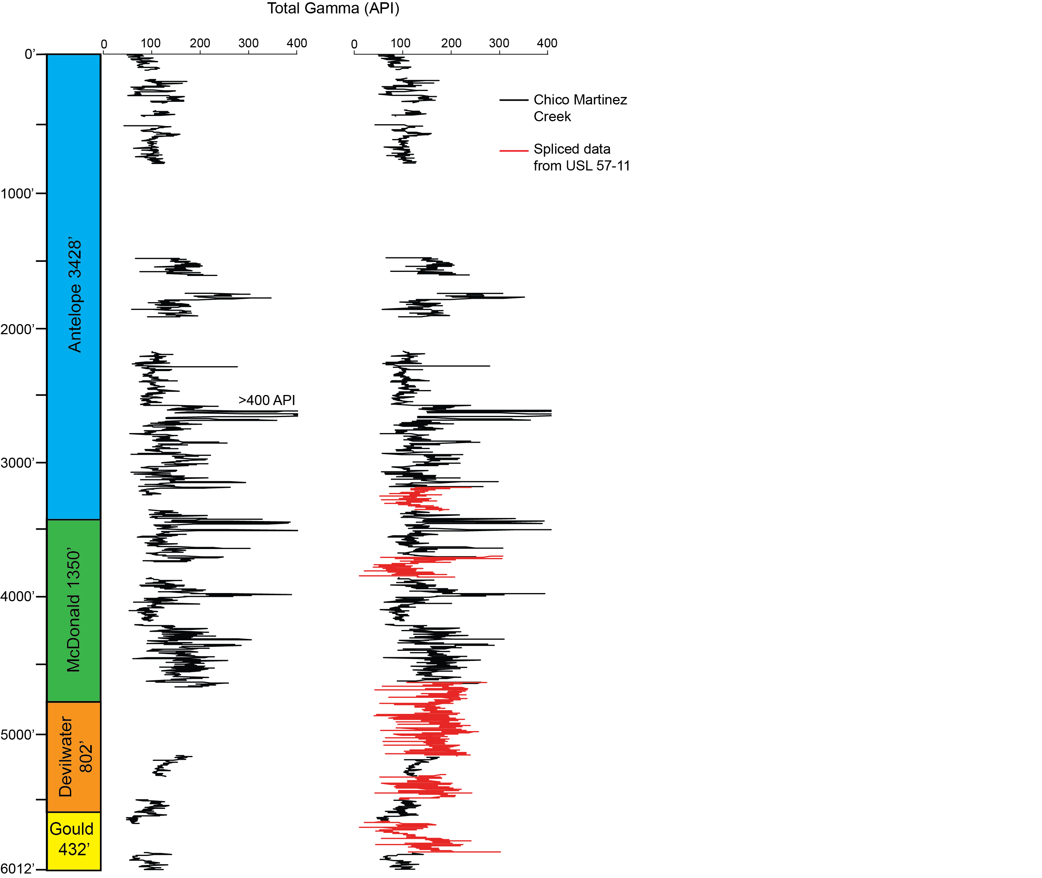
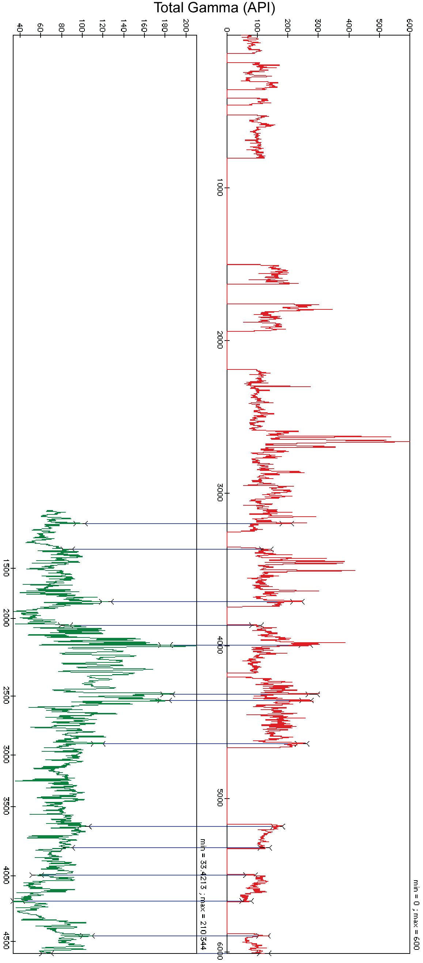
USL 57-11
CMC
From 60% Coverage to ~80%
Notes:
To the left is my correlation with the USL-57-11 well data. To the right you can see the gaps in the original gamma-ray profile now filled with the spliced data in red.

Slide 28
Subsurface Correlation
Notes:
This is a map showing proximal oil fields relative to the CMC section
Data was correlated to the most proximal oil field – South Belridge and one well just north of CMC. These locations were chosen as tie points because they likely lie within the same paleodepocenter as the CMC section and the stratigraphic thickness in these wells have not been structurally compromised.

Slide 29
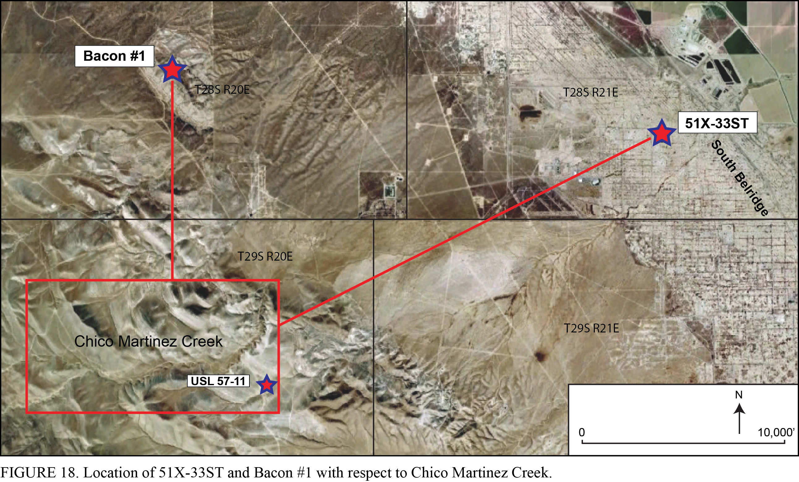
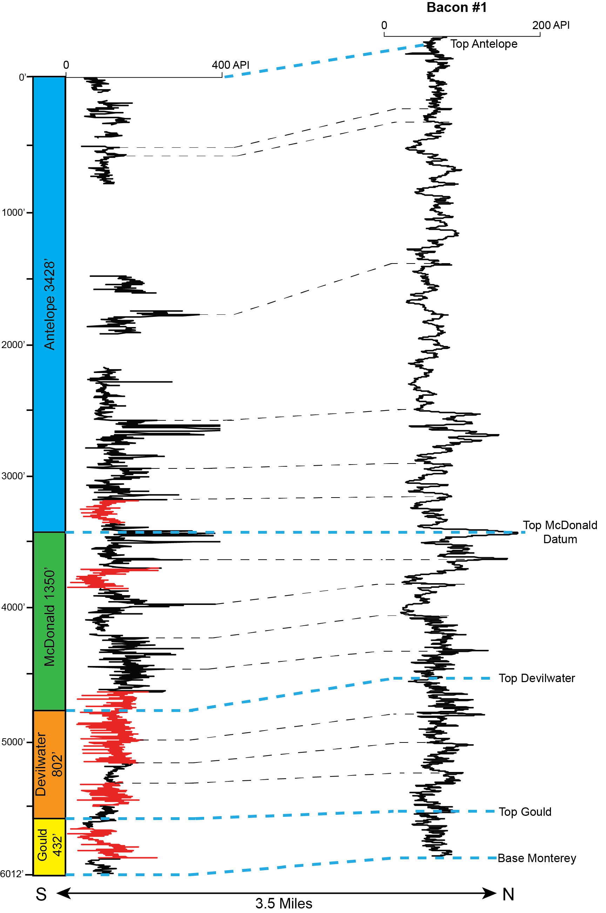
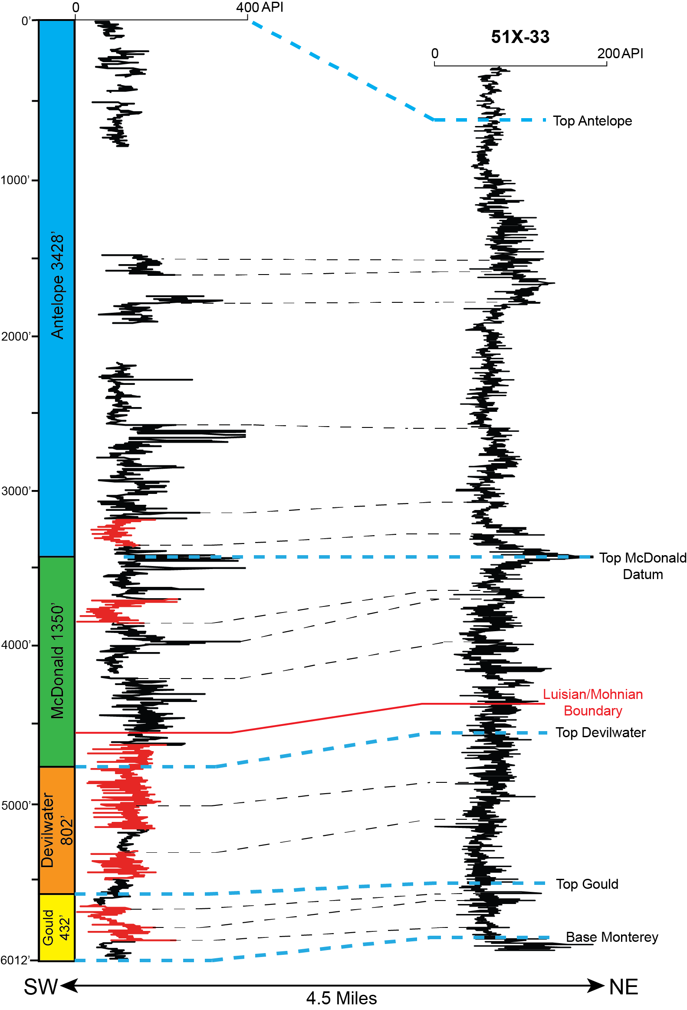
Subsurface Correlation
107 ft
862 ft
Notes:
CMC was correlated to two wells, Bacon #1 located 3.5 miles N and 51X-33ST located 4.5 miles NE.
Going from CMC to Bacon #1 there was a 107’ increase in thickness
Going from CMC to 51X-33ST there was a 862’ decrease in thickness
Both wells indicated very minor variation in thickness

Slide 30
Subsurface Correlation
Lack of thickness variation may have tectonic and paleobathymetric implications
  Tectonically undisturbed during deposition
    Differential accommodation space in structural highs and lows
  Flat paleobathymetry
    Lack of sills and banktops
  Much more data is needed
Notes:
If tectonically disturbed, there would be more lateral variation in thickness reflecting the differential accommodation space in structural highs and lows.
Flat paleobathymetry in this limited area of the depocenter
Much more data is needed – interpretations are only based on 2 wells
But the fact that there is relatively little variation between CMC and the two wells shows that the results of this study are applicable at least to very proximal fields

Slide 31
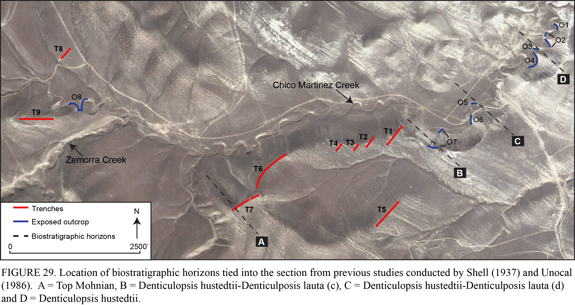
Biostratigraphy
Notes:
This map shows 4 distinct biostratigraphic horizons that were integrated into the measured trench and outcrop sections from the proprietary Unocal and Shell data.

Slide 32
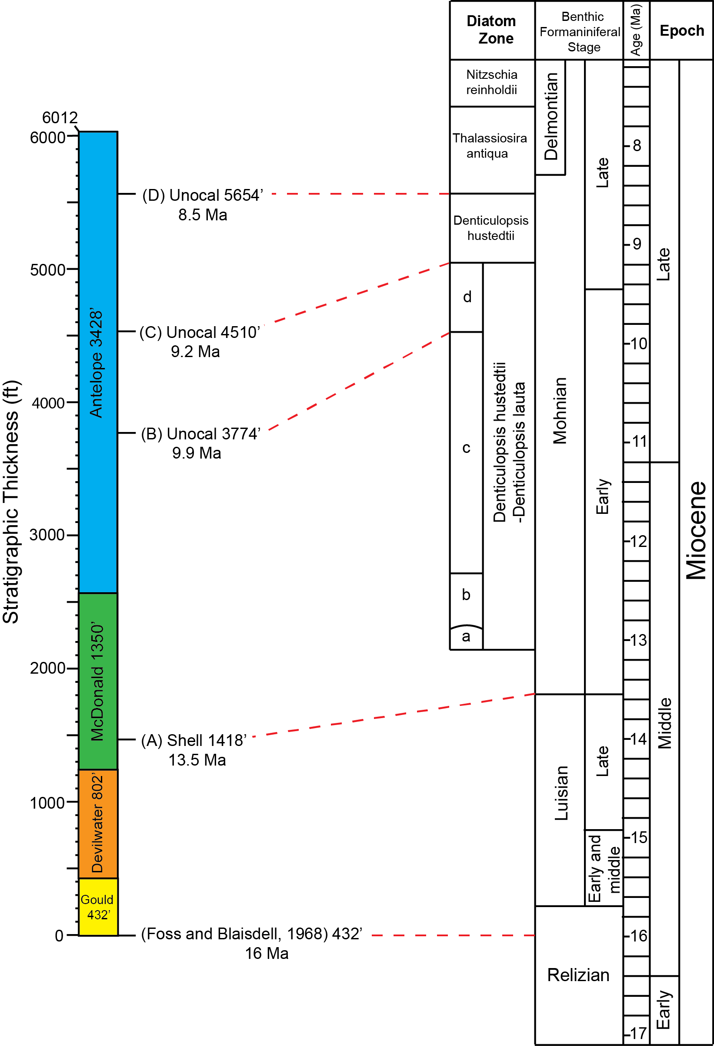
Biostratigraphy
Barron and Isaacs, 2001
Notes:
These included one datum derived from benthic foraminifera from the Shell data an 3 diatom datums from the Unocal study. The base of the section was assigned an age of 16 Ma based on the results of a previous study conducted by Foss and Blaisdell at CMC.

Slide 33
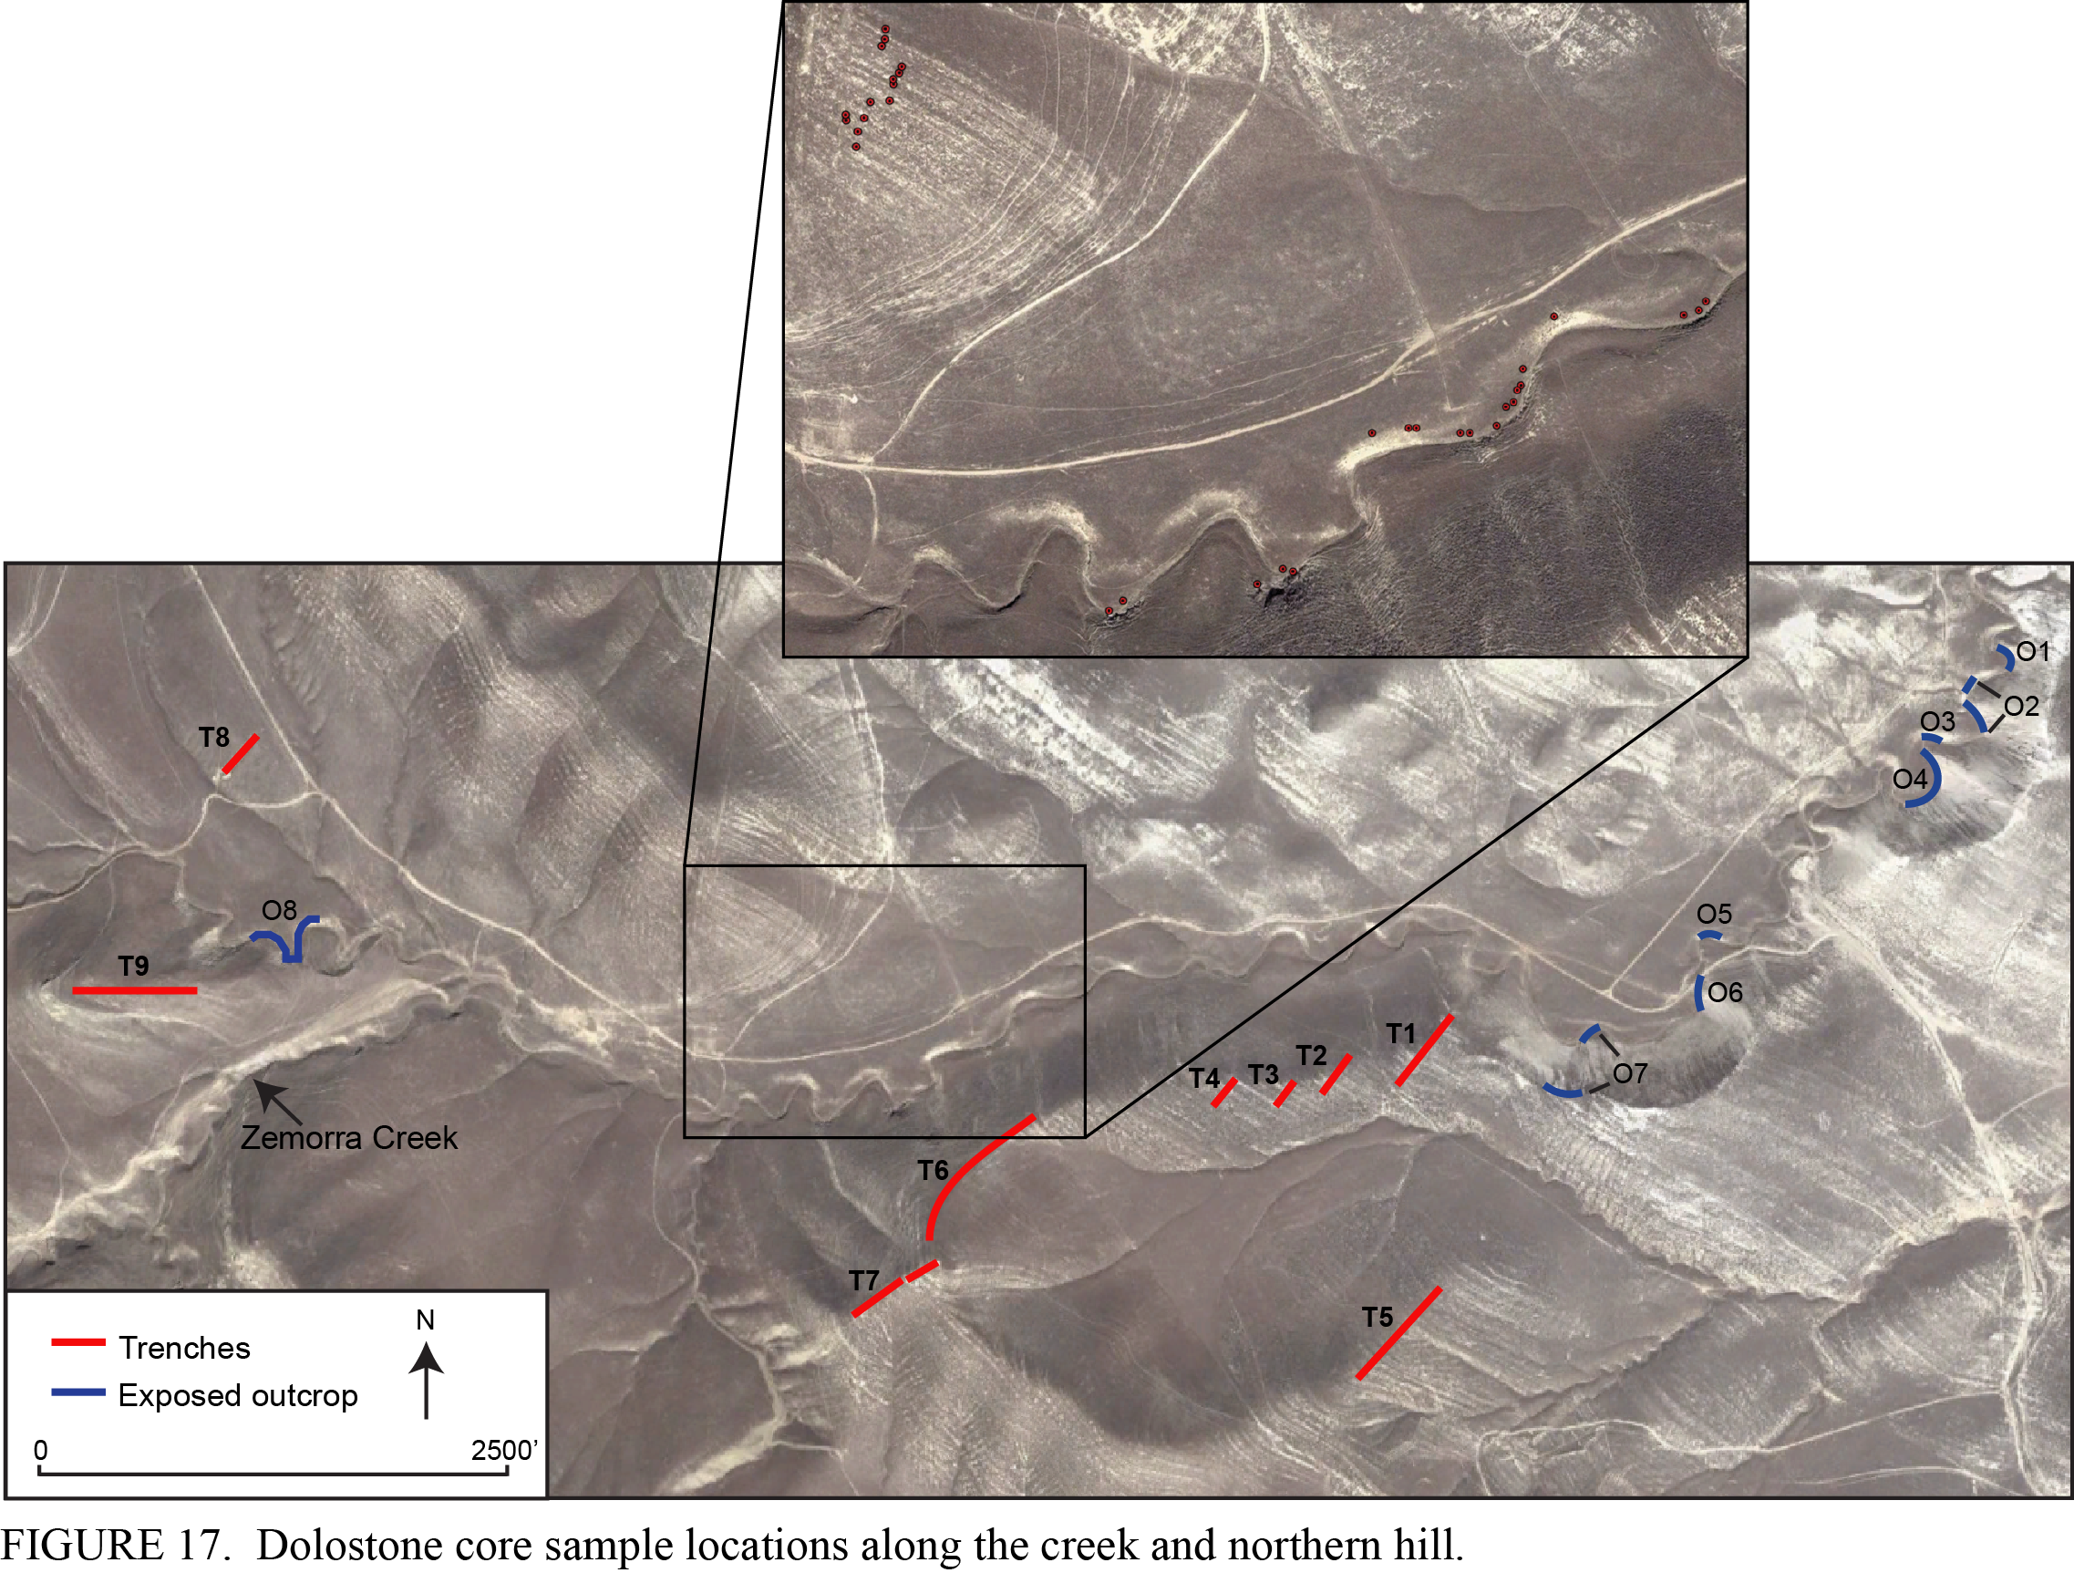
Magnetostratigraphy
Data collected and processed by
Jon Guillaume (M.S.)
Notes:
In order to obtain additional age control, paleomagnetic cores were collected and analyzed by Jon Guillamne from 33 dolostone beds. These were collected from this zoomed in area outlined with the black box along both the creek and the ridgeline to the north. This area covers the lower McDonald and it was selected both because it had the poorest biostratigraphic age control and the highest frequency of dolostone beds.
Above is a picture of these prominent dolostone beds along the hillside.

Slide 34
Magnetostratigraphy
Notes:
In order to obtain additional age control, paleomagnetic cores were collected and analyzed by Jon Guillamne from 33 dolostone beds. These were collected from this zoomed in area outlined with the black box along both the creek and the ridgeline to the north. This area covers the lower McDonald and it was selected both because it had the poorest biostratigraphic age control and the highest frequency of dolostone beds.
Above is a picture of these prominent dolostone beds along the hillside.
With reference to the biostratigraphic framework, the paleomagnetic data was collected here *point at area*

Slide 35
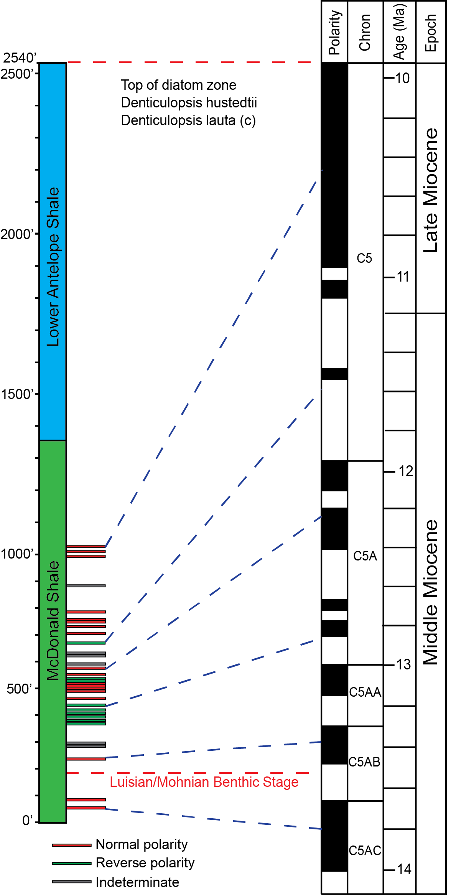
Biostratigraphy
Magnetostratigraphy
6
5
4
3
2
1
Notes:
The figure to the right is my interpretation of how the polarity of these dolostones correlates the geologic timescale within biostratigraphic zones A and B
Conservative age estimates that assumed a relatively constant sedimentation rates were used to assign dolostones to normal and reverse polarity intervals within chrons. Based on this 6 datums were assigned
I want to point out that there is some subjectivity to correlation of the magnetic polarity reversals to specific paleomagnetic events, but we are confident that this is close and different correlations would not make a significant difference in some some of the following calculations of sedimentation rates.

Slide 36
Sediment Accumulation Rates
~10 to 8 Ma
1900 ft/Myr
~14 to 10 Ma
335 ft/Myr
Notes:
This is linear sediment accumulation curve with age on the x-axis and thickness on the y-axis, accumulation rates were calculated as the slope between biostratigraphic and magnetostratigraphic datums. Breakdown of the Monterey members was included so you can see how rates vary between each member
At first glance, one of the most striking things about this sediment accumulation curve is the interval of condensed sedimentation from approx 13.8-10.4 Ma followed by a rapid increase in sedimentation rates from 10.4-8 Ma.
This portion of the presentation is going to focus on theory as to why these changes occurred.

Slide 37
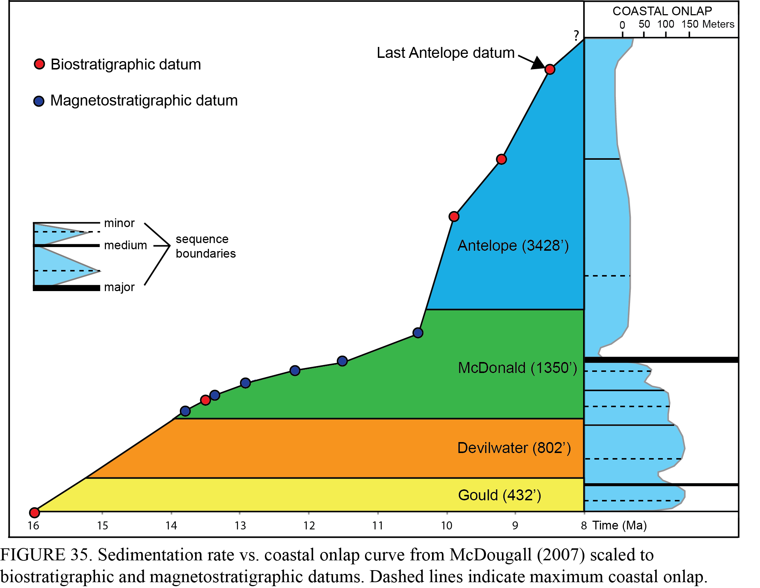
Sea level beginning to fall ~50 meters
Regression associated with formation of the East Antarctic Ice Sheet marked the beginning of a major cooling event
(John et al., 2011)
~14 to 10 Ma
335 ft/Myr
Coastal onlap curve from McDougall (2007) based on Haq and others (1987 and 1988) and further modified by Johnson et al. (2005)
Notes:
In order to assess what was occurring during deposition in a paleoceanographic context, the sediment accumulation curve was compared to coastal onlap curve for California based on the from McDougall and based on the work of Haq and other, later modified by Johnson and others. Bold and dashed black lines represent major and minor sequence boundaries.
What you can see is the onset of condensed deposition at the base of the McDonald at approx 14 Ma was relatively synchronous with a 50 meter sea-level regression.
This regression associated with the formation of the East Antarctic Icesheet

Slide 38
Why condensed sedimentation?
Sea-level fall isolated basin from terrigenous input
  Condensed sections postulated to occur during lowstand systems tracts in other Neogene basins (Bohacs, 1993)
Aridification along the western North American margin (Retallack, 2004)
Basin deepening caused by thermal and isostatic subsidence Neogene pull-apart basins (Compton 1991)
Notes:
Sea level fall could have resulted in Local isolation from terrigenous input – due to changes in sediment migration pathways
Aridification along the western North American margin – which is posited to have occurred due to the formation of the Antarctic Icesheet and global cooling event.
Basin deepening due to thermal and isostatic subsidence – this occurred in many Neogene pull-apart basins in California that underwent rapid extension and subsequent cooling

Slide 39
~10 to 8 Ma
1900 ft/Myr
11.5 Ma
Coastal onlap curve from McDougall (2007) based on Haq and others (1987 and 1988) and further modified by Johnson et al. (2005)
Notes:
The increase in sedimentation at approximately 10 Ma occurs after a major fall in sea-level at approx 11.5 Ma again associated with the East Antarctic Ice Sheet. Typically an increase of this magnitude during a sea-level regression would be due to an influx in detritus. But this is not the case in these hemipelagic sediments.

Slide 40
Why large influx in sedimentation rate?
Increase in diatom productivity associated with this global cooling event
  (Pisciotto and Garrison, 1981; Ingle, 1981; Barron, 1986)
Surge in biologic production and accumulation → increased sedimentation rates
  Terrigenous input was likely limited due to sea-level fall
Change in California Current and outboard to inboard shift in strongest diatom productivity (Barron et al., 2002)
Notes:
Global cooling event associated with a global increase in diatom productivity – This is a theory that is well documented in the Monterey literature.
Actually because of sea-level fall terrigenous input was actually limited and was likely not a factor contributing to this sedimentation rate increase. Also, silica accumulation dropped off in deep, distal ODP sites.

Slide 41
Interpreting paleobasin conditions and lithology from Th/U ratios and CGR
Th-U ratios indicative of basin anoxia
  High Th/U = oxic conditions
  Low Th/U = anoxic conditions
Computed gamma-ray (CGR) incorporates only K and Th, eliminating influence of organic content.
  API = 8U(ppm) + 4Th(ppm) + 16K(%)
  Allows for assessment of detrital clay content
Notes:
To further investigate what kind of basin conditions existed during deposition of this expanded section, I looked at Th/U ratios from the spectral log data which have been used in numerous studies to provide insight into paleobasin conditions.
The concept is low Thorium-Uranium values are indicative of basin anoxia and conversely, high values are related to oxic basin conditions.
I also manipulated the data to create a computed gamma-ray log which basically incorporates only the K and Th, eliminating the influence of organic content. This allows for assessment of detrital content.

Slide 42
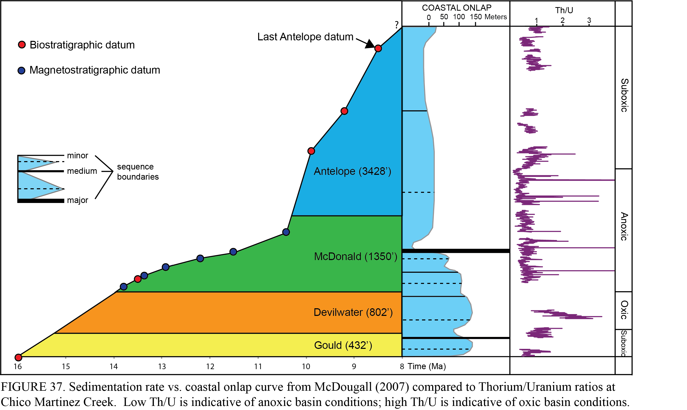
Th/U Ratios
Notes:
Based on Th/U ratios I’ve divided the section based on paleobasin conditions. Low Th/U ratios are indicative of anoxic basin conditions where high Th/U values are indicative of oxic conditions and I added a baseline so you can more see more easily how I broke this down
When comparing the Th/U profile to the sea level curve you can see that anoxic to suboxic basin conditions prevailed during this sea-level lowstand.

Slide 43
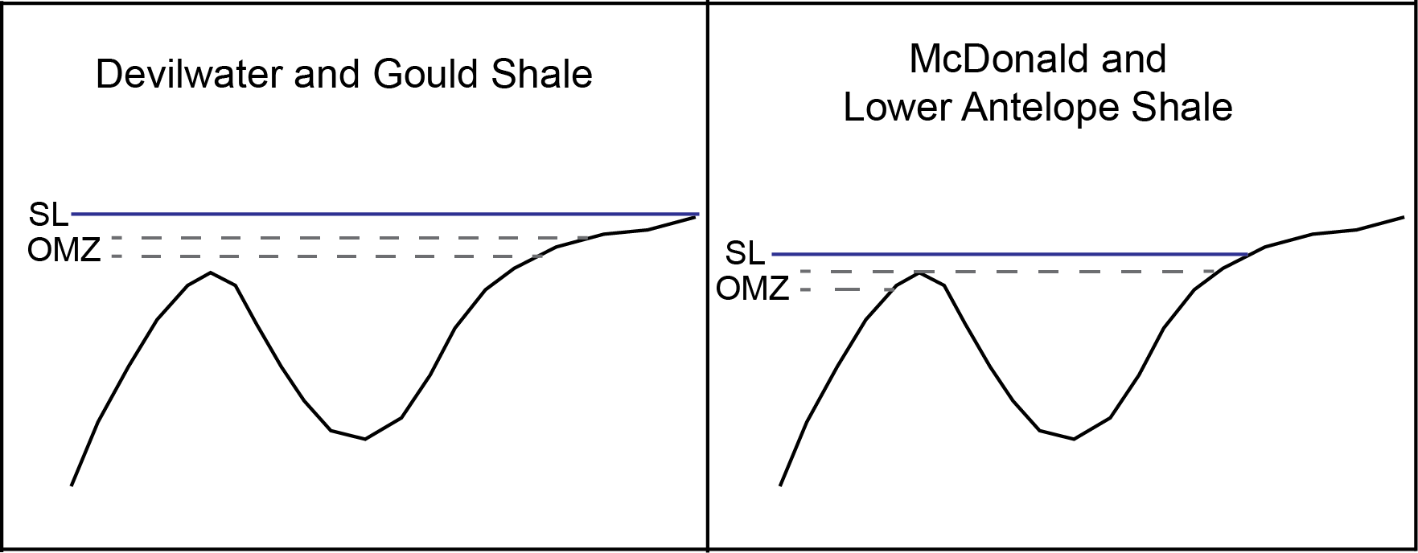
Paleobasin Model
Sea level fall resulted in basin anoxia
  Silled basin where the Oxygen minimum zone (OMZ) intercepts the top of the sill
Notes:
This is a very simplified basin model that explains why basin conditions became anoxic during a sea-level lowstand.
During a sea level highstand when Gould and Devilwater shales were depositied, the OMZ was likely above the basin resulting in oxic basin conditions,
But when the sea level fell during deposition of the McDonald and Antelope shales, the OMZ may have intercepted the sill resulting in basin anoxia

Slide 44
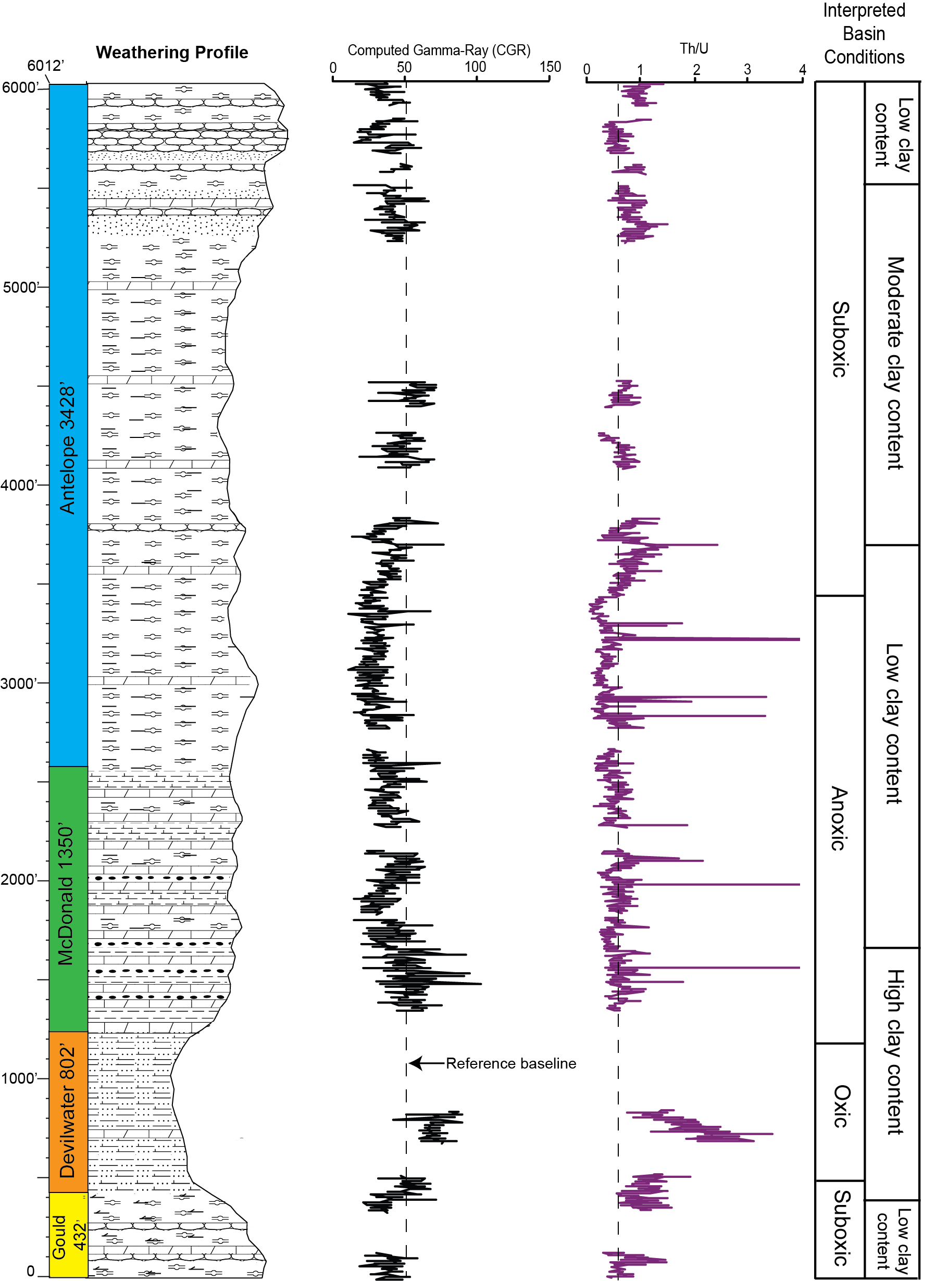
Notes:
The figure shows the CGR profile in addition to the Th/U profile. Low CGR is associated with low clay content and high is associated with high clay content. What I want to point out is the interval of low clay overlaps the anoxic interval.
That makes a lot of sense with this condensed interval and also provides more support that the influx in sedimentation rates were not due to detrital input but something else was going on – in this case an increase in biosiliceous sedimentation.

Slide 45
How do linear sedimentation rates compare to other California Neogene basins?
Similarities provide support that processes that control sedimentation were widespread.
Discrepancies suggest basin-specific mechanisms controlled deposition.
Notes:
So if all these theories for linear sedimentation rate fluctuations in CMC are tied to global events, are these same patterns observed in other Neogene basins in California? So we looked at sediment accumulation rates in 3 other coastal basins: the Pismo, Santa Maria and Santa Barbara basins to see if these similarities existed.

Slide 46
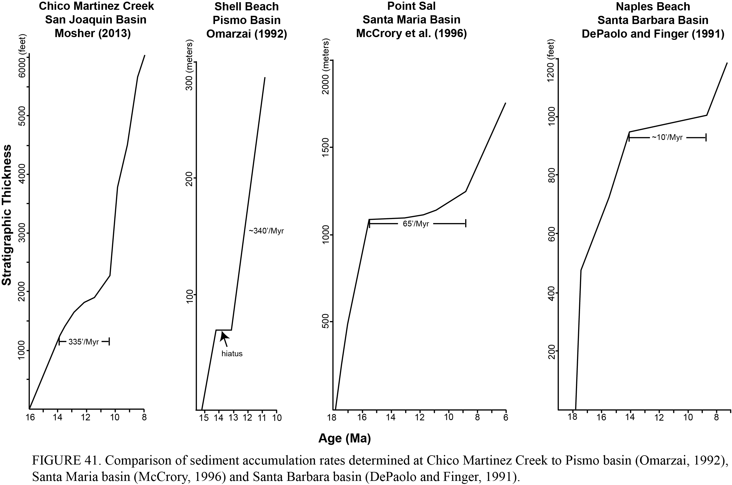
Condensed sedimentation in 4 basins from ~14-10 Ma
Notes:
These are sediment accumulation curves from all 4 basins including Chico Martinez creek which is the first curve. Some of the scales are in meters and some in feet so refer to the numerical value I’ve placed on each curve.
Major lull in sedimentation rates from ~14-10 Ma – varies from very slow rates in San Joaquin and Pismo basins to almost complete depositional hiatuses in Santa Maria and Santa Barbara basins.
Formation of the East Antarctic Ice Sheet and subsequent sea-level fall was a global event – Relatively isochronous impact on Neogene basins

Slide 47
Basin Comparison
Formation of East Antarctic Ice Sheet and subsequent sea-level fall was a global event.
  Isochronous impact on many Neogene basins.
Onset and termination of condensed sedimentation is diachronous across all 4 basins
  May be related to local tectonics.
Notes:
Onset of sea level fall before the increase of diatom productivity, condensed sedimentation.

Slide 48
Conclusions
Lack of thickness variation between proximal wells
  Region did not experience substantial syntectonic deformation
  Relatively flat paleobathymetry
  More data is needed
Notes:
This may indicate that region did not experience substantial syntectonic deformation

Slide 49
Conclusions
Condensed due to a combination of sea-level fall and thermal and isostatic basin subsidence.
Major linear sedimentation rate increase due to an increase in diatom productivity associated with a global cooling.

Slide 50
Conclusions
Sea-level fall resulted in basin anoxia and isolation from terrigenous input.
CGR supports theory that high rates of sediment accumulation at the top of the McDonald were in fact due to an increase in diatom productivity – not detritus.
Notes:
Sea-level fall resulted in basin anoxia and isolation from terrigenous input. – This is demonstrated with the spectral log data
----- Meeting Notes (10/9/13 20:22) -----
Supported by CGR and TH/U ratios

Slide 51
Conclusions
Condensed sedimentation at CMC was synchronous with other California Neogene basins.
  Not just specific to the SJ basin
Sedimentation rates along the California margin may correlate to other global Miocene sediments.

Slide 52
Industry Applications
Manipulation of spectral gamma-ray data can allow for larger-scale correlation.
Sediments with high TOC form under anoxic basin conditions Th/U ratios could be applied to mapping source rock.
Notes:
So if anything, this study highlights the importance of collecting spectral gamma-ray data because when manipulated, you can correlate at a larger scale than small fluctuation seen in total gamma-ray data.
In this case of Th/U ratios you can correlate time-equivalent anoxic basins across a field area.

Slide 53
Industry Applications
Manipulation of spectral gamma-ray data can allow for larger-scale correlation.
Sediments with high TOC form under anoxic basin conditions Th/U ratios could be applied to mapping source rock.
Unique spectral log character can be used for correlation
  Devilwater Shale
Notes:
In some cases unique log character can be used for correlation. The Devilwater Shale is a perfect example of this. This is the only interval throughout the entire succession where the Th is highER than the U

Slide 54
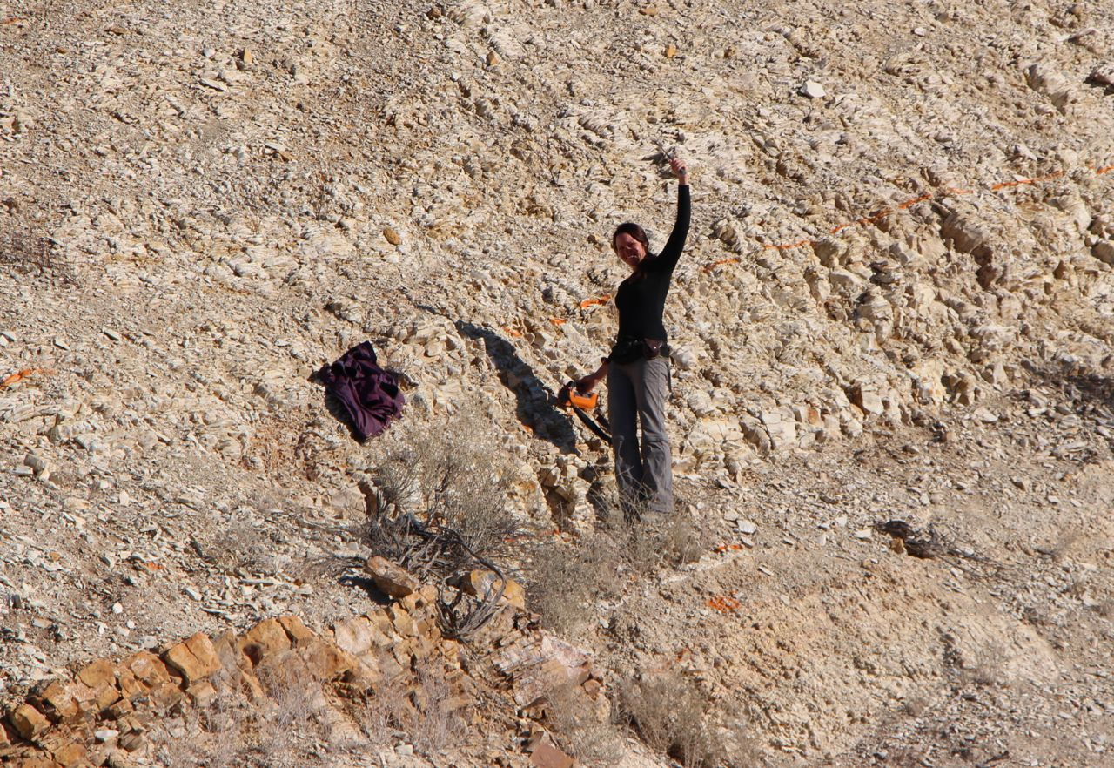
THANK YOU!!!!
Notes:
I want to thank all of the companies in the consortium for making this research effort possible and all of the individuals within the consortium who provided me with data, ideas and feedback.

Slide 55
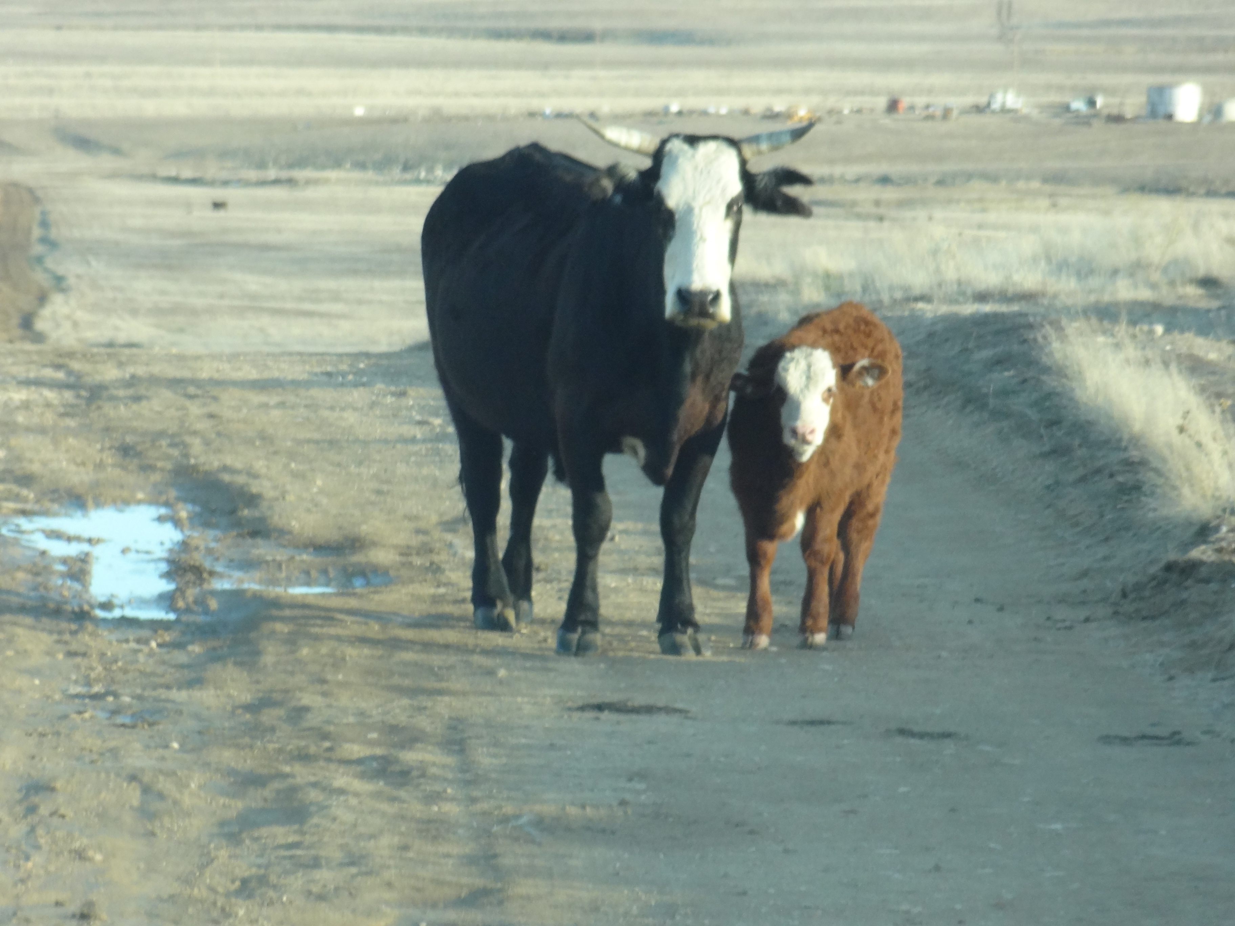
QUESTIONS???

