Slide 1
Offshore Santa Maria Basin: Syntectonic Stratigraphic Evolution of the Monterey Formation in an Outboard Basin
Proposed thesis research of Nelson Doris
Thesis Chair:
Dr. Rick Behl, Department of Geological Sciences, CSULB
Thesis Committee:
Dr. Chris Sorlien, Earth Research Institute, UCSB
Long Beach MARS Project: Monterey and Related Sediments

Slide 2
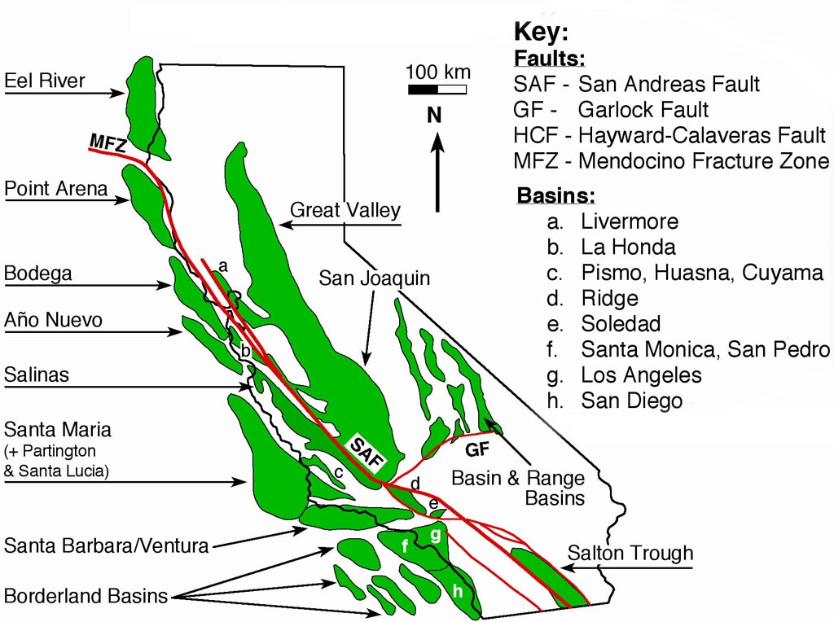

Slide 3
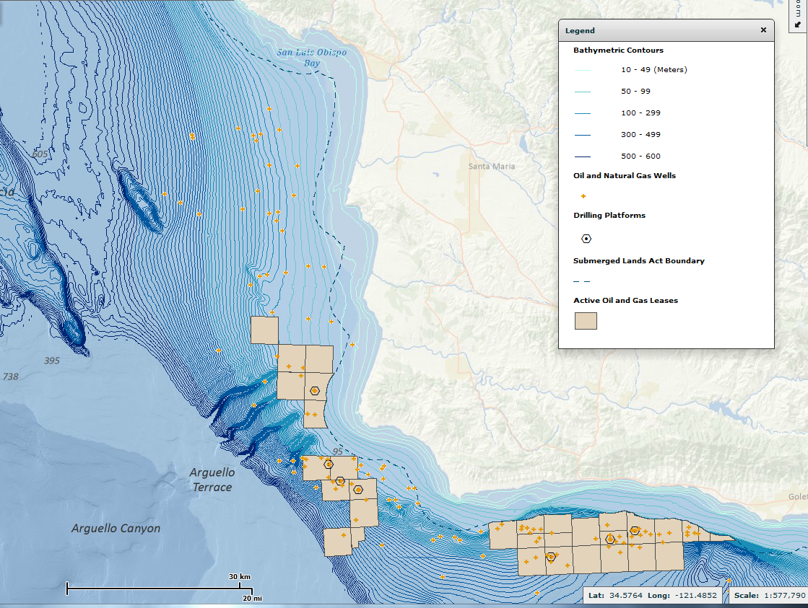
BOEM website

Slide 4
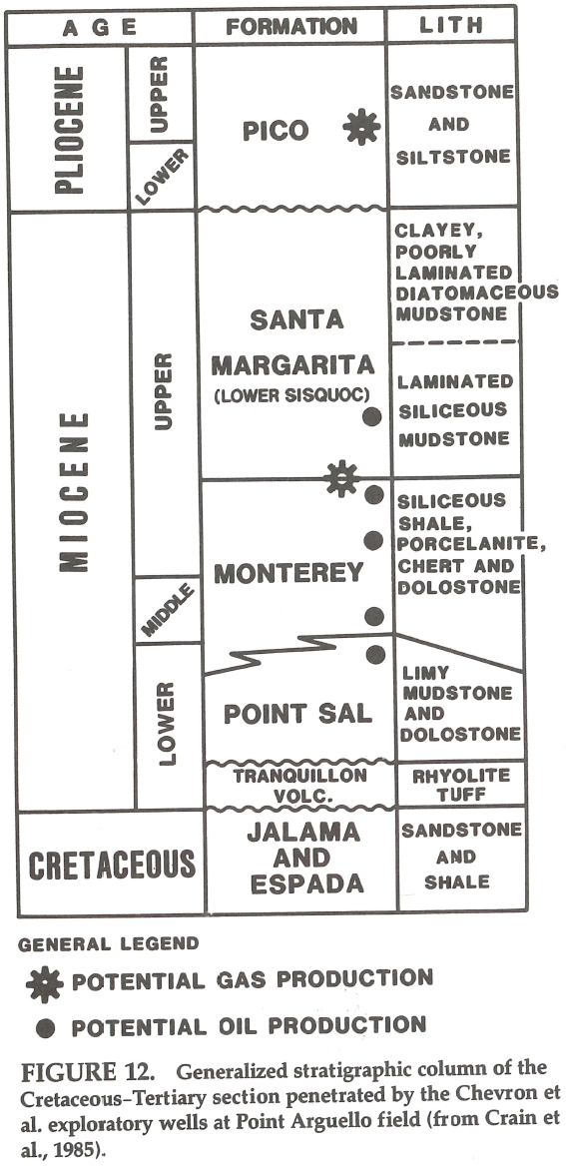
Offshore Stratigraphy: Pt. Arguello field
Mero et al., AAPG m V.54, 1992

Slide 5
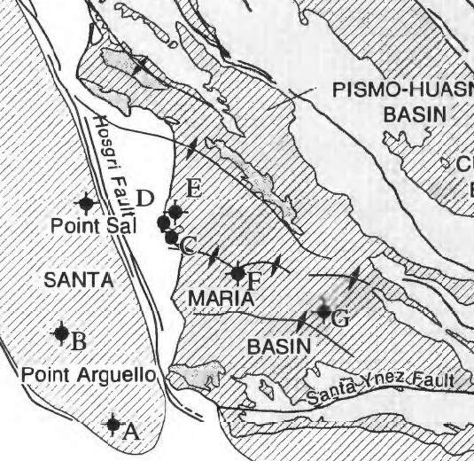
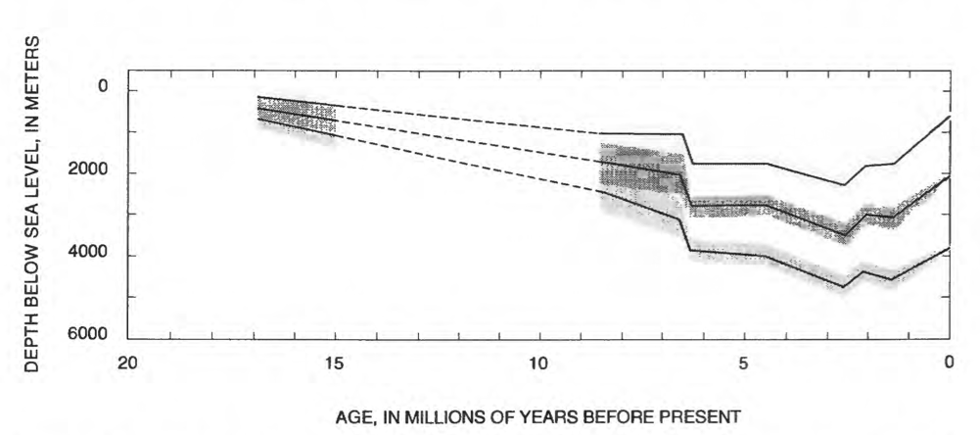
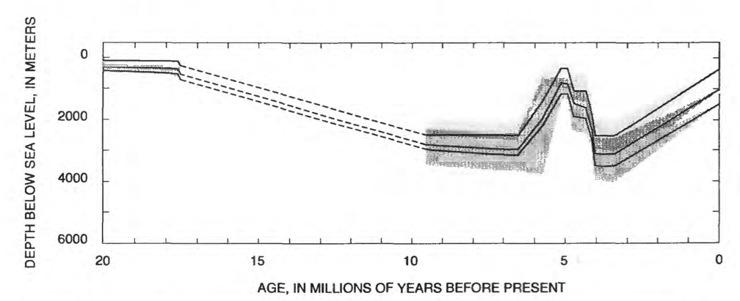
Vastly Different Burial Histories
COST Well
Texaco Nautilus Well

Slide 6
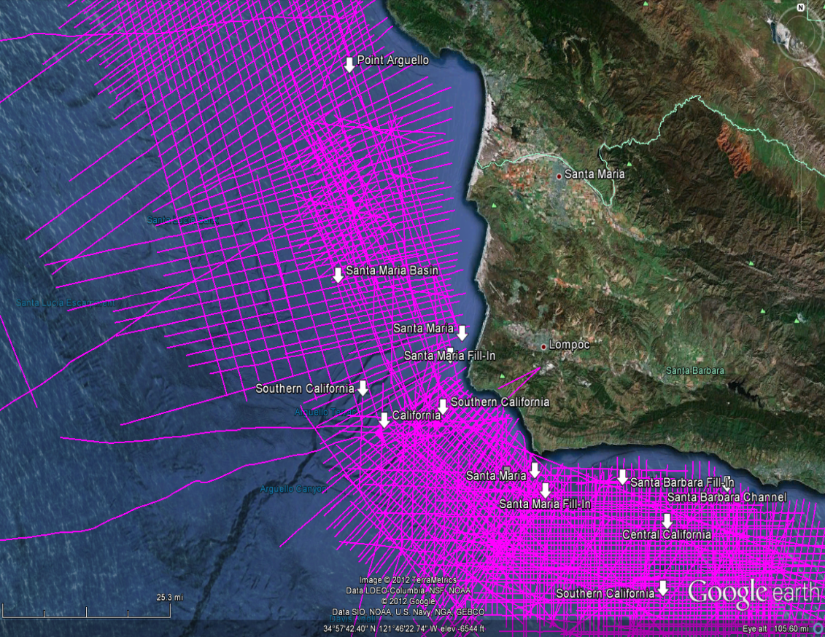
Available seismic lines from NAMSS
USGS NAMSS website + Google earth

Slide 7
Chevron Line 4110

Slide 8
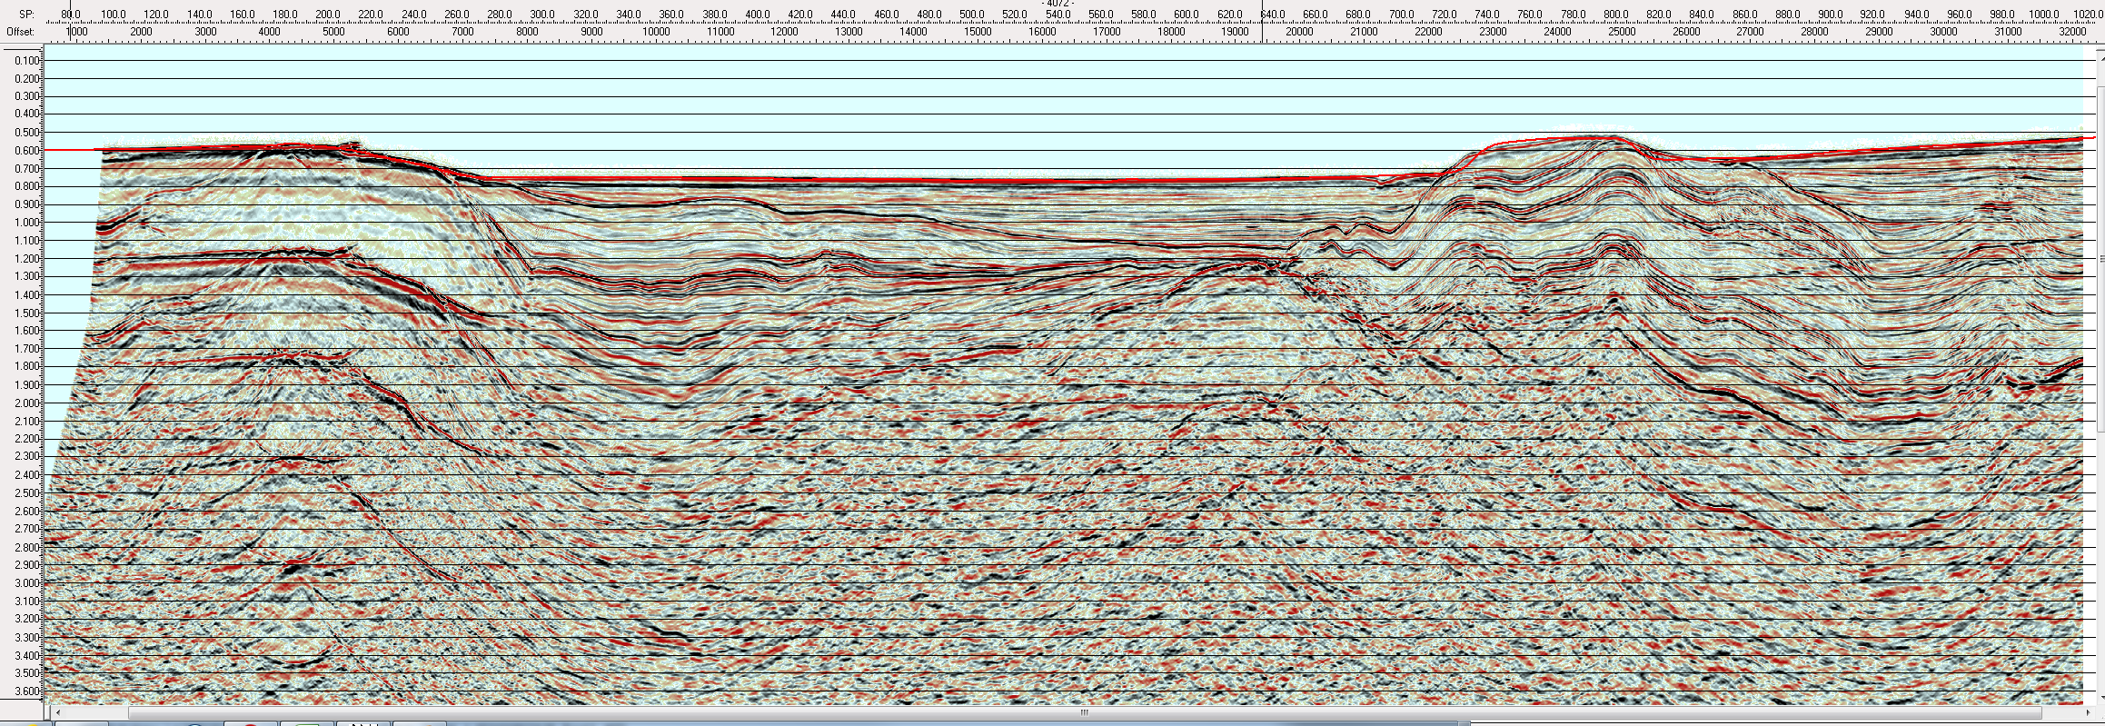
Chevron Line 4072

Slide 9
Next Steps
Load and assess available seismic lines
Try to find Shell 1980’s vintage 3D survey that may be public domain by now
Evaluate well logs from MMS/BOEM
Try to find LAS version instead of TIFFS
Begin interpretation, depth conversion, correlation, and facies analysis.

