Slide 1
Mechanical Stratigraphy of the Monterey Formation and Relationship with Sedimentary Cycles, Montaña de Oro, California
Thesis Proposal by Heather Strickland
Committee Members:
Prof. Richard Behl, CSULB
Dr. Michael Gross Shell E & P
Prof. Tom Kelty, CSULB

Slide 2
Biography
Education:
BS Geology CSULB: May 2011
MS Geology CSULB: Expected Summer 2013
Work Experience
Shell E & P, Structure Research Team: Summer Intern 2012
Occidental Petroleum Incorporated:
Geotechnical Intern, May 2010 – January 2012

Slide 3
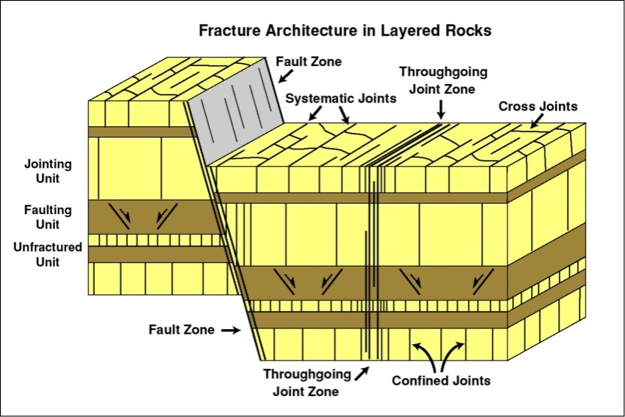
Mechanical Stratigraphy
Defn: subdivision of rock section into discrete units
Defined by structures, deformational style or mechanical properties
Mechanical units are defined by mechanical layer boundaries
Can be defined at different scales
Gross & Ayal (2007)

Slide 4
Hypotheses
Lithology and bed thickness controlled by sedimentary cycles affect fracture densities and dimensions
Mechanical units are partially controlled by stacking patterns within sedimentary cycles
Dimensions of fractures and thickness of mechanical layer boundaries have a scalable relationship

Slide 5
Thesis Deliverables
Map and define mechanical units at different scales
Measure and define fracture architecture and geometry within mechanical units
Quantify cyclic and secular variation in lithologic composition
Correlate variation in stratigraphic architecture and position in sedimentary cycles to fracture densities and dimensions

Slide 6
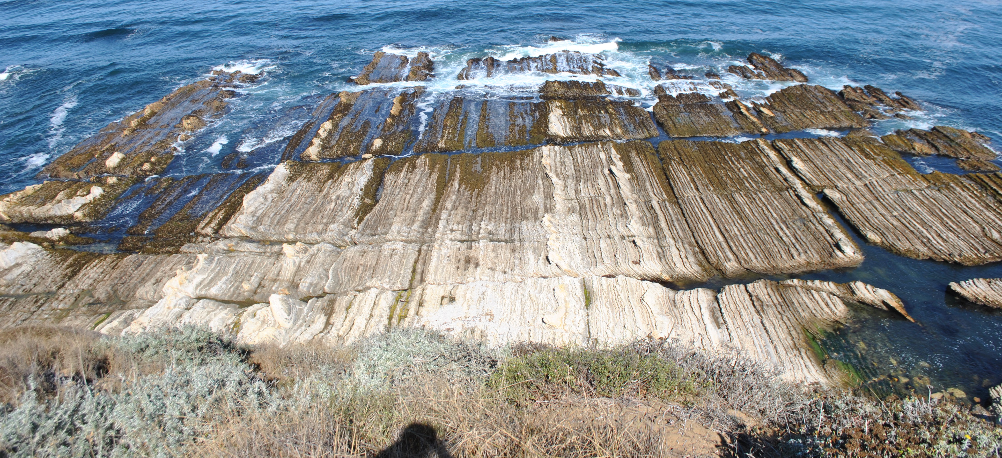
Industry Significance
Connectivity of natural fractures increase permeability
High production zones for hydrocarbons
Pathways for water to wellbore
Understanding mechanical boundaries are important to induced hydraulic fracturing
N

Slide 7
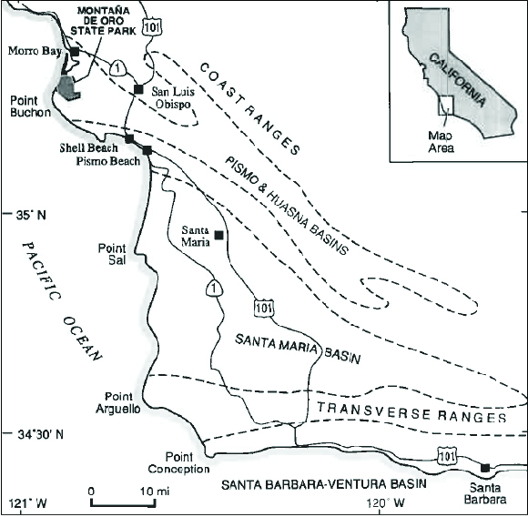
Location: Montaña de Oro
Southern-central California
On the western edge of the Pismo & Huasna basins
Sediments part of the Miguelito Member of the Pismo Formation
Montaña de Oro
State Park
Modified from Keller (1996)

Slide 8
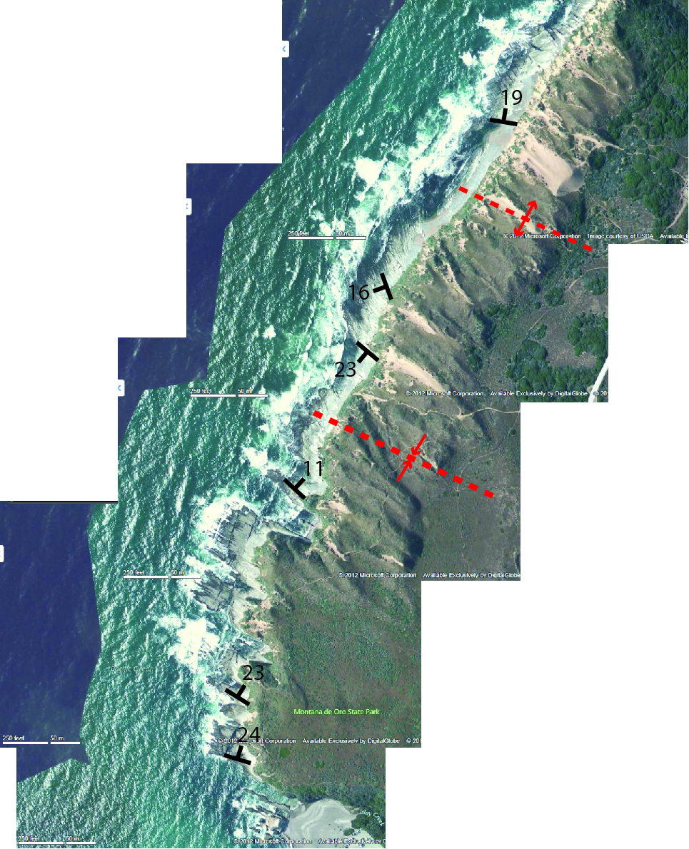
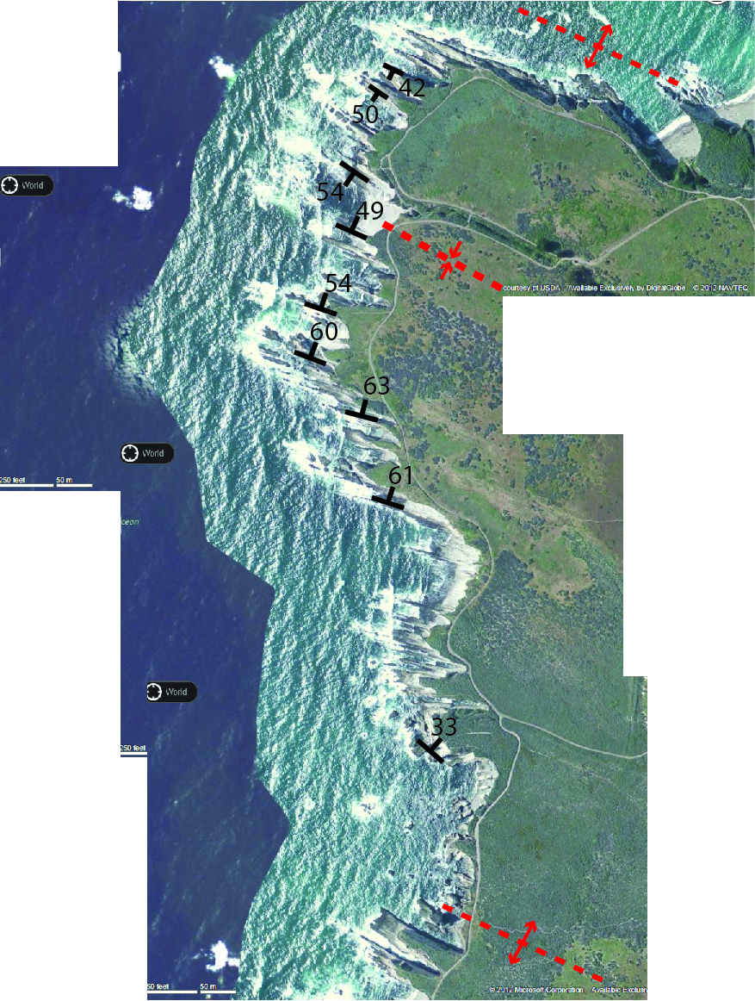
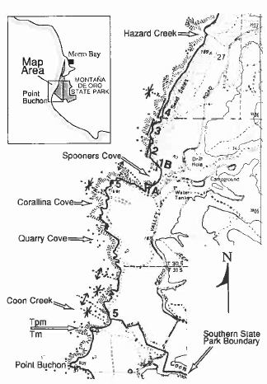
N
N
North of
Spooner’s
Cove
South of
Spooner’s
Cove
Modified from Keller (1996)

Slide 9
Study Location
N
Study area is ~400m in length and ~200m of stratigraphic section
Opal-CT porcelanite, dolomite, mudstone
Homoclinal dip north 25-30 degrees
N

Slide 10
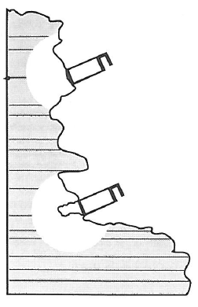
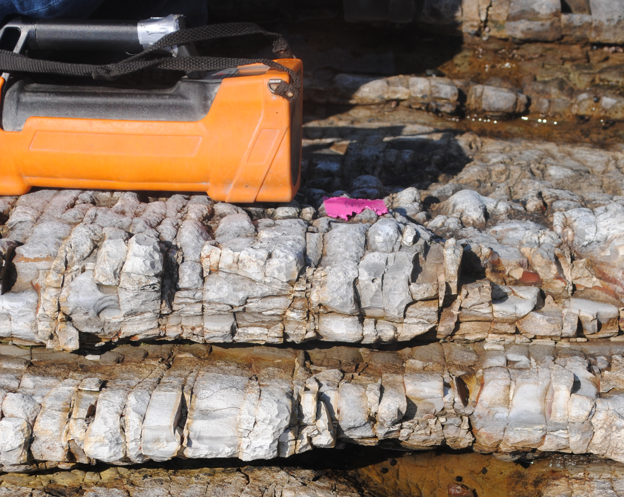
Methods: Sedimentary Cycles
Hand-held spectral gamma ray survey over entire section
U, Th, K
0.25 meter stratigraphic resolution
Schwalbach & Bohacs (1992)

Slide 11
Gamma Ray Stratigraphy

Slide 12
Methods: Sedimentary Cycles

Slide 13
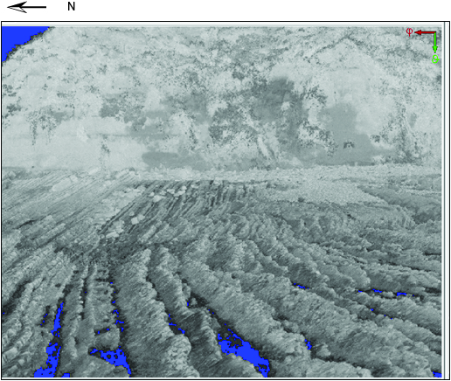
LiDAR Survey
3D LiDAR survey of each platform
Stratigraphic series as proxy for lithology
Petrel Model
Combine with GR for detailed stratigraphic section

Slide 14
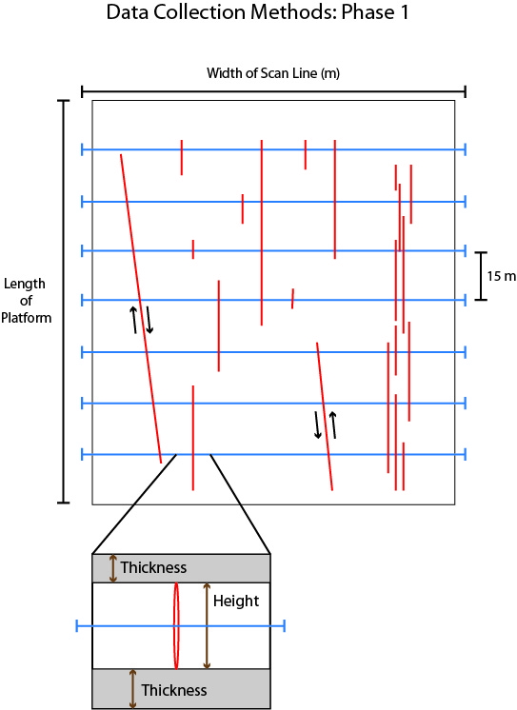
Methods: Fracture Orders

Slide 15
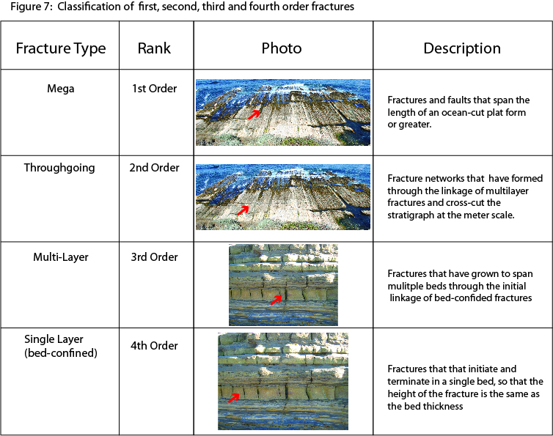
Methods: Fracture Orders

Slide 16
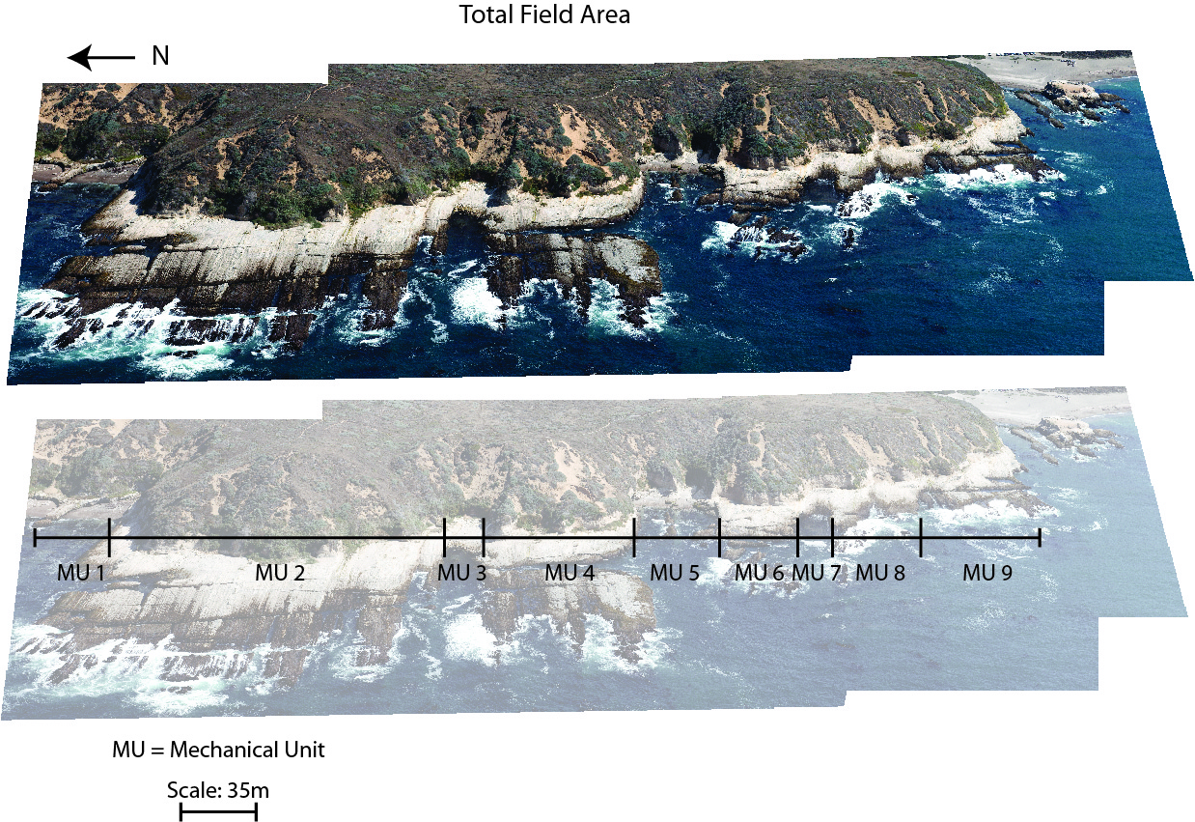
1st Order Mechanical Units

Slide 17
Stacking Patterns for Silica-Clay cycle
Gamma-ray log
Gamma-ray
cycle
Varied bed composition
Varied shale thickness
Varied porcel. thickness
5300
5350
5400
5450
5500
20
30
40
50
60
70
80
90
100
Courtesy Rick Behl

Slide 18
Research Impacts
Better understanding of how sedimentary cycles affect fracture density
Possible identification natural fracture or induced fracture barriers through wireline logs
Quantification of scalable relationship between fractures and stratigraphic characteristics
Predictive tool for Monterey reservoir fracture models on a sub-seismic scale

Slide 19
Thank You

