Slide 1
Field and petrographic study of heterogeneous oil saturation in submarine channel and adjacent facies, Monterey Formation, Point Fermin, Palos Verdes, California.
Thesis Committee Chair: Professor Richard J. Behl, CSULB
Thesis Committee Members: Donald D. Clarke
& Professor Tom Kelty, CSULB
By: Nawaf AlShammary
MARS meeting – Fall 2012

Slide 2
Nawaf AlShammary: Presenter’s Background
Education
MSc, Geological Sciences, CSU Long Beach
( Fall 2010-May 2013)
BSc, Geophysics, minor Physics, University of New Orleans
(1996-2000)
Professional Experience
Seismic Data Processing, Saudi Aramco (2001-2003)
Exploration school, Saudi Aramco and OGCI (2003)
Wellsite Operational Geologist, Saudi Aramco (2003-2008)
Wellsite Development, Saudi Aramco (2008-2010)

Slide 3
Location

Slide 4
Los Angeles Basin
Study area

Slide 5
Stratigraphy & Lithofacies
Monterey Formation in Palos Verdes
Malaga Mudstone
Valmonte Diatomite
Altamira Shale
Altamira Shale
Phosphatic lithofacies
Cherty lithofacies
Tuffaceous lithofacies

Slide 6
Point Fermin
The Altamira Shale (tuffaceous lithofacies)
Hemipelagic sediments
Point Fermin Sandstone
Submarine channel sediments

Slide 7
Contact between the two units
N
(californiacoastline.org)

Slide 8
Channel Margin Contact

Slide 9
Sandstone beds in Altamira Shale

Slide 10
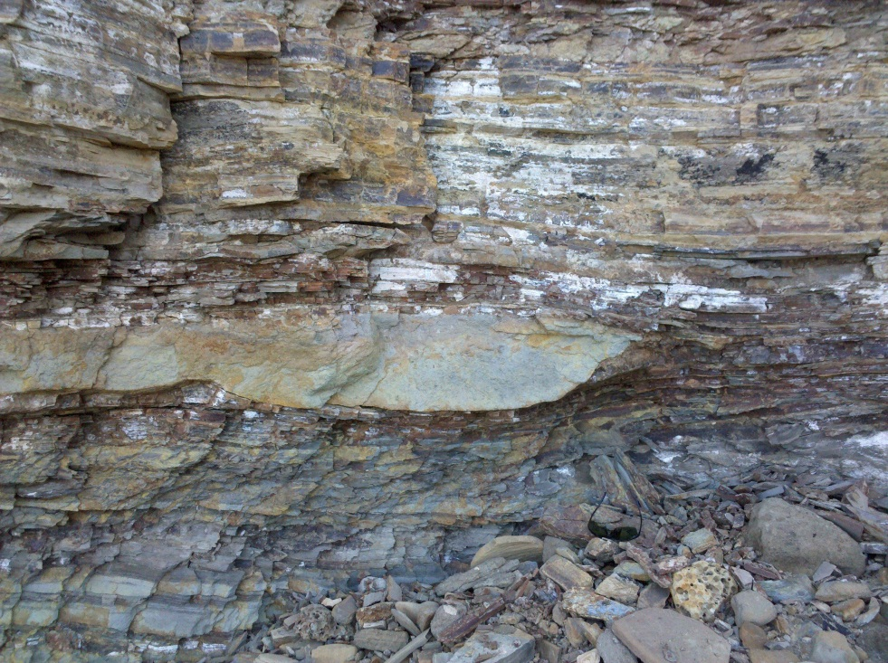
Behl (2012)

Slide 11
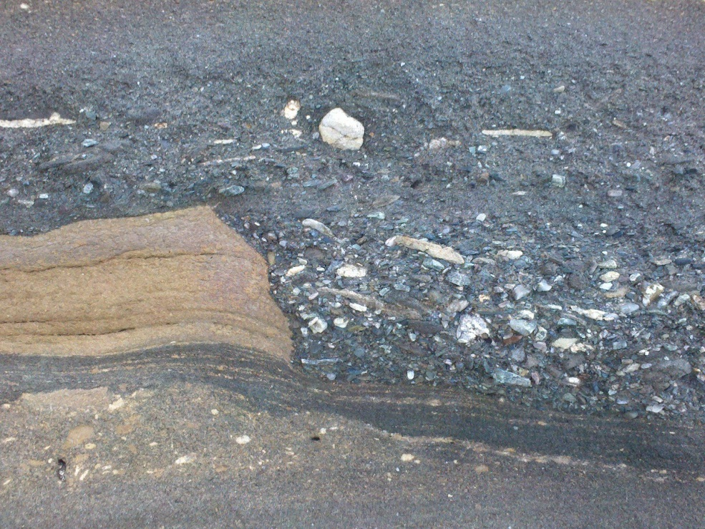
Point Fermin Sandstone facies
Schist and phosphatic breccia scoured
down through sandstone to cohesive shale bed
Dish structures in coarse-grained sandstone
Behl (2012)

Slide 12
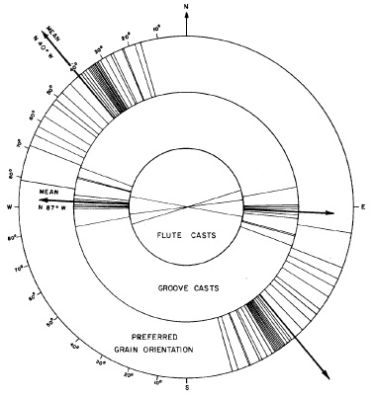
Previous Work
Spotts (1964)
Current flow direction in the submarine channel
Imbricated clasts and sedimentary structures
Source – southeast
Russell (1987)
Stratigraphic and sedimentologic paper on the submarine deposits.
Little emphasis on the Altamira Shale deposits
Concluded – North source based on sedimentary structures

Slide 13
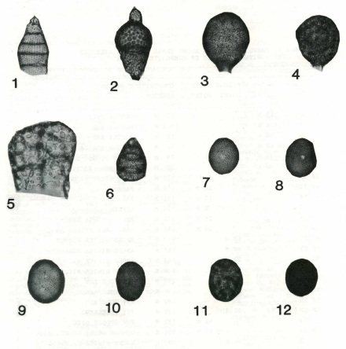
Biostratigraphy
Sloan (1987)
Radiolarians in Point Fermin fan deposits
between 11.4–12.7 Ma

Slide 14
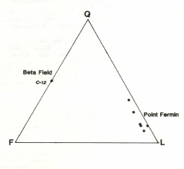
Petrography
Cherven and Russell (1987)
Petrographic study and comparison between the Point Fermin Sandstone (6 samples) and Beta Oil Field (1 sample)
Beta field is quartzofeldspathic arenite
Point Fermin is a lithic arenite
Spotts (1966)
Dolomite at Point Fermin was of
organic origin

Slide 15
Research Objectives
Understand the lateral and vertical heterogeneity in hydrocarbon saturation in closely associated sandstones at Point Fermin
Compare the petrology of sandstone samples from the Point Fermin Sandstone and the adjacent Altamira Shale facies
Examine and explain porosity and permeability differences between the two units
Create a map to show the stratigraphic architecture

Slide 16
Hypothesis
The sandstone is distinct enough in porosity and permeability between the units to influence charge
This is due to distinct depositional environment and processes that made different grain size, sorting and diagenesis
This is due to provenance differences between the Altamira Shale and the Point Fermin Sandstone, that resulted in different grain composition and diagenesis
or

Slide 17
Methods
Field measurement and sampling
Petrographic analysis
Gazzi-Dickinson method (300 points)
Best for provenance studies
50 – 60 samples
Measurement of reservoir properties by a commercial laboratory
Porosity, permeability, and HC saturation, etc
XRD and SEM with EDS/XRF
provide details about composition and grains sufrace
Detailed map of the stratigraphic architecture of the outcrop
LiDAR

Slide 18
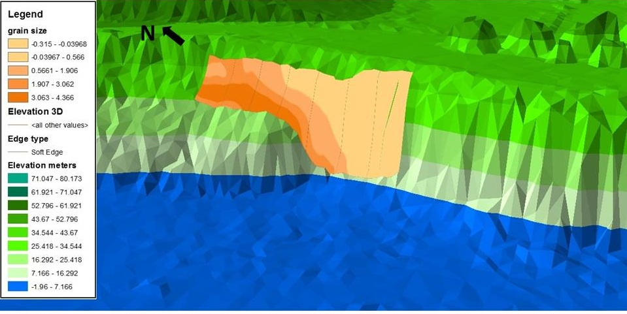
Initial Work: GIS spatial analysis
Sandstone
%
Grain size
(1-fine, 3- medium, 5- coarse)

Slide 19
Pilot data analysis
6 samples were taken
3 from Altamira Shale sandstones
3 from Point Fermin sandstones
Samples sent to Core Lab for conventional core analysis
Permeability, porosity, fluid saturation, grain density, humidity and V-clay.
Made thin sections and study them petrographically
Images, analysis, point counting
XRD and SEM with EDS/XRF

Slide 20
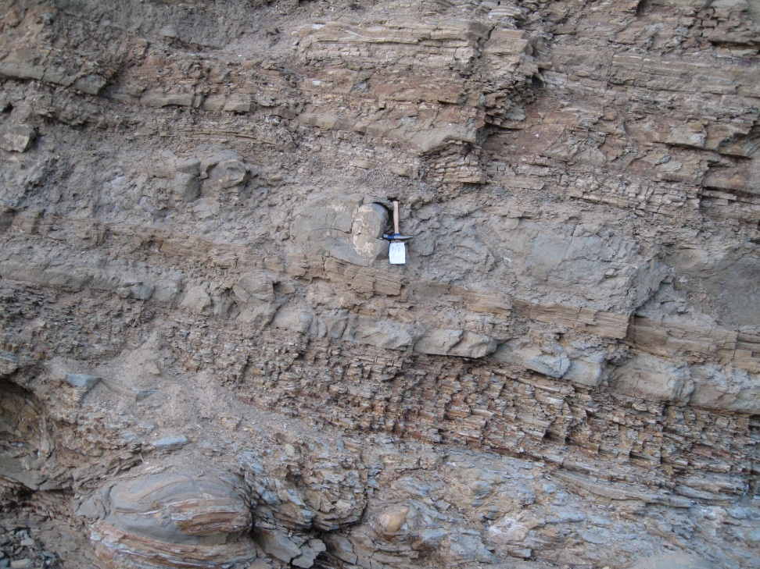
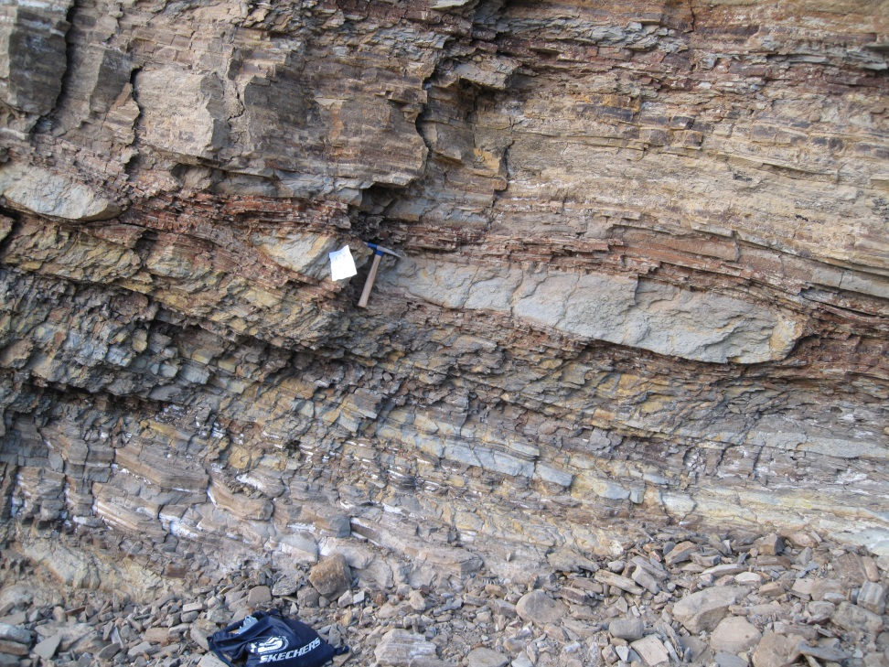
Altamira Shale samples
AS-01
AS-02
AS-03

Slide 21
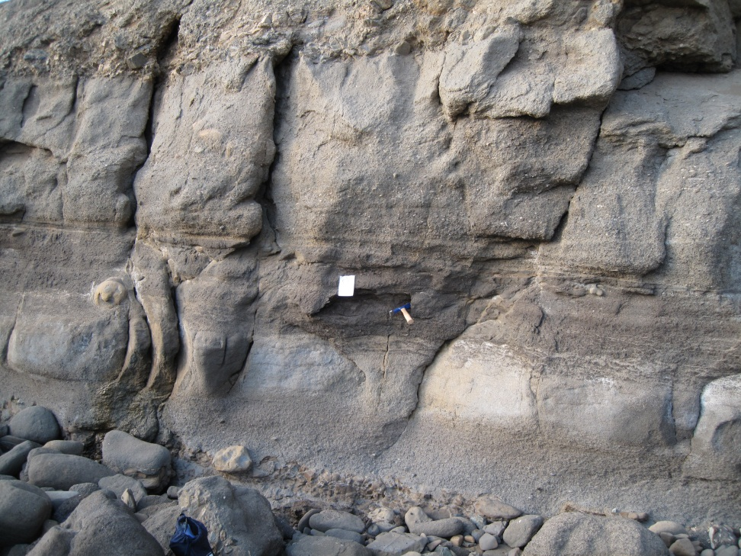
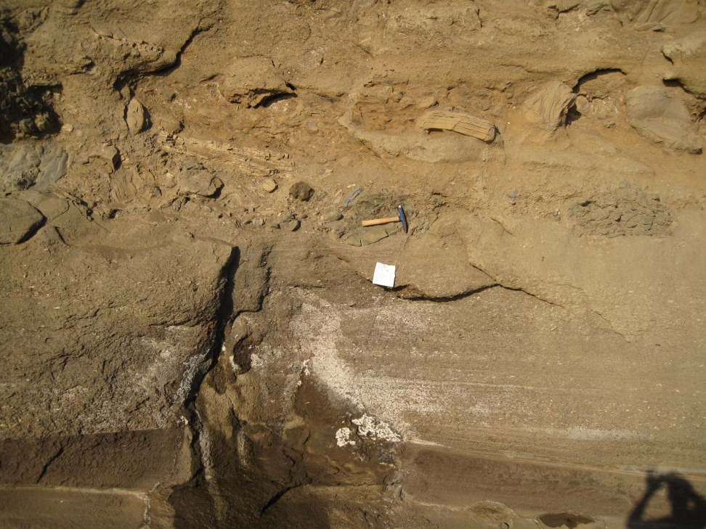
Point Fermin samples
PF-104
PF-105
PF-106

Slide 22
Oil saturation on outcrop
AS-01
PF-105

Slide 23
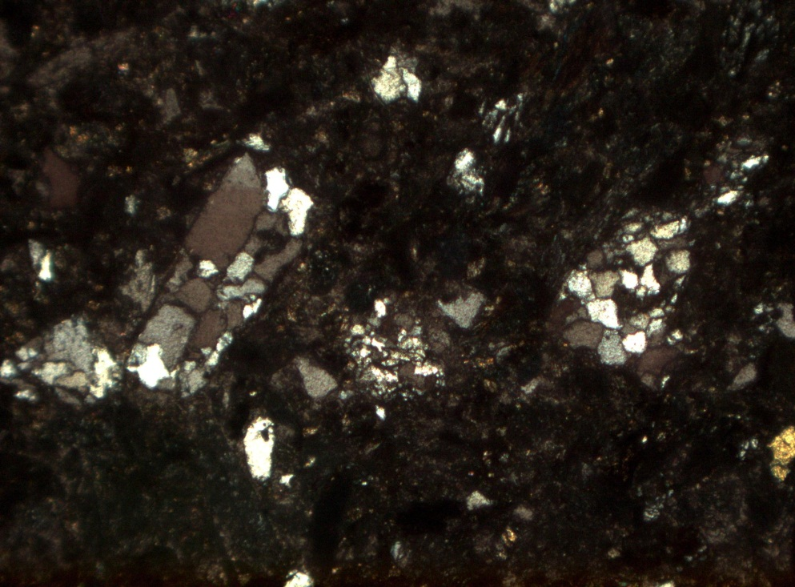
Metamorphic provenance
AS-01
PF-106
Altamira Shale
Point Fermin

Slide 24
Porosity %

Slide 25
Petrographic porosity analysis
* Handling induced
fractures

Slide 26
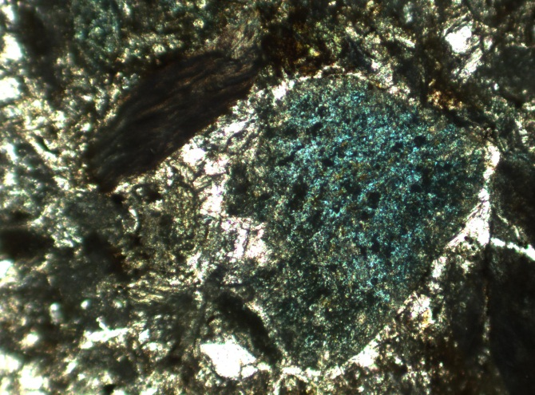
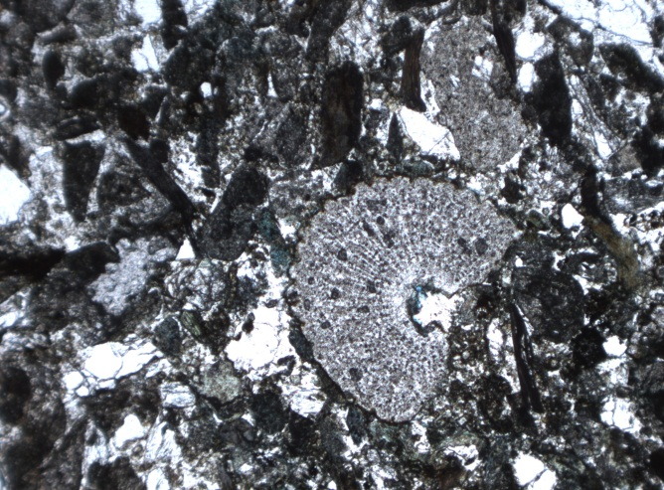
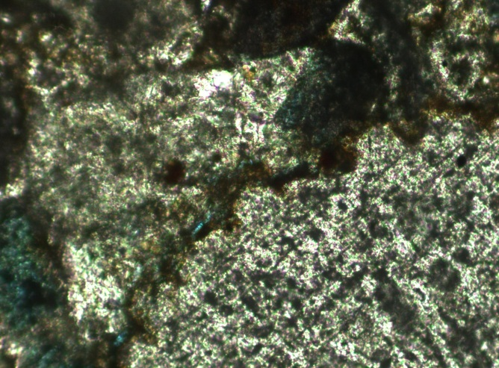
Altamira Shale
Perm: 0.024 md
Porosity: 19.3 %
Oil Saturation: 5.7%
Total fluid saturation:
54.4%
AS-01

Slide 27
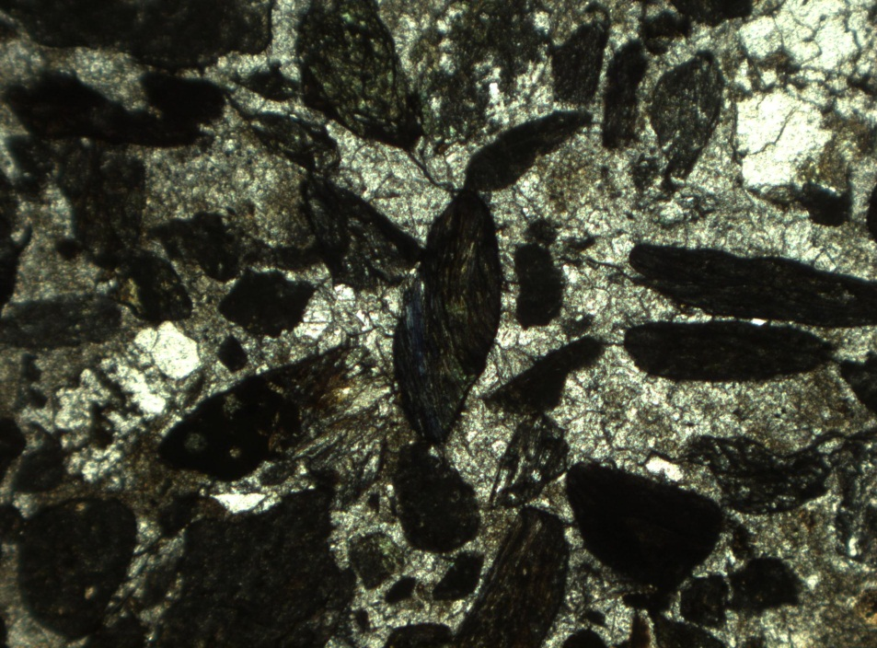
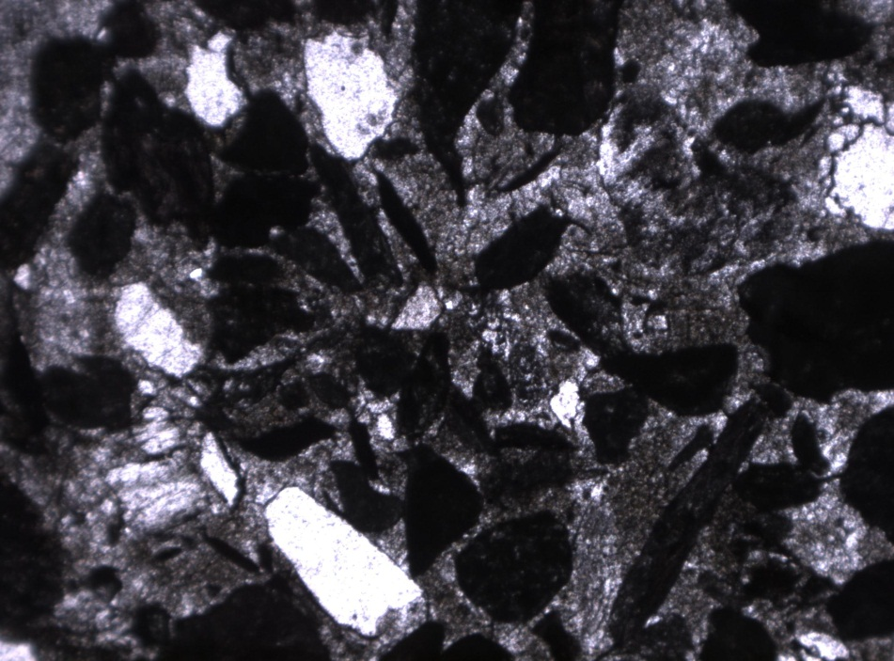
AS-02
Altamira
Shale
Perm.: 0.006 md
Porosity: 4.6%
Oil Satur.: 24.3%
Tot. Fluid Satur.: 81.5%

Slide 28
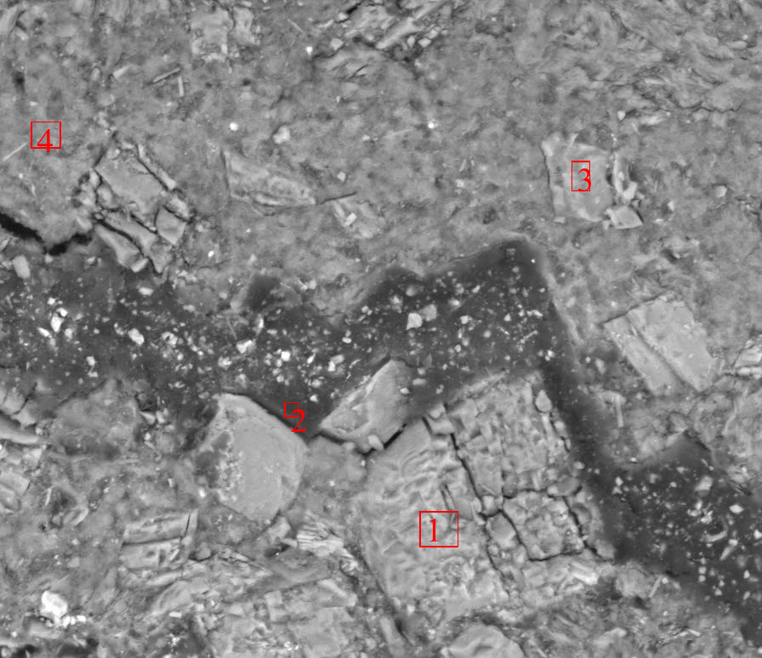
Altamira Shale
epoxy
epoxy
Dolomite crystal

Slide 29
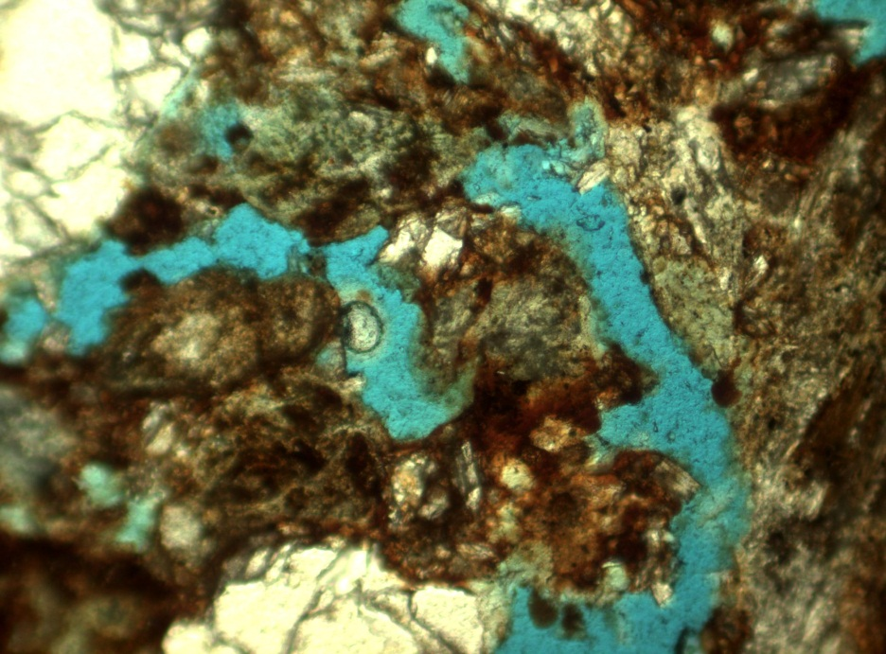
Oil
Point Fermin
epoxy
Oil
Oil
PF-104
PF-105
Perm.: 67.6 md
Porosity: 24.3%
Oil Satur.: 4.2%
Tot. Fluid Satur.:43.9%
Perm.: 202.2 md
Porosity: 40.9%
Oil Satur.: 20.3%
Tot. Fluid Satur.:35.1%

Slide 30
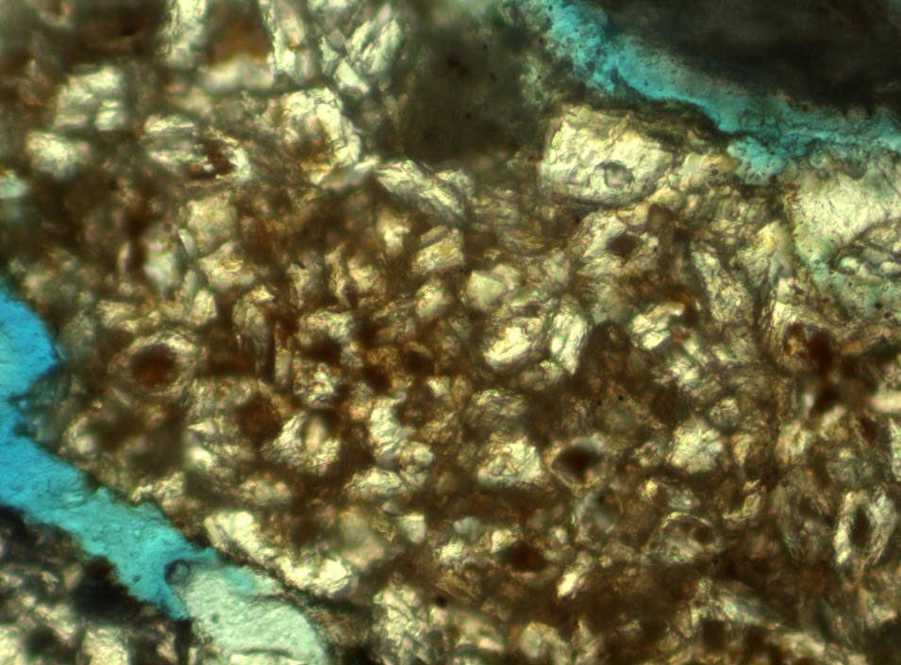
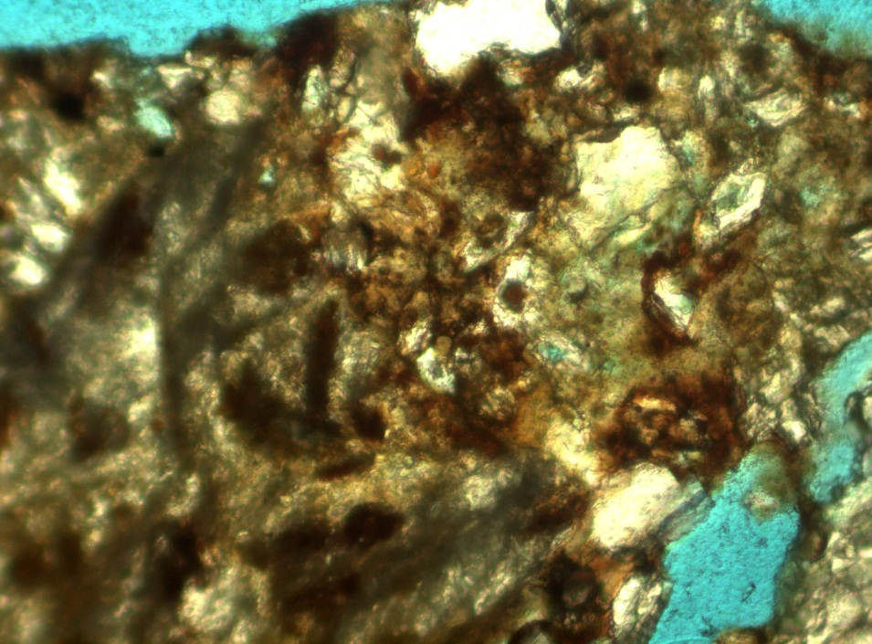
Dolomite cementation crystals with oil nuclei
Point Fermin
Pf-104
Pf-104
PF-106

Slide 31
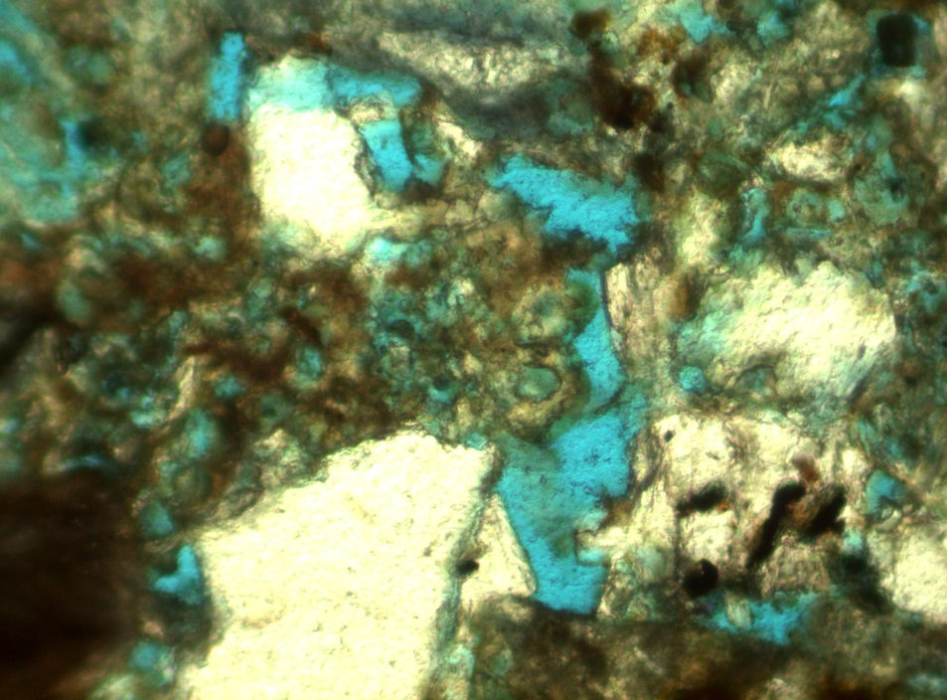
Local intracrystaline porosity in cement
Point Fermin
PF-106
PF-106

Slide 32
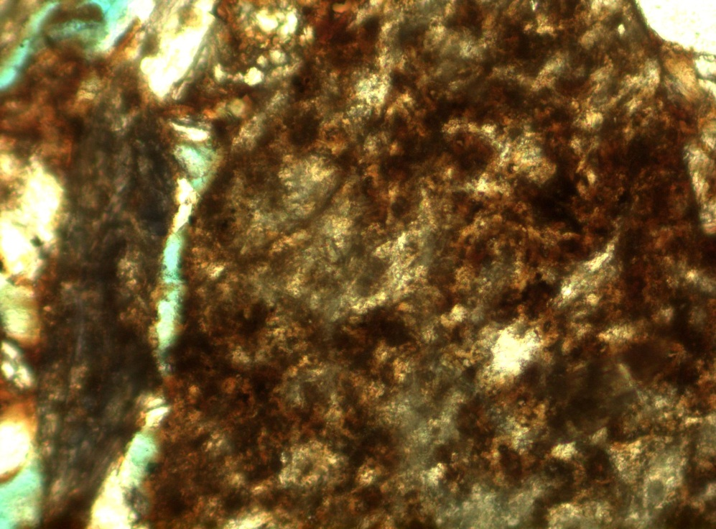
Intragranular porosity in lithic grains
Altamira Shale & Point Fermin
AS-01
AS-01
PF-106

Slide 33
% Oil / Volume Rock

Slide 34
Preliminary Conclusions
Both units have same metamorphic provenance
Significant intragranular porosity in some sandstones
Evidence of early cementation of Altamira Shale sandstones
Depositional and diagenetic environment controlling time of cementation was critical to differences in oil saturation, rather than grain composition or texture

Slide 35
Importance
Importance of the provenance for the sandstone oil reservoirs
Understanding stratigraphic traps
The diagenesis and its effect on oil saturation
Difference in porosity types and its connection to oil saturation

Slide 36
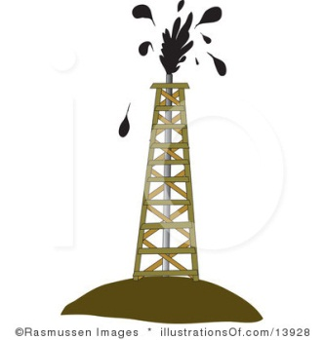
Thank you and appreciate your comments

Slide 37
References
Behl, R.J., and Morita, S., 2007, The Monterey Formation of the Palos Verdes Hills, California: stratigraphy and diagenetic implications for burial and uplift history: in Brown, A.R., Shlemon, R.J., and Cooper, J.D., eds., Geology and Paleontology of the Palos Verdes Hills, California: A 60th Anniversary Revisit to Commemorate 1946 Publication of U. S. Geological Survey Professional Paper 207: Pacific Section SEPM book 103, p. 51-72.
Californiacoastline.org, <http://www.californiacoastline.org>
Cherven, V.B., Russell, P.W., 1987. Glaucophane-rich lithic sandstone at Point Fermin, California. In: Fischer, P.J. (Ed.), Geology of the Palos Verdes Peninsula and San Pedro Bay. Pacific Section, Society of Economic Paleontologists and Mineralogists, Los Angeles, CA, pp. 53–56.
Ingersoll, R. V., Bullard, T. F, Ford, R. L., Grimm, J. P., Pickle, J. D., and Sares, S. W, 1984. The effect of grain size on detrital modes: a test of the Gazzi-Dickinson point-counting method: Journal of Sedimentary Petrology, v. 54, p. 103-116.
Russell, P.W., 1987. Point Fermin submarine fan: A small late middle Miocene age fan within the Monterey Formation. In: Fischer, P.J.(Ed.), Geology of the Palos Verdes Peninsula and San Pedro Bay. Pacific Section, Society of Economic Paleontologists and Mineralogists, Los Angeles, CA, p. 31–46.
Sloan, J. R.., 1987. Age and Paleooceanography of the Point Fermin fan complex. In: Fischer, P.J.(Ed.), Geology of the Palos Verdes Peninsula and San Pedro Bay. Pacific Section, Society of Economic Paleontologists and Mineralogists, Los Angeles, CA, p. 47–52.
Spotts, J. H., 1964, Grain orientation and imbrication in Mioce:1e turbidity current
sandstones: California: Journal of Sedimentary Petrology, v. 34, p. 229-253
Spotts, J. H, and Silverman, S. R, 1966, Organic dolomite from Point Fermin California: The American Mineralogist, v. 51, p. 1144-1155.

