Slide 1
The Descriptive Research Strategy
Chapter 13
BE aware some slides on good items are already covered

Slide 3
Descriptive research
Typically involves measuring a variable or set of variables as they exist naturally.
The descriptive strategy is not concerned with relationships between variables but rather with the description of individual variables.

Slide 4
Examples
The suicide rate for college students is about 7.5 a year per 100,000 students.
Survey results show that 61% of the adults in the United States currently drink alcohol.
Facebook has replaced Google as the number one website in the United States.

Slide 5
Three descriptive research designs
the observational research design,
the survey research design, and
the case study research design.

Slide 6
Sampling Observations
When an observer is confronted with a complex situation take a sample of the potential observations rather than attempt to watch and record everything.
Time sampling (1st week, 5th week, 20th week)
Event sampling (communication, collaboration, stay on task)
Individual sampling (observe individuals one by one)

Slide 7
Measurement process
Establishing behavioral categories
A list of behaviors that is defined as aggressive behavior
Yelling
Sulking
Pushing
Defiance
Name calling

Slide 8
Measurement process
2. Obtain a numerical score for each behavioral category using
the frequency method(how many)
the duration method (how long)
the interval method (how often in 5 minutes)

Slide 9
Measurement process
3. Using multiple observers for at least part of the measurement process to obtain a measure of inter-rater reliability.

Slide 10
Problems with observation
The behaviors might be disrupted or influenced by the presence of an observer.
Subjective judgment, raises the question of reliability

Slide 11
Types of observation
In naturalistic observation, or nonparticipant observation, a researcher observes behavior in a natural setting as unobtrusively as possible. (one-way mirrors)
In participant observation, the researcher engages in the same activities as the people being observed in order to observe and record their behavior. (high school confidential)
Contrived observation, or structured observation, Observation of behavior in settings arranged specifically to facilitate the occurrence of specific behaviors. (Bully)

Slide 12
Solutions
Concealing the observer
Habituation
Develop a list of well-defined categories of behavior;
Use well- trained observers
Use multiple observers

Slide 13
Content Analysis
Content analysis involves using the techniques of behavioral observation to measure the occurrence of specific events in
literature
movies
television programs
other media

Slide 14
The survey research design
A research study that uses a survey to obtain a description of a particular group of individuals is called a survey research design.

Slide 15
Types of Questions
Open- Ended Questions
In your view, what are the most important factors in choosing a college or university?
Restricted Questions
If the election were held today, which of the following candidates would receive your vote?
Mr. Jones
Ms. Smith
Mr. Johnson

Slide 16
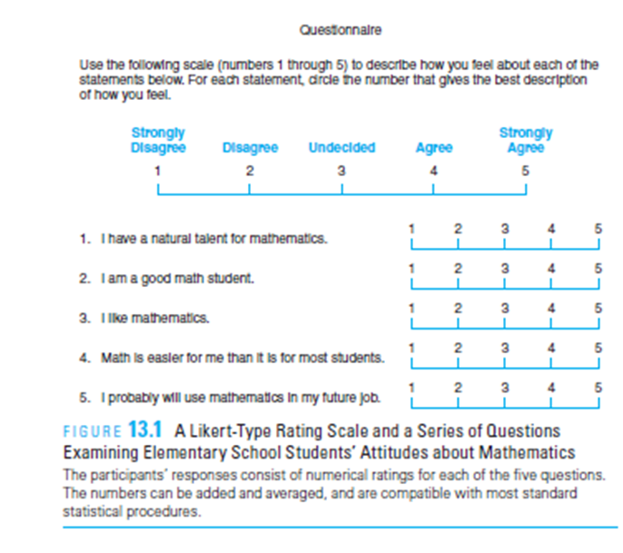
Rating- Scale Questions

Slide 17
Likert scale
This type of rating-scale question is often called a Likert scale
Researchers commonly use from 5 to 10 numerical values.

Slide 18
Criticism of rating- scale
One criticism of rating- scale questions is that participants tend to use the same response to answer all ( or most) of the questions. This tendency is called a response set.
It is recommended that the items include a mixture of positive and negative

Slide 19
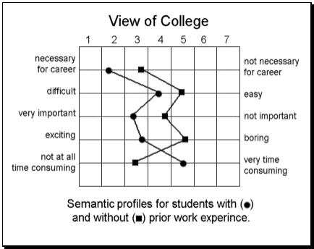
semantic differential
presents pairs of bipolar adjectives ( such as happy— sad, boring— exciting), and asks each participant to identify the location between the two adjectives that best describes a particular individual.

Slide 20
Survey General Guidelines
Demographic questions
Sensitive questions should be placed in the middle of the survey.
Questions dealing with the same general topic should be grouped together.
The format for each page should be relatively simple and uncluttered.
Finally, vocabulary and language style should be easy.

Slide 21
Sampling
Select survey participants to whom the questions are relevant.
The sample of survey participants must not be too restricted.

Slide 22
Administering a Survey
Mail survey
Telephone survey
Email survey
Online forms
In-person surveys or interviews

Slide 23
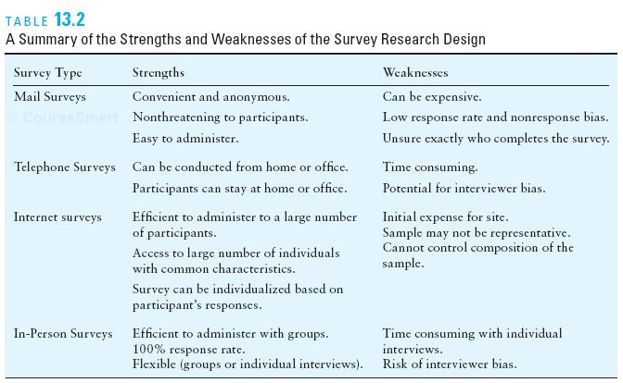

Slide 24
The Case Study Design

Slide 25
The Case Study Design
The case study design involves the in- depth study and detailed description of a single individual ( or a very small group). A case study may involve an intervention or treatment administered by the researcher. When a case study does not include any treatment or intervention, it often is called a case history.

Slide 26
Applications of the Case Study Design
Most commonly used in clinical psychology
Often used to provide researchers with information concerning rare or unusual phenomena such as multiple personality
To use the detailed description of a single individual to demonstrate an exception to the rule
To show that the treatment does not always work.

Slide 27
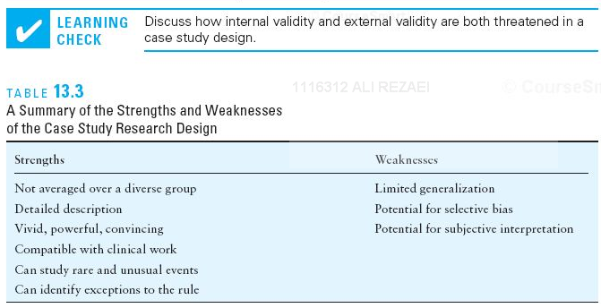
Limitations of case studies

Slide 28
Qualities of good items

Slide 29
Qualities of good items
Include point of reference
Do you spend a lot of time preparing for your classes?
Are most of your students from California?

Slide 30
Qualities of good items
Avoid leading questions
Do you agree with experts that…?
Do you agree with most people that…?

Slide 31
Qualities of good items
Avoid sensitive questions
Do you have high expectations of your students?
Do you like your children?
Do you mind if your instructor is Asian?

Slide 32
Qualities of good items
Do not assume facts not necessarily true
Have you stopped smoking?
How many hours a week do use your computer lab?

Slide 33
Qualities of good items
Address single concept (Avoid double-barreled questions)
Do you use computers and the Internet in your teaching?
Do you think professors should have more contact with staff & administrators?

Slide 34
Avoid double-barreled questions)
Although labor unions are desirable in most fields, they have no place in the teaching profession.

Slide 35
Questionnaire Design
Ask general questions first
Start with a few interesting and nonthreatening items
Put similar item types together
Do not crowd items
Number pages and items
Do not put important questions at the end
Avoid jargon
Demographic questions should go to the end.

Slide 36
Conducting Survey Research
Pretest the questionnaire
Reviews by (3) or (4) individuals
Provides information about deficiencies and suggestions for improvement
Follow-up activities
Reminder postcard
Second survey with a cover letter politely requesting a response
Telephoning a small sample of non-respondents
(non-response bias)

