Slide 1
CSULB E-Advising Initiative
Supporting Student Success and Enabling Advisors!

Slide 2
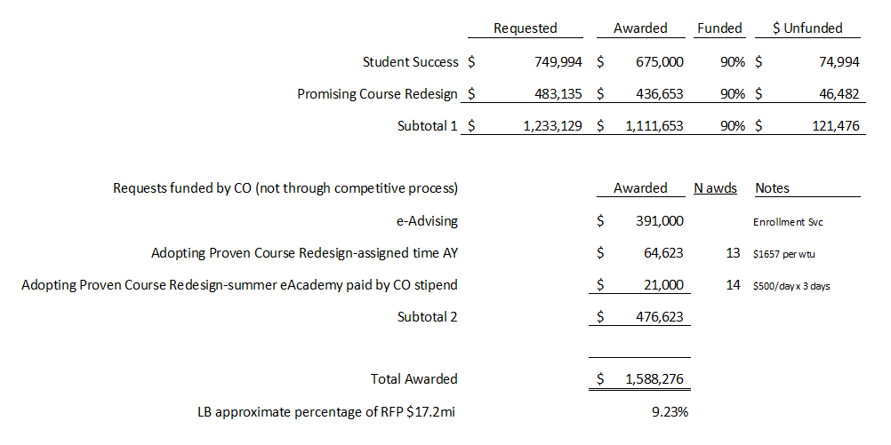
Summary of the $17.2m RFP for Student Success 2013-14:

Slide 3
Background:
RFP process through Chancellor’s Office for funding support and to promote system-wide synergy
Overall goal is to improve student success and timely graduation
Builds on prior investments in technology and advising structures
Campus submitted 4 proposals for the first year (13-14) and all 4 were supported!
Presentation is organized around each of the 4 solutions approved to begin this academic year.

Slide 4
Solution 1: Predictive Analytics
Challenge: We need to identify students who are at-risk in their chosen major and clearly prioritize students needing intervention as well as support an informed choice of major that would be a better match.
Solution: Join the EAB Student Support Collaborative and implement their predictive analytics and advisor dashboard solution.
Time Frame: We have been accepted in the June 2013 cohort.
Summer 2013: data analysis
Fall 2013: analytic model refinement
Late Fall: Advisor dashboard implementation with pilot group (CHHS, COE, EOP)
Complete roll out by end of Spring 2014

Slide 5
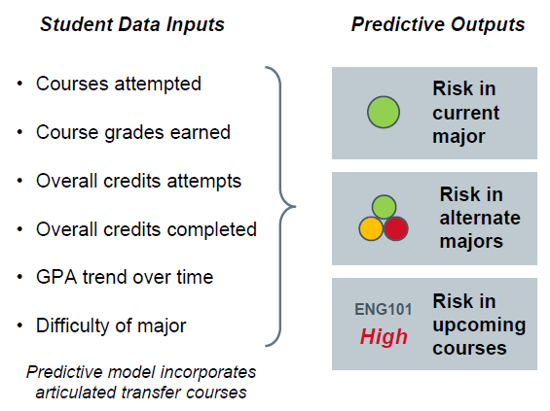

Slide 6
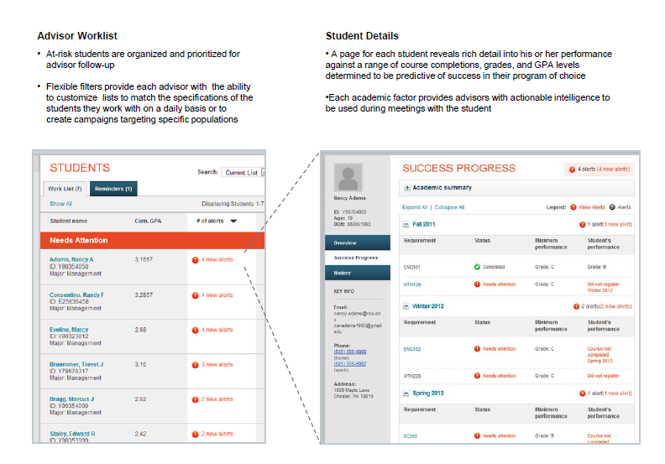

Slide 7
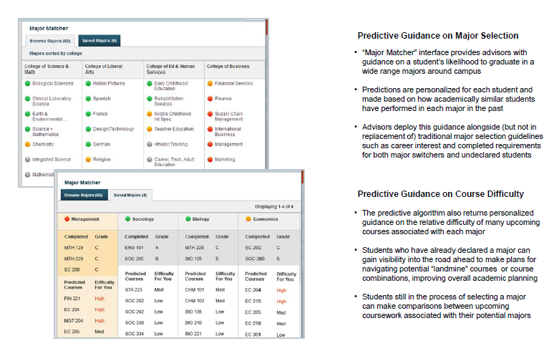

Slide 8
Solution 2: Multi – year Planner and Roadmap
Challenge: We need automated tools that reduce advisor and student time spent creating clear paths to the degree.
Solution: Implement the University of Arizona Smart Planner providing road map and multi-year planner functionality fully integrated within PeopleSoft Advisor and Student Centers.
Time Frame:
January 2014 project start
The first group of major road maps available for use in Spring 15 registration
During 14-15, we will focus on building out the planner to be available to all majors

Slide 9
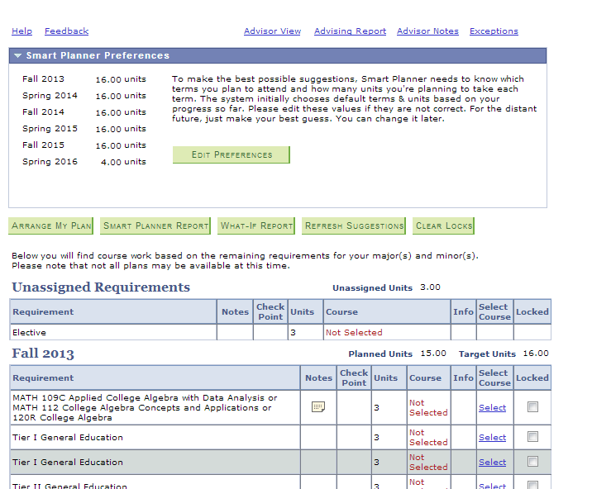
Main Screen

Slide 10
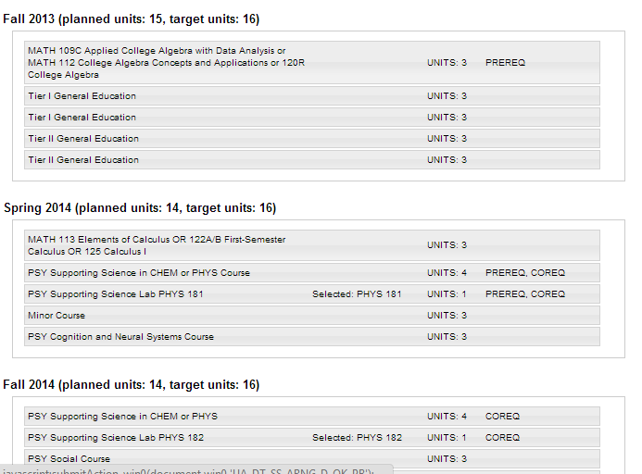
Arrange My Plan (or “Drag and Drop”)

Slide 11
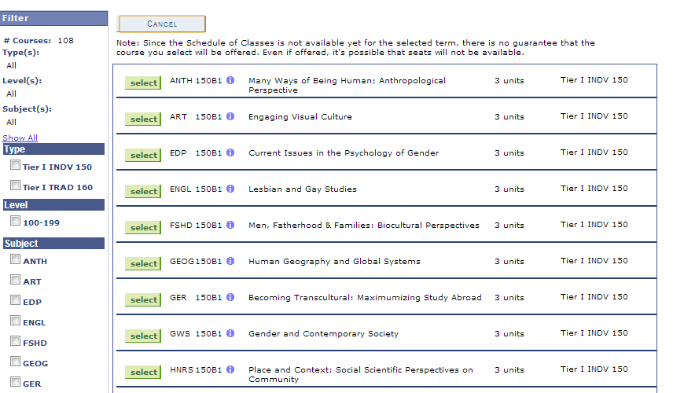
Course Picker

Slide 12
Solution 3: Student Schedule Planner
Challenge: We need to assist students in creating a term schedule that meets their educational and life demands.
Solution: College Scheduler integrated with the student enrollment functions in MyCSULB.
Time Frame:
Core implementation for Summer 14/Fall 14 registration start.

Slide 13
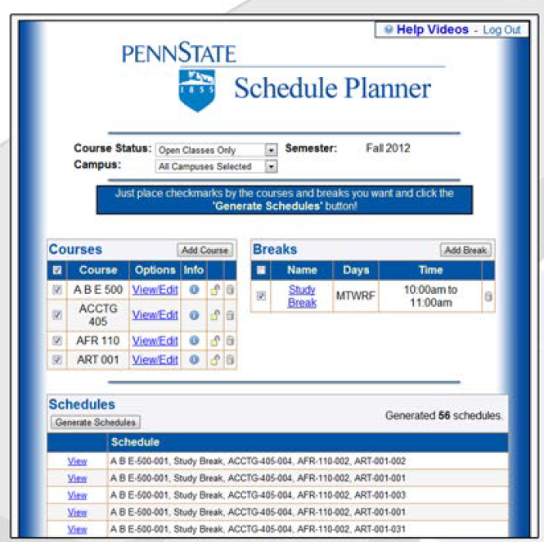

Slide 14
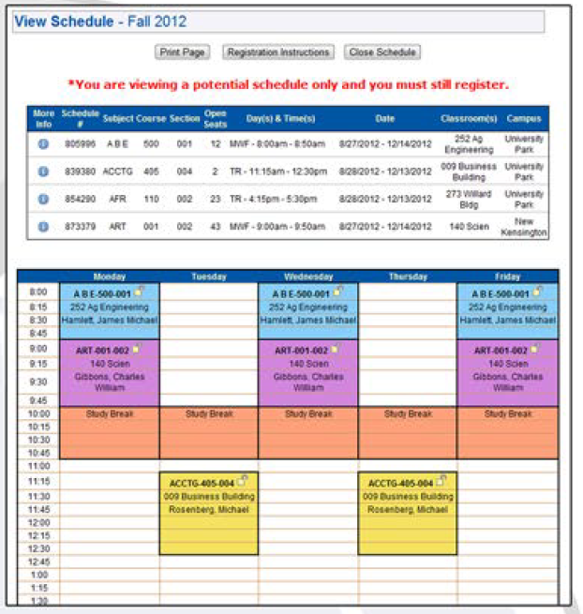

Slide 15
Solution 4: Advisor Support
Challenge: For our at-risk students, we need to coordinate information (both alerts and interventions) across the campus to focus and coordinate our activities.
Solution: "Insight Early Alert" by Symplicity to support advisor appointment and workshop scheduling, early alert tracking, and automated risk assessment. This campus-wide system implementation will replace six separate tools used throughout the campus, improving effectiveness and coordination.
Time Frame: Full adoption in 12-18 months is expected.
Fall start with core implementation of advising components for Fall 14 registration for pilot group (UCUA, CBA, CLA, SSSP).
Refine and expand implementation in Summer and Fall 14.
Prototype early alert for use in Fall 2014 targeted at our Beach Learning Community.

Slide 18
The Circle of Life
Smart Planner recommends plan based on what degree requirements are not met
Student adjusts plan as needed
Student can run degree progress report including planned courses
Time for registration:
Student requests advising appointment or signs up for advising workshop in Symplicity
Advisor reviews multi-year plan and student makes some additional changes
Student moves plan to Schedule Planner to create a feasible weekly schedule
Moves plan into registration and enrolls in classes
Student is not doing well in key course and drops it
Predictive Analytics alerts advisor that student is at risk in major
Advisor requests student to make appointment and student makes appointment
Advisor sees in Predictive Analytics that major is not a good fit
Advisor explores recommended majors from Predictive Analytics with student and uses "what-if " in the Smart Planner to see how long it would take to graduate

Slide 19
Questions?

