Slide 1
The Non-Experimental and Quasi- Experimental Strategies:

Slide 2
Nonexperimental and quasi-experimental
Nonexperimental and quasi-experimental studies often look like experiments in terms of the general structure of the research study since they all compare groups under treated different conditions.

Slide 3
Quasi-experimental design
A quasi-experimental design is one that looks like an experimental design but lacks the key ingredient -- random assignment.
Uses Intact groups – Two high schools treated differently

Slide 4
Difference Non and quasi experimental
Non-experimental research
compares groups but does not attempt to explain the cause and effect relationship.

Slide 5
Two types of n0n-experimentaland quasi experimental designs
Between-subjects designs, also known as nonequivalent group designs
Within-subjects designs, also known as pre–post designs

Slide 6
Nonequivalent group design
Researcher cannot control variables or conditions that makes the two groups equivalent.

Slide 7
3 types of nonequivalent group design
( 1) the differential research design. (Non)
( 2) the posttest- only non-equivalent control group design. (Non)
( 3) the pretest– posttest nonequivalent control group design. (Quasi)

Slide 8
1- Differential research design
Group differences are the primary interest not the cause an effect.
Studies pre-existing groups
No treatment
This type of study often is called ex post facto research because it looks at differences “ after the fact;” that is, at differences that already exist between groups.

Slide 9
Examples
Age differences
Gender differences
Difference between CSULB and CSULA students in their Math scores.
Compare academic performance of 2 groups of high and low self esteem

Slide 10
2- The Posttest- Only Nonequivalent Control Group Design
This type of study is occasionally called a static group comparison.
Compares treatment with no-treatment group

Slide 11
Examples
Example, Difference between those who take a course and those who don’t.
Comparing 2 high schools one with a pregnancy prevention program and one without
Comparing two classes after they were taught with 2 different teaching methods.

Slide 12
3- The Pretest– Posttest Nonequivalent Control Group Design
A much stronger version of the nonequivalent control group design is often called a pretest– posttest nonequivalent control group design and can be represented as follows:
The addition of the pretest measurement allows researchers to address the problem of assignment bias that exists with all nonequivalent group research.

Slide 13
Threats to internal validity
Although the addition of a pretest to the nonequivalent control group design reduces some threats to internal validity, it does not eliminate them completely.
Example,
Groups are equal in their pretest but not in their IQ

Slide 14
Within-subjects Pre-Post designs
A series of observations is made over time. Collectively, such studies are known as pre–post designs.

Slide 15
Two examples of pre–post studies:
One- group pretest– posttest design (Non)
Time- series design (Quasi)

Slide 16
Threats to Internal Validity for Pre– Post Designs
the five categories of time- related threats are history, instrumentation, testing effects, maturation, and statistical regression can threaten internal validity.

Slide 17
One- group pretest– posttest design
Because the one- group pretest– posttest study precludes a cause- and- effect conclusion, this type of research is classified as non-experimental.
example, political advertisement
May
October

Slide 18
A candidate’s approval rate

Slide 19
The Time- Series Design
A time- series design requires a series of observations for each participant before and after a treatment or event.
Thus, the series of observations allows a researcher to minimize most threats to internal validity. As a result, the time- series design is classified as quasi- experimental.

Slide 20
History
It is possible for an external event ( history) to be a threat to internal validity EVEN in time- series designs, but only if the event occurs simultaneously with the treatment.

Slide 21
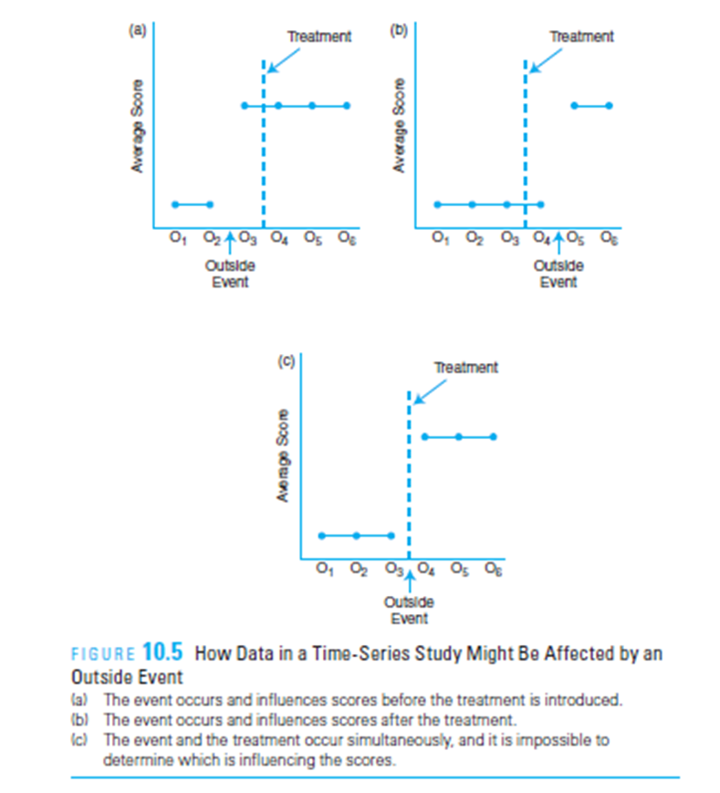

Slide 22
Single- Case Applications of Time- Series Designs
Research designs that focus on a single case, rather than a group of participants, are occasionally called single-case time-series designs but are more often classified as single- subject or single- case designs.

Slide 23
DEVELOPMENTAL RESEARCH DESIGNS

Slide 24
DEVELOPMENTAL RESEARCH DESIGNS
Two basic types of developmental research designs are the cross- sectional design and the longitudinal design.

Slide 25
Attitude toward the opposite gender at different ages

Slide 26
The Cross- Sectional Research Design
The cross- sectional developmental research design uses different age groups of individuals. The different groups are measured at one point in time and then compared.

Slide 27
Strengths and Weaknesses
One obvious advantage of the cross- sectional design is that a researcher can observe how behavior changes as people age without waiting for a group of participants to grow older.
Saves cost of follow up

Slide 28
Weaknesses
A researcher cannot say anything about how a particular individual develops over time because individuals are not followed over years.

Slide 29
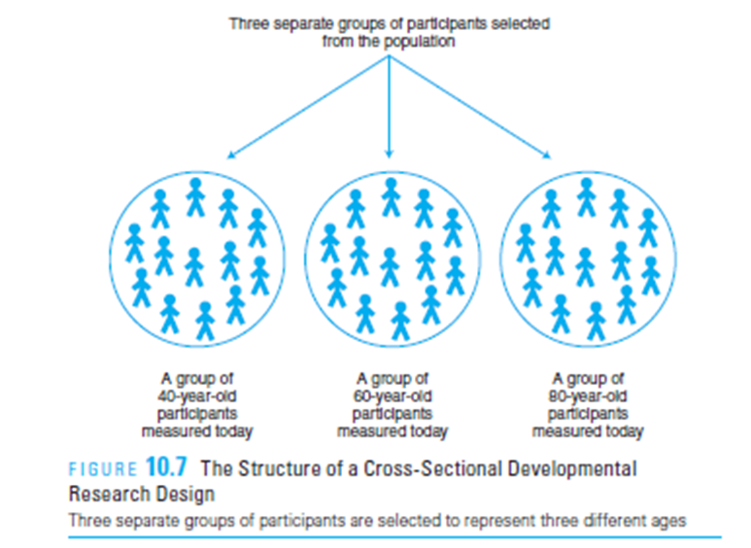
Cohort Effect (Time Period Effect)
Elementary
High School
College
Example 1, drugs legalization
Example 2, computer games

Slide 30
The Longitudinal Developmental Research Design.
The longitudinal developmental research design examines development by observing or measuring a group of subjects over time.

Slide 31
Strength
A major strength of the longitudinal research design is the absence of cohort effects because the researcher examines one group of people over time rather than comparing groups that represent different ages and come from different generations.
Second, with longitudinal research, a researcher can discuss how a single individual’s behavior changes with age.

Slide 32
Weakness
1-longitudinal research is extremely time consuming, both for the participants ( it requires a big commitment to continue in the study) and the researcher.

Slide 33
Weakness
2- In addition, these designs are very expensive
3- These designs are subject to high dropout rates of participants. and it may weaken the internal validity of the research.
4- Testing effects (the same individuals are measured repeatedly).

Slide 34
Trend analysis
Compare the results obtained from separate samples at different times.
typically, this type of research is examining the development of phenomena other than individual aging.
this research combines elements of cross- sectional and longitudinal designs.

Slide 35
Example, the trend of female participation in leadership positions
1970
1990
2010

